Slide 1
Virtual Virginia
Presented by
Brian Mott, PhD
Date
July 24, 2024

Slide 2
VVA Program Overview
For more than 40 years, Virtual Virginia (VVA) has made digital learning available to all students in the Commonwealth with no barriers to enrollment—regardless of each student’s academic history or geographic location.​
VVA is a partner to Virginia’s school divisions.​
Nearly all divisions use VVA in some capacity.​
Students, families, and school personnel report high levels of satisfaction with VVA course offerings.​
VVA student support model involves school/division personnel in a variety of roles.​
Students and schools participate for a variety of reasons.

Slide 3
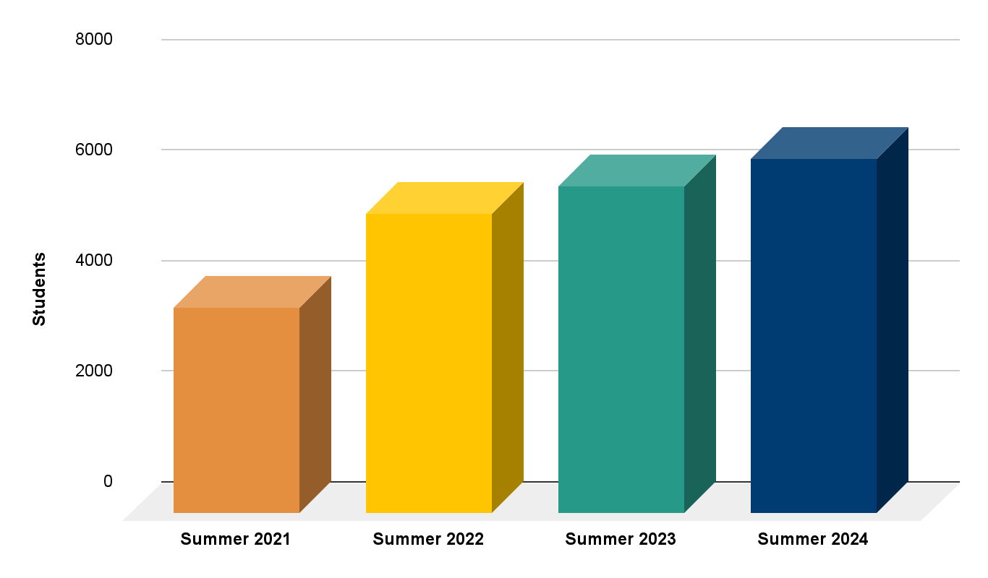
Summer Session 2024
Total Enrollment: 6,399
Top Courses
EPF
Health & PE 10
Geometry
Health & PE 9
Algebra II

Slide 4
Summer Session
"To meet my goal of 15 Advanced Placement classes without giving up my fine arts track, I needed to take summer classes."
"Through Virtual Virginia I was able to take both Health & PE 10 and Chemistry over the summer, [which] allowed me to clear my schedule to still take an AP science class (AP Physics) and add an AP social studies class (AP European History), all while still being able to take Musical Theatre and Honors Choir."
"This would not have been possible without the flexibility of Virtual Virginia."
"My hope is that more students are made aware of the opportunities that are in their reach with the help of Virtual Virginia."
"I appreciate the curriculum of Virtual Virginia. It is challenging but provides many layers of support in order to ensure student success."
Canton Murphy, student,
Williamsburg/James City County

Slide 5
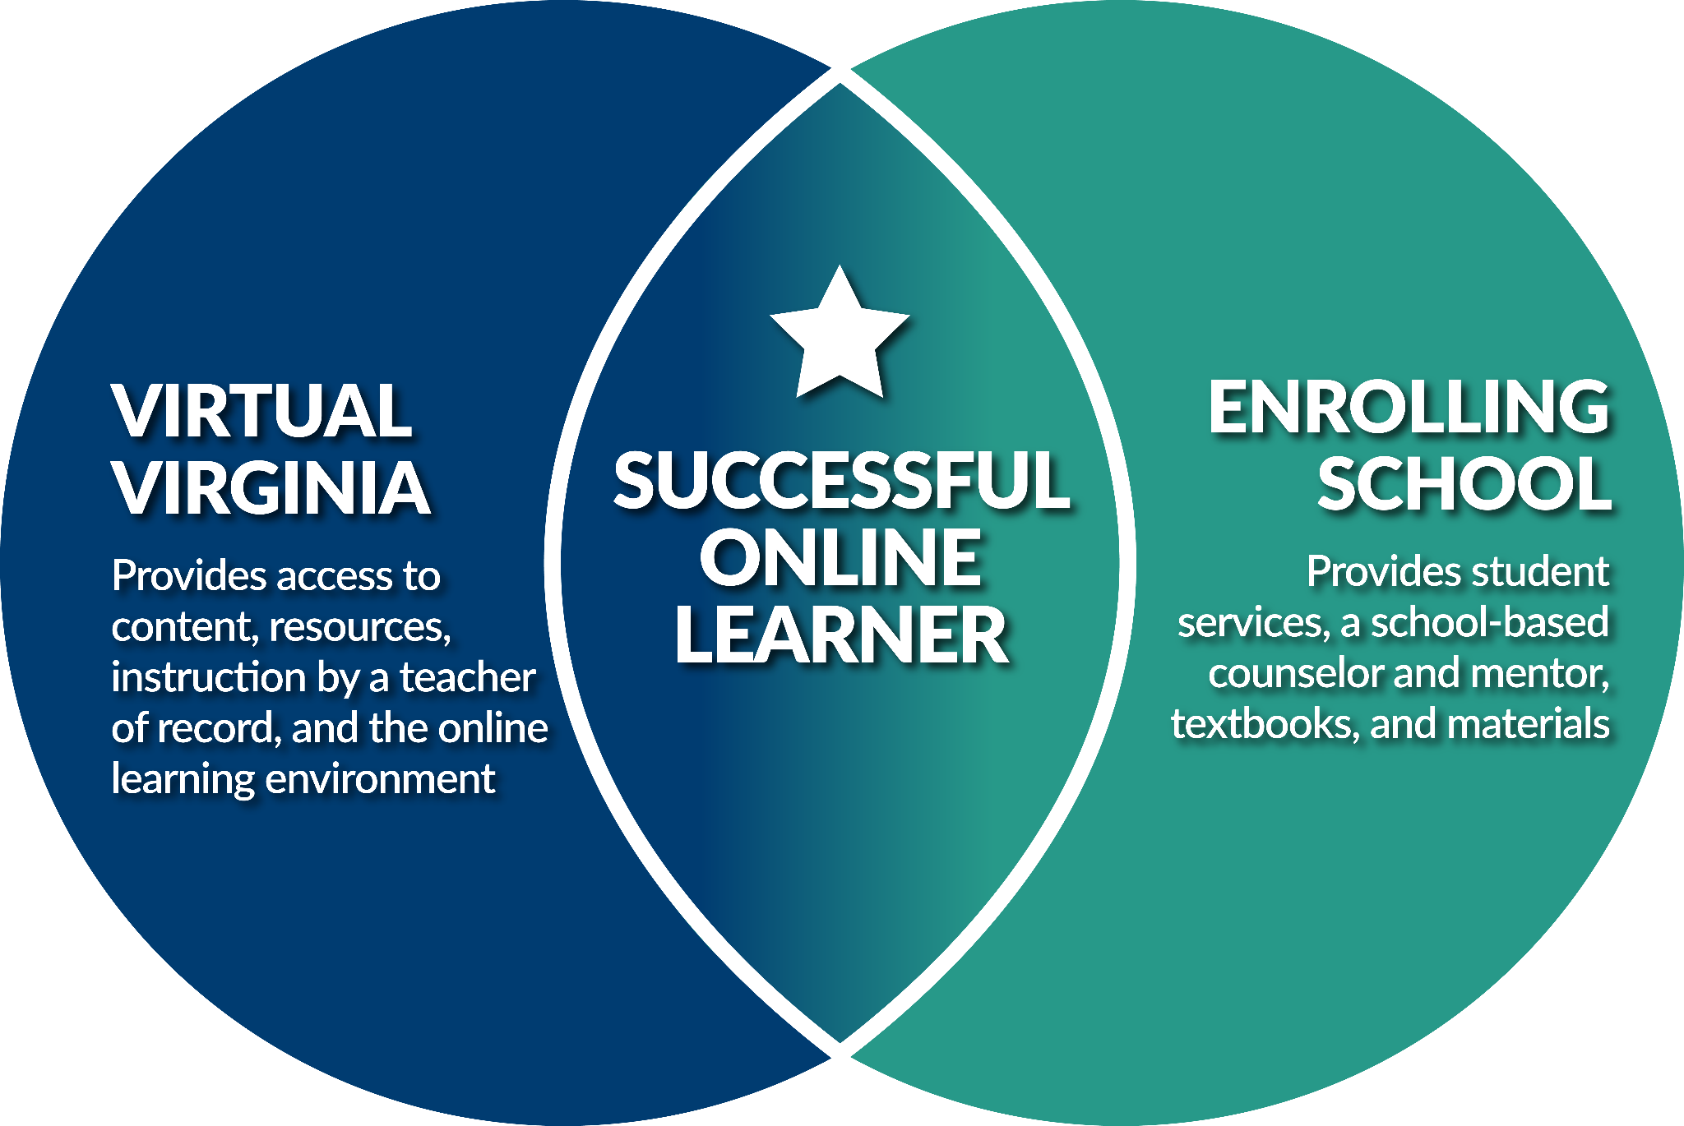
Division Support
The majority, roughly 85%, of students enrolled in VVA are part-time, in-person learners​
Students may be enrolled in synchronous, asynchronous, and mixed delivery courses​
VVA enrollment supports flexible schedules​
Division staffing & innovation

Slide 6
Virtual Live Classroom Model​
Franklin County: Chemistry
Southampton County: Trigonometry
Manassas City: ELA 7

Slide 7
Franklin County | Chemistry I
Multiple class periods
1 Mentor
Several semesters
Delivery: Live & Mixed
Started with synchronous delivery in all periods
Transitioned to first period with synchronous delivery and later periods with asynchronous delivery

Slide 8
Franklin County | Chemistry Mentor

Slide 9
Mixed Independent Synchronous Study​
Charlottesville City: Biology
Grayson County: Spanish I
Appomattox County: Earth Science

Slide 10
Charlottesville City | Science
Biology I or Biology II: Ecology​
Designed as a temporary solution until staffed locally​
Students enrolled after school started​
On-site support & onboarding​
Mentor​
Students​
Transitioned to an in-person teacher after semester​

Slide 11
Charlottesville City | Science Mentor

Slide 12
Asynchronous Advanced Independent Study​
Tazewell County: AP World History
Stafford County: AP CS Principles
Chesapeake City: AP European History

Slide 13
VVA AP Courses
Flexible schedule​
Supports courses with varying enrollment​
Mixed delivery​
Students meet with VVA teachers in whole class, small group, and 1:1 settings

Slide 14
Variety of Advanced Course Offerings
AP
Dual Enrollment
Cybersecurity
Other Advanced Courses
MOPS
(Multidivision Online Providers)

Slide 15
Variety of Advanced Course Offerings
Art History
Comparative Government
Computer Science Principles
European History
Human Geography
Spanish Language & Culture
U.S. History
World History: Modern
…and more!
AP

Slide 16
Variety of Advanced Course Pathways
Career Studies Certificate in Cybersecurity & Network Foundations
VCCS Uniform Certificate of General Studies (UCGS)
VCCS Passport
Dual Enrollment

Slide 17
Variety of Advanced Course Offerings
ITP 100 Software Design
ITN 101 Introduction to Network Concepts
ITN 106 Microcomputer Operating Systems
ITN 107 Personal Computer Hardware & Troubleshooting
INT 260 Network Security Basics
Cybersecurity

Slide 18
Variety of Advanced Courses & Offerings
ASL III
Biology II: Anatomy/Physiology
Creative Writing
Data Science
German III & IV
Health Informatics
Trigonometry
Visual Art & Design II
…and more!
Other Advanced Courses

Slide 19
Other Virtual Course Options
Code of Virginia §22.2-212.23 allows school divisions to offer online instruction using a private organization, educational institution, or nonprofit virtual school organization subject to accreditation and BOE approval.
Can provide one or full array of courses contracted with a local school division.
VDOE currently approves 24 MOPs.
MOPS
(Multidivision Online Providers)

Slide 20
VVA Enrollment Fees (6–12)
BAND I
BAND II
2024-2026 LCI 0.0001-0.3700
Semester (0.5 cr) $125
Year $250
2024-2026 LCI 0.3701–0.5000
Semester (0.5 cr) $175
Year $350
BAND III
GLOBAL*
2024-2026 LCI 0.5001–0.8000
Semester (0.5 cr) $225
Year $450
2024-2026 LCI N/A
Semester (0.5 cr) $275
Year $550
*Global = Band IV: Private school, homeschooled, out-of-state, and international enrollments

Slide 21
Engagement Costs: 6–12 Single Class (30:1) & PT Mentor
BAND I
BAND II
Class Size 30
Semester (0.5 cr) $125
VVA Fees (1.0 cr) $7,500
Mentor: $30/hr (2.0 hr) @ 180 days $10,800
TOTAL $18,300
Class Size 30
Semester (0.5 cr) $175
VVA Fees (1.0 cr) $10,500
Mentor: $30/hr (2.0 hr) @ 180 days $10,800
TOTAL $21,300
BAND III
Class Size 30
Semester (0.5 cr) $225
VVA Fees (1.0 cr) $13,500
Mentor: $30/hr (2.0 hr) @ 180 days $10,800
TOTAL $24,300

Slide 22
Engagement Costs: Teacher (150:1) & FT Mentor
BAND I
BAND II
Class Size 150
Semester (0.5 cr) $125
VVA Fees (1.0 cr) $37,500
Mentor: $125/day @ 180 days $22,500
TOTAL $60,000
Class Size 150
Semester (0.5 cr) $175
VVA Fees (1.0 cr) $52,500
Mentor: $125/day @ 180 days $22,500
TOTAL $75,000
BAND III
Class Size 150
Semester (0.5 cr) $225
VVA Fees (1.0 cr) $67,500
Mentor: $125/day @ 180 days $22,500
TOTAL $90,000

Slide 23
VVA Funding Options
Division leaders should consider the funding sources below to purchase courses, assessments, and VVA mentors that supplement—not supplant—other funding sources.
Funding Source | Student Groups | Allowable Expenses
Perkins | Any high school student enrolled in an approved VVA CTE course | Course materials and board-approved, industry-recognized credentials
Title IV | Any student in any school | Courses and assessments for students of low-income families
IDEA | Students with a virtual course identified in their IEP | Courses, assessments, and mentors
State SOQ Funds | Any student in any school | Courses, assessments, and mentors (after SOQ staffing standards met)
Per Pupil Lottery Funds | Any student in any school | Courses, assessments, and mentors
Local Funds | Any student in any school | Courses, assessments, and mentors
ESSER | Any student in any school | Courses, assessments, and mentors

Slide 24
Enrollment Periods
Fall
2024
Spring
2025
Summer 2025
2 cohorts support statewide division calendars
Deadline: June 27, 2024
Two Extended Enrollment Windows: July–August
2 cohorts support statewide division calendars
Deadline: December 5, 2024
Extended Enrollment Window: January
2 cohorts support statewide division calendars
Enrollment begins March 2025

