Slide 1
Overview of Federal Pandemic Relief Programs Monitoring process
March 2024

Slide 2
Programs to be Monitored
ESSER I, II, and III LEA formula grants
CARES Act ESSER I and GEER I State Set-Aside Grants
Special Education Services and Supports
School-Based Mental Health Services and Supports
Social-Emotional Universal Screener
Summer Academic Academy Success (SAAS)
Instructional Delivery Supports (IDS)
Cleaning and Sanitizing Supplies
Facilities Upgrades and Protective Equipment
School Nutrition Operations
VISION
CRRSA Act ESSER II and GEER II State Set-Aside Grants
Addressing Unfinished Learning
Extended School Year/Year Round School
Bus Driver Incentive Grant
ARP Act ESSER III Set-Aside Grants
Summer School
Before and After School
Addressing Unfinished Learning
CSLFRF HVAC Grant

Slide 3
Spring 2024
King George County
Lexington City
Manassas Park City
Martinsville City
Mathews County
Middlesex County
Norton City
Orange County
Patrick County
Poquoson City
Powhatan County
Radford City
Rappahannock County
Rockbridge County
Rockingham County
Salem City
Roanoke County
Smyth County
Southampton County
Staunton City
Virginia School for the Deaf and Blind
Town of West Point
York County
Albemarle County
Bland County
Buena Vista City
Clarke County
Craig County
Cumberland County
Fauquier County
Fluvanna County
Franklin City
Gloucester County
Goochland County
King and Queen County

Slide 4
Monitoring Timeline
Supts Memo 277-22 includes notification of monitoring
Spring 2024 monitoring will be conducted virtually
March 6, 2024: Webinar for spring 2024 school divisions
March 20, 2024: Email completed Point of Contact form to vdoefederalrelief@doe.virginia.gov
On or before April 22, 2024: Email completed monitoring form to assigned VDOE reviewer and upload evidence to Sharepoint site.
April-May, 2024: VDOE reviewers will conduct follow-up calls
June 2024: Once the final review is completed, a summary of the monitoring results will be sent to the division superintendent and point of contact

Slide 5
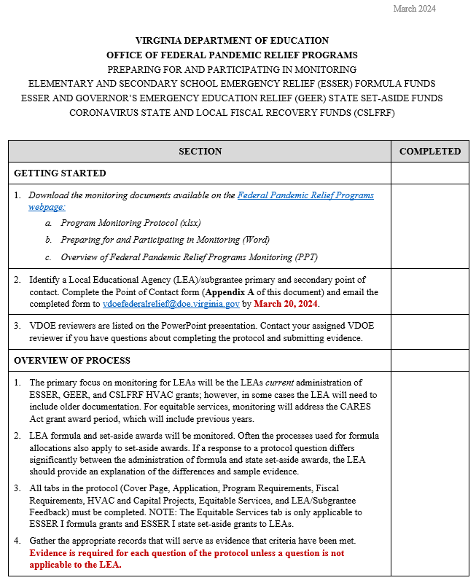
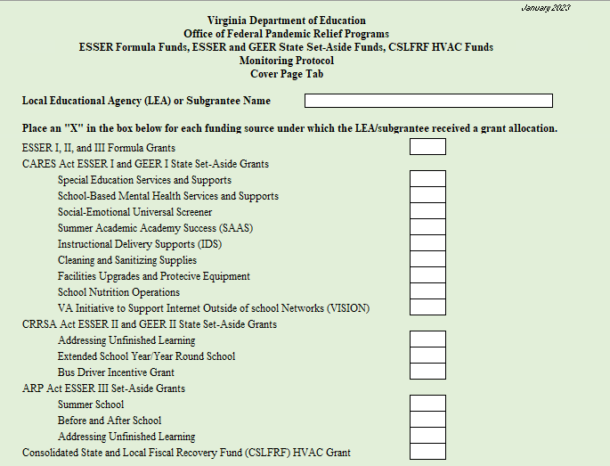
Monitoring Documents
Protocol
Preparing for and Participating in Monitoring

Slide 6
Review of Monitoring Documents
Protocol
Cover Page and Application tabs – Harriet Dawson
Program Requirements tab – Susan Dandridge
Fiscal Requirements tab – Tommy Coleman
HVAC and Capital Projects tab – Tommy Coleman
Equitable Services and LEA Feedback tabs – Carol Sylvester
Preparing for and Participating in Monitoring – Carol Sylvester

Slide 7
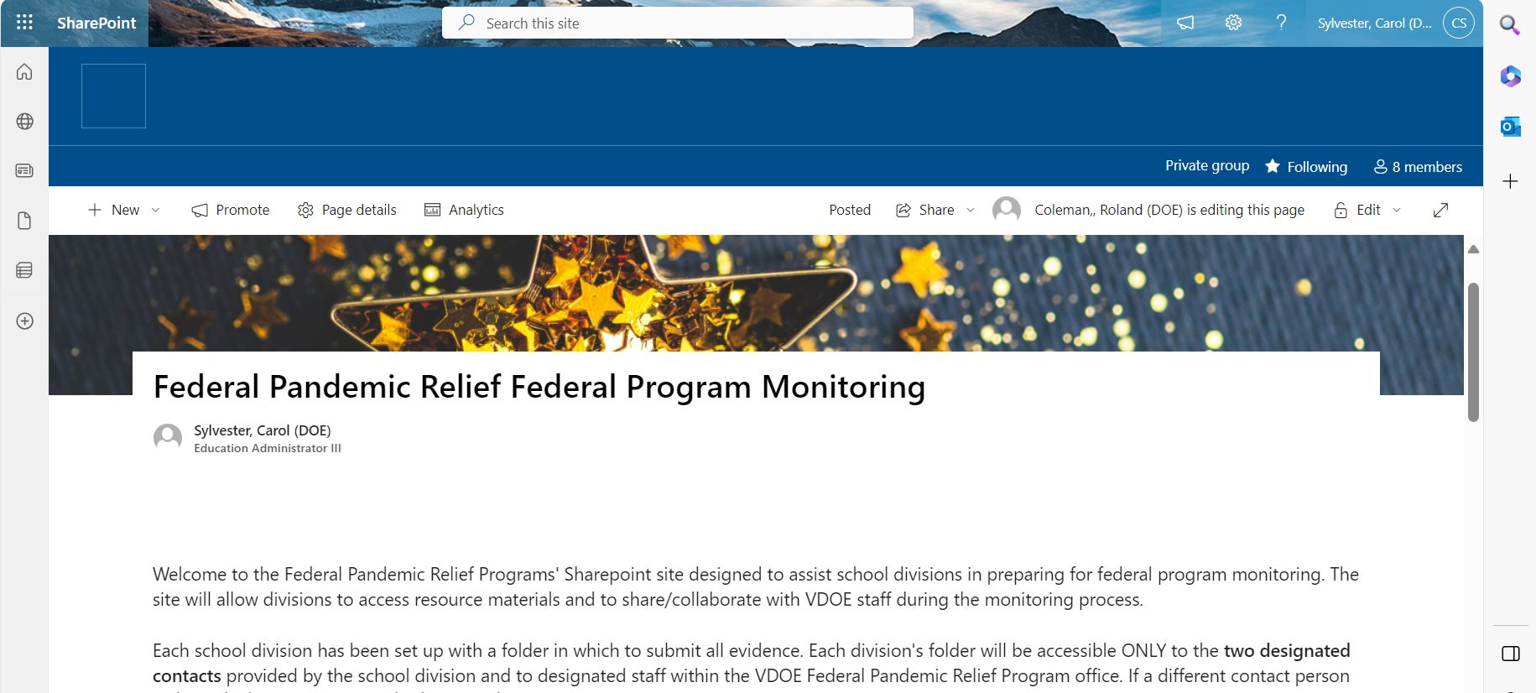
Sharepoint Overview
Documentation can be uploaded to Pandemic Relief Sharepoint Site: DOE-FPM-Federal Pandemic Relief Programs-External - Home (sharepoint.com)
Designated contacts will receive email invitation to site.
Evidence folders are organized to reflect protocol elements.
Please upload all evidence no later than April 22, 2024.

Slide 8
Office of Federal pandemic Relief Programs
Tommy Coleman – Roland.Coleman@doe.virginia.gov
Harriet Dawson– Harriett.Dawson@doe.virginia.gov
Susan Dandridge McFarland – Susan.Dandridge@doe.virginia.gov
Janice Garland – Janice.Garland@doe.virginia.gov
Carol Sylvester – Carol.Sylvester@doe.virginia.gov
General Questions? Send to vdoefederalrelief@doe.virginia.gov

