Slide 1
Virginia’s Early Childhood Advisory Committee (ECAC)
March 7, 2024

Slide 2
Agenda
Full Advisory Committee Convenes
2024 ECAC Meeting Schedule Update
Approval of February Minutes
ECAC Member Introductions
Update: Fast Track Regulatory Revisions Related to Stock Epinephrine
Update: Review of Public Comments for the Notice of Intended Regulatory Action on 8VAC20-780
Update: Lead Testing for Licensed / Regulated Child Care Programs
Presentation: Draft 2024-2025 Virginia Quality Birth to Five (VQB5) Guidelines
Questions and Discussion
Review of Public Comment

Slide 3
Update: Fast Track Regulatory Revisions Related to Stock Epinephrine

Slide 4
Regulatory Changes to Implement § 22.1-289.059
§ 22.1-289.059 Possession and administration of an appropriate weight-based dosage of epinephrine by employees.
Initial action presented to the Board of Education in July 2023.
The following chapters are affected:
8VAC20-780 Standards for Licensed Child Day Centers
8VAC20-790 Child Day Program (Subsidy)
8VAC20-800 Standards for Licensed Family Day Homes
8VAC20-850 Voluntary Registration of Family Day Homes – Requirements for Providers
The original version of the amendments only made reference to the Code requirement. The Office of Attorney General (OAG) must certify the regulation. The OAG has reviewed and requested changes to clarify the Code requirement by adding more detail. Amendments are currently underway.

Slide 5
Update: Review of Public Comments for the Notice of Intended Regulatory Action on 8VAC20-780

Slide 6
NOIRA 8VAC20-780 – Public Comment Review
Public comment ended on January 31, 2024
240+ comments were received and all related to draft regulations.
Comments were specific and requested amendments to clarify, strengthen, or remove requirements.
Areas with the most concern:
Policies and procedures | Screen time
Training and orientation | School-age supervision
Qualifications | Handwashing
Recordkeeping (topical ointment, attendance) | Reptiles and other pets
Safe sleep | Epinephrine
Mixed age playground use | Drinking water lead testing

Slide 7
Process Going Forward
Comments will inform the Department's official proposed draft to be considered by the Board of Education in June 2024. The Board of Education is expected to conduct its second review in July.
A comprehensive review of comments is underway. Substantive changes will be presented to ECAC for review and endorsement at a May meeting.
Items presented to the Board in June:
Formal proposed regulation, 8VAC20-781
Proposed Regulation Agency Background Document – a detailed account of the rationale for revised or new requirements, including responses to comments (TH-02)
If the Board approves the final proposed draft in July, the executive review process will follow (Attorney General, Secretary, Department of Planning and Budget, Office of Regulatory Management, Governor).

Slide 8
Update: Lead Testing for Licensed / Regulated Child Care Programs

Slide 9
Lead Testing in Child Day Programs (1 of 2)
§ 22.1-289.057 was added to Code of Virginia in 2020 to prevent early childhood lead exposure in child day programs.
Law requires licensed child day programs and certain exempt programs that serve preschool-age children to develop and implement a plan to test potable drinking water.
Plans and test results must be submitted to the Virginia Department of Health (VDH) Office of Drinking Water (ODW).
If results indicate elevated lead levels, the program shall remediate, retest, and resubmit results to ODW.
In lieu of developing a plan for testing and remediation, programs can choose to use bottled water that meets FDA standards for bottled water.
Implementation has been delayed since 2020.

Slide 10
Lead Testing in Child Day Programs (2 of 2)
VDOE to determine compliance, but VDH to track and monitor samples and remediation.
As of 2/8/2024, there will be roughly 4628 affected child day programs:
4052 licensed programs (homes and centers), 576 religious exempt centers & certified preschools.
VDH has EPA funding for up to 25,000 samples that must be obligated before 9/1/2024.
Grant funding only available to licensed programs and public schools.
Funding prioritized by demographics indicators; not all programs will receive funding.
Testing typically costs $65/box of 30 tests (rough estimate based on VDH contract).
Process for moving forward:
Communications to providers via memos and webinar begain in Summer 2023.
Targeted communications will continue in Spring-Summer 2024 with memos, webinars, and technical assistance.
Goal to fully implement and require compliance by 2025.

Slide 11
Presentation: Draft 2024-2025 Virginia Quality Birth to Five (VQB5) Guidelines

Slide 12
Our Shared Vision
We envision a Virginia where all children have the opportunity to enter school ready.
All families have affordable access to and support to choose the option that meets their unique needs.
All early childhood programs that take public funds benefit from measurement and supports for improvement, ensuring quality choices are available for all families.
Programs are rewarded for continual improvement and educators are adequately compensated.
Overall Virginia’s early childhood system is unified, data-driven, and resource-effective so families can work, go to school, or pursue employment and children have every opportunity to be successful.
Four out of ten Virginia children enter school without the key literacy, math, and social-emotional skills needed. (VKRP fall 2022)
Notes:
Kris Slides 4-6

Slide 13
VQB5 Theory of Change
To prepare all children for kindergarten, Virginia’s early childhood system must ensure they have access to quality teaching and learning experiences that meet their unique needs.
Working together, through VQB5, Virginia will:
UNIFY around shared and equitable expectations for quality.
MEASURE and strengthen teacher-child interactions and curriculum use in all publicly-funded birth-to-five programs.
IMPROVE supports for educators, prioritizing those who need it most.
Notes:
Erin

Slide 14
VQB5 Guiding Principles
VQB5 must…..
Impact quality and result in improved school readiness for children.
Use measures that can distinguish levels of quality and demonstrate growth over time.
Provide clear, actionable information, resources, and incentives for improvement.
Be affordable for providers and the state.
Scalable for use in 3,500+ sites and 11,000+ classrooms.
Increase opportunity for all children in 1) the outcomes that are measured, and 2) the process for making and using the system.
Serve as a resource for families.

Slide 15
Summary of Year 1 Successes
VQB5 full implementation launched in August 2023 and has been a success:
Participation | 100% of publicly-funded programs in Virginia are participating in VQB5. Nearly 17,000 educators are receiving financial support through RecognizeB5.
Measurement | 99% of VQB5 classrooms completed required fall local CLASS observations through Ready Regions. Nearly 80% of sites reported using an approved quality curriculum in the fall.
Improvement | Feedback from 13,000+ fall local and external CLASS observations is being used to identify strengths and areas for improvement this spring. 60+ curricula are approved, including choices that meet the unique needs of all program types. CLASS and curriculum measurements are being used to prioritize coaching supports for classrooms who need it the most.
Quality Profile Website Development | Feedback from Practice Year 2 participants has informed the development of the new public quality profiles. VDOE is gathering feedback and preparing for launch of website in Fall 2024.

Slide 16
Proposed VQB5 2024-2025 Guidelines

Slide 17
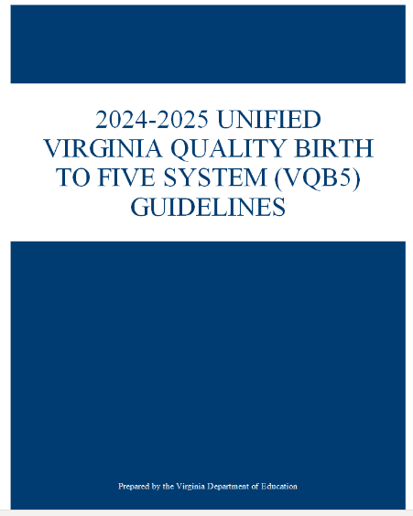
Overview of Guidelines 2024-2025
Proposed VQB5 Guidelines for 2024-2025 follow the same pattern with slight changes for clarity.
VQB5 Guidelines Contents:
Sections 1-2: Background, Vision, and Overview of VQB5
Section 3: Participation Requirements
Section 4: CLASS Observation Requirements
Section 5: Measuring the Use of Quality Curriculum
Section 6: Determining VQB5 Quality Results
Section 7 : Supporting Continuous Quality Improvement
Appendices: Supplemental Details and Data

Slide 18
Summary of Proposed Updates
Proposed Update | Rationale​ | Section in Guidelines ​
1. Require the Completion of Classroom Lists​ | The use of classroom lists in LinkB5 will allow the state to understand how classroom-level experiences impact school readiness and longer-term child outcomes​. Parents will have the choice to opt-out. | Section 3​.2.3
2. Clarify Guidance for CLASS Tool Selection | Additional guidance will ensure that CLASS observations provide accurate and supportive feedback that meets the diverse needs of Virginia’s publicly-funded classrooms. | Section 4​.2
3. Expand Support for Score Replacement | Expanded support will help clarify the score replacement notification process and will provide additional guidance to strengthen regional efforts to support local observers. | Section 4.7
4. Require Improvement Planning for Needs Support Sites | Prioritizes improvement resources and opportunities for sites that have demonstrated the most need. | Section 6.1 Section 7.3
5. Release Public Quality Profiles | Online quality profiles will provide families and the general public with information about the quality and availability of providers as required by state law. | Section 6.3

Slide 19
1) Require Classroom Lists
Beginning in 2024-2025, sites will be required to provide information on child enrollment through classroom lists entered in LinkB5 (Section 3.2.3).
Classroom lists enable the VDOE to link VQB5 classroom-level experiences with K-12 longitudinal data to understand and improve child outcomes. This is required by state law.
VDOE will use this information to support improvement in child outcomes and quantify the impact of public investments in supporting quality classrooms and the workforce (e.g., RecognizeB5).
LinkB5 meets all Commonwealth security standards for sensitive data storage and completes ongoing vulnerability scans to ensure the protection of all data types.
Parents will be able to opt-out via a request in writing.
What does this mean for sites in 2024-2025?
Sites must enter enrollment information by classroom for all enrolled children in LinkB5 by December 22.
Ready Regions will provide reminders and technical assistance to assist with meeting the deadline.
Public schools will not use LinkB5 for uploading class lists because this information has already been collected through the required Fall Student Record Collection, managed by the VDOE.

Slide 20
Connecting Birth-to-5 to K-12 and Beyond
While always vigilantly protecting child-level data, the VDOE can connect multiple outcomes back to early childhood classroom experiences.
Grades 9-12
SOL scores
High school graduation
PSAT/SAT scores
AP test scores
Ages 0-2
Infant CLASS scores
Toddler CLASS scores
ECCE experiences
Grades K-2
Literacy screener outcomes
Kindergarten readiness
Unique IDs are assigned to publicly-funded students at the beginning of their academic career.
Ages 3-4
Pre-K CLASS scores
ECCE experiences
Grades 3-8
Literacy screener outcomes
SOL scores
Adulthood
Higher education enrollment
Workforce participation
SNAP/TANF recipiency

Slide 21
2) Clarify Guidance for CLASS Tool Selection
The Guidelines will provide additional guidance on CLASS tool selection for mixed age and self-contained classrooms to support consistent and developmentally appropriate use of the CLASS across settings. (Section 4.2)
VQB5 uses the Infant, Toddler, and Pre-K CLASS tools. The tool used is determined by the chronological age of the children typically served in the classroom.
Mixed Age Settings use the CLASS tool that aligns with the age of the majority of children typically served during the program year.
VQB5 requires that the same CLASS tool is used in the fall and spring for each classroom, and that both local and external observations use the same CLASS tool.
What does this mean for sites in 2024-2025?
This will not affect most sites. However, Family Day Homes and ECSE Self-Contained Classrooms will have additional guidance in order to ensure CLASS observations are capturing developmentally appropriate teacher-child interactions.
CLASS observation feedback and score comparison will be consistent throughout the year, as the same tool will be used for each observation.

Slide 22
Additional Detail on CLASS Tool Selection
Classroom Type | FY25 Guidance | Rationale
Family Day Home Mixed-Age Classroom | The Toddler CLASS tool will be used in Mixed-age Family Day Homes whose enrollment typically fluctuates throughout the year. | The Toddler version of CLASS incorporates some aspects of Infant CLASS and some aspects of Pre-K CLASS and has broader applicability than either of the other two versions. The assigned observer will know which tool they will use in advance and will not have to make an in-the-field decision. Family Day Home providers will only need to be familiar with one age level, making it easier to set improvement goals.
ECSE Self-Contained Pre-K Classrooms | The Toddler CLASS tool can continue to be used if approved by VDOE based on children’s developmental age and IEP goals. | The Toddler CLASS provides more realistic expectations about what interactions should look like in classrooms that primarily serve children with disabilities who require more support. Using the Toddler CLASS will provide reassurance for ECSE educators that the observer is looking for interactions that are more appropriate for the developmental skills of the children in the classroom.

Slide 23
3) Expand Support for Score Replacement
Guidelines will add more detail on score replacement notification process and provide additional guidance to strengthen Ready Region’s efforts to support sites and local observers. (Section 4.7)
Comparison of local and external CLASS results during Practice Year 2 informed the development of the score replacement protocol, which is being implemented this year to ensure consistency and accuracy statewide.
Fall 2023 Score Replacement data analysis and feedback from the field indicate a need for more ongoing support.
What does this mean for Ready Regions and sites in 2024-2025?
VDOE will conduct in-depth analysis of 2023-2024 score replacement rates by region, age-level, site type and program type. Results will be shared with Ready Regions and the field.
Ready Regions will receive ongoing support from VDOE to strengthen the use of local-external score replacement data to support site leaders and to strengthen local observer capacity.
VDOE will develop new resources and webinars for site leaders at least twice a year to support the use of score replacement information for improvement.

Slide 24
2023-2024 Local and External Observations
VQB5 primarily relies on local observations and local feedback to produce site quality ratings and drive quality improvement across all of Virginia’s publicly-funded classroom settings.​​
 | Fall Completed | Spring Expected* | Total
Local Observations | 10,674 | 10,764 | 21,438
External Observations | 2,881 | 5,192 | 8,073
TOTAL | 13,555 | 15,956 | 29,511
Considering VQB5 includes thousands of observers who observe 1o,000+ classrooms across diverse age groups and settings, the VDOE must ensure the consistency, reliability, and accuracy of these local observations.
*Local observations based on number of VQB5 eligible classrooms in LinkB5 as of January 2023. External observations are to be completed in approximately 75% of all VQB5 eligible classrooms during the 2023-2024 year.

Slide 25
Fall 2023 Score Replacement Summary
In Fall 2023, 2,668 classrooms received a local and an external observation using the same age-level tool. These observations were compared using the score replacement protocol.
Score replacement in 1 or more domains occurred in 1,452 paired observations (54%), with some variation across age-levels.
Score replacement in only 1 domain was the most common type of replacement in the fall. This means most score replacements only impacted part of the local observation score.
Score replacement rates varied by domain, with emotional/behavioral domains being more consistent and instructional domains being less consistent.

Slide 26
Analysis: Impact of Score Replacement
In Fall 2023, there was score replacement in 54% of all paired local and external observations.
When there was a score replacement, external scores were higher in about a third of all classrooms.
Nearly half of classrooms with paired observations had no replacement.
Fall 2023 | Classrooms with Score Replacement |  |  |  |  | No Score Replacement
Classroom Type | External Scored Higher |  | External Scored Lower |  |  | Local and External Scores were Consistent
Infant | 49 | 16% | 104 | 24% |  | 280 | 65%
Toddler | 112 | 18% | 255 | 37% |  | 322 | 47%
Pre-K | 277 | 16% | 635 | 41% |  | 634 | 41%
All Age-Levels Combined | 438 | 16% | 994 | 37% |  | 1,236 | 46%
As of December 22, 2023

Slide 27
Analysis: Order of Observations
The rate of score replacement in the fall did not appear to be impacted by which observation happened first.
Order of Observations Fall 2023 | Classrooms with Score Replacement | Classrooms without Score Replacement
Local Observation was first* | 935 | 788
External Observation was first | 489 | 444
Observations occurred on the same day | 8 | 4
Total Paired Observations (n=2,688) | 1,432 | 1,236
*Note - In the fall, local observations occurred first 65% of the time. This is likely due to the fact that external observations did not begin until October.
As of December 22, 2023

Slide 28
Analysis: Time Between Observations
Length of time between the local and external observations in Fall 2023 did not appear to have an impact on the rate of score replacement.
Statewide average length of time between local and external observations in Fall 2023:
Statewide range of length of time between local and external observations in Fall 2023:
Status | Average Length of Time between Observations
With score replacement | 15 days
With no score replacement | 15 days
Status | Range of Number of Days between Observations
With score replacement | 6 - 28 days
With no score replacement | 2 – 32 days
As of December 22, 2023

Slide 29
Analysis: Different Educators
Nearly 90% of paired observations from Fall 2023 involved the same teacher. However, rates of score replacement did not vary significantly when the observations did involve different educators. In other words, having different teachers was not a key driver of score replacement.
Status | Different Educator | Same Educator | Total |  | Different Educator | Same Educator
Scores Replaced | 209 | 1,214 | 1,423 |  | 59% | 53%
No Score Replacement | 145 | 1,086 | 1,231 |  | 41% | 47%
Total | 354 (13%) | 2,300 (87%) | 2,654 (100%) |  | 100% | 100%
As of December 22, 2023

Slide 30
4) Require Improvement Planning for Needs Support Sites
Sites who receive a Needs Support Rating will be required to participate in Quality Improvement Planning in 2024-2025. (Section 6.2 and Section 7.3)
Quality Improvement Planning is facilitated by VDOE and is the formal mechanism for:
Prioritizing improvement resources and opportunities for sites with the most need.
Monitoring progress throughout the year to ensure sites are improving interactions and will meet expectations in the future.
What does this mean for Needs Support sites in 2024-2025?
Sites will be required to work with a VDOE Quality Consultant who will help them conduct a needs assessment and a quality improvement plan.
Sites will receive frequent in-person and virtual communication from their Quality Consultant.
Sites will receive coaching services from a state funded coaching partner to improve interactions as measured by CLASS.
Out of 27 Needs Support Sites from Practice Year 2: | # | %
Participated in Site Improvement in 2023-2024 | 19 | 70%
Did not participate in Site Improvement in 2023-2024 | 8 | 30%

Slide 31
Improvement Planning Steps
Each Quality Improvement Consultant will support a small caseload of “Needs Support” sites using the following Site Improvement Planning process.
Initial Visit and Needs Assessment
Develop Quality Improvement Plan
Ongoing Monitoring and Progress Updates
Close Out Annual Improvement Plan

Slide 32
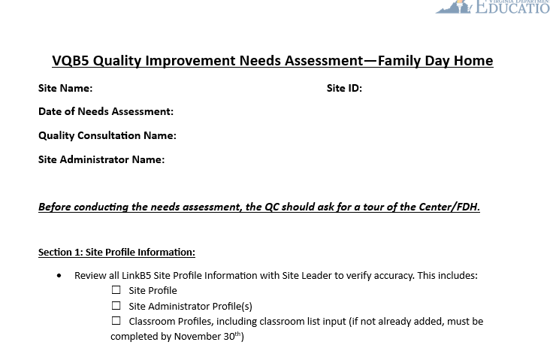
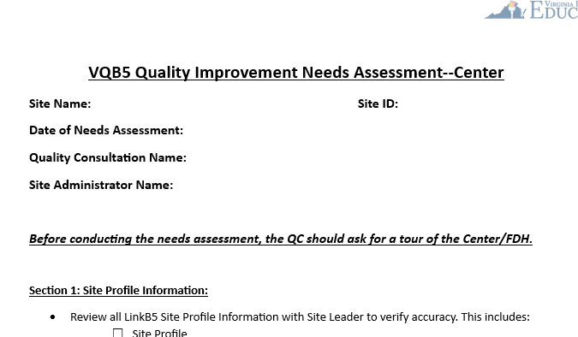
VQB5 Needs Assessment
The VQB5 Needs Assessment has 6 sections:
Site Information
Interactions Information (CLASS)
Curriculum Information
Staff Experience and Professional Development Information
Ready Regions Information
Site Leader Reflections
Forms vary slightly based on whether site is center or family day home.

Slide 33
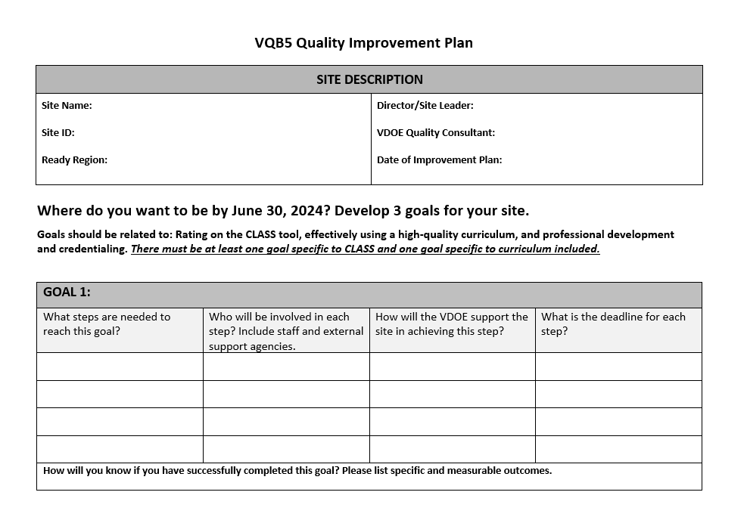
VQB5 Quality Improvement Plan
Plans use most recent VQB5 results and should have at least 3 goals related to teacher-child interactions.

Slide 34
5) Release Public Quality Profiles
VQB5 Quality Profiles, which include the site quality rating, will be posted online starting in the fall of 2024 (Section 6.3).
VQB5 Quality Profiles will include site performance and site information, building on the success of sharing practice year profiles with sites in 2022-2023.
Families will have information and access about quality options, as required by state law.
What does this mean for sites in 2024-2025?
All publicly-funded sites, and non-publicly-funded sites who opt-in to VQB5 will have an online quality profile.
Sites will also receive a certificate to document their annual quality rating for optional display.
Sites will have the opportunity to preview their quality ratings during summer data verification, prior to the fall release.

Slide 35
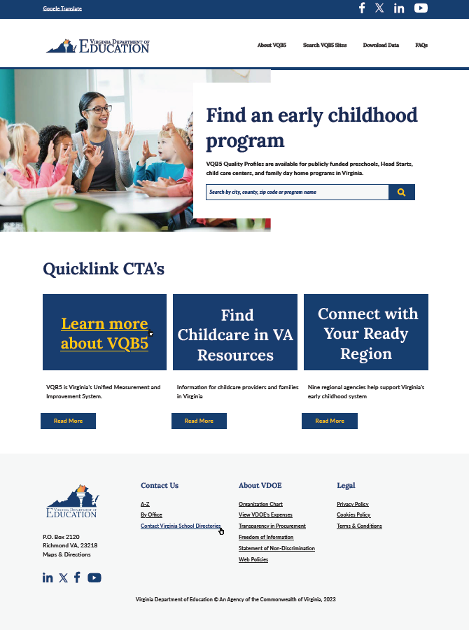
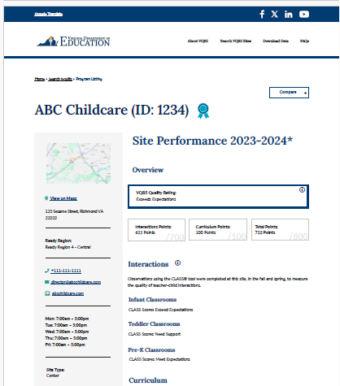
Quality Profile Mock-Ups
VDOE will continue to gather and use feedback to finalize the VQB5 Quality Profiles which will be shared publicly online in Fall 2024.

Slide 36
Engaging the Field On Profiles
VDOE will continue to share the profile and website ‘mock-ups’ with a wide variety of stakeholders to gather feedback and revise design.
Targeted engagement sessions are planned for:
Families
Ready Regions
Program leaders (Head Start, VPI, Mixed Delivery, Early Childhood Special Education)
Family Day Home providers
Improvement partners and Associations (VAAEYC March 14-15)
Sessions will focus on quality profile content, search functions, filters, data download features, images, and overall look/feel​.
Feedback will be collected through an online survey, via email, and in-person.
Save the Date: Quality Profile Preview Webinar – March 19 at 2pm​

Slide 37
VQB5 Guidelines - Next Steps

Slide 38
VQB5 Next Steps – Spring 2024
March
ECAC completes first review of 2024-2025 Guidelines
BOE completes first review of Notice of Intended Regulatory Action (NOIRA)
Engagement begins with families/field on Quality Profiles
April
VDOE completes statewide webinar on 2024-2025 VQB5 Guidelines
BOE completes first review of proposed 2024-2025 VQB5 Guidelines
BOE completes second review of Notice of Intended Regulatory Action (NOIRA)
May
Spring observation window closes on May 31
Curriculum use information updated by May 31

Slide 39
VQB5 Next Steps – Summer 2024
June
Feedback on Quality Profiles will be used to finalize Quality Profiles
ECAC reviews updates on VQB5 Site Quality Profile Development
BOE completes second review of proposed 2024-2025 VQB5 Guidelines
VDOE uses results from 2023-2024 measurements to calculate site quality ratings
July
Sites review and confirm quality profile information during data verification
VDOE makes changes to quality profiles as necessary, and finalize before publication
August
Registration and Fall CLASS Observations begin on August 15
Fall 2024 – Public Quality Profiles released

Slide 40
Review of Public Comment

Slide 41
We are experiencing technical difficulties
The livestream will return momentarily

Slide 42
Appendix A: Section-by-Section Overview of 2024-2025 VQB5 Guidelines

Slide 43
Section 1: Background, Vision, and Overview of VQB5
Section 1 and 2 provide the background and vision for VQB5, and explain the guiding principles that have informed the systems design. The sections identify teacher-child interactions and curriculum as the key quality measures for VQB5.
Key Changes in Section 1 and 2:
There are no key changes to Section 1 and 2. The proposed guidelines include updates on progress of Ready Regions and Virginia's engagement with the conclusion of practice year 2 and the first year of required participation.

Slide 44
Section 3: Summary of Changes to Participation Requirements
Section 3 explains which sites are legislatively required to participate in VQB5, specifies the key activities that a participating site must complete, and discusses consequences for refusal to participate.
Key Changes in Section 3:
Further clarifies classroom type designation during registration for family day homes whose enrollment typically fluctuates during the year.
Details the requirement to complete classroom lists.

Slide 45
Section 4: Summary of Changes to CLASS Observation Requirements
Section 4 explains how the CLASS tool is used to measure the quality of interactions, the specific requirements and observation protocols for local and external CLASS observations, and consequences for not completing required CLASS observations.
Key Changes in Section 4:
Further clarifies guidance for determining which CLASS tool to use for observations: 1) Tool used should match the classroom type in LinkB5, 2) Classroom type in LinkB5 is based on the typical age-level served for the program year, 3) Family Day homes whose enrollment typically fluctuates will use the Toddler CLASS tool.
Expands support for score replacement to help clarify the score replacement notification process and provides additional guidance to strengthen regional efforts for supporting local observers.

Slide 46
Section 5: Summary of Changes to Curriculum Measurement
Section 5 explains how Virginia's Early Learning Standards (ELDS) are foundational to the use of quality curriculum, the optional role of curriculum in VQB5, and the curriculum reporting requirement.
Key Changes in Section 5:
No key changes – lists the updated (to date) list of approved curriculum options for all age-levels, including options specifically for Family Day Homes, faith based providers and options in Spanish
In VQB5 the use of an approved curriculum is optional; there is no curriculum requirement

Slide 47
Section 6: Summary of Changes to Determining VQB5 Results
Section 6 explains how VQB5 quality ratings are determined, details the process for creating and disseminating VQB5 Quality Profiles, and includes information about the data verification process that sites will use to confirm accuracy of results.
Key changes in Section 6:
Provides a progress update on the development of the new public Quality Profiles, including describing how VDOE will gather feedback on the development of the VQB5 Quality Profiles prior to being made publicly available in fall 2024.
Outlines the consequence for sites who receive a Needs Support rating.

Slide 48
Section 7: Summary of Changes to Supporting Quality Improvement
Section 7 explains how VQB5 is designed to support continuous quality improvement, including providing both universal and targeted supports.
Key change in Section 7:
Required Improvement Planning for Needs Support Sites.

