Slide 1
Virginia’s Early Childhood Advisory Committee (ECAC)
February 15, 2024

Slide 2
Agenda
Full Advisory Committee Convenes
Approval of June 2023 Minutes
Welcome new ECAC members, Malinda Langford and Holly McCartney
Update: Early Childhood Advisory Committee (ECAC) Term Limits
Update: Building Blocks for Virginia Families
Update: Child Care and Development Fund (CCDF) 2025-2027 State Plan
Update: Standards for Licensed Child Day Centers
Update: Virginia Quality Birth to Five (VQB5) Progress
Presentation: Notice of Intended Regulatory Action (NOIRA) for VQB5
Review of Public Comment

Slide 3
Update: Early Childhood Advisory Committee (ECAC) Term Limits

Slide 4
ECAC Term Limits
Here are the rules and requirements related to Committee membership, per the Board of Education bylaws and the Code of Virginia:​
Committee terms are set for 3 years.​
ECAC terms currently run from February 2021-June 2024 to coincide with other committee terms.​
Members can be re-appointed but cannot serve more than two consecutive terms.​

Slide 5
The Challenge: All Terms Expire at Once
All 22 members positions are set to expire at the same time (June 30, 2024). This presents three primary challenges:
The ECAC could simultaneously lose all institutional knowledge if all 22 members turn over.
The ECAC's ability to vote and conduct business could be compromised.
The VDOE would be in the position of having to recruit for 22 positions simultaneously every 3 years.

Slide 6
Solution: Stagger Term Limits
The VDOE proposes to stagger the advertisement of ECAC positions over the next three years. This would mean:
Seven to eight ECAC positions would be posted each year for the next three years:
Phase 1: July 1, 2024 - June 30, 2027
Phase 2: July 1, 2025 - June 30, 2028
Phase 3: July 1, 2026 – June 30, 2029
Members holding positions not advertised in a given year can remain in their position without re-applying until the position is posted again.
Positions were randomly selected for each phase while ensuring that categories with multiple representatives (e.g., Head Start) would not be advertised at the same time.
If a position becomes vacant prior to the proposed date of advertisement, the position would still be advertised to align with the assigned phase.
Shift will ensure continuity, efficacy and diverse representation.

Slide 7
Recommended Staggered Terms
Phase 1: July 1, 2024 - June 30, 2027 | Phase 2: July 1, 2025 - June 30, 2028 | Phase 3: July 1, 2026 – June 30, 2029
Publicly-funded, licensed ECCE providers (for profit) | Publicly-funded, licensed ECCE providers (non-profit) | License-exempt ECCE providers (religious-exempt) (2 of 2)
Publicly-funded FDH | ECCE providers that are not publicly funded** | Nonprofit ECCE advocacy organizations (2 of 2)
License-exempt ECCE providers (religious-exempt) (1 of 2) | Head Start (school-based) | Virginia Council for Private Education
Head Start (NOT school-based) (1 of 2)* | Local school divisions or school boards that operate early childhood programs (2 of 2) | Head Start (NOT school-based) (2 of 2)
Local school divisions or school boards that operate early childhood programs (1 of 2) | Nonprofit ECCE advocacy organizations (1 of 2) | Statewide nonprofit association representing before- and after-school nonprofit child care and preschool providers
Professional or faculty member with expertise in early childhood from a college or university in Virginia (1 of 2) | Professional or faculty member with expertise in early childhood from a college or university in Virginia (2 of 2) | Business owners, operators, and employees in Virginia
Nonprofit entity that provides child care resource and referral services | Advocacy or service organization for children with disabilities | Virginia Chapter of the American Academy of Pediatrics
Parents with children enrolled in publicly-funded ECCE programs
Note: Each cell represents one member. *Denotes position is currently held by the ECAC chair. **Denotes position is currently held by the ECAC vice-chair.

Slide 8
Next Steps
The Board of Education accepted the proposal for first review in January and will conduct a final review in March.
If accepted, what does this mean for ECAC members?
The call for nominations for the first phase of positions will be shared in the February 15 Superintendents Memo.
ECAC members interested in serving a second term will be required to re-apply.

Slide 9
Update: Building Blocks for Virginia Families

Slide 10
Key Principles
Recognizing parents are children’s first and most important educators, Virginia prioritizes parent choice. Parents can choose from home-based providers, child care, Head Start, public, private and parochial schools and community partnerships.
Two-thirds of Virginia families are now choosing public-private options.
Virginia’s highest-need working families are striving to build a better future for themselves and their children.
They should be able to choose an early learning option that also addresses work-related child care needs.
Quality matters. Virginia is leading the nation with VQB5, its statewide measurement and data system that measures quality in every classroom or setting receiving public funds.

Slide 11
Key Principles (Cont’d)
Virginia is focused on child outcomes.
VKRP is a nationally-recognized school readiness assessment of early literacy, math, and social skills.
Virginia is recognized nationally for its effective use of public dollars.
A recent Vanderbilt study showed that investments in child care pay for themselves in less than a year; families work and earn more, stimulating the Virginia economy and increasing overall tax revenues.
Virginia prioritizes both keeping children safe and reducing administrative burden.

Slide 12
Governor’s Proposed Budget
In the next biennium, Governor Youngkin proposes that Virginia will invest over $448 million annually in early childhood care and education.
These investments and reforms, which are known as Building Blocks for Virginia Families will:
Help advance Virginia’s best-in-class early learning system;
Serve as a response to the upcoming loss of one-time federal funding by building a viable approach for the future; and
Help ensure the Commonwealth is the best place to live, work, learn, and raise a family.

Slide 13
Overview (1-5)
Building Blocks for Virginia Families seeks to:
Ensure every low-income working family that currently receives public support continues to have access to early childhood and after-school programs.
Accelerate parent choice across child care and early learning settings.
Maximize all available local, state, and federal funding – including allowing funds to be repurposed across programs based on parental demand and eliminating the cap on local match for VPI.
Ensure all ECCE programs annually measure and report unmet parental demand and preferences.
Prioritize attendance across all publicly-funded programs.

Slide 14
Overview (6-8)
Building Blocks for Virginia Families seeks to:
Ensure all families are invested and contributing by establishing consistent co-pays and work or activity requirements for full-day, full-year early childhood care and education.
Encourage shared contributions from employers, philanthropy, local government and other community stakeholders via launching an innovative “digital wallet” for child care and early learning.
Address deserts and increase supply of child care – including replicating innovative regional public-private partnerships and launching a $25 million capital incentive fund to help transform underutilized spaces into sustainable child care sites in partnership with higher education and local government.

Slide 15
Next Steps
Building Blocks for Virginia Families is being considered by the General Assembly, which is currently in session.
The House of Delegates and Senate will release their budgets on February 18.
There is also legislation that could potentially affect early childhood policies and funding levels. All bills would have to be passed by both chambers prior to the end of the General Assembly which is on March 9.
The budget and any new bills would need to be signed by the Governor.

Slide 16
Update: Child Care and Development Fund (CCDF) 2025-2027 State Plan

Slide 17
Overview of the CCDF State Plan
The Child Care Development Block Grant (CCDBG) Act authorizes the Child Care and Development Fund (CCDF), which provides funding to states to support child care assistance to low-income working families and support the health, safety, and quality of the entire child care system.
VDOE serves as the CCDF Lead Agency for Virginia.
Lead Agencies must complete a CCDF State Plan every three years.
The State Plan:
Serves as the application for a three-year cycle of CCDF.
Describes how states are completing activities funded by CCDF and implementing policies in compliance with the law.
Is used as the basis for federal reporting and monitoring.
The CCDF State Plan for federal fiscal years 2025-2027 is due July 1, 2024.

Slide 18
What the CCDF State Plan Covers (1 of 2)
State Plan Section | Key Topics
1. CCDF Program Administration | Information on the Lead Agency, Lead Agency leadership, and the entities and individuals that implement various aspects of CCDBG Identifies the partners consulted in Plan development
2. Child and Family Eligibility and Enrollment and Continuity of Care* | How Lead Agencies define eligible children and families Strategies to promote continuity of care
3. Child Care Affordability* | Policies related to determining family copayments Policies related to waiving copayments or making copayments affordable to families
4. Parental Choice, Equal Access, Payment Rates, and Payment Practices* | Policies that ensure participating families have access to the full range of child care providers How the Lead Agency establishes adequate payment rates for providers and fair payment practices for providers Strategies for building supply
5. Health and Safety of Child Care Settings | Description of child care providers that are subject to and exempt from licensing How the state implements, monitors, and enforces CCDBG-required health and safety standards, including pre-service orientation and professional development requirements State policies related to comprehensive background checks
*Section is relevant only to the Child Care Subsidy Program in Virginia.

Slide 19
What the CCDF State Plan Covers (2 of 2)
State Plan Section | Key Topics
6. Support for a Skilled, Qualified, and Compensated Child Care Workforce | Strategies to support recruitment, retention, and compensation Components and implementation of the state professional development framework Components and implementation of the state early learning and developmental guidelines
7. Quality Improvement Activities | How the state determines where to invest funding to support quality How the state uses CCDF to support quality improvement
8. Lead Agency Coordination and Partnership to Support Service Delivery | Identifies the entities that the Lead Agency collaborates with to implement services How the state meets federal matching and maintenance-of-effort requirements How the state coordinates with child care resource and referral systems How the state encourages public-private partnerships Efforts related to disaster preparedness and response plans during emergencies
9. Family Outreach | Process for parents to submit complaints and how the state maintains records of such complaints A description of the state’s consumer education website How the state makes information about child care options widely accessible to families How the state provides information on developmental screenings to parents
10. Program Integrity | How the state implements effective internal controls How the state investigates fraud, recovers fraud-related overpayments, and issues sanctions
Notes:
For section 8, key partners include:
The state advisory council (ECAC in VA; required)
Local Tribes and Tribal organizations (required)
State agencies responsible for serving children with disabilities, Head Start collaboration, public education/state pre-K, public health, employment services, CACFP, serving homeless families, TANF, Medicaid, mental health, and emergency management and response (required)
State/local agencies administering EHS/CC Partnership grants, higher education, home visiting, child welfare (optional)
Provider groups or associations
Parent groups or associations
Title IV 21st Century learning

Slide 20
Key Activities to Complete State Plan
Milestone | Time Frame for Completion
Consult with key stakeholders: ECAC Chickahominy Tribe Monacan Tribe Local Departments of Social Services Other partner organizations | February
Draft state plan based on current pre-print; make revisions based on final plan posted in April | February—April
Finalize initial State Plan draft and post for public comment | End of April
Public hearing (date TBD) | Mid-May
Compile and review public comments; make final revisions to initial draft | May—June
Submit final FY 2025-2027 CCDF State Plan | June 30

Slide 21
Update: Standards for Licensed Child Day Centers

Slide 22
NOIRA – Licensed Child Day Centers (CDC)
The NOIRA to repeal 8VAC20-780 and replace it with a comprehensive new chapter, 8VAC20-781, was approved by the Governor on December 8, 2023.
Public comment was open from January 1st through January 31st.
Preliminary draft of regulations (ECAC endorsed) was available on Town Hall.
241 public comments were received via Town Hall and 5 via email.
None of the comments received were related to the NOIRA; all of them addressed topics outside of the NOIRA.
Common topics included policies, staff training and qualifications, topical ointment records, attendance records, mixed age groups on playgrounds, handwashing, stock epinephrine, and lead testing.
Notes:
Public comment - Though the public comment period is specific to the NOIRA to open the regulation for amendments, stakeholders took the opportunity to comment on the preliminary draft language. We should expect a lot more comments once a formal proposed draft is available to the public.
ECAC members may want to know if a revised draft will be presented to ECAC for endorsement.

Slide 23
Next Steps
VDOE will share summary of stakeholder comments with ECAC in March.
VDOE will prepare a formal "proposed" draft of regulations with the goal of adding a May ECAC meeting for review.
Proposed draft will reflect public comments, internal review, Governor's Executive Order 19, and any information gathered from stakeholder engagement.
Current goal is to bring regulations for first review to June Board meeting.
Note that a proposed draft is typically submitted within 180 days for Executive Branch review.
Note that the Board will review separate "fast-track" regulations related to legislation that requires child day centers to have Epi-Pens, potentially in March.
Notes:
Public comment - Though the public comment period is specific to the NOIRA to open the regulation for amendments, stakeholders took the opportunity to comment on the preliminary draft language. We should expect a lot more comments once a formal proposed draft is available to the public.
ECAC members may want to know if a revised draft will be presented to ECAC for endorsement.

Slide 24
Update: Virginia Quality Birth to Five System (VQB5) Progress

Slide 25
VQB5 Updates
This section will provide key updates on VQB5 which will inform the proposed NOIRA and the 2025-2026 Guidelines:
Conclusion of Practice Year 2
Year 1 Full VQB5 Implementation
CLASS and Curriculum Fall 2023 Data
Preparation for Statewide Quality Profiles
Next Steps

Slide 26
VQB5 Theory of Change
To prepare all children for kindergarten, Virginia’s early childhood system must ensure they have access to quality teaching and learning experiences that meet their unique needs.
Working together, through VQB5, Virginia will:
UNIFY around shared and equitable expectations for quality.
MEASURE and strengthen teacher-child interactions and curriculum use in all publicly-funded birth-to-five programs.
IMPROVE supports for educators, prioritizing those who need it most.
Notes:
Kris

Slide 27
VQB5: Conclusion of Practice Year 2

Slide 28
Practice Year 2 Completion Rate
Notes:
AE_Working_VQB5_Complete_Incomplete_Site_List_2023-07-13
checked

Slide 29
Overall Practice Year 2 Results
Nearly 99% of sites that completed requirements met or exceeded expectations.​

Slide 30
Practice Year 2 Ratings by Site Type
Nearly all sites who completed the required VQB5 activities met or exceeded practice year expectations, with slight variations by site type.​
Notes:
AE Working_Prelim_PY2_VQB5_Scores_2023-07-13
Checked by LS-correct

Slide 31
Curriculum Impact on Practice Year 2 Ratings
Most but not all sites that received Meets Expectations received 100 curriculum points.
Every site that received an Exceeds Expectations rating received 100 curriculum points.
Every site that received a Needs Support rating received 0 curriculum points.

Slide 32
Practice Year 2 Ratings by Brackets
Needs Support
Meets Expectations
Exceeds Expectations

Slide 33
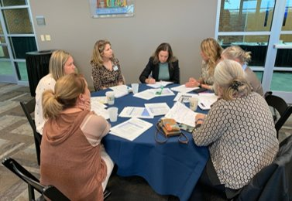
Ready Region Data Deep Dives
During Fall 2023, VDOE traveled to all nine Ready Regions for VQB5 Practice Year 2 data presentations.
During these meetings, local site leaders and Ready Region partners:
Learned about state and regional trends identified during Practice Year 2.​
Identified regional strengths and areas for improvement to inform the first required year of VQB5.​
Provided feedback to VDOE and Ready Regions to inform future efforts to measure and improve quality.​

Slide 34
VQB5: Year 1 of Full Implementation

Slide 35
VQB5 Registration Engagement 2023
Registration was held in Aug 15-Oct 3 for the first required year of VQB5 and was a huge success, engaging nearly 25,000 educators!
3,702
11,688
ECCE Sites
Classrooms
*includes all public ECCE sites, not just VQB5 sites
*includes all full-time and part-time classrooms
24,300
3,860
Educators
Site Administrators
Classroom information entered in LinkB5 during as of Oct 3 was used to determine VQB5 eligibility for 2023-2024 participation as outlined in the VQB5 Guidelines Section 3. ​​​
Notes:
Sites
Operating information
Public funds accepted
Wages and benefits offered to staff
Tuition rates
Classrooms
Ages served
Public funds accepted
Languages spoken
Curriculum used
Teachers & Administrators
Degrees and credentials
Licenses and endorsement
Wages
CLASS training
Students
Demographics
Public funding
Student testing identifier (universal unique ID)
Active status
CLASS™ Observations
Dimension and domain scores for each cycle
Date of observations
Activities done during observation
Number of children and adults

Slide 36
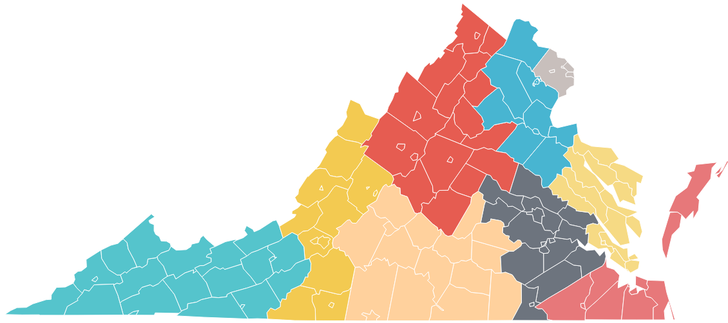
Statewide Registration Support
Throughout the summer and early fall, state and regional partners provided multiple communications and resources to support successful registration.
VDOE provided statewide communications and support:
Letters/Emails to publicly funded site leaders
Webinars/Stakeholder meetings
VQB5 Participation Resources
Ready Regions provided the "on-the-ground" support:
Regional office hours for publicly funded program leaders
On-site visits to help with LinkB5
Emails, newsletters, and social media reminders

Slide 37
VQB5 2023-2024 Participation by Type and Age
100% of eligible publicly funded sites are now participating in VQB5. Site types and age-levels of children served are similar to practice year participation trends.
% Breakdown by Setting
% Breakdown by Age
Infant
Public Schools
Toddler
Centers
Family Day Homes
Pre-K
As of January 2024
Notes:
Data Source: LinkB5 Regional Classroom List – 2.12.24 (VQB5 eligible = 1)

Slide 38
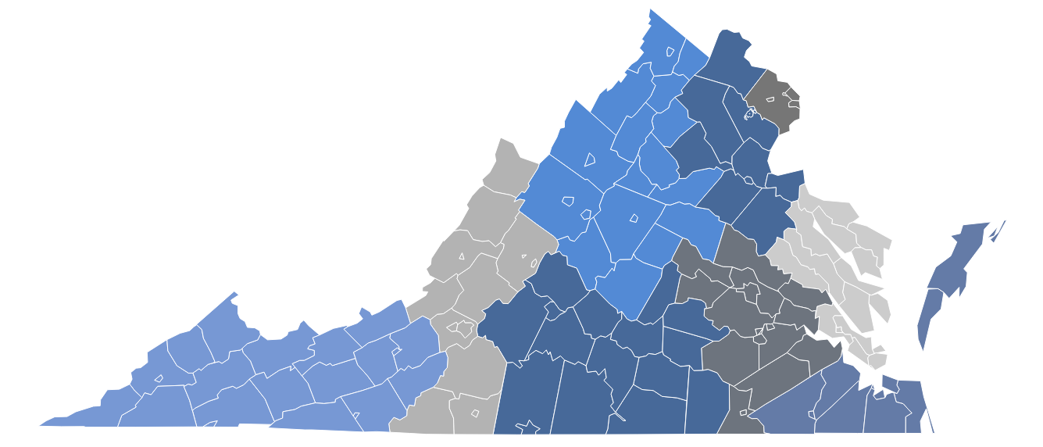
Supporting Educators via RecognizeB5
RecognizeB5 will distribute approximately $41M to more than 16,939 early childhood educators in 2023-2024. In 2022-2023, 9,558 teachers received $22M.
3,725
EDUCATORS AWARDED
3,056
EDUCATORS AWARDED
1,272
EDUCATORS AWARDED
1,289
EDUCATORS AWARDED
801
EDUCATORS AWARDED
2,655
EDUCATORS AWARDED
819
EDUCATORS AWARDED
817
EDUCATORS AWARDED
2,505
EDUCATORS AWARDED
Source: LinkB5 and ReocgnizeB5, Fall 2023

Slide 39
VQB5: CLASS and Curriculum Data from Fall 2023

Slide 40
Local CLASS Observation Growth Over Time
Local CLASS observations have grown exponentially in only 5 years.
As of the close of the Fall window, 10,674 local CLASS observations have already been completed this year.
99% of all VQB5 eligible classrooms completed a local observation in the fall.
Source: LinkB5, 2019-2024
*expected local CLASS observations

Slide 41
2023-2024 Local and External Observations
In VQB5, local CLASS observations happen in the fall and then again in the spring for every classroom. External CLASS observations are completed at every site with every age-level at a site receiving at least one external observation.
 | Fall Completed | Spring Expected* | Total
Local Observations | 10,674 | 10,764 | 21,438
External Observations | 2,881 | 5,192 | 8,073
TOTAL | 13,555 | 15,956 | 29,511
Nearly 30,000 opportunities for feedback to birth to five educators this year!!
*Local observations based on number of VQB5 eligible classrooms in LinkB5 as of January 2023. External observations are to be completed in approximately 75% of all VQB5 eligible classrooms during the 2023-2024 year.
Notes:
Why locals are done fall and spring? - This provides teachers with an opportunity to recognize growth and provides program leaders with a complete reflection of what children are experiencing throughout the year.
Why externals in 75%/each site/age-level? - Doing so will provide sufficient data to ensure consistency and fairness across the state in all programs and age-levels served.

Slide 42
Score Replacement (New for 2023-2024)
To ensure the consistency, quality, and credibility of ratings and performance profiles, VQB5 will use a score replacement protocol to address comparable observations with significantly different scores.
The VDOE now compares all local and external observations that are completed in the same classroom during the same observation window (e.g., fall observation window or spring observation window).
CLASS Domain scores that are within one point are considered consistent, and there would be no replacement.
CLASS Domains where the scores differ by more than one point will be replaced.
The external domain score will be used in place of the local domain score for purposes of calculating the quality rating for the site.
This will only impact domains where the score is off by more than one point. All other consistent domains will use the local observation score.
VQB5 Guidelines Section 4.7

Slide 43
Fall 2023 Score Replacement Summary
In Fall 2023, 2,668 classrooms received a local and an external observation using the same age-level tool. These observations were compared using the score replacement protocol.
Score replacement in 1 or more domains occurred about half of the time, with some variation across age-levels.
Score replacement in only 1 domain was the most common type of replacement in the fall. This means most score replacements only impacted part of the local observation score.
Score replacement rates varied by domain, with emotional/behavioral domains being more consistent and instructional domains being less consistent.

Slide 44
Fall 2023 Score Replacement: Summary​
In the fall, 2,688 classrooms received a local and an external observation using the same age-level tool.
Although about half of all classrooms had a score replacement, only a small percentage of classrooms will have all of their fall local scores replaced.
Classroom Age-Level/Class Tool | Total classrooms locally and externally observed in Fall | Classrooms with 1 Domain Replaced | Classrooms with 2 Domains Replaced |  | Classrooms with 3 Domains Replaced
Infant | 431 classrooms | 35% (152) | N/A | N/A
Toddler | 714 classrooms | 39% (279) | 14% (100) |  | N/A
Pre-K | 1,523 classrooms | 39% (598) | 14% (216) |  | 6% (87)
As of December 22, 2023

Slide 45
Score Replacement by Age-Level and Domain
Score replacement rates varied by domain, with emotional/behavioral focused domains being more consistent and instructional focused domains being less consistent.
Classroom Age-Level/Class Tool and Domain | Classrooms with Score Replacement By Domain | Total Locally and Externally Observed (Fall 2023) | % of Domains Need Replacement
Infant
Relational Climate | 152 | 431 | 35%
Toddler
Emotional and Behavioral Support | 186 | 714 | 26%
Engaged Support for Learning | 293 | 714 | 41%
Pre-K
Emotional Support | 228 | 1,523 | 15%
Classroom Organization | 435 | 1,523 | 29%
Instructional Support | 628 | 1,523 | 41%
As of December 22, 2023

Slide 46
Score Replacement Support for the Field
To support implementation of score replacement, VDOE provided several new supports to the field:
Ready Regions received:
Detailed fall score replacement data and one-on-one support sessions
Guidance to develop tiered supports for local observers
Local Observers received:
Notifications letters with domain level score replacement information
Ready Regions distributed letters
Local Observer Webinar held on February 6
Site Leaders received:
Notification letters with classroom level score replacement information
Score Replacement Resources
Site Leader Webinar held on February 13

Slide 47
Understanding What Children Are Experiencing
With 13,000+ observations this fall, Virginia is gaining valuable insights into what children are experiencing in our publicly funded programs.
Many children in Virginia's publicly-funded classrooms are experiencing responsive and engaging interactions with their teachers and peers.
However, there is a wide range in scores across all program types, indicating that children's experiences vary greatly across programs.
About 10% of observations completed in Virginia this fall received a total CLASS score of 3.99 or lower. These publicly funded classrooms are being prioritized for coaching services.

Slide 48
Curriculum Use in VQB5
Sites that choose to use an approved curriculum in at least one classroom receive additional points for their VQB5 Quality Rating. However, this is not required for participation or to receive a rating that meets expectations.*
Sites enter information about curriculum for each classroom during fall registration. Curriculum information can be updated through May 31.
Sites that are interested in using an approved curriculum can choose to:
Use one of the 65 approved early childhood curriculum available (35 new approved options added since June 2023!) or
Request to have their curriculum of choice reviewed for possible approval.
*VQB5 does not require the use of any curriculum.

Slide 49
Curriculum Use in Sites Fall 2023
Nearly 80% of VQB5 sites reported using an approved curriculum in at least one classroom this fall. ​
NOTE: Sites receive points for using approved curriculum in at least one classroom. Sites can continue to update their curriculum information up until May 31.
Notes:
Data from Registration_2023_Classroom_Profiles (2)

Slide 50
Curriculum Use by Site Type Fall 2023
The use of approved curriculum varies across site types. Almost every public school class reported using an approved curriculum, whereas only a little over half of family day homes reported using an approved curriculum.

Slide 51
Curriculum Use in Classrooms by Age-Level Fall 2023
The use of approved curriculum varies by age-level, with more curriculum usage in preschool classrooms and less in infant and toddler classrooms. ​
Notes:
Counts:
Classroom Type Using Approved Curriculum Not Using Approved Curriculum
Pre-k 5,289 885
Toddler 2,372 851
Infant 1,148 416
Data from Registration_2023_Classroom_Profiles (2)

Slide 52
Shared Understanding about Curriculum
Here are the 5 Key Messages about curriculum use in VQB5:
Curriculum is a choice. Programs can meet Virginia's quality expectations without using an approved curriculum.
All approved curriculum are comprehensive and include key elements of quality.
The approved list includes choice that can meet the unique needs of all program types.
Providers using comprehensive curriculum that is not approved can submit it for review. Reviews continue to happen on a rolling basis.
Curriculum pending as of March will likely not be approved before May 31st for the current year.
Notes:
Want Ready Regions to have the tools to address misconceptions around curriculum choice and share information with VDOE to inform outreach and supports.

Slide 53
Improvement Support in VQB5
Ready Regions and partners are working to ensure coaching options are prioritized for classrooms who need the most support.
VQB5 coaching services focus on improving teacher-child interactions:
Virginia Infant Toddler Specialist Network (VA-ITSN)
Advancing Effective Interactions and Instruction (AEII)
Training and Technical Assistance Centers (TTAC)
STREAMin3 (Curriculum alignment with CLASS)
Early Childhood Mental Health Consultants (ECMHC)
View full list of VQB5 Improvement Partners

Slide 54
Inclusive Classroom Profile Progress Update
VDOE is working with Training and Technical Assistance Centers (TTAC) to support the Inclusive Classroom Profile (ICP) in select inclusive classrooms in VQB5.
To increase the number of reliable users of the ICP, Virginia developed a process to train individuals to become ICP Virginia Reliable Observers.
18 individuals from 8 different programs, including school divisions and community-based providers from across the state were identified to participate in ICP Virginia Reliability Training.
The training will take place in March 2024.
A second opportunity will be offered in Fall 2024.

Slide 55
VQB5: Preparing for Quality Profiles

Slide 56
VQB5 Quality Profile Update
Starting last spring, VDOE has been leading an interactive process to engage the field in the development of VQB5 quality profiles.
Spring 2023
Draft Practice Year 2 Profile Prototypes shared and feedback gathered from the field.
Summer 2023
Practice Year 2 profiles finalized based on measurements from 2022-2023 year. Website vendor secured.
Winter - Spring 2024
New VQB5 Website development underway!; Mock-ups of Quality Profiles will be shared with families and the field for feedback; BOE to approve final profile.
Summer 2024
Fall 2024
Quality Profiles posted publicly on new VQB5 website.
Profiles finalized based on measurements from 2023-2024 program year.
Fall 2023
PY2 profiles shared privately with sites. Sites had the opportunity to provide feedback.
VDOE will inform families about VQB5 Quality Profiles.

Slide 57
Requirements for VQB5 Quality Profiles
VQB5 Quality Profiles must…
Provide parents and families information about the quality and availability of providers by fall 2024 (State Law)
Meet the federal requirements for a child care consumer-friendly website to serve as a resource for families (Federal Regulation)
Be approved by the BOE as part of the FY25 Guidelines
Be scalable to 3,500 sites
Clearly articulate levels of quality and improvement over time
Public VQB5 Profiles must be available online by Fall 2024.

Slide 58
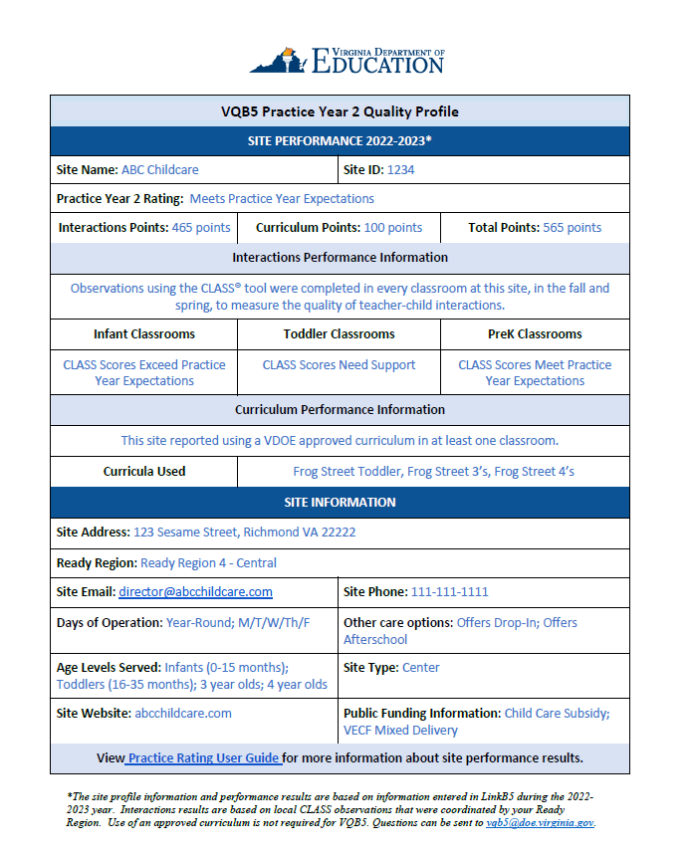
Practice Year 2 Prototype
The public VQB5 quality profiles will include site performance and site information, similar to what was provided in the Practice Year 2 profiles, and as defined in the VQB5 Guidelines Section 6.3.
Site Performance – Based on Measurement results
Site Information – Based on LinkB5 Profiles

Slide 59
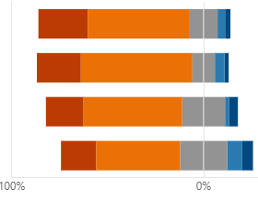
Feedback on Practice Year 2 Prototype
Sites who participated in Practice Year 2 were asked to provide feedback to help inform the development of the new public quality profiles.
The VQB5 PY2 Ratings expectations were clear.
The VQB5 PY2 Profile results were easy to understand.
Receiving my PY2 Profile will help my program improve.
Sharing VQB5 Quality Profiles publicly next year will help inform families and the field about quality options.
79% Strongly Agree or Agree
81% Strongly Agree or Agree
71% Strongly Agree or Agree
62% Strongly Agree or Agree
PY2 site leader survey fall 2023 – 177 responses

Slide 60
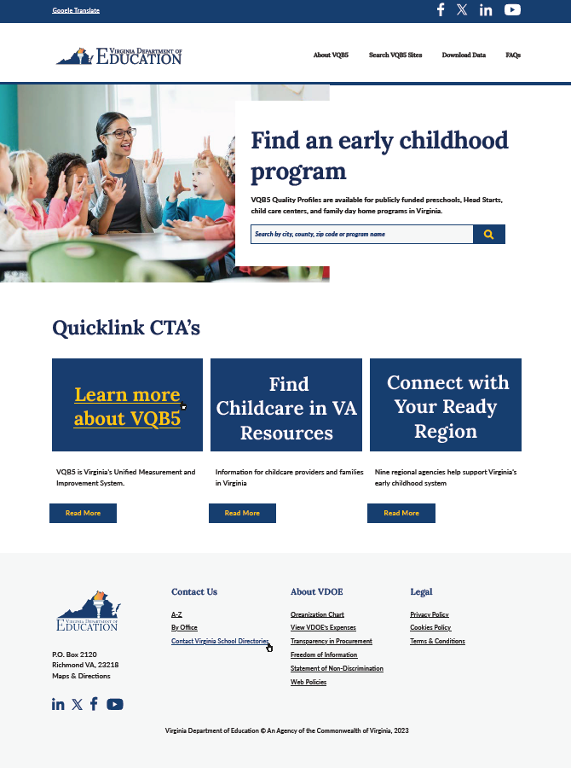
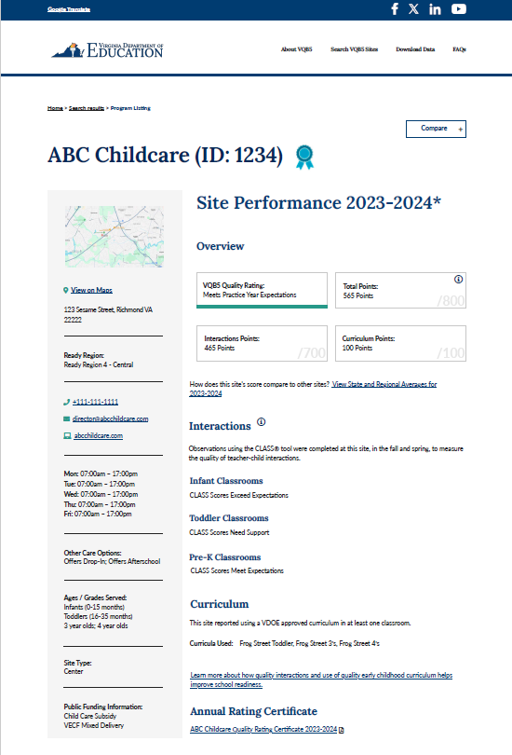
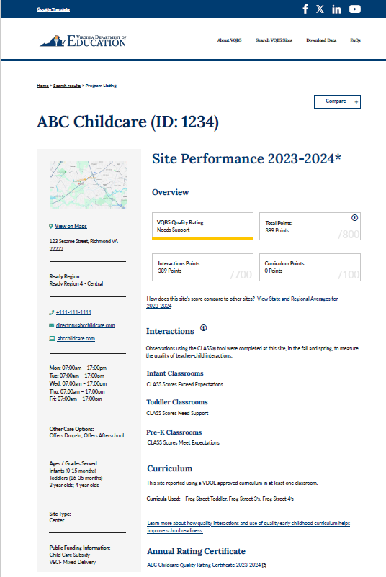
Mock-Ups of Quality Profiles
VDOE has created landing page and site profile "mock ups" to help gather feedback.

Slide 61
Engaging the Field On Profiles
VDOE will share the profile ‘mock-ups’ with stakeholders to gather feedback and revise design.
Targeted engagement sessions are planned for
Families
Ready Regions
Program leaders (Head Start, VPI, Mixed Delivery, Early Childhood Special Education)
Family Day Home providers
ECAC
Improvement partners and Associations
Sessions will focus on quality profile content, search functions, filters, data download features, images, and overall look/feel​.

Slide 62
Presentation: Notice of Intended Regulatory Action for VQB5

Slide 63
VQB5 NOIRA Overview
This Notice of Intended Regulatory Action (NOIRA) is to establish the regulations for the Virginia’s Early Childhood Unified Measurement and Improvement System, known as VQB5.
Proposed regulatory action will establish the regulations required by Section 22.1-289.05 of the Code of Virginia.
In developing regulations, the Board will establish:
Consistent quality standards and measurements that are used to provide parents and families with information about the quality and availability of publicly funded providers.
Mechanism for enforcing the participation requirement for all publicly funded providers.
Consequences for publicly funded providers that fail to participate.
The NOIRA does not replace VQB5 Guidelines.

Slide 64
VQB5 NOIRA Outline
The VQB5 NOIRA includes the following:
Brief Summary
Acronyms and Definitions
Mandate and Impetus
Legal Basis
Purpose
Substance
Alternatives to Regulations
Public Participation

Slide 65
Next Steps
Here are next steps for the VQB5 NOIRA and 2024-2025 Guidelines.
VQB5 NOIRA will be reviewed by Board in March and April.
VQB5 NOIRA will be posted on Virginia's Town Hall for public comment.
As in past years, ECAC and the Board will review VQB5 Guidelines for 2024-2025. ECAC will first review the revised VQB5 Guidelines in March.
2024-2025 VQB5 Guidelines will go to Board in April and June.
VDOE will develop VQB5 Regulations after public comment on NOIRA. Regulations will reinforce the VQB5 Guidelines and will only include key elements required by law.
The VDOE will continue to engage the ECAC and other stakeholders in the development of the proposed regulations throughout 2024.

Slide 66
Review of Public Comment

Slide 67
We are experiencing technical difficulties
The livestream will return momentarily

