Slide 1
VA ABTEL Monthly Meeting
Thursday, November 9, 2023@9AM
Malik K. McKinley, Sr.,
Director of Educational Partnerships

Slide 2
On Today’s Agenda
Overview
Background on ETS
Praxis Tests
Testing Development Process
Standard Setting Study Process
Adoption Process
Praxis Earth and Space Sciences Assessment
Test Summary Changes
Study Companion/Test At A Glance Details
Multi-State Study Information
Newest State Users
Discussion on Test Appropriateness and Score Setting
Q&A

Slide 3
OVERVIEW

Slide 4
BACKGROUND ON ETS
Non-profit organization, founded in 1947; combined ACE, Carnegie Foundation and College Entrance Examination Board
Mission: advance quality and equity in education for all people worldwide
ETS develops, administers, and scores
50+million assessments in
180 countries at over
9,000 locations worldwide

Slide 5
THE PRAXIS PROGRAM
Supporter of educators on their career journey
Provider of tools that allow teaching professionals to succeed in their careers
Partner in solving your most pressing educator shortages

Slide 6
WHAT IS PRAXIS®?
Praxis is a battery of tests used by 40+ states and territories as one of a number of requirements to be met for eligibility for an initial teaching license, which is granted by the state or territory
Praxis® Core Academic Skills for Educators (Core) is used for admission to an EPP, to meet licensure requirements, or serve as a diagnostic test for EPPs
90+ subject-area tests answerable to states’ licensure areas

Slide 7
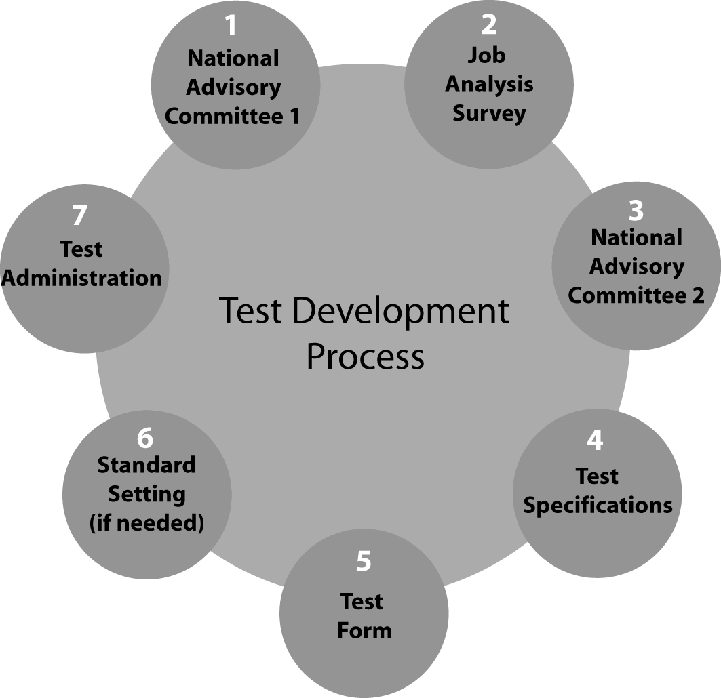
THE PRAXIS SERIES TEST DEVELOPMENT PROCESS

Slide 8
STANDARD SETTING PROCESS
Practitioner panel
Training provided
Practitioners’ judgments about content relevance and recommended passing score collected
Results are reported to the state

Slide 9
STATE ADOPTION PROCESS
Test reviews
Study Report reviewed
Available data reviewed
Department/Agency makes recommendation to the State Board of Education/Professional Standards Board
Board approves use of test and sets passing score
Department/Agency notifies IHEs/EPPs

Slide 10
EARTH AND SPACE SCIENCES (5572)

Slide 12
5572 TEST SUMMARY CHANGES
Launch date: September 2022—created through work with Earth and Space Science teachers and teacher educators as an update to Praxis 5571.
Test format and test length are unchanged: 125 selected response questions in 2.5 hours, but there are changes to the content tested.
The test was regenerated to align with the 2020 National Science Teacher Association (NSTA) Teacher Preparation Standards which integrate expectations from the Next Generation Science Standards (NGSS).

Slide 13
5572 TEST SUMMARY CHANGES
One half or more of the test questions now integrate at least one of the Science and Engineering Practices (SEPs) identified in the NGSS. (This represents an increase in focus on science practices as compared to 5571.)
One quarter to one third of the test questions assess a candidate’s Earth and space science content knowledge as applied to a Task of Teaching of Science.
This is an assessment of the application of content knowledge within an instructional situation).

Slide 14
5572 TEST SUMMARY CHANGES
The scope of Earth and Space Science topics covered is in 5572 is the same as in 5571—with detailed topics provided in the Study Companion. The change in weighting of the subareas of Earth and Space Science—based on recommendations from the field and the test’s National Advisory Committee (NAC)—is shown below, with greater coverage of subareas I, III and IV..
Within Category II, focus on basic principles of matter and energy was also increased at the NAC’s recommendation. These shifts in weighting mean that physical geology and historical geology— covered in Category II—contribute somewhat less to a candidate’s overall score.

Slide 15
5572 STUDY COMPANION TEST AT A GLANCE

Slide 16
5572 STUDY COMPANION TEST AT A GLANCE (Science and Engineering Practices)
The SEPs represent eight practices that scientists and engineers—and students and teachers—use to investigate the world and to design and build systems. Many test questions will integrate one or more of these practices
Asking questions and defining problems
Developing and using models
Planning and carrying out instructions
Analyzing and interpreting data
Using mathematics and computational thinking
Constructing explanations and designing solutions
Engaging in argument from evidence
Obtaining, evaluating, and communicating information

Slide 17
5572 STUDY COMPANION TEST AT A GLANCE (Tasks of Teaching Science)
This list includes instructional tasks that teachers engage in that are essential for effective Earth and Space Science teaching. Many test questions will measure content through application to one or more of these tasks.
Scientific Instructional Goals, Big Ideas, and Topics
Scientific Investigations and Demonstrations
Scientific Resources
Student Ideas
Scientific Language, Discourse, Vocabulary, and Definitions
Scientific Explanations
Scientific Models and Representations

Slide 18
5572 STUDY COMPANION TEST AT A GLANCE

Slide 19
5572 STUDY COMPANION TEST AT A GLANCE

Slide 20
EARTH AND SPACE SCIENCES (5572) (MULTI STATE STUDY INFORMATION)
Convened in December 2021 in Princeton, NJ
Panelists from 10 states (1-panelist from VA)
Neighboring state participation: NC, TN, and WV
21 Panelists total (14-Teachers, 6-College Faculty, and 1-Adm/Dept heads; 19-White, and 1-Black; 13-Female, and 8-Male; 11-Supervise/mentor teachers; 6-Involved in preparing teachers)
Recommended Passing Scores: 62 out of 100 raw score points. 62 represents a score of 154 (score range 100-200 scale).

Slide 21
EARTH AND SPACE SCIENCES (5572) (NEWEST STATE USERS)

Slide 22
EARTH AND SPACE SCIENCES: CONTENT KNOWLEDGE (5571) DATA
Report 1 Test Name: 5571 Earth and Space Sciences: Content Knowledge State/Agency/Institution: All Test Takers, Virginia State Department of Education - DI Administration Date Range: SEP-2018 to AUG-2023 Variable: Total Test Taker Attempts: Highest Score Measure: Scaled Score Include All Delivery Modes: Yes
Administration Date | State/Agency/Institution | Total
 |  | N | # Passing (156 score) | Percent Passing
SEP-2018 to AUG-2023 | Virginia State Department of Education - DI | 699 | 497 | 71.10

Slide 23
EARTH AND SPACE SCIENCES (5572) DATA

Slide 24
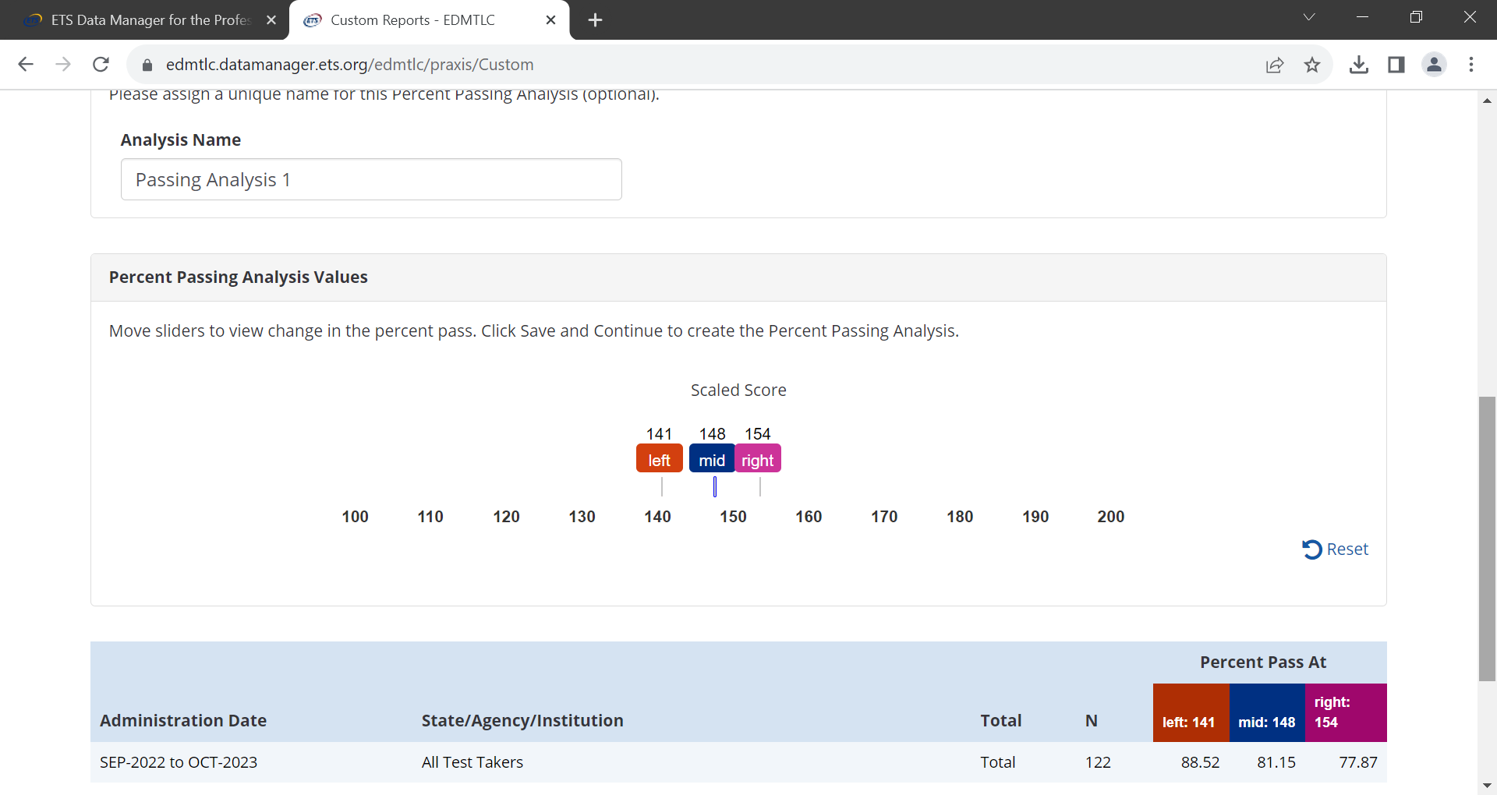
EARTH AND SPACE SCIENCES (5572) DATA

Slide 25
QUESTIONS AND ANSWERS

Slide 26
THANK YOU! Malik McKinley mmckinley@ets.org

