Slide 1
Virtual Learning Advisory Committee (VLAC) Meeting
Thursday, November 9, 2023
10:30-11:45AM
Virtual via Zoom

Slide 2
Agenda
Pursuant to the 2021 Appropriation Act language – SB7001 and meeting by electronic means set forth in subsection C of § 2.2-3708.2 of the Code of Virginia.
Welcome – Dr. Meg Foley
Introductions – Mr. Reggie Fox
Opening Remarks – Dr. Marcey Sorensen
Committee Purpose, Role, Term – Ms. Calypso Gilstrap
Virtual VA Updates – Dr. Brian Mott
Multidivision Online Provider (MOP) & Virtual Learning Updates – Dr. Meg Foley & Mr. Reggie Fox
Technology & Infrastructure – Dr. Susan Clair
Computer Science Updates – Ms. Keisha Tennessee
Instructional Technology Overview – Ms. Calypso Gilstrap
Next Meeting
Public viewing on the VDOE YouTube channel may email questions/comments to the mailbox until November 15, 2023: virtualprograms@doe.virginia.gov.

Slide 3
Committee Members
Dr. Mervin B. Daugherty, Region I, Chesterfield County Schools
(Mr. Ernest Longworth)
Dr. Raymond L. Haynes, Region II, Hampton City Schools
Dr. Bernard Trey Davis, Region III, Richmond County Public Schools
Dr. Kevin Newman, Region IV, Manassas City Public Schools
Dr. Garett Smith, Region V, Staunton Public Schools (Mr. Tom Lundquist)
Mr. C. Dwayne Huff, Region VI, Craig County Schools
Mr. Robert Graham, Region VII, Pulaski County Public Schools (Mr. Lincoln Whitaker)
Dr. Robbie W. Mason, Region VIII, Charlotte County Public Schools (Ms. Karen Osborne)
Mr. Rodney Jordan, Virginia School Boards Association
Ms. Amy Griffin, Executive Director Virginia Association of School Superintendents
Dr. Mitzi Fehl-Seward, Vice President of Digital Learning, WHRO
(Ms. Meagan Taylor-Booth)
Dr. Brian Mott, Executive Director, Virtual VA
(Non-voting ex officio member)

Slide 4
Remarks
Dr. Marcey Sorensen,
Deputy Superintendent for Teaching & Learning

Slide 5
VLAC: Purpose, Role & Term (Calypso Gilstrap)
Advisory group: online courses, in-service training and digital instructional resources necessary for school divisions to meet graduation requirements.
Strategic planning to expand blended and online learning opportunities in Virginia public schools, training, content and digital resources.
Important role sharing experience, expertise & resources
Commitment to meet twice annually
Fall 2023 – Virtual meeting
Spring 2024 – In-person meeting
Membership 3-school year term (Fall 2023 – Spring 2026)
Notes:
ALL VIRTUAL BOARD MEETINGS AND
ELECTRONIC PARTICIPATION IN BOARD MEETINGS
GENERAL POLICY
PURPOSE
The purpose of this policy is to establish a written policy, in accordance with §§ 2.2-3708.2 and 3708.3 of the Code of Virginia (Virginia Code) to allow for and govern participation of Virtual Learning Advisory Committee (VLAC) membership meetings by the means of electronic communication, including, all virtual meetings, and to specify the requirements for remote participation by members. The term Committee may be used synonymously with the term Board.
This Policy was revised and updated August 2022 due to change in the law regarding all virtual meetings.

Slide 6
Virtual VA Update
Dr. Brian Mott, Executive Director

Slide 7
Program Areas
K–12 Instruction
Statewide LMS
Professional Learning
Summer Session

Slide 8
Summer Session 2023

Slide 9
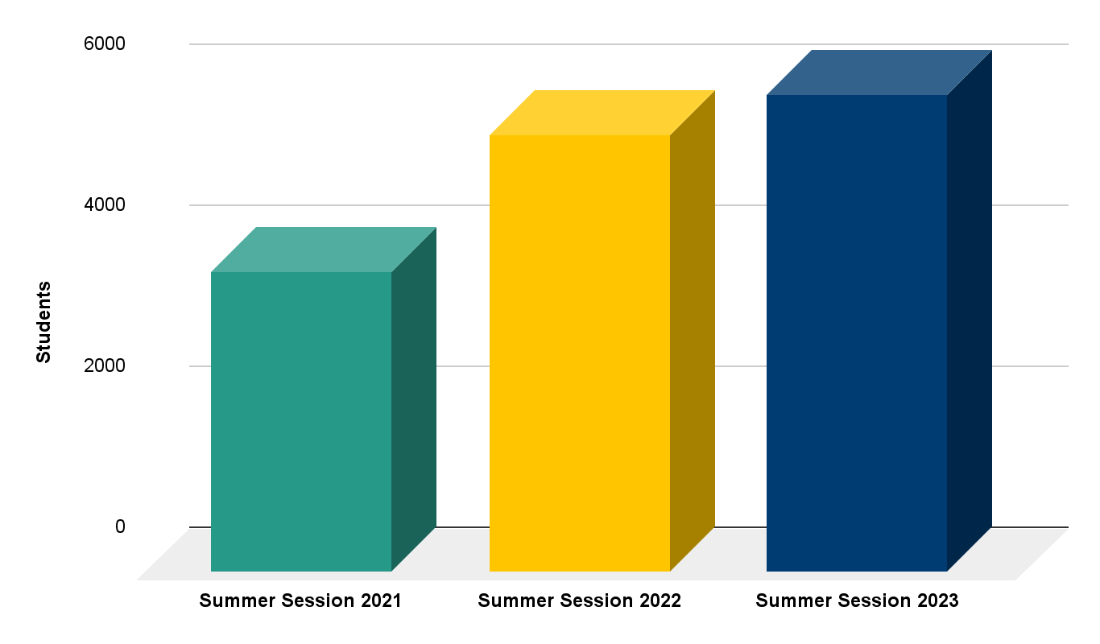
Summer Session Enrollment Summary
+9%

Slide 10
Summer Session
Upcoming Items
Updated Summer Session 2024 Offerings
Session I: 6/3–7/15
Session II: 6/17–7/29

Slide 11
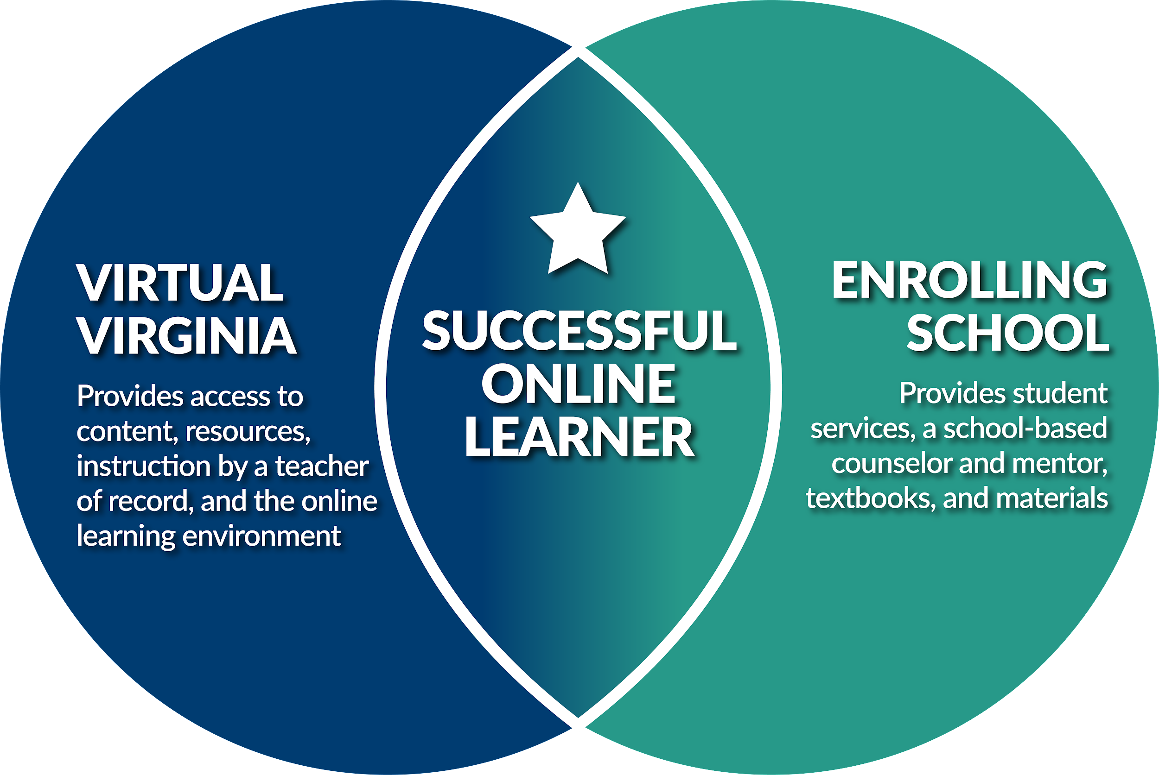
K–12 Instruction

Slide 12
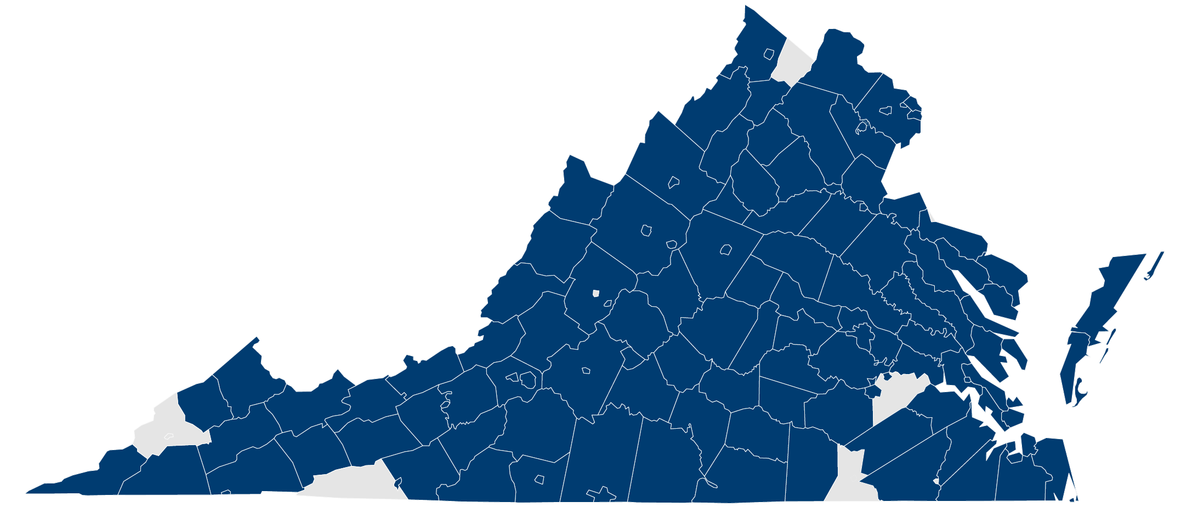
K–12 Instruction Participation, 2023–2024

Slide 13
Full-Time/Part-Time
Academic Year | Total Students | FT Online Students | %FT | PT Online Students | %PT
2023–2024* | 11,873 | 2,098 | 18% | 9,775 | 82%
2022-2023 | 14,162 | 1,866 | 13% | 12,296 | 87%
2021-2022 | 29,710 | 8,788 | 30% | 20,922 | 70%
*As of Nov. 1, 2023

Slide 14
K–12 Instruction Survey Feedback, 2022–2023
88%
98%
STUDENTS
comfortable using online tools and software in VVA courses
95%
SCHOOL PERSONNEL
satisfied with rigor of content in VVA courses
98%
PARENTS/
FAMILIES
satisfied with availability of VVA course offerings
SCHOOL PERSONNEL
satisfied with VVA curriculum alignment

Slide 15
K-12 Instruction
Upcoming Items
Build a "Runway" for evolving 2023–2024 needs
Shifts at Semester 2
Expansion of statewide dual enrollment in 2023–2024

Slide 16
Statewide
LMS

Slide 17
Statewide LMS
Upcoming Items
Virginia Statewide LMS Educator & Infrastructure/
Technology Credentials

Slide 18
Professional
Learning

Slide 19
Statewide PL Enrollments
VVA PL Enrollment YOY
FY24 YTD* | 6,040
FY23 | 16,158
FY22 | 8,879
Top 5 Offerings FY24 YTD*
1. | Statewide LMS Platform Essentials
2. | Canvas for Beginners I
3. | VDOE Team Nutrition
4. | New to View K–5
5. | Build Your Own Instructional Playbook
VVAAS
Total | 741
FY24 YTD* | 20
*As of Nov. 1, 2023

Slide 20
Professional Learning
Upcoming Items
Virginia Statewide LMS Educator & Infrastructure/Technology Credentials
VDOE Leveraging Virtual Learning Pilot Course

Slide 21
Virtual VA Programs
K–12 Instruction
Statewide LMS
Professional Learning
Summer Session

Slide 22
Multidivision Online Provider (MOP) & Virtual Learning Updates
Dr. Meg Foley, Virtual Learning Coordinator & Mr. Reggie Fox, Virtual Learning Specialist

Slide 23
Multidivision online provider (MOP)
MOP Courses
Number of school divisions that used a MOP in 2022-23 (51)
Number of student enrollment (9500)
Number of course enrollment (44811)
New & revised courses submitted and approved aligned with SOL
2023 MOP Course Window Submissions
170 SOL courses – new or revised
300 Elective courses

Slide 24
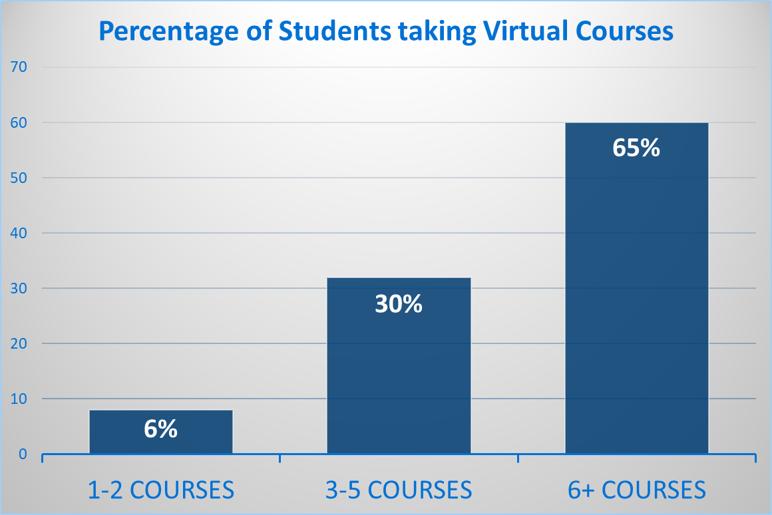
MOP
MOP 2022-23
Family Survey Highlights
1119 people responded to the survey.
How many courses does your child take online?

Slide 25
stats
How often did you or your child experience technical issues?
89% never or rarely
The quality of the course(s) my child has taken with the online program has been good.
97% strongly agree or agree
Was the course appropriately personalized to meet the unique needs of your child?
82% Yes
Notes:
It was a great program.
This online program really helped my child to focus more on education and to become more organized and structured.
My child had a pleasant experience with all courses and teachers and signing up again.
Only difficulty was balancing coursework, scheduled tests, activities which sometimes conflicted.

Slide 26
Comments from Respondents
It was a great program.
This online program really helped my child to focus more on education and to become more organized and structured.
My child had a pleasant experience with all courses and teachers and signing up again.
Only difficulty was balancing coursework, scheduled tests, activities which sometimes conflicted.

Slide 27
Professional Learning Pilot November 8-December 20
Course Components
Learner resources
Lesson content
Facilitated discussions
Module reflections
Content assessments
Notes:
This is a facilitated online course pilot through the Virginia Department of Education, in partnership with WHRO. Whether you are an experienced educator or new to the field of education, this course will engage you to explore lessons related to virtual teaching and learning.

Slide 28
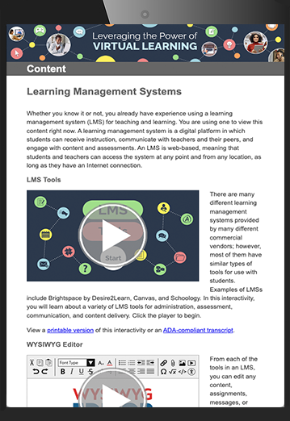
Modules
What is Virtual Learning?
Engaging Successfully in a Virtual Environment
Communication, Collaboration, and Community
Online Engagement: Students, Families, and Community Stakeholders
Assessing Students
Digital Citizenship

Slide 29
The Learner Experience
Engaging and interactive content
Multimedia, ADA compliant transcript and printable versions
Facilitated discussions directly related to the lesson
Four synchronous Zoom sessions for direct feedback
Suggested strategies and reflections – put into action
Module assessments
Certificate of Completion with 18 hours of professional development points

Slide 30
Technology Updates
Dr. Susan M. Clair

Slide 31
Broadband Updates
Commonwealth Connect Five-Year Plan- Department of Housing and Community Development, Office of Broadband.
Access, Affordability, and Adoption
Universal Broadband by 2028 (Broadband Equity Access and Deployment) Funding, 1.4 Billion in Virginia
Blueprint Virginia 2023: A Business Plan for the Commonwealth (p.9) :
K-12 Education: “Expand the use of effective virtual learning strategies as a way to offer improved access to specialized curriculum and flexible instruction options to all students regardless of geography or school division.”
Notes:
Discuss Commonwealth Connect 5- Year Plan – hit the highlights
Discuss Blueprint Virginia and expand broadband, how will this impact Virtual Learning programs ?

Slide 32
Broadband Updates continued
WIFI on buses will be eligible for e-Rate funding support.
Eligible Service Lists Supplements will provide additional information about topics not addressed in the ruling such as:
Will equipment and services be classified as Cat 1 or Cat 2 expense?
Questions related to Form 470, RFP requirements, and parked buses will be addressed.
Notes:
Discuss Commonwealth Connect 5- Year Plan – hit the highlights
Discuss Blueprint Virginia and expand broadband, how will this impact Virtual Learning programs ?

Slide 33
Computer Science Updates
Ms. Keisha Tennessee

Slide 34
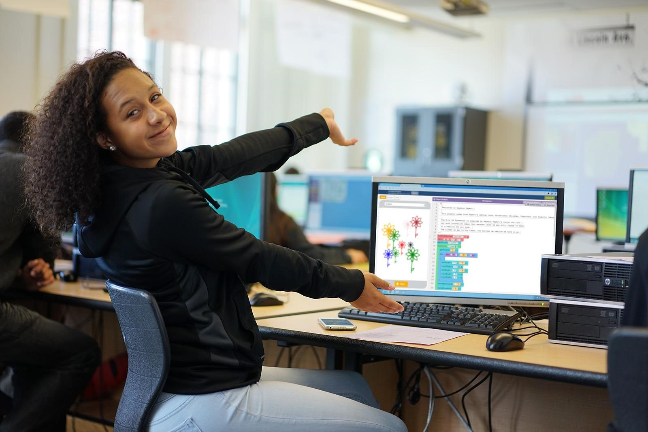
Computer Science
Review and Revision of the 2017 Computer Science Standards of Learning.
First Review: March 2024
Final Adoption: May 2024

Slide 35
Computer Science Awards
National Computer Science Education Week
Launch at VSTE (Computer Science focused sessions)
Nominations for Computer Science Educator of the Year
2022- 2023 School Year Awardees:
Computer Science Educator of the Year: Caren Daniels
K-2 Computer Science Champion: Cori Sowers
3-5 Computer Science Champion: Rebecca Otaizo
6-8 Computer Science Champion: Caren Daniel
9-12 Computer Science Champion: Brian Thomas
Administrators/Counselors Computer Science Champion: Adrienne Sawyer
STE(A)M Coaches/ITRTs Computer Science Champion: Pam Hoyle

Slide 36
Computer Science continued
NEW Release of Computer Science Instructional Resources
Learning with Techne
Computer Science Careers in the Commonwealth
Making Meaningful Connections: Computer Science Integration Course
This Photo by Unknown Author is licensed under CC BY-NC-ND

Slide 37
Instructional Technology Updates
Ms. Calypso Gilstrap

Slide 38
GoOpenVA
Instructional Playbook: includes all the resources needed to create your own instructional playbook
VPM
Climate Focused Careers
Exploring Climate Change
Watershed Investigations
Climate vs Weather
Swimming with the Fishes: Interactive Game
Learning with Teche: Computer Science video series for elementary students
Computer Science Careers Across Virginia: Learn more about different computer science careers in different regions of Virginia
WHRO
What is Data Science?
Data Science Resource Collection
Math Learning Resources for students
Math Learning Resource for teachers
Middle School Career Investigations
Blue Ridge PBS
"What Parents Need to Know" Series includes resources for parents related to opioids, vaping, and problem gambling
Vaping Interactive
The Poe Museum
Military Women's Memorial
VCU Watersheds Education and Training Program
In 2022, 120,000 unique users with 382,000 visits to access our 22,894 resources.
This spring we updated to 2.5 to increase information security.
SAML/SOS with Google and Clever
Virtual Learning Integration with Canvas, Schoology, and Google Classroom

Slide 39
Educational Technology Plan for Virginia 2024-2029
The current plan, which is housed in the comprehensive plan, expires this year.
Reflection, Request, and Research Phase
Final document will be recommended to the Board of Education in November
Goals will include virtual learning access, use, and design.

Slide 40
Internet Safety Advisory Council
The Office of Educational Technology and Classroom Innovation has created an Internet Safety Advisory Council in response to the new legislation (§ 22.1-24.1.) created from House Bill 1575, which is focused on the safe use of media and technology by students and teachers in public elementary and secondary schools in the Commonwealth.
We are charged specifically with curating: successful instructional practices, curricula, and other teacher resources used in school divisions within and outside of the Commonwealth for:
the safe use of media and technology by students and teachers;
safe and responsible use of social networking websites;
the risks of transmitting personal information on the Internet and the importance of privacy protection;
copyright laws on materials posted or shared online;
the importance of establishing open communication with responsible; and
how to recognize, avoid, and report suspicious, potentially dangerous, or illegal online communications or activities.

Slide 41
Coming Soon!
A new podcast is coming in December! The goals of the podcast are:
To activate professional learning by elevating classroom teachers through interviews.
To connect teachers with common practices and success highlights. To encourage self-care for educators.
To amplify the small spaces in instructional technology.
Using a jovial but informative tone, our host, Tom Landon, will be interviewing educators - who will be telling stories of using best practices to inspire student engagement and enhance student achievement. This podcast is a collaboration with Blue Ridge PBS, the Virginia Department of Education, and Virginia Society of Technology Education.
The Virginia Department of Education (VDOE) has partnered with Project Tomorrow to administer surveys in the areas of educational technology.
The Virginia Speak Up surveys are a semi-customized set of questions for students, educators, administrators, and parents. Schools and districts will be able to access their own data for planning purposes.
Surveys are available!
Subscribe to The Office of Educational Technology and Classroom Innovation News!
https://public.govdelivery.com/accounts/VADOE/signup/35952

Slide 42
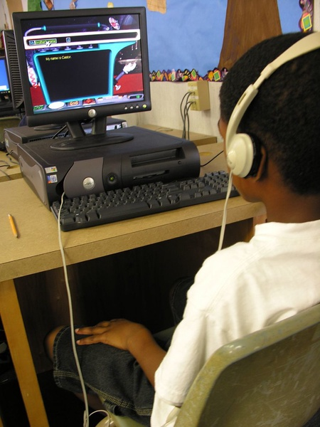
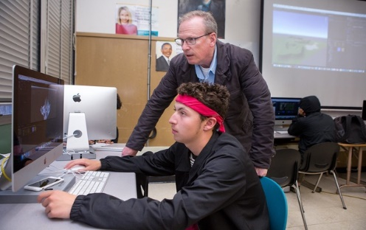
Questions & Collaboration
Discussion of instructional technology initiatives, virtual learning, and other technology related implementation
Next steps
Next meeting (May 2024)
Thank you for your work on this advisory committee
Public viewing on the VDOE YouTube channel may email questions/comments to the mailbox until November 15th, 2023: virtualprograms@doe.virginia.gov.

