Slide 1
Prioritization of 2023 Mathematics SOL Content for the 2023-2024 School Year - Elementary October 2, 2023
Notes:
Thank you for joining us this evening. As many of you are aware, the Virginia Board of Education approved the 2023 Mathematics Standards of Learning on August 31, 2023, with full implementation during the 2024-2025 school year. This webinar is the second in a series of three webinars that will address the transition of mathematics instruction to the 2023 Mathematics Standards of Learning during the 2023-2024 school year.

Slide 2
PURPOSE
This webinar will provide an overview of the Instructional Supports for Prioritization of Content document. This resource highlights the prominent content changes between the 2016 Mathematics Standards of Learning (SOL) and the 2023 Mathematics Standards of Learning and includes instructional notes to support school divisions in making decisions about the prioritization of content during the 2023-2024 transition year.
Notes:
The purpose of today’s webinar is to provide an overview of the Instructional Supports for Prioritization of Content Documents. This resource includes the prominent content changes between the 2016 Mathematics Standards of Learning (SOL) and the 2023 Mathematics Standards of Learning and includes instructional notes to support school divisions in making decisions about the prioritization of content during the 2023-2024 transition year. In conjunction with the 2023 Mathematics Standards of Learning Overview of Revisions document, this document supports the transition of instruction during the 2023-2024 school year. School divisions may wish to use this document when planning for instruction, based upon the options for transitioning, and determining how to supplement existing curriculum to incorporate content from the 2023 Mathematics SOL. School divisions will determine how best to meet the needs of students when incorporating content during the transition year to prepare for full implementation of the 2023 Mathematics Standards of Learning during the 2024-2025 school year.

Slide 3
agenda
Welcome
Review of 2023 Mathematics SOL Documents
Transitioning from 2016 to 2023 Mathematics SOL
Prioritization of Content
Grade Level Examples of Transition

Slide 4
Overview of Transition Options

Slide 5
Educator Transition Team
The Virginia Department of Education partnered with a group of 26 K-12 educators from across the Commonwealth to develop a technical support document that will guide school divisions in next steps for implementation of the revised standards​.
Bedford County Public Schools |  | Harrisonburg City Public Schools
Chesterfield County Public Schools |  | Henrico County Public Schools
Essex County Public Schools |  | Louisa County Public Schools
Falls Church City Public Schools |  | Middlesex County Public Schools
Franklin County Public Schools |  | Norfolk Public Schools
Gloucester County Public Schools |  | Prince William County Public Schools
Goochland County Public Schools |  | Rockingham County Public Schools
Greene County Public Schools |  | Williamsburg James City Public Schools
Hanover County Public Schools |  | Virginia Beach City Public Schools
Notes:
The Virginia Department of Education has partnered with 26 educators from across the Commonwealth to support the work of developing technical support document that will guide school divisions in implementing the revised Mathematics Standards of Learning. These educators work in divisions across the state and represent large school divisions, small school divisions, and all in between. The varying perspectives of this team brings strength to this work as we are able to hear about the needs of all different divisions in regard to the support needed to implement the 2023 Mathematics SOL.

Slide 6
Transition Options - 2023-2024 School Year
Option 1
Full Crosswalk Year
Instruction in both 2016 Mathematics Standards of Learning and the 2023 Mathematics Standards of Learning
Option 2 Partial Crosswalk Year
Instruction in the 2016 Mathematics Standards of Learning with choices for prioritization of key content from the 2023 Mathematics Standards of Learning
Option 3
Instruction focused solely on 2016 Mathematics Standards of Learning
Options for Transitioning to the 2023 Mathematics Standards of Learning (Word | PDF)
Notes:
LINK FOR CHAT: Options for Transitions to the 2023 Mathematics SOL: https://www.doe.virginia.gov/home/showpublisheddocument/49005/638297632355100000
One of the documents that has been developed to support this transition is posted on the VDOE 2023 Mathematics Standards of Learning webpage. The link to this document is being placed in the chat. During the 2023-2024 school year, school divisions will select one of the following transition options to prepare for full implementation of the 2023 Mathematics Standards of Learning in 2024-2025.
Option 1: Full Crosswalk Year – students will receive instruction in both the 2016 Mathematics Standards of Learning and the 2023 Mathematics SOL.
Option 2: Partial Crosswalk Year – students will receive instruction in the 2016 Mathematics SOL with choices for prioritization of key content from the 2023 Mathematics Standards of Learning
Option 3: Students will receive instruction focused solely on the 2016 Mathematics Standards of Learning and use the 2023-2024 to prepare for full implementation of the standards during the 2024-2025 school year.

Slide 7
Supporting Documents Currently Available
Notes:
The VDOE in collaboration with our Mathematics Transition team has been very busy developing documents supporting the implementation of the 2023 Mathematics Standards of Learning. In the chat you will see a link to the webpage where these documents are located: 2023 Mathematics Standards of Learning | Virginia Department of Education

Slide 8
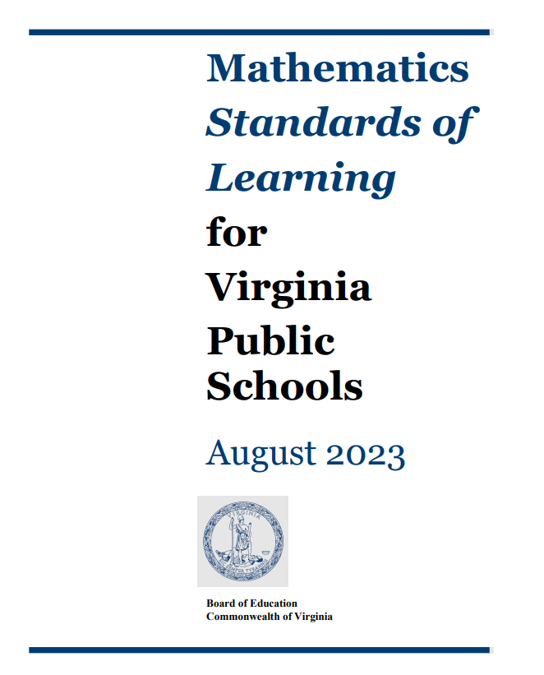
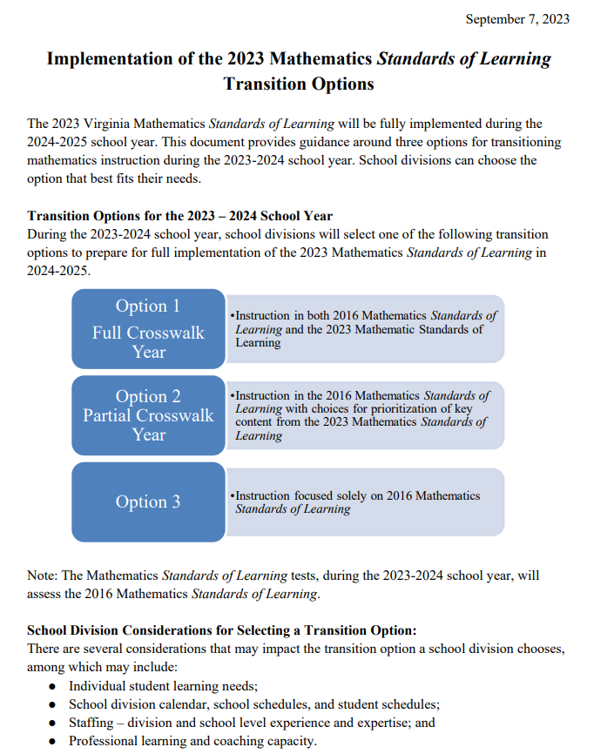
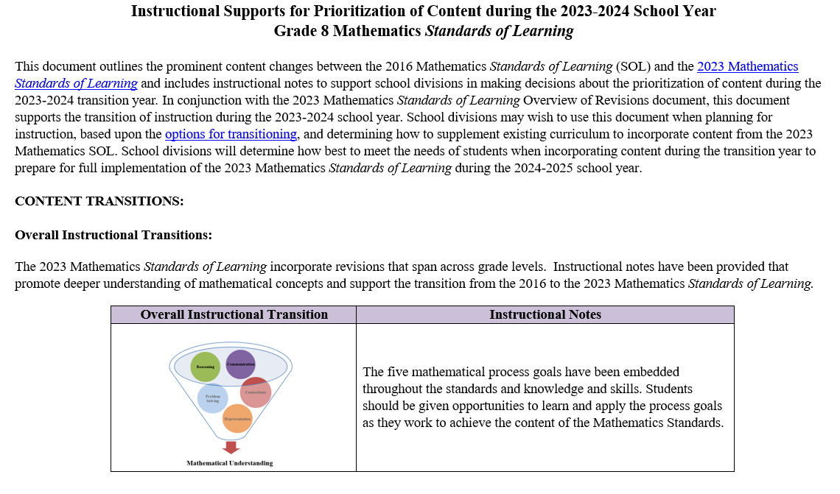
Current 2023 Mathematics SOL Documents
Notes:
Mathematics Standards of Learning documents
2023 Mathematics Standards of Learning Overview of Revisions documents
Implementation of the 2023 Mathematics Standards of Learning Transition Options document
Instructional Supports for Prioritization of Content during the 2023-2024 School Year
2023 Mathematics Standards of Learning | Virginia Department of Education

Slide 9
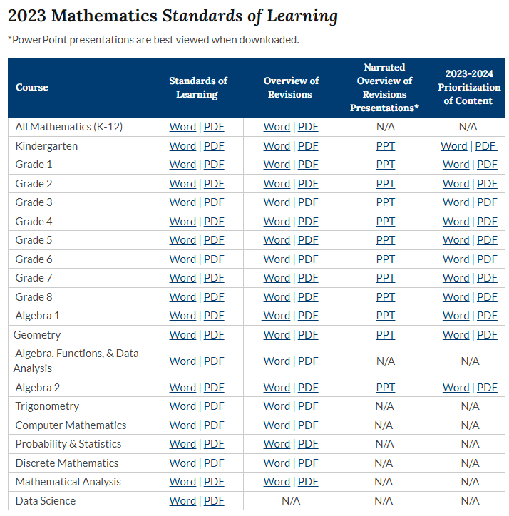
2023 Mathematics SOL Webpage
NEW
Notes:
2023 Mathematics SOL Webpage Link - https://www.doe.virginia.gov/teaching-learning-assessment/k-12-standards-instruction/mathematics/standards-of-learning/2023-mathematics-sol

Slide 10
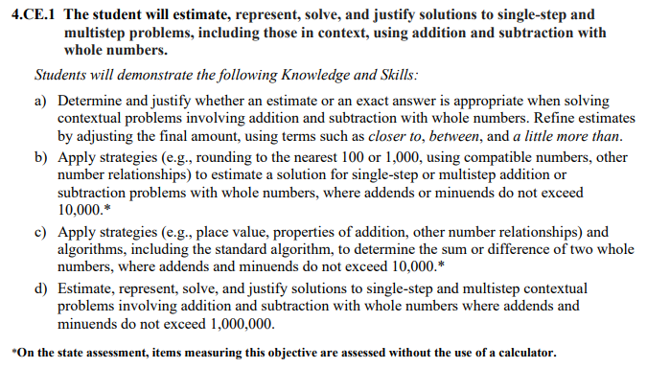
Standards Document
Notes:
The 2023 Mathematics Standards of Learning Document includes the standards and the knowledge and skills associated with each standard. This slide shows an example from the Grade 4 Standards Document.

Slide 11
Changes to Numbering of the SOL
First SOL within this strand
Grade
4
Computation and Estimation
Strand
KEY: NS = Number and Number Sense; CE = Computation and Estimation; MG = Measurement and Geometry; PS = Probability and Statistics; PFA = Patterns, Functions, and Algebra
Notes:
The new numbering system for the standards makes it clear within which strand a standard exists. For instance, the sample shown on the screen highlights 4.CE.1. Four indicates the grade level; CE indicates the Computation and Estimation Strand; and 1 indicates that this is the first standard of learning in this strand. The key shown at the bottom of the screen provides the abbreviations for each of the strands.

Slide 12
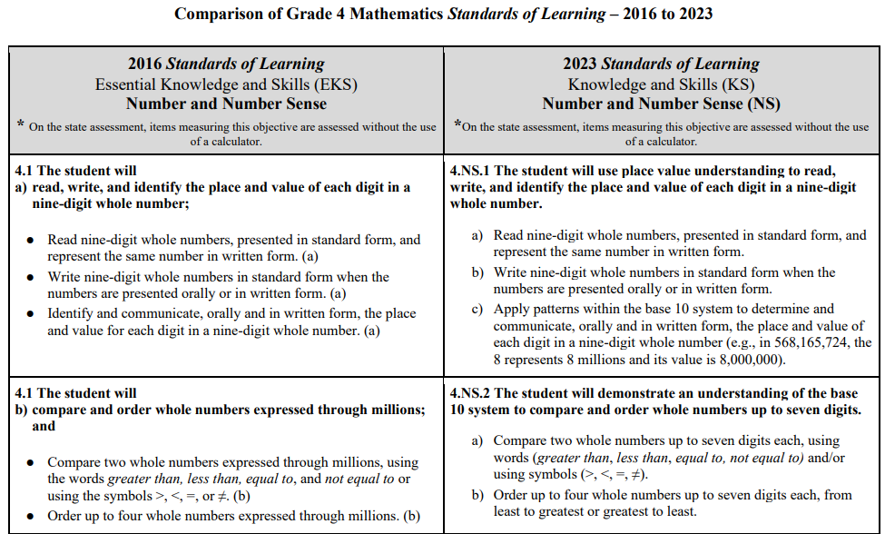
Overview of Revisions (2016 to 2023 Mathematics Standards of Learning) document
Notes:
An Overview of Revisions document has been created for each grade or course. This presentation provides a detailed comparison between the 2016 Standards of Learning and the 2023 Standards of Learning and is based upon the Overview of Revisions document.

Slide 13
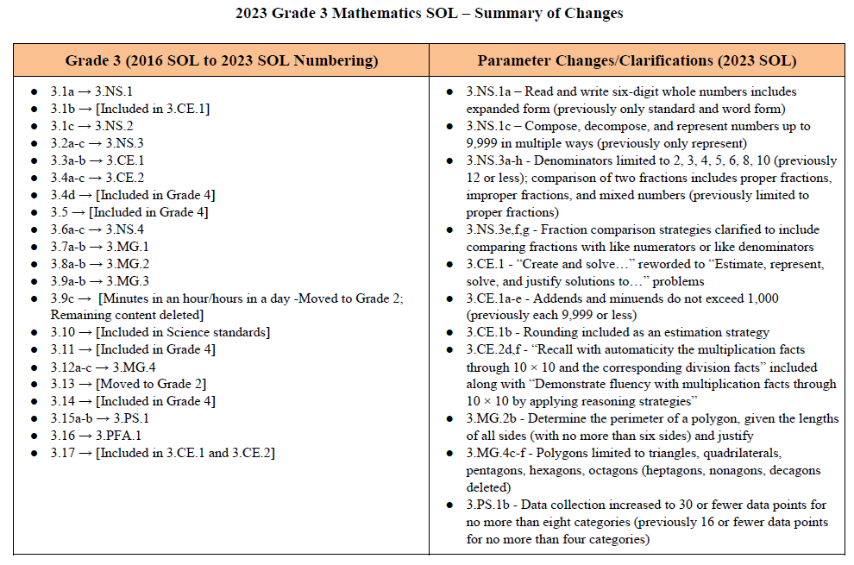
Overview of Revisions- Summary of Changes (1 of 2)
Notes:
At the end of the Overview of Revisions document there is a summary of changes table. One section of the table provides an overview of the changes to the numbering of the standards. Another section provides information regarding the prominent parameter changes and clarifications. Parameter changes and clarifications might be related to an increase or decrease in the limiters of the standards or the knowledge and skills; but might also be related to the depth of understanding of the content or scope of the content.

Slide 14
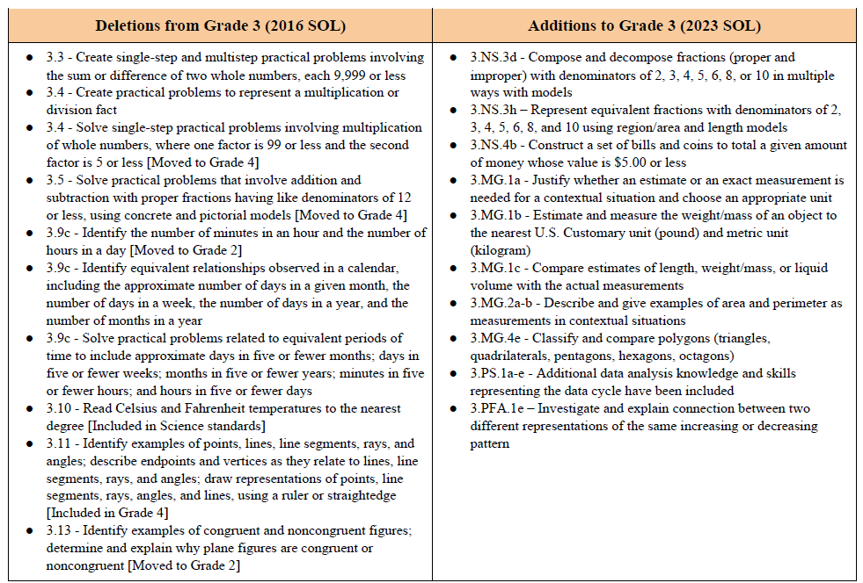
Overview of Revisions- Summary of Changes (2 of 2)
Notes:
The other two sections of the table include deletions from 2016 standards and addition of content to the 2023 standards.

Slide 15
Overview of Prioritization Documents
Notes:
Let’s dig a little more deeply into the prioritization documents that you are here to learn more about tonight.

Slide 16
Purpose of Prioritization Document
Outlines the prominent content changes between the 2016 Mathematics Standards of Learning and the 2023 Mathematics Standards of Learning
Includes instructional notes to support the prioritization of content during the 2023-2024 transition year
School divisions will determine how best to meet the needs of students when incorporating content during the transition year
Notes:
This document outlines the prominent content changes between the 2016 Mathematics Standards of Learning (SOL) and the 2023 Mathematics Standards of Learning and includes instructional notes to support school divisions in making decisions about the prioritization of content during the
2023-2024 transition year.
In conjunction with the 2023 Mathematics Standards of Learning Overview of Revisions document, this document supports the transition of instruction during the 2023-2024 school year. School divisions may wish to use this document when planning for instruction, based upon the options for transitioning, and determining how to supplement existing curriculum to incorporate content from the 2023 Mathematics SOL.
School divisions will determine how best to meet the needs of students when incorporating content during the transition year to prepare for full implementation of the 2023 Mathematics Standards of Learning during the 2024-2025 school year.

Slide 17
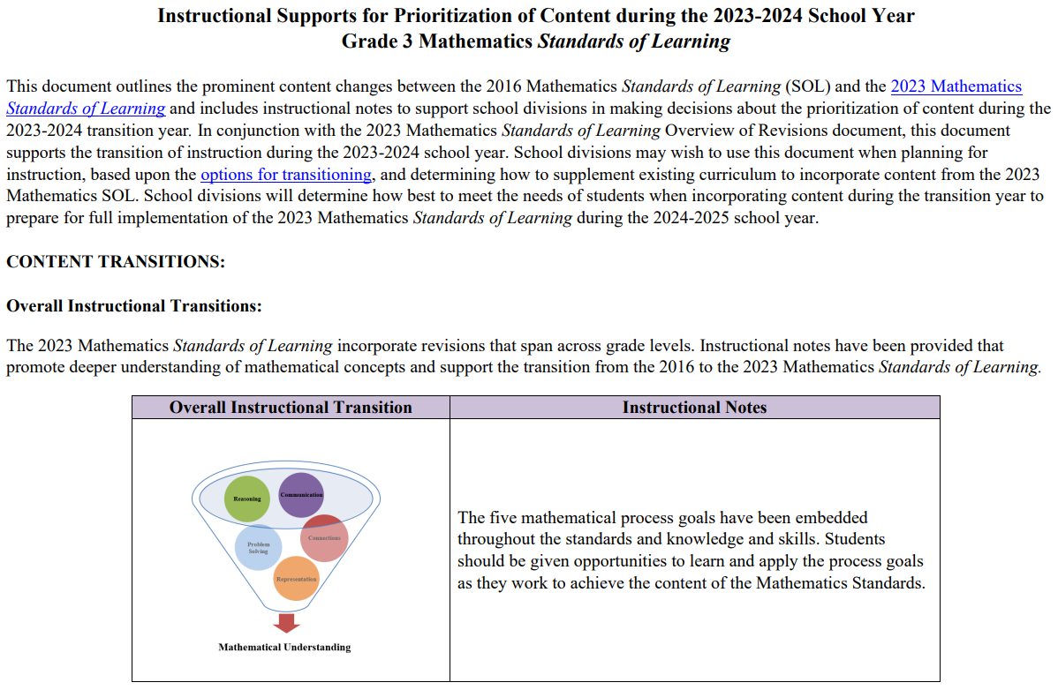
Mathematics Standards of Learning 2023-2024 School Year – Prioritization Notes
Notes:
There are Instructional Supports for Prioritization of Content for all grades levels of mathematics K-8, Algebra 1, Geometry and Algebra 2. These documents are all structured similarly and, as mentioned before, are most powerful when used in conjunction with the corresponding grade or course level Overview of Revisions document. Let’s look at the three common components of this document.

Slide 18
Content Transitions
Critical Instructional Transitions
Includes critical content that could cause gaps in student learning if instruction is not provided during the transition year
Overall Instructional Transitions
Includes overall content changes that span across grade levels and promote deeper understanding of concepts
Specific Instructional Transitions by Strand
Includes suggestions for transitioning from the 2016 to the 2023 Mathematics Standards of Learning by blending specific content from both sets of standards
Notes:
Each document includes three sections:
Critical Instructional Transitions: Includes critical content that could cause gaps in student learning if instruction is not provided during the transition year
Overall Instructional Transitions: Includes overall content changes that span across grade levels and promote deeper understanding of concepts
Specific Instructional Transitions by Strand: Includes suggestions for transitioning from the 2016 to the 2023 Mathematics Standards of Learning by blending specific content from both sets of standards

Slide 19
Critical Instructional Transitions Example – Grade 2
The 2023 Mathematics Standards of Learning include critical content, as shown below, that could cause gaps in student learning if instruction is not provided during the transition year.
Notes:
Third grade content addressing the number of minutes in an hour and number of hours in a day has been moved to second grade in the 2023 Mathematics SOL, as has content addressing congruent figures. These are considered critical instructional transitions since a student during the 2023-2024 School Year who does not receive instruction in this content will also not receive content next year during the 2024-2025 school year since it will no longer be taught in grade 3.

Slide 20
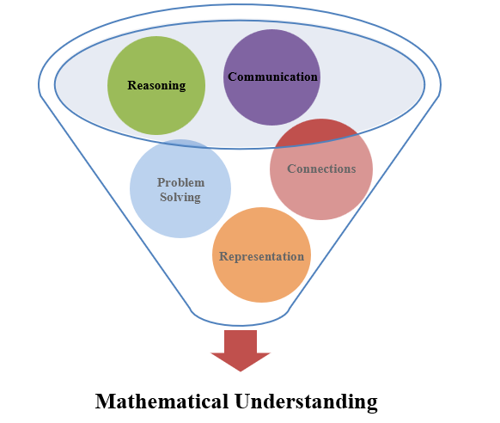
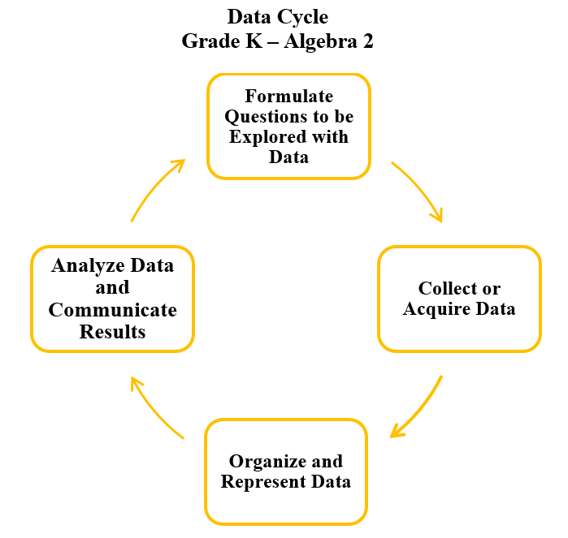
Overall Instructional Transitions
The 2023 Mathematics Standards of Learning incorporate revisions that span across grade levels. Instructional notes have been provided that promote deeper understanding of mathematical concepts and support the transition from the 2016 to the 2023 Mathematics Standards of Learning.
Notes:
The 2023 Mathematics Standards of Learning incorporate additional changes that promote deeper understanding of concepts. Through the embedding of the five mathematical process goals and the infusion of the Data Cycle in standards addressing statistics, the 2023 SOL take a deeper dive into mathematics content. This section includes instructional notes that outline some of the instructional shifts that may be need to be considered, along with pointing out some of the content that may accompany these two overall transitions.

Slide 21
Specific Instructional Transitions by Strand
The 2023 Mathematics Standards of Learning incorporate revisions that are specific to a grade level or course. Instructional notes have been provided for specific standards that support the transition from the 2016 to the 2023 Mathematics Standards of Learning.
Specific Instructional Transitions by Strand:
Notes:
The third section of the Instructional Supports for Prioritization of Content documents address revisions that are specific to a grade level or course and is intended to support divisions and teachers in making decisions about content that might be folded into the instruction during 2023-2024 based on the 2016 Mathematics SOL.

Slide 22
Specific Instructional Transitions – Elementary Prioritization Documents
Notes:
We’ll take some time now to look at an example of specific instructional transition recommendations for each grade level Kindergarten through Grade 5.Deb Delozier-VDOE

Slide 23
Example – Kindergarten
2016 SOL | 2023 SOL
K.3 The student will identify the number after, without counting, when given any number between 0 and 100 and identify the number before, without counting, when given any number between 1 and 10; and count forward by tens to determine the total number of objects to 100. Identify the number after, without counting, when given any number between 0 and 100. (c) Identify the number before, without counting, when given any number between 1 and 10. (c) Count forward orally by tens, starting at 0, to determine the total number of objects up to 100. (d) | K.NS.1 The student will utilize flexible counting strategies to determine and describe quantities up to 100. State the number after, without counting, when given any number between 0 and 30. State the number before, without counting, when given any number between 1 and 20. Use objects, drawings, words, or numbers to compose and decompose numbers 11-19 into a ten and some ones. Group a collection of up to 100 objects (e.g., counters, pennies, cubes,) into sets of ten and count by tens to determine the total (e.g., there are 3 groups of ten and 6 leftovers, 36 total objects).
Revisions:
State the number after, decreased from between 0 and 100 to between 0 and 30
State the number before, increased from between 0 and 10 to between 1 and 20
Use objects, drawings, words, or numbers to compose and decompose numbers 11-19 into a ten and some ones
Group a collection of objects up to 100 into sets of ten and count by tends to determine the total
Notes:
On the screen you are seeing an excerpt from the Kindergarten Overview of Revisions Narrated PowerPoint showing a comparison between the 2016 SOL and the newly adopted 2023 SOL. As you can see the content of SOL K.3 c and d can now be found in K.NS.1 g, h, i, and j of the 2023 standards with any changes highlighted in red.
An excerpt from the Kindergarten Prioritization document is now being shown on the screen. As Tina shared earlier in the presentation, school divisions may wish to use the Prioritization documents when planning for instruction, based upon the options for transitioning, and in determining how to supplement existing curriculum as content from the 2023 Mathematics SOL is incorporated. Notice in this example, K.3d is shown as aligning to K.NS.1ij. The Transition Team has provided instructional notes to support folding in this content. In this instance, it is suggested that as students are learning about the numbers …
Now let’s take a look at an example Grade 1.

Slide 24
Example – Grade 1
2016 SOL | 2023 SOL
1.6 The student will create and solve single-step story and picture problems using addition and subtraction within 20. Create and solve single-step oral or written story and picture problems, using addition and subtraction within 20. Identify a number sentence to solve an oral or written story and picture problem, selecting from among addition and/or subtraction equations (e.g., number sentences). Combine parts contained in larger numbers up to 20 by using related combinations (e.g., 9 + 7 can be thought of as 9 broken up into 2 and 7; using doubles, 7 + 7 = 14; 14 + 2 = 16 or 7 broken up into 1 and 6; making a ten, 1 + 9 = 10; 10 + 6 = 16). Explain strategies used to solve addition and subtraction problems within 20 using spoken words, objects, pictorial models, and number sentences. | 1.CE.1 The student will recall with automaticity addition and subtraction facts within 10 and represent, solve, and justify solutions to single-step problems, including those in context, using addition and subtraction with whole numbers within 20. e) Solve addition and subtraction problems within 20 using various strategies (e.g., inverse relationships: if 9 + 3 = 12 then 12 - 3 = 9; decomposition using known sums/differences: 9 + 7 can be thought of as 9 decomposed into 2 and 7, then use doubles, 7 + 7 = 14; 14 + 2 = 16 or decompose the 7 into 1 and 6; making make a ten: 1 + 9 = 10; 10 + 6 = 16, etc.). f) Represent, solve, and justify solutions to single-step addition and subtraction problems (join, separate, and part-part-whole) within 20, including those in context, using words, objects, drawings, or numbers. g) Determine the unknown whole number that will result in a sum or difference of 10 or 20 (e.g., 14 - __ = 10 or 15 + __ = 20).
Revisions:
Create single-step oral or written story and picture problems, using addition and subtraction within 20 has been removed
Represent, solve, and justify solutions to single-step addition and subtraction problems
Determine the unknown whole number that will result in a sum or difference of 10 or 20 (e.g., 14 - __ = 10 or 15 + __ = 20)
Notes:
The content of SOL 1.6 (Problem Solving with Addition and Subtraction), 1.7 (Fluency with Addition and Subtraction to 10), and 1.15 (Equality) has become SOL 1.CE.1. The Prioritization note included with this content recommends that as students are determining the unknown whole number that will result in a sum or difference of 10 or 20, it will be helpful if students have opportunities to use manipulatives such as math bead racks, double ten frames, and/or number paths that will allow them to anchor to the quantities of 10 or 20. This will increase their fluency and problem-solving abilities.

Slide 25
Example – Grade 2
2016 SOL | 2023 SOL
2.9 The student will tell time and write time to the nearest five minutes, using analog and digital clocks. Show, tell, and write time to the nearest five minutes, using an analog and digital clock. Match a written time (e.g., 4:20, 10:05, 1:50) to a time shown on a clock face to the nearest five minutes. Match the time (to the nearest five minutes) shown on a clock face to a written time. | 2.MG.2 The student will demonstrate an understanding of the concept of time to the nearest five minutes, using analog and digital clocks. Identify the number of minutes in an hour (60 minutes) and the number of hours in a day (24 hours). Determine the unit of time (minutes, hours, days, or weeks) that is most appropriate when measuring a given activity or context and explain reasoning (e.g., Would you measure the time it takes to brush your teeth in minutes or hours?). Show, tell, and write time to the nearest five minutes, using analog and digital clocks. Match a written time (e.g., 1:35, 6:20, 9:05) to the time shown on an analog clock to the nearest five minutes.
Revisions:
Identifying minutes in an hour and the number of hours in a day
Determine appropriate unit of time in context and explain reasoning
Notes:
As indicated in Grade 2 Overview of Revisions Narrated PowerPoint SOL 2.9 is now located in SOL 2.MG.2 - Students will continue to demonstrate an understanding of time by showing, telling, writing, and matching times to the nearest five minutes using analog and digital clocks. New to grade 2 in the 2023 standards is -- Identifying the number of minutes in an hour and number of hours in a day moved from 3.9c (2016) to 2.MG.2 in the 2023 standards and determining the unit of time that is appropriate for given activities or contexts. The prioritization document provides instructional notes on including this content in multiple ways – one example for folding in the content of determining the best unit of time to measure a given activity is to start with common activities that students experience – such as brushing their teeth or traveling to a particular destination – recognizing that it takes only minutes to brush our teeth but maybe hours if they are traveling to visit another state.

Slide 26
Example – Grade 3
2016 SOL | 2023 SOL
3.1 The student will read, write, and identify the place and value of each digit in a six-digit whole number, with and without models; Read six-digit numerals orally. (a) Write six-digit numerals in standard form that are stated verbally or written in words. (a) Determine the value of each digit in a six-digit whole number (e.g., in 165,724, the 7 represents 7 hundreds and its value is 700). (a) Represent numbers up to 9,999 in multiple ways, according to place value (e.g., 256 can be 1 hundred, 14 tens, and 16 ones, but also 25 tens and 6 ones), with and without models. (a) | 3.NS.1 The student will use place value understanding to read, write, and determine the place and value of each digit in a whole number, up to six digits, with and without models. Read and write six-digit whole numbers in standard form, expanded form, and word form. Apply patterns within the base 10 system to determine and communicate, orally and in written form, the place and value of each digit in a six-digit whole number (e.g., in 165,724, the 5 represents 5 thousands and its value is 5,000). Compose, decompose, and represent numbers up to 9,999 in multiple ways, according to place value (e.g., 256 can be 1 hundred, 14 tens, 16 ones, but also 25 tens, 6 ones), with and without models.
Revisions:
Use the standard, word form and expanded form of six-digit numbers
Compose, decompose and represent numbers in a variety of ways
Notes:
SOL 3.1a in 2016 is now SOL 3.NS.1 in the 2023 Standards. Students will continue to use place value understanding to read and write the standard and word form of six-digit numbers. Additionally, students will need to understand the expanded form of six-digit numbers. Students will continue to represent numbers in a variety of ways as they compose and decompose numbers.

Slide 27
Example – Grade 4
2016 SOL | 2023 SOL
4.7 The student will solve practical problems that involve determining perimeter and area in U.S. Customary and metric units. Determine the perimeter of a polygon with no more than eight sides, when the lengths of the sides are given, with diagrams. Determine the perimeter and area of a rectangle when given the measure of two adjacent sides, with and without diagrams. Determine the perimeter and area of a square when the measure of one side is given, with and without diagrams. Solve practical problems that involve determining perimeter and area in U.S. Customary and metric units. | 4.MG.3 The student will use multiple representations to develop and use formulas to solve problems, including those in context, involving area and perimeter limited to rectangles and squares (in both U.S. Customary and metric units). Use concrete materials and pictorial models to develop a formula for the area and perimeter of a rectangle (including a square). Determine the area and perimeter of a rectangle when given the measure of two adjacent sides (in whole number units), with and without models. Determine the area and perimeter of a square when given the measure of one side (in whole number units) with and without models. Use concrete materials and pictorial models to explore the relationship between area and perimeter of rectangles. Identify and represent rectangles with the same perimeter and different areas or with the same area and different perimeters. Solve contextual problems involving area and perimeter of rectangles and squares.
Revisions:
Develop a formula for the area and perimeter of a rectangle (including a square)
Explore the relationship between area and perimeter of rectangles
Identify and represent rectangles with the same perimeter and different areas or with the same area and different perimeters
Determine the perimeter of a polygon with no more than eight side has been removed from the Grade 4 standards
Notes:
SOL 4.7 in 2016 is now SOL 4.MG.3 in the 2023 standards. This standard includes some new content.​
SOL 4.MG.3a and SOL 4.MG.3d contain new content for Grade 4 - students will use concrete materials and pictorial models to develop a formula for the area and perimeter of a rectangle (including a square) and to explore the relationship between area and perimeter of rectangles.​
SOL 4.MG.3e is also new content for Grade 4 - students will identify and represent rectangles with the same perimeter and different areas or with the same area and different perimeters.​
Determining the perimeter of a polygon with no more than eight sides has been removed from the Grade 4 standards.

Slide 28
Example – Grade 5
2016 SOL | 2023 SOL
5.3 The student will identify and describe the characteristics of prime and composite numbers; and identify and describe the characteristics of even and odd numbers. Identify prime numbers less than or equal to 100. (a) Identify composite numbers less than or equal to 100. (a) Demonstrate with concrete or pictorial representations and explain orally or in writing why a number is prime or composite. (a) Identify which numbers are even or odd. (b) [Deleted] Demonstrate with concrete or pictorial representations and explain orally or in writing why a number is even or odd. (b) [Deleted] Demonstrate with concrete or pictorial representations and explain orally or in writing why the sum or difference of two numbers is even or odd. (b) [Deleted] | 5.NS.2 The student will demonstrate an understanding of prime and composite numbers, and determine the prime factorization of a whole number up to 100. Given a whole number up to 100, create a concrete or pictorial representation to demonstrate whether the number is prime or composite, and justify reasoning. Classify, compare, and contrast whole numbers up to 100 using the characteristics prime and composite. Determine the prime factorization for a whole number up to 100
Revisions:
Determine the prime factorization of a whole number up to 100
Identifying and describing odd and even numbers has been removed
Notes:
SOL 5.3a in 2016 is now SOL 5.NS.2 in the 2023 standards. In SOL 5.NS.2 students will continue to demonstrate an understanding of prime and composite numbers up to 100 and will compare and contrast whole numbers using the characteristics of prime and composite. The content in SOL 5.NS.3c, determining prime factorization of a whole number up to 100, is a new expectation of this standard. SOL 5.3b, characteristics of odd and even numbers, has been removed from Grade 5. Identifying and describing odd and even numbers remains in Grade 2.

Slide 29
Questions
vdoe.mathematics@doe.virginia.gov
Virginia Department of Education, 2023

