Slide 1
Fall Positions and Exits Collection (Fall PEC)
September 2023
Notes:
Hello and welcome to the Fall Positions and Exits Collection Overview. My name is Aleta Fonville. I am the data specialist responsible for the Positions & Exits Collection. Helping me today is Dana Ratcliffe. Dana is a data specialist also and works with MSC and IPAL.
Today’s presentation is the same as last year’, with a few updates to the Changes area. Still, it is good information that everyone can use to make sure we are all on the same page.

Slide 2
Agenda
The Purpose
Data File
Changes
FAQs
Resources
Notes:
We are gathering information for the Fall PEC submission file.
First on the agenda is to talk about why we need this data.
I will go over the data file, discussing the points that you need to pay more attention to.
While there aren’t any changes to the layout, I do have some additional data constraints. I will talk about it here.
Next I will review some common questions
Lastly, I want to make sure you are aware of everything you need to successfully submit your Fall data.

Slide 3
Your Story
Your Teacher Shortage Story
Notes:
The Position & Exits collection was created to:
Identify critical shortages of teachers and administrative personnel by endorsement (subject) area, geographic region, or school division and
Collect information on the total number of full-time equivalent positions (FTEs) in administration and instruction and the number of unfilled positions
This is your story.

Slide 4
Readers of Your Story
Your Teacher Shortage Story
VDOE
Governor
Other School Divisions
General Assembly
General Public
Policy Makers
Notes:
And, you tell your story so that others may read it. As it is read, decisions are made on a local, state-wide, and even federal level. There are so many others who are interested in your story including parents, tax payers, other school divisions, media companies, to name a few.

Slide 5
A Balance
Accurate
Timely
Notes:
Because of the attention, it is important that your information is timely and accurate.
Data Services reports your story to other officials like the Secretary, General Assembly, and even the Governor. The timeliness of your submission help us meet our deadlines.
That being said, your data must also be accurate. There are decision makers reading your story. Remember, bad data can result in bad decisions.
So there has to be a balance. The data must be accurate and on time. We have to have both.

Slide 6
Data Reporting Timeline
Division-level data gathering is ongoing July 1, 2023 - June 30, 2024
September 26: Training Webinar
October 1: Fall PEC Window Opens
October 20: Fall PEC Successful Submission Due
November 3: Fall PEC Final Signatures Due
Notes:
In order to be timely, you must know the timeline. Here it is. Today is the first training for PEC Fall. (We started training in September. This is the last session and is being recorded for future reference.)
The data that you are reporting is as of October 1. You can begin uploading your files on October 1st. That’s when the Fall PEC window opens
A successful submission is due on October 20. From the 1st to the 20th is the time for you to upload your data, work out any errors and get the required local signatures.
Please don’t waste this time as the final signatures from your Supervisor is due on November 3rd.

Slide 7
Agenda
The Purpose
Data File
Changes
FAQs
Resources
Notes:
Now that we have discussed the purpose of the data and its timeline, let’s cover some of the details that will be included in your file.

Slide 8
Fall PEC
Emphasis is on number of Positions and the number of Unfilled Positions.
Data will be collected by Full Time Equivalency (FTE).
The as-of date is October 1st.
All positions held by school-level and division-level personnel, both licensed and unlicensed must be reported.
Notes:
There aren’t any changes to the layout of the data from last year. Really, the collection itself is basically the same, with minor changes that will be discussed later on. All else is the same.
We will still report the number of positions that are required to operate the school and/or service the students.
Data is collected by FTE, and the data is as of October 1. The data is “as of” 10/1, but divisions should report all planned FTEs for the year (similar to MSC).
And your data will represent all positions on a school and/or division level, and will include both licensed and unlicensed positions.

Slide 9
Full-Time Equivalency (FTE)
1.00 FTE
The minimum number of hours to be eligible to receive benefits, OR
The IRS definition of full-time
an employee employed on average at least 30 hours of service per week, or 130 hours of service per month
Greater than 1.00 FTE
If an employee takes extra work (class section, extra bus routes, etc.) then the sum of the FTE for the positions filled by that individual would be greater than 1.00 FTE.
For example, a school has one biology teacher who teaches a full course load plus an extra section of biology for an additional stipend.
Notes:
The Fall PEC data is not reporting a person, but a position. And the position is based on FTEs. FTEs are the minimum number of hours to be eligible to receive benefits, or the IRS definition of an FTE.
Because we are reporting positions, it is possible that the FTE representing a person will be greater than 1 FTE. This is the case if a person takes extra work. For example, a school has one biology teacher who teaches a full course load plus an extra section of biology for an additional stipend.
Another thing to keep in mind … a person may have other responsibilities that are not captured in the FTE count, such as planning periods or study hall. Therefore, if they only teach Math, you must relay how much time is actually dedicated to the teaching the subject. This mean you may not automatically have 1 FTE for this math teacher.
As I’ve mentioned the importance of working with a team. Here’s is where an HR team member will be helpful. Basically, the HR rep will understand the FTEs but the IT will understand the technical portion of the submission.

Slide 10
A Record
A12023xxx
Notes:
The A record is different for each submission. For the Fall PEC submission, your a record will contain:
An A for the record type
The number 1 to denote the Fall submission
The current school year of 2023
And your three digit school division number

Slide 11
B Record – Positions by FTE (Fall)
Definition
The number of Positions by FTE. All positions held by school-level and division-level personnel, both licensed and unlicensed, must be reported.
Edits
Must be a valid number greater than or equal to 0
Must contain a decimal point and two decimal places
Notes:
The biggest bulk of your work in the Fall submission will be the B record. An important piece of the B record will be Positions by FTE. If you use the Excel Data File Template, this is column I.
This field is asking for the total positions in FTE are required to run the school and/or to service the students. All positions on the division and school level must be reported.

Slide 12
B Record – Unfilled Positions by FTE
Definition
The number of positions by FTE that were unfilled. Unfilled positions only include those positions that were advertised as available but no one qualified was hired. If the duties of the position were given to an existing employee in lieu of hiring a new employee, the position should still be included in this count.
All positions held by school-level and division-level personnel, both licensed and unlicensed, must be reported on the Fall Submission.
Edits
Must be a valid number greater than or equal to 0
Must contain a decimal point and two decimal places
Notes:
The next important piece of the B record will be Unfilled Positions by FTE. If you use the Excel data file template, this is column J.
Positions by FTE reports what is needed. Of that need, how much is unfilled? Unfilled positions only include those positions that were advertised as available but no one qualified was hired. If the duties of the position were given to an existing employee in lieu of hiring a new employee, the position should still be included in this count.
All positions held by school-level and division-level personnel, both licensed and unlicensed, must be reported on the Fall Submission.

Slide 13
B Record – Bad Example
Notes:
Let’s say you need five FTE history teachers and of that 5, 2 are unfilled. This is the wrong way to report your 5 history teachers. Your Positions and Unfilled positions should not equal to 5.

Slide 14
B Record – Example
Notes:
Because we have an unfilled position column, it’s as if the mind tells us that there is an Filled Positions column. But that’s not what we have.
Rather, if you need 5 history positions (which is represented by the Positions by FTE column), and of that 5 two are unfilled (which is represented by the Unfilled Positions Column), this is how you would report it. Unfilled is a subset of Positions by FTE.

Slide 15
Agenda
The Purpose
Data File
Changes
FAQs
Resources
Notes:
As I said before, the layout to the report has not changed from last year. However, due to feedback we instituted some changes to how data is uploaded.

Slide 16
New Data Constraints
All schools that are opened in the division have related FTEs;
Divisions will not be able to report FTEs for schools that are no longer in operation; and
Only a percentage of total FTEs can be on a division level.
Notes:
The system will not allow your upload to complete if you have not listed FTEs for your opened schools.
You can only report FTEs for schools that are in operation. This will help those divisions that are merging or closing under one name and opening under another.
To help you gauge if you have counted all FTEs in a school, the system will only allow a percentage of total FTEs to be on a division level.

Slide 17
Changes to Position Codes
New
Position 142
Position 141
Position 140
New
Licensed Behavior Analysts
Admin/B Record
Licensed Assistant Behavior Analysts
Admin/B Record
New
Other Licensed Health and Behavioral Positions
Admin/B Record
Notes:
Here are changes to the position codes.
We added three positions for in the behavior area. They are licensed Admin positions. I don’t have definitions as of yet, but if you need clarification I will do my best to get the information for you.

Slide 18
Agenda
The Purpose
Data File
Changes
FAQs
Resources
Notes:
There are several questions that have been prevalent throughout the divisions. This section will discuss the main ones.

Slide 19
FAQ
Who submits data from Regional Centers?
Each school division will report the Positions by FTE and the Unfilled Positions by FTE for each of their schools and central office.
Each regional center will report the Positions by FTE and the Unfilled Positions by FTE for each of their centers/programs and central office.
Governor’s schools
CTE Centers
Alternative Ed, Special Ed
Virtual
Etc.
Private Special Education schools do not report
Notes:
Basically, all regional centers will report their data, unless they have been exempt from self reporting. In these cases, the divisions will report for the regional centers. Email me if you have any questions as to which centers are responsible for self reporting.

Slide 20
FAQ Continued
If a division chooses a MOP or other virtual provider instead of hiring another teacher, does this count as unfilled?
Yes - if the position was advertised and the position wasn’t filled
No - if a MOP was chosen without advertising for a person to fill the position
Are all virtual teaching positions reported?
Yes - if the virtual teacher is hired by the school division or center
Yes – if a MOP is selected to provide a teacher and curriculum for one or more courses in lieu of hiring a person to fill the position
No – if it is a full-time MOP program where participating students only attend classes offered by the MOP
If a teacher teaches 3 sections of inclusive language arts and 2 sections of journalism, would his FTE have to be split between two different position codes?
Yes – so that each position is captured
Notes:
1. Remember, unfilled positions are those positions that were advertised as available but no one qualified was hired. If the duties of a position were given to an exiting person in lieu of hiring a new employee, the position should be included in the unfilled count.

Slide 21
FAQ Continued
What does "licensed" mean?
“Licensed” means the position requires a Board of Education license
Would long-term substitutes be reported anywhere on this report?
This report is by position. The position needs to be reported whether it is filled by a permanent employee or a long-term substitute.
How are long-term substitutes counted when they are not subbing in an unfilled position?
Some schools employ a long-term sub to fill in for teachers when needed instead of pulling a sub from the sub pool. If this is the case, this position would be reported using Position Code = 102
Notes:
There are some positions that require a license on a school/division level. However, for the sake of this collection, licensed positions are based on the Board of Education. Please refer to your Position Codes document for verification of which positions are licensed.

Slide 22
FAQ Continued
How is FTE determined for coaches?
Coaching positions are not part of this collection
Are School Board members included in this report?
No
If a position only requires 4 hours per day (example, a Special Education Paraprofessional for Ages 3-5), is this considered a 1.0 FTE?
No
Assuming the position is 4 hours-5 days a week, that’s 20 hours/wk
If the division defines full time as 40 hours per week, then this position is .50 FTE
If the division defines full time as 36 hours per week, then this position is .56 FTE
If the division does not have a definition of full time thus using the IRS definition of 30 hrs/wk for full time, then this position is .67 FTE
Notes:
Extra-curricular activities are not captured on the Fall PEC report. So, sport-related coaches will not be included. However, if you have subject related coaches, like a math or instructional coach, look at positions codes 114-121 to see which one fits your needs.

Slide 23
FTE Calculations
Hours-a-Day * Days-a-Week / Total Hours-a-Week
4 hours-a-day * 5 days-a-week = 20 / 40 total hours-a-week = .50 total FTE
4*5=20/36= .56
4*5=20/30= .67
If person is teaching a class for 90 minutes-a-day:
Divide 90/60 to get the hours-a-day figure.
Multiply that by the number of days the class is taught.
Divide that by the hours in a week.
1.5 hours a day * 5 days a week = 7.5 / 37.5 total hours a week = .20 total FTE
Notes:
The blue bar shows how to calculate the FTEs for a position. It is:
Hours-a-Day times Days-a-Week divided by Total Hours-a-Week
The question we just went is for 4 hours a day, 5 days a week. That’s 20 hours. Divide that by the total hours a week and that will calculate the FTE.
This is how we came to the .56 and .67 in the example.
For future explanation … suppose we have a position that is taught for 90 minutes, 5 days a week?
Divide 90/60 to get the hours-a-day figure.
Multiply that by the number of days the class is taught.
Divide that by the hours in a week.
1.5 hours a day * 5 days a week = 7.5 / 37.5 total hours a week = .20 total FTE

Slide 24
Agenda
The Purpose
Data File
Changes
FAQs
Resources
Notes:
We have gone over the information that you need for your successful submission. Here are some resources that will also be helpful.

Slide 25
Upload Data
Resolve All issues
Submit For Local Approval
Local PEC Data Approver
Submit For Verification
Goes to Superintendent
Review Verification Report
Local HR Approver
Local Special Education Approver
Notes:
Use this as a reference or a To Do List. Here are the steps you will follow to finalize your submission.
After you upload, resolve any issues and review the verification report. Once that is done, the collection manager needs to submit the file for local approval. This will send the file to the Local PEC Data Approver, the Local HR Approver, and the Local Special Education Approver for their signatures. From there, the Collection Manager will submit the report for Verification, and this will send the file to the Superintendent for approval.

Slide 26
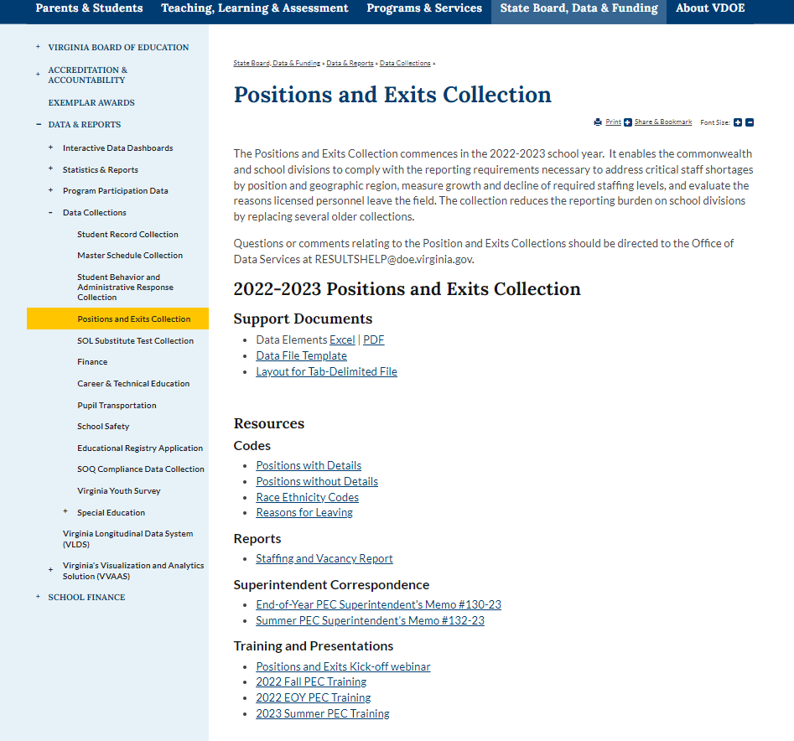
PEC Website
Notes:
The PEC website has been updated for the upcoming year, and has what you need to submit your collection file.
Please note, the Superintendent’s memo for the Fall has been approved and will be uploaded within the next few weeks.
For the Fall, you will need the Data File Template and Position Codes files.
Remember I told you that others are reading your story? The Staffing and Vacancy Report tells the state-wide Teacher Vacancy story.
If you are new to the collection, you will need the PEC December 2021 PowerPoint presentations under Training & PowerPoints.

Slide 27
Divisional Resources
Assistance with file layouts and uploading files in SSWS
Student Record Collection contact
Master Schedule Collection contact
Assistance with access to the PEC application in SSWS
SSWS Account Manager
SSWS back-up Account Manager
Education Registry Application contact
Assistance with setting up local approvers
SSWS Account Manager
SSWS back-up Account Manager
Education Registry Application contact
Notes:
If you need help, your local co-workers can assist you.
Student Record Collection contact
Master Schedule Collection contact
SSWS Account Manager
ERA contact

Slide 28
Additional Resources
Positions & Exits Collection web site
http://www.doe.virginia.gov/info_management/data_collection/positions-exits/index.shtml
Aleta Fonville, Specialist, Office of Data Services
Email: aleta.fonville@doe.virginia.gov or
resultshelp@doe.virginia.gov
Susanna Wells, Office of Licensure and School Leadership
Email: susanna.wells@doe.virginia.gov
Notes:
Here’s the link to the PEC website.
I am Aleta Fonville. If you are new to PEC, please reach out to me so that I can bring you up-to-date with the totality of the Fall PEC submission
If you have any questions regarding licenses, you can contact Maggie Clemmons at this listed email address.

Slide 29
Data Reporting Timeline
Division-level data gathering is ongoing July 1, 2023 - June 30, 2024
September 26: Training Webinar
October 1: Fall PEC Window Opens
October 20: Fall PEC Successful Submission Due
November 3: Fall PEC Final Signatures Due
Notes:
As a recap ….
The Fall PEC data that you are reporting is as of October 1. You can begin uploading your files on October 3rd. That’s when the Fall PEC window opens.
This year, October 1 is on a Saturday. If you can’t pull your data as of 10/1, use Friday’s date and/or data. Monday may include changes that go beyond the October 1 deadline.
A successful submission is due on October 21. From the 3rd to the 21st is the time for you to upload your data, work out any errors and get the required approver signatures.
Please don’t waste this time as the final signatures from your Supervisor is due on November 4th.

Slide 30
Thank You For Your Time and Attention
Notes:
We have completed our agenda. I hope that you have a better understanding of what is required for your successful Fall PEC submission.
Thanks for your time and attention.

