Slide 1

2023 Mathematics Standards of Learning
Grade 8
Overview of Revisions from 2016 to 2023
Notes:
Welcome to the Grade 8 presentation focused on the 2023 Mathematics Standards of Learning. The Proposed 2023 Mathematics Standards of Learning (SOL) were approved by the Board of Education on August 31, 2023.

Slide 2

Purpose
Overview of the 2023 Mathematics Standards of Learning
Highlight information included in the Standards (including the Knowledge and Skills)
Referenced documents available at the Virginia Department of Education 2023 Mathematics Standards of Learning webpage.
Notes:
The purpose of this presentation is to provide a comparison of the 2016 mathematics standards of learning and the 2023 mathematics standards of learning and to highlight changes in the knowledge and skills.

Slide 3
Agenda
2023 Mathematics Standards of Learning Focus
Documents Currently Available
  Standards of Learning Document
  Overview of Revisions (2016 to 2023 Mathematics Standards of Learning) document
Comparison of 2016 to 2023 Standards
  Number and Number Sense
  Computation and Estimation
  Measurement and Geometry
  Probability and Statistics
  Patterns, Functions, and Algebra
Notes:
During this presentation, information will be shared regarding the 2023 Mathematics Standards of Learning documents that are currently available and the focus of the 2023 standards. Then a detailed comparison of the 2016 standards to the newly adopted 2023 standards will be provided.

Slide 4
2023 Mathematics Standards of Learning Focus

Slide 5
2023 Standards of Learning Focus
The Mathematics Standards of Learning:
Include challenging mathematics content;
Reinforce foundational mathematics skills;
Support the application of mathematical concepts; and
Build coherently in complexity across grade levels.
Notes:
The mathematics standards of learning include challenging mathematics content, reinforce foundational mathematics skills, support the application of mathematical concepts, and build coherently in complexity across grade levels.

Slide 6
2023 Mathematics SOL Guiding Principles
Raise the Floor; Remove the Ceiling
Ensure Every Student Builds Strong Mathematics Foundational Skills
Master Critical Content
Integrate Mathematics Across All Content Areas
Prepare Teachers to Teach Mathematics Accurately and Effectively
Apply Mathematics to Better Use Technology
Notes:
There are six Guiding Principles included in the Virginia 2023 Mathematics Standards of Learning document that represent the values and beliefs upon which the revised standards were created. Preparing Virginia’s students to pursue higher education, to compete in a modern workforce, and to be informed citizens requires rigorous mathematical knowledge and skills. Students must gain an understanding of fundamental ideas in number sense, computation, measurement, geometry, probability, data analysis and statistics, and algebra and functions, and they must develop proficiency in mathematical skills. The guiding principles include:
Raise the Floor; Remove the Ceiling:
Ensure Every Student Builds Strong Mathematics Foundational Skills:
Master Critical Content:
Integrate Mathematics Across All Content Areas:
Prepare Teachers to Teach Mathematics Accurately and Effectively:
Apply Mathematics to Better Use Technology:

Slide 7
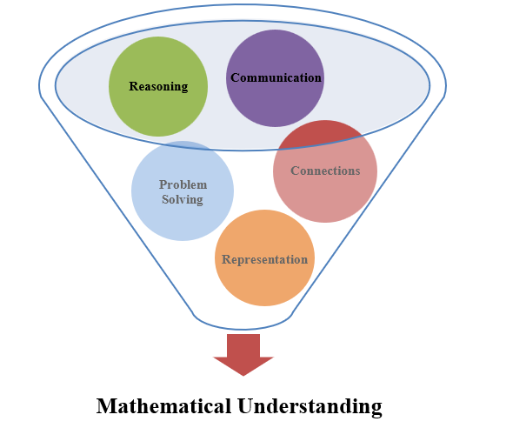
Mathematics Process Goals for Students
The content of the mathematics standards is intended to support the five process goals for students in building understanding.
Notes:
The 2023 Mathematics Standards of Learning foster the application of the five mathematical process goals including reasoning, communication, problem solving, connections, and representation, and set students up to recognize and see mathematics in real-world applications. These processes support students in building understanding of mathematics.

Slide 8
Standards of Learning Supporting Documents
Notes:
Virginia Department of Education documents supporting the transition to the 2023 Mathematics Standards of Learning will now be shared. Additional resources supporting the implementation of the 2023 Mathematics Standards of Learning will be made available on the VDOE Mathematics SOL website.

Slide 9
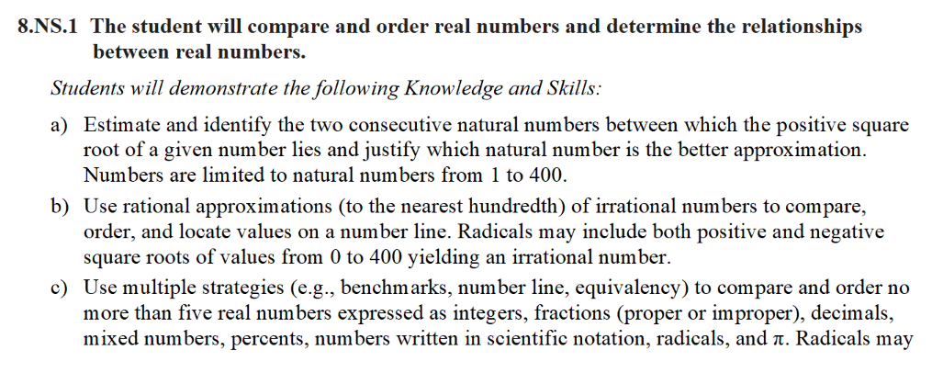
Standards Document
Notes:
The 2023 Mathematics Standards of Learning Document includes the standards and the knowledge and skills associated with each standard. This slide shows an example from the Grade 8 Standards Document.

Slide 10
Changes to Numbering of the SOL
Third SOL within this strand
Grade
Measurement & Geometry Strand
KEY: NS = Number and Number Sense; CE = Computation and Estimation; MG = Measurement and Geometry; PS = Probability and Statistics; PFA = Patterns, Functions, and Algebra
Notes:
The new numbering system for the standards makes it clear within which strand a standard exists. For instance, the sample shown on the screen highlights 8.NS.1. Eight indicates the grade level; NS indicates the Number and Number Sense Strand; and 1 indicates that this is the first standard of learning in this strand. The key shown at the bottom of the screen provides the abbreviations for each of the strands.

Slide 11
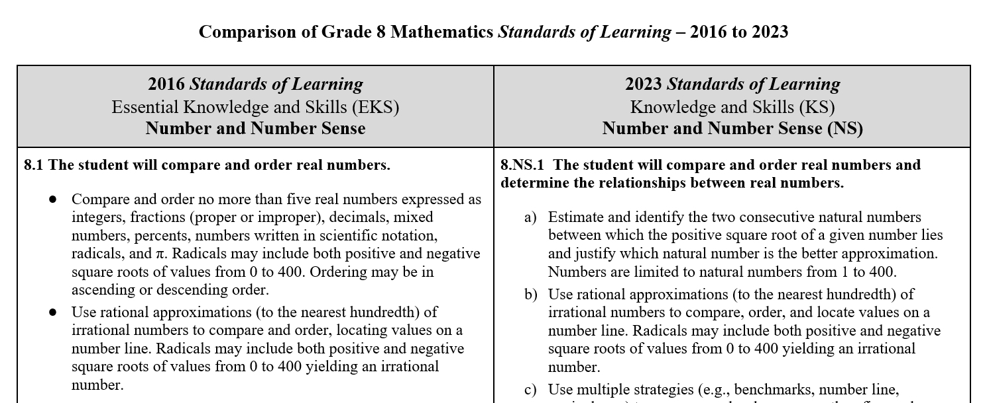
Overview of Revisions (2016 to 2023 Mathematics Standards of Learning) document
Notes:
An Overview of Revisions document has been created for each grade or course. This presentation provides a detailed comparison between the 2016 Standards of Learning and the 2023 Standards of Learning and is based upon the Overview of Revisions document.

Slide 12
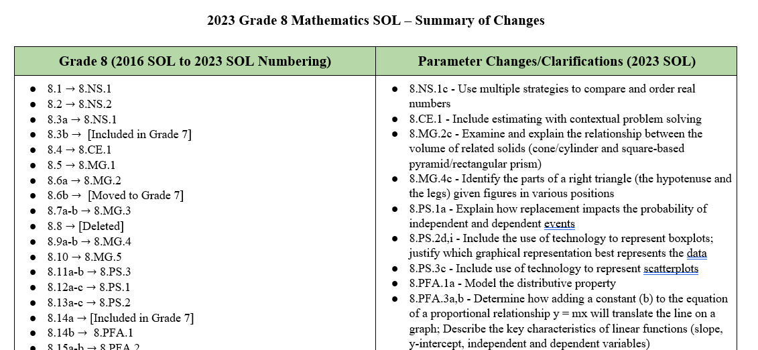
Overview of Revisions- Summary of Changes (1 of 2)
Notes:
At the end of the Overview of Revisions document there is a summary of changes table. One section of the table provides an overview of the changes to the numbering of the standards. Another section provides information regarding the prominent parameter changes and clarifications. Parameter changes and clarifications might be related to an increase or decrease in the limiters of the standards or the knowledge and skills; but might also be related to the depth of understanding of the content or scope of the content.

Slide 13
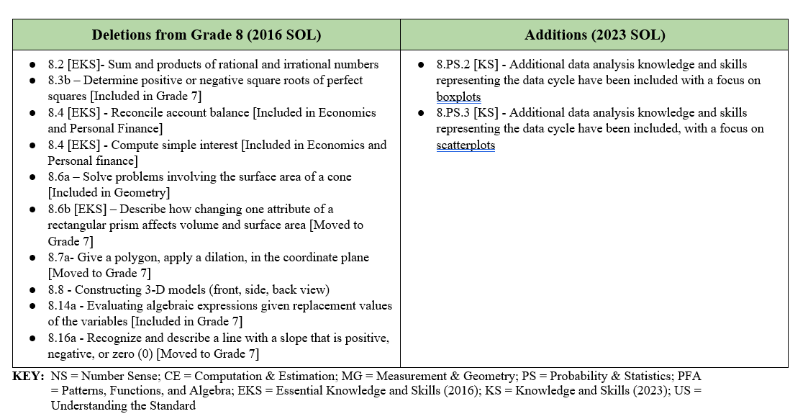
Overview of Revisions- Summary of Changes (2 of 2)
Notes:
The other two sections of the table include deletions from 2016 standards and addition of content to the 2023 standards.

Slide 14
Comparison of
2016 Mathematics SOL to 2023 Mathematics SOL
Notes:
During the remainder of the presentation, we will take a closer look at the revisions to the 2016 standards that resulted in the new 2023 standards.

Slide 15
Number & Number Sense
Notes:
We will first examine the changes that occurred in the Number and Number Sense strand.​​

Slide 16
Standard 8.1 (2016) - Standard 8.ns.1bc (2023)
2016 SOL | 2023 SOL
8.1 The student will compare and order real numbers. Use rational approximations (to the nearest hundredth) of irrational numbers to compare and order, locating values on a number line. Radicals may include both positive and negative square roots of values from 0 to 400 yielding an irrational number. Compare and order no more than five real numbers expressed as integers, fractions (proper or improper), decimals, mixed numbers, percents, numbers written in scientific notation, radicals, and π. Radicals may include both positive and negative square roots of values from 0 to 400. Ordering may be in ascending or descending order. | 8.NS.1 The student will compare and order real numbers, and determine the relationships between real numbers. Use rational approximations (to the nearest hundredth) of irrational numbers to compare, order, and locate values on a number line. Radicals may include both positive and negative square roots of values from 0 to 400 yielding an irrational number. Use multiple strategies (e.g., benchmarks, number line, equivalency) to compare and order no more than five real numbers expressed as integers, fractions (proper or improper), decimals, mixed numbers, percents, numbers written in scientific-notation, radicals, and π. Radicals may include both positive and negative square roots of values from 0 to 400. Ordering may be in ascending or descending order. Justify solutions orally, in writing, or with a model.
Revisions:
Use multiple strategies to compare and order
Justify solutions orally, in writing, or with a model
Notes:
Standard 8.1 in 2016 is now 8.NS.1b and c in the 2023 standards. The new standard requires students to use multiple strategies to compare and order including but not limited to using benchmarks, number lines, and equivalency. Students will also need to justify their solutions orally, in writing, or with a model. 8.NS.1 bullet a corresponds with SOL 8.3a, which will be explained in a few moments.

Slide 17
Standard 8.2 (2016) - Standard 8.ns.2 (2023)
2016 SOL | 2023 SOL
8.2 The student will describe the relationship between the subsets of the real number system. Describe and illustrate the relationships among the subsets of the real number system by using representations (graphic organizers, number lines, etc.). Subsets include rational numbers, irrational numbers, integers, whole numbers, and natural numbers. Classify a given number as a member of a particular subset or subsets of the real number system, and explain why. Describe each subset of the set of real numbers and include examples and non-examples. Recognize that the sum or product of two rational numbers is rational; that the sum of a rational number and an irrational number is irrational; and that the product of a nonzero rational number and an irrational number is irrational. [Deleted] | 8.NS.2 The student will investigate and describe the relationship between the subsets of the real number system. Describe and illustrate the relationships among the subsets of the real number system by using representations (e.g., graphic organizers, number lines). Subsets include rational numbers, irrational numbers, integers, whole numbers, and natural numbers. Classify and explain why a given number is a member of a particular subset or subsets of the real number system. Describe each subset of the set of real numbers and include examples and non-examples.
Revisions:
Sums and products of rational and irrational numbers was removed
Investigate and explain subsets of the real number system
Notes:
Standard 8.2 in 2016 is now 8.NS.2 in the 2023 standards. Students no longer are expected to recognize sums and products of rational and irrational numbers. Students will now investigate and describe in this standard.

Slide 18
Standard 8.3 (2016) - Standard 8.ns.1a (2023)
2016 SOL | 2023 SOL
8.3 The student will estimate and determine the two consecutive integers between which a square root lies; and determine both the positive and negative square roots of a given perfect square. [Deleted; included in Grade 7] Estimate and identify the two consecutive integers between which the positive or negative square root of a given number lies. Numbers are limited to natural numbers from 1 to 400. (a) [included in 8.NS.1] Determine the positive or negative square root of a given perfect square from 1 to 400. (b) [Deleted; included in Grade 7] | 8.NS.1 The student will compare and order real numbers, and determine the relationships between real numbers. Estimate and identify the two consecutive natural numbers between which the positive square root of a given number lies, and justify which natural number is the better approximation. Numbers are limited to natural numbers from 1 to 400.
Revisions:
8.3a is included in 8.NS.1
8.3b moved to Grade 7
Notes:
As mentioned on Slide 16, standard 8.3a in 2016 is now included in 8.NS.1a in the 2023 standards. The parameters of this standard have changed to natural numbers from integers. Students will also now be required to justify which natural number is the better approximation. 8.3b in 2016 is now included in the Grade 7 Mathematics Standards of Learning.

Slide 19
Computation & Estimation
Notes:
Now we will examine the changes that occurred in the Computation and Estimation strand.​​

Slide 20
Standard 8.4 (2016) - Standard 8.ce.1 (2023)
2016 SOL | 2023 SOL
8.4 The student will solve practical problems involving consumer applications. Solve practical problems involving consumer applications by using proportional reasoning and computation procedures for rational numbers. Reconcile an account balance given a statement with five or fewer transactions. [Deleted, included in Economics and Personal Finance] Compute a discount or markup and the resulting sale price for one discount or markup. Compute the sales tax or tip and resulting total. Compute the simple interest and new balance earned in an investment or on a loan given the principal amount, interest rate, and time period in years. [Deleted, included in Economics and Personal Finance] Compute the percent increase or decrease found in a practical situation. | 8.CE.1 The student will estimate and apply proportional reasoning and computational procedures to solve contextual problems. Estimate and solve contextual problems that require the computation of one discount or markup and the resulting sale price. Estimate and solve contextual problems that require the computation of the sales tax, tip, and resulting total. Estimate and solve contextual problems that require the computation of the percent increase or decrease.
Revisions:
Reconcile account balance and compute simple interest in now included in Economics and Personal Finance
Estimate included in contextual problems
Notes:
Standard 8.4 in 2016 is now 8.CE.1 in the 2023 standards. Students will no longer reconcile account balances and compute simple interest in 8th grade because they will do that later in Economics and Personal Finance. The shifts in the standard include estimating and applying proportional reasoning and computational procedures to solve contextual problems as opposed to simply solving practical problems.

Slide 21
Measurement and Geometry
Notes:
We will now look at the changes that occurred in the Measurement and Geometry strand.​

Slide 22
Standard 8.5 (2016) - Standard 8.mg.1 (2023)
2016 SOL | 2023 SOL
8.5 The student will use the relationships among pairs of angles that are vertical angles, adjacent angles, supplementary angles, and complementary angles to determine the measure of unknown angles. Identify and describe the relationship between pairs of angles that are vertical, adjacent, supplementary, and complementary. Use the relationships among supplementary, complementary, vertical, and adjacent angles to solve problems, including practical problems, involving the measure of unknown angles. | 8.MG.1 The student will use the relationships among pairs of angles that are vertical angles, adjacent angles, supplementary angles, and complementary angles to determine the measure of unknown angles. Identify and describe the relationship between pairs of angles that are vertical, adjacent, supplementary, and complementary. Use the relationships among supplementary, complementary, vertical, and adjacent angles to solve problems, including those in context, involving the measure of unknown angles.
Revisions:
No significant changes between the 2016 and 2023 standard.
Notes:
Standard 8.5 in 2016 is now 8.MG.1 in the 2023 standards.

Slide 23
Standard 8.6a (2016) - Standard 8.mg.2 (2023)
2016 SOL | 2023 SOL
8.6 The student will solve problems, including practical problems, involving volume and surface area of cones and square-based pyramids; [surface area of cones included in Geometry] Distinguish between situations that are applications of surface area and those that are applications of volume. (a) Determine the surface area of cones and square-based pyramids by using concrete objects, nets, diagrams, and formulas. (a) [surface area of cones included in Geometry] Determine the volume of cones and square-based pyramids, using concrete objects, diagrams, and formulas. (a) Solve practical problems involving volume and surface area of cones and square-based pyramids. (a) | 8.MG.2 The student will investigate and determine the surface area of square-based pyramids and the volume of cones and square-based pyramids. Determine the surface area of square-based pyramids by using concrete objects, nets, diagrams, and formulas. Determine the volume of cones and square-based pyramids, using concrete objects, diagrams, and formulas. Examine and explain the relationship between the volume of cones and cylinders, and the volume of rectangular prisms and square based pyramids. Solve problems in context involving volume of cones and square-based pyramids and the surface area of square-based pyramids.
Revisions:
Surface area of a cone is included in Geometry
Examine and explain the relationships between volumes of related solids
Distinguishing between applications of surface area and volume will occur through solving problems in context
Notes:
Standard 8.6a in 2016 is now 8.MG.2 in the 2023 standards. Surface area of cones has been removed from 8th grade as students will learn that in Geometry. Students will examine and explain the relationship between volumes of related solids. The 2016 EKS bullet regarding distinguishing between situations that are applications of surface area and volume is inherently included in the new standard 8.MG.2d where students solve problems in context.

Slide 24
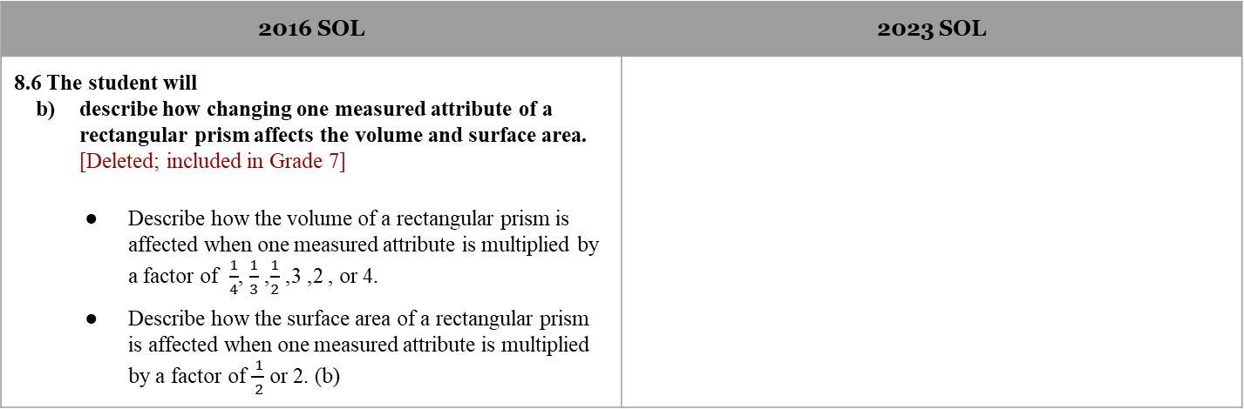
Standard 8.6b (2016)
2016 SOL | 2023 SOL
8.6 The student will describe how changing one measured attribute of a rectangular prism affects the volume and surface area. [Deleted; included in Grade 7] Describe how the volume of a rectangular prism is affected when one measured attribute is multiplied by a factor of $\frac{1}{4}$ ,$\frac{1}{3}$, $\frac{1}{2}$ , 2, 3, or 4. Describe how the surface area of a rectangular prism is affected when one measured attribute is multiplied by a factor of $\frac{ 1}{ 2}$ or 2. (b)
Revisions:
Changing attributes moved to Grade 7
Notes:
Standard 8.6b in 2016 is now included in the 2023 Grade 7 Mathematics Standards of Learning.

Slide 25
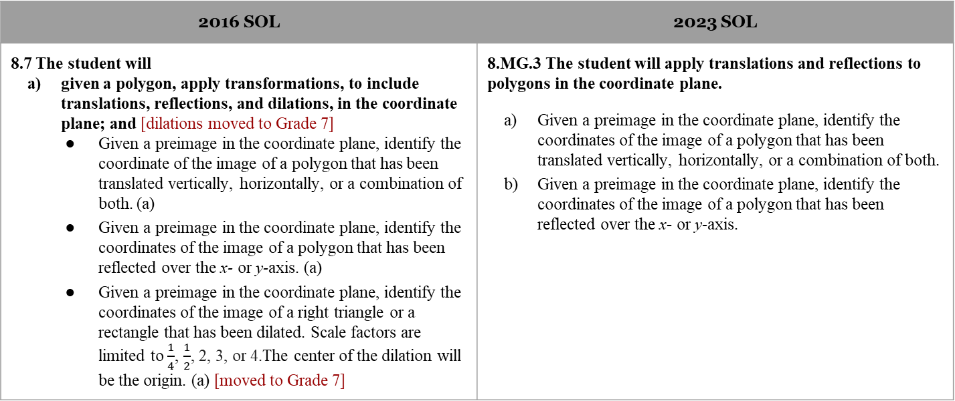
Standard 8.7 (2016) - Standard 8.mg.3 (2023) (1 of 3)
2016 SOL | 2023 SOL
8.7 The student will given a polygon, apply transformations, to include translations, reflections, and dilations, in the coordinate plane; and [dilations moved to Grade 7] Given a preimage in the coordinate plane, identify the coordinate of the image of a polygon that has been translated vertically, horizontally, or a combination of both. (a) Given a preimage in the coordinate plane, identify the coordinates of the image of a polygon that has been reflected over the x- or y-axis. (a) Given a preimage in the coordinate plane, identify the coordinates of the image of a right triangle or a rectangle that has been dilated. Scale factors are limited to $\frac{1}{4}$, $\frac{1}{2}$, 2, 3, or 4.The center of the dilation will be the origin. (a) [moved to Grade 7] | 8.MG.3 The student will apply translations and reflections to polygons in the coordinate plane. Given a preimage in the coordinate plane, identify the coordinates of the image of a polygon that has been translated vertically, horizontally, or a combination of both. Given a preimage in the coordinate plane, identify the coordinates of the image of a polygon that has been reflected over the x- or y-axis.
Revisions:
Applying a dilation moved to Grade 7
Notes:
Standard 8.7a in 2016 is now 8.MG.3 in the 2023 standards. Applying a dilation has been moved to the Grade 7 Mathematics Standards of Learning. Translations and reflections remain in Grade 8.

Slide 26
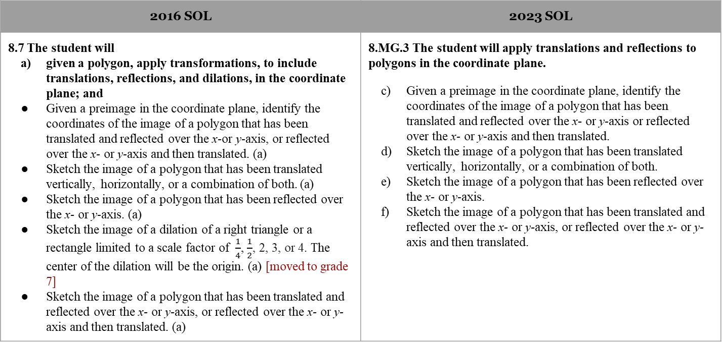
Standard 8.7 (2016) - Standard 8.mg.3 (2023) (2 of 3)
2016 SOL | 2023 SOL
8.7 The student will given a polygon, apply transformations, to include translations, reflections, and dilations, in the coordinate plane; and Given a preimage in the coordinate plane, identify the coordinates of the image of a polygon that has been translated and reflected over the x-or y-axis, or reflected over the x- or y-axis and then translated. (a) Sketch the image of a polygon that has been translated vertically, horizontally, or a combination of both. (a) Sketch the image of a polygon that has been reflected over the x- or y-axis. (a) Sketch the image of a dilation of a right triangle or a rectangle limited to a scale factor of $\frac{1}{4}$, $\frac{1}{2}$, 2, 3, or 4. The center of the dilation will be the origin. (a) [moved to grade 7] Sketch the image of a polygon that has been translated and reflected over the x- or y-axis, or reflected over the x- or y-axis and then translated. (a) | 8.MG.3 The student will apply translations and reflections to polygons in the coordinate plane. Given a preimage in the coordinate plane, identify the coordinates of the image of a polygon that has been translated and reflected over the x- or y-axis or reflected over the x- or y-axis and then translated. Sketch the image of a polygon that has been translated vertically, horizontally, or a combination of both. Sketch the image of a polygon that has been reflected over the x- or y-axis. Sketch the image of a polygon that has been translated and reflected over the x- or y-axis, or reflected over the x- or y-axis and then translated.
Revisions:
Applying a dilation moved to Grade 7
Notes:
The application of translations and reflections have no major revisions.

Slide 27
Standard 8.7 (2016) - Standard 8.mg.3 (2023) (3 of 3)
2016 SOL | 2023 SOL
8.7 The student will identify practical applications of transformations. Identify the type of translation in a given example. (a, b) Identify practical applications of transformations including, but not limited to, tiling, fabric, wallpaper designs, art, and scale drawings. (b) | 8.MG.3 The student will apply translations and reflections to polygons in the coordinate plane. Identify and describe transformations in context (e.g., tiling, fabric, wallpaper designs, art).
Revisions:
Applying a dilation moved to Grade 7
Notes:
Standard 8.7b in 2016 is now 8.MG.3g in the 2023 standards.

Slide 28
Standard 8.8(2016)
2016 SOL | 2023 SOL
8.8 The student will construct a three-dimensional model, given the top or bottom, side, and front views. [Deleted] Construct three-dimensional models, given the top or bottom, side, and front views. Identify three-dimensional models given a two-dimensional perspective. Identify the two-dimensional perspective from the top or bottom, side, and front view, given a three-dimensional model.
Revisions:
This standard has been deleted
Notes:
Standard 8.8 in 2016 has been deleted.

Slide 29
Standard 8.9 (2016) - Standard 8.mg.4 (2023)
2016 SOL | 2023 SOL
8.9 The student will verify the Pythagorean Theorem; and apply the Pythagorean Theorem. Verify the Pythagorean Theorem, using diagrams, concrete materials, and measurement. (a) Determine whether a triangle is a right triangle given the measures of its three sides. (b) Determine the measure of a side of a right triangle, given the measures of the other two sides. (b) Solve practical problems involving right triangles by using the Pythagorean Theorem. (b) | 8.MG.4 The student will apply the Pythagorean Theorem to solve problems involving right triangles, including those in context. Verify the Pythagorean Theorem using diagrams, concrete materials, and measurement. Determine whether a triangle is a right triangle given the measures of its three sides. Identify the parts of a right triangle (the hypotenuse and the legs) given figures in various orientations. Determine the measure of a side of a right triangle, given the measures of the other two sides. Apply the Pythagorean Theorem, and its converse, to solve problems involving right triangles in context.
Revisions:
Identify parts of the right triangle in various orientations
Notes:
Standard 8.9 in 2016 is now 8.MG.4 in the 2023 standards. Students will be asked to identify the parts of right triangles specifically the hypotenuse and legs, when presented with right triangles in various orientations. The remainder of the standard has no major revisions.

Slide 30
Standard 8.10 (2016) - Standard 8.mg.5 (2023)
2016 SOL | 2023 SOL
8.10 The student will solve area and perimeter problems, including practical problems, involving composite plane figures. Subdivide a plane figure into triangles, rectangles, squares, trapezoids, parallelograms, and semicircles. Determine the area of subdivisions and combine to determine the area of the composite plane figure. Subdivide a plane figure into triangles, rectangles, squares, trapezoids, parallelograms, and semicircles. Use the attributes of the subdivisions to determine the perimeter of the composite plane figure. Apply perimeter, circumference, and area formulas to solve practical problems involving composite plane figures. | 8.MG.5 The student will solve area and perimeter problems involving composite plane figures, including those in context. Subdivide a plane figure into triangles, rectangles, squares, trapezoids, parallelograms, circles, and semicircles. Determine the area of subdivisions and combine to determine the area of the composite plane figure. Subdivide a plane figure into triangles, rectangles, squares, trapezoids, parallelograms, and semicircles. Use the attributes of the subdivisions to determine the perimeter of the composite plane figure. Apply perimeter, circumference, and area formulas to solve contextual problems involving composite plane figures.
Revisions:
Circles included in 2-dimensional figures allowed when subdividing to find area of a composite plane figure
Notes:
Standard 8.10 in 2016 is now 8.MG.5 in the 2023 standards. Circles are now included as possible 2-dimensional figure to create when subdividing composite figures to find area. The remainder of the standard has no major revisions.

Slide 31
Probability and Statistics
Notes:
We will now discuss the changes that occurred in the Probability and Statistics strand.​

Slide 32
Standard 8.11 (2016) - Standard 8.ps.1 (2023)
2016 SOL | 2023 SOL
8.11 The student will compare and contrast the probability of independent and dependent events; and determine probabilities for independent and dependent events. Determine whether two events are independent or dependent. (a) Compare and contrast the probability of independent and dependent events. (a) Determine the probability of two independent events. (b) Determine the probability of two dependent events. (b) | 8.PS.1 The student will use statistical investigation to determine the probability of independent and dependent events, including those in context. Determine whether two events are independent or dependent and explain how replacement impacts the probability. Compare and contrast the probability of independent and dependent events. Determine the probability of two independent events. Determine the probability of two dependent events.
Revisions:
Explain how replacement impacts probability
Notes:
Standard 8.11 in 2016 is now 8.PS.1 in the 2023 standards. The standard remains much the same except that now students will need to be able to explain how replacement impacts probability.

Slide 33

Standard 8.12 (2016) - Standard 8.ps.2 (2023) (1 of 3)
2016 SOL | 2023 SOL
8.12 The student will represent numerical data in boxplots Collect and display a numeric data set of no more than 20 items, using boxplots. (a) | 8.PS.2 The student will apply the data cycle (formulate questions; collect or acquire data; organize and represent data; and analyze data and communicate results) with a focus on boxplots. Formulate questions that require the collection or acquisition of data with a focus on boxplots. Determine the data needed to answer a formulated question and collect the data (or acquire existing data) using various methods (e.g., observations, measurement, surveys, experiments).
Revisions:
Formulate questions that require the collection of data
Notes:
Standard 8.12 in 2016 is now 8.PS.2 in the 2023 standards. The shift in this standard requires students to apply the data cycle and maintains boxplots as the representation. Students will formulate questions that require the collection or acquisition of data with a focus on boxplots.

Slide 34
Standard 8.12 (2016) - Standard 8.ps.2 (2023) (2 of 3)
2016 SOL | 2023 SOL
8.12 The student will represent numerical data in boxplots make observations and inferences about data represented in boxplots; and Collect and display a numeric data set of no more than 20 items, using boxplots. (a) Given a data set represented in a boxplot, identify, and describe the lower extreme (minimum), upper extreme (maximum), median, upper quartile, lower quartile, range, and interquartile range. (b) | 8.PS.2 The student will apply the data cycle (formulate questions; collect or acquire data; organize and represent data; and analyze data and communicate results) with a focus on boxplots. Determine how statistical bias might affect whether the data collected from the sample is representative of the larger population. Organize and represent a numeric data set of no more than 20 items, using boxplots, with and without the use of technology. Identify and describe the lower extreme (minimum), upper extreme (maximum), median, upper quartile, lower quartile, range, and interquartile range given a data set represented by a boxplot.
Revisions:
Determine show statistical bias might affect whether sample is representative of population
Include the use of technology to represent boxplots
Notes:
Students will determine how statistical bias might affect data collection and they should be given the opportunity to organize and represent data with and without the use of technology tools.

Slide 35
Standard 8.12 (2016) - Standard 8.ps.2 (2023) (3 of 3)
2016 SOL | 2023 SOL
8.12 The student will make observations and inferences about data represented in boxplots; and compare and analyze two data sets using boxplots. Make observations and inferences about data represented in a boxplot. (b) Compare and analyze two data sets represented in boxplots. (c) | 8.PS.2 The student will apply the data cycle (formulate questions; collect or acquire data; organize and represent data; and analyze data and communicate results) with a focus on boxplots. Describe how the presence of an extreme data point (outlier) affects the shape and spread of the data distribution of a boxplot. Analyze data represented in a boxplot by making observations and drawing conclusions. Compare and analyze two data sets represented in boxplots. Given a contextual situation, justify which graphical representation (e.g., pictographs, bar graphs, line graphs, line plots/dot plots, stem-and-leaf plots, circle graphs, histograms, and boxplots) best represents the data. Identify components of graphical displays that can be misleading.
Revisions:
Describe how presence of outlier affects shape and spread
Justify which graphical representations best represent data
Explore how graphical displays can be misleading
Notes:
Students will also describe how the presence of an outlier affects the shape and spread of the data distribution, as well as determine which graphical representation best represents data. Finally, they will identify components of graphical displays that can be misleading.

Slide 36
Standard 8.13 (2016) - Standard 8.ps.3 (2023) (1 of 2)
2016 SOL | 2023 SOL
8.13 The student will represent data in scatterplots; make observations about data represented in scatterplots; and Collect, organize, and represent a data set of no more than 20 items using scatterplots. (a) Make observations about a set of data points in a scatterplot as having a positive linear relationship, a negative linear relationship, or no relationship. (b) | 8.PS.3 The student will apply the data cycle (formulate questions; collect or acquire data; organize and represent data; and analyze data and communicate results) with a focus on scatterplots. Formulate questions that require the collection or acquisition of data with a focus on scatterplots. Determine the data needed to answer a formulated question and collect the data (or acquire existing data) of no more than 20 items using various methods (e.g., observations, measurement, surveys, experiments). Organize and represent numeric bivariate data using scatterplots, with and without the use of technology. Make observations about a set of data points in a scatterplot as having a positive linear relationship, a negative linear relationship, or no relationship.
Revisions:
Formulate questions that require the collection of data
Use technology to represent scatterplots
Notes:
Standard 8.13 in 2016 is now 8.PS.3 in the 2023 standards. The shift in this standard requires students to apply the data cycle but maintains scatterplots as the representation. Students will formulate questions that require the collection or acquisition of data with a focus on scatterplots. Students should be given the opportunity to organize and represent data with and without the use of technology tools.

Slide 37
Standard 8.13 (2016) - Standard 8.ps.3 (2023) (2 of 2)
2016 SOL | 2023 SOL
8.13 The student will use a drawing to estimate the line of best fit for data represented in a scatterplot. Estimate the line of best fit with a drawing for data represented in a scatterplot. (c) | 8.PS.3 The student will apply the data cycle (formulate questions; collect or acquire data; organize and represent data; and analyze data and communicate results) with a focus on scatterplots. Analyze and justify the relationship of the quantitative bivariate data represented in scatterplots. Sketch the line of best fit for data represented in a scatterplot.
Revisions:
Analyze and justify the relationship of the quantitative bivariate data in scatterplots
Notes:
Students will analyze and justify the relationship of the quantitative bivariate data in the scatterplot as well as sketch the line of best fit.

Slide 38
Patterns, Functions & Algebra
Notes:
Finally, we will look at the changes that have occurred in the Patterns, Functions, and Algebra strand.

Slide 39
Standard 8.14a (2016)
2016 SOL | 2023 SOL
8.14 The student will evaluate an algebraic expression for given replacement values of the variables; [Included in Grade 7] Use the order of operations and apply the properties of real numbers to evaluate algebraic expressions for the given replacement values of the variables. Exponents are limited to whole numbers and bases are limited to integers. Square roots are limited to perfect squares. Limit the number of replacements to no more than three per expression. (a)
Revisions:
8.14a is in included in Grade 7
Notes:
Standard 8.14a in 2016 is included in the Grade 7 Mathematics Standards of Learning.

Slide 40
Standard 8.14b (2016) - Standard 8.pfa.1 (2023)
2016 SOL | 2023 SOL
8.14 The student will simplify algebraic expressions in one variable. Represent algebraic expressions using concrete materials and pictorial representations. Concrete materials may include colored chips or algebra tiles. (a) Simplify algebraic expressions in one variable. Expressions may need to be expanded (using the distributive property) or require combining like terms to simplify. Expressions will include only linear and numeric terms. Coefficients and numeric terms may be rational. (b) | 8.PFA.1 The student will represent, simplify, and generate equivalent algebraic expressions in one variable. Represent algebraic expressions, using concrete manipulatives or pictorial representations (e.g., colored chips, algebra tiles), including expressions that apply the distributive property. Simplify and generate equivalent algebraic expressions in one variable by applying the order of operations and properties of real numbers. Expressions may need to be expanded (using the distributive property) or require combining like terms to simplify. Expressions will include only linear and numeric terms. Coefficients and numeric terms may be rational.
Revisions:
Model the distributive property
Generate equivalent algebraic expressions
Notes:
Standard 8.14b in 2016 is now 8.PFA.1 in the 2023 standards. Students will apply the distributive property when representing algebraic expressions. Students will simplify algebraic expressions and generate equivalent expressions. While the content of simplifying algebraic expressions has not changed, note the language change in that simplifying algebraic expressions is a way of generating equivalent expressions.

Slide 41
Standard 8.15 (2016) - Standard 8.pfa.2 (2023)
2016 SOL | 2023 SOL
8.15 The student will determine whether a given relation is a function; and determine the domain and range of a function. Determine whether a relation, represented by a set of ordered pairs, a table, or a graph of discrete points is a function. Sets are limited to no more than 10 ordered pairs. (a) Identify the domain and range of a function represented as a set of ordered pairs, a table, or a graph of discrete points. (b) | 8.PFA.2 The student will determine whether a given relation is a function and determine the domain and range of a function. Determine whether a relation, represented by a set of ordered pairs, a table, or a graph of discrete points is a function. Sets are limited to no more than 10 ordered pairs. Identify the domain and range of a function represented as a set of ordered pairs, a table, or a graph of discrete points.
Revisions:
No significant changes between the 2016 and 2023 standard.
Notes:
Standard 8.15 in 2016 is now 8.PFA.2 in the 2023 standards. There are no revisions to this standard.

Slide 42
Standard 8.16 (2016) - Standard 8.pfa.3 (2023) (1 of 3)
2016 SOL | 2023 SOL
8.16 The student will recognize and describe the graph of a linear function with a slope that is positive, negative, or zero; [Moved to Grade 7] identify the slope and y-intercept of a linear function given a table of values, a graph, or an equation in y = mx + b form; Recognize and describe a line with a slope that is positive, negative, or zero (0). (a) [Deleted; included in Grade 7] | 8.PFA.3 The student will represent and solve problems, including those in context, by using linear functions and analyzing their key characteristics (the value of the y-intercept (b) and the coordinates of the ordered pairs in graphs will be limited to integers). Determine how adding a constant (b) to the equation of a proportional relationship y = mx will translate the line on a graph.
Revisions:
8.16a moved to Grade 7
Introduction of y-intercept is moved from Grade 7 to Grade 8
Notes:
Standard 8.16a in 2016 is now included in the Grade 7 Mathematics Standards of Learning. Standard 8.16b-e in 2016 are now 8.PFA.3 in the 2023 standards. Students will begin their study of the y-intercept in Grade 8 through exploration of translations of the equation y = mx.

Slide 43
Standard 8.16 (2016) - Standard 8.pfa.3 (2023) (2 of 3)
2016 SOL | 2023 SOL
8.16 The student will identify the slope and y-intercept of a linear function given a table of values, a graph, or an equation in y = mx + b form; determine the independent and dependent variable, given a practical situation modeled by a linear function; Given a table of values for a linear function, identify the slope and y-intercept. The table will include the coordinate of the y-intercept. (b) Given a linear function in the form y = mx + b, identify the slope and y-intercept. (b) Given the graph of a linear function, identify the slope and y-intercept. The value of the y-intercept will be limited to integers. The coordinates of the ordered pairs shown in the graph will be limited to integers. (b) Identify the dependent and independent variable, given a practical situation modeled by a linear function. (c) | 8.PFA.3 The student will represent and solve problems, including those in context, by using linear functions and analyzing their key characteristics (the value of the y-intercept (b) and the coordinates of the ordered pairs in graphs will be limited to integers). Describe key characteristics of linear functions including slope (m), y-intercept (b), and independent and dependent variables.
Revisions:
Describe key characteristics of linear functions
Notes:
Students will now describe the key characteristics of linear functions to include slope, y-intercept, and independent and dependent variables.

Slide 44
Standard 8.16 (2016) - Standard 8.pfa.3 (2023) (3 of 3)
2016 SOL | 2023 SOL
8.16 The student will graph a linear function given the equation in y = mx + b form; and make connections between and among representations of a linear function using verbal descriptions, tables, equations, and graphs. Given the equation of a linear function in the form y = mx + b, graph the function. The value of the y-intercept will be limited to integers. (d) Write the equation of a linear function in the form y = mx + b given values for the slope, m, and the y-intercept or given a practical situation in which the slope, m, and y-intercept are described verbally. (e) Make connections between and among representations of a linear function using verbal descriptions, tables, equations, and graphs. (e). | 8.PFA.3 The student will represent and solve problems, including those in context, by using linear functions and analyzing their key characteristics (the value of the y-intercept (b) and the coordinates of the ordered pairs in graphs will be limited to integers). Graph a linear function given a table, equation, or a situation in context. Create a table of values for a linear function given a graph, equation in the form of y = mx + b, or context. Write an equation of a linear function in the form y = mx + b, given a graph, table, or a situation in context. Create a context for a linear function given a graph, table, or equation in the form y = mx + b.
Revisions:
Given one representation create the other three (context, table of values, table, y=mx+b)
Notes:
There will be four representations of linear functions considered in 8.PFA.3: contextual situations, graphs, tables, and equations in slope intercept form. Students will be provided one of the representations and be asked to provide the remaining three representations. The focus of this standard shifts to creating representations which requires students to be able to make connections between the different representations.

Slide 45
Standard 8.17 (2016) - Standard 8.pfa.4 (2023) (1 of 2)
2016 SOL | 2023 SOL
8.17 The student will solve multistep linear equations in one variable with the variable on one or both sides of the equation, including practical problems that require the solution of a multistep linear equation in one variable. Represent and solve multistep linear equations in one variable with the variable on one or both sides of the equation (up to four steps) using a variety of concrete materials and pictorial representations. Apply properties of real numbers and properties of equality to solve multistep linear equations in one variable (up to four steps). Coefficients and numeric terms will be rational. Equations may contain expressions that need to be expanded (using the distributive property) or require collecting like terms to solve. | 8.PFA.4 The student will write and solve multistep linear equations in one variable, including problems in context that require the solution of a multistep linear equation in one variable. Represent and solve multistep linear equations in one variable with the variable on one or both sides of the equation (up to four steps) using a variety of concrete materials and pictorial representations. Apply properties of real numbers and properties of equality to solve multistep linear equations in one variable (up to four steps). Coefficients and numeric terms will be rational. Equations may contain expressions that need to be expanded (using the distributive property) or require combining like terms to solve.
Revisions:
No significant changes in the first two knowledge and skills of this standard
Notes:
Standard 8.17 in 2016 is now 8.PFA.4 in the 2023 standards. The content of the first two Knowledge and Skills bullets has not changed.

Slide 46
Standard 8.17 (2016) - Standard 8.pfa.4 (2023) (2 of 2)
2016 SOL | 2023 SOL
8.17 The student will solve multistep linear equations in one variable with the variable on one or both sides of the equation, including practical problems that require the solution of a multistep linear equation in one variable. Write verbal expressions and sentences as algebraic expressions and equations. Write algebraic expressions and equations as verbal expressions and sentences. Solve practical problems that require the solution of a multistep linear equation. Confirm algebraic solutions to linear equations in one variable. | 8.PFA.4 The student will write and solve multistep linear equations in one variable, including problems in context that require the solution of a multistep linear equation in one variable. Write a multistep linear equation in one variable to represent a verbal situation, including those in context. Create a verbal situation in context given a multistep linear equation in one variable. Solve problems in context that require the solution of a multistep linear equation. Interpret algebraic solutions in context to linear equations in one variable. Confirm algebraic solutions to linear equations in one variable.
Revisions:
Write multistep linear equations to represent verbal and contextual situations
Create verbal situations in context given a multistep linear equation in one variable
Interpret algebraic solutions in context
Notes:
In further study of equations, students will write equations to represent verbal and contextual situations, create verbal situations in context for given equations, and interpret algebraic solutions in context.

Slide 47
Standard 8.18 (2016) - Standard 8.pfa.5 (2023) (1 of 2)
2016 SOL | 2023 SOL
8.18 The student will solve multistep linear inequalities in one variable with the variable on one or both sides of the inequality symbol, including practical problems, and graph the solution on a number line. Apply properties of real numbers and properties of inequality to solve multistep linear inequalities (up to four steps) in one variable with the variable on one or both sides of the inequality. Coefficients and numeric terms will be rational. Inequalities may contain expressions that need to be expanded (using the distributive property) or require collecting like terms to solve. Graph solutions to multistep linear inequalities on a number line. | 8.PFA.5 The student will write and solve multistep linear inequalities in one variable, including problems in context that require the solution of a multistep linear inequality in one variable. Apply properties of real numbers and properties of inequality to solve multistep linear inequalities (up to four steps) in one variable with the variable on one or both sides of the inequality. Coefficients and numeric terms will be rational. Inequalities may contain expressions that need to be expanded (using the distributive property) or require combining like terms to solve. Represent solutions to inequalities algebraically and graphically using a number line.
Revisions:
Algebraically represent solutions to linear inequalities
Notes:
Standard 8.18 in 2016 is now 8.PFA.5 in the 2023 standards. Students are explicitly required to represent solutions algebraically as well as graphically on a number line.

Slide 48
Standard 8.18 (2016) - Standard 8.pfa.5 (2023) (2 of 2)
2016 SOL | 2023 SOL
8.18 The student will solve multistep linear inequalities in one variable with the variable on one or both sides of the inequality symbol, including practical problems, and graph the solution on a number line. Write verbal expressions and sentences as algebraic expressions and inequalities. Write algebraic expressions and inequalities as verbal expressions and sentences. Solve practical problems that require the solution of a multistep linear inequality in one variable. Identify a numerical value(s) that is part of the solution set of as given inequality. | 8.PFA.5 The student will write and solve multistep linear inequalities in one variable, including problems in context that require the solution of a multistep linear inequality in one variable. Write multistep linear inequalities in one variable to represent a verbal situation, including those in context. Create a verbal situation in context given a multistep linear inequality in one variable. Solve problems in context that require the solution of a multistep linear inequality in one variable. Identify a numerical value(s) that is part of the solution set of a given inequality. Interpret algebraic solutions in context to linear inequalities in one variable.
Revisions:
Write multistep linear inequalities to represent verbal and contextual situations
Create verbal situations in context given a multistep linear inequality in one variable
Interpret algebraic solutions in context
Notes:
In further study of inequalities, students will now write inequalities to represent verbal and contextual situations, create verbal situations in context for given inequalities, and interpret algebraic solutions in context.

Slide 49
Questions?
Contact the
Virginia Department of Education’s Mathematics Team at vdoe.mathematics@doe.virginia.gov
Notes:
This concludes the presentation on the 2023 Grade 8 Mathematics Standards of Learning revisions. It may be helpful to refer back to this presentation as you are using the Overview of Revisions document to plan for instruction. Should you have any questions, feel free to contact a member of the Mathematics Team at email address shown on the screen.

