Slide 1
2023 Mathematics Standards of Learning
Grade 7
Overview of Revisions from 2016 to 2023
Notes:
Welcome to the Grade 7 presentation focused on the 2023 Mathematics Standards of Learning. The Proposed 2023 Mathematics Standards of Learning (SOL) were approved by the Board of Education on August 31, 2023.

Slide 2
Purpose
Overview of the 2023 Mathematics Standards of Learning
Highlight information included in the Standards (including the Knowledge and Skills)
Referenced documents available at the Virginia Department of Education 2023 Mathematics Standards of Learning webpage.
Notes:
The purpose of this presentation is to provide a comparison of the 2016 mathematics standards of learning and the 2023 mathematics standards of learning and to highlight changes in the knowledge and skills.

Slide 3
Agenda
2023 Mathematics Standards of Learning Focus
Documents Currently Available
Standards of Learning Document
Overview of Revisions (2016 to 2023 Mathematics Standards of Learning) document
Comparison of 2016 to 2023 Standards
Number and Number Sense
Computation and Estimation
Measurement and Geometry
Probability and Statistics
Patterns, Functions, and Algebra
Notes:
During this presentation, information will be shared regarding the 2023 Mathematics Standards of Learning documents that are currently available and the focus of the 2023 standards. Then a detailed comparison of the 2016 standards to the newly adopted 2023 standards will be provided.

Slide 4
2023 Mathematics Standards of Learning Focus

Slide 5
2023 Standards of Learning Focus
The Mathematics Standards of Learning:
Include challenging mathematics content;
Reinforce foundational mathematics skills;
Support the application of mathematical concepts; and
Build coherently in complexity across grade levels.
Notes:
The mathematics standards of learning include challenging mathematics content, reinforce foundational mathematics skills, support the application of mathematical concepts, and build coherently in complexity across grade levels.

Slide 6
2023 Mathematics SOL Guiding Principles
Raise the Floor; Remove the Ceiling
Ensure Every Student Builds Strong Mathematics Foundational Skills
Master Critical Content
Integrate Mathematics Across All Content Areas
Prepare Teachers to Teach Mathematics Accurately and Effectively
Apply Mathematics to Better Use Technology
Notes:
There are six Guiding Principles included in the Virginia’s 2023 Mathematics Standards of Learning document that represent the values and beliefs upon which the revised standards were created. Preparing Virginia’s students to pursue higher education, to compete in a modern workforce, and to be informed citizens requires rigorous mathematical knowledge and skills. Students must gain an understanding of fundamental ideas in number sense, computation, measurement, geometry, probability, data analysis and statistics, and algebra and functions, and they must develop proficiency in mathematical skills.
Raise the Floor; Remove the Ceiling:
Ensure Every Student Builds Strong Mathematics Foundational Skills:
Master Critical Content:
Integrate Mathematics Across All Content Areas:
Prepare Teachers to Teach Mathematics Accurately and Effectively:
Apply Mathematics to Better Use Technology:

Slide 7
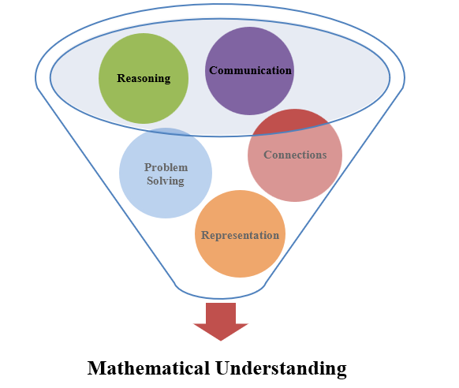
Mathematics Process Goals for Students
The content of the mathematics standards is intended to support the five process goals for students in building understanding.
Notes:
The 2023 Mathematics Standards of Learning foster the application of the five mathematical process goals including reasoning, communication, problem solving, connections, and representation, and set students up to recognize and see mathematics in real-world applications. These processes support students in building understanding of mathematics.

Slide 8
Standards of Learning Supporting Documents
Notes:
Virginia Department of Education documents supporting the transition to the 2023 Mathematics Standards of Learning will now be shared. Additional resources supporting the implementation of the 2023 Mathematics Standards of Learning will be made available on the VDOE Mathematics SOL website.

Slide 9
Standards Document
Notes:
The 2023 Mathematics Standards of Learning Document includes the standards and the knowledge and skills associated with each standard. This slide shows an example from the Grade 7 Standards Document.

Slide 10
Changes to Numbering of the SOL
Third SOL within this strand
Grade
Measurement & Geometry Strand
KEY: NS = Number and Number Sense; CE = Computation and Estimation; MG = Measurement and Geometry; PS = Probability and Statistics; PFA = Patterns, Functions, and Algebra
Notes:
The new numbering system for the standards makes it clear within which strand a standard exists. For instance, the sample shown on the screen highlights 7.NS.1. Seven indicates the grade level; NS indicates the Number and Number Sense Strand; and 1 indicates that this is the first standard of learning in this strand. The key shown at the bottom of the screen provides the abbreviations for each of the strands.

Slide 11
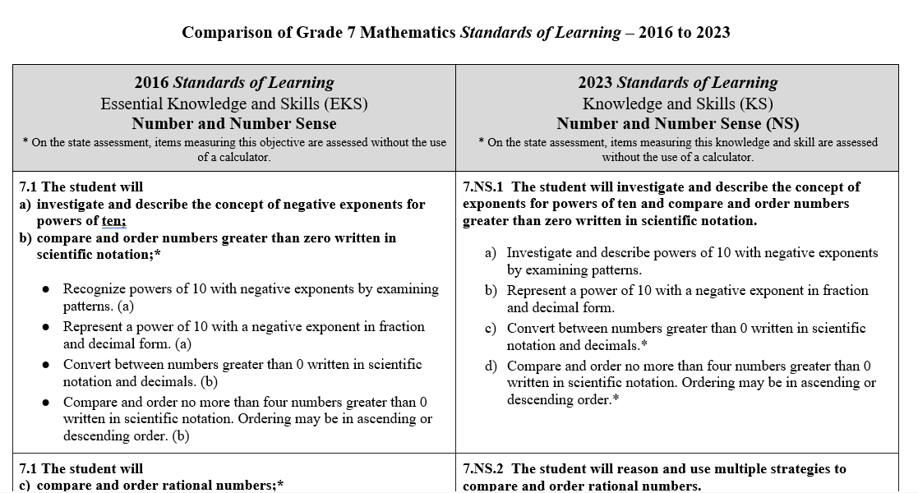
Overview of Revisions (2016 to 2023 Mathematics Standards of Learning) document
Notes:
An Overview of Revisions document has been created for each grade or course. This presentation provides a detailed comparison between the 2016 Standards of Learning and the 2023 Standards of Learning and is based upon the Overview of Revisions document.

Slide 12
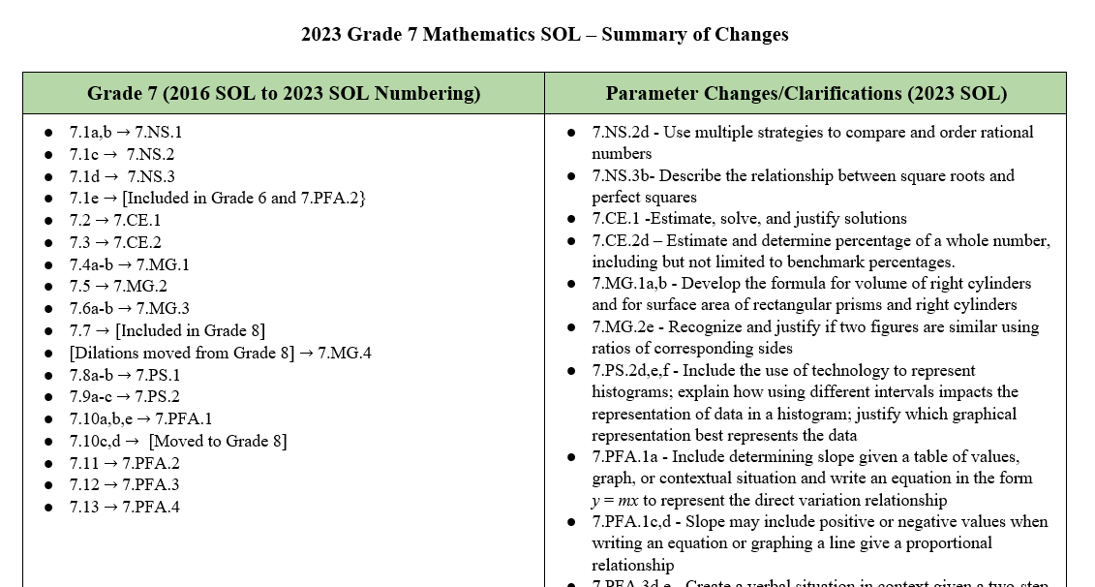
Overview of Revisions- Summary of Changes (1 of 2)
Notes:
At the end of the Overview of Revisions document there is a summary of changes table. One section of the table provides an overview of the changes to the numbering of the standards. Another section provides information regarding the prominent parameter changes and clarifications. Parameter changes and clarifications might be related to an increase or decrease in the limiters of the standards or the knowledge and skills; but might also be related to the depth of understanding of the content or scope of the content.

Slide 13
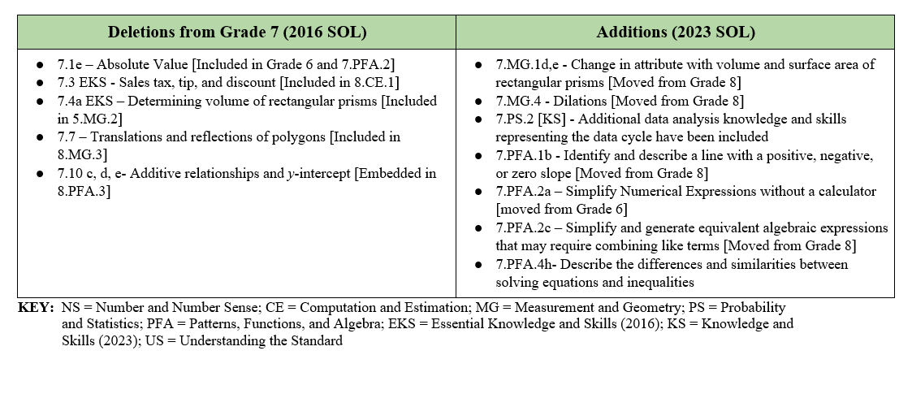
Overview of Revisions- Summary of Changes (2 of 2)
Notes:
The other two sections of the table include deletions from 2016 standards and addition of content to the 2023 standards.

Slide 14
Comparison of 2016 Mathematics SOL to 2023 Mathematics SOL
Notes:
During the remainder of the presentation, we will take a closer look at the revisions to the 2016 standards that resulted in the new 2023 standards.

Slide 15
Number & Number Sense
Notes:
We will first examine the changes that occurred in the Number and Number Sense strand.​​

Slide 16
Standard 7.1A,B (2016) – Standard 7.NS.1 (2023)
2016 SOL | 2023 SOL
7.1 The student will investigate and describe the concept of negative exponents for powers of ten; compare and order numbers greater than zero written in scientific notation;* Recognize powers of 10 with negative exponents by examining patterns. (a) Represent a power of 10 with a negative exponent in fraction and decimal form. (a) Convert between numbers greater than 0 written in scientific notation and decimals. (b) Compare and order no more than four numbers greater than 0 written in scientific notation. Ordering may be in ascending or descending order. (b) | 7.NS.1 The student will investigate and describe the concept of exponents for powers of ten and compare and order numbers greater than zero written in scientific notation. Investigate and describe powers of 10 with negative exponents by examining patterns. Represent a power of 10 with a negative exponent in fraction and decimal form. Convert between numbers greater than 0 written in scientific notation and decimals.* Compare and order no more than four numbers greater than 0 written in scientific notation. Ordering may be in ascending or descending order.*
Revisions:
No significant changes between the 2016 and 2023 standard
Notes:
Standard 7.1a,b in 2016 is now 7.NS.1 in the 2023 Standards. Students will investigate and describe powers of 10 with negative exponents by examining patterns - which is beyond the recognition of powers as expressed in the 2016 Standards. Two of the knowledge and skills of this standard are assessed without the use of a calculator. Note the asterisk in 2016 was included at the standard level; in 2023, the asterisk is included at the knowledge and skill level. Anywhere you see an asterisk moving forward in this presentation, denote that on the state assessments, these skills and knowledge are assessed without the use of a calculator.

Slide 17
Standard 7.1c (2016) – Standard 7.NS.2 (2023)
2016 SOL | 2023 SOL
7.1 The student will compare and order rational numbers;* Compare and order no more than four rational numbers expressed as integers, fractions (proper or improper), mixed numbers, decimals, and percents. Fractions and mixed numbers may be positive or negative. Decimals may be positive or negative and are limited to the thousandths place. Ordering may be in ascending or descending order. (c) | 7.NS.2 The student will reason and use multiple strategies to compare and order rational numbers. Use multiple strategies (e.g., benchmarks, number line, equivalency) to compare (using symbols <, >, =) and order (a set of no more than four) rational numbers expressed as integers, fractions (proper or improper), mixed numbers, decimals, and percents. Fractions and mixed numbers may be positive or negative. Decimals may be positive or negative and are limited to the thousandths place. Ordering may be in ascending or descending order. Justify solutions orally, in writing or with a model.*
Revisions:
Multiple strategies will be used to compare and order rational numbers to include benchmarks, number lines, and equivalency.
Justify solutions orally, in writing, or with a model.
Notes:
Standard 7.1c in 2016 is now 7.NS.2 in the 2023 Standards. Multiple strategies will be used to compare and order rational numbers to include benchmarks, number lines, and equivalency. Students will also be expected to justify solutions orally, in writing, or with a model.

Slide 18
Standard 7.1d,e (2016) – Standard 7.NS.3 (2023)
2016 SOL | 2023 SOL
7.1 The student will determine square roots of perfect squares;* and Identify and describe the absolute value of rational numbers. [Included in Grade 6 and 7.PFA.2] Identify the perfect squares from 0 to 400. (d) Determine the positive square root of a perfect square from 0 to 400. (d)) Demonstrate absolute value using a number line. (e) | 7.NS.3 The student will recognize and describe the relationship between square roots and perfect squares. Determine the positive square root of a perfect square from 0 to 400.* Describe the relationship between square roots and perfect squares.*
Revisions:
Describe the relationship between square roots and perfect squares.
Identifying and describing the absolute value of rational numbers is included in Grade 6 and 7.PFA.2.
Notes:
Standard 7.1d,e in 2016 is now 7.NS.3 in the 2023 Standards. Standard 7.NS.3 requires students to describe the relationship between square roots and perfect squares. Identifying and describing the absolute value of rational numbers is included in Grade 6 and 7.PFA.2

Slide 19
Computation & Estimation
Notes:
Now we will examine the changes that occurred in the Computation and Estimation strand.​​

Slide 20
Standard 7.2 (2016) – Standard 7.CE.1 (2023)
2016 SOL | 2023 SOL
7.2 The student will solve practical problems involving operations with rational numbers. Solve practical problems involving addition, subtraction, multiplication, and division with rational numbers expressed as integers, fractions (proper or improper), mixed numbers, decimals, and percents. Fractions may be positive or negative. Decimals may be positive or negative and are limited to the thousandths place. | 7.CE.1 The student will estimate, solve, and justify solutions to multistep contextual problems involving operations with rational numbers. Estimate, solve, and justify solutions to contextual problems involving addition, subtraction, multiplication, and division with rational numbers expressed as integers, fractions (proper or improper), mixed numbers, and decimals. Fractions may be positive or negative. Decimals may be positive or negative and are limited to the thousandths place.
Revisions:
Estimate, determine, and justify solutions to contextual problems.
Notes:
Standard 7.2 in 2016 is now 7.CE.1 in the 2023 standards. In this standard, students will estimate and justify in addition to determining solutions to contextual problems with rational numbers using all operations.

Slide 21
Standard 7.3 (2016) – Standard 7.CE.2 (2023)
2016 SOL | 2023 SOL
7.3 The student will solve single-step and multistep practical problems, using proportional reasoning. Given a proportional relationship between two quantities, create and use a ratio table to determine missing values. Write and solve a proportion that represents a proportional relationship between two quantities to find a missing value. Apply proportional reasoning to convert units of measurement within and between the U.S. Customary System and the metric system when given the conversion factor. Apply proportional reasoning to solve practical problems, including scale drawings. Scale factors shall have denominators no greater than 12 and decimals no less than tenths. [Moved to 7.MG.2] Using 10% as a benchmark, compute 5%, 10%, 15%, or 20% of a given whole number. Using 10% as a benchmark, compute 5%, 10%, 15%, or 20% in a practical situation such as tips, tax, and discounts. [Included in Grade 8] Solve problems involving tips, tax, and discounts. Limit problems to only one percent computation per problem. [Included in Grade 8] | 7.CE.2 The student will solve problems, including those in context, involving proportional relationships. Given a proportional relationship between two quantities, create and use a ratio table to determine missing values. Write and solve a proportion that represents a proportional relationship between two quantities to find a missing value, including problems in context. Apply proportional reasoning to solve problems in context, including converting units of measurement, when given the conversion factor. Estimate and determine the percentage of a given whole number, including but not limited to the use of benchmark percentages.
Revisions:
Applying proportional reasoning to solve problems in context, including scale drawings has moved to 2023 SOL 7.MG.2.
Estimate and determine the percentage of a given whole number, including benchmark percentages.
Solving problems involving tips, tax, and discounts is included in Grade 8.
Notes:
Standard 7.3 in 2016 is now SOL 7.CE.2 in the 2023 standards. Students will estimate as well as determine the percentage of a given whole number, including but not limited to the use of benchmark percentages. Applying proportional reasoning to solve practical problems, including scale drawings, has moved to 2023 SOL 7.MG.2. Solving problems involving tips, tax, and discounts is included in Grade 8.

Slide 22
Measurement and Geometry
Notes:
We will now look at the changes that occurred in the Measurement and Geometry strand.​

Slide 23
Standard 7.4 (2016) - Standard 7.MG.1 (2023)
2016 SOL | 2023 SOL
7.4 The student will describe and determine the volume and surface area of rectangular prisms and cylinders; and [volume of rectangular prisms included in Grade 5] solve problems, including practical problems, involving the volume and surface area of rectangular prisms and cylinders. Determine the surface area of rectangular prisms and cylinders using concrete objects, nets, diagrams, and formulas. (a) Determine the volume of rectangular prisms and cylinders using concrete objects, diagrams, and formulas. (a) Determine if a practical problem involving a rectangular prism or cylinder represents the application of volume or surface area. (b) Solve practical problems that require determining the surface area of rectangular prisms and cylinders. (b) Solve practical problems that require determining the volume of rectangular prisms and cylinders. (b). | 7.MG.1 The student will investigate and determine the volume formula for right cylinders and the surface area formulas for rectangular prisms and right cylinders and apply the formulas in context. Develop the formulas for determining the volume of right cylinders and solve problems, including those in contextual situations, using concrete objects, diagrams, and formulas. Develop the formulas for determining the surface area of rectangular prisms and right cylinders and solve problems, including those in contextual situations, using concrete objects, two-dimensional diagrams, nets, and formulas. Determine if a problem in context, involving a rectangular prism or right cylinder, represents the application of volume or surface area. Describe how the volume of a rectangular prism is affected when one measured attribute is multiplied by a factor of $\frac{1}{4}, \frac{1}{3}, \frac{1}{2}, 2, 3, or 4,$including those in contextual situations. Describe how the surface area of a rectangular prism is affected when one measured attribute is multiplied by a factor of $\frac{1}{2}$or 2, including those in contextual situations.
Revisions:
Develop the formula for volume of right cylinders and surface area for right rectangular prisms and right cylinders
Describe how volume and surface area of a rectangular prism is affected when one attribute is multiplied by a factor
Notes:
Standard 7.4 in 2016 is now 7.MG.1 in the 2023 standards. Volume and surface area formulas will be applied in context. As a reminder, students learned how to find the volume of rectangular prisms in grade 5. In this standard, students will develop the formula for volume of right cylinders and for surface area for rectangular prisms and right cylinders. A new expectation moved from Grade 8 is that students will describe how volume and surface area of rectangular prisms are affected when one attribute is multiplied by a scale factor.

Slide 24
Standard 7.5 (2016) – Standard 7.MG.2 (2023)
2016 SOL | 2023 SOL
7.5 The student will solve problems, including practical problems, involving the relationship between corresponding sides and corresponding angles of similar quadrilaterals and triangle Identify corresponding sides and corresponding congruent angles of similar quadrilaterals and triangles. Given two similar quadrilaterals or triangles, write similarity statements using symbols. Write proportions to express the relationships between the lengths of corresponding sides of similar quadrilaterals and triangles. Solve a proportion to determine a missing side length of similar quadrilaterals or triangles. Given angle measures in a quadrilateral or triangle, determine unknown angle measures in a similar quadrilateral or triangle. | 7.MG.2 The student will solve problems and justify relationships of similarity using proportional reasoning. Identify corresponding congruent angles of similar quadrilaterals and triangles, through the use of geometric markings. Identify corresponding sides of similar quadrilaterals and triangles. Given two similar quadrilaterals or triangles, write similarity statements using symbols. Write proportions to express the relationships between the lengths of corresponding sides of similar quadrilaterals and triangles. Recognize and justify if two quadrilaterals or triangles are similar using the ratios of corresponding side lengths. Solve a proportion to determine a missing side length of similar quadrilaterals or triangles. Given angle measures in a quadrilateral or triangle, determine unknown angle measures in a similar quadrilateral or triangle. Apply proportional reasoning to solve problems in context including scale drawings. Scale factors shall have denominators no greater than 12 and decimals no less than tenths.
Revisions:
Recognize and justify if two figures are similar using ratios of corresponding sides.
Apply proportional reasoning to solve problems in context including scale drawings.
Notes:
7.5 in 2016 is now 7.MG.2 in the 2023 standards. New to this standard, students are asked to recognize and justify if two figures are similar using ratios of corresponding sides. Additionally, recall that the scale drawing portion of 2016 SOL 7.3, where students apply proportional reasoning to solve problems in context including scale drawings, has moved to this standard.

Slide 25
Standard 7.6 (2016) – Standard 7.MG.3 (2023)
2016 SOL | 2023 SOL
7.6 The student will compare and contrast quadrilaterals based on their properties; and determine unknown side lengths or angle measures of quadrilaterals. Compare and contrast properties of the following quadrilaterals: parallelogram, rectangle, square, rhombus, and trapezoid. (a) Sort and classify quadrilaterals, as parallelograms, rectangles, trapezoids, rhombi, and/or squares based on their properties. (a) Given a diagram, determine an unknown angle measure in a quadrilateral, using properties of quadrilaterals. (b) Given a diagram, determine an unknown side length in a quadrilateral using properties of quadrilaterals. (b) | 7.MG.3 The student will compare and contrast quadrilaterals based on their properties and determine unknown side lengths and angle measures of quadrilaterals. Compare and contrast properties of the following quadrilaterals: parallelogram, rectangle, square, rhombus, and trapezoid: parallel/perpendicular sides and diagonals; congruence of angle measures, side, and diagonal lengths; and lines of symmetry. Sort and classify quadrilaterals as parallelograms, rectangles, trapezoids, rhombi, and/or squares based on their properties: parallel/perpendicular sides and diagonals; congruence of angle measures, side, and diagonal lengths; and lines of symmetry. Given a diagram, determine an unknown angle measure in a quadrilateral, using properties of quadrilaterals. Given a diagram, determine an unknown side length in a quadrilateral using properties of quadrilaterals.
Revisions:
Compare, contrast, sort, and classify quadrilaterals according to the properties listed
Notes:
7.6 in 2016 is now 7.MG.3 in the 2023 standards. Note in 7.MG.3a and b when comparing, contrasting, sorting, and classifying quadrilaterals, the following properties are identified - parallel/perpendicular sides and diagonals; congruence of angle measures, side, and diagonal lengths; and lines of symmetry.

Slide 26
Standard 7.7 (2016) - Deleted
2016 SOL | 2023 SOL
7.7 The student will apply translations and reflections of right triangles or rectangles in the coordinate plane. Given a preimage in the coordinate plane, identify the coordinates of the image of a right triangle or rectangle that has been translated either vertically, horizontally, or a combination of a vertical and horizontal translation. Given a preimage in the coordinate plane, identify the coordinates of the image of a right triangle or a rectangle that has been reflected over the x- or y-axis.
Revisions:
Removed from Grade 7 and included in Grade 8
Notes:
7.7 in 2016 is included in SOL 8.MG.3 in the 2023 standards.

Slide 27
Standard 7.MG.4 (2023)
2016 SOL | 2023 SOL
 | 7.MG.4 The student will apply dilations of polygons in the coordinate plane. Given a preimage in the coordinate plane, identify the coordinates of the image of a polygon that has been dilated. Scale factors are limited to $\frac{1}{4},\frac{1}{2},$2, 3, or 4. The center of the dilation will be the origin. Sketch the image of a dilation of a polygon limited to a scale factor of $\frac{1}{4},\frac{1}{2},$2, 3, or 4. The center of the dilation will be the origin. Identify and describe dilations in context including, but not limited to, scale drawings and graphic design.
Revisions:
Dilations have been moved from Grade 8 to Grade 7
Notes:
7.MG.4 is a new 2023 standard that was previously in Grade 8. In Grade 7, students will apply dilations of polygons in the coordinate plane.

Slide 28
Probability and Statistics
Notes:
We will now discuss the changes that occurred in the Probability and Statistics strand.​

Slide 29
Standard 7.8 (2016) - Standard 7.PS.1 (2023)
2016 SOL | 2023 SOL
7.8 The student will determine the theoretical and experimental probabilities of an event; and investigate and describe the difference between the experimental probability and theoretical probability of an event. Determine the theoretical probability of an event. (a) Determine the experimental probability of an event. (a) Describe changes in the experimental probability as the number of trials increases. (b) Investigate and describe the difference between the probability of an event found through experiment or simulation versus the theoretical probability of that same event. (b) | 7.PS.1 The student will use statistical investigation to determine the probability of an event and investigate and describe the difference between the experimental and theoretical probability. Determine the theoretical probability of an event. Given the results of a statistical investigation, determine the experimental probability of an event. Describe changes in the experimental probability as the number of trials increases. Investigate and describe the difference between the probability of an event found through experiment or simulation versus the theoretical probability of that same event.
Revisions:
No significant changes between the 2016 and 2023 standard
Notes:
Standard 7.8 in 2016 is now 7.PS.1 in the 2023 standards.

Slide 30
Standard 7.9 (2016) - Standard 7.PS.2 (2023) (1 of 2)
2016 SOL | 2023 SOL
7.9 The student, given data in a practical situation, will represent data in a histogram; Collect, organize, and represent data in a histogram. (a) | 7.PS.2 The student will apply the data cycle (formulate questions; collect or acquire data; organize and represent data; and analyze data and communicate results) with a focus on histograms. Formulate questions that require the collection or acquisition of data with a focus on histograms. Determine the data needed to answer a formulated question and collect the data (or acquire existing data) using various methods including (e.g., observations, measurement, surveys, experiments)., etc. Determine how sample size and randomness will ensure that the data collected is a sample that is representative of a larger population. Organize and represent numerical data using histograms with and without the use of technology. Investigate and explain how using different intervals could impact the representation of the data in a histogram.
Revisions:
Formulate questions that require the collection or acquisition of data
Determine how sample size and randomness ensure that the sample is representative of a larger population
Include the use of technology to represent histograms
Investigate and explain how using different intervals impacts the representation of data in a histogram
Notes:
Standard 7.9a in 2016 is 7.PS.2a-e in the 2023 standards. Students will apply the data cycle with a focus on histograms. Students will formulate a question that requires collecting or acquiring data with a focus on histograms. Students will determine how sample size and randomness ensures that data collected is a sample that is representative of the larger population. Students should be given the opportunity to organize and represent data with and without the use of technology tools. As students organize and represent data in a histogram, they will specifically investigate and explain how using different intervals could impact the representation of data in a histogram.

Slide 31
Standard 7.9 (2016) - Standard 7.PS.2 (2023) (2 of 2)
2016 SOL | 2023 SOL
7.9 The student, given data in a practical situation, will make observations and inferences about data represented in a histogram; and compare histograms with the same data represented in stem-and-leaf plots, line plots, and circle graphs. Make observations and inferences about data represented in a histogram. (b) Compare data represented in histograms with the same data represented in line plots, circle graphs, and stem-and-leaf plots. (c) | 7.PS.2 The student will apply the data cycle (formulate questions; collect or acquire data; organize and represent data; and analyze data and communicate results) with a focus on histograms. Compare data represented in histograms with the same data represented in other graphs, including but not limited to line plots (dot plots), circle graphs, and stem-and-leaf plots, and Given the context, justify which graphical representation (e.g., pictographs, bar graphs, line graphs, line plots, stem-and-leaf plots, circle graphs, and histograms) best represents the data. Analyze data represented in histograms by making observations and drawing conclusions. Determine how histograms reveal patterns in data that cannot be easily seen by looking at the corresponding given data set.
Revisions:
Justify which graphical representation best represents the data
Determine how histograms reveal patterns in data that cannot be easily seen by looking at the data set.
Notes:
Standard 7.9b and c in 2016 are now 7.PS.2f and g in the 2023 standards. Note that these standards have been clarified to include not only comparing data represented in histograms with other graphs, but to also justify which graphical representation best represents the data. Additionally, when making observations, students will need to determine how histograms reveal patterns in data that cannot be easily seen by looking at the corresponding data set.

Slide 32
Patterns, Functions & Algebra
Notes:
Finally, we will look at the changes that have occurred in the Patterns, Functions, and Algebra strand.

Slide 33
Standard 7.10 (2016) - Standard 7.PFA.1 (2023) (1 of 3)
2016 SOL | 2023 SOL
7.10 The student will determine the slope, m, as a rate of change in a proportional relationship between two quantities and write an equation in the form y = mx to represent the relationship; Determine the slope, m, as rate of change in a proportional relationship between two quantities given a table of values or a verbal description, including those represented in a practical situation, and write an equation in the form y = mx to represent the relationship. Slope will be limited to positive values. (a) | 7.PFA.1 The student will investigate and analyze proportional relationships between two quantities using verbal descriptions, tables, equations in y = mx form, and graphs, including problems in context. Determine the slope, m, as the rate of change in a proportional relationship between two quantities given a table of values, graph, or contextual situation and write an equation in the form y = mx to represent the direct variation relationship. Slope may include positive or negative values (slope will be limited to positive values in a contextual situation). Identify and describe a line with a slope that is positive, negative, or zero (0), given a graph.
Revisions:
Slope may include positive and negative values (slope will be limited to positive values in a contextual situation)
Direct variation relationship
Identify and describe a line with a slope that is positive, negative or zero, given a graph.
Notes:
Standard 7.10a in the 2016 standards is 7.PFA.1a in the 2023 standards. Note that there an addition of the vocabulary of a direct variation relationship, as well as that the slope is no longer limited to positive values and can include negative values. The slope will continue to be limited to positive values within contextual situations. 7.PFA.1b is a new expectation with students needing to identify and describe a line with a slope that is positive, negative, or zero given a graph.

Slide 34
Standard 7.10 (2016) - Standard 7.PFA.1 (2023) (2 of 3)
2016 SOL | 2023 SOL
7.10 The student will graph a line representing a proportional relationship between two quantities given the slope and an ordered pair, or given the equation in y = mx form, where m represents the slope as rate of change; make connections between and among representations of a proportional or additive relationship between two quantities using verbal descriptions, tables, equations, and graphs. [additive relationships embedded in Grade 8] Graph a line representing a proportional relationship, between two quantities given an ordered pair on the line and the slope, m, as rate of change. Slope will be limited to positive values. (b) Graph a line representing a proportional relationship between two quantities given the equation of the line in the form y = mx, where m represents the slope as rate of change. Slope will be limited to positive values. (b) Make connections between and among representations of a proportional or additive relationship between two quantities using verbal descriptions, tables, equations, and graphs. (e) | 7.PFA.1 The student will investigate and analyze proportional relationships between two quantities using verbal descriptions, tables, equations in y = mx form, and graphs, including problems in context. Graph a line representing a proportional relationship, between two quantities given an ordered pair on the line and the slope, m, as rate of change. Slope may include positive or negative values. Graph a line representing a proportional relationship between two quantities given the equation of the line in the form y = mx, where m represents the slope as rate of change. Slope may include positive or negative values. Make connections between and among representations of a proportional relationship between two quantities using problems in context, tables, equations, and graphs. Slope may include positive or negative values (slope will be limited to positive values in a contextual situation).
Revisions:
Slope may include positive and negative values (slope will be limited to positive values in a contextual situation)
Additive relationships embedded in Grade 8
Notes:
7.10b and 7.10e in 2016 are 7.PFA.1c, d, and e in the 2023 standards. In 7.PFA.1 the knowledge and skills were revised to include both positive and negative values for slope, however the slope will continue to be limited to positive values in contextual situations. Additive relationships are embedded in the Grade 8 linear function standard 8.PFA.3.

Slide 35
Standard 7.10 (2016) - Standard 7.PFA.1 (2023) (3 of 3)
2016 SOL | 2023 SOL
7.10 The student will determine the y-intercept, b, in an additive relationship between two quantities and write an equation in the form y = x + b to represent the relationship; [Embedded in Grade 8] graph a line representing an additive relationship between two quantities given the y-intercept and an ordered pair, or given the equation in the form y = x + b, where b represents the y-intercept; [Embedded in Grade 8] Determine the y-intercept, b, in an additive relationship between two quantities given a table of values or a verbal description, including those represented in a practical situation, and write an equation in the form y = x + b, b 0, to represent the relationship. (c) Graph a line representing an additive relationship (y = x + b, b 0) between two quantities, given an ordered pair on the line and the y-intercept (b). The y-intercept (b) is limited to integer values and slope is limited to 1. (d)
Revisions:
Additive relationships and y-intercept were removed from Grade 7 and embedded in Grade 8
Notes:
7.10c and 7.10d in 2016 are no longer in the grade 7 standards. Additive relationships and y-intercept are embedded in SOL 8.PFA.3 in the 2023 standards.

Slide 36
Standard 7.11 (2016) - Standard 7.PFA.2 (2023) (1 of 2)
2016 SOL | 2023 SOL
7.11 The student will evaluate algebraic expressions for given replacement values of the variables. Represent algebraic expressions using concrete materials and pictorial representations. Concrete materials may include colored chips or algebra tiles. | 7.PFA.2 The student will simplify numerical expressions, simplify and generate equivalent algebraic expressions in one variable, and evaluate algebraic expressions for given replacement values of the variables. Use the order of operations and apply the properties of real numbers to simplify numerical expressions. Exponents are limited to 1, 2, 3, or 4 and bases are limited to positive integers. Expressions should not include braces { } but may include brackets [ ] and absolute value bars | |. Square roots are limited to perfect squares.* Represent equivalent algebraic expressions in one variable using concrete manipulatives and pictorial representations (e.g., colored chips, algebra tiles). Simplify and generate equivalent algebraic expressions in one variable by applying the order of operations and properties of real numbers. Expressions may require combining like terms to simplify. Expressions will include only linear and numeric terms. Coefficients and numeric terms may be rational.*
Revisions:
Simplify numerical expressions without the use of a calculator
Simplify and generate equivalent algebraic expressions, including expressions that may require combining like terms
Notes:
7.11 in 2016 is now 7.PFA.2 in the 2023 standards. 7.PFA.2a is a new expectation moving from Grade 6 in the 2016 standards, where students need to simplify numerical expressions without the use of a calculator. Additionally, 7.PFA.2c requires students to simplify and generate equivalent algebraic expressions in one variable, including expressions that may require combining like terms to simplify, which is a move from Grade 8 in the 2016 standards.
7.PFA.2 is continued on the next slide.

Slide 37
Standard 7.11 (2016) - Standard 7.PFA.2 (2023) (2 of 2)
2016 SOL | 2023 SOL
7.11 The student will evaluate algebraic expressions for given replacement values of the variables. Use the order of operations and apply the properties of real numbers to evaluate expressions for given replacement values of the variables. Exponents are limited to 1, 2, 3, or 4 and bases are limited to positive integers. Expressions should not include braces { } but may include brackets [ ] and absolute value | |. Square roots are limited to perfect squares. Limit the number of replacements to no more than three per expression. | 7.PFA.2 The student will simplify numerical expressions, simplify and generate equivalent algebraic expressions in one variable, and evaluate algebraic expressions for given replacement values of the variables. Use the order of operations and apply the properties of real numbers to evaluate algebraic expressions for given replacement values of the variables. Exponents are limited to 1, 2, 3, or 4 and bases are limited to positive integers. Expressions should not include braces { } but may include brackets [ ] and absolute value bars | |. Square roots are limited to perfect squares. Limit the number of replacements to no more than three per expression. Replacement values may be positive or negative rational numbers.
Revisions:
Replacement values can be positive or negative rational numbers
Notes:
Standard 7.11 in the 2016 standards is further clarified in 7.PFA.2d in the 2023 standards, where it states that replacement values for evaluating algebraic expressions can be positive or negative rational numbers.

Slide 38
Standard 7.12 (2016) - Standard 7.PFA.3 (2023)
2016 SOL | 2023 SOL
7.12 The student will solve two-step linear equations in one variable, including practical problems that require the solution of a two-step linear equation in one variable. Represent and solve two-step linear equations in one variable using a variety of concrete materials and pictorial representations. Apply properties of real numbers and properties of equality to solve two-step linear equations in one variable. Coefficients and numeric terms will be rational. Confirm algebraic solutions to linear equations in one variable. Write verbal expressions and sentences as algebraic expressions and equations. Write algebraic expressions and equations as verbal expressions and sentences. Solve practical problems that require the solution of a two-step linear equation. | 7.PFA.3 The student will create write and solve two-step linear equations in one variable, including problems in context, that require the solution of a two-step linear equation in one variable. Represent and solve two-step linear equations in one variable using a variety of concrete materials and pictorial representations. Apply properties of real numbers and properties of equality to solve two-step linear equations in one variable. Coefficients and numeric terms will be rational. Confirm algebraic solutions to linear equations in one variable. Write a two-step linear equation in one variable to represent a verbal situation, including those in context. Create a verbal situation in context given a two-step linear equation in one variable. Solve problems in context that require the solution of a two-step linear equation.
Revisions:
Create a verbal situation in context given a two-step linear equation
Write a two-step linear equation to represent a verbal situation in context
Notes:
7.12 in 2016 is now 7.PFA.3 in the 2023 standards. Note that 7.PFA.3d and e were revised to include writing a two-step linear equation to represent a verbal situation, including those in context and creating verbal situations in context given a two-step linear equation.

Slide 39
Standard 7.13 (2016) - Standard 7.PFA.4 (2023) (1 of 2)
2016 SOL | 2023 SOL
7.13 The student will solve one- and two-step linear inequalities in one variable, including practical problems, involving addition, subtraction, multiplication, and division, and graph the solution on a number line. Apply properties of real numbers and the multiplication and division properties of inequality to solve one-step inequalities in one variable, and the addition, subtraction, multiplication, and division properties of inequality to solve two-step inequalities in one variable. Coefficients and numeric terms will be rational. Represent solutions to inequalities algebraically and graphically using a number line. Write verbal expressions and sentences as algebraic expressions and inequalities. Write algebraic expressions and inequalities as verbal expressions and sentences. | 7.PFA.4 The student will create write and solve one- and two-step linear inequalities in one variable, including problems in context, that require the solution of a one- and two-step linear inequality in one variable. Apply properties of real numbers and the addition, subtraction, multiplication, and division properties of inequality to solve one- and two-step inequalities in one variable. Coefficients and numeric terms will be rational. Investigate and explain how the solution set of a linear inequality is affected by multiplying or dividing both sides of the inequality statement by a rational number less than zero. Represent solutions to one- or two-step linear inequalities in one variable algebraically and graphically using a number line. Write one- or two-step linear inequalities in one variable to represent a verbal situation, including those in context. Create a verbal situation in context given a one- or two-step linear inequality in one variable.
Revisions:
Create a verbal situation in context given a one or two-step linear inequality
Write a two-step linear inequality to represent a verbal situation in context
Notes:
Standard 7.13 in 2016 is now 7.PFA.4 in the 2023 standards. In 7.PFA.4b, an additional parameter is that students will investigate and explain how the solution set of a linear inequality is affected by multiplying or dividing both sides of the inequality statement by a rational number less than zero.

Slide 40
Standard 7.13 (2016) - Standard 7.PFA.4 (2023) (2 of 2)
2016 SOL | 2023 SOL
7.13 The student will solve one- and two-step linear inequalities in one variable, including practical problems, involving addition, subtraction, multiplication, and division, and graph the solution on a number line. Solve practical problems that require the solution of a one- or two-step inequality. Identify a numerical value(s) that is part of the solution set of a given inequality. | 7.PFA.4 The student will create write and solve one- and two-step linear inequalities in one variable, including problems in context, that require the solution of a one- and two-step linear inequality in one variable. Solve problems in context that require the solution of a one- or two-step inequality. Identify a numerical value(s) that is part of the solution set of as given one- or two-step linear inequality in one variable. Describe the differences and similarities between solving linear inequalities in one variable and linear equations in one variable.
Revisions:
Describe the differences and similarities between solving linear inequalities and linear equations
Notes:
In addition to students solving problems in context and identifying a value that is a part of the solution set, Standard 7.PFA.4h in the 2023 Standards includes a new expectation of students describing the differences and similarities between solving linear inequalities in one variable and linear equations in one variable.

Slide 41
Questions?
Contact the
Virginia Department of Education’s Mathematics Team at vdoe.mathematics@doe.virginia.gov
Notes:
This concludes the presentation on the 2023 Grade 7 Mathematics Standards of Learning revisions. It may be helpful to refer back to this presentation as you are using the Overview of Revisions document to plan for instruction. Should you have any questions, feel free to contact a member of the Mathematics Team at email address shown on the screen.

