Slide 1
2023 Mathematics Standards of Learning
Grade 5
Overview of Revisions from 2016 to 2023
Notes:
Welcome to the Grade 5 presentation focused on the 2023 Mathematics Standards of Learning. The Proposed 2023 Mathematics Standards of Learning (SOL) were approved by the Board of Education on August 31, 2023.

Slide 2
Purpose
Overview of the 2023 Mathematics Standards of Learning
Highlight information in the Standards (including the Knowledge and Skills)
Referenced documents available at the Virginia Department of Education 2023 Mathematics Standards of Learning webpage.
Notes:
The purpose of this presentation is to provide a comparison of the 2016 mathematics standards of learning and the 2023 mathematics standards of learning and to highlight changes in the knowledge and skills.

Slide 3
Agenda
2023 Mathematics Standards of Learning Focus
Standards of Learning Supporting Documents
Standards of Learning Document
Overview of Revisions (2016 to 2023 Mathematics Standards of Learning) document
Comparison of 2016 to 2023 Standards
Number and Number Sense
Computation and Estimation
Measurement and Geometry
Probability and Statistics
Patterns, Functions, and Algebra
Notes:
During this presentation, information will be shared regarding the 2023 Mathematics Standards of Learning documents that are currently available and the focus of the 2023 standards. Then a detailed comparison of the 2016 standards to the newly adopted 2023 standards will be provided.

Slide 4
2023 Mathematics Standards of Learning Focus
Notes:
The focus of the 2023 Mathematics Standards of Learning are included in the following slides.

Slide 5
2023 Standards of Learning Focus
The Mathematics Standards of Learning:
Include challenging mathematics content;
Reinforce foundational mathematics skills;
Support the application of mathematical concepts; and
Build coherently in complexity across grade levels.
Notes:
The Mathematics Standards of Learning include challenging mathematics content, reinforce foundational mathematics skills, support the application of mathematical concepts, and build coherently in complexity across grade levels.

Slide 6
2023 Mathematics SOL Guiding Principles
Raise the Floor; Remove the Ceiling
Ensure Every Student Builds Strong Mathematics Foundational Skills
Master Critical Content
Integrate Mathematics Across All Content Areas
Prepare Teachers to Teach Mathematics Accurately and Effectively
Apply Mathematics to Better Use Technology
Notes:
There are six Guiding Principles included in the Virginia’s 2023 Mathematics Standards of Learning document that represent the values and beliefs upon which the revised standards were created. Preparing Virginia’s students to pursue higher education, to compete in a modern workforce, and to be informed citizens requires rigorous mathematical knowledge and skills. Students must gain an understanding of fundamental ideas in number sense, computation, measurement, geometry, probability, data analysis and statistics, and algebra and functions, and they must develop proficiency in mathematical skills. The six guiding principles are as follows:
Raise the Floor; Remove the Ceiling:
Ensure Every Student Builds Strong Mathematics Foundational Skills:
Master Critical Content:
Integrate Mathematics Across All Content Areas:
Prepare Teachers to Teach Mathematics Accurately and Effectively:
Apply Mathematics to Better Use Technology:

Slide 7
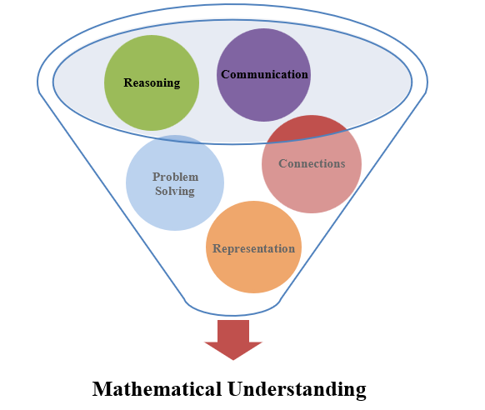
Mathematics Process Goals for Students
The content of the mathematics standards is intended to support the five process goals for students.
Notes:
The 2023 Mathematics Standards of Learning foster the application of the five mathematical process goals including reasoning, communication, problem solving, connections, and representation, and set students up to recognize and see mathematics in real-world applications. These processes support students in building understanding of mathematics.

Slide 8
Standards of Learning Supporting Documents
Notes:
Virginia Department of Education documents supporting the transition to the 2023 Mathematics Standards of Learning will now be shared. Additional resources supporting the implementation of the 2023 Mathematics Standards of Learning will be made available on the VDOE Mathematics SOL website.

Slide 9
Standards Document
Notes:
The 2023 Mathematics Standards of Learning Document includes the standards and the knowledge and skills associated with each standard. This slide shows an example from the Grade 5 Standards Document.

Slide 10
Changes to Numbering of the SOL
Second SOL within this strand
Grade 5
Number and Number Sense Strand
KEY: NS = Number and Number Sense; CE = Computation and Estimation; MG = Measurement and Geometry; PS = Probability and Statistics; PFA = Patterns, Functions, and Algebra
Notes:
The new numbering system for the standards makes it clear within which strand a standard exists. For instance, the sample shown on the screen highlights 5.NS.2. The number five indicates the grade level; NS indicates the Number and Number Sense strand; and 2 indicates that this is the second standard of learning in this strand. The key shown at the bottom of the screen provides the abbreviations for each of the strands.

Slide 11
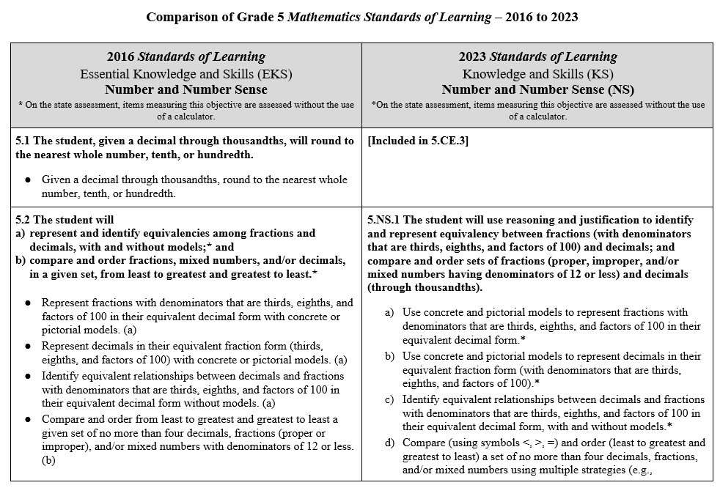
Overview of Revisions (2016 to 2023 Mathematics Standards of Learning) document
Notes:
An Overview of Revisions document has been created for each grade or course. This presentation provides a detailed comparison between the 2016 Standards of Learning and the 2023 Standards of Learning and is based upon the Overview of Revisions document.

Slide 12
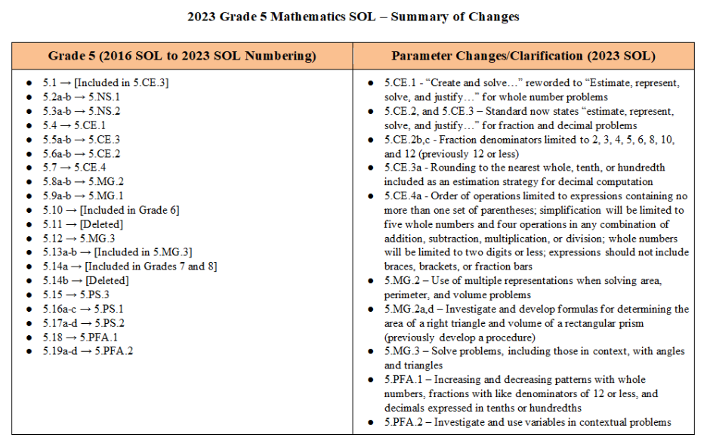
Overview of Revisions- Summary of Changes (1 of 2)
Notes:
At the end of the Overview of Revisions document there is a summary of changes table. One section of the table provides an overview of the changes to the numbering of the standards. Another section provides information regarding the prominent parameter changes and clarifications. Parameter changes and clarifications might be related to an increase or decrease in the limiters of the standards or the knowledge and skills; but might also be related to the depth of understanding of the content or scope of the content.

Slide 13
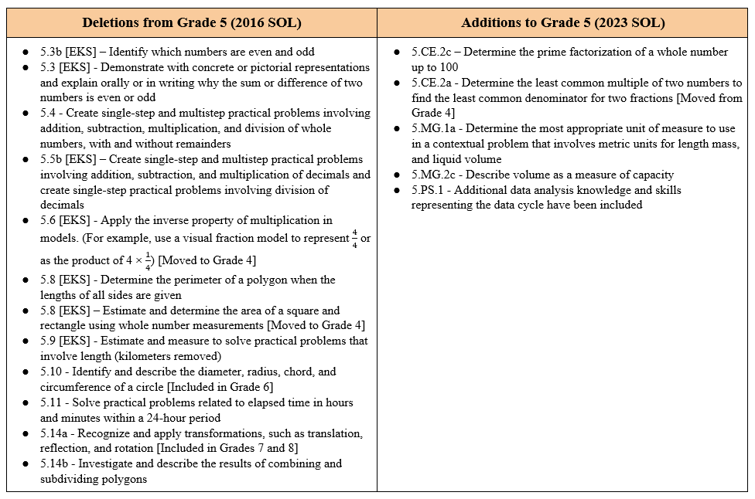
Overview of Revisions- Summary of Changes (2 of 2)
Notes:
The other two sections of the table include deletions from 2016 standards and any addition of content to the 2023 standards.

Slide 14
Comparison of 2016 Mathematics SOL to 2023 Mathematics SOL
Notes:
During the remainder of the presentation, we will take a closer look at the revisions to the 2016 standards that resulted in the new 2023 standards.

Slide 15
Number and Number Sense
Notes:
First, we will discuss the standards in the Grade 5 Number and Number Sense strand.

Slide 16
Standard 5.1 (2016) - Included in Standard 5.MG.2 (2023)
2016 SOL | 2023 SOL
5.1 The student, given a decimal through thousandths, will round to the nearest whole number, tenth, or hundredth. Given a decimal through thousandths, round to the nearest whole number, tenth, or hundredth. [Included in SOL 5.CE.3] | [Included in 5.CE.3]
Revisions:
SOL 5.1 is now included within SOL 5.CE.3
Notes:
SOL 5.1 from the 2016 standards, rounding of decimals, is now included within the Computation and Estimation strand in standard 5.CE.3.

Slide 17
Standard 5.2 (2016) - Standard 5.NS.1 (2023)
2016 SOL | 2023 SOL
5.2 The student will represent and identify equivalencies among fractions and decimals, with and without models;* and compare and order fractions, mixed numbers, and/or decimals, in a given set, from least to greatest and greatest to least.* Represent fractions with denominators that are thirds, eighths, and factors of 100 in their equivalent decimal form with concrete or pictorial models. (a) Represent decimals in their equivalent fraction form (thirds, eighths, and factors of 100) with concrete or pictorial models. (a) Identify equivalent relationships between decimals and fractions with denominators that are thirds, eighths, and factors of 100 in their equivalent decimal form without models. (a) Compare and order from least to greatest and greatest to least a given set of no more than four decimals, fractions (proper or improper), and/or mixed numbers with denominators of 12 or less. (b) Use the symbols >, <, =, and ≠ to compare decimals through thousandths, fractions (proper or improper fractions), and/or mixed numbers, having denominators of 12 or less. (b) | 5.NS.1 The student will use reasoning and justification to identify and represent equivalency between fractions (with denominators that are thirds, eighths, and factors of 100) and decimals; and compare and order sets of fractions (proper, improper, and/or mixed numbers having denominators of 12 or less) and decimals (through thousandths). Use concrete and pictorial models to represent fractions with denominators that are thirds, eighths, and factors of 100 in their equivalent decimal form.* Use concrete and pictorial models to represent decimals in their equivalent fraction form (thirds, eighths, and factors of 100).* Identify equivalent relationships between decimals and fractions with denominators that are thirds, eighths, and factors of 100 in their equivalent decimal form, with and without models.* Compare (using symbols <, >, =) and order (least to greatest and greatest to least) a set of no more than four decimals and fractions (proper, improper) and/or mixed numbers using multiple strategies (e.g., benchmarks, place value, number lines). Justify solutions orally, in writing, or with a model.*
Revisions:
Justify solutions orally, in writing, or with a model
Compare and order decimals using multiple strategies
Notes:
SOL 5.2 in 2016 is now SOL 5.NS.1 in the 2023 standards. In SOL 5.NS.1 students will continue to identify and represent equivalences between fractions and decimals, with and without models and compare and order fractions. In addition, when comparing and ordering, they will justify solutions orally, in writing, or with a model with fractions and decimals through thousandths. Students should become flexible in their use of strategies - examples include benchmarks, place value, and number lines.
As in the 2016 standards, content that is labeled with an asterisk (*) means that items measuring that objective are assessed without the use of a calculator. It is important to note that in the 2016 standards the asterisk was included at the standard level; in the 2023 standards, the asterisk is included at the knowledge and skills level.

Slide 18
Standard 5.3 (2016) - Standard 5.NS.2 (2023)
2016 SOL | 2023 SOL
5.3 The student will identify and describe the characteristics of prime and composite numbers; and identify and describe the characteristics of even and odd numbers. Identify prime numbers less than or equal to 100. (a) Identify composite numbers less than or equal to 100. (a) Demonstrate with concrete or pictorial representations and explain orally or in writing why a number is prime or composite. (a) Identify which numbers are even or odd. (b) [Deleted] Demonstrate with concrete or pictorial representations and explain orally or in writing why a number is even or odd. (b) [Deleted] Demonstrate with concrete or pictorial representations and explain orally or in writing why the sum or difference of two numbers is even or odd. (b) [Deleted] | 5.NS.2 The student will demonstrate an understanding of prime and composite numbers, and determine the prime factorization of a whole number up to 100. Given a whole number up to 100, create a concrete or pictorial representation to demonstrate whether the number is prime or composite, and justify reasoning. Classify, compare, and contrast whole numbers up to 100 using the characteristics prime and composite. Determine the prime factorization for a whole number up to 100
Revisions:
Determine the prime factorization of a whole number up to 100
Identifying and describing odd and even numbers has been removed
Notes:
SOL 5.3a in 2016 is now SOL 5.NS.2 in the 2023 standards. In SOL 5.NS.2 students will continue to demonstrate an understanding of prime and composite numbers up to 100 and will compare and contrast whole numbers using the characteristics of prime and composite. The content in SOL 5.NS.3c, determining prime factorization of a whole number up to 100, is a new expectation of this standard. SOL 5.3b, characteristics of odd and even numbers, has been removed from Grade 5. Identifying and describing odd and even numbers remains in Grade 2.

Slide 19
Computation and Estimation
Notes:
Now we will discuss the standards in the Grade 5 Computation and Estimation strand.

Slide 20
Standard 5.4 (2016) - Standard 5.CE.1 (2023)
2016 SOL | 2023 SOL
5.4 The student will create and solve single-step and multistep practical problems involving addition, subtraction, multiplication, and division of whole numbers. Create single-step and multistep practical problems involving addition, subtraction, multiplication, and division of whole numbers, with and without remainders. Estimate the sum, difference, product, and quotient of whole numbers. Apply strategies, including place value and application of the properties of addition and multiplication, to solve single-step and multistep practical problems involving addition, subtraction, multiplication, and division of whole numbers, with and without remainders, in which: sums, differences, and products do not exceed five digits; factors do not exceed two digits by three digits; divisors do not exceed two digits; or dividends do not exceed four digits. Use the context of a practical problem to interpret the quotient and remainder. | 5.CE.1 The student will estimate, represent, solve, and justify solutions to single-step and multistep contextual problems using addition, subtraction, multiplication, and division with whole numbers. Estimate the sum, difference, product, and quotient of whole numbers in contextual problems. Represent, solve, and justify solutions to single-step and multistep contextual problems by applying strategies (e.g., estimation, properties of addition and multiplication) and algorithms, including the standard algorithm, involving addition, subtraction, multiplication, and division of whole numbers, with and without remainders, in which: sums, differences, and products do not exceed five digits; factors do not exceed two digits by three digits; divisors do not exceed two digits; or dividends do not exceed four digits. Interpret the quotient and remainder when solving a contextual problem.
Revisions:
Create practical problems with whole numbers has been removed
Represent and justify solutions to contextual problems
Notes:
SOL 5.4 in 2016 is now 5.CE.1 in the 2023 Standards. In SOL 5.CE.1, students continue to solve whole number contextual problems. Clarification has been provided that students will estimate solutions prior to solving problems and will represent, solve, and justify their solutions to single and multistep contextual problems. Creating practical problems has been removed from the Grade 5 mathematics standards.

Slide 21
Standard 5.5 (2016) - Standard 5.CE.3 (2023) 1 of 3
2016 SOL | 2023 SOL
5.5 The student will estimate and determine the product and quotient of two numbers involving decimals* and Estimate and determine the product of two numbers in which: the factors do not exceed two digits by two digits (e.g., 2.3 × 4.5, 0.08 × 0.9, 0.85 × 2.3, 1.8 × 5); and the products do not exceed the thousandths place. (Leading zeroes will not be considered when counting digits.) (a) Estimate and determine the quotient of two numbers in which quotients do not exceed four digits with or without a decimal point; quotients may include whole numbers, tenths, hundredths, or thousandths; divisors are limited to a single digit whole number or a decimal expressed as tenths; and no more than one additional zero will need to be annexed. (a) Use multiple representations to model multiplication and division of decimals and whole numbers. (a) | 5.CE.3 The student will estimate, represent, solve, and justify solutions to single-step and multistep problems, including those in context, using addition, subtraction, multiplication, and division with decimal numbers. Apply estimation strategies (e.g., rounding to the nearest whole number, tenth or hundredth; compatible numbers, place value) to determine a reasonable solution for single-step and multistep contextual problems involving addition, subtraction, and multiplication of decimals, and single-step contextual problems involving division of decimals. Estimate and determine the product of two numbers using strategies and algorithms, including the standard algorithm, when given: a two-digit factor and a one-digit factor (e.g., 2.3 × 4; 0.08 × 0.9; .16 × 5);* a three-digit factor and a one-digit factor (e.g., 0.156 × 4, 3.28 × 7, 8.09 × 0.2);* and a two-digit factor and a two-digit factor (e.g., 0.85 × 3.7, 14 × 1.6, 9.2 × 3.5).* (Products will not exceed the thousandths place, and leading zeroes will not be considered when counting digits.)
Revisions:
Represent and justify solutions
Notes:
SOL 5.5a in 2016 is now 5.CE.3 in the 2023 Standards. In SOL 5.CE.3 students will estimate and solve single-step and multistep problems with decimals. In addition, clarification has been provided that students in Grade 5 should represent and justify their solutions. A new content expectation at this level is students will estimate and determine the product when given a three-digit factor and a one-digit factor. It is also important to note that rounding of decimals is now embedded within this standard. Students should become flexible in their use of estimation strategies - examples include using rounding, compatible numbers, and place value.

Slide 22
Standard 5.5 (2016) - Standard 5.CE.3 (2023) – 2 of 3
2016 SOL | 2023 SOL
5.5 The student will estimate and determine the product and quotient of two numbers involving decimals* and Estimate and determine the product of two numbers in which: the factors do not exceed two digits by two digits (e.g., 2.3 × 4.5, 0.08 × 0.9, 0.85 × 2.3, 1.8 × 5); and the products do not exceed the thousandths place. (Leading zeroes will not be considered when counting digits.) (a) Estimate and determine the quotient of two numbers in which quotients do not exceed four digits with or without a decimal point; quotients may include whole numbers, tenths, hundredths, or thousandths; divisors are limited to a single digit whole number or a decimal expressed as tenths; and no more than one additional zero will need to be annexed. (a) Use multiple representations to model multiplication and division of decimals and whole numbers. (a) | 5.CE.3 The student will estimate, represent, solve, and justify solutions to single-step and multistep problems, including those in context, using addition, subtraction, multiplication, and division with decimal numbers. Estimate and determine the quotient of two numbers using strategies and algorithms, including the standard algorithm, in which:* quotients do not exceed four digits with or without a decimal point; quotients may include whole numbers, tenths, hundredths, or thousandths; divisors are limited to a single digit whole number or a decimal expressed as tenths; and no more than one additional zero will need to be annexed.
Revisions:
No changes to the parameters for estimating and solving problems with division
Notes:
No changes have been made to the parameters for estimating and solving problems with division of decimals.

Slide 23
Standard 5.5 (2016) - Standard 5.CE.3 (2023) 3 of 3
2016 SOL | 2023 SOL
5.5 The student will create and solve single-step and multistep practical problems involving addition, subtraction, and multiplication of decimals, and create and solve single-step practical problems involving division of decimals. Create and solve single-step and multistep practical problems involving addition, subtraction, and multiplication of decimals. (b) [Create has been deleted] Create and solve single-step practical problems involving division of decimals. (b) [Create has been deleted] | 5.CE.3 The student will estimate, represent, solve, and justify solutions to single-step and multistep problems, including those in context, using addition, subtraction, multiplication, and division with decimal numbers. Solve single-step and multistep contextual problems involving addition, subtraction, and multiplication of decimals by applying strategies (e.g., estimation, modeling) and algorithms, including the standard algorithm. Solve single-step contextual problems involving division with decimals by applying strategies (e.g., estimation, modeling) and algorithms, including the standard algorithm.
Revisions:
Create practical problems involving decimals has been removed
Notes:
Part of SOL 5.5 from the 2016 standards, creating practical problems involving decimals, has been removed from the Grade 5 mathematics standards.

Slide 24
Standard 5.6 (2016) - Standard 5.CE.2 (2023)
2016 SOL | 2023 SOL
5.6 The student will solve single-step and multistep practical problems involving addition and subtraction with fractions and mixed numbers; solve single-step practical problems involving multiplication of a whole number, limited to 12 or less, and a proper fraction, with models.* Solve single-step and multistep practical problems involving addition and subtraction with fractions (proper or improper) having like and unlike denominators and/or mixed numbers. Denominators in the problems should be limited to 12 or less (e.g., $\frac{5}{8}$ + $\frac{1}{4}$ , $\frac{5}{6}$ − $\frac{2}{3}$ , 3$\frac{3}{4}$ + 2$\frac{5}{12}$) and answers should be expressed in simplest form. (a) Solve single-step practical problems involving multiplication of a whole number, limited to 12 or less, and a proper fraction (e.g., 6 × $\frac{1}{3}$ , $\frac{1}{4}$ × 8, 9 × $\frac{2}{3}$), with models. The denominator will be a factor of the whole number and answers should be expressed in simplest form. (b) Apply the inverse property of multiplication in models. (For example, use a visual fraction model to represent $\frac{4}{4}$ or as the product of 4 × $\frac{1}{4}$). (b) [Deleted; included in Grade 4] | 5.CE.2 The student will estimate, represent, solve, and justify solutions to single-step and multistep problems, including those in context, using addition and subtraction of fractions with like and unlike denominators (with and without models), and solve single-step contextual problems involving multiplication of a whole number and a proper fraction, with models. Determine the least common multiple of two numbers to find the least common denominator for two fractions. Estimate and determine the sum or difference of two fractions (proper or improper) and/or mixed numbers, having like and unlike denominators limited to 2, 3, 4, 5, 6, 8, 10, and 12 (e.g., $\frac{5}{8}$ + $\frac{1}{4}$, $\frac{4}{5}$ − $\frac{2}{3}$ , 3$\frac{3}{4}$ + 2$\frac{5}{12}$), and simplify the resulting fraction.* Estimate and solve single-step and multistep contextual problems involving addition and subtraction with fractions (proper or improper) and/or mixed numbers having like and unlike denominators, with and without models. Denominators should be limited to 2, 3, 4, 5, 6, 8, 10, and 12. Answers should be expressed in simplest form. Solve single-step contextual problems involving multiplication of a whole number, limited to 12 or less, and a proper fraction (e.g., 9 × $\frac{2}{3}$, 8 × $\frac{3}{4}$), with models. The denominator will be a factor of the whole number and answers should be expressed in simplest form.*
Revisions:
Determine the least common multiple of two numbers to find least common denominator
Determine the sum or difference of two fractions with like and unlike denominators without context (no access to a calculator)
Estimate , represent, and justify solutions
Denominators limited to 2, 3, 4, 5, 6, 8, 10, and 12
Inverse property of multiplication has been removed
Notes:
SOL 5.6 in 2016 is now SOL 5.CE.2 in the 2023 Standards. There are several new content expectations in this standard. First, students should be able to determine the least common multiple of two numbers in order to find the least common denominator for two fractions. Students should also estimate the sum or difference of two fractions, with and without contextual situations, and they are expected to represent and justify their solutions. As in the 2016 standards, grade 5 students will continue to solve fraction addition and subtraction problems with like and unlike denominators. Denominators should be limited to 2, 3, 4, 5, 6, 8, 10, and 12. When solving problems without context, students will not have access to a calculator. When solving contextual problems, students will have access to a calculator. It is also important to note that fourth grade fraction expectations related to fraction computation have changed, and students are not expected to add and subtract fractions with unlike denominators until Grade 5. Finally, applying the inverse property of multiplication in models has been removed from Grade 5 and is now included in Grade 4 content.

Slide 25
Standard 5.7 (2016) - Standard 5.CE.4 (2023)
2016 SOL | 2023 SOL
5.7 The student will simplify whole number numerical expressions using the order of operations.* Use the order of operations to simplify whole number numerical expressions, limited to addition, subtraction, multiplication, and division. Expressions may contain parentheses. Given a whole number numerical expression involving more than one operation, describe which operation is completed first, which is second, etc. | 5.CE.4 The student will simplify numerical expressions with whole numbers using the order of operations. Use order of operations to simplify numerical expressions with whole numbers, limited to addition, subtraction, multiplication, and division in which:* expressions may contain no more than one set of parentheses; simplification will be limited to five whole numbers and four operations in any combination of addition, subtraction, multiplication, or division; whole numbers will be limited to two digits or less; and expressions should not include braces, brackets, or fraction bars. Given a whole number numerical expression involving more than one operation, describe which operation is completed first, which is second, and which is third.*
Revisions:
Parameters for order of operations include:
no more than one set of parentheses
limited to five whole numbers and four operations
whole numbers limited to two digits or less
Notes:
SOL 5.7 in 2016 is now SOL 5.CE.4 in the 2023 Standards. In SOL 5.CE.4 students will continue to simplify whole number expressions with the added parameters of no more than one parentheses, five whole numbers, four operations, and two-digit numbers. Expressions at this level should not include braces, brackets, or fraction bars.

Slide 26
Measurement and Geometry
Notes:
Next, we will discuss the standards in the Grade 5 Measurement and Geometry strand.

Slide 27
Standard 5.8 (2016) - Standard 5.MG.2 (2023) 1 of 2
2016 SOL | 2023 SOL
5.8 The student will solve practical problems that involve perimeter, area, and volume in standard units of measure; and Solve practical problems that involve perimeter, area, and volume in standard units of measure. (a) Determine the perimeter of a polygon, with or without diagrams, when the lengths of all sides of a polygon that is not a rectangle or a square are given; the length and width of a rectangle are given; or the length of a side of a square is given. (a) [Deleted] Estimate and determine the area of a square and rectangle using whole number measurements given in metric or U.S. Customary units, and record the solution with the appropriate unit of measure (e.g., 24 square inches). (a) [Deleted; included in Grade 4] Develop a procedure for determining the area of a right triangle using only whole number measurements given in metric or U.S. Customary units, and record the solution with the appropriate unit of measure (e.g., 12 square inches). (a) Estimate and determine the area of a right triangle, with diagrams, when the base and the height are given. (a) | 5.MG.2 The student will use multiple representations to solve problems, including those in context, involving perimeter, area, and volume. Investigate and develop a formula for determining the area of a right triangle. Estimate and determine the area of a right triangle, with diagrams, when the base and the height are given in whole number units, in metric or U.S. Customary units, and record the solution with the appropriate unit of measure (e.g., 16 square inches).
Revisions:
Determine the perimeter of a polygon, with or without diagrams has been removed
Estimate and determine the area of a square and rectangle using whole number measurements deleted
Investigate and develop a formula for determining the area of a right triangle
Notes:
SOL 5.8 in 2016 is now SOL 5.MG.2 in the 2023 Standards. Determining the perimeter of a polygon has been removed from the Grade 5 mathematics standards. Estimating and determining the area of a square and rectangle remains in Grade 4. In 5.MG.2a students should use multiple representations to solve problems and be given opportunities for hands-on exploration to investigate and develop a formula for determining the area of a right triangle.

Slide 28
Standard 5.8 (2016) - Standard 5.MG.2 (2023) 2 of 2
2016 SOL | 2023 SOL
5.8 The student will solve practical problems that involve perimeter, area, and volume in standard units of measure; and differentiate among perimeter, area, and volume and identify whether the application of the concept of perimeter, area, or volume is appropriate for a given situation. Develop a procedure for determining volume using manipulatives (e.g., cubes). (a) Estimate and determine the volume of a rectangular prism with diagrams, when the length, width, and height are given, using whole number measurements. Record the solution with the appropriate unit of measure (e.g., 12 cubic inches). (a) Describe practical situations where perimeter, area, and volume are appropriate measures to use, and justify orally or in writing. (b) Identify whether the application of the concept of perimeter, area, or volume is appropriate for a given situation. (b) | 5.MG.2 The student will use multiple representations to solve problems, including those in context, involving perimeter, area, and volume. Describe volume as a measure of capacity and give examples of volume as a measurement in contextual situations. Investigate and develop a formula for determining the volume of rectangular prisms using concrete objects. Solve problems, including those in context, to estimate and determine the volume of a rectangular prism using concrete objects, diagrams, and formulas when the length, width, and height are given in whole number units. Record the solution with the appropriate unit of measure (e.g., 12 cubic inches). Identify whether the application of the concept of perimeter, area, or volume is appropriate for a given situation. Solve contextual problems that involve perimeter, area, and volume in standard units of measure.
Revisions:
Describe volume as a measure of capacity
Investigate and develop a formula for determining the volume of rectangular prisms
Notes:
A new expectation in SOL 5.MG.2c asks students to describe volume as a measure of capacity and give examples of volume as a measurement in contextual situations. Students are also expected to investigate and develop a formula for determining the volume of rectangular prisms.

Slide 29
Standard 5.9 (2016) - Standard 5.MG.1 (2023) 1 of 2
2016 SOL | 2023 SOL
5.9 The student will given the equivalent measure of one unit, identify equivalent measurements within the metric system; and Given the equivalent measure of one unit, identify equivalent measurements within the metric system for the following: length (millimeters, centimeters, meters, and kilometers); mass (grams and kilograms); and liquid volume (milliliters and liters). (a) solve practical problems involving length, mass, and liquid volume using metric units. Estimate and measure to solve practical problems that involve metric units: length (millimeters, centimeters, meters, and kilometers); mass (grams and kilograms); and liquid volume (milliliters, and liters). (b) | 5.MG.1 The student will reason mathematically to solve problems, including those in context, that involve length, mass, and liquid volume using metric units. Determine the most appropriate unit of measure to use in a contextual problem that involves metric units: length (millimeters, centimeters, meters, and kilometers); mass (grams and kilograms); and liquid volume (milliliters and liters).
Revisions:
Determine the most appropriate unit of measure to use in a contextual problem that involves metric units for length mass, and liquid volume
Notes:
SOL 5.9 in 2016 is now SOL 5.MG.1 in the 2023 Standards. In SOL 5.MG.1 students will reason mathematically to solve problems, including those in context that involve length, mass, and liquid volume using metric units. SOL 5.MG.1a includes a new expectation that requires students to determine the most appropriate unit of measure to use in a contextual problem.

Slide 30
Standard 5.9 (2016) - Standard 5.MG.1 (2023) 2 of 2
2016 SOL | 2023 SOL
5.9 The student will given the equivalent measure of one unit, identify equivalent measurements within the metric system; and Given the equivalent measure of one unit, identify equivalent measurements within the metric system for the following: length (millimeters, centimeters, meters, and kilometers); mass (grams and kilograms); and liquid volume (milliliters and liters). (a) solve practical problems involving length, mass, and liquid volume using metric units. Estimate and measure to solve practical problems that involve metric units: length (millimeters, centimeters, meters, and kilometers); [Deleted kilometers] mass (grams and kilograms); and liquid volume (milliliters, and liters). (b) | 5.MG.1 The student will reason mathematically to solve problems, including those in context, that involve length, mass, and liquid volume using metric units. Estimate and measure to solve contextual problems that involve metric units: length (millimeters, centimeters, and meters); mass (grams and kilograms); and liquid volume (milliliters and liters). Given the equivalent metric measure of one unit, in a contextual problem, determine the equivalent measurement within the metric system: length (millimeters, centimeters, meters, and kilometers); mass (grams and kilograms); and liquid volume (milliliters and liters). [Reordered]
Revisions:
Estimate and measure to solve contextual problems that involve kilometers removed
Solve problems in context that involve length, mass, liquid volume in metric units
Notes:
Please note in 5.MG.1b that students are no longer expected to estimate and measure to solve contextual problems that involve kilometers. Clarification has been provided that students will solve problems, including those in context, related to length, mass, and liquid volume using metric units.

Slide 31
Standard 5.10 (2016) – Deleted (2023)
2016 SOL | 2023 SOL
5.10 The student will identify and describe the diameter, radius, chord, and circumference of a circle. [Deleted, included in Grade 6] Identify and describe the diameter, radius, chord, and circumference of a circle. Investigate and describe the relationship between diameter and radius; diameter and chord; radius and circumference; and diameter and circumference. | [Deleted; included in Grade 6]
Revisions:
Circles have been deleted from Grade 5
Notes:
SOL 5.10 from the 2016 standards has been deleted from the Grade 5 standards and is now included in the Grade 6 mathematics standards.

Slide 32
Standard 5.11 (2016) – Deleted (2023)
2016 SOL | 2023 SOL
5.11 The student will solve practical problems related to elapsed time in hours and minutes within a 24-hour period. Solve practical problems related to elapsed time in hours and minutes within a 24-hour period: when given the beginning time and the ending time, determine the time that has elapsed; when given the beginning time and amount of elapsed time in hours and minutes, determine the ending time; or when given the ending time and the elapsed time in hours and minutes, determine the beginning time. | [Deleted]
Revisions:
Elapsed time has been removed
Notes:
SOL 5.11 from the 2016 standards has been removed from the Grade 5 mathematics standards. Elapsed time remains in Grade 3 and Grade 4.

Slide 33
Standard 5.12 (2016) - Standard 5.MG.3 (2023)
2016 SOL | 2023 SOL
5.12 The student will classify and measure right, acute, obtuse, and straight angles. Classify angles as right, acute, obtuse, or straight. Identify the appropriate tools (e.g., protractor and straightedge or angle ruler as well as available software) used to measure and draw angles. Measure right, acute, obtuse, and straight angles, using appropriate tools, and identify their measures in degrees. Solve addition and subtraction problems to determine unknown angle measures on a diagram in practical problems. | 5.MG.3 The student will classify and measure angles and triangles, and solve problems, including those in context. Classify angles as right, acute, obtuse, or straight and justify reasoning. Classify triangles as right, acute, or obtuse and equilateral, scalene, or isosceles and justify reasoning. Identify congruent sides and right angles using geometric markings to denote properties of triangles. Compare and contrast the properties of triangles. Identify the appropriate tools (e.g., protractor, straightedge, angle ruler, available technology) to measure and draw angles. Measure right, acute, obtuse, and straight angles, using appropriate tools, and identify measures in degrees. Use models to prove that the sum of the interior angles of a triangle is 180 degrees and use the relationship to determine an unknown angle measure in a triangle. Solve addition and subtraction contextual problems to determine unknown angle measures on a diagram.
Revisions:
Solve problems, including those in context, when classifying and measuring angles and triangles
Notes:
SOL 5.12 and SOL 5.13 in 2016 have been combined into 5.MG.3 in the 2023 Standards. Students will continue to classify and measure angles and solve problems, including those in context.

Slide 34
Standard 5.13 (2016) - Included in 5.MG.3 (2023)
2016 SOL | 2023 SOL
5.13 The student will classify triangles as right, acute, or obtuse and equilateral, scalene, or isosceles; and investigate the sum of the interior angles in a triangle and determine an unknown angle measure. Classify triangles as right, acute, or obtuse. (a) Classify triangles as equilateral, scalene, or isosceles. (a) Compare and contrast the properties of triangles. (a) Identify congruent sides and right angles using geometric markings to denote properties of triangles. (a) Use models to prove that the sum of the interior angles of a triangle is 180 degrees, and use that relationship to determine an unknown angle measure in a triangle. (b) | 5.MG.3 The student will classify and measure angles and triangles, and solve problems, including those in context. Classify angles as right, acute, obtuse, or straight and justify reasoning. Classify triangles as right, acute, or obtuse and equilateral, scalene, or isosceles and justify reasoning. Identify congruent sides and right angles using geometric markings to denote properties of triangles. Compare and contrast the properties of triangles. Identify the appropriate tools (e.g., protractor, straightedge, angle ruler, available technology) to measure and draw angles. Measure right, acute, obtuse, and straight angles, using appropriate tools, and identify measures in degrees. Use models to prove that the sum of the interior angles of a triangle is 180 degrees and use the relationship to determine an unknown angle measure in a triangle. Solve addition and subtraction contextual problems to determine unknown angle measures on a diagram.
Revisions:
No significant changes between the 2016 and 2023 standard
Notes:
SOLs 5.12 and 5.13 in 2016 have now been combined into SOL 5.MG.3 in the 2023 Standards. Students will continue to classify and measure triangles, including those in context.

Slide 35
Standard 5.14a (2016) - Deleted (2023)
2016 SOL | 2023 SOL
5.14 The student will recognize and apply transformations, such as translation, reflection, and rotation; and [Deleted; Included in Grades 7 and 8] Apply transformations to polygons in order to determine congruence. (a) Recognize that translations, reflections, and rotations preserve congruency. (a) Identify the image of a polygon resulting from a single transformation (translation, reflection, or rotation). (a) | [Deleted; included in Grades 7 and 8]
Revisions:
Transformations have been removed
Notes:
SOL 5.14a from the 2016 standards has been removed from Grade 5. Transformations are now included in the Grade 7 and Grade 8 mathematics standards.

Slide 36
Standard 5.14b (2016) - Deleted (2023)
2016 SOL | 2023 SOL
5.14 The student will investigate and describe the results of combining and subdividing polygons. [Deleted] Investigate and describe the results of combining and subdividing polygons. (b) Compare and contrast the characteristics of a given polygon that has been subdivided with the characteristics of the resulting parts. (b) | [Deleted]
Revisions:
Combining and subdividing polygons have been deleted
Notes:
SOL 5.14b from the 2016 standards has been deleted from the Grade 5 mathematics standards. The combining and subdividing of polygons remains in Grade 3.

Slide 37
Probability and Statistics
Notes:
We will now discuss the standards in the Grade 5 Probability and Statistics strand.

Slide 38
Standard 5.15 (2016) - Standard 5.ps.3 (2023)
2016 SOL | 2023 SOL
5.15 The student will determine the probability of an outcome by constructing a sample space or using the Fundamental (Basic) Counting Principle. Construct a sample space, using a tree diagram to identify all possible outcomes. Construct a sample space, using a list or chart to represent all possible outcomes. Determine the probability of an outcome by constructing a sample space. The sample space will have a total of 24 or fewer equally likely possible outcomes. Determine the number of possible outcomes by using the Fundamental (Basic) Counting Principle. | 5.PS.3 The student will determine the probability of an outcome by constructing a model of a sample space and using the Fundamental (Basic) Counting Principle. Determine the probability of an outcome by constructing a sample space (with a total of 24 or fewer equally likely possible outcomes), using a tree diagram, list, or chart to represent and determine all possible outcomes. Determine the number of possible outcomes by using the Fundamental (Basic) Counting Principle.
Revisions:
No significant changes between the 2016 and 2023 standard
Notes:
SOL 5.15 in 2016 is now SOL 5.PS.3 in the 2023 Standards. There are no significant changes in the content of this standard.

Slide 39
Standard 5.16 (2016) - Standard 5.ps.1 (2023) 1 of 2
2016 SOL | 2023 SOL
5.16 The student, given a practical problem, will represent data in line plots and stem-and-leaf plots; Collect data, using observations (e.g., weather), measurement (e.g., shoe sizes), surveys (e.g., hours watching television), or experiments (e.g., plant growth). (a) Organize the data into a chart or table. (a) Represent data in a line plot. Line plots will have no more than 30 data points. (a) Represent data in a stem-and-leaf plot where the stem is listed in ascending order and the leaves are in ascending order, with or without commas between leaves. Stem-and-leaf plots will be limited to no more than 30 data points. (a) Title the given graph or identify an appropriate title. (a) | 5.PS.1 The student will apply the data cycle (formulate questions; collect or acquire data; organize and represent data; and analyze data and communicate results) with a focus on line plots (dot plots) and stem-and-leaf plots. Formulate questions that require the collection or acquisition of data. Determine the data needed to answer a formulated question and collect or acquire existing data (limited to 30 or fewer data points) using various methods (e.g., polls, observations, measurements, experiments). Organize and represent a data set using a line plot (dot plot) with a title, labeled axes, and a key, with and without the use of technology tools. Lines plots (dot plots) may contain whole numbers, fractions, or decimals. Organize and represent numerical data using a stem-and-leaf plot with a title and key, where the stems are listed in ascending order and the leaves are in ascending order, with or without commas between the leaves.
Revisions:
Formulate questions that require the collection or acquisition of data
Determine the data needed to answer a formulated question
Notes:
SOL 5.16 in 2016 is now SOL 5.PS.1 in the 2023 Standards. Additional data analysis knowledge and skills representing the data cycle have been included. New expectations for students in Grade 5 include formulating questions that require the collection or acquisition of data and determining the data needed to answer a formulated question.

Slide 40
Standard 5.16 (2016) - Standard 5.ps.1 (2023) 2 of 2
2016 SOL | 2023 SOL
5.16 The student, given a practical problem, will interpret data represented in line plots and stem-and-leaf plots; and compare data represented in a line plot with the same data represented in a stem-and-leaf plot. Interpret data by making observations from line plots and stem-and-leaf plots, describing the characteristics of the data, and describing the data as a whole. One set of data will be represented on a graph. (b) Interpret data by making inferences from line plots and stem-and-leaf plots. (b) Compare data represented in a line plot with the same data represented in a stem-and-leaf plot. (c) | 5.PS.1 The student will apply the data cycle (formulate questions; collect or acquire data; organize and represent data; and analyze data and communicate results) with a focus on line plots (dot plots) and stem-and-leaf plots. Analyze data represented in line plots (dot plots) and stem-and-leaf plots and communicate results orally and in writing: describe the characteristics of the data represented in a line plot (dot plot) and stem-and-leaf plot as a whole (e.g., the shape and spread of the data); make inferences about data represented in line plots (dot plots) and stem-and-leaf plots (e.g., based on a line plot (dot plot) of the number of books students in a bus line have in their backpack, every student will have from two to four books in their backpack); identify parts of the data that have special characteristics and explain the meaning of the greatest, the least, or the same (e.g., the stem-and-leaf plot shows that the same number of students scored in the 90s as scored in the 70s); draw conclusions about the data and make predictions based on the data to answer questions; and solve single-step and multistep addition and subtraction problems using data from line plots (dot plots) and stem-and-leaf plots.
Revisions:
Solve single-step and multistep addition and subtraction problems using data from line plots (dot plots) and stem-and-leaf plots
Notes:
SOL 5.16 in 2016 is now SOL 5.PS.1 in the 2023 Standards. Students will continue to represent and analyze data in stem-and-leaf plots as well as line plots. Line plots are often referred to as dot plots. Students should be familiar with both terms. In addition, students are now expected to draw conclusions about the data and make predictions based on the data to answer questions, and to solve single-step and multistep addition and subtraction problems using data from line plots and stem-and-leaf plots.

Slide 41
Standard 5.17 (2016) - Standard 5.ps.2 (2023)
2016 SOL | 2023 SOL
5.17 The student, given a practical context, will describe mean, median, and mode as measures of center; describe mean as fair share; describe the range of a set of data as a measure of spread; and determine the mean, median, mode, and range of a set of data. Describe and determine the mean of a group of numbers representing data from a given context as a measure of center. (a, d) Describe and determine the median of a group of numbers representing data from a given context as a measure of center. (a, d) Describe and determine the mode of a group of numbers representing data from a given context as a measure of center. (a, d) Describe mean as fair share. (b) Describe and determine the range of a group of numbers representing data from a given context as a measure of spread. (c, d) | 5.PS.2 The student will solve contextual problems using measures of center and the range. Describe mean as fair share. Describe and determine the mean of a set of data values representing data from a given context as a measure of center. Describe and determine the median of a set of data values representing data from a given context as a measure of center. Describe and determine the mode of a set of data values representing data from a given context as a measure of center. Describe and determine the range of a set of data values representing data from a given context as a measure of spread.
Revisions:
No significant changes between the 2016 and 2023 standard
Notes:
SOL 5.17 in 2016 is now SOL 5.PS.2 in the 2023 Standards. There are no significant content changes for this standard.

Slide 42
Patterns, Functions, and Algebra
Notes:
We will now discuss the standards in the Grade 5 Patterns, Functions, and Algebra strand.

Slide 43
Standard 5.18 (2016) - Standard 5.pfa.1 (2023)
2016 SOL | 2023 SOL
5.18 The student will identify, describe, create, express, and extend number patterns found in objects, pictures, numbers, and tables. Identify, create, describe, and extend patterns using concrete materials, number lines, tables, or pictures. Describe and express the relationship found in patterns, using words, tables, and symbols. Solve practical problems that involve identifying, describing, and extending single-operation input and output rules (limited to addition, subtraction, and multiplication of whole numbers; addition and subtraction of fractions, with denominators of 12 or less; and addition and subtraction of decimals expressed in tenths or hundredths). Identify the rule in a single-operation numerical pattern found in a list or table (limited to addition, subtraction, and multiplication of whole numbers; addition and subtraction of fractions, with denominators of 12 or less; and addition and subtraction of decimals expressed in tenths or hundredths). | 5.PFA.1 The student will identify, describe, extend, and create increasing and decreasing patterns with whole numbers, fractions, and decimals, including those in context, using various representations. Identify, describe, extend, and create increasing and decreasing patterns using various representations (e.g., objects, pictures, numbers, number lines, input/output tables, function machines). Analyze an increasing or decreasing single-operation numerical pattern found in lists, input/output tables, and function machines, and generalize the change to identify the rule, extend the pattern, or identify missing terms. (Patterns will be limited to addition, subtraction, multiplication, and division of whole numbers; addition and subtraction of fractions with like denominators of 12 or less; and addition and subtraction of decimals expressed in tenths or hundredths). Solve contextual problems that involve identifying, describing, and extending increasing and decreasing patterns using single-operation input and output rules (limited to addition, subtraction, multiplication, and division of whole numbers; addition and subtraction of fractions with like denominators of 12 or less; and addition and subtraction of decimals expressed in tenths or hundredths).
Revisions:
Analyze patterns, including those in context using various representations
Notes:
SOL 5.18 in 2016 is now SOL 5.PFA.1 in the 2023 Standards. Students will continue to identify, describe, extend, and create increasing and decreasing patterns including those in context, using various representations. It is important to note that division is now included when analyzing patterns and solving contextual problems involving patterns, and that patterns may contain whole numbers, fractions with like denominators, or decimals expressed in tenths or hundredths.

Slide 44
Standard 5.19 (2016) - Standard 5.pfa.2 (2023)
2016 SOL | 2023 SOL
5.19 The student will investigate and describe the concept of variable; write an equation to represent a given mathematical relationship, using a variable; use an expression with a variable to represent a given verbal expression involving one operation; and create a problem situation based on a given equation, using a single variable and one operation. Describe the concept of a variable (presented as boxes, letters, or other symbols) as a representation of an unknown quantity. (a) Write an equation with addition, subtraction, multiplication, or division, using a variable to represent an unknown quantity. (b) Use an expression with a variable to represent a given verbal expression involving one operation (e.g., “5 more than a number” can be represented by y + 5). (c) Create and write a word problem to match a given equation with a single variable and one operation. (d) | 5.PFA.2 The student will investigate and use variables in contextual problems. Describe the concept of a variable (presented as a box, letter, or other symbol) as a representation of an unknown quantity. Write an equation (with a single variable that represents an unknown quantity and one operation) from a contextual situation, using addition, subtraction, multiplication, or division. Use an expression with a variable to represent a given verbal expression involving one operation (e.g., “5 more than a number” can be represented by y + 5). Create and write a word problem to match a given equation with a single variable and one operation.
Revisions:
Investigate and use variables in contextual problems
Notes:
SOL 5.19 in 2016 is now SOL 5.PFA.2 in the 2023 Standards. Clarification has been provided stating that students will investigate and use variables in contextual problems. There have been no other significant changes to this standard.

Slide 45
Questions?
Contact the
Virginia Department of Education’s Mathematics Team at vdoe.mathematics@doe.virginia.gov
Notes:
This concludes the presentation on the 2023 Grade 5 Mathematics Standards of Learning revisions. It may be helpful to refer back to this presentation as you are using the Overview of Revisions document to plan for instruction. Should you have any questions, feel free to contact the Virginia Department of Education's Mathematics Team at the email address shown on the screen.

