Slide 1
2023 Mathematics Standards of Learning
Grade 4
Overview of Revisions from 2016 to 2023
Notes:
Welcome to the Grade 4 presentation focused on the 2023 Mathematics Standards of Learning. The Proposed 2023 Mathematics Standards of Learning (SOL) were approved by the Board of Education on August 31, 2023.

Slide 2
Purpose
Overview of the 2023 Mathematics Standards of Learning
Highlight information in the Standards (including the Knowledge and Skills)
Referenced documents available at the Virginia Department of Education 2023 Mathematics Standards of Learning webpage.
Notes:
The purpose of this presentation is to provide a comparison of the 2016 Mathematics Standards of Learning and the 2023 Mathematics Standards of Learning and to highlight changes in the knowledge and skills.

Slide 3
Agenda
2023 Mathematics Standards of Learning Focus
Standards of Learning Supporting Documents
Standards of Learning Document
Overview of Revisions (2016 to 2023 Mathematics Standards of Learning) document
Comparison of 2016 to 2023 Standards
Number and Number Sense
Computation and Estimation
Measurement and Geometry
Probability and Statistics
Patterns, Functions, and Algebra
Notes:
During this presentation, information will be shared regarding the 2023 Mathematics Standards of Learning documents that are currently available and the focus of the 2023 standards. Then a detailed comparison of the 2016 standards to the newly adopted 2023 standards will be provided.

Slide 4
2023 Mathematics Standards of Learning Focus
Notes:
The focus of the 2023 Mathematics Standards of Learning are included in the following slides.

Slide 5
2023 Standards of Learning Focus
The Mathematics Standards of Learning:
Include challenging mathematics content;
Reinforce foundational mathematics skills;
Support the application of mathematical concepts; and
Build coherently in complexity across grade levels.
Notes:
The Mathematics Standards of Learning include challenging mathematics content, reinforce foundational mathematics skills, support the application of mathematical concepts, and build coherently in complexity across grade levels.

Slide 6
2023 Mathematics SOL Guiding Principles
Raise the Floor; Remove the Ceiling
Ensure Every Student Builds Strong Mathematics Foundational Skills
Master Critical Content
Integrate Mathematics Across All Content Areas
Prepare Teachers to Teach Mathematics Accurately and Effectively
Apply Mathematics to Better Use Technology
Notes:
There are six Guiding Principles included in the Virginia’s 2023 Mathematics Standards of Learning document that represent the values and beliefs upon which the revised standards were created. Preparing Virginia’s students to pursue higher education, to compete in a modern workforce, and to be informed citizens requires rigorous mathematical knowledge and skills. Students must gain an understanding of fundamental ideas in number sense, computation, measurement, geometry, probability, data analysis and statistics, and algebra and functions, and they must develop proficiency in mathematical skills. The six guiding principles are as follows:
Raise the Floor; Remove the Ceiling
Ensure Every Student Builds Strong Mathematics Foundational Skills
Master Critical Content
Integrate Mathematics Across All Content Areas
Prepare Teachers to Teach Mathematics Accurately and Effectively
Apply Mathematics to Better Use Technology

Slide 7
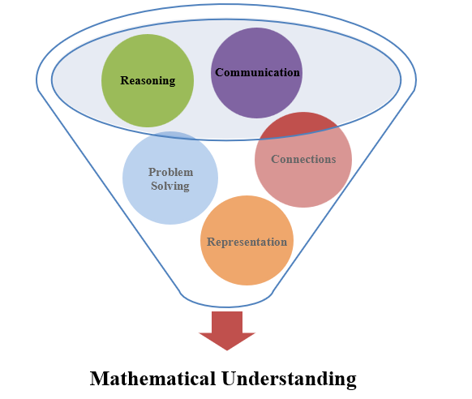
Mathematics Process Goals for Students
The content of the mathematics standards is intended to support the five process goals for students.
Notes:
The 2023 Mathematics Standards of Learning foster the application of the five mathematical process goals including reasoning, communication, problem solving, connections, and representation, and set students up to recognize and see mathematics in real-world applications. These processes support students in building understanding of mathematics.

Slide 8
Standards of Learning Supporting Documents
Notes:
Virginia Department of Education documents supporting the transition to the 2023 Mathematics Standards of Learning will now be shared. Additional resources supporting the implementation of the 2023 Mathematics Standards of Learning will be made available on the VDOE Mathematics SOL website.

Slide 9
Standards Document
Notes:
The 2023 Mathematics Standards of Learning Document includes the standards and the knowledge and skills associated with each standard. This slide shows an example from the Grade 4 Standards Document.

Slide 10
Changes to Numbering of the SOL
Grade 4
Third SOL within this strand
Measurement & Geometry Strand
KEY: NS = Number and Number Sense; CE = Computation and Estimation; MG = Measurement and Geometry; PS = Probability and Statistics; PFA = Patterns, Functions, and Algebra
Notes:
The new numbering system for the standards makes it clear within which strand a standard exists. For instance, the sample shown on the screen highlights 4.MG.3. The number four indicates the grade level; MG indicates the Measurement and Geometry Strand; and 3 indicates that this is the third standard of learning in this strand. The key shown at the bottom of the screen provides the abbreviations for each of the strands.

Slide 11
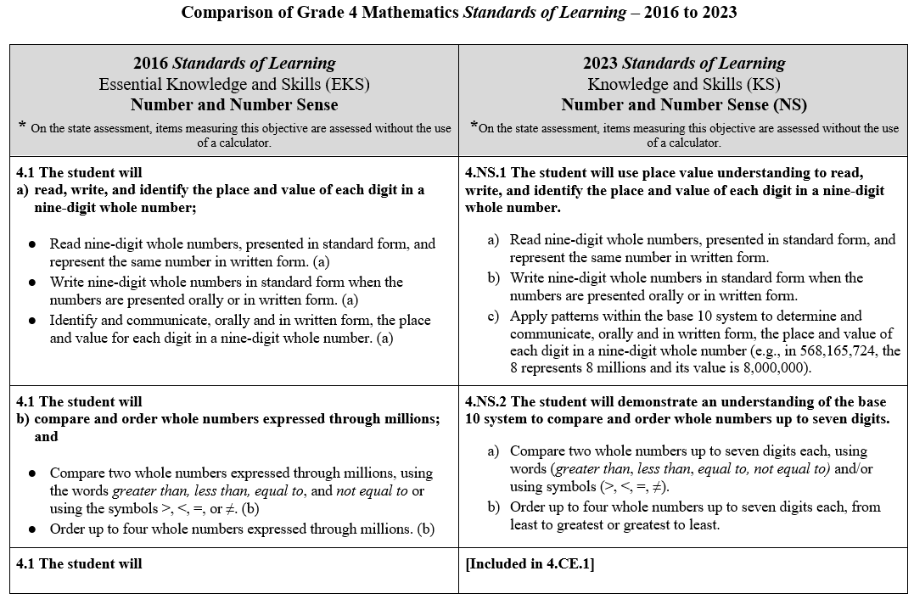
Overview of Revisions (2016 to 2023 Mathematics Standards of Learning) document
Notes:
An Overview of Revisions document has been created for each grade or course. This presentation provides a detailed comparison between the 2016 Standards of Learning and the 2023 Standards of Learning and is based upon the Overview of Revisions document.

Slide 12
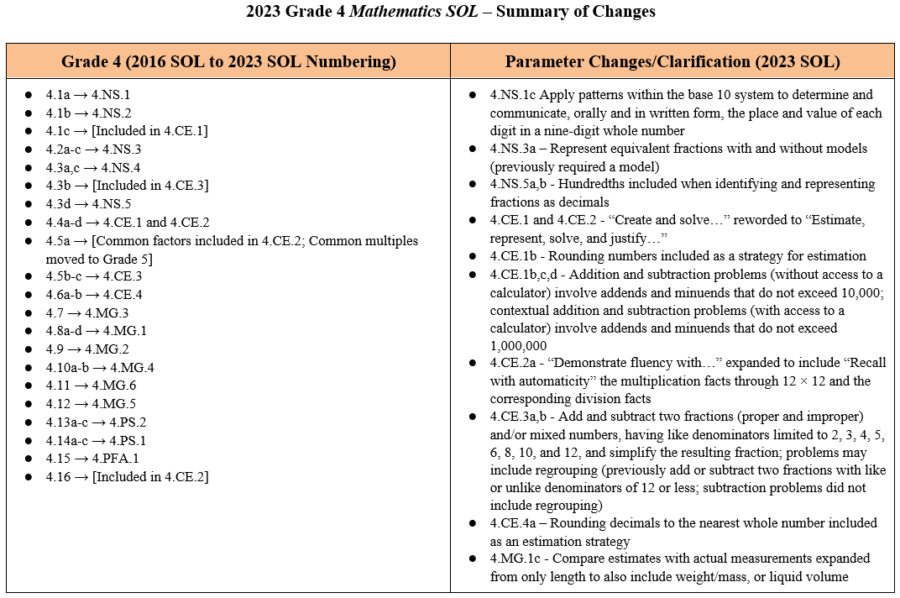
Overview of Revisions- Summary of Changes (1 of 2)
Notes:
At the end of the Overview of Revisions document there is a summary of changes table. One section of the table provides an overview of the changes to the numbering of the standards. Another section provides information regarding the prominent parameter changes and clarifications. Parameter changes and clarifications might be related to an increase or decrease in the limiters of the standards or the knowledge and skills; but might also be related to the depth of understanding of the content or scope of the content.

Slide 13
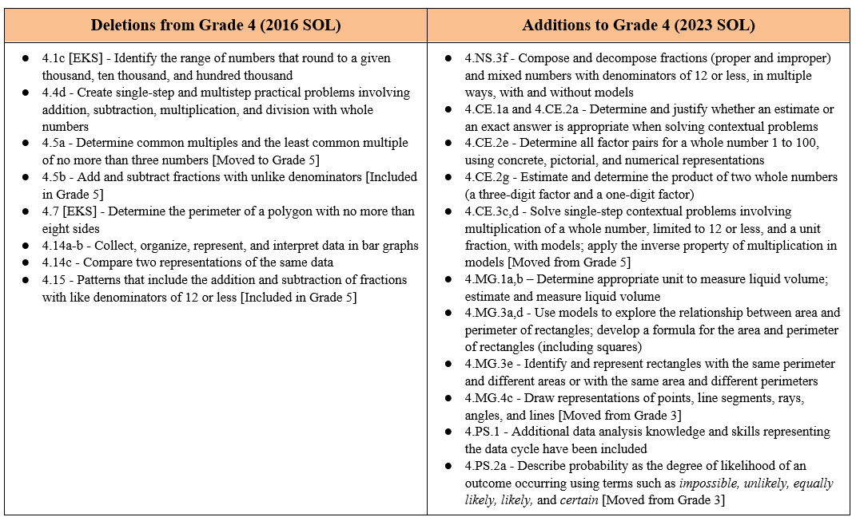
Overview of Revisions- Summary of Changes (2 of 2)
Notes:
The other two sections of the table include deletions from 2016 standards and any addition of content to the 2023 standards.

Slide 14
Comparison of 2016 Mathematics SOL to 2023 Mathematics SOL
Notes:
During the remainder of the presentation, we will take a closer look at the revisions to the 2016 standards that resulted in the new 2023 standards.

Slide 15
Number and Number Sense
Notes:
First, we will discuss the standards in the Grade 4 Number and Number Sense strand.

Slide 16
Standard 4.1a (2016) - Standard 4.NS.1 (2023)
2016 SOL | 2023 SOL
4.1 The student will read, write, and identify the place and value of each digit in a nine-digit whole number; Read nine-digit whole numbers, presented in standard form, and represent the same number in written form. (a) Write nine-digit whole numbers in standard form when the numbers are presented orally or in written form. (a) Identify and communicate, orally and in written form, the place and value for each digit in a nine-digit whole number. (a) | 4.NS.1 The student will use place value understanding to read, write, and identify the place and value of each digit in a nine-digit whole number. Read nine-digit whole numbers, presented in standard form, and represent the same number in written form. Write nine-digit whole numbers in standard form when the numbers are presented orally or in written form. Apply patterns within the base 10 system to determine and communicate, orally and in written form, the place and value of each digit in a nine-digit whole number (e.g., in 568,165,724, the 8 represents 8 millions and its value is 8,000,000).
Revisions:
Apply patterns within the base 10 system to determine the place and value of each digit
Notes:
SOL 4.1a in 2016 is now SOL 4.NS.1 in the 2023 Standards. In SOL 4.NS.1 students will continue to read and write nine-digit numbers. In addition, students will apply patterns within the base 10 system to determine and communicate, orally and in written form, the place and value of each digit in a nine-digit whole number.

Slide 17
Standard 4.1b (2016) - Standard 4.NS.2 (2023)
2016 SOL | 2023 SOL
4.1 The student will b) compare and order whole numbers expressed through millions; and Compare two whole numbers expressed through millions, using the words greater than, less than, equal to, and not equal to or using the symbols >, <, =, or ≠. (b) Order up to four whole numbers expressed through millions. (b) | 4.NS.2 The student will demonstrate an understanding of the base 10 system to compare and order whole numbers up to seven digits. Compare two whole numbers up to seven digits each, using words (greater than, less than, equal to, not equal to) and/or symbols (>, <, =, ≠). Order up to four whole numbers up to seven digits each, from least to greatest or greatest to least.
Revisions:
No significant changes in the content of this standard
Notes:
SOL 4.1b in 2016 is now SOL 4.NS.2 in the 2023 Standards. There are no significant content changes in this standard. Students will continue to compare two whole numbers up to seven digits using words and symbols as well as order up to four whole numbers up to seven digits each.

Slide 18
Standard 4.1c (2016) - Included in Standard 4.CE.1 (2023)
2016 SOL | 2023 SOL
4.1 The student will round whole numbers expressed through millions to the nearest thousand, ten thousand, and hundred thousand. Round whole numbers expressed through millions to the nearest thousand, ten thousand, and hundred thousand place. (c) Identify the range of numbers that round to a given thousand, ten thousand, and hundred thousand. (c) | [Included in 4.CE.1]
Revisions:
Rounding whole numbers has been embedded in SOL 4.CE.1
Notes:
SOL 4.1c from 2016 which states that students will round whole numbers expressed through millions to the nearest thousand, ten thousand, and hundred thousand is now included in the Computation and Estimation strand. It is embedded within SOL 4.CE.1 as a strategy for estimating addition and subtraction problems.

Slide 19
Standard 4.2a (2016) - Standard 4.ns.3a-d (2023)
2016 SOL | 2023 SOL
4.2 The student will compare and order fractions and mixed numbers, with and without models;* Compare and order no more than four fractions having like and unlike denominators of 12 or less, using concrete and pictorial models. (a) Use benchmarks (e.g., 0, $\frac{1}{2}$ or 1) to compare and order no more than four fractions having unlike denominators of 12 or less. (a) Compare and order no more than four fractions with like denominators of 12 or less by comparing the number of parts (numerators) (e.g., $\frac{1}{5}$ < $\frac{3}{5}$). (a) Compare and order no more than four fractions with like numerators and unlike denominators of 12 or less by comparing the size of the parts (e.g., $\frac{3}{9}$ < $\frac{3}{5}$). (a) Compare and order no more than four fractions (proper or improper), and/or mixed numbers, having denominators of 12 or less. (a) Use the symbols >, <, =, and ≠ to compare fractions (proper or improper) and/or mixed numbers having denominators of 12 or less. (a) | 4.NS.3 The student will use mathematical reasoning and justification to represent, compare, and order fractions (proper, improper, and mixed numbers with denominators 12 or less), with and without models. Compare and order no more than four fractions (proper or improper), and/or mixed numbers, with like denominators by comparing the number of parts (numerators) using fractions with denominators of 12 or less (e.g., $\frac{1}{5}$ < $\frac{3}{5}$). Justify solutions orally, in writing, or with a model.* Compare and order no more than four fractions (proper or improper), and/or mixed numbers, with like numerators and unlike denominators by comparing the size of the parts using fractions with denominators of 12 or less (e.g., $\frac{3}{8}$ < $\frac{3}{5}$). Justify solutions orally, in writing, or with a model.* Use benchmarks (e.g., 0, $\frac{1}{2}$, or 1) to compare and order no more than four fractions (proper or improper), and/or mixed numbers, with like and unlike denominators of 12 or less.* Compare two fractions (proper or improper) and/or mixed numbers using fractions with denominators of 12 or less, using the symbols >, <, and = (e.g., $\frac{2}{3}>\frac{1}{7}$). Justify solutions orally, in writing, or with a model.*
Revisions:
Justify solutions orally, in writing, or with a model
Notes:
SOL 4.2a in 2016 is now SOL 4.NS.3a-d in the 2023 Standards. In 4.NS.3 students will continue to compare and order no more than four fractions. In addition, they will justify solutions orally, in writing, or with a model when comparing or ordering fractions (proper or improper) and/or mixed numbers.
As in the 2016 standards, content that is labeled with an asterisk (*) means that items measuring that objective are assessed without the use of a calculator. It is important to note that in the 2016 standards the asterisk was included at the standard level; in the 2023 standards, the asterisk is included at the knowledge and skills level.

Slide 20
Standard 4.2b,c (2016) - Standard 4.ns.3e-g (2023)
2016 SOL | 2023 SOL
4.2 The student will represent equivalent fractions;* and identify the division statement that represents a fraction, with models and in context. Represent equivalent fractions through twelfths, using region/area models, set models, and measurement/length models. (b) Identify the division statement that represents a fraction with models and in context (e.g., $\frac{3}{5}$ means the same as 3 divided by 5 or $\frac{3}{5}$ represents the amount of muffin each of five children will receive when sharing 3 muffins equally). (c)SOL 4.3(b) has been embedded within SOL 4.CE.4 | 4.NS.3 The student will use mathematical reasoning and justification to represent, compare, and order fractions (proper, improper, and mixed numbers with denominators 12 or less), with and without models. Represent equivalent fractions with denominators of 12 or less, with and without models.* Compose and decompose fractions (proper and improper) and/or mixed numbers with denominators of 12 or less, in multiple ways, with and without models.* Represent the division of two whole numbers as a fraction given a contextual situation and a model (e.g., $\frac{3}{5}$ means the same as 3 divided by 5 or $\frac{3}{5}$ represents the amount of muffin each of five children will receive when sharing 3 muffins equally).
Revisions:
Compose and decompose fractions (proper and improper) and/or mixed numbers with denominators of 12 or less, in multiple ways, with and without models (without access to a calculator)
Notes:
SOL 4.2bc in 2016 is now SOL 4.NS.3e-g in the 2023 Standards. In 4.NS.3e-g, students will be expected to represent equivalent fractions with and without models. Students will also now need to be able to compose and decompose proper fractions, improper fractions, and/or mixed numbers in multiple ways, with and without models.

Slide 21
Standard 4.3a,c (2016) - Standard 4.ns.4 (2023)
2016 SOL | 2023 SOL
4.3 The student will read, write, represent, and identify decimals expressed through thousandths; compare and order decimals; and Read and write decimals expressed through thousandths, using base-ten manipulatives, drawings, and numerical symbols. (a) Represent and identify decimals expressed through thousandths, using base-ten manipulatives, pictorial representations, and numerical symbols (e.g., relate the appropriate drawing to 0.05). (a) Investigate the ten-to-one place value relationship for decimals through thousandths, using base-ten manipulatives (e.g., place value mats/charts, decimal squares, and base-ten blocks). (a) Identify and communicate, both orally and in written form, the position and value of a decimal through thousandths (e.g., given 0.385, the 8 is in the hundredths place and has a value of 0.08). (a) Compare two decimals expressed through thousandths, using symbols (>, <, =, and ≠) and/or words (greater than, less than, equal to, and not equal to). (c) Order a set of up to four decimals, expressed through thousandths, from least to greatest or greatest to least. (c) | 4.NS.4 The student will use mathematical reasoning and justification to represent, compare, and order decimals through thousandths, with and without models. Investigate and describe the ten-to-one place value relationship for decimals through thousandths, using concrete models (e.g., place value mats/charts, decimal squares, base 10 blocks). Represent and identify decimals expressed through thousandths, using concrete, pictorial, and numerical representations. Read and write decimals expressed through thousandths, using concrete, pictorial, and numerical representations. Identify and communicate, both orally and in written form, the place and value of each digit in a decimal through thousandths (e.g., given 0.385, the 8 is in the hundredths place and has a value of 0.08). Compare using symbols (<, >, =) and/or words (greater than, less than, equal to) and order (least to greatest and greatest to least), a set of no more than four decimals expressed through thousandths, using multiple strategies (e.g., benchmarks, place value, number lines). Justify solutions with a model, orally, and in writing.
Revisions:
Clarifies that representing, comparing, and ordering decimals may occur with and without models
Justify thinking when representing, comparing, and ordering decimals through thousandths
Notes:
Most of SOL 4.3 from 2016 is now SOL 4.NS.4 in the 2023 Standards. In SOL 4.NS.4a students will continue to investigate the ten-to-one place value relationship using concrete models; in addition, they will now describe that relationship. Students will continue to compare and order decimals through thousandths. Students should become flexible in their use of strategies - examples include benchmarks, place value, and number lines. In addition, they will justify solutions with a model, orally, and in writing.

Slide 22
Standard 4.3b (2016) - Included in Standard 4.CE.4 (2023)
2016 SOL | 2023 SOL
4.3 The student will round decimals to the nearest whole number; Round decimals expressed through thousandths to the nearest whole number. (b) | [Included in 4.CE.4]
Revisions:
Rounding decimals has been embedded in 4.CE4
Notes:
SOL 4.3b in 2016 states that students will round decimals to the nearest whole number. Rounding of decimals is now included in the computation and estimation strand. It is embedded in 4.CE.4 as a strategy for estimating sums and differences with decimals.

Slide 23
Standard 4.3d (2016) - Standard 4.ns.5 (2023)
2016 SOL | 2023 SOL
4.3 The student will given a model, write the decimal and fraction equivalents. * Represent fractions for halves, fourths, fifths, and tenths as decimals through hundredths, using concrete objects. (d) Relate fractions to decimals, using concrete objects (e.g., 10-by 10 grids, meter sticks, number lines, decimal squares, decimal circles, money). (d) Write the decimal and fraction equivalent for a given model (e.g., $\frac{1}{4}$ = 0.25 or 0.25 = $\frac{1}{4}$; 1.25 = $\frac{5}{4}$ or 1$\frac{1}{4}$). (d) | 4.NS.5 The student will reason about the relationship between fractions and decimals (limited to halves, fourths, fifths, tenths, and hundredths) to identify and represent equivalencies. Represent fractions (proper or improper) and/or mixed numbers as decimals through hundredths, using multiple representations, limited to halves, fourths, fifths, tenths, and hundredths.* Identify and model equivalent relationships between fractions (proper or improper) and/or mixed numbers and decimals, using halves, fourths, fifths, tenths, and hundredths.* Write the decimal and fraction equivalent for a given model (e.g., $\frac{1}{4}$ = 0.25 or 0.25 = $\frac{1}{4}$; 1.25 = $\frac{5}{4}$ or 1 $\frac{1}{4}$; 1.02 = $\frac{102}{100}$ or 1 $\frac{2}{100}$).*
Revisions:
Clarifies that fractions may include improper fractions and/or mixed numbers when being represented as decimals
Parameters changed for this standard to include hundredths
Notes:
SOL 4.3d in 2016 is now SOL 4.NS.5 in the 2023 Standards. In SOL 4.NS.5 the language has been clarified to highlight that hundredths should be included when students represent fractions as decimals and when students identify and model equivalent fractions and decimals.
In addition, 4.NS.5 clarifies that fractions include proper fractions, improper fractions, and/or mixed numbers when representing them as decimals or modeling equivalent relationships.

Slide 24
Computation and Estimation
Notes:
Next, we will discuss the standards in the Grade 4 Computation and Estimation strand.

Slide 25
Standard 4.4a (2016) - Standard 4.ce.2 (2023)
2016 SOL | 2023 SOL
4.4 The student will demonstrate fluency with multiplication facts through 12 × 12, and the corresponding division facts;* Demonstrate fluency with multiplication through 12 × 12, and the corresponding division facts. (a) | 4.CE.2 The student will estimate, represent, solve, and justify solutions to single-step and multistep problems, including those in context, using multiplication with whole numbers, and single-step problems, including those in context, using division with whole numbers; and recall with automaticity the multiplication facts through 12 × 12 and the corresponding division facts. Recall with automaticity the multiplication facts through 12 × 12 and the corresponding division facts.*
Revisions:
Standard 4.4 has been broken into two standards: 4.CE.2 (multiplication and division) and 4.CE.1 (addition and subtraction)
Recall with automaticity multiplication facts through 12 x 12 and corresponding division facts
Notes:
SOL 4.4 in 2016 included addition, subtraction, multiplication, and division. This standard has been reorganized in the 2023 standards. SOL 4.CE.1 focuses on addition and subtraction while SOL 4.CE.2 focuses on multiplication and division.
SOL 4.4a in 2016 is now SOL 4.CE.2b in the 2023 Standards. In 4.CE.2b, the language has been clarified that students will now recall with automaticity the multiplication facts through 12 x 12 and the corresponding division facts.

Slide 26
Standard 4.4b,c (2016) - Standard 4.ce.2 (2023) 1 of 2
2016 SOL | 2023 SOL
4.4 The student will estimate and determine sums, differences, and products of whole numbers;* estimate and determine quotients of whole numbers, with and without remainders;* and Estimate whole number sums, differences, products, and quotients, with and without context. (b, c) Apply strategies, including place value and the properties of multiplication and/or addition, to determine the product of two whole numbers when both factors have two digits or fewer. (b) Apply strategies, including place value and the properties of multiplication and/or addition, to determine the quotient of two whole numbers, given a one-digit divisor and a two- or three-digit dividend, with and without remainders. (c) Refine estimates by adjusting the final amount, using terms such as closer to, between, and a little more than. (b, c) | 4.CE.2 The student will estimate, represent, solve, and justify solutions to single-step and multistep problems, including those in context, using multiplication with whole numbers, and single-step problems, including those in context, using division with whole numbers; and recall with automaticity the multiplication facts through 12 × 12 and the corresponding division facts. Determine and justify whether an estimate or an exact answer is appropriate when solving contextual problems involving multiplication and division of whole numbers. Refine estimates by adjusting the final amount, using terms such as closer to, between, and a little more than. Create an equation using addition, subtraction, multiplication, and division to represent the relationship between equivalent mathematical expressions (e.g., 4 × 3 = 2 × 6; 10 + 8 = 36 ÷ 2; 12 × 4 = 60 - 12). Identify and use the appropriate symbol to distinguish between expressions that are equal and expressions that are not equal, using addition, subtraction, multiplication, and division (e.g., 4 × 12 = 8 × 6 and 64 ÷ 8 ≠ 8 × 8).
Revisions:
Determine and justify whether an estimate or an exact answer is appropriate when solving contextual problems
SOL 4.15 has been embedded into SOL 4.CE.2 as bullets c and d
Notes:
SOL 4.4b,c in 2016 is now SOL 4.CE.2a,c,d in the 2023 Standards. This standard focuses on multiplication and division. The standard clarifies that students are expected to estimate, represent, solve, and justify their solutions to single-step and multistep problems. In addition, 4.CE.2a clarifies that students will now determine and justify whether a contextual problem requires an estimate or an exact answer.
An important thing to note is that the content in SOL 4.15 from 2016 is now included in 4.CE.2c,d in the 2023 Standards.
Additional content from SOL 4.4b,c is contained on the next slide.

Slide 27
Standard 4.4b (2016) - Standard 4.ce.2 (2023) 2 of 2
2016 SOL | 2023 SOL
4.4 The student will estimate and determine sums, differences, and products of whole numbers;* estimate and determine quotients of whole numbers, with and without remainders;* and Estimate whole number sums, differences, products, and quotients, with and without context. (b, c) Apply strategies, including place value and the properties of multiplication and/or addition, to determine the product of two whole numbers when both factors have two digits or fewer. (b) Apply strategies, including place value and the properties of multiplication and/or addition, to determine the quotient of two whole numbers, given a one-digit divisor and a two- or three-digit dividend, with and without remainders. (c) Refine estimates by adjusting the final amount, using terms such as closer to, between, and a little more than. (b, c) | 4.CE.2 The student will estimate, represent, solve, and justify solutions to single-step and multistep problems, including those in context, using multiplication with whole numbers, and single-step problems, including those in context, using division with whole numbers; and recall with automaticity the multiplication facts through 12 × 12 and the corresponding division facts. Determine all factor pairs for a whole number 1 to 100, using concrete, pictorial, and numerical representations. Determine common factors and the greatest common factor of no more than three numbers. Apply strategies (e.g., rounding, place value, properties of multiplication and/or addition) and algorithms, including the standard algorithm, to estimate and determine the product of two whole numbers when given: a two-digit factor and a one-digit factor;* a three-digit factor and a one-digit factor;* or a two-digit factor and a two-digit factor.* Apply strategies (e.g., rounding, compatible numbers, and place value) and algorithms, including the standard algorithm, to estimate and determine the quotient of two whole numbers, given a one-digit divisor and a two- or three-digit dividend, with and without remainders.*
Revisions:
Determine all factor pairs for a whole number 1 to 100, using concrete, pictorial, and numerical representations
Estimate and determine the product of whole numbers when given: a three-digit factor and a one-digit factor
Notes:
SOL 4.CE.2 includes several bullets of new content. Students are expected to be able to determine all factor pairs for a whole number 1-100 using concrete, pictorial, and numerical representations. They are also expected to determine common factors and the greatest common factor of no more than three numbers, which was originally SOL 4.5 in the 2016 standards. Additionally, in SOL 4.CE.2g the parameters have been extended to include multiplying a three-digit factor by a one-digit factor when applying strategies and algorithms, including the standard algorithm.

Slide 28
Standard 4.4d (2016) - Standard 4.ce.2 (2023)
2016 SOL | 2023 SOL
4.4 The student will create and solve single-step and multistep practical problems involving addition, subtraction, and multiplication, and single step practical problems involving division with whole numbers. Create and solve single-step and multistep practical problems involving addition, subtraction, and multiplication with whole numbers. (d) Create and solve single-step practical problems involving division with whole numbers. (d) Use the context in which a practical problem is situated to interpret the quotient and remainder. (d) | 4.CE.2 The student will estimate, represent, solve, and justify solutions to single-step and multistep problems, including those in context, using multiplication with whole numbers, and single-step problems, including those in context, using division with whole numbers; and recall with automaticity the multiplication facts through 12 × 12 and the corresponding division facts. Estimate, represent, solve, and justify solutions to single-step and multistep contextual problems that involve multiplication with whole numbers. Estimate, represent, solve, and justify solutions to single-step contextual problems involving division with whole numbers. Interpret the quotient and remainder when solving a contextual problem.
Revisions:
Estimate, represent, solve, and justify solutions to problems, including those in context
Create practical problems was removed
Notes:
SOL 4.4d in 2016 has been included in 4.CE.2h,j,k in the 2023 Standards. Students will continue to solve whole number contextual problems involving multiplication and division. In addition, students will estimate solutions prior to solving, and will represent and justify their solutions. Creating practical problems has been removed from the Grade 4 mathematics standards.

Slide 29
Standard 4.4b,d (2016) - Standard 4.ce.1 (2023)
2016 SOL | 2023 SOL
4.4 The student will estimate and determine sums, differences, and products of whole numbers;* create and solve single-step and multistep practical problems involving addition, subtraction, and multiplication, and single step practical problems involving division with whole numbers. Estimate whole number sums, differences, products, and quotients, with and without context. (b, c) Apply strategies, including place value and the properties of addition to determine the sum or difference of two whole numbers, each 999,999 or less. (b) Refine estimates by adjusting the final amount, using terms such as closer to, between, and a little more than. (b, c) Create and solve single-step and multistep practical problems involving addition, subtraction, and multiplication with whole numbers. (d) | 4.CE.1 The student will estimate, represent, solve, and justify solutions to single-step and multistep problems, including those in context, using addition and subtraction with whole numbers. Determine and justify whether an estimate or an exact answer is appropriate when solving contextual problems involving addition and subtraction with whole numbers. Refine estimates by adjusting the final amount, using terms such as closer to, between, and a little more than. Apply strategies (e.g., rounding to the nearest 100 or 1,000, using compatible numbers, other number relationships) to estimate a solution for single-step or multistep addition or subtraction problems with whole numbers, where addends or minuends do not exceed 10,000.* Apply strategies (e.g., place value, properties of addition, other number relationships) and algorithms, including the standard algorithm, to determine the sum or difference of two whole numbers, where addends and minuends do not exceed 10,000.* Estimate, represent, solve, and justify solutions to single-step and multistep contextual problems involving addition and subtraction with whole numbers where addends and minuends do not exceed 1,000,000.
Revisions:
In addition to estimating and solving, students are asked to represent and justify their solution
Addends and minuends do not exceed 10,000 without the use of a calculator.
Notes:
SOL 4.4b,d in 2016 is now SOL 4.CE.1a-d in the 2023 Standards. This standard focuses on addition and subtraction. The standard clarifies that students are expected to estimate, represent, solve, and justify their solutions to single-step and multistep problems.
SOL 4.CE.1a clarifies that students will now determine and justify whether a contextual problem requires an estimate or an exact answer.
Students should become flexible in their use of strategies and algorithms when solving addition and subtraction problems with whole numbers- examples include place value, properties of addition, other number relationships, and the standard algorithm.
Parameters have been clarified for 4.CE.1b,c. When students do not have access to a calculator, addends and minuends should not exceed 10,000. However, when students have access to a calculator, addends and minuends may not exceed 1,000,000.
In addition, students are expected to represent and justify their solutions to contextual problems.

Slide 30
Standard 4.5a (2016) - Included in Standard 4.CE.2 (2023)
2016 SOL | 2023 SOL
4.5 The student will determine common multiples and factors, including least common multiple and greatest common factor; Determine common multiples and common factors of numbers. (a) Determine the least common multiple and greatest common factor of no more than three numbers. (a) | [Common factors/GCF included in 4.CE.2; Common multiples/LCM moved to Grade 5]
Revisions:
Common factors/Greatest Common Factor have been embedded into SOL 4.CE.2
Common multiples/Least Common Multiple have been removed from Grade 4 mathematics standards
Notes:
Part of SOL 4.5a from 2016, determining common factors and greatest common factor, is now embedded within the Computation and Estimation strand as part of SOL 4.CE.2.
The other part of SOL 4.5a, determining common multiples and the least common multiple, has been removed from the Grade 4 mathematics standards. This content has moved to Grade 5.

Slide 31
Standard 4.5b,c (2016) - Standard 4.ce.3 (2023) 1 of 2
2016 SOL | 2023 SOL
4.5 The student will add and subtract fractions and mixed numbers having like and unlike denominators; * and solve single-step practical problems involving addition and subtraction with fractions and mixed numbers. Determine a common denominator for fractions, using common multiples. Common denominators should not exceed 60. (b) Estimate the sum or difference of two fractions. (b, c) Add and subtract fractions (proper or improper) and/or mixed numbers, having like and unlike denominators limited to 2, 3, 4, 5, 6, 8, 10, and 12, and simplify the resulting fraction. (Subtraction with fractions will be limited to problems that do not require regrouping). (b) Solve single-step practical problems that involve addition and subtraction with fractions (proper or improper) and/or mixed numbers, having like and unlike denominators limited to 2, 3, 4, 5, 6, 8, 10, and 12, and simplify the resulting fraction. (Subtraction with fractions will be limited to problems that do not require regrouping). (c) | 4.CE.3 The student will estimate, represent, solve, and justify solutions to single-step problems, including those in context, using addition and subtraction of fractions (proper, improper, and mixed numbers with like denominators of 2, 3, 4, 5, 6, 8, 10, and 12), with and without models; and solve single-step contextual problems involving multiplication of a whole number (12 or less) and a unit fraction, with models. Estimate and determine the sum or difference of two fractions (proper or improper) and/or mixed numbers, having like denominators limited to 2, 3, 4, 5, 6, 8, 10, and 12 (e.g., $\frac{3}{8}$ + $\frac{3}{8}$, 2$\frac{1}{5}$ + $\frac{4}{5}$, $\frac{7}{4}$ - $\frac{5}{4} )$ and simplify the resulting fraction. Addition and subtraction with fractions may include regrouping.* Estimate, represent, solve, and justify solutions to single-step contextual problems using addition and subtraction with fractions (proper or improper) and/or mixed numbers, having like denominators limited to 2, 3, 4, 5, 6, 8, 10, and 12, and simplify the resulting fraction. Addition and subtraction with fractions may include regrouping.
Revisions:
Addition and subtraction with fractions limited to like denominators
Addition and subtraction with fractions may include regrouping
Notes:
SOL 4.5b,c in 2016 is now 4.CE.3 in the 2023 Standards. The parameter has changed in 4.CE.3 to read that students will estimate and determine the sum or difference of proper fractions, improper fractions, and/or mixed numbers having like denominators, and may include regrouping. Students will continue to simplify the resulting fraction. In addition, students will justify and represent solutions to single-step contextual problems when adding and subtracting proper fractions, improper fractions, and/or mixed numbers with like denominators.

Slide 32
Standard 4.5b,c (2016) - Standard 4.ce.3 (2023) 2 of 2
2016 SOL | 2023 SOL
[Moved from Grade 5] | 4.CE.3 The student will estimate, represent, solve, and justify solutions to single-step problems, including those in context, using addition and subtraction of fractions (proper, improper, and mixed numbers with like denominators of 2, 3, 4, 5, 6, 8, 10, and 12), with and without models; and solve single-step contextual problems involving multiplication of a whole number (12 or less) and a unit fraction, with models. Solve single-step contextual problems involving multiplication of a whole number, limited to 12 or less, and a unit fraction (e.g., 6 × $\frac{1}{3}$, $\frac{1}{5}$ × 8, 2 × $\frac{1}{10})$, with models.* Apply the inverse property of multiplication in models (e.g., use a visual fraction model to represent $\frac{4}{4}$ or 1 as the product of 4 × $\frac{1}{4})$.
Revisions:
Solve single-step contextual problems involving multiplication of a whole number, limited to 12 or less, and a unit fraction, with models
Apply the inverse property of multiplication in models
Notes:
Additionally, there is new content added in SOL 4.CE.3c, which states that students will now solve single-step contextual problems involving multiplication of a whole number, limited to 12 or less, and a unit fraction with models. There is additional new content in SOL 4.CE.3d, which states that students will also be expected to apply the inverse property of multiplication in models.

Slide 33
Standard 4.6 (2016) - Standard 4.ce.4 (2023)
2016 SOL | 2023 SOL
4.6 The student will add and subtract decimals;* and solve single-step and multistep practical problems involving addition and subtraction with decimals. Estimate sums and differences of decimals. (a) Add and subtract decimals through thousandths, using concrete materials, pictorial representations, and paper and pencil. (a) Solve single-step and multistep practical problems that involve adding and subtracting with decimals through thousandths. (b) | 4.CE.4 The student will estimate, represent, solve, and justify solutions to single-step and multistep problems, including those in context, using addition and subtraction of decimals through the thousandths, with and without models. Apply strategies (e.g., rounding to the nearest whole number, using compatible numbers) and algorithms, including the standard algorithm, to estimate and determine the sum or difference of two decimals through the thousandths, with and without models, in which:* decimals do not exceed the thousandths; and addends, subtrahends, and minuends are limited to four digits. Estimate, represent, solve, and justify solutions to single-step and multistep contextual problems using addition and subtraction of decimals through the thousandths.
Revisions:
Apply strategies and algorithms, including the standard algorithm, when solving addition and subtraction problems with decimals
Addends, subtrahends, and minuends are limited to four digits
Students should represent and justify their solutions
Notes:
SOL 4.6 in 2016 is now SOL 4.CE.4 in the 2023 Standards. Students should become flexible in their use of strategies as they solve addition and subtraction problems with decimals - examples include rounding to the nearest whole number, using compatible numbers, and using the standard algorithm when estimating and determining the sum or difference of two decimals through the thousandths. An important thing to note is that SOL 4.3b from the 2016 standards, rounding decimals to the nearest whole number, has been included in this standard as a strategy for estimation.
In addition, parameters have been clarified for SOL 4.CE.4a that state when estimating and solving, the addends, subtrahends, and minuends do not exceed four digits.
In addition, students will justify and represent solutions to contextual problems involving decimals.

Slide 34
Measurement and Geometry
Notes:
Next, we will discuss the standards in the Grade 4 Measurement and Geometry strand.

Slide 35
Standard 4.7 (2016) - Standard 4.MG.3 (2023)
2016 SOL | 2023 SOL
4.7 The student will solve practical problems that involve determining perimeter and area in U.S. Customary and metric units. Determine the perimeter of a polygon with no more than eight sides, when the lengths of the sides are given, with diagrams. Determine the perimeter and area of a rectangle when given the measure of two adjacent sides, with and without diagrams. Determine the perimeter and area of a square when the measure of one side is given, with and without diagrams. Solve practical problems that involve determining perimeter and area in U.S. Customary and metric units. | 4.MG.3 The student will use multiple representations to develop and use formulas to solve problems, including those in context, involving area and perimeter limited to rectangles and squares (in both U.S. Customary and metric units). Use concrete materials and pictorial models to develop a formula for the area and perimeter of a rectangle (including a square). Determine the area and perimeter of a rectangle when given the measure of two adjacent sides (in whole number units), with and without models. Determine the area and perimeter of a square when given the measure of one side (in whole number units) with and without models. Use concrete materials and pictorial models to explore the relationship between area and perimeter of rectangles. Identify and represent rectangles with the same perimeter and different areas or with the same area and different perimeters. Solve contextual problems involving area and perimeter of rectangles and squares.
Revisions:
Develop a formula for the area and perimeter of a rectangle (including a square)
Explore the relationship between area and perimeter of rectangles
Identify and represent rectangles with the same perimeter and different areas or with the same area and different perimeters
Determine the perimeter of a polygon with no more than eight side has been removed from the Grade 4 standards
Notes:
SOL 4.7 in 2016 is now SOL 4.MG.3 in the 2023 standards. This standard includes some new content.​
SOL 4.MG.3a and SOL 4.MG.3d contain new content for Grade 4 - students will use concrete materials and pictorial models to develop a formula for the area and perimeter of a rectangle (including a square) and to explore the relationship between area and perimeter of rectangles.​
SOL 4.MG.3e is also new content for Grade 4 - students will identify and represent rectangles with the same perimeter and different areas or with the same area and different perimeters.​
Determining the perimeter of a polygon with no more than eight sides has been removed from the Grade 4 standards.

Slide 36
Standard 4.8a,b (2016) - Standard 4.MG.1 (2023)
2016 SOL | 2023 SOL
4.8 The student will estimate and measure length and describe the result in U.S. Customary and metric units; estimate and measure weight/mass and describe the result in U.S. Customary and metric units; Determine an appropriate unit of measure (inch, foot, yard, mile, millimeter, centimeter, and meter) to use when measuring length in both U.S. Customary and metric units. (a) Estimate and measure length in U.S. Customary and metric units, measuring to the nearest part of an inch ($\frac{1}{2}$, $\frac{1}{4}$, $\frac{1}{8}$), and to the nearest foot, yard, millimeter, centimeter, or meter, and record the length including the unit of measure (e.g., 24 inches). (a) Compare estimates of the length with the actual measurement of the length. (a) Determine an appropriate unit of measure (ounce, pound, gram, and kilogram) to use when measuring the weight/mass of everyday objects in both U.S. Customary and metric units. (b) Estimate and measure the weight/mass of objects in both U.S. Customary and metric units (ounce, pound, gram, or kilogram) to the nearest appropriate measure, using a variety of measuring instruments. (b) Record the weight/mass of an object with the unit of measure (e.g., 24 grams). (b) | 4.MG.1 The student will reason mathematically to solve problems, including those in context, that involve length, weight/mass, and liquid volume using U.S. Customary and metric units. Determine an appropriate unit of measure to use when measuring: length in both U.S. Customary (inch, foot, yard, mile) and metric units (millimeter, centimeter, meter); weight/mass in both U.S. Customary (ounce, pound) and metric units (gram, kilogram); and liquid volume in both U.S. Customary (cup, pint, quart, gallon) and metric units (milliliter, liter). Estimate and measure: length of an object to the nearest U.S. Customary unit ($\frac{1}{2}$ inch, $\frac{1}{4}$ inch, $\frac{1}{8}$ inch, foot, yard) and nearest metric unit (millimeter, centimeter, or meter); weight/mass of an object to the nearest U.S. Customary unit (ounce, pound) and nearest metric unit (gram, kilogram); and liquid volume to the nearest U.S. Customary unit (cup, pint, quart, gallon) and nearest metric unit (milliliter, liter). Compare estimates of length, weight/mass, or liquid volume with the actual measurements.
Revisions:
Determine an appropriate unit of measure, estimate, and measure liquid volume in both U.S. Customary and metric units
Compare estimates of weight/mass or liquid volume with the actual measurements
Notes:
SOL 4.8 from the 2016 standards is now SOL 4.MG.1 in the 2023 standards.​
Students will now determine an appropriate unit of measure to use when measuring liquid volume in both U.S. Customary (cup, pint, quart, gallon) and metric units (milliliter, liter). Similarly, students will now also estimate and measure liquid volume to the nearest U.S. Customary unit (cup, pint, quart, gallon) and nearest metric unit (milliliter, liter).​
New parameters for 4.MG.1c have been added - Students will now compare estimates of weight/mass or liquid volume with the actual measurements.

Slide 37
Standard 4.8c,d (2016) - Standard 4.MG.1 (2023)
2016 SOL | 2023 SOL
4.8 The student will given the equivalent measure of one unit, identify equivalent measures of length, weight/mass, and liquid volume between units within the U.S. Customary system; and solve practical problems that involve length, weight/mass, and liquid volume in U.S. Customary units. Record the weight/mass of an object with the unit of measure (e.g., 24 grams). (b) Given the equivalent measure of one unit, identify equivalent measures between units within the U.S. Customary system for: length (inches and feet, feet and yards, inches and yards); yards and miles; weight/mass (ounces and pounds); and liquid volume (cups, pints, quarts, and gallons). (c) Solve practical problems that involve length, weight/mass, and liquid volume in U.S. Customary units. (d) | 4.MG.1 The student will reason mathematically to solve problems, including those in context, that involve length, weight/mass, and liquid volume using U.S. Customary and metric units. Given the equivalent measure of one unit, solve problems, including those in context, by determining the equivalent measures within the U.S. Customary system for: length (inches and feet, feet and yards, inches and yards); weight/mass (ounces and pounds); and liquid volume (cups, pints, quarts, and gallons)
Revisions:
Finding equivalent measures between yards and miles has been removed from Grade 4 mathematics standards
Notes:
In SOL 4.MG.1d there are no significant changes from SOL 4.8c,d. Students continue to be expected to solve problems, including those in context, by determining the equivalent measures within the U.S. Customary system for length, weight/mass, and liquid volume, when given the equivalent measure of one unit. One parameter parameter change in this content is that students are no longer expected to find equivalent measures between units for yards and miles.

Slide 38
Standard 4.9 (2016) - Standard 4.MG.2 (2023)
2016 SOL | 2023 SOL
4.9 The student will solve practical problems related to elapsed time in hours and minutes within a 12-hour period. Solve practical problems related to elapsed time in hours and minutes, within a 12-hour period (within a.m., within p.m., and across a.m. and p.m.): when given the beginning time and the ending time, determine the time that has elapsed; when given the beginning time and amount of elapsed time in hours and minutes, determine the ending time; and when given the ending time and the elapsed time in hours and minutes, determine the beginning time. | 4.MG.2 The student will solve single-step and multistep contextual problems involving elapsed time (limited to hours and minutes within a 12-hour period). Solve single-step and multistep contextual problems involving elapsed time in hours and minutes, within a 12-hour period (within a.m., within p.m., and across a.m. and p.m.) when given: the starting time and the ending time, determine the amount of time that has elapsed in hours and minutes; the starting time and amount of elapsed time in hours and minutes, determine the ending time; or the ending time and the amount of elapsed time in hours and minutes, determine the starting time.
Revisions:
Solve single-step and multistep contextual problems involving elapsed time
Notes:
SOL 4.9 from the 2016 standards is now SOL 4.MG.2 in the 2023 standards. The wording of this standard has been clarified to include the expectation of solving single-step and multistep contextual problems involving elapsed time.

Slide 39
Standard 4.10 (2016) - Standard 4.MG.4 (2023)
2016 SOL | 2023 SOL
4.10 The student will identify and describe points, lines, line segments, rays, and angles, including endpoints and vertices; and identify and describe intersecting, parallel, and perpendicular lines. Identify and describe points, lines, line segments, rays, and angles, including endpoints and vertices. (a) Use symbolic notation to name points, lines, line segments, rays, and angles. (a) Identify parallel, perpendicular, and intersecting line segments in plane and solid figures. (b) Identify practical situations that illustrate parallel, intersecting, and perpendicular lines. (b) Use symbolic notation to describe parallel lines and perpendicular lines. (b) | 4.MG.4 The student will identify, describe, and draw points, rays, line segments, angles, and lines, including intersecting, parallel, and perpendicular lines. Identify and describe points, lines, line segments, rays, and angles, including endpoints and vertices. Describe endpoints and vertices in relation to lines, line segments, rays, and angles. Draw representations of points, line segments, rays, angles, and lines, using a ruler or straightedge. Identify parallel, perpendicular, and intersecting lines and line segments in plane and solid figures, including those in context. Use symbolic notation to name points, lines, line segments, rays, angles, and to describe parallel and perpendicular lines.
Revisions:
Draw representations of points, line segments, rays, angles, and lines
Notes:
SOL 4.10 in the 2016 standards is now SOL 4.MG.4 in the 2023 standards.
SOL 4.MG.4c is content that was moved from Grade 3. Students will draw representations of points, line segments, rays, angles, and lines, using a ruler or straightedge.

Slide 40
Standard 4.11 (2016) - Standard 4.MG.6 (2023)
2016 SOL | 2023 SOL
4.11 The student will identify, describe, compare, and contrast plane and solid figures according to their characteristics (number of angles, vertices, edges, and the number and shape of faces) using concrete models and pictorial representations. Identify concrete models and pictorial representations of solid figures (cube, rectangular prism, square pyramid, sphere, cone, and cylinder). Identify and describe solid figures (cube, rectangular prism, square pyramid, and sphere) according to their characteristics (number of angles, vertices, edges, and by the number and shape of faces). Compare and contrast plane and solid figures (circle/sphere, square/cube, triangle/square pyramid, and rectangle/ rectangular prism) according to their characteristics (number of sides, angles, vertices, edges, and the number and shape of faces). | 4.MG.6 The student will identify, describe, compare, and contrast plane and solid figures according to their characteristics (number of angles, vertices, edges, and the number and shape of faces), with and without models. Identify concrete models and pictorial representations of solid figures (cube, rectangular prism, square pyramid, sphere, cone, and cylinder). Identify and describe solid figures (cube, rectangular prism, square pyramid, and sphere) according to their characteristics (number of angles, vertices, edges, and by the number and shape of faces). Compare and contrast plane and solid figures (limited to circles, squares, triangles, rectangles, spheres, cubes, square pyramids, and rectangular prisms) according to their characteristics (number of sides, angles, vertices, edges, and the number and shape of faces).
Revisions:
Identify, describe, compare, and contrast plane and solid figures with and without models
Notes:
SOL 4.11 in the 2016 standards is now SOL 4.MG.6 in the 2023 standards.
There is a parameter change in this standard. Students are now expected to identify, describe, compare, and contrast plane and solid figures according to their characteristics both with and without models.

Slide 41
Standard 4.12 (2016) - Standard 4.MG.5 (2023)
2016 SOL | 2023 SOL
4.12 The student will classify quadrilaterals as parallelograms, rectangles, squares, rhombi, and/or trapezoids. Develop definitions for parallelograms, rectangles, squares, rhombi, and trapezoids. Identify properties of quadrilaterals including parallel, perpendicular, and congruent sides. Classify quadrilaterals as parallelograms, rectangles, squares, rhombi, and/or trapezoids. Compare and contrast the properties of quadrilaterals. Identify parallel sides, congruent sides, and right angles using geometric markings to denote properties of quadrilaterals. | 4.MG.5 The student will classify and describe quadrilaterals (parallelograms, rectangles, squares, rhombi, and/or trapezoids) using specific properties and attributes. Develop definitions for parallelograms, rectangles, squares, rhombi, and trapezoids through the exploration of properties and attributes. Identify and describe points, line segments, angles, and vertices in quadrilaterals. Identify and describe parallel, intersecting, perpendicular, and congruent sides in quadrilaterals. Compare, contrast, and classify quadrilaterals (parallelograms, rectangles, squares, rhombi, and/or trapezoids) based on the following properties and attributes: i) parallel sides; ii) perpendicular sides; iii) congruence of sides; and iv) number of right angles. Denote properties of quadrilaterals and identify parallel sides, congruent sides, and right angles by using geometric markings. Use symbolic notation to name line segments and angles in quadrilaterals.
Revisions:
Identify and describe points, line segments, angles, and vertices in quadrilaterals
Use symbolic notation to name line segments and angles in quadrilaterals
Notes:
SOL 4.12 in the 2016 standards is now SOL 4.MG.5 in the 2023 standards.
Students will classify and describe quadrilaterals using specific properties and attributes. Clarification is also provided in the Knowledge and Skills bullets that students should identify and describe points, line segments, angles, and vertices in quadrilaterals, and they should use symbolic notation to name line segments and angles in quadrilaterals.

Slide 42
Probability and Statistics
Notes:
Next, we will discuss the standards in the Grade 4 Probability and Statistics strand.

Slide 43
Standard 4.13 (2016) - Standard 4.PS.2 (2023)
2016 SOL | 2023 SOL
4.13 The student will determine the likelihood of an outcome of a simple event; represent probability as a number between 0 and 1, inclusive; and create a model or practical problem to represent a given probability. Model and determine all possible outcomes of a given simple event where there are no more than 24 possible outcomes, using a variety of manipulatives (e.g., coins, number cubes, and spinners). (a) Determine the outcome of an event that is least likely to occur or most likely to occur where there are no more than 24 possible outcomes. (a) Write the probability of a given simple event as a fraction, where there are no more than 24 possible outcomes. (b) Determine the likelihood of an event occurring and relate it to its whole number or fractional representation (e.g., impossible or zero; equally likely; certain or one). (a, b) Create a model or practical problem to represent a given probability. (c) | 4.PS.2 The student will model and determine the probability of an outcome of a simple event. Describe probability as the degree of likelihood of an outcome occurring using terms such as impossible, unlikely, equally likely, likely, and certain. Model and determine all possible outcomes of a given simple event where there are no more than 24 possible outcomes, using a variety of manipulatives (e.g., coins, two-sided counters, number cubes, spinners). Write the probability of a given simple event as a fraction between 0 and 1, where there are no more than 24 possible outcomes. Determine the likelihood of an event occurring and relate it to its whole number or fractional representation (e.g., impossible or zero; equally likely; certain or one). Create a model or contextual problem to represent a given probability.
Revisions:
Describe probability as the degree of likelihood of an outcome occurring using terms such as impossible, unlikely, equally likely, likely, and certain [Moved from Grade 3]
Notes:
SOL 4.13 in the 2016 standards is now SOL 4.PS.2 in the 2023 standards.
SOL 4.PS.2a contains new content that was moved from Grade 3. Students will describe probability as the degree of likelihood of an outcome occurring using terms such as impossible, unlikely, equally likely, likely, and certain.

Slide 44
Standard 4.14a (2016) - Standard 4.PS.1 (2023)
2016 SOL | 2023 SOL
4.14 The student will collect, organize, and represent data in bar graphs and line graphs; Collect data, using, for example, observations, measurement, surveys, scientific experiments, polls, or questionnaires. (a) Organize data into a chart or table. (a) Represent data in bar graphs, labeling one axis with equal whole number increments of one or more (numerical data) (e.g., 2, 5, 10, or 100) and the other axis with categories related to the title of the graph (categorical data) (e.g., swimming, fishing, boating, and water skiing as the categories of “Favorite Summer Sports”). (a) Represent data in line graphs, labeling the vertical axis with equal whole number increments of one or more and the horizontal axis with continuous data commonly related to time (e.g., hours, days, months, years. Line graphs will have no more than 10 identified points along a continuum for continuous data. (a) Title the graph or identify an appropriate title. Label the axes or identify the appropriate labels. (a) | 4.PS.1 The student will apply the data cycle (formulate questions; collect or acquire data; organize and represent data; and analyze data and communicate results) with a focus on line graphs. Formulate questions that require the collection or acquisition of data. Determine the data needed to answer a formulated question and collect or acquire existing data (limited to 10 or fewer data points) using various methods (e.g., observations, measurements, experiments). Organize and represent a data set using line graphs with a title and labeled axes with whole number increments, with and without the use of technology tools.
Revisions:
Apply the data cycle with a focus on line graphs
Organize data using line graphs with and without the use of technology tools
Bar graphs have been removed from the Grade 4 standards
Notes:
SOL 4.14a from the 2016 standards is now 4.PS.1 in the 2023 standards.
SOL 4.PS.1 states that students will apply the data cycle, which includes students formulating questions that require the collection or acquisition of data, and determining the data needed to answer a formulated question. Students are also expected to use technology tools to organize and represent a data set using line graphs, and to communicate the results.
Collect, organize, represent, and interpret data in bar graphs has been removed from the Grade 4 standards.

Slide 45
Standard 4.14bc (2016) - Standard 4.PS.1 (2023)
2016 SOL | 2023 SOL
4.14 The student will interpret data represented in bar graphs and line graphs; and compare two different representations of the same data (e.g., a set of data displayed on a chart and a bar graph, a chart and a line graph, or a pictograph and a bar graph). Interpret data by making observations from bar graphs and line graphs by describing the characteristics of the data and the data as a whole (e.g., the time period when the temperature increased the most, the category with the greatest/least, categories with the same number of responses, similarities and differences, the total number). One set of data will be represented on a graph. (b) Interpret data by making inferences from bar graphs and line graphs. (b) Interpret the data to answer the question posed, and compare the answer to the prediction (e.g., “The summer sport preferred by most is swimming, which is what I predicted before collecting the data.”). (b) Write at least one sentence to describe the analysis and interpretation of the data, identifying parts of the data that have special characteristics, including categories with the greatest, the least, or the same. (b) Compare two different representations of the same data (e.g., a set of data displayed on a chart and a bar graph; a chart and a line graph; a pictograph and a bar graph). (c) | 4.PS.1 The student will apply the data cycle (formulate questions; collect or acquire data; organize and represent data; and analyze data and communicate results) with a focus on line graphs. Analyze data represented in line graphs and communicate results orally and in writing: describe the characteristics of the data represented in a line graph and the data as a whole (e.g., the time period when the temperature increased the most); identify parts of the data that have special characteristics and explain the meaning of the greatest, the least, or the same (e.g., the highest temperature shows the warmest day); make inferences about data represented in line graphs; draw conclusions about the data and make predictions based on the data to answer questions; and solve single-step and multistep addition and subtraction problems using data from line graphs
Revisions:
Comparing two different representations of the same data has been removed from the Grade 4 standards
Notes:
SOL 4.PS.1d focuses on analyzing data represented in line graphs and communicating results orally and in writing. As part of their analysis, students are expected to draw conclusions about the data and make predictions based on the data to answer questions, and to solve single-step and multistep addition and subtraction problems using data from line graphs.
Comparing two different representations of the same data has been removed from Grade 4.

Slide 46
Patterns, Functions, and Algebra
Notes:
Next, we will look at the standards in the Grade 4 Patterns, Functions, and Algebra strand.

Slide 47
Standard 4.15 (2016)-Standard 4.PFA.1 (2023)
2016 SOL | 2023 SOL
4.15 The student will identify, describe, create, and extend patterns found in objects, pictures, numbers, and tables. Identify and describe patterns, using words, objects, pictures, numbers, and tables. Create patterns using objects, pictures, numbers, and tables. Extend patterns, using objects, pictures, numbers, and tables. Solve practical problems that involve identifying, describing, and extending single-operation input and output rules, limited to addition, subtraction, and multiplication of whole numbers and addition and subtraction of fractions with like denominators of 12 or less. Identify the rule in a single-operation numerical pattern found in a list or table, limited to addition, subtraction, and multiplication of whole numbers. | 4.PFA.1 The student will identify, describe, extend, and create increasing and decreasing patterns (limited to addition, subtraction, and multiplication of whole numbers), including those in context, using various representations. Identify, describe, extend, and create increasing and decreasing patterns using various representations (e.g., objects, pictures, numbers, number lines, input/output tables, and function machines). Analyze an increasing or decreasing single-operation numerical pattern found in lists, input/output tables, or function machines and generalize the change to identify the rule, extend the pattern, or identify missing terms. Given a rule, create increasing and decreasing patterns using numbers and input/output tables (including function machines). Solve contextual problems that involve identifying, describing, and extending increasing and decreasing patterns using single-operation input and output rules.
Revisions:
Repeating patterns was removed from Grade 4
I identify, describe, extend, and create increasing and decreasing patterns.
Number lines added to an example of patterns
Analyze an increasing or decreasing single-operation numerical pattern found in lists, input/output tables, or function machines and generalize the change to identify the rule, extend the pattern, or identify missing terms.
Given a rule, create increasing and decreasing patterns using numbers and input/output tables (including function machines).
Notes:
SOL 4.15 in the 2016 standards is now SOL 4.PFA.1 in the 2023 standards.
Repeating patterns are no longer part of the Grade 4 content. Students now identify, describe, extend, and create increasing and decreasing patterns which are limited to addition, subtraction and multiplication of whole numbers.
Patterns may be in context and will use various representations.
Number lines are now listed as a possible representation for patterns in addition to the variety of representations listed as examples such as objects, pictures, numbers, input/output tables, and function machines.
A parameter change in this standard is SOL 4.PFA.1c which states that when given a rule, students are expected to create increasing and decreasing patterns using numbers and input/output tables.

Slide 48
Standard 4.16 (2016)-Included in Standard 4.CE.2 (2023)
2016 SOL | 2023 SOL
4.16 The student will recognize and demonstrate the meaning of equality in an equation. Write an equation to represent the relationship between equivalent mathematical expressions (e.g., 4 x 3 = 2 x 6; 10 + 8 = 36 ÷ 2; 12 x 4 = 60 - 12). Identify and use the appropriate symbol to distinguish between expressions that are equal and expressions that are not equal, using addition, subtraction, multiplication, and division (e.g., 4 × 12 = 8 × 6 and 64 ÷ 8 ≠ 8 × 8). | [Included in 4.CE.2]
Revisions:
The meaning of equality in an equation has been embedded in Standard 4.CE.2.
Notes:
SOL 4.16 in the 2016 standards is now included in the Computation and Estimation strand. Recognizing and demonstrating the meaning of equality is now part of SOL 4.CE.2 in the 2023 standards.

Slide 49
Questions?
Contact the
Virginia Department of Education’s Mathematics Team at vdoe.mathematics@doe.virginia.gov
Notes:
This concludes the presentation on the 2023 Grade 4 Mathematics Standards of Learning revisions. It may be helpful to refer back to this presentation as you are using the Overview of Revisions document to plan for instruction. Should you have any questions, feel free to contact the Virginia Department of Education's Mathematics Team at the email address shown on the screen.

