Slide 1
2023 Mathematics Standards of Learning
Grade 3
Overview of Revisions from 2016 to 2023
Notes:
Welcome to the Grade 3 presentation focused on the 2023 Mathematics Standards of Learning. The Proposed 2023 Mathematics Standards of Learning (SOL) were approved by the Board of Education on August 31, 2023.

Slide 2
Purpose
Overview of the 2023 Mathematics Standards of Learning
Highlight information in the Standards (including the Knowledge and Skills)
Referenced documents available at the Virginia Department of Education 2023 Mathematics Standards of Learning webpage.
Notes:
The purpose of this presentation is to provide a comparison of the 2016 Mathematics Standards of Learning and the 2023 Mathematics Standards of Learning and to highlight changes in the knowledge and skills.

Slide 3
Agenda
2023 Mathematics Standards of Learning Focus
Standards of Learning Supporting Documents
Standards of Learning Document
Overview of Revisions (2016 to 2023 Mathematics Standards of Learning) document
Comparison of 2016 to 2023 Standards
Number and Number Sense
Computation and Estimation
Measurement and Geometry
Probability and Statistics
Patterns, Functions, and Algebra
Notes:
During this presentation, information will be shared regarding the 2023 Mathematics Standards of Learning documents that are currently available and the focus of the 2023 standards. Then a detailed comparison of the 2016 standards to the newly adopted 2023 standards will be provided.

Slide 4
2023 Mathematics Standards of Learning Focus
Notes:
The focus areas of the 2023 Mathematics Standards of Learning are included in the following slides.

Slide 5
2023 Standards of Learning Focus
The Mathematics Standards of Learning:
Include challenging mathematics content;
Reinforce foundational mathematics skills;
Support the application of mathematical concepts; and
Build coherently in complexity across grade levels.
Notes:
The Mathematics Standards of Learning include challenging mathematics content, reinforce foundational mathematics skills, support the application of mathematical concepts, and build coherently in complexity across grade levels.

Slide 6
2023 Mathematics SOL Guiding Principles
Raise the Floor; Remove the Ceiling
Ensure Every Student Builds Strong Mathematics Foundational Skills
Master Critical Content
Integrate Mathematics Across All Content Areas
Prepare Teachers to Teach Mathematics Accurately and Effectively
Apply Mathematics to Better Use Technology
Notes:
There are six Guiding Principles included in the Virginia’s 2023 Mathematics Standards of Learning document that represent the values and beliefs upon which the revised standards were created. Preparing Virginia’s students to pursue higher education, to compete in a modern workforce, and to be informed citizens requires rigorous mathematical knowledge and skills. Students must gain an understanding of fundamental ideas in number sense, computation, measurement, geometry, probability, data analysis and statistics, and algebra and functions, and they must develop proficiency in mathematical skills. The six guiding principles are as follows:
Raise the Floor; Remove the Ceiling:
Ensure Every Student Builds Strong Mathematics Foundational Skills:
Master Critical Content:
Integrate Mathematics Across All Content Areas:
Prepare Teachers to Teach Mathematics Accurately and Effectively:
Apply Mathematics to Better Use Technology:

Slide 7
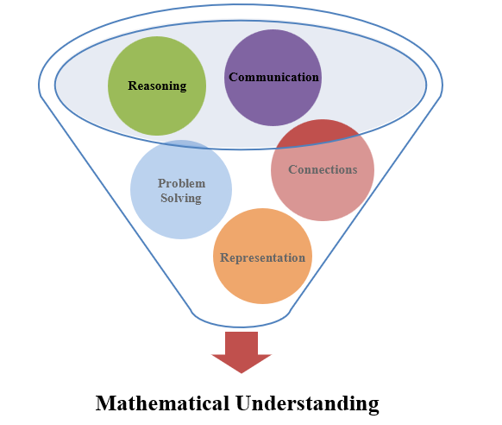
Mathematics Process Goals for Students
The content of the mathematics standards is intended to support the five process goals for students.
Notes:
The 2023 Mathematics Standards of Learning foster the application of the five mathematical process goals including reasoning, communication, problem solving, connections, and representation, and set students up to recognize and see mathematics in real-world applications. These processes support students in building an understanding of mathematics.

Slide 8
Standards of Learning Supporting Documents
Notes:
Virginia Department of Education documents supporting the transition to the 2023 Mathematics Standards of Learning will now be shared. Additional resources supporting the implementation of the 2023 Mathematics Standards of Learning will be made available on the VDOE Mathematics SOL website.

Slide 9
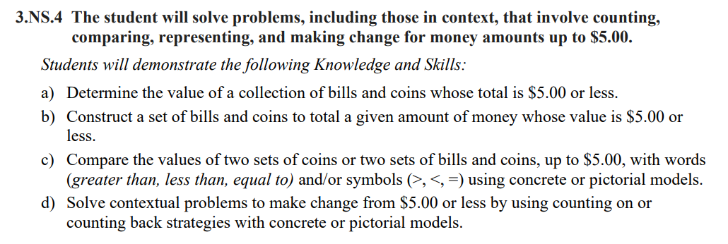
Standards Document
Notes:
The 2023 Mathematics Standards of Learning Document includes the standards and the knowledge and skills associated with each standard. This slide shows an example from the Grade 3 Standards Document.

Slide 10
Changes to Numbering of the SOL
Fourth standard within this strand
Grade 3
Number and Number Sense Strand
KEY: NS = Number and Number Sense; CE = Computation and Estimation; MG = Measurement and Geometry; PS = Probability and Statistics; PFA = Patterns, Functions, and Algebra
Notes:
The new numbering system for the standards makes it clear within which strand a standard exists. For instance, the sample shown on the screen highlights 3.NS.4. The number three indicates the grade level; NS indicates the Number and Number Sense Strand; and 4 indicates that this is the fourth standard of learning in this strand. The key shown at the bottom of the screen provides the abbreviations for each of the strands.

Slide 11
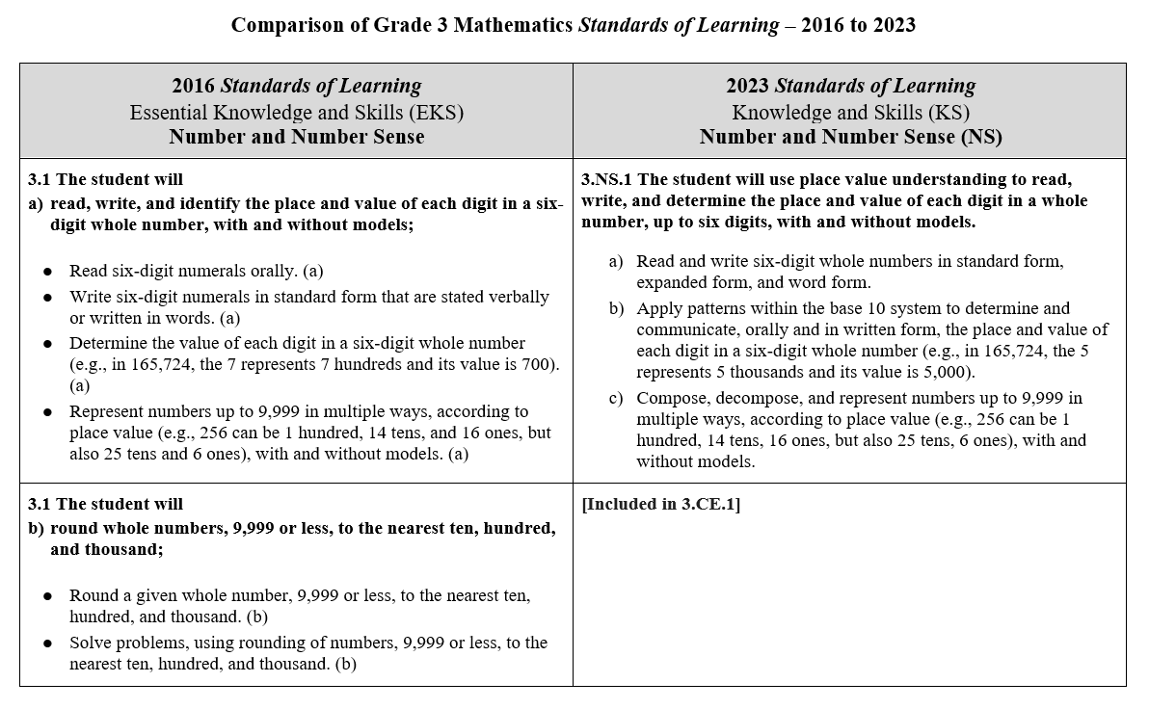
Overview of Revisions (2016 to 2023 Mathematics Standards of Learning) document
Notes:
An Overview of Revisions document has been created for each grade or course. This presentation provides a detailed comparison between the 2016 Standards of Learning and the 2023 Standards of Learning and is based upon the Overview of Revisions document, available on the VDOE Mathematics website.

Slide 12
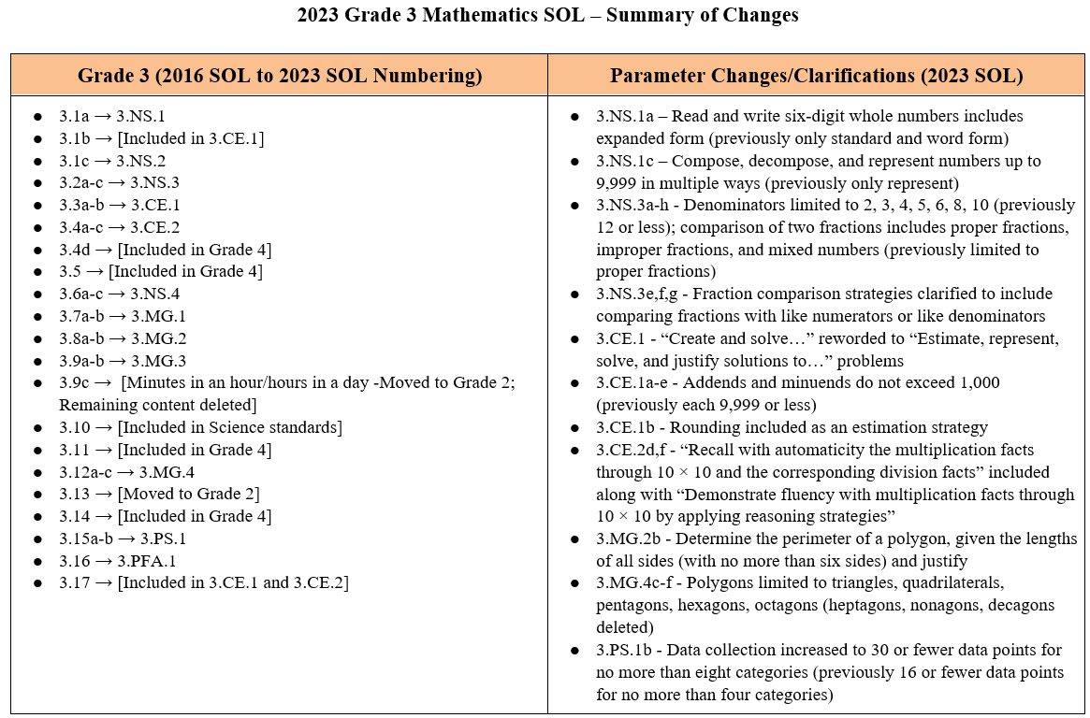
Overview of Revisions- Summary of Changes (1 of 2)
Notes:
At the end of the Overview of Revisions document there is a summary of changes table. One section of the table provides an overview of the changes to the numbering of the standards. Another section provides information regarding the prominent parameter changes and clarifications. Parameter changes and clarifications might be related to an increase or decrease in the limiters of the standards or the knowledge and skills; but might also be related to the depth of understanding of the content or scope of the content.

Slide 13
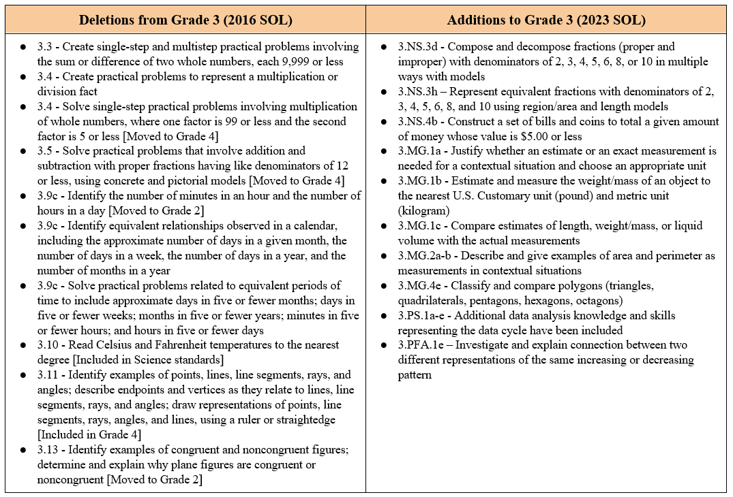
Overview of Revisions- Summary of Changes (2 of 2)
Notes:
The other two sections of the table include deletions from 2016 standards and any addition of content to the 2023 standards.

Slide 14
Comparison of 2016 Mathematics SOL to 2023 Mathematics SOL
Notes:
During the remainder of the presentation, we will take a closer look at the revisions to the 2016 standards that resulted in the new 2023 standards.

Slide 15
Number and Number Sense
Notes:
First, we will discuss the standards in the Grade 3 Number and Number Sense Strand.

Slide 16
Standard 3.1 (2016) - Standard 3.NS.1 (2023)
2016 SOL | 2023 SOL
3.1 The student will read, write, and identify the place and value of each digit in a six-digit whole number, with and without models; Read six-digit numerals orally. (a) Write six-digit numerals in standard form that are stated verbally or written in words. (a) Determine the value of each digit in a six-digit whole number (e.g., in 165,724, the 7 represents 7 hundreds and its value is 700). (a) Represent numbers up to 9,999 in multiple ways, according to place value (e.g., 256 can be 1 hundred, 14 tens, and 16 ones, but also 25 tens and 6 ones), with and without models. (a) | 3.NS.1 The student will use place value understanding to read, write, and determine the place and value of each digit in a whole number, up to six digits, with and without models. Read and write six-digit whole numbers in standard form, expanded form, and word form. Apply patterns within the base 10 system to determine and communicate, orally and in written form, the place and value of each digit in a six-digit whole number (e.g., in 165,724, the 5 represents 5 thousands and its value is 5,000). Compose, decompose, and represent numbers up to 9,999 in multiple ways, according to place value (e.g., 256 can be 1 hundred, 14 tens, 16 ones, but also 25 tens, 6 ones), with and without models.
Revisions:
Use the standard, word form and expanded form of six-digit numbers
Compose, decompose and represent numbers in a variety of ways
Notes:
SOL 3.1a in 2016 is now SOL 3.NS.1 in the 2023 Standards. Students will continue to use place value understanding to read and write the standard and word form of six-digit numbers. Additionally, students will need to understand the expanded form of six-digit numbers. Students will continue to represent numbers in a variety of ways as they compose and decompose numbers.

Slide 17
Standard 3.1 (2016) – Included in Standard 3.CE.1 (2023)
2016 SOL | 2023 SOL
3.1 The student will b) round whole numbers, 9,999 or less, to the nearest ten, hundred, and thousand; [Included in 3.CE.1] Round a given whole number, 9,999 or less, to the nearest ten, hundred, and thousand. (b) Solve problems, using rounding of numbers, 9,999 or less, to the nearest ten, hundred, and thousand. (b) | [Included in 3.CE.1]
Revisions:
Rounding whole numbers now embedded in the computation and estimation standards
Notes:
Rounding whole numbers, a part of SOL 3.1b in the 2016 standards is now embedded in the computation and estimation standard 3.CE.1 in the 2023 standards as a strategy for determining the solution to an addition, subtraction, multiplication or division problem.

Slide 18
Standard 3.1 (2016) - Standard 3.NS.2 (2023)
2016 SOL | 2023 SOL
3.1 The student will c) compare and order whole numbers, each 9,999 or less. Compare two whole numbers, each 9,999 or less, using symbols (>, <, =, or ≠) and/or words (greater than, less than, equal to, and not equal to). (c) Order up to three whole numbers, each 9,999 or less, represented with concrete objects, pictorially, or symbolically from least to greatest and greatest to least. (c) | 3.NS.2 The student will demonstrate an understanding of the base 10 system to compare and order whole numbers up to 9,999. Compare two whole numbers, each 9,999 or less, using symbols (>, <, =, ≠) and/or words (greater than, less than, equal to, not equal to), with and without models. Order up to three whole numbers, each 9,999 or less, represented with and without models, from least to greatest and greatest to least.
Revisions:
No significant changes between the 2016 and 2023 standard
Notes:
SOL 3.1c, comparing and ordering whole numbers, is now SOL 3.NS.2 in the 2023 standards. There are no significant changes in the content of this standard.

Slide 19
Standard 3.2 (2016) - Standard 3.NS.3 (2023) 1 of 2
2016 SOL | 2023 SOL
3.2 The student will name and write fractions and mixed numbers represented by a model; represent fractions and mixed numbers, with models and symbols; and Name and write fractions (proper and improper) and mixed numbers with denominators of 12 or less in symbols represented by concrete and/or pictorial models. (a) Represent a given fraction (proper or improper) and mixed numbers, using concrete or pictorial set, area/region, length/measurement models and symbols. (b) Identify a fraction represented by a model as the sum of unit fractions. (b) Using a model of a fraction greater than one, count the fractional parts to name and write it as an improper fraction and as a mixed number e.g., $\frac{1}{4}$, $\frac{2}{4}$, $\frac{3}{4}$, $\frac{4}{4}$, $\frac{5}{4}$ = 1$\frac{1}{4}$, or 2$\frac{1}{3}$ = $\frac{7}{3}$). (b) | 3.NS.3 The student will use mathematical reasoning and justification to represent and compare fractions (proper and improper) and mixed numbers with denominators of 2, 3, 4, 5, 6, 8, and 10), including those in context. Represent, name, and write a given fraction (proper or improper) or mixed number with denominators of 2, 3, 4, 5, 6, 8, and 10 using: i) region/area models (e.g., pie pieces, pattern blocks, geoboards); ii) length models (e.g., paper fraction strips, fraction bars, rods, number lines); and iii) set models (e.g., chips, counters, cubes). Identify a fraction represented by a model as the sum of unit fractions. Using a model of a fraction greater than one, count the fractional parts to name and write it as an improper fraction and as a mixed number (e.g., $\frac{1}{4}$, $\frac{2}{4}$, $\frac{3}{4}$, $\frac{4}{4}$, $\frac{5}{4}$ = 1 $\frac{1}{4}$). Compose and decompose fractions (proper and improper) with denominators of 2, 3, 4, 5, 6, 8, and 10 in multiple ways (e.g., $\frac{7}{4}$ = $\frac{4}{4}$ + $\frac{3}{4}$ or $\frac{4}{6}$ = $\frac{3}{6}$ + $\frac{1}{6}$ = $\frac{2}{6}$ + $\frac{2}{6}).$
Revisions:
Use mathematical reasoning and justification to represent and compare fractions and mixed numbers
Denominators previously 12 or less now limited to 2, 3, 4, 5, 6, 8, 10
Compose and decompose fractions (proper and improper) with denominators of 2, 3, 4, 5, 6, 8, and 10 in multiple ways
Notes:
SOL 3.2a-b in 2016 is now SOL 3.NS.3a-c in the 2023 Standards. Students will use mathematical reasoning and justify their fraction sense as they represent and compare proper and improper fractions as well as mixed numbers. Students should have experiences with fractions and mixed numbers with denominators of 2, 3, 4, 5, 6, 8, and 10 using the region/area, length and set models. These fractions and mixed numbers can be presented in context. Students will also use mathematical reasoning and justification to compose and decompose fractions (proper and improper) with denominators of 2, 3, 4, 5, 6, 8, and 10 in multiple ways.

Slide 20
Standard 3.2 (2016) - Standard 3.NS.3 (2023) 2 of 2
2016 SOL | 2023 SOL
3.2 The student will compare fractions having like and unlike denominators, using words and symbols (>, <, =, or ≠), with models. Compare a model of a fraction, less than or equal to one, to the benchmarks of 0, $\frac{1}{2}$, and 1. (c) Compare proper fractions using the terms greater than, less than, equal to, or not equal to and the symbols (<, >, =, and ≠). Comparisons are made between fractions with both like and unlike denominators, with concrete or pictorial models. (c) | 3.NS.3 The student will use mathematical reasoning and justification to represent and compare fractions (proper and improper) and mixed numbers with denominators of 2, 3, 4, 5, 6, 8, and 10), including those in context. Compare a fraction, less than or equal to one, to the benchmarks of 0, $\frac{1}{2}$, and 1 using area/region models, length models, and without models. Compare two fractions (proper or improper) and/or mixed numbers with like numerators of 2, 3, 4, 5, 6, 8, and 10 (e.g., $\frac{2}{3}$ > $\frac{2}{8}$) using words (greater than, less than, equal to) and/or symbols (>, <, =), using area/region models, length models, and without models. Compare two fractions (proper or improper) and/or mixed numbers with like denominators of 2, 3, 4, 5, 6, 8, and 10 (e.g., $\frac{3}{6}$ < $\frac{4}{6}$) using words (greater than, less than, equal to) and/or symbols (>, <, =), using area/region models, length models, and without models. Represent equivalent fractions with denominators of 2, 3, 4, 5, 6, 8, or 10, using region/area models and length models.
Revisions:
Comparison of two fractions includes proper fractions, improper fractions, and mixed numbers (previously limited to proper fractions)
Represent equivalent fractions with denominators of 2, 3, 4, 5, 6, 8, or 10 using region/area models and length models
Notes:
SOL 3.2c in 2016 is now 3.NS.3d-h in the 2023 Standards. Students will compare fractions to the benchmarks 0, 1 and ½ using area/region and length models. In addition, students will compare two fractions and/or mixed numbers with like numerators as well as fractions and mixed numbers with like denominators using the area/region and length models. Students will also represent equivalent fractions with denominators of 2, 3, 4, 5, 6, 8, or 10 using region/area models and length models.

Slide 21
Standard 3.6 (2016) - Standard 3.NS.4 (2023)
2016 SOL | 2023 SOL
[Previously 3.6 Measurement and Geometry] 3.6 The student will determine the value of a collection of bills and coins whose total value is $5.00 or less; compare the value of two sets of coins or two sets of coins and bills; and make change from $5.00 or less. Determine the value of a collection of coins and bills whose total value is $5.00 or less. (a) Compare the values of two sets of coins or two sets of coins and bills, up to $5.00, using the terms greater than, less than, and equal to. (b) Make change from $5.00 or less. (c) | 3.NS.4 The student will solve problems, including those in context, that involve counting, comparing, representing, and making change for money amounts up to $5.00. Determine the value of a collection of bills and coins whose total is $5.00 or less. Construct a set of bills and coins to total a given amount of money whose value is $5.00 or less. Compare the values of two sets of coins or two sets of bills and coins, up to $5.00, with words (greater than, less than, equal to) and/or symbols (>, <, =) using concrete or pictorial models. Solve contextual problems to make change from $5.00 or less by using counting on or counting back strategies with concrete or pictorial models.
Revisions:
Construct a set of bills and coins to total a given amount of money whose value is $5.00 or less
Notes:
SOL 3.6a-c found in the Measurement and Geometry strand in 2016 is now 3.NS.4, a part of the Number and Number Sense strand in 2023. Students will solve problems, including those in context that involve counting, comparing, representing and making change for amounts up to $5.00. A content addition is that students will now be expected to construct a set of bills and coins to total a given amount of money whose value is $5.00 or less.

Slide 22
Computation and Estimation
Notes:
Next, we will discuss the standards in the Grade 3 Computation and Estimation strand.

Slide 23
Standard 3.3 (2016) - Standard 3.CE.1 (2023) 1 of 2
2016 SOL | 2023 SOL
3.3 The student will estimate and determine the sum or difference of two whole numbers; and create and solve single-step and multistep practical problems involving sums or differences of two whole numbers, each 9,999 or less. Determine whether an estimate or an exact answer is an appropriate solution for practical addition and subtraction problems involving single-step and multistep problems. (a, b) Estimate the sum of two whole numbers with sums to 9,999. (a) Estimate the difference of two whole numbers, each 9,999 or less. (a) Apply strategies, including place value and the properties of addition, to add two whole numbers with sums to 9,999. (a, b) Apply strategies, including place value and the properties of addition, to subtract two whole numbers, each 9,999 or less. (a, b) | 3.CE.1 The student will estimate, represent, solve, and justify solutions to single-step and multistep problems, including those in context, using addition and subtraction with whole numbers where addends and minuends do not exceed 1,000. Determine and justify whether an estimate or an exact answer is appropriate when solving single-step and multistep contextual problems involving addition and subtraction, where addends and minuends do not exceed 1,000. Apply strategies, (e.g., rounding to the nearest 10 or 100, using compatible numbers, using other number relationships) to estimate a solution for single-step or multistep addition or subtraction problems, including those in context, where addends or minuends do not exceed 1,000. Apply strategies (e.g., place value, properties of addition, other number relationships) and algorithms, including the standard algorithm, to determine the sum or difference of two whole numbers where addends and minuends do not exceed 1,000.
Revisions:
Estimate, represent, solve, and justify solutions to single-step and multistep problems
Apply strategies and algorithms, including the standard algorithm
Whole numbers where addends and minuends do not exceed 1,000
Notes:
SOL 3.3a-b in 2016 is now SOL 3.CE.1a-e in the 2023 standards. In SOL 3.CE.1, students are asked to estimate, represent and justify their solution in addition to determining the answer to addition and subtraction problems. Students are expected to apply strategies and algorithms, including the standard algorithm, to determine the sum or difference. Whole number addends and minuends for this standard do not exceed 1,000, which is a change from the 2016 standards.

Slide 24
Standard 3.3 (2016) - Standard 3.CE.1 (2023) 2 of 2
2016 SOL | 2023 SOL
3.3 The student will estimate and determine the sum or difference of two whole numbers; and create and solve single-step and multistep practical problems involving sums or differences of two whole numbers, each 9,999 or less. Use inverse relationships between addition and subtraction facts to solve practical problems. (b) Create and solve single-step and multistep practical problems involving the sum or difference of two whole numbers, each 9,999 or less. (b) | 3.CE.1 The student will estimate, represent, solve, and justify solutions to single-step and multistep problems, including those in context, using addition and subtraction with whole numbers where addends and minuends do not exceed 1,000. Identify and use the appropriate symbol to distinguish between expressions that are equal and expressions that are not equal (e.g., 256 - 13 = 220 + 23; 457 + 100 ≠ 557 + 100). Represent, solve, and justify solutions to single-step and multistep contextual problems involving addition and subtraction with whole numbers where addends and minuends do not exceed 1,000.
Revisions:
Identify and use the appropriate symbol to distinguish between expressions that are equal and expressions that are not equal
Estimate, represent, solve, and justify solutions to single-step and multistep problems
Whole numbers where addends and minuends do not exceed 1,000
Notes:
SOL 3.17 in 2016 is now included in the Computation and Estimation Strand as 3.CE.1d in the 2023 standards. Students will Identify and use the appropriate symbol to distinguish between expressions that are equal and expressions that are not equal. The focus of SOL 3.CE.1 is for students to estimate, represent, solve, and justify solutions to single-step and multistep problems. A parameter change should be noted: students will now use whole numbers where addends and minuends do not exceed 1,000.

Slide 25
Standard 3.4a-c (2016) - Standard 3.CE.2 (2023) 1 of 2
2016 SOL | 2023 SOL
3.4 The student will represent multiplication and division through 10 × 10, using a variety of approaches and models; create and solve single-step practical problems that involve multiplication and division through 10 × 10; demonstrate fluency with multiplication facts of 0, 1, 2, 5, and 10; and Represent multiplication using a variety of approaches and models (e.g., repeated addition, equal-sized groups, arrays, equal jumps on a number line, skip counting). (a) Represent division using a variety of approaches and models (e.g., repeated subtraction, equal sharing, equal groups). (a) Write three related equations (fact sentences) when given one equation (fact sentence) for multiplication or division (e.g., given 6 × 7 = 42, write 7 × 6 = 42, 42 ÷ 7 = 6, and 42 ÷ 6 = 7. (a) | 3.CE.2 The student will recall with automaticity multiplication and division facts through 10 × 10; and represent, solve, and justify solutions to single-step contextual problems using multiplication and division with whole numbers. Represent multiplication and division of whole numbers through 10 × 10, including in a contextual situation, using a variety of approaches and models (e.g., repeated addition/subtraction, equal-sized groups/sharing, arrays, equal jumps on a number line, using multiples to skip count). Use inverse relationships to write the related facts connected to a given model for multiplication and division of whole numbers through 10 × 10.
Revisions:
Recall with automaticity multiplication and division facts through 10 × 10
Represent, solve, and justify solutions to single-step contextual problems that involve multiplication and division of whole numbers through 10 × 10
Create an equation to represent the mathematical relationship between equivalent expressions using multiplication and/or division facts
Notes:
SOL 3.4a-c in 2016 is now SOL 3.CE.2 in the 2023 Standards.

Slide 26
Standard 3.4a-c (2016) - Standard 3.CE.2 (2023) 2 of 2
2016 SOL | 2023 SOL
3.4 The student will represent multiplication and division through 10 × 10, using a variety of approaches and models; create and solve single-step practical problems that involve multiplication and division through 10 × 10; demonstrate fluency with multiplication facts of 0, 1, 2, 5, and 10; and Create practical problems to represent a multiplication or division fact. (b) Use multiplication and division basic facts to represent a given situation, using a number sentence. (b) Recognize and use the inverse relationship between multiplication and division to solve practical problems. (b) Solve single-step practical problems that involve multiplication and division of whole numbers through 10 × 10. (b) Demonstrate fluency with multiplication facts of 0, 1, 2, 5, and 10. (c) Apply strategies, including place value and the properties of multiplication and/or addition when multiplying and dividing whole numbers. (a, b, c, d) | 3.CE.2 The student will recall with automaticity multiplication and division facts through 10 × 10; and represent, solve, and justify solutions to single-step contextual problems using multiplication and division with whole numbers. Apply strategies, (e.g., place value, the properties of multiplication and/or addition) when multiplying and dividing whole numbers. Demonstrate fluency with multiplication facts through 10 × 10 by applying reasoning strategies (e.g., doubling, add-a-group, subtract-a-group, near squares, and inverse relationships). Represent, solve, and justify solutions to single-step contextual problems that involve multiplication and division of whole numbers through 10 × 10. Recall with automaticity the multiplication facts through 10 × 10 and the corresponding division facts. Create an equation to represent the mathematical relationship between equivalent expressions using multiplication and/or division facts through 10 × 10 (e.g., 4 × 3 = 14 - 2, 35 ÷ 5 = 1 × 7).
Revisions:
Recall with automaticity multiplication and division facts through 10 x 10
Represent, solve, and justify solutions to single-step contextual problems that involve multiplication and division of whole numbers through 10 × 10
Create an equation to represent the mathematical relationship between equivalent expressions using multiplication and/or division facts
Notes:
Students will continue to demonstrate fluency with multiplications facts. However, students will now recall with automaticity multiplication and division facts through 10 × 10. Students should have experiences solving single step-contextual problems to better understand multiplication and division of whole numbers through 10 × 10. From the 2016 standards, SOL 3.17, which states that students will create equations to represent equivalent mathematical relationships using multiplication and or division facts, is now included in the Computation and Estimation strand as SOL 3.CE.2g in the 2023 standards.

Slide 27
Standard 3.4d (2016) - Deleted (2023)
2016 SOL | 2023 SOL
3.4 The student will d) solve single-step practical problems involving multiplication of whole numbers, where one factor is 99 or less and the second factor is 5 or less. [Deleted; included in Grade 4] Solve single-step practical problems involving multiplication of whole numbers, where one factor is 99 or less and the second factor is 5 or less. (d) | [Included in Grade 4]
Revisions:
Solving single step-problems involving multiplication where one factor is 99 or less and the other is 5 or less has been removed from the Grade 3 mathematics standards
Notes:
SOL 3.4 has been deleted. Students will now solve single-step problems involving multiplication where one factor is 99 or less and the second factor is 5 or less in grade 4.

Slide 28
Standard 3.5 (2016) - Deleted (2023)
2016 SOL | 2023 SOL
3.5 The student will solve practical problems that involve addition and subtraction with proper fractions having like denominators of 12 or less. [Deleted; included in Grade 4] Solve practical problems that involve addition and subtraction with proper fractions having like denominators of 12 or less, using concrete and pictorial models representing area/regions (e.g., circles, squares, and rectangles), length/measurements (e.g., fraction bars and strips), and sets (e.g., counters). | [Included in Grade 4]
Revisions:
Solving practical problems involving addition and subtraction of proper fractions has been removed from the Grade 3 mathematics standards
Notes:
SOL 3.5 has been deleted. Students will now solve practical problems involving addition and subtraction of fractions in grade 4.

Slide 29
Measurement and Geometry
Notes:
We will now discuss the standards in the Grade 3 Measurement and Geometry strand.

Slide 30
Standard 3.6 (2016) - Moved to 3.NS.4 (2023)
2016 SOL | 2023 SOL
3.6 The student will determine the value of a collection of bills and coins whose total value is $5.00 or less; compare the value of two sets of coins or two sets of coins and bills; and make change from $5.00 or less. Determine the value of a collection of coins and bills whose total value is $5.00 or less. (a) Compare the values of two sets of coins or two sets of coins and bills, up to $5.00, using the terms greater than, less than, and equal to. (b) Make change from $5.00 or less. (c) | [Moved to 3.NS.4]
Revisions:
Determining the value of money, comparing sets and making change has been moved to the Number and Number Sense strand
Notes:
SOL 3.6 has been moved to the Number and Number Sense strand. It is now labeled as SOL 3.NS.4 and was discussed previously in this presentation.

Slide 31
Standard 3.7 (2016) - 3.MG.1 (2023)
2016 SOL | 2023 SOL
3.7 The student will estimate and use U.S. Customary and metric units to measure length to the nearest $\frac{1}{2}$ inch, inch, foot, yard, centimeter, and meter; and liquid volume in cups, pints, quarts, gallons, and liters. Estimate and use U.S. Customary and metric units to measure lengths of objects to the nearest $\frac{1}{2}$ inch, inch, foot, yard, centimeter, and meter. (a) Determine the actual measure of length using U.S. Customary and metric units to measure objects to the nearest $\frac{1}{2}$ inch, foot, yard, centimeter, and meter. (a) Estimate and use U.S. Customary and metric units to measure liquid volume to the nearest cup, pint, quart, gallon, and liter. (b) Determine the actual measure of liquid volume using U.S. Customary and metric units to measure to the nearest cup, pint, quart, gallon, and liter. (b) | 3.MG.1 The student will reason mathematically using standard units (U.S. Customary and metric) with appropriate tools to estimate and measure objects by length, weight/mass, and liquid volume to the nearest half or whole unit. Justify whether an estimate or an exact measurement is needed for a contextual situation and choose an appropriate unit. Estimate and measure: length of an object to the nearest U.S. Customary unit (12 inch, inch, foot, yard) and metric unit (centimeter, meter); weight/mass of an object to the nearest U.S. Customary unit (pound) and metric unit (kilogram); and liquid volume to the nearest U.S. Customary unit (cup, pint, quart, gallon) and metric unit (liter). Compare estimates of length, weight/mass, or liquid volume with the actual measurements.
Revisions:
Reason mathematically to estimate and measure weight/mass
Justify whether an estimate or an exact measurement is needed for a contextual situation and choose an appropriate unit
Compare estimates of length, weight/mass, or liquid volume with the actual measurements
Notes:
SOL 3.7 in 2016 is now SOL 3.MG.1 in the 2023 Standards. Students will reason mathematically to estimate and measure length and liquid volume. Students will now also estimate and measure weight or mass to the nearest pound or kilogram. Students will justify whether an estimate or an exact measurement is needed for a contextual situation and choose an appropriate unit, and will compare their estimates of length, weight, or liquid volume to the actual measurements.

Slide 32
Standard 3.8 (2016) - 3.MG.2 (2023)
2016 SOL | 2023 SOL
3.8 The student will estimate and measure the distance around a polygon in order to determine its perimeter using U.S. Customary and metric units; and count the number of square units needed to cover a given surface in order to determine its area. Estimate and use U.S. Customary and metric units to measure the distance around a polygon with no more than six sides to determine the perimeter. (a) Determine the area of a given surface by estimating and then counting the number of square units needed to cover the surface. (b) | 3.MG.2 The student will use multiple representations to estimate and solve problems, including those in context, involving area and perimeter (in both U.S. Customary and metric units). Solve problems, including those in context, involving area: describe and give examples of area as a measurement in contextual situations; and estimate and determine the area of a given surface by counting the number of square units, describe the measurement (using the number and unit) and justify the measurement. Solve problems, including those in context, involving perimeter: describe and give examples of perimeter as a measurement in contextual situations; estimate and measure the distance around a polygon (with no more than six sides) to determine the perimeter and justify the measurement; and given the lengths of all sides of a polygon (with no more than six sides), determine its perimeter and justify the measurement.
Revisions:
Describe and give examples of area and perimeter as a measurement in contextual situations
Given the lengths of all sides of a polygon, determine the perimeter
Notes:
SOL 3.8 in 2016 is now SOL 3.MG.2 in the 2023 Standards. Students will use multiple representations to estimate and solve problems involving area and perimeter. Experiences should provide students with opportunities to describe and give examples of area and perimeter as a measurement in contextual situations. Students are also expected to determine the perimeter of a polygon when given the lengths of all sides of the polygon.

Slide 33
Standard 3.9a,b (2016) - 3.MG.3 (2023)
2016 SOL | 2023 SOL
3.9 The student will tell time to the nearest minute, using analog and digital clocks; solve practical problems related to elapsed time in one-hour increments within a 12-hour period; and Tell time to the nearest minute, using analog and digital clocks. (a) Match a written time (e.g., 4:38, 7:09, 12:51) to the time shown on analog and digital clocks to the nearest minute. (a) Solve practical problems related to elapsed time in one-hour increments, within a 12-hour period (within a.m. or within p.m.): when given the beginning time and the ending time, determine the time that has elapsed; (b) when given the beginning time and amount of elapsed time in one-hour increments, determine the ending time; or (b) | 3.MG.3 The student will demonstrate an understanding of the concept of time to the nearest minute and solve single-step contextual problems involving elapsed time in one-hour increments within a 12-hour period. Tell and write time to the nearest minute, using analog and digital clocks. Match a written time (e.g., 4:38, 7:09, 12:51) to the time shown on analog and digital clocks to the nearest minute. Solve single-step contextual problems involving elapsed time in one-hour increments, within a 12-hour period (within a.m. or within p.m.) when given: the starting time and the ending time, determine the amount of time that has elapsed; the starting time and amount of elapsed time in one-hour increments, determine the ending time; or the ending time and the amount of elapsed time in one-hour increments, determine the starting time.
Revisions:
No significant changes between the 2016 and 2023 standard
Notes:
SOL 3.9a-b in 2016 is now SOL 3.MG.3 in the 2023 Standards. Students will demonstrate an understanding of the concept of time to the nearest minute. Students will continue to tell and write time, match times on analog and digital clocks and solve single-step contextual problems involving elapsed time in one-hour increments.

Slide 34
Standard 3.9c (2016) - Deleted (2023)
2016 SOL | 2023 SOL
3.9 The student will identify equivalent periods of time and solve practical problems related to equivalent periods of time. [deleted] Identify the number of minutes in an hour and the number of hours in a day. (c) Identify equivalent relationships observed in a calendar, including the approximate number of days in a given month (about 30), the number of days in a week, the number of days in a year (about 365 14 ), and the number of months in a year. (c) Solve practical problems related to equivalent periods of time to include: approximate days in five or fewer months; days in five or fewer weeks; months in five or fewer years; minutes in five or fewer hours; and hours in five or fewer days. (c) | [Minutes in an hour and hours in a day moved to Grade 2] [Equivalent relationships and practical problems related to equivalent periods of time deleted]
Revisions:
Identifying the number of minutes in an hour and the number of hours in a day has been moved to Grade 2
Identifying equivalent periods of time and solving practical problems has been removed from the Grade 3 mathematics standards
Notes:
SOL 3.9 in the 2016 standards includes identifying equivalent periods of time and solving practical problems related to equivalent periods of time. This content is no longer in the Grade 3 mathematics standards. Identifying the number of minutes in an hour and the number of hours in a day has been moved to Grade 2. Identifying equivalent relationships and solving practical problems related to equivalent periods of time has been deleted from the Grade 3 standards.

Slide 35
Standard 3.10 (2016) - deleted (2023)
2016 SOL | 2023 SOL
3.10 The student will read temperature to the nearest degree. [deleted] Read Celsius and Fahrenheit temperatures to the nearest degree using real thermometers, physical models, or pictorial representations. | [Included in Grade 3 Science standards]
Revisions:
Reading Celsius and Fahrenheit temperatures has been removed from the Grade 3 mathematics standards
Notes:
SOL 3.10 in the 2016 standards states that students will read temperature to the nearest degree. This content has been removed from the Grade 3 mathematics standards. It is included in the Grade 3 Science standards.

Slide 36
Standard 3.11 (2016) - Deleted (2023)
2016 SOL | 2023 SOL
3.11 The student will identify and draw representations of points, lines, line segments, rays, and angles. [deleted] Identify examples of points, lines, line segments, rays, and angles. Describe endpoints and vertices as they relate to lines, line segments, rays, and angles. Draw representations of points, line segments, rays, angles, and lines, using a ruler or straightedge. | [Included in Grade 4]
Revisions:
Identifying and drawing representations of points, lines, line segments, rays, and angles has been removed from the Grade 3 mathematics standards
Notes:
SOL 3.11 in the 2016 standards states that students will identify and draw representations of points, lines, line segments, rays, and angles. This content has been deleted from the Grade 3 standards and is included in the Grade 4 standards.

Slide 37
Standard 3.12 (2016) - 3.MG.4 (2023)
2016 SOL | 2023 SOL
3.12 The student will define polygon; identify and name polygons with 10 or fewer sides; and combine and subdivide polygons with three or four sides and name the resulting polygon(s). Define polygon. (a) Classify figures as polygons or not polygons. (a) Identify and name polygons with 10 or fewer sides in various orientations: triangle is a three-sided polygon; quadrilateral is a four-sided polygon; pentagon is a five-sided polygon; hexagon is a six-sided polygon; heptagon is a seven-sided polygon; octagon is an eight-sided polygon; nonagon is a nine-sided polygon; and decagon is a ten-sided polygon. (b) Combine no more than three polygons, where each has three or four sides, and name the resulting polygon. (c) Subdivide a three-sided or four-sided polygon into no more than three parts and name the resulting polygon(s). (c) | 3.MG.4 The student will identify, describe, classify, compare, combine, and subdivide polygons. Describe a polygon as a closed plane figure composed of at least three line segments that do not cross. Classify figures as polygons or not polygons and justify reasoning. Identify and describe triangles, quadrilaterals, pentagons, hexagons, and octagons in various orientations, with and without contexts. Identify and name examples of polygons (triangles, quadrilaterals, pentagons, hexagons, octagons) in the environment. Classify and compare polygons (triangles, quadrilaterals, pentagons, hexagons, octagons). Combine no more than three polygons, where each has three or four sides, and name the resulting polygon (triangles, quadrilaterals, pentagons, hexagons, octagons). Subdivide a three-sided or four-sided polygon into no more than three parts and name the resulting polygons.
Revisions:
Polygons are limited to triangles, quadrilaterals, pentagons, hexagons, and octagons
Classify and compare polygons
Notes:
SOL 3.12 in 2016 is now 3.MG.4 in the 2023 Standards. Polygons will be limited to triangles, quadrilaterals, pentagons, hexagons, and octagons. Heptagons, nonagons, and decagons are deleted from the grade 3 mathematics standards. In addition, students should have experiences classifying and comparing polygons.

Slide 38
Standard 3.13 (2016) - Deleted (2023)
2016 SOL | 2023 SOL
3.13 The student will identify and describe congruent and noncongruent figures. [Deleted; moved to Grade 2] Identify examples of congruent and noncongruent figures. Determine and explain why plane figures are congruent or noncongruent. | [Moved to Grade 2]
Revisions:
Identifying and describing congruent and noncongruent figures has been removed from the grade 3 mathematics standards
Notes:
SOL 3.13 in the 2016 standards states that students will identify and describe congruent and noncongruent figures. This content has been removed from the grade 3 mathematics standards and this skill is now included in Grade 2.

Slide 39
Probability and Statistics
Notes:
Next, we will discuss the standards in the Grade 3 Probability and Statistics strand.

Slide 40
Standard 3.14 (2016) - deleted (2023)
2016 SOL | 2023 SOL
3.14 The student will investigate and describe the concept of probability as a measurement of chance and list possible outcomes for a single event. [Deleted; included in Grade 4] Define probability as the measurement of chance that an event will happen. List all possible outcomes for a single event (e.g., heads and tails are the two possible outcomes of flipping a coin). Limit the number of outcomes to 12 or fewer. Describe the degree of likelihood of an outcome occurring using terms such as impossible, unlikely, equally likely, likely, and certain. | [Included in Grade 4]
Revisions:
Investigating and describing the concept of probability has been removed from the Grade 3 mathematics standards
Notes:
SOL 3.14 from the 2016 standards states that students will investigate and describe the concept of probability as a measurement of chance and list possible outcomes for a single event. This content has been removed from the Grade 3 mathematics standards and these skills are now included in Grade 4.

Slide 41
Standard 3.15 (2016) - 3.PS.1 (2023) 1 of 2
2016 SOL | 2023 SOL
3.15 The student will collect, organize, and represent data in pictographs or bar graphs; and read and interpret data represented in pictographs and bar graphs. Formulate questions to investigate. (a) Design data investigations to answer formulated questions, limiting the number of categories for data collection to four. (a) Collect and organize data, using various forms of data collections (e.g., surveys, polls, questionnaires, scientific experiments, observations). (a) Represent data in a pictograph (limited to 16 or fewer data points for no more than four categories). (a) Represent data in a bar graph (limited to 16 or fewer data points for no more than four categories). (a) label each axis on a bar graph and give the bar graph a title. Limit increments on the numerical axis to whole numbers representing multiples of 1, 2, 5, or 10. (a) | 3.PS.1 The student will apply the data cycle (formulate questions; collect or acquire data; organize and represent data; and analyze data and communicate results) with a focus on pictographs and bar graphs. Formulate questions that require the collection or acquisition of data. Determine the data needed to answer a formulated question and collect or acquire existing data (limited to 30 or fewer data points for no more than eight categories) using various methods (e.g., polls, observations, tallies). Organize and represent a data set using pictographs that include an appropriate title, labeled axes, and key. Each pictograph symbol should represent 1, 2, 5 or 10 data points. Organize and represent a data set using bar graphs with a title and labeled axes, with and without the use of technology tools. Determine and use an appropriate scale (increments limited to multiples of 1, 2, 5 or 10).
Revisions:
Apply the data cycle with an emphasis on pictographs and bar graphs
An increase in allowable number of data points (up to 30) and number of categories (up to 8) in data collection
Notes:
SOL 3.15 in 2016 is now SOL 3.PS.1 in the 2023 Standards. The student will apply the data cycle with a focus on pictographs and bar graphs. The data cycle requires students to formulate questions; collect or acquire data; organize and represent data; and analyze data and communicate results. Students should have experiences working with data limited to 30 or fewer data points for no more than eight categories. This is an increase from the 2016 standard which was limited to 16 or fewer data points for no more than four categories.

Slide 42
Standard 3.15 (2016) - 3.PS.1 (2023) 2 of 2
2016 SOL | 2023 SOL
3.15 The student will collect, organize, and represent data in pictographs or bar graphs; and read and interpret data represented in pictographs and bar graphs. Analyze data represented in pictographs and bar graphs, orally and in writing. (b) read the information presented on a bar or pictograph (e.g., the title, the categories, the description of the two axes). (b) Interpret information from pictographs and bar graphs, with up to 30 data points and up to eight categories, describe interpretation orally and by writing at least one sentence. (b) describe the categories of data and the data as a whole (e.g., data were collected on preferred ways to cook or prepare eggs — scrambled, fried, hard boiled, and egg salad); (b) identify parts of the data that have special characteristics, including categories with the greatest, the least, or the same (e.g., most students prefer scrambled eggs); and (b) select a correct interpretation of a graph from a set of interpretations, where one is correct and the remaining are incorrect. (b) | 3.PS.1 The student will apply the data cycle (formulate questions; collect or acquire data; organize and represent data; and analyze data and communicate results) with a focus on pictographs and bar graphs. Analyze data represented in pictographs and bar graphs, and communicate results orally and in writing: describe the categories of data and the data as a whole (e.g., data were collected on preferred ways to cook or prepare eggs - scrambled, fried, hard-boiled, and egg salad); identify parts of the data that have special characteristics, including categories with the greatest, the least, or the same (e.g., most students prefer scrambled eggs); make inferences about data represented in pictographs and bar graphs; use characteristics of the data to draw conclusions about the data and make predictions based on the data (e.g., it is unlikely that a third grader would like hard boiled eggs); and solve one- and two-step addition and subtraction problems using data from pictographs and bar graphs.
Revisions:
Solve one- and two-step addition and subtraction problems using data from pictographs and bar graphs
Notes:
As part of the data cycle, students will continue to analyze data represented in pictographs and bar graphs, and to communicate results orally and in writing. Additionally, students will make inferences about data represented in pictographs and bar graphs, will use characteristics of the data to draw conclusions about the data and make predictions based on the data, and will solve one- and two-step addition and subtraction problems using data from pictographs and bar graphs.

Slide 43
Patterns, Functions, and Algebra
Notes:
Next, we will discuss the standards in the Grade 3 Patterns, Functions, and Algebra strand.

Slide 44
Standard 3.16 (2016) - 3.Pfa.1 (2023)
2016 SOL | 2023 SOL
3.16 The student will identify, describe, create, and extend patterns found in objects, pictures, numbers, and tables. Identify and describe repeating and growing patterns using words, objects, pictures, numbers, and tables. Identify a missing term in a pattern (e.g., 4, 6, _, 10, 12, 14). Create repeating and growing patterns using objects, pictures, numbers, and tables. Extend or identify missing parts in repeating and growing patterns using objects, pictures, numbers, and tables. Solve problems that involve the application of input and output rules limited to addition and subtraction of whole numbers. When given the rule, determine the missing values in a list or table. (Rules will be limited to addition and subtraction of whole numbers.) | 3.PFA.1 The student will identify, describe, extend, and create increasing and decreasing patterns (limited to addition and subtraction of whole numbers), including those in context, using various representations. Identify and describe increasing and decreasing patterns using various representations (e.g., objects, pictures, numbers, number lines). Analyze an increasing or decreasing pattern and generalize the change to extend the pattern or identify missing terms using various representations. Solve contextual problems that involve identifying, describing, and extending patterns. Create increasing and decreasing patterns using objects, pictures, numbers, and number lines. Investigate and explain the connection between two different representations of the same increasing or decreasing pattern.
Revisions:
Repeating patterns and patterns found in tables has been removed from Grade 3 mathematics standards
Investigate and explain connections between various representations of growing patterns
Notes:
SOL 3.16 in the 2016 standards is now SOL 3.PFA.1 in the 2023 Standards. Students will identify, describe, extend, and create increasing and decreasing patterns (limited to addition and subtraction of whole numbers), including those in context, using various representations. Student should have experiences that require them to investigate and explain connections between various representations of growing patterns. Identifying, describing, creating, and extending repeating patterns has been removed from Grade 3 and is now included in Grades 1 and 2. Patterns in tables, including solving problems that involve the application of input and output rules and determining the missing values in a table, has been removed from Grade 3 and is now included in Grade 4.

Slide 45
Standard 3.17 (2016) – Moved to 3.CE.1 and 3.CE.2 (2023)
2016 SOL | 2023 SOL
3.17 The student will create equations to represent equivalent mathematical relationships. Identify and use the appropriate symbol to distinguish between expressions that are equal and expressions that are not equal (e.g., 256 - 13 = 220 + 23; 143 + 17 = 140 + 20; 457 + 100 ≠ 557 +100). Create equations to represent equivalent mathematical relationships (e.g., 4 × 3 = 14 - 2). | [Included in 3.CE.1 and 3.CE.2]
Revisions:
Identify and use the appropriate symbol to distinguish between expressions that are equal and expressions that are not equal moved to 3.CE.1
Create equations to represent equivalent mathematical relationships moved to 3.CE.2
Notes:
SOL 3.17 in the 2016 standards in now included in 3.CE.1 and 3.CE.2 in the 2023 Standards. Identifying and using the appropriate symbol to distinguish between expressions that are equal and expressions that are not equal has moved to 3.CE.1 while creating equations to represent equivalent mathematical relationships has moved to 3.CE.2. These standards were discussed previously in the presentation.

Slide 46
Questions?
Contact the
Virginia Department of Education’s Mathematics Team at vdoe.mathematics@doe.virginia.gov
Notes:
This concludes the presentation on the 2023 Grade 3 Mathematics Standards of Learning revisions. It may be helpful to refer back to this presentation as you are using the Overview of Revisions document to plan for instruction. Should you have any questions, feel free to contact the Virginia Department of Education's Mathematics Team at the email address shown on the screen.

