Slide 1
2023 Mathematics Standards of Learning
Grade 2
Overview of Revisions from 2016 to 2023
Notes:
Welcome to the Grade 2 presentation focused on the 2023 Mathematics Standards of Learning. The Proposed 2023 Mathematics Standards of Learning (SOL) were approved by the Board of Education on August 31, 2023.

Slide 2
Purpose
Overview of the 2023 Mathematics Standards of Learning
Highlight information in the Standards (including the Knowledge and Skills)
Referenced documents available at the Virginia Department of Education 2023 Mathematics Standards of Learning webpage.
Notes:
The purpose of this presentation is to provide a comparison of the 2016 mathematics standards of learning and the 2023 mathematics standards of learning and to highlight changes in the knowledge and skills.

Slide 3
Agenda
2023 Mathematics Standards of Learning Focus
Standards of Learning Supporting Documents
Standards of Learning Document
Overview of Revisions (2016 to 2023 Mathematics Standards of Learning) document
Comparison of 2016 to 2023 Standards
Number and Number Sense
Computation and Estimation
Measurement and Geometry
Probability and Statistics
Patterns, Functions, and Algebra
Notes:
During this presentation, information will be shared regarding the 2023 Mathematics Standards of Learning documents that are currently available and the focus of the 2023 standards. Then a detailed comparison of the 2016 standards to the newly adopted 2023 standards will be provided.

Slide 4
2023 Mathematics Standards of Learning Focus
Notes:
The focus of the 2023 Mathematics Standards of Learning are included in the following slides.

Slide 5
2023 Standards of Learning Focus
The Mathematics Standards of Learning:
Include challenging mathematics content;
Reinforce foundational mathematics skills;
Support the application of mathematical concepts; and
Build coherently in complexity across grade levels.
Notes:
The mathematics standards of learning include challenging mathematics content, reinforce foundational mathematics skills, support the application of mathematical concepts, and build coherently in complexity across grade levels.

Slide 6
2023 Mathematics SOL Guiding Principles
Raise the Floor; Remove the Ceiling
Ensure Every Student Builds Strong Mathematics Foundational Skills
Master Critical Content
Integrate Mathematics Across All Content Areas
Prepare Teachers to Teach Mathematics Accurately and Effectively
Apply Mathematics to Better Use Technology
Notes:
There are six Guiding Principles included in the Virginia’s 2023 Mathematics Standards of Learning document that represent the values and beliefs upon which the revised standards were created. Preparing Virginia’s students to pursue higher education, to compete in a modern workforce, and to be informed citizens requires rigorous mathematical knowledge and skills. Students must gain an understanding of fundamental ideas in number sense, computation, measurement, geometry, probability, data analysis and statistics, and algebra and functions, and they must develop proficiency in mathematical skills. The six guiding principles are as follows:
Raise the Floor; Remove the Ceiling
Ensure Every Student Builds Strong Mathematics Foundational Skills
Master Critical Content
Integrate Mathematics Across All Content Areas
Prepare Teachers to Teach Mathematics Accurately and Effectively
Apply Mathematics to Better Use Technology

Slide 7
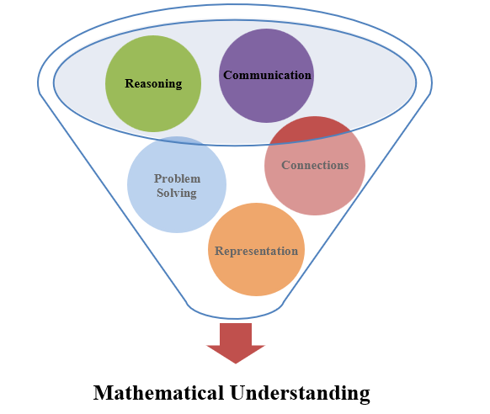
Mathematics Process Goals for Students
The content of the mathematics standards is intended to support the five process goals for students.
Notes:
The 2023 Mathematics Standards of Learning foster the application of the five mathematical process goals including reasoning, communication, problem solving, connections, and representation, and set students up to recognize and see mathematics in real-world applications. These processes support students in building understanding of mathematics.

Slide 8
Standards of Learning Supporting Documents
Notes:
Virginia Department of Education documents supporting the transition to the 2023 Mathematics Standards of Learning will now be shared. Additional resources supporting the implementation of the 2023 Mathematics Standards of Learning will be made available on the VDOE Mathematics SOL website.

Slide 9
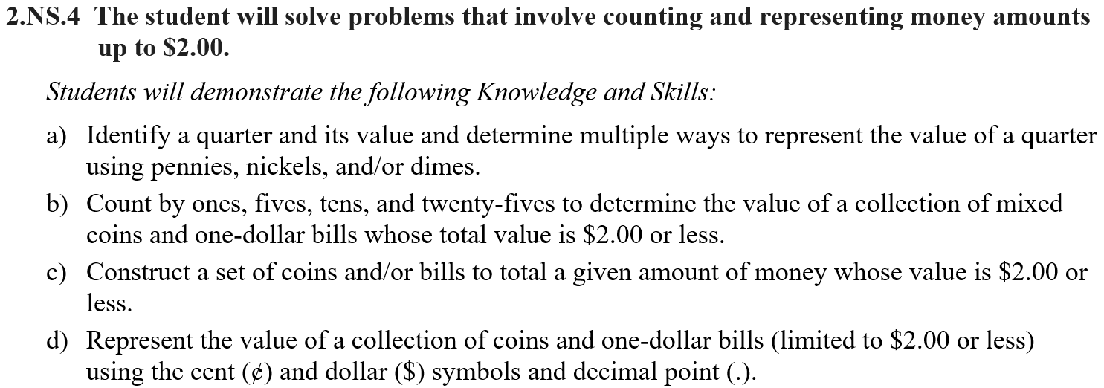
Standards Document
Notes:
The 2023 Mathematics Standards of Learning Document includes the standards and the knowledge and skills associated with each standard. This slide shows an example from the Grade 2 Standards Document.

Slide 10
Changes to Numbering of the SOL
Third SOL within this strand
Grade
Measurement & Geometry Strand
KEY: NS = Number and Number Sense; CE = Computation and Estimation; MG = Measurement and Geometry; PS = Probability and Statistics; PFA = Patterns, Functions, and Algebra
Notes:
The new numbering system for the standards makes it clear within which strand a standard exists. For instance, the sample shown on the screen highlights 2.MG.3. The number two indicates the grade level; MG indicates the Measurement and Geometry Strand; and 3 indicates that this is the third standard of learning in this strand. The key shown at the bottom of the screen provides the abbreviations for each of the strands.

Slide 11
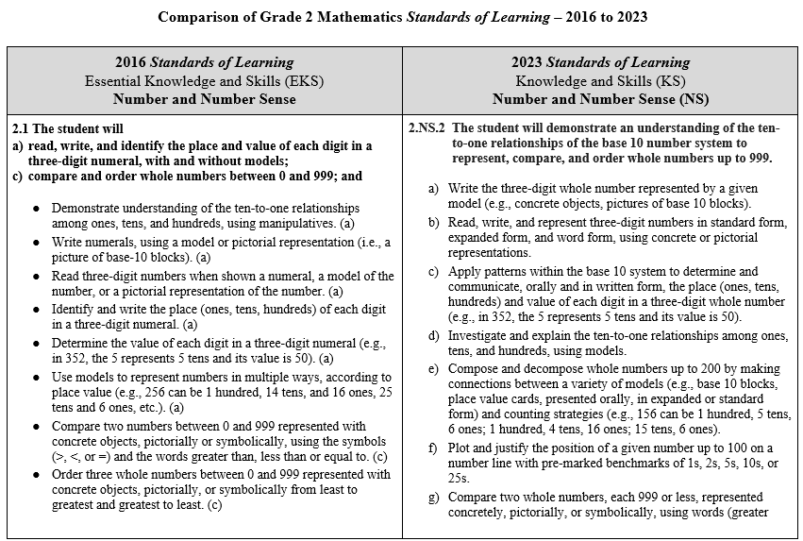
Overview of Revisions (2016 to 2023 Mathematics Standards of Learning) document
Notes:
An Overview of Revisions document has been created for each grade or course. This presentation provides a detailed comparison between the 2016 Standards of Learning and the 2023 Standards of Learning and is based upon the Overview of Revisions document.

Slide 12
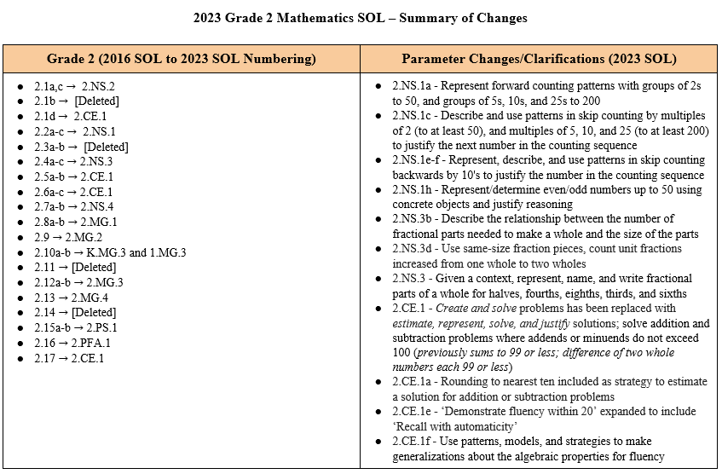
Overview of Revisions- Summary of Changes (1 of 2)
Notes:
At the end of the Overview of Revisions document there is a summary of changes table. One section of the table provides an overview of the changes to the numbering of the standards. Another section provides information regarding the prominent parameter changes and clarifications. Parameter changes and clarifications might be related to an increase or decrease in the limiters of the standards or the knowledge and skills; but might also be related to the depth of understanding of the content or scope of the content.

Slide 13
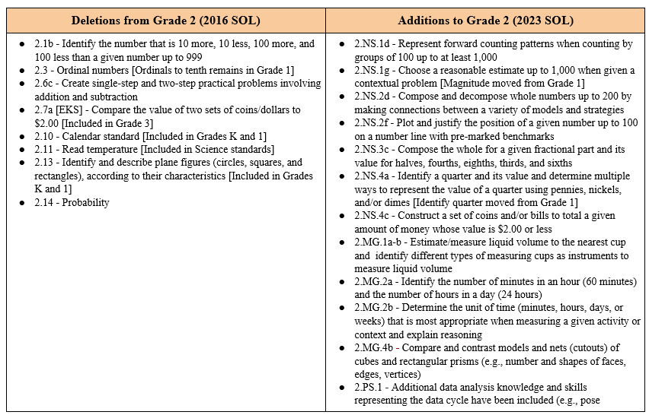
Overview of Revisions- Summary of Changes (2 of 2)
Notes:
The other two sections of the table include deletions from 2016 standards and any addition of content to the 2023 standards.

Slide 14
Comparison of 2016 Mathematics SOL to 2023 Mathematics SOL
Notes:
During the remainder of the presentation, we will take a closer look at the revisions to the 2016 standards that resulted in the new 2023 standards.

Slide 15
Number & Number Sense
Notes:
Let’s take a look at the Number and Number Sense Strand.

Slide 16
Standard 2.1a (2016) - Standard 2.ns.2 (2023)
2016 SOL | 2023 SOL
2.1 The student will read, write, and identify the place and value of each digit in a three-digit numeral, with and without models; identify the number that is 10 more, 10 less, 100 more, and 100 less than a given number up to 999; [Deleted; embedded in 2.NS.1] Demonstrate understanding of the ten-to-one relationships among ones, tens, and hundreds, using manipulatives. (a) Write numerals, using a model or pictorial representation (i.e., a picture of base-10 blocks). (a) Read three-digit numbers when shown a numeral, a model of the number, or a pictorial representation of the number. (a) Identify and write the place (ones, tens, hundreds) of each digit in a three-digit numeral. (a) Determine the value of each digit in a three-digit numeral (e.g., in 352, the 5 represents 5 tens and its value is 50). (a) Use models to represent numbers in multiple ways, according to place value (e.g., 256 can be 1 hundred, 14 tens, and 16 ones, 25 tens and 6 ones, etc.). (a) | 2.NS.2 The student will demonstrate an understanding of the ten-to-one relationships of the base 10 number system to represent, compare, and order whole numbers up to 999. Write the three-digit whole number represented by a given model (e.g., concrete objects, pictures of base 10 blocks). Read, write, and represent three-digit numbers in standard form, expanded form, and word form, using concrete or pictorial representations. Apply patterns within the base 10 system to determine and communicate, orally and in written form, the place (ones, tens, hundreds) and value of each digit in a three-digit whole number (e.g., in 352, the 5 represents 5 tens and its value is 50). Investigate and explain the ten-to-one relationships among ones, tens, and hundreds, using models. Compose and decompose whole numbers up to 200 by making connections between a variety of models (e.g., base 10 blocks, place value cards, presented orally, in expanded or standard form) and counting strategies (e.g., 156 can be 1 hundred, 5 tens, 6 ones; 1 hundred, 4 tens, 16 ones; 15 tens, 6 ones). Plot and justify the position of a given number up to 100 on a number line with pre-marked benchmarks of 1s, 2s, 5s, 10s, or 25s.
Revisions:
Identify the number that is 10 more, 10 less, 100 more, and 100 has been removed
Compose and decompose whole numbers up to 200 by making connections between a variety of models and strategies
Plot and justify the position of a given number up to 100 on a number line with pre-marked benchmarks
Notes:
Throughout this presentation red text in the 2023 column indicates a parameter change or addition to the content at this level. Red text in the 2016 column provides notes about where content may have been moved or deleted. You will also see symbols that indicate content that is NEW to the grade level or course.
SOL 2.1a content is now located in SOL 2.NS.2. A new expectation for Grade 2 students is composing and decomposing whole numbers up to 200 by making connections between a variety of models and counting strategies. See 2.NS.2e shown on the slide. In addition, students will also plot and justify the position for a given number up to 100 on a number line. Number lines should include pre-marked benchmarks of 1s, 2s, 5s, 10s, or 25s given to students to help understand and determine the magnitude of numbers.
SOL 2.1b - 10 more/10 less and 100 more/100 less has been removed and is embedded in the standard 2.NS.1 with the development of flexible counting strategies to determine and describe quantities which includes counting groups of 10 to 200 and groups of 100 to 1,000.

Slide 17
Standard 2.1c (2016) - Standard 2.NS.2 (2023)
2016 SOL | 2023 SOL
2.1 The student will compare and order whole numbers between 0 and 999; and round two-digit numbers to the nearest ten. [Embedded in 2.CE.1] Compare two numbers between 0 and 999 represented with concrete objects, pictorially or symbolically, using the symbols (>, <, or =) and the words greater than, less than or equal to. (c) Order three whole numbers between 0 and 999 represented with concrete objects, pictorially, or symbolically from least to greatest and greatest to least. (c) Round two-digit numbers to the nearest ten. (d) | 2.NS.2 The student will demonstrate an understanding of the ten-to-one relationships of the base 10 number system to represent, compare, and order whole numbers up to 999. Compare two whole numbers, each 999 or less, represented concretely, pictorially, or symbolically, using words (greater than, less than, or equal to) and symbols (>, <, or =). Justify reasoning orally, in writing, or with a model. Order up to three whole numbers, each 999 or less, represented concretely, pictorially, or symbolically from least to greatest and greatest to least.
Revisions:
Justify reasoning when comparing numbers
Round two-digit numbers embedded within the computation and estimation standard 2.CE.1
Notes:
The content of SOL 2.1c is now located in 2.NS.2 -- Students will continue to compare and order whole numbers up to 999. It is important to note that students should also justify their reasoning when comparing whole numbers. This can be done orally, in writing, or with a model.
SOL 2.1d rounding of two-digit numbers has been embedded within SOL 2.CE.1 as a strategy to estimate solutions for single step addition and subtraction problems.

Slide 18
Standard 2.2 (2016) - Standard 2.ns.1 (2023) – 1 of 2
2016 SOL | 2023 SOL
2.2 The student will count forward by twos, fives, and tens to 120, starting at various multiples of 2, 5, or 10; Determine patterns created by counting by twos, fives, and tens to 120 on number charts. (a) Describe patterns in skip counting and use those patterns to predict the next number in the counting sequence. (a) Skip count by twos, fives, and tens to 120 from various multiples of 2, 5 or 10, using manipulatives, a hundred chart, mental mathematics, a calculator, and/or paper and pencil. (a) Skip count by two to 120 starting from any multiple of 2. (a) Skip count by five to 120 starting at any multiple of 5. (a) Skip count by 10 to 120 starting at any multiple of 10. (a) | 2.NS.1 The student will utilize flexible counting strategies to determine and describe quantities up to 200. Represent forward counting patterns when counting by groups of 2 up to at least 50, starting at various multiples of 2 and using a variety of tools (e.g., objects, number lines, hundreds charts) Represent forward counting patterns created when counting by groups of 5s, 10s, and 25s starting at various multiples up to at least 200 using a variety of tools (e.g., objects, number lines, hundreds charts). Describe and use patterns in skip counting by multiples of 2 (to at least 50), and multiples of 5, 10, and 25 (to at least 200) to justify the next number in the counting sequence. Represent forward counting patterns when counting by groups of 100 up to at least 1,000 starting at 0 using a variety of tools (e.g., objects, number lines, calculators, one thousand charts).
Revisions:
Count forward extended to include representing and using patterns in skip counting to justify the next number in a counting sequence
Represent forward counting patterns by groups of 2 includes a parameter of at least 50
Represent forward counting patterns extended to include groups of 25 to at least 200
Represent forward counting patterns extended to include groups of 100 to at least 1,000
Notes:
SOL 2.2 is now 2.NS.1. In the 2023 standards, greater emphasis was placed on the development of flexible counting strategies to determine and describe quantities. Students will represent, describe, and use forward counting patterns in skip counting to justify the next number in the counting sequence.
Representing forward counting patterns by groups of 2 now includes a parameter of at least 50. The 2016 counting standard has been extended to include representing forward counting patterns by groups of 25 to 200 and groups of 100 to 1,000.
Tools such as objects, number lines, calculators, and hundred/thousands charts can be used to support the understanding of this standard.

Slide 19
Standard 2.2 (2016) - Standard 2.ns.1 (2023) – 2 of 2
2016 SOL | 2023 SOL
2.2 The student will count backward by tens from 120; and use objects to determine whether a number is even or odd. Count backward by 10 from 120. (b) Use objects to determine whether a number is even or odd (e.g., dividing collections of objects into two equal groups or pairing objects). (c) | 2.NS.1 The student will utilize flexible counting strategies to determine and describe quantities up to 200. Represent backward counting patterns when counting by groups of 10 from 200 or less using a variety of tools including objects, number lines, calculators, and hundreds charts. Describe and use patterns in skip counting backwards by 10s (from at least 200) to justify the next number in the counting sequence. Choose a reasonable estimate up to 1,000 when given a contextual problem (e.g., What would be the best estimate for the number of students in our school – 5, 50, or 500?). Represent even numbers (up to 50) with concrete objects, using two equal groups or two equal addends. Represent odd numbers (up to 50) with concrete objects, using two equal groups with one leftover or two equal addends plus 1. Determine whether a number (up to 50) is even or odd using concrete objects and justify reasoning (e.g., dividing collections of objects into two equal groups, pairing objects).
Revisions:
Represent backward counting patterns increased from 120 to 200 when skip counting backwards by groups of 10
Choose a reasonable estimate up to 1,000 when given a contextual problem
Represent and determine even/odd numbers up to 50 using concrete objects and justify reasoning
Notes:
Students will continue to count backwards by tens. In the 2023 standard, the parameter has increased from 120 to 200 when skip counting backwards by groups of 10.
Choosing a reasonable estimate up to 1,000 when given a contextual problem was moved from first grade to 2.NS.1. Students will determine the best estimate for situations like the number of students in a school with choices of 5, 50 or 500.
Students will still determine if a number is odd or even with a new parameter of numbers up to 50. This will be explored through representation along with justification of reasoning.

Slide 20
Standard 2.3 (2016) - Deleted
2016 SOL | 2023 SOL
2.3 The student will count and identify the ordinal positions first through twentieth, using an ordered set of objects; and write the ordinal numbers 1st through 20th. [Deleted; included in Grade 1] Count an ordered set of objects, using the ordinal number words first through twentieth. (a) Identify the ordinal positions first through twentieth, using an ordered set of objects presented in lines or rows from left to right; right to left; top to bottom; and bottom to top. (a) Write 1st, 2nd, 3rd, through 20th in numerals. (b)
Revisions:
Ordinal numbers has been removed
Notes:
SOL 2.3 has been removed from Grade 2. Students will continue to learn ordinal numbers first through tenth in Grade 1.

Slide 21
Standard 2.4 (2016) - Standard 2.NS.3 (2023) – 1 of 2
2016 SOL | 2023 SOL
2.4 The student will name and write fractions represented by a set, region, or length model for halves, fourths, eighths, thirds, and sixths; represent fractional parts with models and with symbols; and Recognize fractions as representing equal-size parts of a whole. (a) Name and write fractions represented by a set model showing halves, fourths, eighths, thirds, and sixths. (a, b) Name and write fractions represented by a region/area model showing halves, fourths, eighths, thirds, and sixths. (a, b) Name and write fractions represented by a length model showing halves, fourths, eighths, thirds, and sixths. (a, b) Represent, with models and with symbols, fractional parts of a whole for halves, fourths, eighths, thirds, and sixths, using: region/area models (e.g., pie pieces, pattern blocks, geoboards); sets (e.g., chips, counters, cubes); and length/measurement models (e.g., fraction strips or bars, rods, connecting cube trains). (b)stan | 2.NS.3 The student will use mathematical reasoning and justification to solve contextual problems that involve partitioning models into equal-sized parts (halves, fourths, eighths, thirds, and sixths). Model and describe fractions as representing equal-size parts of a whole. Describe the relationship between the number of fractional parts needed to make a whole and the size of the parts (i.e., as the whole is divided into more parts, each part becomes smaller). Compose the whole for a given fractional part and its value (in context) for halves, fourths, eighths, thirds, and sixths (e.g., when given 1/4 , determine how many pieces would be needed to make 4/4 ). Using same-size fraction pieces, from a region/area model, count by unit fractions up to two wholes (e.g., zero one-fourths, one one-fourth, two one-fourths, three one-fourths, four one-fourths, five one-fourths; or zero-fourths, one-fourth, two-fourths, three-fourths, four-fourths, five-fourths).
Revisions:
Describe the relationship between the number of fractional parts needed to make a whole and the size of the parts
Compose the whole for a given fractional part and its value for halves, fourths, eights, thirds, and sixths
Count by unit fractions increased to up to two wholes
Notes:
SOL 2.4 is now SOL 2.NS.3 - In the 2023 standards, greater emphasis has been placed on the development of conceptual understanding of fractions through representing, naming, and writing fractions when given a contextual problem. Students will now also model and describe fractions to understand equal size parts of the whole and the relationship between the number of fractional parts needed to make the whole. This will develop a sense of the fraction magnitude and the understanding of when the whole is divided into more parts, each part becomes smaller. To support the development of understanding how many pieces are needed to make a whole, students will also compose the whole given fractional parts such as halves, thirds, fourths, etc. Note that counting by unit fractions has been expanded to go beyond one whole and up to two wholes. This will enable students to see when a whole has been created and begins to develop an understanding of fractions greater than one which will be expanded upon in Grade 3.

Slide 22
Standard 2.4 (2016) - Standard 2.NS.3 (2023) – 2 of 2
2016 SOL | 2023 SOL
2.4 The student will compare the unit fractions for halves, fourths, eighths, thirds, and sixths, with models. Compare unit fractions for halves, fourths, eighths, thirds, and sixths), using words (greater than, less than or equal to) and symbols (>, <, =), with models. (c) Using same-size fraction pieces, from region/area models or length/measurement models, count the pieces (e.g., one-fourth, two-fourths, three-fourths, etc.) and compare those pieces to one whole (e.g., four-fourths will make one whole; one-fourth is less than a whole). (c) | 2.NS.3 The student will use mathematical reasoning and justification to solve contextual problems that involve partitioning models into equal-sized parts (halves, fourths, eighths, thirds, and sixths). Given a context, represent, name, and write fractional parts of a whole for halves, fourths, eighths, thirds, and sixths using: region/area models (e.g., pie pieces, pattern blocks, geoboards); length models (e.g., paper fraction strips, fraction bars, rods, number lines); and set models (e.g., chips, counters, cubes). Compare unit fractions for halves, fourths, eighths, thirds, and sixths using words (greater than, less than, or equal to) and symbols (>, <, =), with region/area and length models.
Revisions:
Compare unit fractions limited to area and length models
Notes:
In the 2023 standards, students will continue to compare unit fractions for halves, fourths, eighths, thirds, and sixths using the words greater than, less than, and equal along with the corresponding symbols. The area/region and length models are now specifically noted as students in Grade 2 will not be expected to compare unit fractions using set models.

Slide 23
Computation & Estimation
Notes:
We will now take a look at the Computation and Estimation Strand. The two Computation and Estimation standards from 2016 have been combined with equality to one standard 2.CE.1.

Slide 24
Standard 2.5 (2016) - Standard 2.CE.1 (2023)
2016 SOL | 2023 SOL
2.5 The student will recognize and use the relationships between addition and subtraction to solve single-step practical problems, with whole numbers to 20; and demonstrate fluency with addition and subtraction within 20. Recognize and use the relationship between addition and subtraction to solve single-step practical problems, with whole numbers to 20. (a) Determine the missing number in an equation (number sentence) (e.g., 3 + = 5 or + 2 = 5; 5 – = 3 or 5 – 2 = ). (a) Write the related facts for a given addition or subtraction fact (e.g., given 3 + 4 = 7, write 7 – 4 = 3 and 7 – 3 = 4). (a) Demonstrate fluency with addition and subtraction within 20. | 2.CE.1 The student will recall with automaticity addition and subtraction facts within 20 and estimate, represent, solve, and justify solutions to single-step and multistep problems, including those in context, using addition and subtraction with whole numbers where addends or minuends do not exceed 100. Demonstrate fluency with addition and subtraction within 20 by applying reasoning strategies (e.g., doubles, near doubles, make-a-ten, compensations, inverse relationships). Recall with automaticity addition and subtraction facts within 20. Use patterns, models, and strategies to make generalizations about the algebraic properties for fluency (e.g., 4 + 3 is equal to 3 + 4; 0 + 8 = 8). Determine the missing number in an equation (number sentence) through modeling and justification with addition and subtraction within 20 (e.g., 3 + = 5 or + 2 = 5; 5 – = 3 or 5 – 2 = ). Use inverse relationships to write all related facts connected to a given addition or subtraction fact model within 20 (e.g., given a model for 3 + 4 = 7, write 4 + 3 = 7, 7 – 4 = 3, and 7 – 3 = 4).
Revisions:
Recall addition and subtraction facts within 20
Notes:
SOL 2.5 is now 2.CE.1 - Students will continue to demonstrate fluency with addition and subtraction within 20 but are now expected to recall with automaticity.

Slide 25
Standard 2.6 (2016) - Standard 2.CE.1 (2023)
2016 SOL | 2023 SOL
2.6 The student will estimate sums and differences; determine sums and differences, using various methods; and create and solve single-step and two-step practical problems involving addition and subtraction. Estimate the sum of two whole numbers whose sum is 99 or less and recognize whether the estimation is reasonable (e.g., 27 + 41 is about 70, because 27 is about 30 and 41 is about 40, and 30 + 40 is 70). (a) Estimate the difference between two whole numbers each 99 or less and recognize whether the estimate is reasonable. (a) Determine the sum of two whole numbers whose sum is 99 or less, using various methods. (b) Determine the difference of two whole numbers each 99 or less, using various methods. (b) Create and solve single-step practical problems involving addition or subtraction. [Deleted] Create and solve two-step practical problems involving addition, subtraction, or both addition and subtraction. [Deleted] | 2.CE.1 The student will recall with automaticity addition and subtraction facts within 20 and estimate, represent, solve, and justify solutions to single-step and multistep problems, including those in context, using addition and subtraction with whole numbers where addends or minuends do not exceed 100. Apply strategies, including rounding to the nearest 10, using compatible numbers or other number relationships, to estimate a solution for single-step addition or subtraction problems, including those in context, where addends and minuends do not exceed 100. Apply strategies, including the use of concrete and pictorial models and place value, to determine the sum or difference of two whole numbers where addends or minuends do not exceed 100. Represent, solve, and justify solutions to single-step and multistep contextual problems (e.g., join, separate, part-whole, comparison) involving addition or subtraction of whole numbers where addends or minuends do not exceed 100.
Revisions:
Rounding is included as a strategy for estimating solutions to addition and subtraction problems
Parameter change for determining sums/differences and contextual problems - addends and minuends do not exceed 100
Create practical problems has been deleted
Notes:
SOL 2.6 is now 2.CE.1 - Students will continue to solve single-step and multi-step contextual problems but are now expected to represent and justify their solutions. It is important to note that the parameters for addition and subtraction problems have changed. In the 2023 standards, students will solve problems where the addends and minuends do not exceed 100. This means in an addition problem, the sum of two numbers can go up to 200. This change correlates to 2.NS.1 where students use flexible counting strategies to skip count to 200.
As pointed out in prior slides, rounding of two-digit numbers has been embedded within SOL 2.CE.1 as a strategy to estimate solutions for single step addition and subtraction problems. Other estimation strategies include using compatible numbers or other number relationships.
Creating single-step and two-step practical problems, using addition and subtraction has been removed from the 2016 standards.

Slide 26
Measurement and Geometry
Notes:
We will now take a look at the Measurement & Geometry strand.

Slide 27
Standard 2.7 (2016) - Standard 2.ns.4 (2023)
2016 SOL | 2023 SOL
2.7 The student will count and compare a collection of pennies, nickels, dimes, and quarters whose total value is $2.00 or less; and use the cent symbol, dollar symbol, and decimal point to write a value of money. Determine the value of a collection of coins and one-dollar bills whose total value is $2.00 or less. (a) Count by ones, fives, tens, and twenty-fives to determine the value of a collection of coins whose total value is $2.00 or less. (a) Compare the values of two sets of coins and one-dollar bills (each set having a total value of $2.00 or less), using the terms greater than, less than, or equal to. (a) [Deleted; included in Grade 3] Use the cent (¢) and dollar ($) symbols and decimal point (.) to write a value of money which is $2.00 or less. (b) | 2.NS.4 The student will solve problems that involve counting and representing money amounts up to $2.00. Identify a quarter and its value and determine multiple ways to represent the value of a quarter using pennies, nickels, and/or dimes. Count by ones, fives, tens, and twenty-fives to determine the value of a collection of mixed coins and one-dollar bills whose total value is $2.00 or less. Construct a set of coins and/or bills to total a given amount of money whose value is $2.00 or less. Represent the value of a collection of coins and one-dollar bills (limited to $2.00 or less) using the cent (¢) and dollar ($) symbols and decimal point (.).
Revisions:
Compare the value of two sets of coins/dollars to $2.00 has been removed from Grade 2
Identify a quarter and its value and determine multiple ways to represent the value of a quarter using pennies, nickels, and/or dimes
Construct a set of coins and/or bills to total a given amount of money whose value is $2.00 or less
Notes:
SOL 2.7 has moved from Measurement and Geometry to Number Sense 2.NS.4. Within this standard students will continue to solve problems that involve counting and representing money amounts up to $2.00.
From the 2016 2.7a [EKS] - Compare the value of two sets of coins/dollars to $2.00 was removed from Grade 2; comparing the value of two sets of coins up to $5.00 remains in Grade 3.
Identify a quarter and its value and determine multiple ways to represent the value of a quarter using pennies, nickels, and/or dimes was deleted from 1st grade and is now included in the Grade 2 mathematics standard.
In 2.NS.4 students will construct a set of coins and/or bills to total a given amount of money whose value is $2.00 or less. The skill of representing forward counting patterns created when counting by groups of 5s, 10s, and 25s (as previously shared in 2.NS.2) will contribute to students constructing and representing sets of coins to $2.00.

Slide 28
Standard 2.8 (2016) - 2.MG.1 (2023)
2016 SOL | 2023 SOL
2.8 The student will estimate and measure length to the nearest inch; and weight to the nearest pound. Identify a ruler as an instrument to measure length. (a) Estimate and then measure the length of various line segments and objects to the nearest inch using a ruler. (a) Identify different types of scales as instruments to measure weight. (b) Estimate and then measure the weight of objects to the nearest pound using a scale. (b) | 2.MG.1 The student will reason mathematically using standard units (U.S. Customary) with appropriate tools to estimate, measure, and compare objects by length, weight, and liquid volume to the nearest whole unit. Explain the purpose of various measurement tools and how to use them appropriately by: identifying a ruler as an instrument to measure length identifying different types of scales as instruments to measure weight; and identifying different types of measuring cups as instruments to measure liquid volume. Use U.S. Customary units to estimate, measure, and compare the two for reasonableness: the length of an object to the nearest inch, using a ruler; the weight of an object to the nearest pound, using a scale; and the liquid volume of a container to the nearest cup, using a measuring cup.
Revisions:
Estimate, measure, and compare liquid volume (to the nearest cup)
Estimate and measure, then compare the two for reasonableness
Notes:
SOL 2.8 is now SOL 2.MG.1.
Students will continue to estimate and measure length and weight. An addition to the 2023 standards is that students will measure liquid volume to the nearest whole unit. Students will identify measuring cups as instruments to accurately measure liquid volume.

Slide 29
Standard 2.9 (2016) - 2.MG.2 (2023)
2016 SOL | 2023 SOL
2.9 The student will tell time and write time to the nearest five minutes, using analog and digital clocks. Show, tell, and write time to the nearest five minutes, using an analog and digital clock. Match a written time (e.g., 4:20, 10:05, 1:50) to a time shown on a clock face to the nearest five minutes. Match the time (to the nearest five minutes) shown on a clock face to a written time. | 2.MG.2 The student will demonstrate an understanding of the concept of time to the nearest five minutes, using analog and digital clocks. Identify the number of minutes in an hour (60 minutes) and the number of hours in a day (24 hours). Determine the unit of time (minutes, hours, days, or weeks) that is most appropriate when measuring a given activity or context and explain reasoning (e.g., Would you measure the time it takes to brush your teeth in minutes or hours?). Show, tell, and write time to the nearest five minutes, using analog and digital clocks. Match a written time (e.g., 1:35, 6:20, 9:05) to the time shown on an analog clock to the nearest five minutes.
Revisions:
Identifying minutes in an hour and the number of hours in a day
Determine appropriate unit of time in context and explain reasoning
Notes:
SOL 2.9 is now located in SOL 2.MG.2 - Students will continue to demonstrate an understanding of time by showing, telling, writing, and matching times to the nearest five minutes using analog and digital clocks. Identifying the number of minutes in an hour and number of hours in a day moved from 3.9c (2016) to 2.MG.2 in the 2023 standards. In addition, students will determine the unit of time that is appropriate for given activities or contexts and will be expected to explain their reasoning.

Slide 30
Standard 2.10 (2016) - Deleted
2016 SOL | 2023 SOL
2.10 The student will determine past and future days of the week; and identify specific days and dates on a given calendar. [Deleted; included in Grade 1] Determine the day that is a specific number of days or weeks n the past or in the future from a given date, using a calendar. (a) Identify specific days and dates (e.g., What is the third Monday in a given month? What day of the week is May 11?). (b)
Revisions:
Determining past and future days of the weeks or specific days/dates on a calendar deleted from Grade 2
Notes:
SOL 2.10 the calendar standard skills have been deleted from Grade 2; this content is included in Grade 1.

Slide 31
Standard 2.11 (2016) - Deleted
2016 SOL | 2023 SOL
2.11 The student will read temperature to the nearest 10 degrees. [Deleted; Included in Science standards] Identify different types of thermometers as instruments used to measure temperature. Read temperature in Fahrenheit to the nearest ten degrees on thermometers (real world, physical model, and pictorial representations).
Revisions:
Temperature has been removed from Grade 2 mathematics standards
Notes:
SOL 2.11 has been deleted. Students will continue to use thermometers and read temperature as part of the Science standards.

Slide 32
Standard 2.12 (2016) - 2.MG.3 (2023)
2016 SOL | 2023 SOL
2.12 The student will draw a line of symmetry in a figure; and identify and create figures with at least one line of symmetry. Draw a line of symmetry in a figure. (a) Identify figures with at least one line of symmetry, using various concrete materials (e.g., mirrors, paper folding, pattern blocks). (b) Determine a line of symmetry that results in two figures that have the same size and shape and explain reasoning. (a, b) Create figures with at least one line of symmetry using various concrete materials. (b) | 2.MG.3 The student will identify, describe, and create plane figures (including circles, triangles, squares, and rectangles) that have at least one line of symmetry and explain its relationship with congruency. Explore a figure using a variety of tools (e.g., paper folding, geoboards, drawings) to show and justify a line of symmetry, if one exists. Create figures with at least one line of symmetry using various concrete and pictorial representations. Describe the two resulting figures formed by a line of symmetry as being congruent (having the same shape and size).
Revisions:
Congruency moved from Grade 3
Show and justify a line of symmetry
Use ‘congruent’ to describe the resulting figures formed by a line of symmetry
Notes:
The 2023 standard includes exploring a figure to show and justify a line of symmetry. This is done through the use of tools such as paper folding, geoboards and drawing. The 2016 standard 3.13, identify examples of congruent figures, has been included in 2.MG.3 to align with symmetry to develop the understanding of same shape and size.

Slide 33
Standard 2.13 (2016) - 2.MG.4 (2023)
2016 SOL | 2023 SOL
2.13 The student will identify, describe, compare, and contrast plane and solid figures (circles/spheres, squares/cubes, and rectangles/rectangular prisms). Determine similarities and differences between related plane and solid figures (circles/spheres, squares/cubes, rectangles/rectangular prisms), using models and cutouts. Trace faces of solid figures (cubes and rectangular prisms) to create the set of plane figures related to the solid figure. Identify and describe plane figures (circles, squares, and rectangles), according to their characteristics (number of sides, vertices, and angles). Squares and rectangles have four right angles. Identify and describe solid figures (spheres, cubes, and rectangular prisms), according to the shape of their faces, number of edges, and number of vertices, using models. Compare and contrast plane and solid figures (circles/spheres, squares/cubes, and rectangles/rectangular prisms) according to their characteristics (number and shape of their faces, edges, vertices, and angles). | 2.MG.4 The student will describe, name, compare, and contrast plane and solid figures (circles/spheres, squares/cubes, and rectangles/rectangular prisms). Trace faces of solid figures (cubes and rectangular prisms) to create the set of plane figures related to the solid figure. Compare and contrast models and nets (cutouts) of cubes and rectangular prisms (e.g., number and shapes of faces, edges, vertices). Given a concrete or pictorial model, name and describe the solid figure (sphere, cube, and rectangular prism) by its characteristics (e.g., number of edges, number of vertices, shapes of faces). Compare and contrast plane and solid figures (circles/spheres, squares/cubes, and rectangles/rectangular prisms) according to their characteristics (e.g., number and shapes of their faces, edges, vertices).
Revisions:
Compare and contrast models and nets of cubes and rectangular prisms
Notes:
SOL 2.13 is now SOL 2.MG.4 - When comparing and contrasting plane and solid figures according to characteristics, students will also compare and contrast models and nets, or cutouts, of cubes and rectangular prisms.

Slide 34
Probability and Statistics
Notes:
We will now take a look at the Probability and Statistics strand.

Slide 35
Standard 2.14 (2016) - Deleted
2016 SOL | 2023 SOL
2.14 The student will use data from probability experiments to predict outcomes when the experiment is repeated. [Deleted] Conduct probability experiments using multicolored spinners, colored tiles, or number cubes and use the data from the experiments to predict outcomes if the experiment is repeated. Record the results of probability experiments, using tables, charts, and tally marks. Interpret the results of probability experiments. Predict which of two events is more or less likely to occur if an experiment is repeated.
Revisions:
Probability has been removed from Grade 2
Notes:
SOL 2.14 has been removed from Grade 2. Probability instruction will now begin in Grade 4.

Slide 36
Standard 2.15 (2016) - 2.PS.1 (2023) – 1 of 2
2016 SOL | 2023 SOL
2.15 The student will collect, organize, and represent data in pictographs and bar graphs; and Collect and organize data using various forms of data collection (e.g., lists, tables, objects, pictures, symbols, tally marks, charts). Data points, collected by students, should be limited to 16 or fewer for no more than four categories. (a) Represent data in pictographs and bar graphs (limited to 16 or fewer data points for no more than four categories). (a) | 2.PS.1 The student will apply the data cycle (pose questions; collect or acquire data; organize and represent data; and analyze data and communicate results) with a focus on pictographs and bar graphs. Pose questions, given a predetermined context, that require the collection of data (limited to 25 or fewer data points for no more than six categories). Determine the data needed to answer a posed question and collect the data using various methods (e.g., voting; creating lists, tables, or charts; tallying). Organize and represent a data set using a pictograph where each symbol represents up to 2 data points. Determine and use a key to assist in the analysis of the data. Organize and represent a data set using a bar graph with a title and labeled axes (limited to 25 or fewer data points for up to six categories, and limit increments of scale to multiples of 1 or 2).
Revisions:
Pose questions that require the collection of data
Determine the data needed to answer a posed question
Data collected increased to 25 data points for no more than six categories
Notes:
SOL 2.15 is now SOL 2.PS.1 - Additional data analysis knowledge and skills representing the data cycle have been included. Students are now expected to pose questions that require data collection and determine the data needed to answer the formulated question.
When organizing and representing a data set, the parameter has been increased from 16 data points to 25 data points; this will enable the collection of data from an entire class of students. For instance, collecting data on favorite ice cream flavors to determine what ice cream might be purchased for an end-of-year party could represent all 25 students. In addition, the number of categories increased from four to six allowing for a larger number of choices.

Slide 37
Standard 2.15 (2016) - 2.PS.1 (2023) – 2 of 2
2016 SOL | 2023 SOL
2.15 The student will read and interpret data represented in pictographs and bar graphs. Read and interpret data represented in pictographs and bar graphs with up to 25 data points for no more than six categories (represented horizontally or vertically). State orally and in writing (at least one statement) that includes one or more of the following: Describes the categories of data and the data as a whole (e.g., adding together all data points will equal the total number of responses); Identifies parts of the data that have special characteristics; including categories with the greatest, the least, or the same; Uses the data to make comparisons; and Makes predictions and generalizations. (b) | 2.PS.1 The student will apply the data cycle (pose questions; collect or acquire data; organize and represent data; and analyze data and communicate results) with a focus on pictographs and bar graphs. Analyze data represented in pictographs and bar graphs and communicate results: ask and answer questions about the data represented in pictographs and bar graphs (e.g., total number of data points represented, how many in each category, how many more or less are in one category than another). Pictograph keys will be limited to symbols representing 1, 2, 5, or 10 pieces of data and bar graphs will be limited to scales with increments in multiples of 1, 2, 5, or 10; and draw conclusions about the data and make predictions based on the data.
Revisions:
Analyze data, ask and answer questions about the data and draw conclusions about the data
Notes:
As part of the data cycle, students are also expected to analyze, ask and answer questions, and draw conclusions about data in pictographs and bar graphs.

Slide 38
Patterns, Functions & Algebra
Notes:
Let’s take a look at the Patterns, Functions and Algebra strand.

Slide 39
Standard 2.16 (2016) - 2.PFA.1 (2023)
2016 SOL | 2023 SOL
2.16 The student will identify, describe, create, extend, and transfer patterns found in objects, pictures, and numbers. Identify a pattern as growing or repeating. Describe the core (the part of the sequence that repeats) of a given repeating pattern. Describe how a given growing pattern is changing. Create a growing or repeating pattern, using objects, pictures, or numbers. Extend a given pattern, using objects, pictures, or numbers. Transfer a given growing or repeating pattern from one form to another using objects, pictures, or numbers. | 2.PFA.1 The student will describe, extend, create, and transfer repeating and increasing patterns (limited to addition of whole numbers) using various representations. Identify and describe repeating and increasing patterns. Analyze a repeating or increasing pattern and generalize the change to extend the pattern using objects, pictures, and numbers. Create a repeating or increasing pattern using various representations (e.g., objects, pictures, numbers). Transfer a given repeating or increasing pattern from one form to another (e.g., objects, pictures, numbers) and explain the connection between the two patterns.
Revisions:
Growing patterns, are now referred to as increasing patterns
When transferring a pattern from one form to another, communicate the connection between the two patterns created
Notes:
SOL 2.16 is now SOL 2.PFA.1 - In the 2023 standards, students will continue to describe, extend, create and transfer both repeating and growing patterns. The vocabulary for “growing” has changed to “increasing” to be more specific. When transferring patterns, emphasis on the process goals of communication and connections are embedded as students explain the connection between two patterns.

Slide 40
Standard 2.17 (2016) - Standard 2.CE.1 (2023)
2016 SOL | 2023 SOL
2.17 The student will demonstrate an understanding of equality through the use of the equal symbol and the use of the not equal symbol. Identify the equal symbol (=) as the symbol used to indicate that the values on either side are equal. Identify the not equal symbol (≠) as the symbol used to indicate that two values on either side are not equal. Identify values and expressions that are equal (e.g., 8 = 8, 8 = 4 + 4). Identify values and expressions that are not equal (e.g., 8 ≠ 9, 4 + 3 ≠ 8). Identify and use the appropriate symbol to distinguish between equal and not equal quantities (e.g., 9 + 24 = 10 + 23; 45 –9 = 46 – 10; 15 + 16 ≠ 31 + 15). Use a model to represent the relationship of two expressions of equal value and two expressions that are not equivalent. | 2.CE.1 The student will recall with automaticity addition and subtraction facts within 20 and estimate, represent, solve, and justify solutions to single-step and multistep problems, including those in context, using addition and subtraction with whole numbers where addends or minuends do not exceed 100. Describe the not equal symbol (≠) as representing a relationship where expressions on either side of the not equal symbol represent different values and justify reasoning. Represent and justify the relationship between values and expressions as equal or not equal using appropriate models and/or symbols (e.g., 9 + 24 = 10 + 23; 45 - 9 = 46 - 10; 15 +16 ≠ 31 +15).
Revisions:
Describe the not equal symbol as representing a relationship
Justify the relationship between values and expressions
Notes:
The content from SOL 2.17 has been moved from Patterns, Functions and Algebra to the Computation and Estimation standard 2.CE.1. Students will continue to represent the relationship of two expressions using the equal and not equal symbols; in addition, they will now also describe the not equal symbol as representing different values; students will continue to represent (and will now also justify) the relationship between values and expressions as equal and not equal.

Slide 41
Questions?
Contact the
Virginia Department of Education’s Mathematics Team at vdoe.mathematics@doe.virginia.gov
Notes:
This concludes the presentation on the 2023 Grade 2 Mathematics Standards of Learning revisions. It may be helpful to refer back to this presentation as you are using the Overview of Revisions document to plan for instruction. Should you have any questions, feel free to contact the Virginia Department of Education's Mathematics Team at the email address shown on the screen.

