Slide 1
2023 Mathematics Standards of Learning
Grade 1
Overview of Revisions from 2016 to 2023
Notes:
Welcome to the Grade 1 presentation focused on the 2023 Mathematics Standards of Learning. The Proposed 2023 Mathematics Standards of Learning (SOL) were approved by the Board of Education on August 31, 2023.

Slide 2
Purpose
Overview of the 2023 Mathematics Standards of Learning
Highlight information in the Standards (including the Knowledge and Skills)
Referenced documents available at the Virginia Department of Education 2023 Mathematics Standards of Learning webpage.
Notes:
The purpose of this presentation is to provide a comparison of the 2016 mathematics standards of learning and the 2023 mathematics standards of learning and to highlight changes in the knowledge and skills.

Slide 3
Agenda
2023 Mathematics Standards of Learning Focus
Standards of Learning Supporting Documents
Standards of Learning Document
Overview of Revisions (2016 to 2023 Mathematics Standards of Learning) document
Comparison of 2016 to 2023 Standards
Number and Number Sense
Computation and Estimation
Measurement and Geometry
Probability and Statistics
Patterns, Functions, and Algebra
Notes:
During this presentation, information will be shared regarding the 2023 Mathematics Standards of Learning documents that are currently available and the focus of the 2023 standards. Then a detailed comparison of the 2016 standards to the newly adopted 2023 standards will be provided.

Slide 4
2023 Mathematics Standards of Learning Focus
Notes:
The focus of the 2023 Mathematics Standards of Learning are included in the following slides.

Slide 5
2023 Standards of Learning Focus
The Mathematics Standards of Learning:
Include challenging mathematics content;
Reinforce foundational mathematics skills;
Support the application of mathematical concepts; and
Build coherently in complexity across grade levels.
Notes:
The mathematics standards of learning include challenging mathematics content, reinforce foundational mathematics skills, support the application of mathematical concepts, and build coherently in complexity across grade levels.

Slide 6
2023 Mathematics SOL Guiding Principles
Raise the Floor; Remove the Ceiling
Ensure Every Student Builds Strong Mathematics Foundational Skills
Master Critical Content
Integrate Mathematics Across All Content Areas
Prepare Teachers to Teach Mathematics Accurately and Effectively
Apply Mathematics to Better Use Technology
Notes:
There are six Guiding Principles included in the Virginia’s 2023 Mathematics Standards of Learning document that represent the values and beliefs upon which the revised standards were created. Preparing Virginia’s students to pursue higher education, to compete in a modern workforce, and to be informed citizens requires rigorous mathematical knowledge and skills. Students must gain an understanding of fundamental ideas in number sense, computation, measurement, geometry, probability, data analysis and statistics, and algebra and functions, and they must develop proficiency in mathematical skills. The six guiding principles are as follows:
Raise the Floor; Remove the Ceiling:
Ensure Every Student Builds Strong Mathematics Foundational Skills:
Master Critical Content:
Integrate Mathematics Across All Content Areas:
Prepare Teachers to Teach Mathematics Accurately and Effectively:
Apply Mathematics to Better Use Technology:

Slide 7
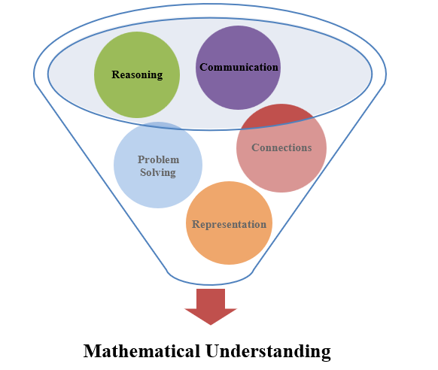
Mathematics Process Goals for Students
The content of the mathematics standards is intended to support the five process goals for students.
Notes:
The 2023 Mathematics Standards of Learning foster the application of the five mathematical process goals including reasoning, communication, problem solving, connections, and representation, and set students up to recognize and see mathematics in real-world applications. These processes support students in building understanding of mathematics.

Slide 8
Standards of Learning Supporting Documents
Notes:
Virginia Department of Education documents supporting the transition to the 2023 Mathematics Standards of Learning will now be shared. Additional resources supporting the implementation of the 2023 Mathematics Standards of Learning will be made available on the VDOE Mathematics SOL website.

Slide 9
Standards Document
Notes:
The 2023 Mathematics Standards of Learning Document includes the standards and the knowledge and skills associated with each standard. This slide shows an example from the Grade 1 Standards Document.

Slide 10
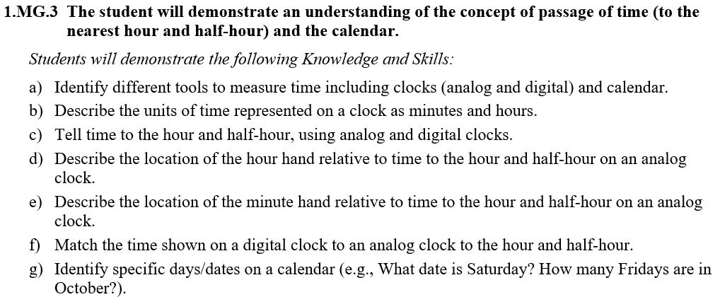
Changes to Numbering of the SOL
Third SOL within this strand
Grade
Measurement & Geometry Strand
KEY: NS = Number and Number Sense; CE = Computation and Estimation; MG = Measurement and Geometry; PS = Probability and Statistics; PFA = Patterns, Functions, and Algebra
Notes:
The new numbering system for the standards makes it clear within which strand a standard exists. For instance, the sample shown on the screen highlights 1.MG.3. The number one indicates the grade level; MG indicates the Measurement and Geometry Strand; and 3 indicates that this is the third standard of learning in this strand. The key shown at the bottom of the screen provides the abbreviations for each of the strands.

Slide 11
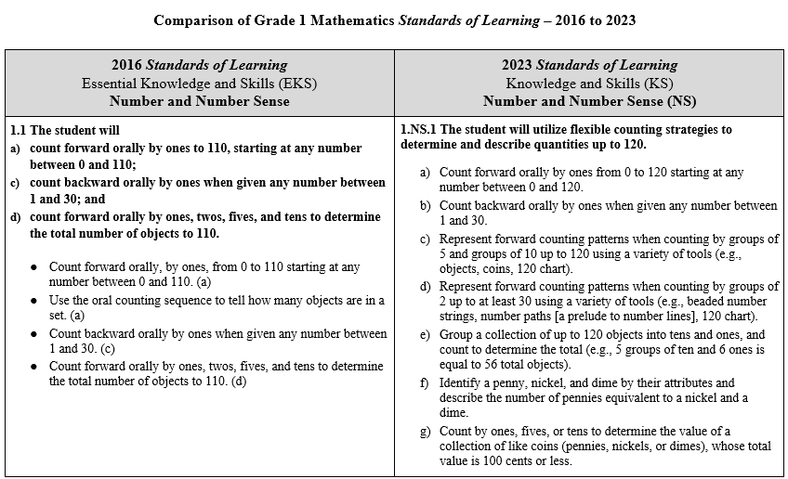
Overview of Revisions (2016 to 2023 Mathematics Standards of Learning) document
Notes:
An Overview of Revisions document has been created for each grade or course. This presentation provides a detailed comparison between the 2016 Standards of Learning and the 2023 Standards of Learning and is based upon the Overview of Revisions document.

Slide 12
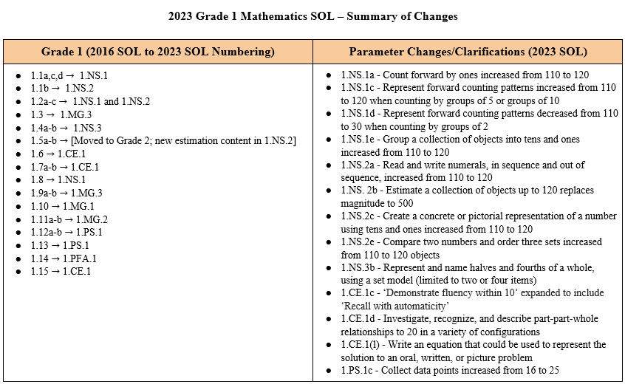
Overview of Revisions- Summary of Changes (1 of 2)
Notes:
At the end of the Overview of Revisions document there is a summary of changes table. One section of the table provides an overview of the changes to the numbering of the standards. Another section provides information regarding the prominent parameter changes and clarifications. Parameter changes and clarifications might be related to an increase or decrease in the limiters of the standards or the knowledge and skills; but might also be related to the depth of understanding of the content or scope of the content.

Slide 13
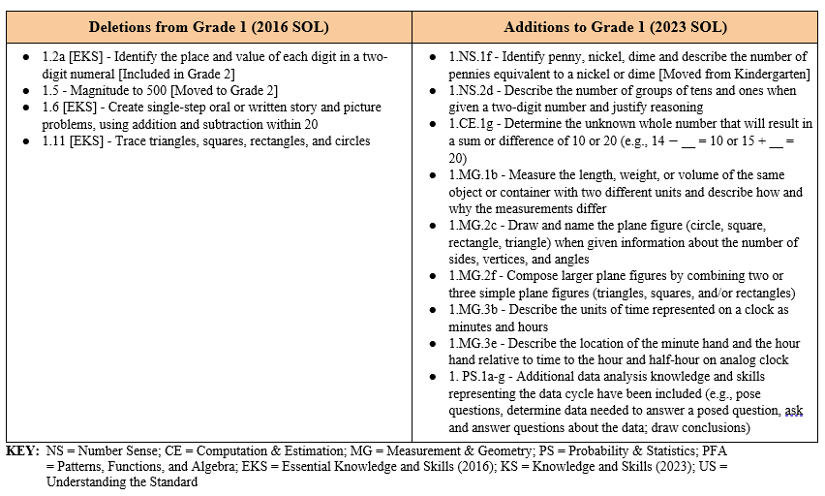
Overview of Revisions- Summary of Changes (2 of 2)
Notes:
The other two sections of the table include deletions from 2016 standards and addition of content to the 2023 standards.

Slide 14
Comparison of 2016 Mathematics SOL to 2023 Mathematics SOL
Notes:
During the remainder of the presentation, we will take a closer look at the revisions to the 2016 standards that resulted in the new 2023 standards.

Slide 15
Number & Number Sense
Notes:
Let’s take a look at the Number and Number Sense Strand.

Slide 16
Standard 1.1a,c,d (2016) - Standard 1.NS.1 (2023)
2016 SOL | 2023 SOL
1.1 The student will count forward orally by ones to 110, starting at any number between 0 and 110; count backward orally by ones when given any number between 1 and 30; and count forward orally by ones, twos, fives, and tens to determine the total number of objects to 110. Count forward orally, by ones, from 0 to 110 starting at any number between 0 and 110. (a) Use the oral counting sequence to tell how many objects are in a set. (a) Count backward orally by ones when given any number between 1 and 30. (c) Count forward orally by ones, twos, fives, and tens to determine the total number of objects to 110. (d) | 1.NS.1 The student will utilize flexible counting strategies to determine and describe quantities up to 120. Count forward orally by ones from 0 to 120 starting at any number between 0 and 120. Count backward orally by ones when given any number between 1 and 30. Represent forward counting patterns when counting by groups of 5 and groups of 10 up to 120 using a variety of tools ( e.g., objects, coins, 120 chart). Represent forward counting patterns when counting by groups of 2 up to at least 30 using a variety of tools (e.g., beaded number strings, number paths (a prelude to number lines), 120 chart). Group a collection of up to 120 objects into tens and ones, and count to determine the total (e.g., 5 groups of ten and 6 ones is equal to 56 total objects).
Revisions:
Count forward orally by ones increased from 110 to 120
Represent forward counting patterns decreased from 110 to 30 when counting by groups of 2
Represent forward counting patterns increased from 110 to 120 when counting by groups of 5 or groups of 10
Group a collection of objects by tens and ones increased from 110 to 120
Notes:
Throughout this presentation red text in the 2023 column indicates a parameter change or addition to the content at this level. Red text in the 2016 column provides notes about where content may have been moved or deleted. You will also see symbols that indicate content that is NEW to the grade level or course.
SOL 1.1a, c and d have become 1.NS.1.
1.NS.1 includes several parameter changes -- Counting forward orally by ones has been increased from 110 to 120. Students should be able to count forward starting at any number between 0 and 120.
Represent forward counting patterns by groups of 5 and groups of 10 has increased from 110 to 120. The expectation for representing skip counting by two is limited to a total number of objects up to 30. When representing skip counting it is recommended that tools, such as objects, coins, number paths, beaded number strings, and 120 charts be used to support student understanding of these standards. Students should also be able to group a collection of up to 120 objects into tens and ones and counting the groups of tens and ones in order to determine the total.

Slide 17
Standard 1.1b and 1.2a-c (2016) - Standard 1.NS.2 (2023)
2016 SOL | 2023 SOL
1.1 The student will write the numerals 0 to 110 in sequence and out-of-sequence; Write numerals 0-110 in sequence and out of sequence. (b) 1.2 The student, given up to 110 objects, will group a collection into tens and ones and write the corresponding numeral; compare two numbers between 0 and 110 represented pictorially or with concrete objects, using the words greater than, less than or equal to; and order three or fewer sets from least to greatest and greatest to least. Group a collection of up to 110 objects into sets of tens and ones. (a) Write the numeral that corresponds to the total number of objects in a given collection of up to 110 objects that have been grouped into sets of tens and ones. (a) | 1.NS.2 The student will represent, compare, and order quantities up to 120. Read and write numerals 0-120 in sequence and out of sequence. Estimate the number of objects (up to 120) in a given collection and justify the reasonableness of an answer. Create a concrete or pictorial representation of a number using tens and ones and write the corresponding numeral up to 120 (e.g., 47 can be represented as 47 ones or it can be grouped into 4 tens with 7 ones leftover). Describe the number of groups of tens and ones when given a two-digit number and justify reasoning.
Revisions:
Read and write numerals, in sequence and out of sequence increased from 110 to 120
Estimate a collection of objects up to 120 replaces magnitude to 500
Create a concrete or pictorial representation of a number using tens and ones increased from 110 to 120
Describe the number of groups of tens and ones when given a two-digit number and justify reasoning
Notes:
SOL 1.1b and SOL 1.2a, b, and c have become SOL1.NS.2.
The expectations for representing, comparing and ordering quantities increased from 110 to 120. Students are expected to estimate a collection of up to 120 objects and to justify the reasonableness of an answer. This replaces the former magnitude standards for Grade 1 and brings the expectation for estimation in line with the number of objects students are working with at this level. The parameters around the place value understanding have been expanded from the 2016 expectation where students were to identify the number of tens and ones that can be made from any number to 100 to the 2023 expectation where they will create a concrete or pictorial representation of a number and describe the number of groups of tens and ones when given a two-digit number as well as justify their reasoning.

Slide 18
Standard 1.2 (2016) - Standard 1.NS.2 (2023)
2016 SOL | 2023 SOL
1.2 The student, given up to 110 objects, will group a collection into tens and ones and write the corresponding numeral; [Deleted; Included in Grade 2] compare two numbers between 0 and 110 represented pictorially or with concrete objects, using the words greater than, less than or equal to; and order three or fewer sets from least to greatest and greatest to least. Compare two numbers between 0 and 110 represented pictorially or with concrete objects, using the words greater than, less than or equal to. (b) Order three or fewer sets, each set containing up to 110 objects, from least to greatest and greatest to least. (c) | 1.NS.2 The student will represent, compare, and order quantities up to 120. Compare two numbers between 0 and 120 represented pictorially and with concrete objects using the terms greater than, less than, or equal to. Order three sets, each set containing up to 120 objects, from least to greatest, and greatest to least.
Revisions:
Compare two numbers and order three sets increased from 110 to 120 objects
Identify the place and value of each digit in a two-digit numeral has been removed
Notes:
In SOL 1.NS.2, comparing and ordering numbers increased from 110 to 120 objects.
Students will compare two numbers between 0-120 represented pictorially or with concrete objects, using the words greater than, less than, or equal to. Students are not expected to use the symbols for greater than, less than, or equal until second grade. When ordering sets of objects, the number of sets continue to be limited to three, with each set containing up to 120 objects. Identifying the place and value of each digit in a two-digit numeral has been removed from Grade 1 and is included in Grade 2.

Slide 19
Standard 1.3 (2016) - Standard 1.MG.3 (2023)
2016 SOL | 2023 SOL
1.3 The student, given an ordered set of ten objects and/or pictures, will indicate the ordinal position of each object, first through tenth. Identify the ordinal positions first through tenth using ordered sets of 10 objects and/or pictures of such sets presented from: left to right; right to left; top to bottom; and/or bottom to top. | 1.MG.3 The student will demonstrate an understanding of the concept of passage of time (to the nearest hour and half-hour) and the calendar. Use ordinal numbers first through tenth to describe the relative position of specific days/dates (e.g., What is the first Monday in October? What day of the week is May 6th?). Determine the day/date before and after a given day/date (e.g., Today is the 8th, so yesterday was the ?), and a date that is a specific number of days/weeks in the past or future (e.g., Tim’s birthday is in 10 days, what will be the date of his birthday?).
Revisions:
Ordinal Numbers moved to 1.MG.3h,i incorporating this language with study of time and calendar
Notes:
For SOL1.3, note that the ordinal numbers first through tenth are now embedded in SOL1.MG.3 which focuses on time and calendar. In 1.MG.3h and i, ordinal numbers first through tenth are used to describe the relative position of specific days and dates on a calendar.

Slide 20
Standard 1.4 (2016) - Standard 1.NS.3 (2023)
2016 SOL | 2023 SOL
1.4 The student will represent and solve practical problems involving equal sharing with two or four sharers; and represent and name fractions for halves and fourths, using models. Share a whole equally with two or four sharers, when given a practical situation. (a) Represent fair shares pictorially, when given a practical situation. (a) Describe shares as equal pieces or parts of the whole (e.g., halves, fourths), when given a practical situation. (a) Represent halves and fourths of a whole, using a region/area model (e.g., pie pieces, pattern blocks, paper folding, and drawings). (b) Name fractions represented by drawings or concrete materials for halves and fourths. (b) | 1.NS.3 The student will use mathematical reasoning and justification to solve contextual problems that involve partitioning models into two and four equal-sized parts. Represent equal shares of a whole with two or four sharers, when given a contextual problem. Represent and name halves and fourths of a whole, using a region/area model (e.g., pie pieces, pattern blocks, paper folding, drawings) and a set model (e.g., eggs, marbles, counters) limited to two or four items. Describe and justify how shares are equal pieces or equal parts of the whole (limited to halves, fourths) when given a contextual problem.
Revisions:
Represent equal shares of a whole with two or four sharers
Represent and name halves and fourths of a whole, using a set model (limited to two or four items)
Notes:
SOL 1.4 is now SOL1.NS.3.
In the 2023 standards, greater emphasis was placed on the development of conceptual understanding of fractions through representing and solving contextual problems that involve equal sharing with two or four sharers with the region/area model and the set model limited to two or four items. Young children intuitively understand equal sharing problems based on their experiences sharing objects with siblings or friends. Students should describe and justify how shares are equal pieces or equal parts of the whole. While students should use the vocabulary for halves and fourths they are not expected to use fraction notation at this level. Note that in the 2023 standards, the topic of fractions is not introduced until Grade 1, as the Kindergarten SOLs no longer include a fraction standard.

Slide 21
Standard 1.5 (2016) - Standard 2.NS.2 (2023)
2016 SOL | 2023 SOL
1.5 The student, given a familiar problem situation involving magnitude, will select a reasonable order of magnitude from three given quantities: a one-digit numeral, a two-digit numeral, and a three-digit numeral (e.g., 5, 50, 500); and explain the reasonableness of the choice. Select a reasonable order of magnitude for a given set from three given quantities: a one-digit numeral, a two-digit numeral, and a three-digit numeral (e.g., 5, 50, or 500 jelly beans in jars) in a familiar problem situation. (a) Explain why a particular estimate was chosen as the most reasonable from three given quantities (a one‑digit numeral, a two‑digit numeral, and a three‑digit numeral), given a familiar problem situation. (b) | [Magnitude moved to Grade 2; new estimation content is included in 1.NS.2]
Revisions:
Magnitude to 500 [Moved to Grade 2]
Notes:
SOL 1.5 Magnitude has been moved to Grade 2 since the Number and Number Sense standard at that level extends to 1,000. New estimation content for Grade 1 is embedded in SOL 1.NS.2b – students will estimate the number of objects (up to 120) in a given collection and justify the reasonableness of an answer.

Slide 22
Computation & Estimation
Notes:
We will now take a look at the Computation and Estimation Strand.

Slide 23
Standard 1.6 (2016) – Standard 1.CE.1 (2023)
2016 SOL | 2023 SOL
1.6 The student will create and solve single-step story and picture problems using addition and subtraction within 20. Create and solve single-step oral or written story and picture problems, using addition and subtraction within 20. Identify a number sentence to solve an oral or written story and picture problem, selecting from among addition and/or subtraction equations (e.g., number sentences). Combine parts contained in larger numbers up to 20 by using related combinations (e.g., 9 + 7 can be thought of as 9 broken up into 2 and 7; using doubles, 7 + 7 = 14; 14 + 2 = 16 or 7 broken up into 1 and 6; making a ten, 1 + 9 = 10; 10 + 6 = 16). Explain strategies used to solve addition and subtraction problems within 20 using spoken words, objects, pictorial models, and number sentences. | 1.CE.1 The student will recall with automaticity addition and subtraction facts within 10 and represent, solve, and justify solutions to single-step problems, including those in context, using addition and subtraction with whole numbers within 20. e) Solve addition and subtraction problems within 20 using various strategies (e.g., inverse relationships: if 9 + 3 = 12 then 12 - 3 = 9; decomposition using known sums/differences: 9 + 7 can be thought of as 9 decomposed into 2 and 7, then use doubles, 7 + 7 = 14; 14 + 2 = 16 or decompose the 7 into 1 and 6; making make a ten: 1 + 9 = 10; 10 + 6 = 16, etc.). f) Represent, solve, and justify solutions to single-step addition and subtraction problems (join, separate, and part-part-whole) within 20, including those in context, using words, objects, drawings, or numbers. g) Determine the unknown whole number that will result in a sum or difference of 10 or 20 (e.g., 14 - __ = 10 or 15 + __ = 20).
Revisions:
Create single-step oral or written story and picture problems, using addition and subtraction within 20 has been removed
Represent, solve, and justify solutions to single-step addition and subtraction problems
Determine the unknown whole number that will result in a sum or difference of 10 or 20 (e.g., 14 - __ = 10 or 15 + __ = 20)
Notes:
The content of SOL 1.6 (Problem Solving with Addition and Subtraction), 1.7 (Fluency with Addition and Subtraction to 10), and 1.15 (Equality) has become SOL 1.CE.1. Creating single step oral or written story and picture problems, using addition and subtraction within 20 has been removed from the 2023 standards. In this standard, students will be expected to justify their solutions to single step problems, including those in context, using addition and subtraction. Determining the unknown number that will result in a sum or difference to 10 or 20 is also included in 1.CE.1g.

Slide 24
Standard 1.7 (2016) - Standard 1.CE.1 (2023)
2016 SOL | 2023 SOL
1.7 The student will recognize and describe with fluency part-whole relationships for numbers up to 10; and demonstrate fluency with addition and subtraction within 10. Recognize and describe with fluency part-whole relationships for numbers up to 10 in a variety of configurations. (a) Identify + as a symbol for addition, - as a symbol for subtraction, and = as a symbol for equality. (b) Demonstrate fluency with addition and subtraction within 10. (b) | 1.CE.1 The student will recall with automaticity addition and subtraction facts within 10 and represent, solve, and justify solutions to single-step problems, including those in context, using addition and subtraction with whole numbers within 20. a) Recognize and describe with fluency part-part-whole relationships for numbers up to 10 in a variety of configurations. b) Demonstrate fluency with addition and subtraction within 10 by applying reasoning strategies (e.g., count on/count back, one more/one less, doubles, make ten). c) Recall with automaticity addition and subtraction facts within 10. d) Investigate, recognize, and describe part-part-whole relationships for numbers up to 20 in a variety of configurations (e.g., beaded racks, double ten frames, etc.).
Revisions:
Demonstrate fluency within 10 has been expanded to include ‘Recall with automaticity’
Investigate, recognize, and describe part-part-whole relationships to 20 in a variety of configurations
Notes:
1.CE.1 demonstrate fluency has been expanded to include “Recall with Automaticity” addition and subtraction facts within 10. Also included in 1.CE.1 is investigate, recognize, and describe part-whole relationships to 20 in a variety of configurations.
SOL 1.15 equality transition to 1.CE.1 h-l will be shown in the Patterns, Functions, and Algebra section of this presentation.

Slide 25
Measurement and Geometry
Notes:
We will now take a look at the Measurement & Geometry strand.

Slide 26
Standard 1.8 (2016) - Standard 1.NS.1 (2023)
2016 SOL | 2023 SOL
1.8 The student will determine the value of a collection of like coins (pennies, nickels, or dimes) whose total value is 100 cents or less. Count by ones to determine the value of a collection of pennies whose total value is 100 cents or less. Group a collection of pennies by fives and tens as a way to determine the value. The total value of the collection is 100 cents or less. Count by fives to determine the value of a collection of nickels whose total value is 100 cents or less. Count by tens to determine the value of a collection of dimes whose total value is 100 cents or less. | 1.NS.1 The student will utilize flexible counting strategies to determine and describe quantities up to 120. Identify a penny, nickel, and dime by their attributes and describe the number of pennies equivalent to a nickel and a dime. Count by ones, fives, or tens to determine the value of a collection of like coins (pennies, nickels, or dimes), whose total value is 100 cents or less.
Revisions:
Identify penny, nickel, dime and describe the number of pennies equivalent to a nickel or dime
Notes:
SOL 1.8 Money is now addressed in the Number Sense Strand, SOL1.NS.1. New to SOL 1.NS.1f is identifying a penny, nickel, and dime by their attributes and describing the number of pennies equivalent to a nickel and dime. This has been moved from kindergarten to first grade. The content of SOL1.8 has moved to SOL1.NS.1g as counting collections of like coins by nickels supports orally skip counting by 5s and counting by dimes supports orally skip counting by 10s. Counting by ones (pennies), fives (nickels), and tens (dimes) up to 100 cents or less is included in SOL1.NS.1g.

Slide 27
Standard 1.9 (2016) - Standard 1.MG.3 (2023)
2016 SOL | 2023 SOL
1.9 The student will investigate the passage of time and tell time to the hour and half-hour, using analog and digital clocks; and read and interpret a calendar. Identify different types of clocks (analog and digital) as instruments to measure time. (a) Tell time shown on an analog clock to the hour and half-hour. (a) Tell time shown on a digital clock to the hour and half-hour. (a) Match a written time (e.g., 1:00, 3:30, 11:00) to the time shown on a digital and analog clock to the hour and half-hour. (a) Read a calendar to locate a given day or date (e.g., What day of the week is the 10th? What date is Saturday?). (b) Determine the day/date before and after a given day/date (e.g., Today is the 30th, so yesterday must have been the __?). (b) Given a calendar, determine the number of any day of the week (e.g., How many Fridays are in the month of October?) (b) | 1.MG.3 The student will demonstrate an understanding of the concept of passage of time (to the nearest hour and half-hour) and the calendar. Identify different tools to measure time including clocks (analog and digital) and calendar. Describe the units of time represented on a clock as minutes and hours. Tell time to the hour and half-hour, using analog and digital clocks. Describe the location of the hour hand relative to time to the hour and half-hour on an analog clock. Describe the location of the minute hand relative to time to the hour and half-hour on an analog clock. Match the time shown on a digital clock to an analog clock to the hour and half-hour. Identify specific days/dates on a calendar (e.g., What date is Saturday? How many Fridays are in October?).
Revisions:
Describe the units of time represented on a clock as minutes and hours
Describe the location of the minute hand and the hour hand relative to time to the hour and half-hour on analog clock
Notes:
SOL 1.9 content is now located in SOL1.MG.3. New additions to the time and calendar standard in Grade 1 include describing the units of time represented on a clock as minutes and hours and describing the location of the hour and minute hand relative to time to the hour and half-hour on an analog clock.

Slide 28
Standard 1.10 (2016) - Standard 1.MG.1 (2023) - 1 of 2
2016 SOL | 2023 SOL
1.10 The student will use nonstandard units to measure and compare length, weight, and volume. Measure the length of objects, using various nonstandard units (e.g., connecting cubes, paper clips, erasers). Compare the length of two objects, using the terms longer/shorter, taller/shorter, or same as. Measure the weight of objects, using a balance or pan scale with various nonstandard units (e.g., paper clips, bean bags, cubes). Identify a balance scale or a pan scale as a tool for measuring weight. Compare the weight of two objects, using the terms lighter, heavier, or the same, using a balance scale. | 1.MG.1 The student will reason mathematically using nonstandard units to measure and compare objects by length, weight, and volume. Use nonstandard units to measure the: lengths of two objects (units laid end to end with no gaps or overlaps) and compare the measurements using the terms longer/shorter, taller/shorter, or the same as; weights of two objects (using a balance scale or a pan scale) and compare the measurements using the terms lighter, heavier, or the same as; and volumes of two containers and compare the measurements using the terms more, less, or the same as. Measure the length, weight, or volume of the same object or container with two different units and describe how and why the measurements differ.
Revisions:
Measure the length, weight, or volume of the same object or container with two different units and describe how and why the measurements differ
Notes:
SOL 1.10 is now SOL1.MG.1 - An addition to the 2023 standards is 1.MG.1b, where students are expected to measure the length, weight, or volume of the same object or container with two different units and describe how and why the measurements differ. An example would be measuring the length of their desk using unit cubes and then measuring it with paper clips; they then would explain why the number of units differ. The paper clip for instance is larger than a unit cube and therefore it takes fewer paper clips to measure the length of the desk. The remaining content from SOL 1.10 is shown on the following slide.

Slide 29
Standard 1.10 (2016) - Standard 1.MG.1 (2023) - 2 of 2
2016 SOL | 2023 SOL
1.10 The student will use nonstandard units to measure and compare length, weight, and volume. Measure the volume of objects, using various nonstandard units (e.g., connecting cubes, blocks, rice, water). Compare the volumes of two containers to determine whether the volume of one is more, less, or equivalent to the other, using nonstandard units of measure (e.g., a spoonful or scoopful of rice, sand, jellybeans). Compare the volumes of two containers to determine whether the volume of one is more, less, or equivalent to the other by pouring the contents of one container into the other.
Revisions:
Measure the length, weight, or volume of the same object or container with two different units and describe how and why the measurements differ
Notes:
No additional edits have been made to SOL 1.10.

Slide 30
Standard 1.11 (2016) - Standard 1.MG.2 (2023) - 1 of 2
2016 SOL | 2023 SOL
1.11 The student will identify, trace, describe, and sort plane figures (triangles, squares, rectangles, and circles) according to number of sides, vertices, and angles; and identify and describe representations of circles, squares, rectangles, and triangles in different environments, regardless of orientation, and explain reasoning. Identify the name of the plane figure when given information about the number of sides, vertices, and angles. (a) Trace triangles, squares, rectangles, and circles. (a) Describe a circle using terms such as round and curved. (a) Describe triangles, squares, and rectangles by the number of sides, vertices, and angles. (a) | 1.MG.2 The student will describe, sort, draw, and name plane figures (circles, triangles, squares, and rectangles), and compose larger plane figures by combining simple plane figures. Describe triangles, squares, and rectangles using the terms sides, vertices, and angles. Describe a circle using terms such as round and curved. Sort plane figures based on their characteristics (e.g., number of sides, vertices, angles, curved). Draw and name the plane figure (circle, square, rectangle, triangle) when given information about the number of sides, vertices, and angles. Identify, name, and describe representations of circles, squares, rectangles, and triangles, regardless of orientation, in different environments and explain reasoning.
Revisions:
Trace triangles, squares, rectangles, and circles has been deleted
Draw and name the plane figure (circle, square, rectangle, triangle) when given information about the number of sides, vertices, and angles
Notes:
SOL 1.11 has become SOL 1.MG.2. The 2023 standards no longer include tracing of triangles, squares, rectangles, and circles; students in Grade 2 will trace the faces of solid figures. Additions to SOL1.MG.2 include drawing and naming the plane figure when given information about the number of sides, vertices, and angles.

Slide 31
Standard 1.11 (2016) - Standard 1.MG.2 (2023) - 2 of 2
2016 SOL | 2023 SOL
1.11 The student will identify, trace, describe, and sort plane figures (triangles, squares, rectangles, and circles) according to number of sides, vertices, and angles; and identify and describe representations of circles, squares, rectangles, and triangles in different environments, regardless of orientation, and explain reasoning. Recognize that rectangles and squares have special types of angles called right angles. (a) Sort plane figures based on their characteristics (number of sides, vertices, angles, curved, etc.). (a) Identify and describe representations of circles, squares, rectangles, and triangles, regardless of orientation, in different environments and explain reasoning. (b) | 1.MG.2 The student will describe, sort, draw, and name plane figures (circles, triangles, squares, and rectangles), and compose larger plane figures by combining simple plane figures. Recognize and name the angles found in rectangles and squares as right angles. Compose larger plane figures by combining two or three simple plane figures (triangles, squares, and/or rectangles).
Revisions:
Compose larger plane figures by combining two or three simple plane figures (triangles, squares, and/or rectangles)
Notes:
Also new to SOL1.MG.2 is that students will be composing larger plane figures by combining two or three simple plane figures (limited to triangles, squares and/or rectangles.)

Slide 32
Probability and Statistics
Notes:
We will now take a look at the Probability and Statistics strand.

Slide 33
Standard 1.12 (2016) - Standard 1.PS.1 (2023) - 1 of 2
2016 SOL | 2023 SOL
1.12 The student will collect, organize, and represent various forms of data using tables, picture graphs, and object graphs; and Collect and organize data using various forms of data collection (e.g., counting and tallying, informal surveys, observations, voting). Data points, collected by students, should be limited to 16 or fewer for no more than four categories. (a) Represent data in tables, picture graphs, and object graphs. (a) Analyze information displayed in tables, picture graphs, and object graphs (horizontally or vertically represented): Read the graph to determine the categories of data and the data as a whole (e.g., the total number of responses) and its parts (e.g., 15 people are wearing sneakers); and | 1.PS.1 The student will apply the data cycle (pose questions; collect or acquire data; organize and represent data; and analyze data and communicate results) with a focus on object graphs, picture graphs, and tables. Sort and classify concrete objects into appropriate subsets (categories) based on one or two attributes, such as size, shape, color, and/or thickness (e.g., sort a set of objects that are both red and thick). Describe and label attributes of a set of objects that has been sorted. Pose questions, given a predetermined context, that require the collection of data (limited to 25 or fewer data points for no more than four categories). Determine the data needed to answer a posed question and collect the data using various methods (e.g., counting objects, drawing pictures, tallying).
Revisions:
Pose questions that require the collection of data
Determine the data needed to answer a posed question
Limitations on data points collected by students increased from 16 to 25
Notes:
SOL1.12 has become SOL1.PS.1. Notice, that SOL1.13 sorting and classifying is now included in the statistics standard moving forward; sorting and classifying are often a part of collecting and organizing data.
New to all grade levels in the 2023 Standards Revisions is the application of the data cycle. The focus in Grade 1 remains on object graphs, picture graphs, and tables. As a part of the data cycle, students will pose questions, collect or acquire data, organize and represent data, analyze the data, and communicate the results. The number of data points has increased from 16 to 25 to accommodate realistic data collection in Grade 1, which may include surveying an entire class of students. Students will also determine what data is needed to answer a posed question.
Additional content is included on the next slide.

Slide 34
Standard 1.12 (2016) - Standard 1.PS.1 (2023) - 2 of 2
2016 SOL | 2023 SOL
1.12 The student will read and interpret data displayed in tables, picture graphs, and object graphs, using the vocabulary more, less, fewer, greater than, less than, and equal to. Interpret the data that represents numerical relationships, to include using the words more, less, fewer, greater than, less than, and equal to. (b) | 1.PS.1 The student will apply the data cycle (pose questions; collect or acquire data; organize and represent data; and analyze data and communicate results) with a focus on object graphs, picture graphs, and tables. Organize and represent a data set by sorting the collected data using various methods (e.g., tallying, T-charts). Represent a data set (vertically or horizontally) using object graphs, picture graphs, and tables Analyze data represented in object graphs, picture graphs, and tables and communicate results: ask and answer questions about the data represented in object graphs, picture graphs, and tables (e.g., total number of data points represented, how many in each category, how many more or less are in one category than another); and draw conclusions about the data and make predictions based on the data.
Revisions:
Additional data analysis knowledge and skills representing the data cycle have been included
Collect data points increased from 16 to 25
Notes:
A new expectation in SOL 1.PS.1g includes analyzing data and communicating results by asking and answering questions about data represented in object graphs, picture graphs, and tables as well as drawing conclusions about the data and making predictions based on the data.

Slide 35
Patterns, Functions & Algebra
Notes:
Let’s take a look at the Patterns, Functions and Algebra strand.

Slide 36
Standard 1.13 (2016) - Standard 1.PS.1 (2023)
2016 SOL | 2023 SOL
1.13 The student will sort and classify concrete objects according to one or two attributes. Sort and classify concrete objects into appropriate subsets (categories) based on one or two attributes, such as size, shape, color, and/or thickness (e.g., sort a set of objects that are both red and thick). Label attributes of a set of objects that has been sorted. Name multiple ways to sort a set of objects. | [Moved to 1.PS.1]
Revisions:
Sort and classify concrete objects has been moved to 1.PS.1
Notes:
As noted in prior slides, the content of SOL1.13 sort and classify concrete objects has been moved to 1.PS.1.

Slide 37
Standard 1.14 (2016) - Standard 1.PFA.1 (2023)
2016 SOL | 2023 SOL
1.14 The student will identify, describe, extend, create, and transfer growing and repeating patterns. Identify the pattern in a given rhythmic, color, geometric figure, or numerical sequence. Describe the pattern in a given rhythmic, color, geometric figure, or numerical sequence in terms of the core (the part of the sequence that repeats). Extend a repeating or growing pattern, using manipulatives, geometric figures, numbers, or calculators. Create a repeating or growing pattern, using manipulatives, geometric figures, numbers, or calculators (e.g., the growing patterns 2, 3, 2, 4, 2, 5, 2, 6, 2, 7). Transfer a pattern from one form to another. | 1.PFA.1 The student will identify, describe, extend, create, and transfer repeating patterns and increasing patterns using various representations. Students will demonstrate the following Knowledge and Skills: Identify and describe repeating and increasing patterns in terms of the core. Analyze a repeating or increasing pattern and generalize the change to extend the pattern using objects, pictures, movements, colors, or geometric figures. Create a repeating or increasing patterns using objects, pictures, movements, colors, or geometric figures. Transfer a repeating or increasing pattern from one form to another.
Revisions:
Growing patterns are now referred to as increasing patterns
Notes:
The content of SOL 1.14 is now included in 1.PFA.1. There are no significant changes to this content; the term growing patterns is now referred to as increasing patterns. First graders will only be working with repeating patterns or patterns that increase. An example of an increasing pattern might be 1, 3, 5, 7 etc.

Slide 38
Standard 1.15 (2016) - Standard 1.CE.1 (2023)
2016 SOL | 2023 SOL
1.15 The student will demonstrate an understanding of equality through the use of the equal symbol. Describe the concept of equality. Identify equivalent values and represent equalities through the use of objects, words, and the equal (=) symbol. Identify and describe expressions that are not equal (e.g., 4 + 3 is not equal to 3 + 5). Recognize that equations can be used to represent the relationship between two expressions of equal value (e.g., 4 + 2 = 2 + 4 and 6 + 1= 4 + 3). Model an equation that represents the relationship of two expressions of equal value. | 1.CE.1 The student will recall with automaticity addition and subtraction facts within 10 and represent, solve, and justify solutions to single-step problems, including those in context, using addition and subtraction with whole numbers within 20. h) Identify and use (+) as a symbol for addition and (-) as a symbol for subtraction. i) Describe the equal symbol (=) as a balance representing an equivalent relationship between expressions on either side of the equal symbol (e.g., 6 and 1 is the same as 4 and 3; 6 + 1 is balanced with 4 + 3; 6 + 1 = 4 + 3). j) Use concrete materials to model, identify, and justify when two expressions are not equal (e.g., 10 - 3 is not equal to 3 + 5). k) Use concrete materials to model an equation that represents the relationship of two expressions of equal value. l) Write an equation that could be used to represent the solution to an oral, written, or picture problem.
Revisions:
Write an equation that could be used to represent the solution to an oral, written, or picture problem
Notes:
SOL 1.15 developing understanding of the addition and subtraction symbols, and the equal symbol (=) as a balance representing equivalent relationships between expressions has been moved to the content standard focusing on solving problems SOL 1.CE.1. Using concrete materials to model, identify and justify when two expressions are not equal has also been moved to 1.CE.1j. Lastly, new expectations for students in Grade 1 includes writing an equation that could be used to represent a solution to an oral, written, or picture problem.

Slide 39
Questions?
Contact the
Virginia Department of Education’s Mathematics Team at vdoe.mathematics@doe.virginia.gov
Notes:
This concludes the presentation on the 2023 Grade 1 Mathematics Standards of Learning revisions. It may be helpful to refer back to this presentation as you are using the Overview of Revisions document to plan for instruction. Should you have any questions, feel free to contact the Virginia Department of Education's Mathematics Team at the email address shown on the screen.

