Slide 1
2023 Mathematics Standards of Learning
Geometry
Overview of Revisions from 2016 to 2023
Notes:
Welcome to the Geometry presentation focused on the 2023 Mathematics Standards of Learning. The Proposed 2023 Mathematics Standards of Learning (SOL) were approved by the Board of Education on August 31, 2023.​

Slide 2
Purpose
Overview of the 2023 Mathematics Standards of Learning
Highlight information included in the Standards (including the Knowledge and Skills)
Referenced documents available at the Virginia Department of Education 2023 Mathematics Standards of Learning webpage.
Notes:
Our purpose is to provide an overview of the changes to the standards and to highlight information included in the knowledge and skills.

Slide 3
Agenda
2023 Mathematics Standards of Learning Focus
Documents Currently Available
Standards of Learning Document
Overview of Revisions (2016 to 2023 Mathematics Standards of Learning) document
Comparison of 2016 to 2023 Standards
Reasoning, Lines, and Transformations
Triangles
Polygons and Circles
Two- and Three-Dimensional Figures
Notes:
During this presentation, information will be shared regarding the 2023 Mathematics Standards of Learning documents that are currently available and the focus of the 2023 standards. Then a detailed comparison of the 2016 standards to the newly adopted 2023 standards will be provided.

Slide 4
2023 Mathematics Standards of Learning Focus
Notes:
The focus of the 2023 Mathematics Standards of Learning are included in the following slides.

Slide 5
2023 Standards of Learning Focus
The Mathematics Standards of Learning:
Include challenging mathematics content;
Reinforce foundational mathematics skills;
Support the application of mathematical concepts; and
Build coherently in complexity across grade levels.
Notes:
The mathematics standards of learning include challenging mathematics content, reinforce foundational mathematics skills, support the application of mathematical concepts, and build coherently in complexity across grade levels.

Slide 6
2023 Mathematics SOL Guiding Principles
Raise the Floor; Remove the Ceiling
Ensure Every Student Builds Strong Mathematics Foundational Skills
Master Critical Content
Integrate Mathematics Across All Content Areas
Prepare Teachers to Teach Mathematics Accurately and Effectively
Apply Mathematics to Better Use Technology
Notes:
There are six Guiding Principles included in the Virginia’s 2023 Mathematics Standards of Learning document that represent the values and beliefs upon which the revised standards were created. Preparing Virginia’s students to pursue higher education, to compete in a modern workforce, and to be informed citizens requires rigorous mathematical knowledge and skills. Students must gain an understanding of fundamental ideas in number sense, computation, measurement, geometry, probability, data analysis and statistics, and algebra and functions, and they must develop proficiency in mathematical skills. The six guiding principles are as follows:
Raise the Floor; Remove the Ceiling:
Ensure Every Student Builds Strong Mathematics Foundational Skills:
Master Critical Content:
Integrate Mathematics Across All Content Areas:
Prepare Teachers to Teach Mathematics Accurately and Effectively:
Apply Mathematics to Better Use Technology:

Slide 7
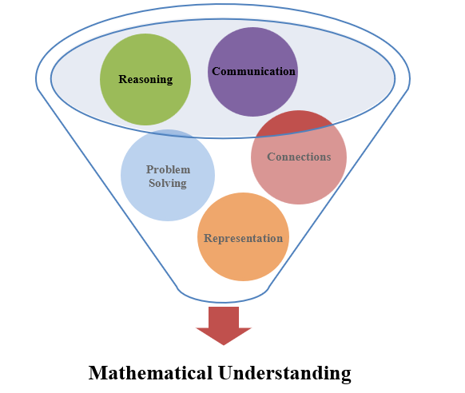
Mathematics Process Goals for Students
The content of the mathematics standards is intended to support the five process goals for students.
Notes:
The 2023 Mathematics Standards of Learning foster the application of the five mathematical process goals including reasoning, communication, problem solving, connections, and representation, and set students up to recognize and see mathematics in real-world applications. These processes support students in building understanding of mathematics.

Slide 8
Standards of Learning Supporting Documents
Notes:
Virginia Department of Education documents supporting the transition to the 2023 Mathematics Standards of Learning will now be shared.

Slide 9
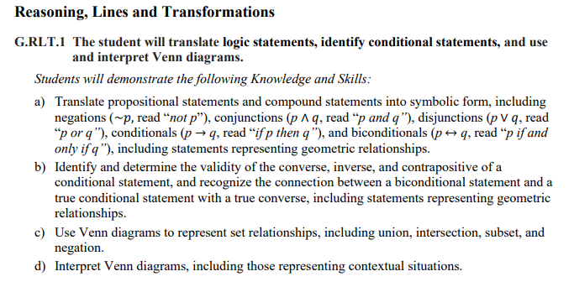
Standards Document
Notes:
The 2023 Mathematics Standards of Learning Document includes the standards and the knowledge and skills associated with each standard. This slide shows an example from the Geometry Standards Document.

Slide 10
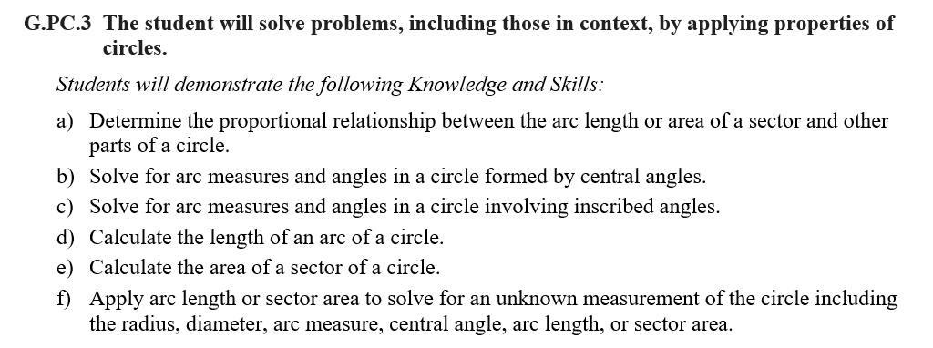
Changes to Numbering of the SOL
Third SOL within this strand
Course
Polygons & Circles Strand
KEY: RLT = Reasoning, Lines, and Transformations; TR = Triangles; PC = Polygons and Circles; DF = Two-Dimensional and Three-Dimensional Figures
Notes:
The new numbering system for the standards makes it clear within which strand a standard exists. For instance, the sample shown on the screen highlights G.PC.3. G indicates the course - Geometry; PC indicates the Polygons and Circles Strand; and 3 indicates that this is the third standard of learning in this strand. The key shown at the bottom of the screen provides the abbreviations for each of the strands.

Slide 11
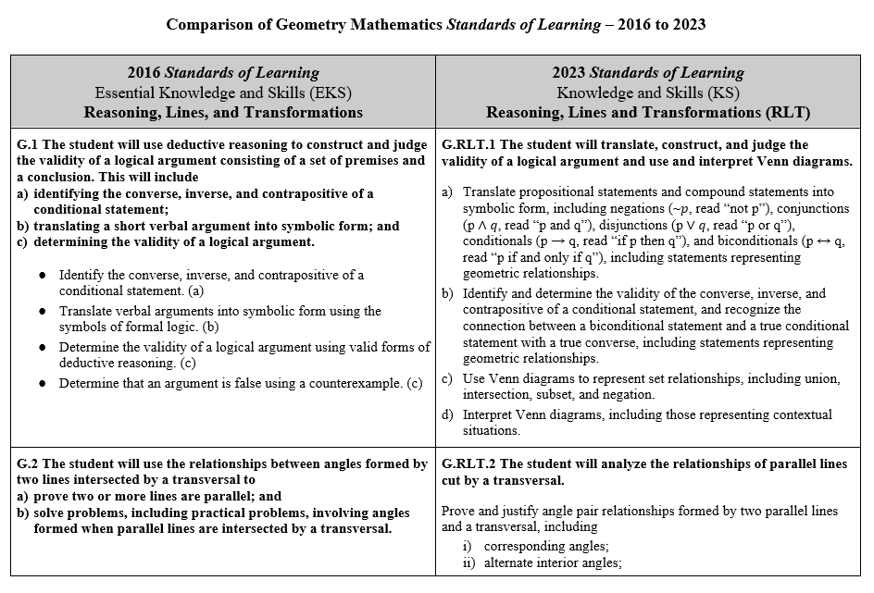
Overview of Revisions (2016 to 2023 Mathematics Standards of Learning) document
Notes:
An Overview of Revisions document has been created for each grade or course. This presentation provides a detailed comparison between the 2016 Standards of Learning and the 2023 Standards of Learning and is based upon the Overview of Revisions document.

Slide 12
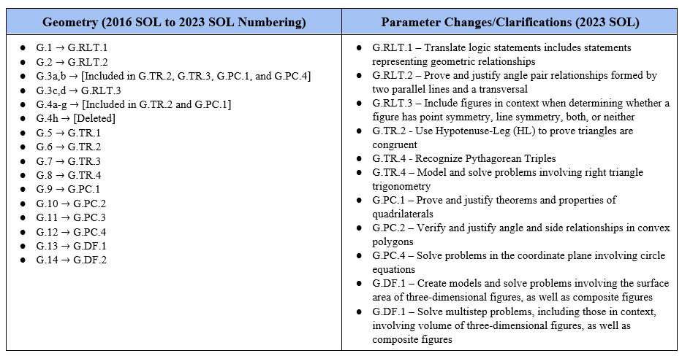
Overview of Revisions- Summary of Changes (1 of 2)
Notes:
At the end of the Overview of Revisions document there is a summary of changes table. One section of the table provides an overview of the changes to the numbering of the standards. Another section provides information regarding the prominent parameter changes and clarifications. Parameter changes and clarifications might be related to an increase or decrease in the limiters of the standards or the knowledge and skills; but might also be related to the depth of understanding of the content or scope of the content.

Slide 13
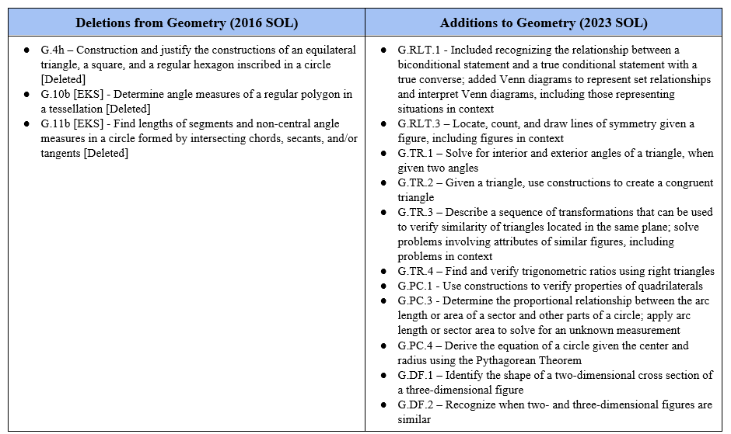
Overview of Revisions- Summary of Changes (2 of 2)
Notes:
The other two sections of the table include deletions from 2016 standards and addition of content to the 2023 standards.

Slide 14
Comparison of 2016 Mathematics SOL to 2023 Mathematics SOL
Notes:
During the remainder of the presentation, we will take a closer look at the revisions to the 2016 standards that resulted in the new 2023 standards.

Slide 15
Reasoning, Lines, and Transformations
Notes:
We will first examine the changes that occurred in the Reasoning, Lines, and Transformations strand.

Slide 16
Standard G.1 (2016) - Standard G.RLT.1 (2023)
2016 SOL | 2023 SOL
G.1 The student will use deductive reasoning to construct and judge the validity of a logical argument consisting of a set of premises and a conclusion. This will include identifying the converse, inverse, and contrapositive of a conditional statement; translating a short verbal argument into symbolic form; and determining the validity of a logical argument. Identify the converse, inverse, and contrapositive of a conditional statement. (a) Translate verbal arguments into symbolic form using the symbols of formal logic. (b) Determine the validity of a logical argument using valid forms of deductive reasoning. (c) Determine that an argument is false using a counterexample. (c) | G.RLT.1 The student will translate logic statements, identify conditional statements, and use and interpret Venn diagrams. Translate propositional statements and compound statements into symbolic form, including negations (~p, read “not p”), conjunctions (p ∧ q, read “p and q”), disjunctions (p ∨ q, read “p or q”), conditionals (p → q, read “if p then q”), and biconditionals (p ↔ q, read “p if and only if q”), including statements representing geometric relationships. Identify and determine the validity of the converse, inverse, and contrapositive of a conditional statement, and recognize the connection between a biconditional statement and a true conditional statement with a true converse, including statements representing geometric relationships. Use Venn diagrams to represent set relationships, including union, intersection, subset, and negation. Interpret Venn diagrams, including those representing contextual situations.
Revisions:
G.RLT.1a - The study of propositional logic should include statements which represent geometric relationships.
G.RLT.1b - Students will need to recognize the connection between a biconditional statement and a true conditional statement with a true converse.
G.RLT.1c,d - Students will represent set relationships using Venn diagrams and interpret Venn diagrams.
Notes:
Throughout this presentation red text in the 2023 column indicates a change or addition to the content at this level. Red text in the 2016 column provides notes about where content may have been moved or deleted. You will also see symbols that indicate content that is NEW to the grade level or course.
The 2016 standard G.1 becomes standard G.RLT.1 in the revised 2023 SOL. The first strand in the Geometry standards is “Reasoning, Lines, and Transformations,” which is denoted by the acronym “RLT” in the standard numbers.
The following revisions are included in the 2023 Geometry Standards of Learning.
The study of propositional logic in the standards should include statements which represent geometric relationships. The purpose of learning propositional logic in Geometry is the application of the learned rules to understand and represent geometric relationships.
The use of and interpretation of Venn diagrams will be expected from students. This should also include representations of contextual situations, including geometric relationships. An example of using Venn diagrams to represent relationships might include the properties of quadrilaterals.
The use of deductive reasoning and determining the validity of a logical argument, including the use of counterexample, should be embedded across the Geometry standards

Slide 17
Standard G.2 (2016) - Standard G.RLT.2 (2023)
2016 SOL | 2023 SOL
G.2 The student will use the relationships between angles formed by two lines intersected by a transversal to prove two or more lines are parallel; and solve problems, including practical problems, involving angles formed when parallel lines are intersected by a transversal. Prove two or more lines are parallel given angle measurements expressed numerically or algebraically. (a) Prove two lines are parallel using deductive proofs given relationships between and among angles. (a) Solve problems by using the relationships between pairs of angles formed by the intersection of two parallel lines and a transversal including corresponding angles, alternate interior angles, alternate exterior angles, same-side (consecutive) interior angles, and same-side (consecutive) exterior angles. (b) Solve problems, including practical problems, involving intersecting and parallel lines. (b) | G.RLT.2 The student will analyze, prove, and justify the relationships of parallel lines cut by a transversal. Prove and justify angle pair relationships formed by two parallel lines and a transversal, including: corresponding angles; alternate interior angles; alternate exterior angles; same-side (consecutive) interior angles; and same-side (consecutive) exterior angles. Prove two or more lines are parallel given angle measurements expressed numerically or algebraically. Solve problems by using the relationships between pairs of angles formed by the intersection of two parallel lines and a transversal.
Revisions:
SOL G.2 is now labeled SOL G.RLT.2 in the 2023 standards. In part a) of G.RLT.2, students will still be expected to prove two lines are parallel, but also prove and justify angle pair relationships.
Notes:
Standard G.2 becomes Standard G.RLT.2
In part a of G.RLT.2, students will still be expected to prove two lines are parallel, but also prove and JUSTIFY angle pair relationships.

Slide 18
Standard G.3a and G.3b (2016) - Deleted
2016 SOL | 2023 SOL
G.3 The student will solve problems involving symmetry and transformation. This will include investigating and using formulas for determining distance, midpoint, and slope; applying slope to verify and determine whether lines are parallel or perpendicular; Determine the coordinates of the midpoint or endpoint of a segment, using the midpoint formula. (a) [Included in G.PC.1 and G.PC.4] Use a formula to determine the slope of a line. (a) [Included in Algebra 1 and G.PC.1] Apply the distance formula to determine the length of a line segment when given the coordinates of the endpoints. (a) [Included in G.TR.2, G.TR.3, and G.PC.1] Compare the slopes to determine whether two lines are parallel, perpendicular, or neither. (b) [Included in Algebra 1 and G.PC.1]
Revisions:
2016 G.3 a, b - The distance, midpoint, and slope formulas will be incorporated into standards where those skills are needed coordinate geometry.
Notes:
The content in G.3a and G.3b is still found within the 2023 Geometry Standards of Learning, as indicated in the first column.
The distance, midpoint, and slope formulas are incorporated into the 2023 Geometry standards where those skills are needed in coordinate geometry.
Proving theories and properties of quadrilaterals on the coordinate plane in G.PC.1 will utilize the distance, midpoint, and slope formulas, including the determination of whether two lines in the coordinate plane are parallel, perpendicular, or neither.
Properties of circles on the coordinate plane in G.PC.4 will utilize the distance and midpoint formulas.
Determining whether triangles on the coordinate plane are congruent in G.TR.2 and determining whether triangles on the coordinate plane are similar in G.TR.3 will utilize the distance formula, the slope formula, and the determination of whether two lines of the coordinate plane to be parallel, perpendicular, or neither. Comparing slope to determine whether two lines are parallel, perpendicular, or neither is also included in the 2023 Algebra 1 standards.

Slide 19
Standard G.3c and G.3d (2016) - Standard G.RLT.3 (2023)
2016 SOL | 2023 SOL
G.3 The student will solve problems involving symmetry and transformation. This will include c) investigating symmetry and determining whether a figure is symmetric with respect to a line or a point; and d) determining whether a figure has been translated, reflected, rotated, or dilated, using coordinate methods. Determine whether a figure has point symmetry, line symmetry, both, or neither. (c) Given an image and preimage, identify the transformation or combination of transformations that has/have occurred. Transformations include: a translation; a reflection over any horizontal or vertical line or the lines y = x or y = −x; a clockwise or counterclockwise rotation of 90°, 180°, 270°, or 360° on a coordinate grid where the center of rotation is limited to the origin; and dilations, from a fixed point on a coordinate grid. | G.RLT.3 The student will solve problems, including contextual problems, involving symmetry and transformation. Locate, count, and draw lines of symmetry given a figure, including figures in context. Determine whether a figure has point symmetry, line symmetry, both, or neither, including figures in context. Given an image or preimage, identify the transformation or combination of transformations that has/have occurred. Transformations include: translations; reflections over any horizontal or vertical line or the lines y = x or y = -x; clockwise or counterclockwise rotations of 90°, 180°, 270°, or 360° on a coordinate grid where the center of rotation is limited to the origin; and dilations, from a fixed point on a coordinate grid.
Revisions:
G.RLT.3a - Students will be required analyze a figure to locate, count, and draw lines of symmetry, including figures in context.
G.RLT.3b – Students will determine whether a figure in context has point symmetry, line symmetry, both or neither.
Notes:
The 2016 standards G.3c and G.3d become standard G.RLT.3 in the 2023 Geometry standards.
New for 2023, students will be analyzing figures to locate, count, and draw lines of symmetry. Students will also be expected to analyze figures in context to determine whether a figure has point symmetry, line symmetry, both, or neither.

Slide 20
Standard G.4 (2016) – Deleted (1 of 2)
2016 SOL | 2023 SOL
G.4 The student will construct and justify the constructions of a line segment congruent to a given line segment; [Included in G.TR.2 and G.PC.1] the perpendicular bisector of a line segment; a perpendicular to a given line from a point not on the line; [Included in G.TR.2 and G.PC.1] a perpendicular to a given line at a given point on the line; [Included in G.TR.2 and G.PC.1] Construct and justify the constructions of a line segment congruent to a given line segment; (a) the perpendicular bisector of a line segment; (b) a perpendicular to a given line from a point not on the line; (c) a perpendicular to a given line at a given point on the line; (d)
Revisions:
The 2016 G.4 standard addressing constructions is no longer a standalone standard and instead has been included in other 2023 Geometry standards where the skills may be used. Specific constructions from SOL G.4 a-g will be included in G.TR.2 and G.PC.1.
Notes:
The 2016 G.4 standard addressing constructions is no longer a standalone standard and instead has been included in other 2023 Geometry standards where the skills may be used. On this slide you can see G.4a through G.4d.
Students will use constructions of a congruent line segment, a congruent angle, and/or perpendicular line constructions to create a congruent triangle in G.TR.2 and verify properties of quadrilaterals in G.PC.1.

Slide 21
Standard G.4 (2016) – Deleted (2 of 2)
2016 SOL | 2023 SOL
G.4 The student will construct and justify the constructions of the bisector of a given angle; [Included in G.PC.1] an angle congruent to a given angle; [Included in G.TR.2 and G.PC.1] a line parallel to a given line through a point not on the line; and [Included in G.PC.1] an equilateral triangle, a square, and a regular hexagon inscribed in a circle. [Deleted] Construct and justify the constructions of the bisector of a given angle; (e) an angle congruent to a given angle; (f) a line parallel to a given line through a point not on the given line; (g) and an equilateral triangle, a square, and a regular hexagon inscribed in a circle. (h)
Revisions:
The 2016 G.4 standard addressing constructions is no longer a standalone standard and instead has been included in other 2023 Geometry standards where the skills may be used. Specific constructions from SOL G.4 a-g will be included in G.TR.2 and G.PC.1.
SOL G.4h will be deleted.
Notes:
The 2016 standard G.4 continues with e) through h) SOL G.4h will be deleted and not included in the 2023 Geometry Standards.
Students will use constructions of an angle congruent to a given angle to create a congruent triangle in G.TR.2 and use constructions of the bisector of a given angle, of an angle congruent to a given angle, and a line parallel to a given line through a point not on the line to verify properties of quadrilaterals in G.PC.1.

Slide 22
Triangles
Notes:
We will now examine the changes that occurred in the Triangles strand.

Slide 23
Standard G.5 (2016) - Standard G.TR.1 (2023)
2016 SOL | 2023 SOL
G.5 The student, given information concerning the lengths of sides and/or measures of angles in triangles, will solve problems, including practical problems. This will include ordering the sides by length, given angle measures; ordering the angles by degree measure, given side lengths; determining whether a triangle exists; and determining the range in which the length of the third side must lie. Given information about the lengths of sides and/or measures of angles in triangles, solve problems, including practical problems. (a, b, c, d) Order the sides of a triangle by their lengths when given information about the measures of the angles. (a) Order the angles of a triangle by their measures when given information about the lengths of the sides. (b) Given the lengths of three segments, determine whether a triangle could be formed. (c) Given the lengths of two sides of a triangle, determine the range in which the length of the third side must lie. (d) | G.TR.1 The student will determine the relationships between the measures of angles and lengths of sides in triangles, including problems in context. Given the lengths of three segments, determine whether a triangle could be formed. Given the lengths of two sides of a triangle, determine the range in which the length of the third side must lie. Order the sides of a triangle by their lengths when given information about the measures of the angles. Order the angles of a triangle by their measures when given information about the lengths of the sides. Solve for interior and exterior angles of a triangle, when given two angles.
Revisions:
G.TR.1e - Students will solve for interior and exterior angles of a triangle when two angle measures are provided.
Notes:
2016 standard G.5 becomes standard G.TR.1 in the 2023 Geometry standards. Note that TR represents the strand name, “Triangles”.
When provided with two angles of a triangle, students will be expected to solve for either individual or all interior and exterior angles of a triangle.

Slide 24
Standard G.6 (2016) - Standard G.TR.2 (2023)
2016 SOL | 2023 SOL
G.6 The student, given information in the form of a figure or statement, will prove two triangles are congruent. Prove two triangles congruent given relationships among angles and sides of triangles expressed numerically or algebraically. Prove two triangles congruent given representations in the coordinate plane and using coordinate methods (distance formula and slope formula). Use direct proofs to prove two triangles congruent. | G.TR.2 The student will, given information in the form of a figure or statement, prove and justify two triangles are congruent using direct and indirect proofs, and solve problems involving measured attributes of congruent triangles. Use definitions, postulates, and theorems (including Side-Side-Side (SSS); Side-Angle-Side (SAS); Angle-Side-Angle (ASA); Angle-Angle-Side (AAS); and Hypotenuse-Leg (HL)) to prove and justify two triangles are congruent. Use algebraic methods to prove that two triangles are congruent. Use coordinate methods, such as the slope formula and the distance formula, to prove two triangles are congruent. Given a triangle, use congruent segment, congruent angle, and/or perpendicular line constructions to create a congruent triangle (SSS, SAS, ASA, AAS, and HL).
Revisions:
G.TR.2d - Students will be constructing a triangle congruent to a given triangle.
Notes:
2016 Geometry standard G.6 becomes the 2023 standard G.TR.2
Here is our first example of the use of constructions as a method of understanding or proof of the properties of a geometric figure as students will be combining individual construction methods to construct a triangle congruent to a given triangle.

Slide 25
Standard G.7 (2016) - Standard G.TR.3 (2023)
2016 SOL | 2023 SOL
G.7 The student, given information in the form of a figure or statement, will prove two triangles are similar. Prove two triangles similar given relationships among angles and sides of triangles expressed numerically or algebraically. Prove two triangles similar given representations in the coordinate plane and using coordinate methods (distance formula and slope formula). Use direct proofs to prove triangles similar. | G.TR.3 The student will, given information in the form of a figure or statement, prove and justify two triangles are similar using direct and indirect proofs, and solve problems, including those in context, involving measured attributes of similar triangles. Use definitions, postulates, and theorems (including Side-Angle-Side (SAS); Side-Side-Side (SSS); and Angle-Angle (AA)) to prove and justify that triangles are similar. Use algebraic methods to prove that triangles are similar. Use coordinate methods, such as the slope formula and the distance formula, to prove two triangles are similar. Describe a sequence of transformations that can be used to verify similarity of triangles located in the same plane. Solve problems, including those in context, involving attributes of similar triangles.
Revisions:
G.TR.3d - Students will describe the transformations that can be used to verify similarity of triangles.
G.TR.3e - Students will also solve problems involving the attributes of similar triangles.
Notes:
2016 Geometry standard G.7 becomes 2023 standard G.TR.3
There are two new content expectations in parts d) and e). Students will recognize similarity using rigid transformations and solve problems involving attributes of similar triangles.

Slide 26
Standard G.8a and G.8b - Standard G.TR.4
2016 SOL | 2023 SOL
G.8 The student will solve problems, including practical problems, involving right triangles. This will include applying the Pythagorean Theorem and its converse; properties of special right triangles; and Solve problems, including practical problems, using right triangle trigonometry and properties of special right triangles. (a, b, c) Determine whether a triangle formed with three given lengths is a right triangle. (a) Solve for missing lengths in geometric figures, using properties of 45°-45°-90° triangles where rationalizing denominators may be necessary. (b) Solve for missing lengths in geometric figures, using properties of 30°-60°-90° triangles where rationalizing denominators may be necessary. (b). | G.TR.4 The student will model and solve problems, including those in context, involving trigonometry in right triangles and applications of the Pythagorean Theorem. Determine whether a triangle formed with three given lengths is a right triangle. Solve problems using the properties of special right triangles. Solve for missing lengths in geometric figures, using properties of 45°-45°-90° triangles, where rationalizing denominators may be necessary. Solve for missing lengths in geometric figures, using properties of 30°-60°-90° triangles, where rationalizing denominators may be necessary. Solve problems, including those in context, involving right triangles using the Pythagorean Theorem and its converse, including recognizing Pythagorean Triples.
Revisions:
G.TR.4 - Students will solve problems involving right triangles using the Pythagorean Theorem and its converse, including recognizing Pythagorean Triples
Notes:
The 2016 standard G.8 becomes 2023 Geometry standard G.TR.4. This slide addresses the 2016 SOL G.8a and G.8b which become G.TR.4 part a) and parts d) through g). 2016 SOL G.8c will be addressed on the next slide.
Solving problems involving right triangles using the Pythagorean Theorem and its converse has the added expectation in the 2023 Geometry SOL of recognizing Pythagorean Triples.
Solving problems involving right triangles using special right triangles will remain the same.

Slide 27
Standard G.8c - Standard G.TR.4
2016 SOL | 2023 SOL
G.8 The student will solve problems, including practical problems, involving right triangles. This will include applying trigonometric ratios. Solve problems, including practical problems, using right triangle trigonometry and properties of special right triangles. (a, b, c) Solve problems, including practical problems, involving right triangles with missing side lengths or angle measurements, using sine, cosine, and tangent ratios. (c) | G.TR.4 The student will model and solve problems, including those in context, involving trigonometry in right triangles and applications of the Pythagorean Theorem. Find and verify trigonometric ratios using right triangles. Model and solve problems, including those in context, involving right triangle trigonometry (sine, cosine, and tangent ratios).
Revisions:
G.TR.4b - Students will find and verify trigonometric ratios using measurements in right triangles.
G.TR.4c - Students will be expected to model problems involving right triangle trigonometry.
Notes:
The rest of Standard G.8 from the 2016 standards and G.TR.4 from the 2023 SOL involves right triangle trigonometry.
In the 2023 SOLs, new expectations for students include the modeling of problems and finding and verifying trigonometric ratios. This will help to build a foundational understanding of how and why the trigonometric ratios can be used to solve problems involving right triangles.

Slide 28
Polygons and Circles
Notes:
We will now look at the changes that occurred in the Polygons and Circles strand.

Slide 29
Standard G.9 - Standard G.PC.1
2016 SOL | 2023 SOL
G.9 The student will verify and use properties of quadrilaterals to solve problems, including practical problems. Solve problems, including practical problems, using the properties specific to parallelograms, rectangles, rhombi, squares, isosceles trapezoids, and trapezoids. Prove that quadrilaterals have specific properties, using coordinate and algebraic methods, such as the distance formula, slope, and midpoint formula. Prove the properties of quadrilaterals, using direct proofs. | G.PC.1 The student will prove and justify theorems and properties of quadrilaterals, and verify and use properties of quadrilaterals to solve problems, including the relationships between the sides, angles, and diagonals. Solve problems using the properties specific to parallelograms, rectangles, rhombi, squares, isosceles trapezoids, and trapezoids. Prove and justify that quadrilaterals have specific properties, using coordinate and algebraic methods, such as the slope formula, the distance formula, and the midpoint formula. Prove and justify theorems and properties of quadrilaterals using deductive reasoning. Use congruent segment, congruent angle, angle bisector, perpendicular line, and/or parallel line constructions to verify properties of quadrilaterals.
Revisions:
G.PC.1b - Students will prove and justify that quadrilaterals have specific properties
G.PC.1c – Students will prove and justify theorems and properties of quadrilaterals using deductive reasoning.
G.PC.1d - Students will use constructions to verify properties of quadrilaterals
Notes:
The G.9 2016 standard is now the G.PC.1 2023 Geometry standard.
The 2023 standard now includes having students prove and justify theorems of quadrilaterals and justify properties of quadrilaterals. Additionally, students will use congruent segment, congruent angle, angle bisector, perpendicular line, and/or parallel line constructions to verify the properties of quadrilaterals. Direct proofs are not specifically listed in the new standard but would fall under deductive reasoning to prove and justify the theorems and properties in the 2023 standards and should be included.

Slide 30
Standard G.10 - Standard G.PC.2
2016 SOL | 2023 SOL
G.10 The student will solve problems, including practical problems, involving angles of convex polygons. This will include determining the sum of the interior and/or exterior angles; measure of an interior and/or exterior angle; and number of sides of a regular polygon. Solve problems, including practical problems, involving angles of convex polygons. (a, b, c) Determine the sum of the measures of the interior and exterior angles of a convex polygon. (a) Determine the measure of each interior and exterior angle of a regular polygon. (b) Determine angle measures of a regular polygon in a tessellation. (b) [Deleted] Determine the number of sides of a regular polygon, given the measures of interior or exterior angles of the polygon. (c) | G.PC.2 The student will verify relationships and solve problems, involving the number of sides and measures of angles of convex polygons. Solve problems, involving the number of sides of a regular polygon given the measures of the interior and exterior angles of the polygon. Justify the relationship between the sum of the measures of the interior and exterior angles of a convex polygon and solve problems involving the sum of the measures of the angles. Justify the relationship between the measure of each interior and exterior angle of a regular polygon and solve problems involving the measures of the angles.
Revisions:
G.PC.2b and G.PC.2c - Students will verify and justify angle and side relationships in convex polygons
The use of tessellations to solve for angle measures of a regular polygon is removed from the standard.
Notes:
The 2016 standard G.10 is now the G.PC.2 2023 standard
The 2023 standard now includes verifying and justifying angle and side relationships in convex polygons. Not included in this new standard is the use of tessellations to solve for angle measurements of a regular polygon.

Slide 31
Standard G.11 - Standard G.PC.3 (1 of 2)
2016 SOL | 2023 SOL
G.11 The student will solve problems, including practical problems, by applying properties of circles. This will include determining angle measures formed by intersecting chords, secants, and/or tangents; [Deleted] lengths of segments formed by intersecting chords, secants, and/or tangents; [Deleted] arc length; and area of a sector. Solve problems, including practical problems, by applying properties of circles. (a, b, c, d) Determine angle measures and arc measures associated with two intersecting chords; two intersecting secants; an intersecting secant and tangent; two intersecting tangents; and central and inscribed angles. (a) | G.PC.3 The student will solve problems, including those in context, by applying properties of circles. Determine the proportional relationship between the arc length or area of a sector and other parts of a circle. Solve for arc measures and angles in a circle formed by central angles. Solve for arc measures and angles in a circle involving inscribed angles. Calculate the length of an arc of a circle. Calculate the area of a sector of a circle. Apply arc length or sector area to solve for an unknown measurement of the circle including the radius, diameter, arc measure, central angle, arc length, or sector area.
Revisions:
G.PC.3a - Students will determine proportional relationship between arc length or area of circle and other parts of circle
G.PC.3f - Students will apply arc length or sector area to solve for unknown parts of circles
Determining lengths of segments and non-central angles formed by intersecting chords, secants and/or tangents is not included in the 2023 standards
Notes:
The G.11 2016 standard is now the G.PC.3 2023 Geometry standard. There are two slides showing this change in order to show all of the content bullets from the 2016 standard.
The 2023 standard now includes determining the proportional relationship between the arc length or area of a circle and the other parts of the circle and using the arc length or sector area to solve for unknown parts of the circle. No longer included in the standard are determining lengths of segments and non-central angles formed by intersecting chords, secants and/or tangents.

Slide 32
Standard G.11 - Standard G.PC.3 (2 of 2)
2016 SOL | 2023 SOL
G.11 The student will solve problems, including practical problems, by applying properties of circles. This will include determining angle measures formed by intersecting chords, secants, and/or tangents; lengths of segments formed by intersecting chords, secants, and/or tangents; arc length; and area of a sector. Determine segment lengths associated with: two intersecting chords; two intersecting secants; an intersecting secant and tangent; and two intersecting tangents. (b) Calculate the length of an arc of a circle. (c) Calculate the area of a sector. (d) | G.PC.3 The student will solve problems, including those in context, by applying properties of circles. Determine the proportional relationship between the arc length or area of a sector and other parts of a circle. Solve for arc measures and angles in a circle formed by central angles. Solve for arc measures and angles in a circle involving inscribed angles. Calculate the length of an arc of a circle. Calculate the area of a sector of a circle. Apply arc length or sector area to solve for an unknown measurement of the circle including the radius, diameter, arc measure, central angle, arc length, or sector area.
Revisions:
G.PC.3a - Students will determine proportional relationship between arc length or area of circle and other parts of circle
G.PC.3f - Students will apply arc length or sector area to solve for unknown parts of circles
Determining lengths of segments and non-central angles formed by intersecting chords, secants and/or tangents is not included in the 2023 standards
Notes:
This is the continuation of the previous slide where G.11 2016 standard is now the G.PC.3 2023 standard

Slide 33
Standard G.12 - Standard G.PC.4 (1 of 2)
2016 SOL | 2023 SOL
G.12 The student will solve problems involving equations of circles. Given a graph or the equation of a circle in standard form, identify the coordinates of the center of the circle. Given the coordinates of the endpoints of a diameter of a circle, determine the coordinates of the center of the circle. Given a graph or the equation of a circle in standard form, identify the length of the radius or diameter of the circle. Given the coordinates of the endpoints of the diameter of a circle, determine the length of the radius or diameter of the circle. Given the coordinates of the center and the coordinates of a point on the circle, determine the length of the radius or diameter of the circle. Given the coordinates of the center and length of the radius of a circle, identify the coordinates of a point(s) on the circle. | G.PC.4 The student will solve problems in the coordinate plane, involving equations of circles. Derive the equation of a circle of given the center and radius using the Pythagorean Theorem. Solve problems in the coordinate plane involving equations of circles: given a graph or the equation of a circle in standard form, identify the coordinates of the center of the circle; given the coordinates of the endpoints of a diameter of a circle, determine the coordinates of the center of the circle. given a graph or the equation of a circle in standard form, identify the length of the radius or diameter of the circle. given the coordinates of the endpoints of the diameter of a circle, determine the length of the radius or diameter of the circle. given the coordinates of the center and the coordinates of a point on the circle, determine the length of the radius or diameter of the circle; and given the coordinates of the center and length of the radius of a circle, identify the coordinates of a point(s) on the circle.
Revisions:
G.PC.4a - Students will derive the equation of circle from Pythagorean Theorem.
G.PC.4b - Students will solve problems in the coordinate plane involving circle equations
Notes:
The G.12 2016 standard is now the G.PC.4 2023 standard. There are two slides showing this change in order to show all of the content bullets from the 2016 standard.
The 2023 standard now includes stating specifically that students will use the coordinate planes to solve problems including equations of circles. Additionally, when given the center and radius of a circle, students will use the Pythagorean Theorem to derive the equation of a circle.

Slide 34
Standard G.12 - Standard G.PC.4 (2 of 2)
2016 SOL | 2023 SOL
G.12 The student will solve problems involving equations of circles. Determine the equation of a circle given: a graph of a circle with a center with coordinates that are integers; coordinates of the center and a point on the circle; coordinates of the center and the length of the radius or diameter; or coordinates of the endpoints of a diameter | G.PC.4 The student will solve problems in the coordinate plane, involving equations of circles. c) Determine the equation of a circle given: a graph of a circle with a center with coordinates that are integers; coordinates of the center and a point on the circle; coordinates of the center and the length of the radius or diameter; and coordinates of the endpoints of a diameter.
Revisions:
G.PC.4a - Students will derive the equation of circle from Pythagorean Theorem.
G.PC.4b - Students will solve problems in the coordinate plane involving circle equations
Notes:
The G.12 2016 standard is now the G.PC.4 2023 standard. This slide shows 2016 SOL G.16 involving equations of a circle and the 2023 G.PC.4c knowledge and skills.
The 2023 standard now includes stating specifically that students will use the coordinate planes to solve problems including equations of circles.

Slide 35
Three-Dimensional Figures
Notes:
We will now discuss the changes that occurred in the Three-Dimensional Figures strand.

Slide 36
Standard G.13 - Standard G.DF.1
2016 SOL | 2023 SOL
G.13 The student will use surface area and volume of three-dimensional objects to solve practical problems. Determine the surface area of cylinders, prisms, pyramids, cones, hemispheres, and spheres, using the appropriate formulas. Determine the volume of cylinders, prisms, pyramids, cones, hemispheres, and spheres, using the appropriate formulas. Solve problems including practical problems, involving surface area and volume of cylinders, prisms, pyramids, cones, hemispheres, and spheres, as well as composite three-dimensional figures. Solve problems, including practical problems, involving the lateral area of circular cylinders, prisms, and regular pyramids. Given information about a three-dimensional figure such as length of a side, area of a face, or volume, determine missing information. | G.DF.1 The student will create models and solve problems, including those in context, involving surface area and volume of rectangular and triangular prisms, cylinders, cones, pyramids, and spheres. Identify the shape of a two-dimensional cross section of a three-dimensional figure. Create models and solve problems, including those in context involving surface area of three-dimensional figures, as well as composite three-dimensional figures. Solve multistep problems, including those in context, involving volume of three-dimensional figures, as well as composite three-dimensional figures. Determine unknown measurements of three-dimensional figures using information such as length of a side, area of a face, or volume.
Revisions:
G.DF.1a - Students will identify a two-dimensional cross section of a three-dimensional figure
G.DF.1b - Students will create models and solve problems involving surface area of three-dimensional figures, as well as composite 3-D figures
G.DF.1c - Students will solve multi-step problems involving volume of three-dimensional figures, as well as composite 3-D figures
Hemispheres (half of a sphere) are still included in the 2023 standard, while not specifically listed.
Notes:
The G.13 2016 standard is now the G.DF.1 2023 standard.
The 2023 standard now includes students creating models involving surface area and volume of three-dimensional figures, identifying the shape of a two-dimensional cross section of a three-dimensional figure, and solving multi-step problems involving surface area. Hemispheres (half of a sphere) are still included in the 2023 standard, while not specifically listed.

Slide 37
Standard G.14 - Standard G.DF.2 (1 of 2)
2016 SOL | 2023 SOL
G.14 The student will apply the concepts of similarity to two- or three-dimensional geometric figures. This will include comparing ratios between lengths, perimeters, areas, and volumes of similar figures; determining how changes in one or more dimensions of a figure affect area and/or volume of the figure; determining how changes in area and/or volume of a figure affect one or more dimensions of the figure; and solving problems, including practical problems, about similar geometric figures. Compare ratios between side lengths, perimeters, areas, and volumes, given two similar figures. (a) Describe how changes in one or more dimensions affect other derived measures (perimeter, area, surface area, and volume) of a figure. (b) | G.DF.2 The student will determine the effects of changing one or more dimensions of a three-dimensional geometric figure and describe the relationship between the original and changed figure. Describe how changes in one or more dimensions of a figure affect other derived measures (perimeter, area, total surface area, and volume) of the figure. Describe how changes in surface area and/or volume of a figure affect the measures of one or more dimensions of the figure. Solve problems, including those in context, involving changing the dimensions or derived measures of a three-dimensional figure. Compare ratios between side lengths, perimeters, areas, and volumes of similar figures. Recognize when two- and three-dimensional figures are similar and solve problems, including those in context, involving attributes of similar geometric figures.
Revisions:
G.DF.2a and G.DF.2b - Students will describe the relationship between the original and changed figure.
G.DF.2f - Students will recognize when two- and three-dimensional figures are similar.
Notes:
The G.14 2016 Geometry standard is now the G.DF.2 2023 standard. There are two slides showing this change in order to show all of the content bullets from the 2016 standard.
In G.DF.2a and b, students will describe the relationship between the original and changed figure. In G.DF.2f, students will recognize when two- and three-dimensional figures are similar.

Slide 38
Standard G.14 - Standard G.DF.2 (2 of 2)
2016 SOL | 2023 SOL
G.14 The student will apply the concepts of similarity to two- or three-dimensional geometric figures. This will include comparing ratios between lengths, perimeters, areas, and volumes of similar figures; determining how changes in one or more dimensions of a figure affect area and/or volume of the figure; determining how changes in area and/or volume of a figure affect one or more dimensions of the figure; and solving problems, including practical problems, about similar geometric figures. Describe how changes in one or more measures (perimeter, area, surface area, and volume) affect other measures of a figure. (c) Solve real-world problems involving measured attributes of similar figures. (d) | G.DF.2 The student will determine the effects of changing one or more dimensions of a three-dimensional geometric figure and describe the relationship between the original and changed figure. Describe how changes in one or more dimensions of a figure affect other derived measures (perimeter, area, total surface area, and volume) of the figure. Describe how changes in surface area and/or volume of a figure affect the measures of one or more dimensions of the figure. Solve problems, including those in context, involving changing the dimensions or derived measures of a three-dimensional figure. Compare ratios between side lengths, perimeters, areas, and volumes of similar figures. Recognize when two- and three-dimensional figures are similar and solve problems, including those in context, involving attributes of similar geometric figures.
Revisions:
G.DF.2a and G.DF.2b - Students will describe the relationship between the original and changed figure.
G.DF.2f - Students will recognize when two- and three-dimensional figures are similar.
Notes:
The G.14 2016 standard is now the G.DF.2 2023 standard. This slide includes the additional content from the 2016 SOL G.14 that did not fit on the first slide.

Slide 39
Questions?
Contact the
Virginia Department of Education’s Mathematics Team at vdoe.mathematics@doe.virginia.gov
Notes:
This concludes the presentation on the 2023 Geometry Standards of Learning revisions. It may be helpful to refer to this presentation as you are using the Overview of Revisions document to plan for instruction.
Should you have any questions, feel free to contact a member of the Mathematics Team at email address shown on the screen.

