Slide 1
2023 Mathematics Standards of Learning
Algebra 1
Overview of Revisions from 2016 to 2023
Notes:
Welcome to the Algebra 1 presentation focused on the 2023 Mathematics Standards of Learning. The Proposed 2023 Mathematics Standards of Learning (SOL) were approved by the Board of Education on August 31, 2023.​

Slide 2
Purpose
Overview of the 2023 Mathematics Standards of Learning
Highlight information included in the Standards (including the Knowledge and Skills)
Referenced documents available at the Virginia Department of Education 2023 Mathematics Standards of Learning webpage.
Notes:
Our purpose is to provide an overview of the changes to the standards and to highlight information included in the knowledge and skills.

Slide 3
Agenda
2023 Mathematics Standards of Learning Focus
Documents Currently Available
Standards of Learning Document
Overview of Revisions (2016 to 2023 Mathematics Standards of Learning) document
Comparison of 2016 to 2023 Standards
Expressions and Operations
Equations and Inequalities
Functions
Statistics
Notes:
During this presentation, information will be shared regarding the 2023 Mathematics Standards of Learning documents that are currently available and the focus of the 2023 standards. Then a detailed comparison of the 2016 standards to the newly adopted 2023 standards will be provided.

Slide 4
2023 Mathematics Standards of Learning Focus
Notes:
The focus of the 2023 Mathematics Standards of Learning are included in the following slides.

Slide 5
2023 Standards of Learning Focus
The Mathematics Standards of Learning:
Include challenging mathematics content;
Reinforce foundational mathematics skills;
Support the application of mathematical concepts; and
Build coherently in complexity across grade levels.
Notes:
The mathematics standards of learning include challenging mathematics content, reinforce foundational mathematics skills, support the application of mathematical concepts, and build coherently in complexity across grade levels.

Slide 6
2023 Mathematics SOL Guiding Principles
Raise the Floor; Remove the Ceiling
Ensure Every Student Builds Strong Mathematics Foundational Skills
Master Critical Content
Integrate Mathematics Across All Content Areas
Prepare Teachers to Teach Mathematics Accurately and Effectively
Apply Mathematics to Better Use Technology
Notes:
There are six Guiding Principles included in the Virginia’s 2023 Mathematics Standards of Learning document that represent the values and beliefs upon which the revised standards were created. Preparing Virginia’s students to pursue higher education, to compete in a modern workforce, and to be informed citizens requires rigorous mathematical knowledge and skills. Students must gain an understanding of fundamental ideas in number sense, computation, measurement, geometry, probability, data analysis and statistics, and algebra and functions, and they must develop proficiency in mathematical skills. The six guiding principles are as follows:
Raise the Floor; Remove the Ceiling:
Ensure Every Student Builds Strong Mathematics Foundational Skills:
Master Critical Content:
Integrate Mathematics Across All Content Areas:
Prepare Teachers to Teach Mathematics Accurately and Effectively:
Apply Mathematics to Better Use Technology:

Slide 7
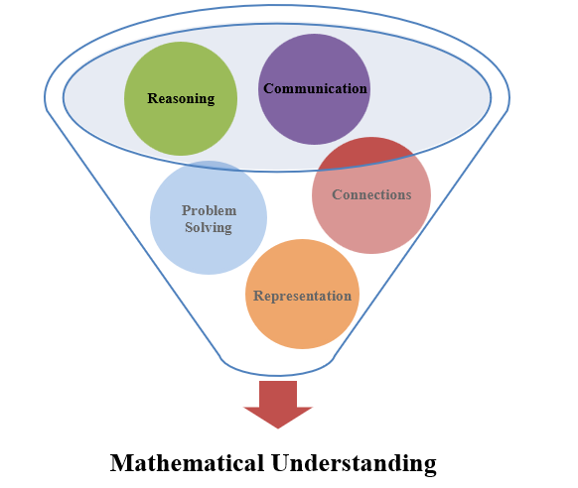
Mathematics Process Goals for Students
The content of the mathematics standards is intended to support the five process goals for students.
Notes:
The 2023 Mathematics Standards of Learning foster the application of the five mathematical process goals including reasoning, communication, problem solving, connections, and representation, and set students up to recognize and see mathematics in real-world applications. These processes support students in building understanding of mathematics.

Slide 8
Standards of Learning Supporting Documents
Notes:
Virginia Department of Education documents supporting the transition to the 2023 Mathematics Standards of Learning will now be shared.

Slide 9
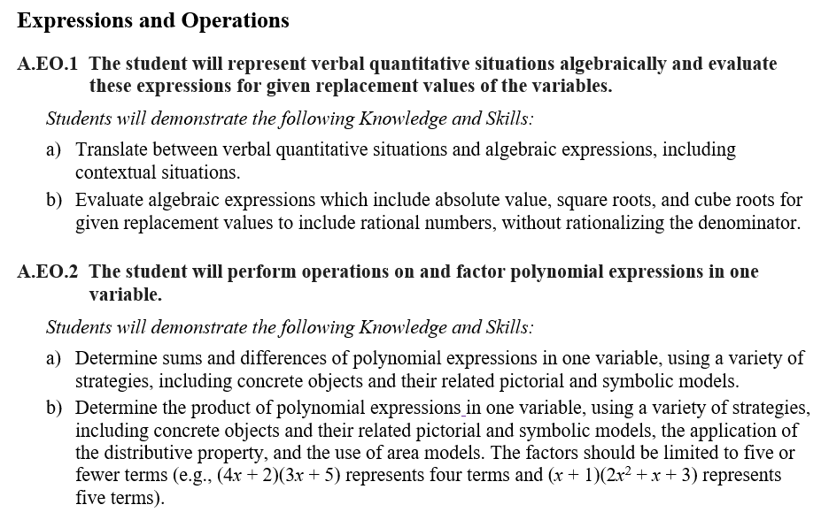
Standards Document
Notes:
The 2023 Mathematics Standards of Learning Document includes the standards and the knowledge and skills associated with each standard. This slide shows an example from the Grade XX Standards Document.

Slide 10
Changes to Numbering of the SOL
Third SOL within this strand
Course
Equations & Inequalities Strand
KEY: EO = Expressions and Operations; EI = Equations and Inequalities; F = Functions; ST = Statistics
Notes:
The new numbering system for the standards makes it clear within which strand a standard exists. For instance, the sample shown on the screen highlights A.EI.3. A indicates the course, Algebra 1; EI indicates the Equations and Inequalities Strand; and 3 indicates that this is the third standard of learning in this strand. The key shown at the bottom of the screen provides the abbreviations for each of the strands.

Slide 11
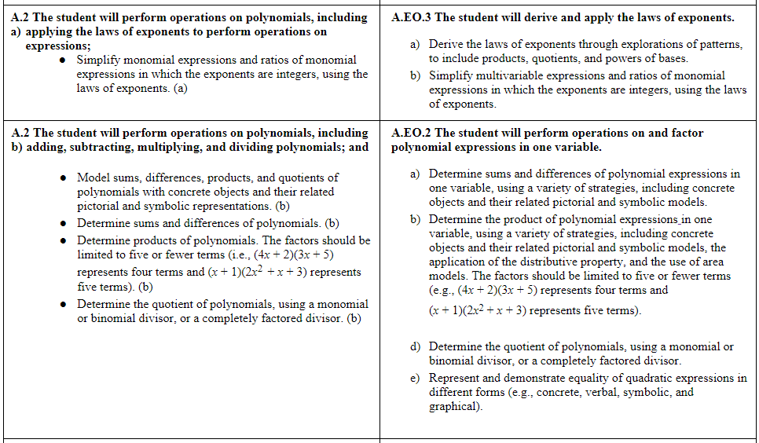
Overview of Revisions (2016 to 2023 Mathematics Standards of Learning) document
Notes:
An Overview of Revisions document has been created for each grade or course. This presentation provides a detailed comparison between the 2016 Standards of Learning and the 2023 Standards of Learning and is based upon the Overview of Revisions document.

Slide 12
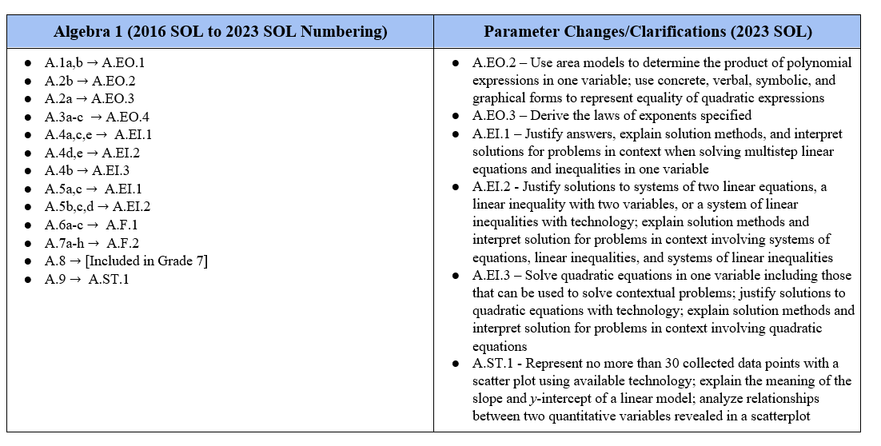
Overview of Revisions- Summary of Changes (1 of 2)
Notes:
At the end of the Overview of Revisions document there is a summary of changes table. One section of the table provides an overview of the changes to the numbering of the standards. Another section provides information regarding the prominent parameter changes and clarifications. Parameter changes and clarifications might be related to an increase or decrease in the limiters of the standards or the knowledge and skills; but might also be related to the depth of understanding of the content or scope of the content.

Slide 13
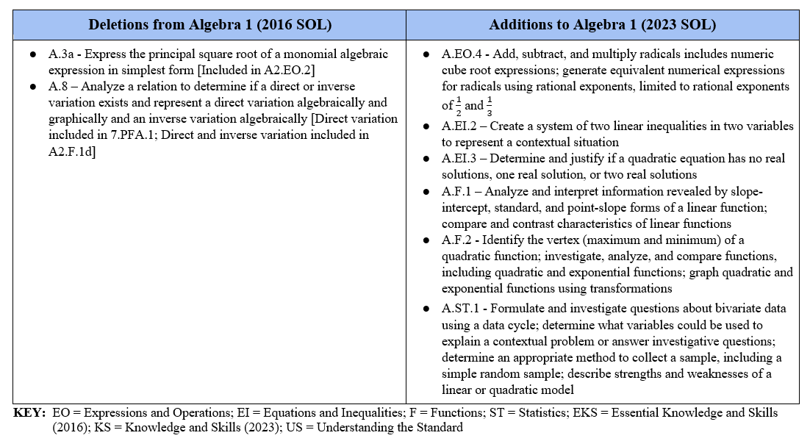
Overview of Revisions- Summary of Changes (2 of 2)
Notes:
The other two sections of the table include deletions from 2016 standards and addition of content to the 2023 standards.

Slide 14
Comparison of 2016 Mathematics SOL to 2023 Mathematics SOL
Notes:
During the remainder of the presentation, we will take a closer look at the revisions to the 2016 standards that resulted in the new 2023 standards.

Slide 15
Expressions & Operations
Notes:
We will first examine the changes that occurred in the Expressions and Operations strand.

Slide 16
Standard A.1 (2016) - Standard A.EO.1 (2023)
2016 SOL | 2023 SOL
A.1 The student will represent verbal quantitative situations algebraically; and evaluate algebraic expressions for given replacement values of the variables. Translate between verbal quantitative situations and algebraic expressions and equations. (a) Represent practical situations with algebraic expressions in a variety of representations (e.g., concrete, pictorial, symbolic, verbal). (a) Evaluate algebraic expressions, using the order of operations, which include absolute value, square roots, and cube roots for given replacement values to include rational numbers, without rationalizing the denominator. (b) | A.EO.1 The student will represent verbal quantitative situations algebraically and evaluate these expressions for given replacement values of the variables. Translate between verbal quantitative situations and algebraic expressions, including contextual situations. Evaluate algebraic expressions which include absolute value, square roots, and cube roots for given replacement values to include rational numbers, without rationalizing the denominator.
Revisions:
A..EO.1a includes both translating between verbal quantitative situations and algebraic expressions, including contextual situations.
Notes:
Throughout this presentation red text in the 2023 column indicates a change or addition to the content at this level. Red text in the 2016 column provides notes about where content may have been moved or deleted. You will also see symbols that indicate content that is NEW to the grade level or course.
As we begin with the Algebra standards, we have the first opportunity to see the new numbering system with 2016 SOL A.1 becoming 2023 SOL A.EO.1. There are not significant changes to this standard. The first two bullets from the previous Essential Knowledge and Skills (EKS) are now combined to create the Knowledge and Skill statement designated by “a.” The third bullet is now represented by “b”.
It is notable to mention that the phrase ‘practical situations’ from 2016 has been replaced with ‘contextual situations’ in 2023 Mathematics Standards of Learning. This is to put a stronger emphasis on realistic applications within mathematical problem solving.

Slide 17
Standard A.2.a (2016) - Standard A.EO.3 (2023)
2016 SOL | 2023 SOL
A.2 The student will perform operations on polynomials, including applying the laws of exponents to perform operations on expressions; Simplify monomial expressions and ratios of monomial expressions in which the exponents are integers, using the laws of exponents. (a) | A.EO.3 The student will derive and apply the laws of exponents. Derive the laws of exponents through explorations of patterns, to include products, quotients, and powers of bases. Simplify multivariable expressions and ratios of monomial expressions in which the exponents are integers, using the laws of exponents.
Revisions:
The 2016 A.2 standard of polynomial operations and exponential laws has been divided into two standards in 2023; A.EO.2 and A.EO.3.
A.EO.3a - In addition to applying the laws of exponents, the 2023 SOL specify that students derive the laws of exponents through exploring patterns to develop their understanding of these laws.
Notes:
The 2016 A.2 standard included laws of exponents, operations on polynomials, and factoring. In 2023 this has been divided into two standards to deepen the exploration of polynomials and exponents. The A.2.a standard from 2016 is now A.EO.3. With these new standards students are now expected to derive the laws of exponents through exploration of patterns as well as apply them.

Slide 18
Standard A.2.b (2016) - Standard A.EO.2 (2023)
2016 SOL | 2023 SOL
A.2 The student will perform operations on polynomials, including adding, subtracting, multiplying, and dividing polynomials; and Model sums, differences, products, and quotients of polynomials with concrete objects and their related pictorial and symbolic representations. (b) Determine sums and differences of polynomials. (b) Determine products of polynomials. The factors should be limited to five or fewer terms (i.e., (4x + 2)(3x + 5) represents four terms and (x + 1)(2x² + x + 3) represents five terms). (b) Determine the quotient of polynomials, using a monomial or binomial divisor, or a completely factored divisor. (b) | A.EO.2 The student will perform operations on and factor polynomial expressions in one variable. Determine sums and differences of polynomial expressions in one variable, using a variety of strategies, including concrete objects and their related pictorial and symbolic models. Determine the product of polynomial expressions in one variable, using a variety of strategies, including concrete objects and their related pictorial and symbolic models, the application of the distributive property, and the use of area models. The factors should be limited to five or fewer terms (e.g., (4x + 2)(3x + 5) represents four terms and (x + 1)(2x² + x + 3) represents five terms. Determine the quotient of polynomials, using a monomial or binomial divisor, or a completely factored divisor. Represent and demonstrate equality of quadratic expressions in different forms (e.g., concrete, verbal, symbolic, and graphical).
Revisions:
The 2016 A.2 standard of polynomial operations and exponential laws has been divided into two standards in 2023; A.EO.2 and A.EO.3.
A.EO.2b – Students will use area models when representing the product of polynomial expressions.
A.EO.2e - As students explore the equality of quadratic expressions, they will utilize models and manipulatives.
Notes:
As mentioned within the previous slide, in order to strength the students’ understanding of polynomials operations, this portion of the 2016 A.2 standard has become A.EO.2 in the 2023 Algebra 1 standards.
Students are expected to perform operations on polynomials and factor polynomial expressions in one variable. As before, students should continue to use concrete objects and pictorial and symbolic models in their work with sums and differences of polynomial expressions.
Additionally, in A.EO.2b students will use area models in their exploration of polynomial multiplication.
In A.EO.2e, an emphasis has been put on representing equality of quadratic expressions through different forms to include manipulatives, graphs, and symbols.
Note that 2023 A.EO.2e will also connect with 2016 SOL A.2c addressing factoring shown on the next slide.

Slide 19
Standard A.2.c (2016) - Standard A.EO.2 (2023)
2016 SOL | 2023 SOL
A.2 The student will perform operations on polynomials, including factoring completely first- and second-degree binomials and trinomials in one variable. Factor completely first- and second-degree polynomials in one variable with integral coefficients. After factoring out the greatest common factor (GCF), leading coefficients should have no more than four factors. (c) Factor and verify algebraic factorizations of polynomials with a graphing utility. (c) | A.EO.2 The student will perform operations on and factor polynomial expressions in one variable. Factor completely first- and second-degree polynomials in one variable with integral coefficients. After factoring out the greatest common factor (GCF), leading coefficients should have no more than four factors. Represent and demonstrate equality of quadratic expressions in different forms (e.g., concrete, verbal, symbolic, and graphical).
Revisions:
The 2016 A.2 standard of polynomial operations and exponential laws has been divided into two standards in 2023; A.EO.2 and A.EO.3.
A.EO.2e - As students explore the equality of quadratic expressions, they will utilize models and manipulatives.
Notes:
Factoring polynomials, 2016 SOL A.2c is included in A.EO.2 as part “c”. In emphasizing the equality of quadratic expressions; concrete, verbal, symbolic and graphical representations should be incorporated into factoring polynomials as well as the other polynomial operations mentioned in A.2b on the previous slide.
Note that 2023 A.E0.2e is also connected with 2016’s A.2b operation standard on the previous slide.

Slide 20
Standard A.3 (2016) - Standard A.EO.4 (2023)
2016 SOL | 2023 SOL
A.3 The student will simplify square roots of whole numbers and monomial algebraic expressions; cube roots of integers; and numerical expressions containing square or cube roots. Express the square root of a whole number in simplest form. (a) Express the principal square root of a monomial algebraic expression in simplest form where variables are assumed to have positive values. (a) Express the cube root of an integer in simplest form. (b) Simplify a numerical expression containing square or cube roots. (c) Add, subtract, and multiply two monomial radical expressions limited to a numerical radicand. (c) | A.EO.4 The student will simplify and determine equivalent radical expressions involving square roots of whole numbers and cube roots of integers. Simplify and determine equivalent radical expressions involving the square root of a whole number in simplest form. Simplify and determine equivalent radical expressions involving the cube root of an integer. Add, subtract, and multiply radicals, limited to numeric square and cube root expressions. Generate equivalent numerical expressions and justify their equivalency for radicals using rational exponents, limited to rational exponents of $\frac{1}{2}$ and $\frac{1}{3}$ (e.g., $\sqrt{5}$ = $5^{\frac{1}{2}}$; $\sqrt[3]{8}=8^{\frac{1}{3}}$ = ${\left(2^{3}\right)}^{\frac{1}{3}}$ = 2).
Revisions:
A.EO.4c – Students will add, subtract, and multiply radicals, including numeric cube root expressions.
A.EO.4d - Students will now explore rational exponents as equivalent to square and cube root notation.
Notes:
2016 SOL A.3, simplifying radical expressions, becomes the fourth standard within the Expressions and Operations strand, A.EO.4. The 2023 standards now clarify that students will perform addition, subtraction, and multiplication with expressions including cube roots as well as those with square roots. Additionally, with simplifying radical expressions, students will explore equivalencies of square and cube roots with rational exponents.

Slide 21
Equations & Inequalities
Notes:
The next strand of the Algebra 1 standards that we will examine is Equations and Inequalities.

Slide 22
Standard A.4a,c (2016) - Standard A.EI.1 (2023)
2016 SOL | 2023 SOL
A.4 The student will solve multistep linear equations in one variable algebraically; literal equations for a specified variable; Determine whether a linear equation in one variable has one, an infinite number, or no solutions. (a) Apply the properties of real numbers and properties of equality to simplify expressions and solve equations. (a, b) Solve multistep linear equations in one variable algebraically. (a) Solve a literal equation for a specified variable. (c) | A.EI.1 The student will represent, solve, explain, and interpret the solution to multistep linear equations and inequalities in one variable and literal equations for a specified variable. Write a linear equation or inequality in one variable to represent a contextual situation. Solve multistep linear equations in one variable, including those in contextual situations, by applying the properties of real numbers and/or properties of equality. Rearrange a formula or literal equation to solve for a specified variable by applying the properties of equality. Determine if a linear equation in one variable has one solution, no solution, or an infinite number of solutions. Verify possible solution(s) to multistep linear equations and inequalities in one variable algebraically, graphically, and with technology to justify the reasonableness of the answer(s). Explain the solution method and interpret solutions for problems given in context.
Revisions:
A.EI.1 combines solving multistep linear equations from A.4 and solving multistep linear inequalities from A.5.
Students will deepen their understanding by justifying and explaining solution methods.
Notes:
In 2016, the standards separated Linear Equations into A.4 and Inequalities into A.5. In 2023 Linear Equations and Inequalities are combined in both standard A.EI.1 and standard A.EI.2. A.EI.1 focuses on solving linear equations and inequalities and A.EI.2 focuses on solving linear systems of equations and systems of inequalities.
Within A.EI.1, students will further their conceptual understanding of solutions to linear equations and inequalities by justifying their solutions and assessing the reasonableness of their answer.
A.EI.1a is further connected to A.5 on a future slide as this standard includes writing linear equations and inequalities.

Slide 23
Standard A.4b (2016) - Standard A.EI.3 (2023)
2016 SOL | 2023 SOL
A.4 The student will solve quadratic equations in one variable algebraically; Apply the properties of real numbers and properties of equality to simplify expressions and solve equations. (a, b) Solve quadratic equations in one variable algebraically. Solutions may be rational or irrational. (b) | A.EI.3 The student will represent, solve, and interpret the solution to a quadratic equation in one variable. Solve a quadratic equation in one variable over the set of real numbers with rational or irrational solutions, including those that can be used to solve contextual problems. Determine and justify if a quadratic equation in one variable has no real solutions, one real solution, or two real solutions. Verify possible solution(s) to a quadratic equation in one variable algebraically, graphically, and with technology to justify the reasonableness of answer(s). Explain the solution method and interpret solutions for problems given in context.
Revisions:
A.4b, solving quadratic equations, has been further expanded into its own standard A.EI.3.
Students will deepen their understanding by justifying and explaining solution methods.
Notes:
In the 2016 Mathematics Standards of Learning, linear and quadratic equations were combined in A.4. In the 2023 Mathematics Standards of Learning, quadratic equations have been separated into their own standards of A.EI.3. Within this standard students will solve quadratic equations including those used in contextual situations.
The new standards now clarify that students will determine and justify the number of solutions in a quadratic equation.
Students will continue to deepen their understanding of quadratic solutions by using technology to justify the reasonableness of a solution. Students will justify their answers and solution methods and interpret their solutions for problems given in context.

Slide 24
Standard A.4d (2016) - Standard A.EI.2 (2023)
2016 SOL | 2023 SOL
A.4 The student will solve systems of two linear equations in two variables algebraically and graphically; and Given a system of two linear equations in two variables that has a unique solution, solve the system by substitution or elimination to identify the ordered pair which satisfies both equations. (d) Given a system of two linear equations in two variables that has a unique solution, solve the system graphically by identifying the point of intersection. (d) Solve and confirm algebraic solutions to a system of two linear equations using a graphing utility. (d) Determine whether a system of two linear equations has one, an infinite number, or no solutions. (d) | A.EI.2 The student will represent, solve, explain, and interpret the solution to a system of two linear equations, a linear inequality in two variables, or a system of two linear inequalities in two variables. Apply the properties of real numbers and/or properties of equality to solve a system of two linear equations in two variables, algebraically and graphically. Determine whether a system of two linear equations has one solution, no solution, or an infinite number of solutions.
Revisions:
A.EI.2 combines solving systems of equations from A.4 and systems of linear inequalities from A.5.
Notes:
A.4d, solving systems of equations, and A.5d, systems of inequalities, have been combined in standard A.EI.2. The portions of A.EI.2 that connect to A.4d are parts “b” & “c”. On a future slide we will see the inequalities portion of standard A.EI.2.
The first two bullets of A.4d Essential Knowledge and Skills (EKS) are combined in A.EI.2b, where students will solve systems of two linear equations algebraically and graphically through applications of properties. The fourth bullet became A.EI.2c.

Slide 25
Standard A.4e (2016) - Standard A.EI.2 (2023)
2016 SOL | 2023 SOL
A.4 The student will solve practical problems involving equations and systems of equations. Write a system of two linear equations that models a practical situation. (e) Interpret and determine the reasonableness of the algebraic or graphical solution of a system of two linear equations that models a practical situation. (e) Solve practical problems involving equations and systems of equations. (e) | A.EI.2 The student will represent, solve, explain, and interpret the solution to a system of two linear equations, a linear inequality in two variables, or a system of two linear inequalities in two variables Create a system of two linear equations in two variables to represent a contextual situation; Verify possible solution(s) to a system of two linear equations, a linear inequality in two variable, or a system of two linear inequalities algebraically, graphically, and with technology to justify the reasonableness of the answer(s). Explain the solution method and interpret solutions for problems given in context. A.EI.1 The student will represent, solve, explain, and interpret the solution to multistep linear equations and inequalities in one variable and literal equations for a specified variable. Write a linear equation or inequality in one variable to represent a contextual situation;
Revisions:
2023 SOL A.EI.2 combines solving systems of equations from 2016 SOL A.4 and systems of linear inequalities from 2016 SOL A.5.
A.EI.2h - Students will deepen their understanding by justifying and explaining solution methods.
Notes:
In A.4e students solve practical problems involving equations and systems of equations. The concepts in this standard are captured in A.EI.1 which includes multistep equations and A.EI.2 that focuses on systems of equations.
The first bullet in A.4e Essential Knowledge and Skills (EKS) becomes A.EI.2a and the practical problems involving equations component of the third bullet is incorporated in A.EI.1a writing linear equations to represent a contextual situation.
Note that 2023 A.EI.2h also connects with 2016’s A.5c inequalities standard on a future slide and 2023 A.EI.1a is also connected with 2016’s A.5d inequalities standard on a future slide.

Slide 26
Standard A.5a,b (2016) - Standard A.EI.2 (2023)
2016 SOL | 2023 SOL
A.5 The student will solve multistep linear inequalities in one variable algebraically and represent the solution graphically; represent the solution of linear inequalities in two variables graphically; Solve multistep linear inequalities in one variable algebraically and represent the solution graphically. (a) Apply the properties of real numbers and properties of inequality to solve multistep linear inequalities in one variable algebraically. (a) Represent the solution of a linear inequality in two variables graphically. (b) Determine and verify algebraic solutions using a graphing utility. (a, b, c, d) | A.EI.1 The student will represent, solve, explain, and interpret the solution to multistep linear equations and inequalities in one variable and literal equations for a specified variable. Solve multistep linear inequalities in one variable algebraically and graph the solution set on a number line, including those in contextual situations, by applying the properties of real numbers and/or properties of inequality. A.EI.2 The student will represent, solve, explain, and interpret the solution to a system of two linear equations, a linear inequality in two variables, or a system of two linear inequalities in two variables. Create a linear inequality in two variables to represent a contextual situation. Represent the solution of a linear inequality in two variables graphically on a coordinate plane.
Revisions:
2023 SOL A.EI.1 combines solving multistep linear equations from 2016 SOL A.4 and solving multistep linear inequalities from 2016 SOL A.5.
Notes:
2023 SOL A.EI.1 addresses multistep linear equations and inequalities. SOL A.EI.2 in 2023 is primarily focused on systems of linear equations and inequalities. However, 2023 SOL A.EI.2 is also where solving a linear inequality in two variables resides. Because of this the 2016 A.5 a-b standard is included in two different standards in 2023.
Note that 2023 A.EI.1c is also connected with 2016’s A.5c practical problem Knowledge and Skill on the next slide.

Slide 27
Standard A.5c (2016) - Standard A.EI.2 (2023)
2016 SOL | 2023 SOL
A.5 The student will solve practical problems involving inequalities; and Solve practical problems involving linear inequalities. (c) Determine whether a coordinate pair is a solution of a linear inequality or a system of linear inequalities. (c) Determine and verify algebraic solutions using a graphing utility. (a, b, c, d) | A.EI.1 The student will represent, solve, explain, and interpret the solution to multistep linear equations and inequalities in one variable and literal equations for a specified variable. Write a linear equation or inequality in one variable to represent a contextual situation. Solve multistep linear inequalities in one variable algebraically and graph the solution set on a number line, including those in contextual situations, by applying the properties of real numbers and/or properties of inequality.
Revisions:
A.EI.1 combines solving multistep linear equations from A.4 and solving multistep linear inequalities from A.5.
Notes:
To further develop the students’ conceptual understanding of solving linear equations and inequalities, A.5c, solving practical problems with inequalities, has been combined with components of A.4, solving practical problems with linear equations, in the 2023 Standard A.EI.1.
Also note that 2023 A.EI.1a is also connected with 2016’s A.4 equation standard on a previous slide. 2023 A.EI.1c is also connected with 2016’s A.4a solving inequalities standard on the previous slide.

Slide 28
Standard A.5d (2016) - Standard A.EI.2 (2023)
2016 SOL | 2023 SOL
A.5 The student will represent the solution to a system of inequalities graphically. Represent the solution of a system of two linear inequalities graphically. (d) Determine and verify algebraic solutions using a graphing utility. (a, b, c, d) | A.EI.2 The student will represent, solve, explain, and interpret the solution to a system of two linear equations, a linear inequality in two variables, or a system of two linear inequalities in two variables. Create a system of two linear inequalities in two variables to represent a contextual situation. Represent the solution set of a system of two linear inequalities in two variables, graphically on a coordinate plane. Verify possible solution(s) to a system of two linear equations, a linear inequality in two variable, or a system of two linear inequalities algebraically, graphically, and with technology to justify the reasonableness of the answer(s). Explain the solution method and interpret solutions for problems given in context.
Revisions:
A.EI.2 combines solving systems of equations from A.4 and systems of linear inequalities from A.5
Systems of inequalities will now include more contextual situations, and students will be asked to create these systems from the given context.
Students will deepen their understanding by justifying and explaining solution methods.
Notes:
As previously mentioned, systems of equations and systems of inequalities are combined in A.EI.2. Within A.EI.2, students will create and solve systems of inequalities representing contextual situations. Within A.5d, students use a graphing utility to verify solutions. A.EI.2 requires students to verify solutions through technology, opening opportunities beyond graphical representations.

Slide 29
Functions
Notes:
In the Functions strand of the Algebra 1 standards we will explore 2016 SOLs of A.6, A.7, and A.8.
The A.6 standard was previously in the Equations and Inequalities strand, but it is focused on graphing functions and the attributes of these graphs.
For this reason, these skills are now considered a part of the Functions strand.

Slide 30
Standard A.6.a (2016) - Standard A.F.1 (2023)
2016 SOL | 2023 SOL
A.6 The student will determine the slope of a line when given an equation of the line, the graph of the line, or two points on the line; Determine the slope of the line, given the equation of a linear function. (a) Determine the slope of a line, given the coordinates of two points on the line. (a) Determine the slope of a line, given the graph of a line. (a) Recognize and describe a line with a slope or rate of change that is positive, negative, zero, or undefined. (a) | A.F.1 The student will investigate, analyze, and compare linear functions algebraically and graphically, and model linear relationships. Determine and identify the domain, range, zeros, slope, and intercepts of a linear function, presented algebraically or graphically, including the interpretation of these characteristics in contextual situations.
Revisions:
A.F.1a – Determining slope of a linear function represented algebraically and graphically is included alongside other characteristics of linear functions such as domain, range, zeros, and intercepts. Contextual situations are also included.
Notes:
Linear components of 2016 SOL A.6 and A.7 are included in the 2023 SOL A.F.1.
In 2023 A.F.1a Determining the slope of a line is included in this 2023 Knowledge and Skill. Just as in the 2016 standard, students will be expected to determine slope given the equation of a line, the coordinates of two points on the line, and given a graph of a line. Students are also still expected to recognize and describe a line with a slope that is positive, negative, zero, or undefined, which builds upon the concept of slope introduced in middle school.
2023 A.F.1a also combines other content related to linear functions from 2016 SOL A.6 and A.7. All non-linear functions (including the addition of exponential) are now in A.F.2.
A.6 and the linear components of A.7 are combined in A.F.1.
Point-slope form has moved from US to ES
The characteristics of functions have moved into linear (previously this list in part a was only for quadratic)

Slide 31
Standard A.6.b (2016) - Standard A.F.1 (2023)
2016 SOL | 2023 SOL
A.6 The student will write the equation of a line when given the graph of the line, two points on the line, or the slope and a point on the line; and Write the equation of a line when given the graph of a line. (b) Write the equation of a line when given two points on the line whose coordinates are integers. (b) Write the equation of a line when given the slope and a point on the line whose coordinates are integers. (b) Write the equation of a vertical line as x = a. (b) Write the equation of a horizontal line as y = c. (b) Write the equation of a line parallel or perpendicular to a given line through a given point. (b) | A.F.1 The student will investigate, analyze, and compare linear functions algebraically and graphically, and model linear relationships. Write equivalent algebraic forms of linear functions, including slope-intercept form, standard form, and point-slope form, and analyze and interpret the information revealed by each form. Write the equation of a linear function to model a linear relationship between two quantities, including those that can represent contextual situations. Writing the equation of a linear function will include the following situations: given the graph of a line; given two points on the line whose coordinates are integers; given the slope and a point on the line whose coordinates are integers; vertical lines as x = a; and horizontal lines as y = c. Write the equation of a line parallel or perpendicular to a given line through a given point.
Revisions:
A.F.1c - Students will write linear equations in multiple forms, including point-slope form, and analyze and interpret the information presented in each form.
Notes:
In 2023 SOL A.F.1 students will investigate linear functions much in the same fashion as noted in 2016 SOL A.6b with a few notable additions. New for 2023 is that students will write the equation of a line in slope-intercept, standard, and point-slope form. To build upon students mathematical reasoning skills, they will interpret and analyze the information presented in each form.

Slide 32
Standard A.6.c (2016) - Standard A.F.1 (2023)
 | 2023 SOL
A.6 The student will graph linear equations in two variables. Graph a linear equation in two variables, including those that arise from a variety of practical situations. (c) Use the parent function y = x and describe transformations defined by changes in the slope or y-intercept. (c) | A.F.1 The student will investigate, analyze, and compare linear functions algebraically and graphically, and model linear relationships. Investigate and explain how transformations to the parent function y = x affects the rate of change (slope) and the y-intercept of a linear function. Graph a linear function in two variables, with and without the use of technology, including those that can represent contextual situations. For any value, x, in the domain of f, determine f(x), and determine x given any value f(x) in the range of f, given an algebraic or graphical representation of a linear function. Compare and contrast the characteristics of linear functions represented algebraically, graphically, in tables, and in contextual situations.
Revisions:
A.F.1f – The standards specify that students are expected to graph linear functions with and without technology.
A.F.1h – Student compare and contrast characteristics of linear functions represented algebraically, graphically, and in contextual situations.
Notes:
2023 SOL A.F.1 focuses on behaviors and characteristics of linear functions, including graphing linear functions as stated in 2016’s A.6 standard. In A.F.1f the 2023 standards specify that students should graph a linear function with and without the use of technology. The 2023 standard A.F.1g specifically has students determine the range value of a linear function, given a domain value including representations given both algebraically and graphically. This standard was previously addressed in 2016 SOL A.7e for both linear and quadratic functions.
The 2023 Standards are directly addressing the need for students to be able to make connections between functions in the form of tables, graphs and how these can be applied in various contextual situations.

Slide 33
Standard A.7 (2016) - Standard A.F.2 (2023)
2016 SOL | 2023 SOL
A.7 The student will investigate and analyze linear and quadratic function families and their characteristics both algebraically and graphically, including determining whether a relation is a function; domain and range; zeros; intercepts; Determine whether a relation, represented by a set of ordered pairs, a table, a mapping, or a graph is a function. (a) Identify the domain, range, zeros, and intercepts of a function presented algebraically or graphically. (b, c, d) Use the x-intercepts from the graphical representation of a quadratic function to determine and confirm its factors. (c, d) Investigate and analyze characteristics and multiple representations of functions with a graphing utility. (a, b, c, d, e, f) | A.F.2 The student will investigate, analyze, and compare characteristics of functions, including quadratic, and exponential functions, and model quadratic and exponential relationships. Determine whether a relation, represented by a set of ordered pairs, a table, a mapping, or a graph is a function; for relations that are functions, determine the domain and range. Given an equation or graph, determine key characteristics of a quadratic function including x-intercepts (zeros), y-intercept, vertex (maximum or minimum), and domain and range (including when restricted by context); interpret key characteristics as related to contextual situations, where applicable. Graph a quadratic function, f(x), in two variables using a variety of strategies, including transformations f(x) + k and kf(x), where k is limited to rational values. Make connections between the algebraic (standard and factored forms) and graphical representation of a quadratic function.
Revisions:
A.F.2 – Investigate, analyze, and compare characteristics of exponential functions and model exponential relationships is now in A.F.2.
A.F.2b – Students are expected to determine the vertex of a quadratic function
A.F.2c – Students are expected to graph a quadratic function in two variables using transformations, using specified function notation.
The linear portions of 2016 SOL A.7 are in 2023 SOL A.F.1.
Notes:
2016 Standard A.7 covers the characteristics and behaviors of linear and quadratic functions. To best align the algebra skills in the area of functions, these two function families have split into two standards A.F.1 for linear functions and A.F.2: nonlinear functions. A.F.2 includes quadratic and exponential functions. More information regarding the exponential functions will be provided on the next slide.
Within the 2023 SOL A.F.2, students will expand their understanding of quadratic functions by determining various characteristics including the vertex as a maximum or minimum. Students will also explore the result of a transformation on the graph of a quadratic function using a variety of strategies.

Slide 34
Standard A.7 (2016) - Standard A.F.2 (2023)
2016 SOL | 2023 SOL
A.7 The student will investigate and analyze linear and quadratic function families and their characteristics both algebraically and graphically, including values of a function for elements in its domain; and connections between and among multiple representations of functions using verbal descriptions, tables, equations, and graphs. For any value, x, in the domain of f, determine f(x). (e) Represent relations and functions using verbal descriptions, tables, equations, and graph. Given one representation, represent the relation in another form. (f) Investigate and analyze characteristics and multiple representations of functions with a graphing utility. (a, b, c, d, e, f) | A.F.2 The student will investigate, analyze, and compare characteristics of functions, including quadratic, and exponential functions, and model quadratic and exponential relationships. Given an equation or graph of an exponential function in the form y = ab^{x} (where b is limited to a natural number), interpret key characteristics, including y-intercepts and domain and range; interpret key characteristics as related to contextual situations, where applicable. Graph an exponential function, f(x), in two variables using a variety of strategies, including transformations f(x) + k and kf(x), where k is limited to rational values. For any value, x, in the domain of f, determine f(x) of a quadratic or exponential function. Determine x given any value f(x) in the range of f of a quadratic function. Explain the meaning of x and f(x) in context. Compare and contrast the key characteristics of linear functions (f(x) = x), quadratic functions (f(x) = x² ), and exponential functions (f(x) = b^{x} ) using tables and graphs.
Revisions:
In the 2016 A.7 standard it covers linear and quadratic function families. Non-linear functions (including exponential functions) are now in A.F.2.
The linear portions of A.7 are in A.F.1.
A.F.2e,f - Students will analyze and graph exponential functions in addition to linear and quadratic functions.
Notes:
The depth of the context covered in 2016’s A.7 has expanded with the adoption of 2023’s A.F.2. Students will continue to evaluate functions for a given domain and determine the range of the function, however students will now work with quadratic and exponential functions. These results will be evaluated in context to provide meaningful connections to this topic.
Students will also explore the characteristics of exponential functions to include transformations and how it affects the graph.
Reminder that this is a continuation of the students’ development of a functional understanding as they move from
linear in Math 8,
deepening their understanding of Linear as well as adding Quadratic and Exponential in Algebra 1,
and extending on to other polynomial and logarithmic functions in Algebra 2.
Part h of A.F.2 is building the bridge between linear and nonlinear functions in order to strengthen connections within these concepts.

Slide 35
Standard A.8 (2016) - Deleted (2023)
2016 SOL | 2023 SOL
A.8 The student, given a data set or practical situation, will analyze a relation to determine whether a direct or inverse variation exists, and represent a direct variation algebraically and graphically and an inverse variation algebraically. Given a data set or practical situation, determine whether a direct variation exists. Given a data set or practical situation, determine whether an inverse variation exists. Given a data set or practical situation, write an equation for a direct variation. Given a data set or practical situation, write an equation for an inverse variation. Given a data set or practical situation, graph an equation representing a direct variation. | [Direct variation is included in Grade 7] [Both direct and inverse variation are included in Algebra 2]
Revisions:
2016 SOL A.8 has been removed from the Algebra 1 standards. Direct variation is included in 7.PFA.1 and Inverse Variation is included in A2.F.1d
Notes:
Standard A.8 is deleted from the 2023 Algebra 1 Standards as this content fits appropriately with other grade level standards. Direct Variation is covered in Grade 7 when students will graph proportional relationships in the form y=mx. Inverse variation is included in Algebra 2 as students explore connections between inverse and direct variation.

Slide 36
Statistics
Notes:
The 2023 Standards have a Data Cycle at the center of the statistical standards in all courses, K-12. This pushes students to not just DO things with data, but expands the expectation for students to ask critical questions and analyze the story that comes from the data.
In Algebra 1 there is no expansion on the types of data displays for students in this course. The 2023 standards continue to with scatterplots to look for patterns with the data.

Slide 37
Standard A.9 (2016) - Standard A.ST.1 (2023)
2016 SOL | 2023 SOL
A.9 The student will collect and analyze data, determine the equation of the curve of best fit in order to make predictions, and solve practical problems, using mathematical models of linear and quadratic functions. Determine an equation of a curve of best fit, using a graphing utility, given a set of no more than twenty data points in a table, a graph, or a practical situation. Make predictions, using data, scatterplots, or the equation of the curve of best fit. Solve practical problems involving an equation of the curve of best fit. Evaluate the reasonableness of a mathematical model of a practical situation. | A.ST.1 The student will apply the data cycle (formulate questions; collect or acquire data; organize and represent data; and analyze data and communicate results) with a focus on representing bivariate data in scatterplots and determining the curve of best fit using linear and quadratic functions. Formulate investigative questions that require the collection or acquisition of bivariate data. Determine what variables could be used to explain a given contextual problem or situation or answer investigative questions. Determine an appropriate method to collect a representative sample, which could include a simple random sample, to answer an investigative question. Given a table of ordered pairs or a scatterplot representing no more than 30 data points, use available technology to determine whether a linear or quadratic function would represent the relationship, and if so, determine the equation of the curve of best fit.
Revisions:
Students are expected to use data cycle (emphasized K-12) to analyze information beyond just an application.
Notes:
The data cycle that students will work with throughout the K-12 mathematics standards includes the steps of: formulating questions, collecting data, organizing and representing data, analyzing this data, and then communicating results.
The use of this cycle process in the exploration of data is to emphasize the problem-solving nature of the data all around us. It is not common that people outside of the classroom will have simple and straightforward questions provided to them. Students are now expected to wrestle with the ambiguities of the story that data can tell. Questions such as “what am I interested in exploring?”, or “what type of data do I need?”, or “does this data provide clarity to the question we are asking?” are crucial as students explore more relevant data conversations. This relates directly to the the 5 C’s of education: Critical thinking, Communication, Creativity, Collaboration, and Citizenship.
The word ‘bivariate’ is new term in 2023, but it is referencing data that can be listed as ordered pairs (x,y) and plotted on a coordinate plane. The focus on bivariate data in Algebra 1 is intentional as it will connect to the study of linear and nonlinear functions.

Slide 38
Standard A.9 (2016) - Standard A.ST.1 (2023)
2016 SOL | 2023 SOL
A.9 The student will collect and analyze data, determine the equation of the curve of best fit in order to make predictions, and solve practical problems, using mathematical models of linear and quadratic functions. Determine an equation of a curve of best fit, using a graphing utility, given a set of no more than twenty data points in a table, a graph, or a practical situation. Make predictions, using data, scatterplots, or the equation of the curve of best fit. Solve practical problems involving an equation of the curve of best fit. Evaluate the reasonableness of a mathematical model of a practical situation. | A.ST.1 The student will apply the data cycle (formulate questions; collect or acquire data; organize and represent data; and analyze data and communicate results) with a focus on representing bivariate data in scatterplots and determining the curve of best fit using linear and quadratic functions. Use linear and quadratic regression methods available through technology to write a linear or quadratic function that represents the data where appropriate and describe the strengths and weaknesses of the model. Use a linear model to predict outcomes and evaluate the strength and validity of these predictions, including through the use of technology. Investigate and explain the meaning of the rate of change (slope) and y-intercept (constant term) of a linear model in context. Analyze relationships between two quantitative variables revealed in a scatterplot. Make conclusions based on the analysis of a set of bivariate data and communicate the results.
Revisions:
Students are expected to use data cycle (emphasized K-12) to analyze information beyond just an application.
Notes:
Students will continue to use models of data to make predictions. However, as we explore larger data sets, using technology becomes essential in this exploration.
As noted with the previously discussed Function standards, students will be asked to explore the relationships found in data sets in order to correctly select the appropriate model for the data.

Slide 39
Questions?
Contact the
Virginia Department of Education’s Mathematics Team at vdoe.mathematics@doe.virginia.gov
Notes:
This concludes the presentation on the 2023 Algebra 1 Mathematics Standards of Learning revisions. It may be helpful to refer back to this presentation as you are using the Overview of Revisions document to plan for instruction.
Should you have any questions, feel free to contact a member of the Mathematics Team at vdoe.mathematics@doe.virginia.gov.

