Slide 1
College Partnership Laboratory Schools Planning Grant Updates
State Board of Education
Lab School Standing Committee Meeting
Wednesday, April 12, 2023

Slide 2
Lab Schools – Website & Updates
Interactive and Superintendent’s Region Map of Applications to date, awards, and pipeline

Slide 3
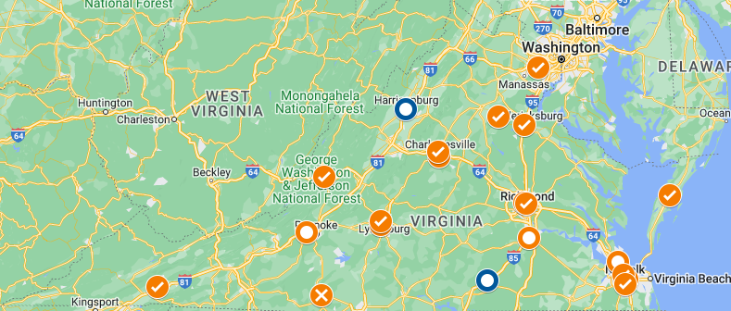
Lab Schools - Interactive Map
VDOE’s Lab Schools page now has a Planning Grant and Lab School Applications interactive map, which provides the status of each applicant/awardee, the location and focus of the proposed Lab School, and a list of the proposed community, school division, and private sector/industry partners.
This tool allows other four and two year colleges and universities and higher education centers, as well as other Planning Grant Applicants, to identify Planning Grant Awardees, and can prompt private sector/industry partners on how they can get involved.

Slide 4
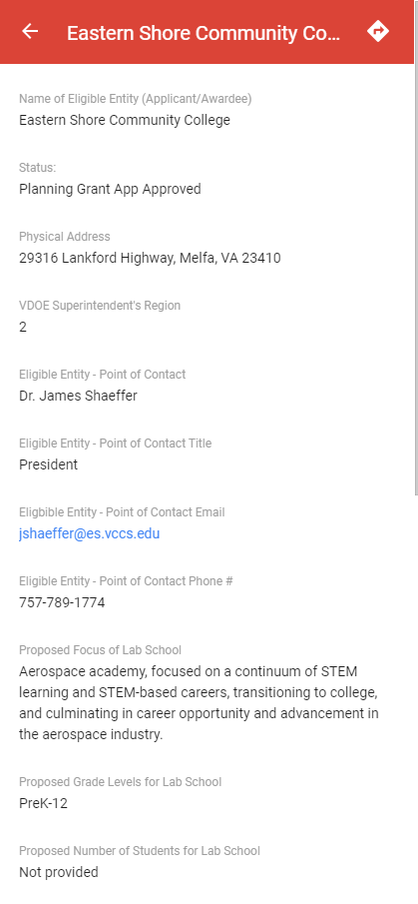
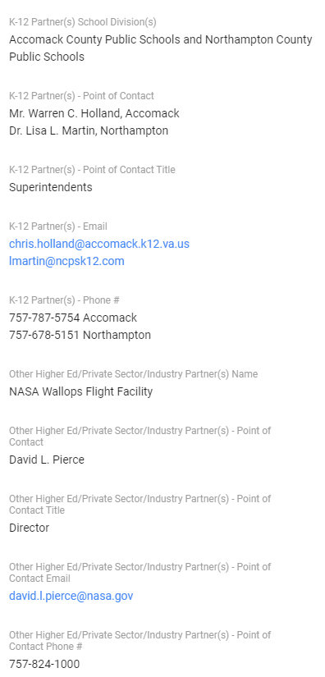
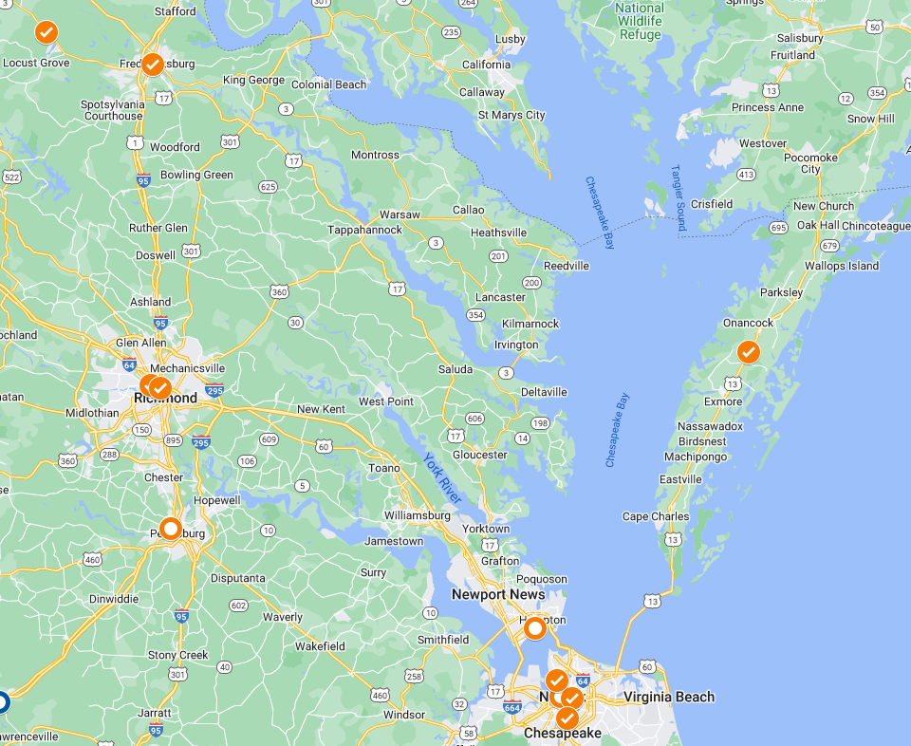
Lab Schools - Interactive Map

Slide 5
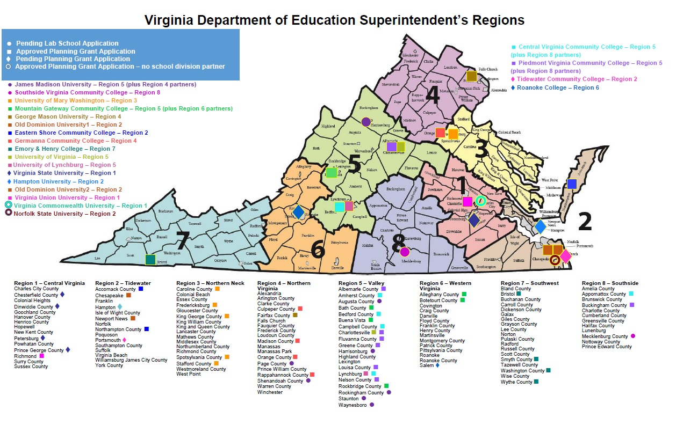
Lab Schools – region map

Slide 6
Planning Grant Applications and Awards
Planning Grant Applications to date, awards, and pipeline

Slide 7
Planning Grants – Review Process
Application Received and Acknowledged
Application Reviewed and scored by Evaluation Team
Evaluations Scored and Approved
Evaluations Scored and Technical Assistance Offered for Resubmission
Approval Letters and Grant Awards Sent
Awardees submit quarterly reports and receive partial fund awards
Within 12 Months Planning Grant Awardees submit their Laboratory School Applications

Slide 8
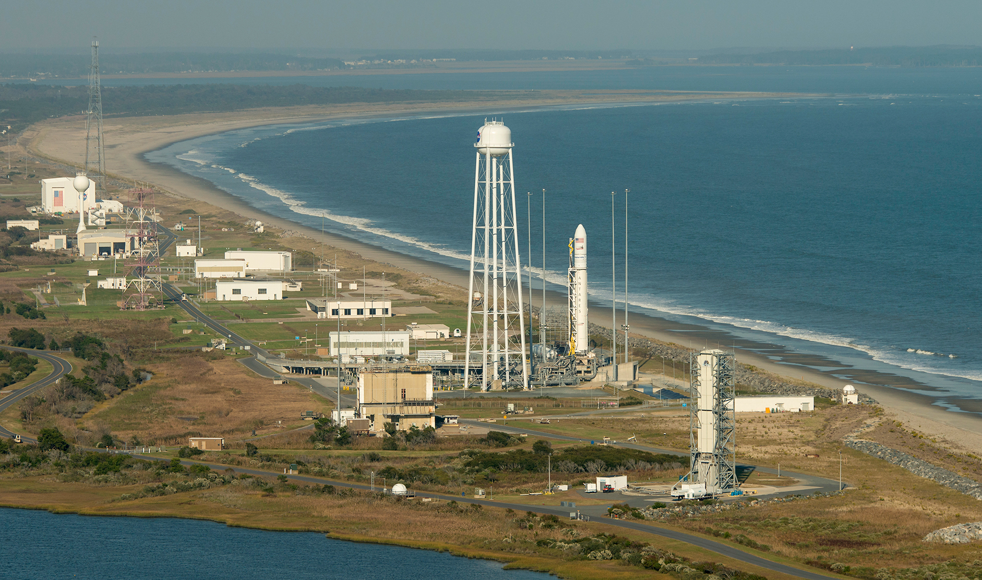
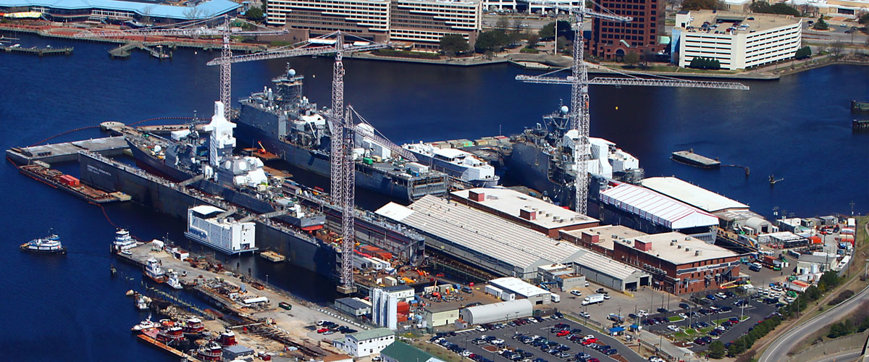
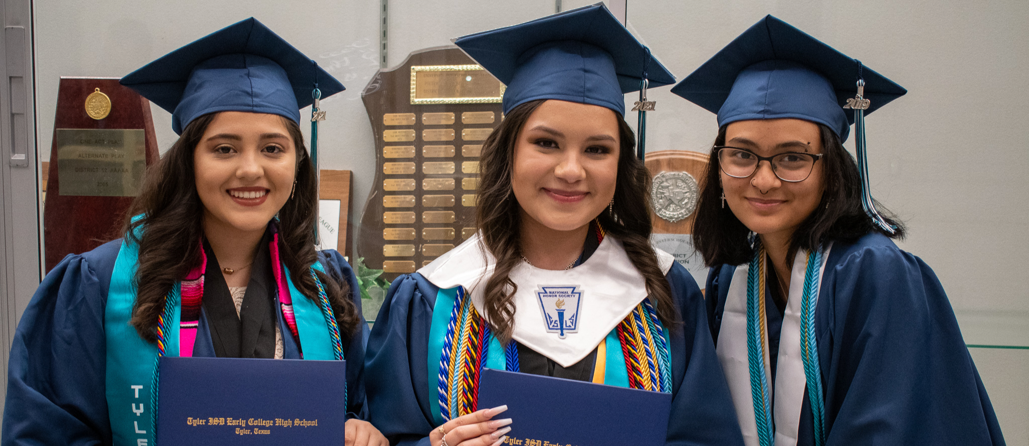
Planning Grants – Roll-up

Slide 9
Planning Grants – Roll-up
School Models
On IHE Campus School | School Within a School
School Foci
Career Preparation
Teacher Preparation
Early Literacy Support
Innovative Instructional Models
Early College

Slide 10
Planning Grants – Roll-up
Name of Eligible Entity (Applicant/Awardee) | Status: | VDOE Supt's Region | GRADE LEVELS | LAB SCHOOL INDUSTRY/AREA OF FOCUS | Proposed Grade Levels for Lab School | Proposed Number of Students for Lab School | K-12 Partner(s) School Division(s)
Central Virginia Community College | Planning Grant App Submitted | 5 | High School | CTE + COLLEGE & CAREER PATHWAYS | 11-12 | 200 students | Amherst, Appomattox, Bedford, and Campbell County Public Schools and Lynchburg City Public Schools
Eastern Shore Community College | Planning Grant App Approved | 2 | All (PreK-12) | AEROSPACE INDUSTRY + COLLEGE & CAREER PATHWAYS | PreK-12 | Not provided | Accomack County Public Schools and Northampton County Public Schools
Emory & Henry College | Planning Grant App Approved | 7 | High School | HEALTHCARE INDUSTRY CAREER PATHWAYS | 10-12 | Initial cohort: 32 students Total future cohort: 96 students | Smyth County Public Schools Also, Wythe County, Washington County, and the City of Bristol, and the A. Linwood Holton Governor’s School
George Mason University | Planning Grant App Approved | 4 | High School | INFORMATION TECHNOLOGY PATHWAYS + ACCELERATED COLLEGE, ASSOCIATE DEGREE, CREDENTIALS | 11-12 | Initial cohort: 30 students in 11th grade and 30 students in 12th grade Total future cohort: Potential to expand to additional students and/or grade levels as the program develops | Fairfax County Public Schools
Germanna Community College | Planning Grant App Approved | 4 | All (PreK-12) | ACADEMIC LEARNING LOSS + TEACHER PREPARATION & LICENSURE | PreK-12 | Initial cohort: 24 students Total future cohort: Not provided | Culpeper County Public Schools Orange County Public Schools Madison County Public Schools Rappahannock County Public Schools

Slide 11
Planning Grants – Roll-up
Hampton University | Planning Grant App Submitted | 2 | Elementary (K-5) | ARTS, INCLUDING DIGITAL | K-5 | 300 students | Hampton City Schools
James Madison University | Lab School Application Submitted | 5 | High School | INTERDISCIPLINARY + COLLEGE & CAREER PATHWAYS, WITH TEACHER PREPARATION | 9-12 | Initial cohort: 100 Freshmen and 100 Sophomores Future total cohort: 400 students | Augusta, Harrisonburg, Page, Rockingham, Shenandoah, Staunton, and Waynesboro County Public Schools
Mountain Gateway Community College | Planning Grant App Approved | 6 | High School | INFORMATION TECHNOLOGY & CYBERSECURITY PATHWAYS + CERTIFICATIONS | 10-12 | Not provided | Alleghany, Bath, Botetourt, and Rockbridge County Public Schools
New College Institute | Planning Grant App Not Approved | 6 | All (K-12) | INTEGRATIVE STEM & EXPERIENTIAL LEARNING | K-12 | Not provided | Franklin County Public Schools
Norfolk State University | Planning Grant App Approved | 2 | Elementary (PreK-2) | READING FOR STEAM GIFTED + IN-SERVICE TEACHER TRAINING | PreK-2 | Not Provided | Support from, though not partnering directly with, Norfolk Public Schools, Chesapeake City Schools, Suffolk Public Schools, Newport News Public Schools, and Hampton City Schools
Old Dominion University | Planning Grant App Approved | 2 | High School | MARITIME INDUSTRY + COLLEGE & CAREER PATHWAYS & IN-SERVICE TEACHER TRAINING | 9-12 | Initial cohort: Pilot group of 100 students Future cohort: Gradually move to increase to a full high school program of 100 students per level in grades 9-12; 400 students total. | Newport News Public Schools
Old Dominion University | Planning Grant App Approved | 2 | Middle School | COMPUTER SCIENCE IB + COLLEGE & CAREER PATHWAYS | 6-8 | Not provided | Chesapeake City Public Schools

Slide 12
Planning Grants – Roll-up
Piedmont Virginia Community College | Planning Grant App Approved | 5 | High School | HIGH SCHOOL: ADVANCED MANUFACTURING & IT COLLEGE & CAREER PATHWAYS + DUAL ENROLLMENT | 11-12 | 80 students | Potential partnering school divisions: Albemarle County Public Schools Charlottesville City Schools Louisa County Public Schools Fluvanna County Public Schools Greene County Public Schools Nelson County Public Schools Buckingham County Public Schools
Roanoke College | Planning Grant App Submitted | 6 | High School | HIGH SCHOOL: EDUCATION, STEM & COMMUNICATIONS COLLEGE & CAREER PATHWAYS | 9-12 | 25 students | Salem City Schools
Southside Virginia Community College | Lab School Application Submitted | 8 | High School | CAREER LITERACY PATHWAYS | 9-12 | Not provided | Mecklenburg County Public Schools
Tidewater Community College | Planning Grant App Submitted | 2 | PreK | KINDERGARTEN READINESS + PRE-SERVICE & IN-SERVICE TEACHER TRAINING | PreK | 20 students | Portsmouth Public Schools
University of Lynchburg | Planning Grant App Approved | 6 | Elementary (K-5) | EARLY LITERACY & SCIENCE OF READING | Beginning with grades K-1, adding grade levels up to 5th grade | 140 students | Lynchburg City Public Schools

Slide 13
Planning Grants – Roll-up
University of Mary Washington | Planning Grant App Approved | 3 | High School | COMPUTER & DATA SCIENCE + COLLEGE & CAREER PATHWAYS | 9-12 | 400 students | Stafford County Public Schools
University of Virginia | Planning Grant App Approved | 5 | Middle School | STEM & COMPUTER SCIENCE | 7-8 | 599 students | Charlottesville City Schools
Virginia Commonwealth University, Richmond Teacher Residency Program | Planning Grant App Approved | 1 | High School | COMPUTER SCIENCE + PRE-SERVICE TEACHER RESIDENCY & IN-SERVICE TRAINING | 9-12 | 345 or more students | Henrico County Public Schools
Virginia State University | Planning Grant App Submitted | 1 | Elementary (PreK-5) OR Middle & High School (6-12) | STEM PROGRAMMING & INITIATIVES | PreK-12 | Not provided | Petersburg Public Schools, and in partnership with Chesterfield, Dinwiddie, and Prince George Public Schools
Virginia Union University | Planning Grant App Approved | 1 | Middle & High School | STEAM | 6-12 | Not Provided | Richmond Public Schools

Slide 14
Planning Grant applications
A total of 20 Planning Grants Applications have been received to date:
Awarded: 15 Planning Grants have been awarded
Pending: 3 Applications are in the pipeline, with Applicants receiving technical assistance, submitting additional detail or pending receipt of scores
Received: 1 Application has been received and is pending assignment to the Funding Evaluation Review Committee for scoring
Declined: 1 Application has been declined

Slide 15
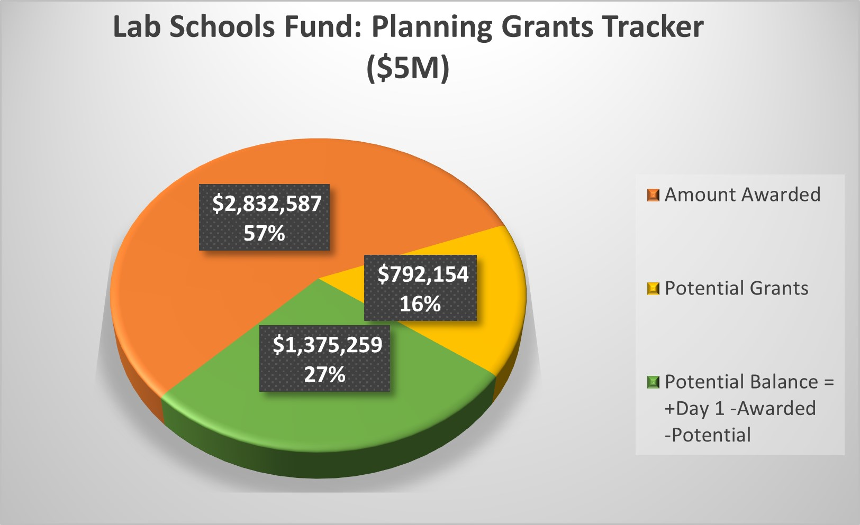
Planning Grant Awards
The College Partnership Laboratory Schools Fund, set out in § 22.1-349.2, provides $5M Planning Grants, of which:
The 15 Planning Grants Awards to date total $2.83 M
The Planning Grant Applications in the pipeline, or potential grants, total $792 K

Slide 16
Upcoming Event: Lab Schools Bootcamp May 3rd, 2023 Inviting Applicants, Awardees, and Industry/Private Sector Partners to Richmond for a day-long summit, peer-to-peer discussions, inquiry, and technical assistance Q&A

