Slide 1
The Virginia Literacy Act
Virginia Board of Education Work Session
March 2023

Slide 2
Objective and Agenda
Today’s presentation will provide an update on the Virginia Literacy Act (VLA) and an overview of the core instructional program review.
Overview of the VLA
Timeline and Accomplishments
Opportunities for Engagement
Core Instructional Program Review

Slide 3
Overview of the VLA

Slide 4
Why We Need the VLA
To reverse the trend in literacy levels
To address learning loss from the pandemic
To ensure all children read at benchmark in K-3
To provide support for increasing
numbers of at-risk readers
To provide teachers with evidence-based instructional strategies and curricula

Slide 5
How the VLA Will Improve Literacy
Virginia is taking the lead to reverse these trends and improve early literacy outcomes for the Commonwealth’s youngest learners.
Prepare Teachers
Align Curricula, Screening & Intervention Methods
Science-Based Reading Research
Evidence-Based
Literacy
Instruction
The Virginia Literacy Act
Partner with Families
Require Continuing Professional Development

Slide 6
Key Components of the VLA
Defines Evidence-Based Literacy Instruction and Science-Based Reading Research
Aligns Core Curricula, Screening, and Intervention Materials
Requires core instructional, supplemental, and intervention programs in grades K-3 be aligned with science-based reading research, as set out in a division-wide literacy plan.
Adds a division-wide staffing ratio of one reading specialist per 550 students in K-3.
Requires Professional Development for Reading Specialists, Teachers, and Principals
Partners with Families
Ensures parents are engaged in student reading plans and have access to resources.
Aligns Educator Preparation and Licensure
Requires certain educator preparation programs to ensure candidates have a program of coursework and demonstrate mastery in science-based reading research and evidence-based literacy instruction.
Requires literacy assessment for licensure or alternate route to licensure with certain endorsements.
Establishes a micro-credential program for add-on reading specialist endorsement.

Slide 7
Accomplishments and Timeline

Slide 8
Accomplishments To Date
The VDOE, in partnership with Virginia Literacy Partnerships at the University of Virginia, has made progress towards implementation:
Designed and launched Instructional Program Review Process for Core Curriculum, including developing rubrics, selecting and training Virginia reviewers, and facilitating multi-level decisions, with applications from 13 commercial programs and 2 division-developed programs.
Launched Advisory Workgroup with 33 members for 13 different roles that meets quarterly.
Hired 6 statewide Literacy Coaches who are designing integrated, hybrid, knowledge-based professional development for Reading Specialists that will launch Fall 2023.
Continued to overhaul the statewide literacy screener in English and Spanish; will pilot with 17 school divisions in 2023-2024 with full statewide implementation slated for 2024-2025.
Joined The Path Forward initiative to engage higher education and national experts in aligning educator preparation and endorsement programming.
Increased awareness via multiple webinars, memos, meetings, and conference sessions, and launched VLA-specific website.

Slide 9
High Level Timeline
Fall 2022 –
Round 1 of K-3 core curriculum reviews
Spring/Summer 2023– Board reviews recommended core curriculum from Round 1
Fall 2023 –
Additional rounds of reviews for core curriculum, supplemental, and intervention materials
Summer 2024 – Statewide training for teachers kicks off
Winter 2022 – Advisory Work Group launches
Summer 2023 – Statewide training for Reading Specialists kicks off
Winter-Spring 2024– Board reviews recommended materials from additional rounds
Fall 2024 –
All K-3 classrooms are using approved materials and teachers are supported to implement evidence-based literacy instruction
Notes:
JC

Slide 10
Preparation for 2023-2024
In 2023-2024, the VDOE and divisions will take additional steps to prepare for full implementation of the VLA by 2024-2025.
There will be additional rounds to identify best-in-class literacy instructional materials focused on core, supplemental and intervention materials.
Statewide training options in evidence-based literacy instruction and science-based reading research will be available for teachers and principals, beginning Summer 2024.
VDOE will release templates, tools, and guidance for division-wide literacy plans and student-specific reading plans along with a proposed calendar for annual VLA data collection and reporting.
VDOE will also work closely with educator preparation programs to begin to institute the shifts required by the VLA with a focus on Reading Specialists.

Slide 11
Opportunities for Engagement

Slide 12
Opportunities for Engagement
Implementing the VLA successfully requires building partnerships, securing buy-in, and ensuring the perspectives of leaders, educators, experts, and families are fully included. Here are the key ways the VDOE is engaging stakeholders:
Conducting quarterly meetings with the Virginia Literacy Act Advisory Work Group that includes a broad set of stakeholders (33) to solicit their insights and feedback.
Engaging Virginia literacy experts and educators through the instructional program review process.
Continuing to engage a separate Task Force that is advising the pilot of Virginia’s New Literacy Screener.
Conducting outreach within existing structures including conferences, webinars, regional meetings, and other events and activities.

Slide 13
Overview of Core Instructional Program Review

Slide 14
Purpose of Program Review
Provide a vetted list to the VDOE and VBOE for approval
Provide high-quality, Tier 1 reading instruction to every student in the Commonwealth of Virginia
Ensure that evidence-based literacy curriculum is implemented during the entire literacy block
Ensure teachers feel supported and well-equipped to meet student needs

Slide 15
Rubric Development
Consulted with curriculum review teams from CO, AK, LA
Revised rubrics based on feedback
Ensured that rubrics fully align with the law

Slide 16
Rubric Review
Received feedback from several sources, including colleagues in higher education and educators in K-12 schools
Examined rubrics in other states, including CO & LA
Created rubrics modeled on other states with similar legislation
Simulated program review using rubrics and with commercially available core K-3 curriculum in summer of 2022. Both VDOE and VLP staff were involved

Slide 17
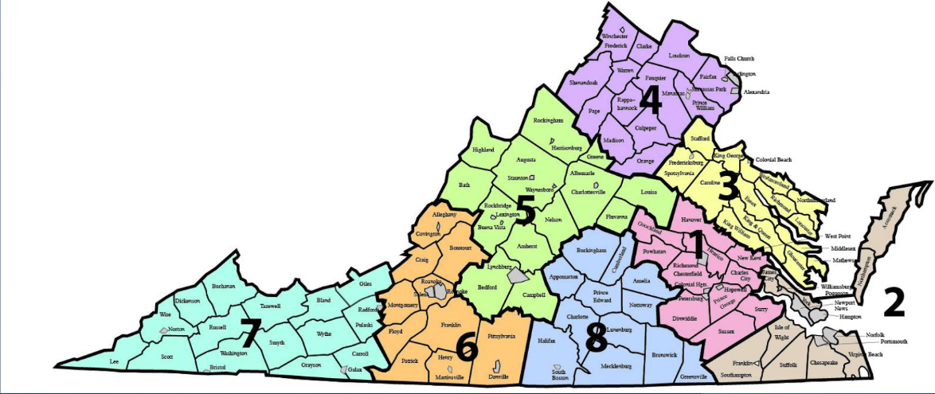
Representative & Inclusive Teams
VLP and VDOE partnered to interview and select Review Team (RT) Members:
180 applicants in total
36 chosen for Review Teams
8 additional reserve team members selected
Representation from all 8 geographical regions of the state on teams
Inclusion of teachers, Reading Specialists, literacy division leads, and administrators on teams

Slide 18
Training & Implementation
Webinars were developed for providers detailing the application procedure
Facilitators and RT members screened to ensure no affiliation exists with any provider/program
Quality Control measures identified in both Phase I and II ensure fidelity to the review process
Every RT member attended training for Phase I and Phase II
Facilitators meet twice weekly for norming analysis, recalibration, and reaching consensus as needed

Slide 19
Two-Phase Process
Phase I (4 weeks)
Phase II (8 weeks)
Goal: Ensure programs are aligned to science-based reading research, as well as Virginia Standards of Learning
Assess using a broad evaluative rubric
Eliminate programs that are clearly misaligned with science-based reading research
Goal: Delve deep into program and all materials to determine how aligned the program is to science-based reading research
Assess using detailed evaluation of all components of literacy instruction

Slide 20
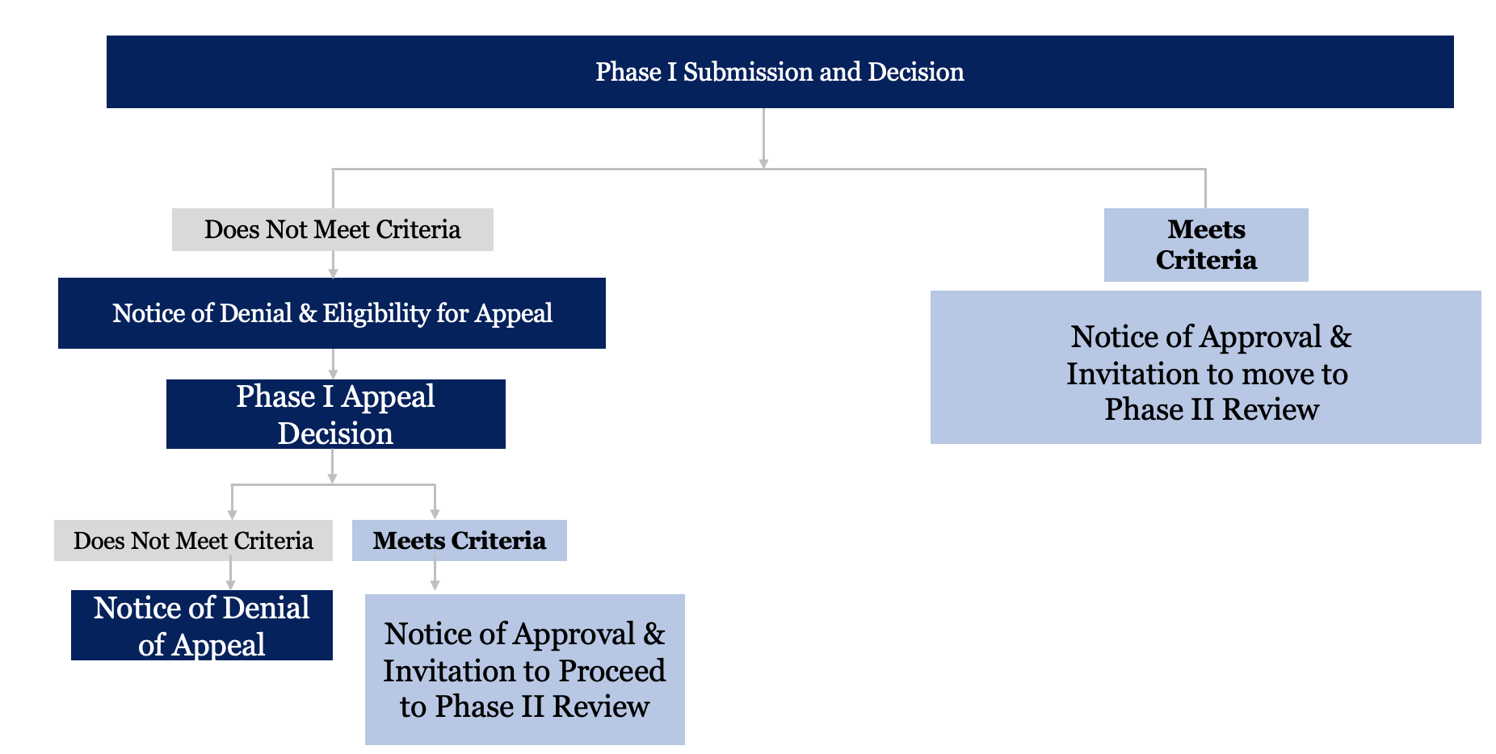
Process Workflow Phase I

Slide 21
Process Workflow Phase II

Slide 22
Process Review Timeline
Mid March –
Review Teams finish
Program review;
Decisions communicated to providers
Early-Mid April – Review Team appeals process
Late April/Early May –Anticipated date of VDOE submission of recommended Core Instructional Program Guide to VBOE
Early April –Appeals process begins
Mid April –
Final decisions to providers
Summer –
following VBOE approval, VDOE publishes the approved Core Instructional Program Guide
Notes:
JC

Slide 23
Final Result
At the conclusion of the Core Instructional Program Review, school divisions will be able to choose a program that:
Meets expectations in science-based reading research and evidence-based literacy instruction as defined in the Virginia Literacy Act;
Provides choice for divisions; and
Includes the assurance that each program has been fully vetted.

Slide 24
Alternative Programs
The VLA provides a provision for divisions to seek approval from the VDOE for use of an alternative program not included on the approved list.
Any alternative option would be subject to the same level of review and the program must be aligned to science-based reading research and evidence-based literacy instruction.
VLA Citation: “…Each local school board shall use programs from the lists developed by the Department pursuant to subsection C of § 22.1-253.13:5 and subdivision H 2 of § 22.1-253:1 or seek approval from the Department for the use of alternative programs that consist of evidence-based literacy instruction and align with science-based reading research.”

Slide 25
Questions?

