Slide 1
Update on School Accreditation Ratings under the Revised Standards of Accreditation
October 2018

Slide 2
Revisions to the Standards of Accreditation
Revisions to the Standards of Accreditation (SOA) were approved by the Board of Education in November 2017
Effective in the current 2018-2019 school year
Revised SOA is more comprehensive:
Defining school quality and expanding accountability
Implementing the Profile of a Virginia Graduate

Slide 3
State Accreditation Results: Academic Achievement
Data Source: 2018-2019 School Accreditation Data, Virginia Department of Education

Slide 4
State Accreditation Results: Achievement Gaps
Data Source: 2018-2019 School Accreditation Data, Virginia Department of Education

Slide 5
State Accreditation Results: English Achievement Gaps
Data Source: 2018-2019 School Accreditation Data, Virginia Department of Education

Slide 6
State Accreditation Results: Math Achievement Gaps
Data Source: 2018-2019 School Accreditation Data, Virginia Department of Education

Slide 7
State Accreditation Results: Chronic Absenteeism
Data Source: 2018-2019 School Accreditation Data, Virginia Department of Education
Notes:
Chronic absenteeism is a new indicator for state accreditation, and is also used for identifying schools under federal accountability. As you can see, most schools met the Level One benchmark for chronic absenteeism.

Slide 8
State Accreditation Results: Graduation and Completion Index and Dropout Rate
Data Source: 2018-2019 School Accreditation Data, Virginia Department of Education
Notes:
The total numbers are smaller for these two indicators as they only apply to schools with a graduating class. Most of our high schools me the Level One benchmark for GCI and for dropout; however nearly 1 in 5 schools were below the Level One benchmark for drop out, meaning their dropout rates were greater than 6 percent.

Slide 9
Application of Indicator Performance Levels to VDOE Actions
Performance Level | Actions
Level One: At or Above Standard | School monitors indicators and strives for continuous improvement
Level Two: Near Standard | School conducts comprehensive needs assessment and incorporates findings into school improvement plan For academic achievement indicators, VDOE academic review is required
Level Three: Below Standard | Work with VDOE to develop corrective action plan VDOE provides tailored technical assistance and intervention, including agreements between state and local superintendent

Slide 10
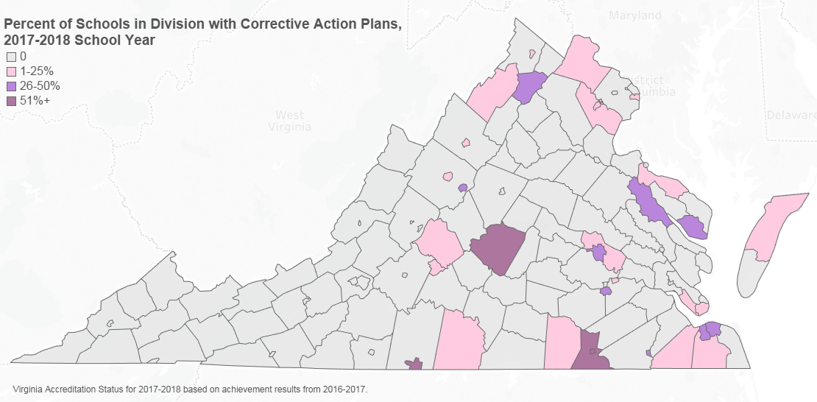
Corrective Action Plans Under Previous Accreditation System

Slide 11
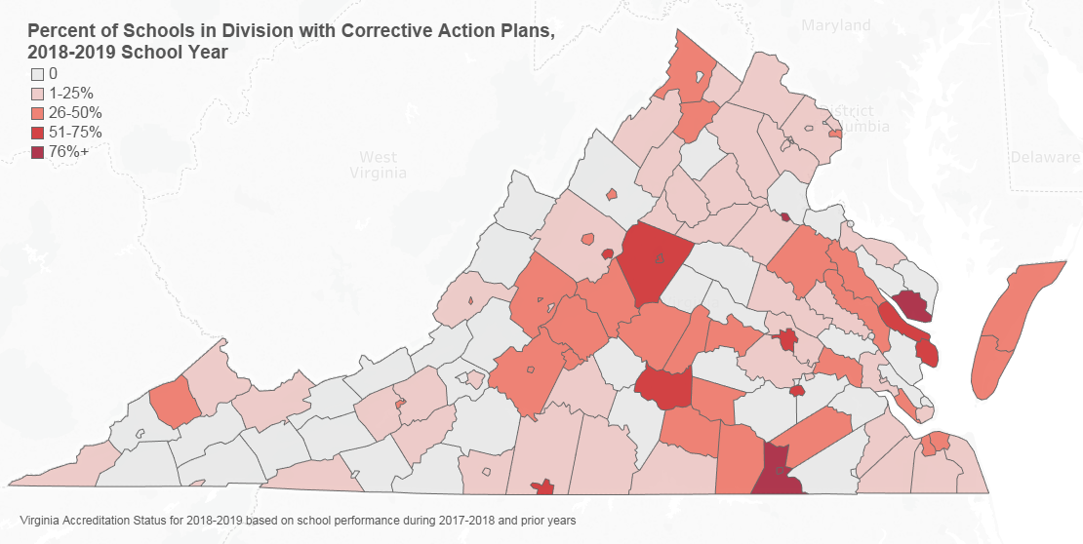
Corrective Action Plans Under Revised Accreditation System

Slide 12
State Accreditation Results: School Ratings
Data Source: 2018-2019 School Accreditation Data, Virginia Department of Education

