Slide 1
Virginia is For Learners
Accreditation and School Accountability Reform in Virginia

Slide 2
Why Change The Accountability System?
To provide a more comprehensive picture of school quality
To drive continuous improvement
To address the needs of every student
To provide tailored, timely, effective support to schools
To honor students’ growth towards benchmarks

Slide 3
Timeline for Implementation of New Accreditation System
2017: Board of Education adopts revised Standards of Accreditation
2018-2019 ratings (Transition Year): Schools could be accredited under the “old” accreditation rules or under the new system
2019-2020: Full implementation of the new accreditation system

Slide 4
School Quality Indicators
School Quality Indicators
Student Achievement
Chronic Absenteeism
Achievement Gaps
Student achievement for each major racial/ethnic group, students w/disabilities, English learners, economically disadvantaged students
Pass rates and year-to-year student growth
Percent of students missing ten percent or more of the school year
Graduation & Completion Index
Dropout Rate
Continues to measure the degree of students completing high school
Measures rate of students that leave high school permanently
College, Career, and Civic Readiness
Measures high school student engagement in advanced coursework, career and tech education, and work- and service-based learning
Not measured until 2021-22

Slide 5
Performance Levels
Assigned for each School Quality Indicator
Level 1
Meeting or exceeding the state standard or making adequate improvement
Level 2
Near the state standard or making adequate improvement
Level 3
Below the state standard

Slide 6
Recognizing School Improvement
A school with Level 2 Performance in a school quality indicator
Significant Improvement from the prior year
Level 1
A school with Level 3 Performance in a school quality indicator
Significant Improvement from the prior year
Level 2
Example of Significant Improvement: 10% reduction in failure rate

Slide 7
Where We Are:
Driving Continuous Improvement for ALL Schools

Slide 8
School Improvement Actions
Required for each School Quality Indicator
Level 1
Monitor and continue planning for improvement
Level 2
School division to develop and implement a school improvement plan
Level 3
State intervention, including corrective action plans and possibly, a memorandum of understanding

Slide 9
Accreditation Ratings
Accredited
All LEVEL 1 or LEVEL 2 School Quality Indicators
Accredited with Conditions
One or more LEVEL 3 School Quality Indicators
Accreditation Denied
One or more LEVEL 3 School Quality Indicators, and failure to adopt or implement corrective actions with fidelity
Notes:
A school may be accredited based on certain waivers, however if the have an indicator at Level Three, they are still required to develop a corrective action plan with VDOE. If an all students academic indicator (English, math or science) is at Level Two, they are also still required to undergo an academic review under the direction of VDOE.

Slide 10
Sample High School
English
Level 1
Chronic Absenteeism
Level 2
Mathematics
Level 1
Graduation & Completion Index
Level 1
Science
Level 1
Dropout Rate
Level 1
Achievement Gaps:
English
Level 2
OVERALL:
Accredited
Achievement Gaps: Mathematics
Level 2
Notes:
This school has all Level 1 and Level 2 indicators but need to develop local school improvement plans to address achievement gaps and chronic absenteeism
Virginia Continuous School Improvement Planning Process provides a research-based tool for school teams to examine multiple data sources and use the information to develop a multi-year improvement plan designed to improve student performance on school quality indicators. The process includes:
Conducting a Comprehensive Needs Assessment
Completing the Continuous School Improvement Plan
Training offered to all school division during 2018-2019. Intended as a means to move all schools toward a continuous improvement model.

Slide 11
Sample Middle School
English
Level 2
Chronic Absenteeism
Level 2
Mathematics
Level 1
Science
Level 1
OVERALL:
Accredited
with
Conditions
Achievement Gaps: English
Level 3
Achievement Gaps: Mathematics
Level 2
Notes:
School has one Level 3 Indicator so is Accredited with Conditions
School and division would develop local improvement plans to address English for all students, Achievement Gaps – Math, and Chronic Absenteeism
School would receive support from VDOE, including an academic review, and be required to develop a corrective action plan to address English Achievement Gaps

Slide 12
Sample Elementary School
English
Level 3
Chronic Absenteeism
Level 1
Mathematics
Level 3
OVERALL:
Accredited
with Conditions
Science
Level 2
Achievement Gaps: English
Level 3
IF CORRECTIVE ACTIONS
NOT TAKEN:
Accreditation Denied
Achievement Gaps: Mathematics
Level 3
Notes:
School has several Level 3 Indicators and is Accredited with Conditions
The SOA provides guidance as to the factors that are considered when determining the level of direction and intervention from the Department for schools with Level 3 Indicators:
Specific characteristics of the school and school division;
The number of school quality indicators at Level Three for the school;
A school's trajectory on the indicators at Level Three;
The length of time the school indicator has been at Level Three; and
The number of schools in the division with multiple school quality indicators at Level Three.
If school continues to perform at Level 3 AND does not implement improvement plans – Accreditation will be denied.

Slide 13
Statewide Pass Rates by Subject Area: 2016-2017 to 2018-2019
Notes:
New math assessments were implemented in 2018-19 school year, and new cut scores applied.
New verified credit rules in Science and History.

Slide 14
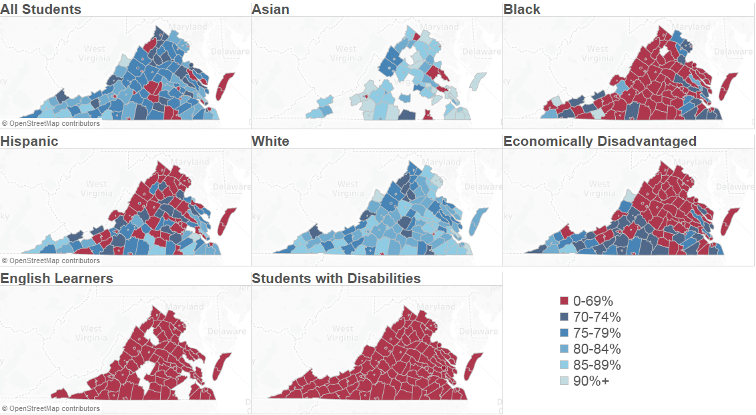
2018-2019 SOL Reading Pass Rate

Slide 15
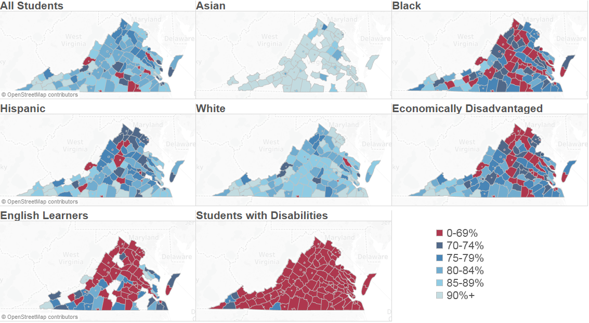
2018-2019 SOL Mathematics Pass Rate
Note: Pass rates are calculated as the number of students passing the assessment divided by the number of students tested.

Slide 16
School Quality Indicators
2018-2019 Accreditation Summary
Accredited Schools: 1,683
Accredited with Conditions Schools: 131
Schools with ALL Level One Indicators: 740
Schools with a Level Three Indicator: 271

Slide 17
School Quality Indicators
2019-2020 Accreditation Summary
Accredited Schools: 1,682
Accredited with Conditions Schools: 132
Schools with ALL Level One Indicators: 821
Schools with a Level Three Indicator: 193
Notes:
Of the 193 schools that have a Level 3 indicator, only 132 are Accredited with Conditions. The remaining 61 schools are on a waiver from annual accreditation. In comparison, last year, 116 schools were on a waiver from annual accreditation that otherwise would have been rated as Accredited with Conditions.
Compared to 2018:
A half percent more accredited with conditions schools (7.1% in 2018)
Less elementary schools, more middle and high schools accredited with conditions
Of the 130 schools accredited with conditions last year, 41 are accredited this year
Among schools accredited last year, 45 are accredited with conditions
The increase in schools with all Level One indicators can primarily be attributed to the new math assessments as discussed in slide 13.

Slide 18
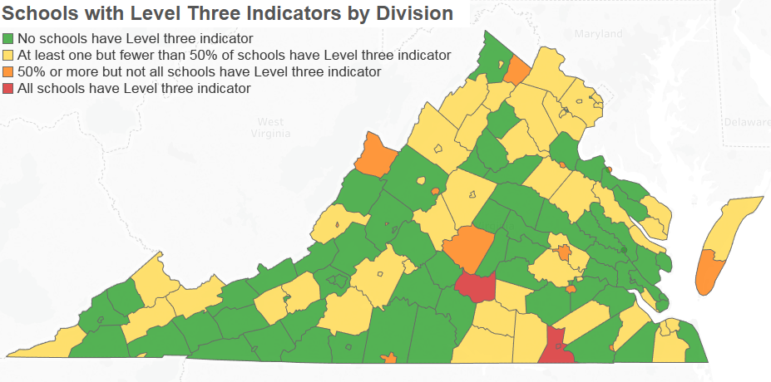
School Quality Indicators
Schools with Level 3 Indicators by Division
Notes:
If multiple schools in a school division are Accredited with Conditions, VDOE may consider entering into a division-wide MOU with the division
VDOE currently has MOUs with 3 divisions: Petersburg, Richmond and Greensville

Slide 19
Providing Effective Supports and Assistance to Individual Schools

Slide 20
New Accreditation System
Year 1
English
Level 1
Mathematics
Level 1
Science
Level 1
Achievement Gaps: English
Level 2
Division- developed Improvement Plan
Achievement Gaps: Math
Level 2
Chronic Absenteeism
Level 2
Graduation & Completion
Level 1
Dropout Rate
Level 2
ACCREDITED
Notes:
This school has level 2 performance in Achievement gaps for math, English, Chronic absenteeism, and dropout rates.
The school division will be required to develop improvement plans for these areas for these areas.

Slide 21
New Accreditation System
Year 1
Year 2
English
Level 1
Level 1
Mathematics
Level 1
Level 1
Science
Level 1
Level 1
Achievement Gaps: English
Level 2
Level 1
Achievement Gaps: Math
Level 2
Level 1
Division- developed Improvement Plan
Chronic Absenteeism
Level 2
Level 2
Graduation & Completion
Level 1
Level 1
Dropout Rate
Level 2
Level 1
ACCREDITED
ACCREDITED
ACCREDITED
Notes:
In the second year, the school has improved, and only shows Level two performance in Chronic absenteeism – the school will need to revisit its improvement plans

Slide 22
New Accreditation System
Year 1
Year 2
Year 3
English
Level 1
Level 1
Level 1
Mathematics
Level 1
Level 1
Level 1
Science
Level 1
Level 1
Level 1
Achievement Gaps: English
Level 2
Level 1
Level 1
Achievement Gaps: Math
Level 2
Level 1
Level 1
Chronic Absenteeism
Level 2
Level 2
Level 1
Graduation & Completion
Level 1
Level 1
Level 1
Dropout Rate
Level 2
Level 1
Level 1
ACCREDITED
ACCREDITED
ACCREDITED
Notes:
By the third year, the school is meets all standards and is Level 1 in all indicators
School is expected to continue to monitor the indicator and plan for improvement

Slide 23
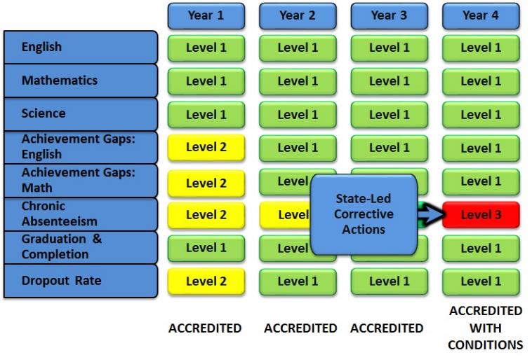
New Accreditation System
State-Led Academic Review
Level 2
Notes:
By the fourth year, the school regresses in chronic absenteeism and all students English achievement
The state will take a lead in supporting the school through development of corrective action plans for chronic absenteeism and an academic review for English

Slide 24
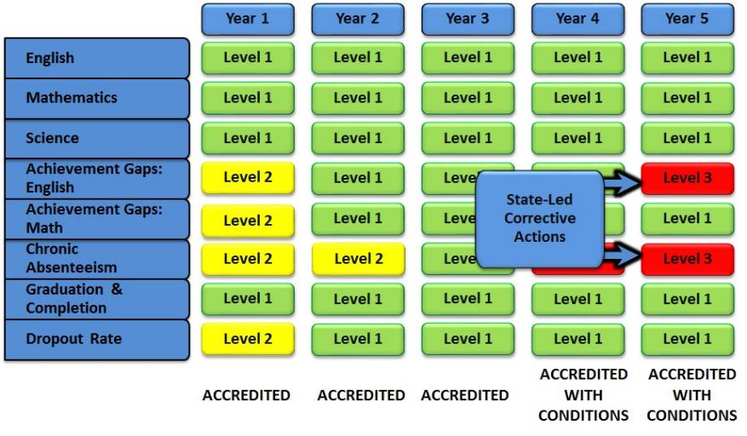
New Accreditation System
Level 2
Notes:
By the fifth year, the school continues to struggle with chronic absenteeism, and regresses in English achievement gaps
The scope of the support from the state would expand to address the achievement gap problems as well.

