Slide 1
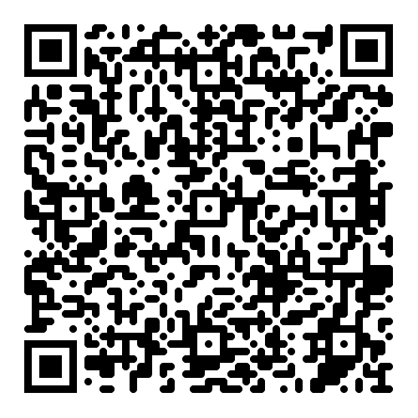
Did you know...?
Adult education in Virginia enrolled 18,118 individuals in program year 2022-2023
and…
Adult education is a minority-serving program, enrolling 77% non-white population.
Adult education students are working learners, 56% reported being employed at intake.
66% of adult education students are enrolled to learn English, and 3,538 foreign-born students are internationally trained professionals with a postsecondary degree or credential.
Adult Education in Virginia
Adult education offers a critical path for incarcerated adults and those reentering society; 615 correctional students were served.
Adult education is a career pathway program, enrolling 1,868 students in integrated education and training programs to earn industry-recognized credentials for employment and career advancement.
Data reflects services provided in program year 2022-2023
Scan or click the QR Code to get this and more fact sheets.
2024

