Slide 1
2019-2020 Balanced Assessment Plan Desk Reviews: Findings and Recommendations
May 29, 2020 Webinar
This presentation will be emailed to those registered for the webinar.

Slide 2
Agenda
Selections and Submissions
Expectations and Review Process
Findings from the Desk Reviews and Examples from School Divisions
Best Practices and More Examples from School Divisions
What is going well? What is challenging?
Expectations Moving Forward, Additional Content Resources, and Recommendations

Slide 3
v
Selections and Submissions

Slide 4
Selection Process
The Virginia Department of Education (VDOE) selected 24 school divisions for review.
Three divisions from each Superintendent’s Region were selected to represent a variety of types (e.g., rural, city, suburb, town, large, small, distant, fringe).
Selection also included one division from each region that also participated in the Local Alternative Assessment desk reviews conducted for 2014-2015.

Slide 5
Balanced Assessment Plans Submitted
VDOE asked each school division to submit Balanced Assessment Plans (BAPs) for two specified local alternative assessment areas.
Balanced Assessment Plans submitted:
Grade 3 History: 9 plans
Grade 3 Science: 10 plans
Grade 5 Writing: 10 plans
U.S. History to 1865: 9 plans
U.S. History: 1865 to the Present: 10 plans

Slide 6
x
Expectations and Review Process

Slide 7
General Process
VDOE staff from the offices of Student Assessment, Humanities, and STEM & Innovation reviewed each plan submitted.
VDOE requested telephone interviews with each school division to discuss local processes and learn more about successes and challenges.

Slide 8
What did we expect to see in the plans?
Information detailed in Superintendent’s Memo No. 181-19 and its attachment, “Overview: Balanced Assessment Plans,” set expectations for these desk reviews.

Slide 9
What guided VDOE’s review?
Purpose:
Reviewers looked for evidence that shows
expectations for BAPs are understood and
expectations for BAPs are being met.
What examples could be used to support other school divisions?
Process: Reviewers from the Department of Learning and from the Office of Student Assessment used a series of guiding questions or “look fors” to document evidence found within each plan.

Slide 10
Guiding Questions or “Look Fors” (1 of 6)
The guiding questions or “look fors” used by reviewers addressed the requirements for Balanced Assessment Plans and the practices that are encouraged but not required.
Guiding questions for required information:
What evidence is provided that all Standards of Learning (SOL) content and SOL skills are being measured?

Slide 11
Guiding Questions or “Look Fors” (2 of 6)
Indicate the types of local alternative assessments (LAA) documented in the plan.
Formative/ summative/ diagnostic/ interim?
Information about item types?
From the information included, does it appear that the assessment type used is a good fit for the skills and content being measured? (This may be more easily answered by reviewing assessment samples.)

Slide 12
Guiding Questions or “Look Fors” (3 of 6)
What evidence is provided that the division supports effective use of daily ongoing formative assessment practices in the classroom?
What evidence is provided that the division is using assessment data to inform instruction and support deeper learning for students?

Slide 13
Guiding Questions or “Look Fors” (4 of 6)
For divisions that also submitted Local Alternative Assessment Plans for 2014-2015, look for evidence of progress in implementing performance assessments.
List elements of the plan that reflect best practice and could serve as examples or models to support other school divisions.

Slide 14
Guiding Questions or “Look Fors” (5 of 6)
Guiding questions for practices that are encouraged but not required:
If the division submitted a completed Assessment Inventory, note any questions or areas to highlight.
Note evidence of opportunities for students to demonstrate the 5C’s.

Slide 15
Guiding Questions or “Look Fors” (6 of 6)
Note assessment innovation in other (non-LAA) courses that has been included in the plan or other information about innovation in instruction/assessment.
Has the division included optional information within plan that reflects best practice, which would be helpful as examples for other divisions?

Slide 16
..
Findings from the Desk Reviews
and Examples from School Divisions

Slide 17
Performance Assessment for Each Reporting Category/Strand
The original guidelines for LAAs suggested that school divisions administer LAAs for each reporting category or strand in the pertinent SOL.
Finding: It is best practice to use larger “chunks” of connected content focused on big ideas as the basis for performance assessments.
School divisions shared, through interviews and their Balanced Assessment Plans, that some content is more appropriate to assess with performance assessment while other content is better assessed through a traditional summative assessment.

Slide 18
Document How the SOL Are Assessed
BAP are expected to provide evidence that each Standard of Learning is assessed in some manner.
All SOL skills and content for the course should be documented, and the type of assessment used to gauge understanding of each should be included.
Many plans only documented SOL that are assessed through performance assessment.
During interviews, divisions shared that other SOL not documented in their BAPs were assessed through teacher-created unit tests, formative assessments, etc.

Slide 19
Documenting SOL
The following slides provide examples of evidence that school divisions assess the SOL, along with the types of assessments.
Examples are included to assist school divisions but are not meant to suggest divisions must use any specific template, model, or format.
Examples throughout this presentation are not meant to suggest that local plans should be changed, but consider if these examples can be used to inform future plans.

Slide 20
Document All SOL: Carroll County
The following table is an at-a-glance view of the main SOL strands, including skills, and how they are being assessed throughout the year.
This table illustrates a variety of assessment types and project based outcomes.

Slide 21
Carroll County Sample

Slide 22
Document All SOL: Staunton City (1 of 2)
Staunton City’s Balanced Assessment Plan for Grade 5 Writing documents all SOL for the content area.
Note: Some links in documents provided by school divisions in 2020 may no longer work. Please contact the school division if you have questions.

Slide 23
Document All SOL: Staunton City (2 of 2)
The SOL in this example are color coded to show the quarter in which the content will be taught and assessed.
During the interview, participants from Staunton City stated that “layering the content” helped students to build skills in writing. Attention was paid to teaching the specific content at strategic times.
Note: Some links in documents provided by school divisions in 2020 may no longer work. Please contact the school division if you have questions.

Slide 24
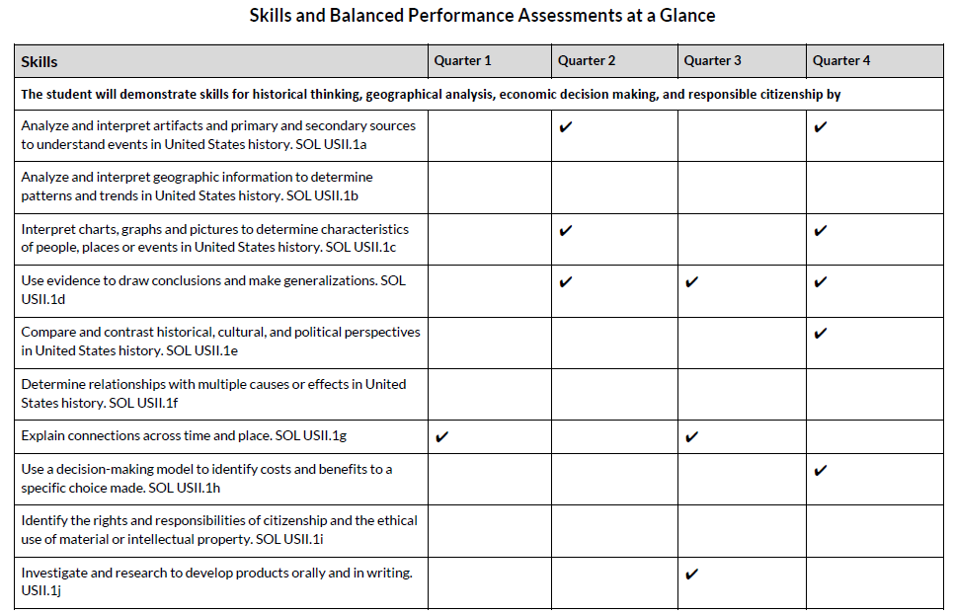
Documenting the Assessment of Skills: Danville
Danville Public Schools created a table to document when each of the history skills is formally measured through performance assessment. Tables within the plan also detail assessment types administered.
Note: Some links in documents provided by school divisions in 2020 may no longer work. Please contact the school division if you have questions.
Notes:
This example shows how one school division uses performance assessments to measure skills in one content area. This is not meant to imply that performance assessments are the only type of assessment that should be used to measure learning,

Slide 25
Documenting Assessment and Item Types
Balanced Assessment Plans should include evidence of a variety of assessment types to assess all skills.
Attention should be given to the type of assessment that would be most appropriate for a specific skill or content piece.

Slide 26
Assessment Variety: Lunenburg Co.
According to Lunenburg County’s Balanced Assessment Plan narrative:
“[T]he use of multiple, complementary assessments at various milestone points over the school year allows more valid and reliable evidence of student learning….”
“[Because] some essential intended learning outcomes are broad in scope but of lower cognitive levels…some [assessments] would best take the form select-response assessments (i.e., multiple choice question and technology-enhanced items).”

Slide 27
Assessment Variety: Frederick Co. (1 of 2)
Provided by Frederick County, the Balanced Assessment Plan for US History, Civics, and Economics to 1865 structured information into four columns: Unit Topic, Essential Questions, SOL, and Assessments.
Note: Some links in documents provided by school divisions in 2020 may no longer work. Please contact the school division if you have questions.

Slide 28
Assessment Variety: Frederick Co. (2 of 2)
The Assessments column is broken into three rows to show the diagnostic, formative, and summative assessments that will be used for each unit topic.

Slide 29
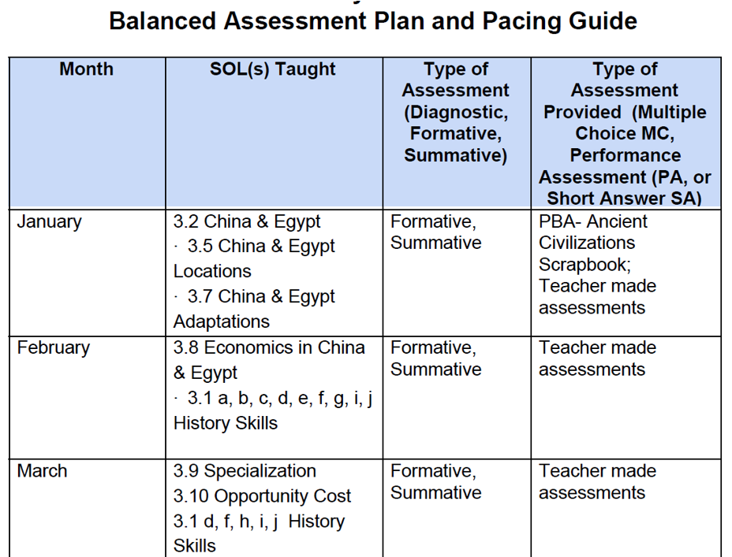
Documenting Coverage of SOL and Variety of Assessment and Item Types
Brunswick County Public Schools used existing monthly pacing guides that cover all SOL as the basis for its Balanced Assessment Plans. The plan indicates if assessments are used as formative or summative measures, and it contains information about different types of items that are administered to students during the year.
Note: Some links in documents provided by school divisions in 2020 may no longer work. Please contact the school division if you have questions.

Slide 30
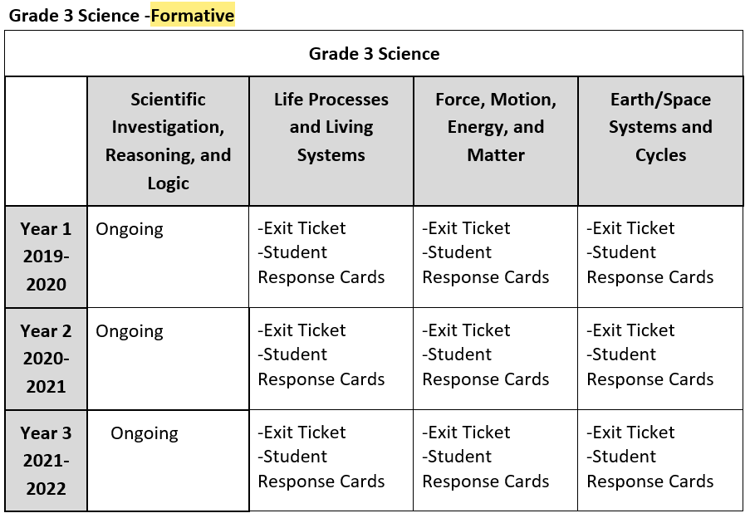
Documenting Formative Assessment
Lunenburg County Public Schools Balanced Assessment Plan includes examples of specific methods used to gather formative assessment data in different content areas.

Slide 31
Formative Assessment: Staunton City
During the interview process, participants from Staunton City stated that instruction was modified in order to prepare students for the different types of assessments they would receive.
Participants described breaking the Grade 5 Writing rubric into pieces so that instruction can be layered throughout the year based on specific features of the rubric. This helps with assigned vs. taught writing – students receive direct instruction and formative assessment in writing.
“[Students] have to have the background and skills before they can do the work.”

Slide 32
Using Data to Inform Instruction and Support Deeper Learning
Data collected from assessments should be used intentionally to inform instruction and support deeper learning.
Participants in interviews discussed examining data to determine if the assessment was appropriate to measuring the skill or content and to determine how to modify instruction to support student learning.
Examples of effective use of assessment data included determining a more effective pacing for units and lessons, breaking tasks into smaller pieces, adjusting tasks for equity and accessibility, and providing professional development to assist content teachers.
Notes:
Note- these data could be diagnostic, formative, or summative. This slide does not only refer to SOL test data or data from benchmark tests, for example, but is meant to encompass all assessment data.

Slide 33
Informing Instruction: Fredericksburg
Fredericksburg realized the value of having teachers “frontload” certain information or skills at the beginning of a course so that students are better able to take a concept or questions and explore for learning.
It is best practice to allow for teacher collaboration and input as Balanced Assessment Plans are created and revised. As teachers are practicing formative assessment in the classroom, they are equipped to identify what works and what needs adjusting.

Slide 34
Shifting Practice: Danville
Danville Public Schools’ Balanced Assessment Plans for history included information shared during professional development. These events focused on the instructional shifts needed to prepare students for success on performance assessments.

Slide 35
Modifying Instruction: Radford City
The Balanced Assessment Plan for Grade 5 Writing in Radford City included a section of best practice in preparing students for writing performance tasks. The section includes important information such as integrating grammar with writing instruction throughout the year and using mentor texts to teach writing.

Slide 36
Comparing BAPs to 2014-2015 LAA Plans
Reviewers noted that most school divisions have developed and implemented additional performance assessments since 2014-2015.
In some school divisions, changes in school and division-level leadership has influenced the rate and type of progress made since 2014-2015.

Slide 37
.
Best Practices and
More Examples from School Divisions

Slide 38
Conducting an Assessment Inventory
Conducting an assessment inventory is a best practice that is encouraged but not required.
An inventory of all assessments administered to students K-12 provides a comprehensive picture that assists with deliberate decision-making when developing the BAP.

Slide 39
Why conduct an assessment inventory?
An assessment inventory may:
Identify assessments that do not serve the intended purpose;
Ensure each assessment provides useful data that justifies the instructional time required for its administration;
Identify redundancies where assessments should be considered for elimination;
Identify gaps where measures are needed for certain content or skills; and
Identify professional development needed to support teachers on using data to inform instruction.
The Assessment Inventory Tool is a sample available for use.

Slide 40
The Impact of an Assessment Inventory
The BAP Narrative for Rockbridge County Public Schools referenced the use of a K-12 Assessment Inventory (including an outline of types of assessments and use of data for instruction) in evolving from the division’s former Local Alternative Assessment Plan.
“Once the assessment list was generated, the team…outlined how the data would be used to guide future instruction.”

Slide 41
Assessment Inventory Example
Chesapeake Public Schools’ Balanced Assessment Plan provides an overview of the results from its inventory of K-5 assessments.
Note: Some links in documents provided by school divisions in 2020 may no longer work. Please contact the school division if you have questions.
Notes:
To view the information shared by Chesapeake Public Schools, click on the hyperlink, download the .zip file, and then open the compressed folder.

Slide 42
Grade Level Assessment Summary Example
Chesapeake Public Schools’ Balanced Assessment Plan also illustrates the general time frame for each assessment administered at a grade level.

Slide 43
Sharing Information with Stakeholders
Sharing Balanced Assessment Plans and information about assessment practices with stakeholders (school staff, parents, community members, etc.) is a best practice that is encouraged but not required.
These plans could be used to build common understanding of assessment types and purposes while also informing families about some of the assessments that will be administered to their children.

Slide 44
Sharing Information: Roanoke County
Participants from the Roanoke County interview shared that they had a Curriculum, Instruction, and Assessment conference and a Parent Adjunct Committee (teachers and parents) to discuss the current state of instruction and assessment.
All schools responded with very constructive conversations.

Slide 45
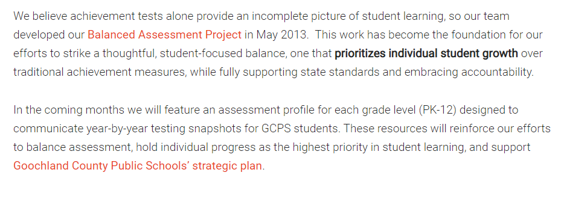
Chronicling the Past and Road Forward
Included as a part of its Assessment Webpage, Goochland County Public Schools provides public information for stakeholders related to its history and future with balanced assessments and efforts to increase a student-focused balance.
Note: Some links in documents provided by school divisions in 2020 may no longer work. Please contact the school division if you have questions.

Slide 46
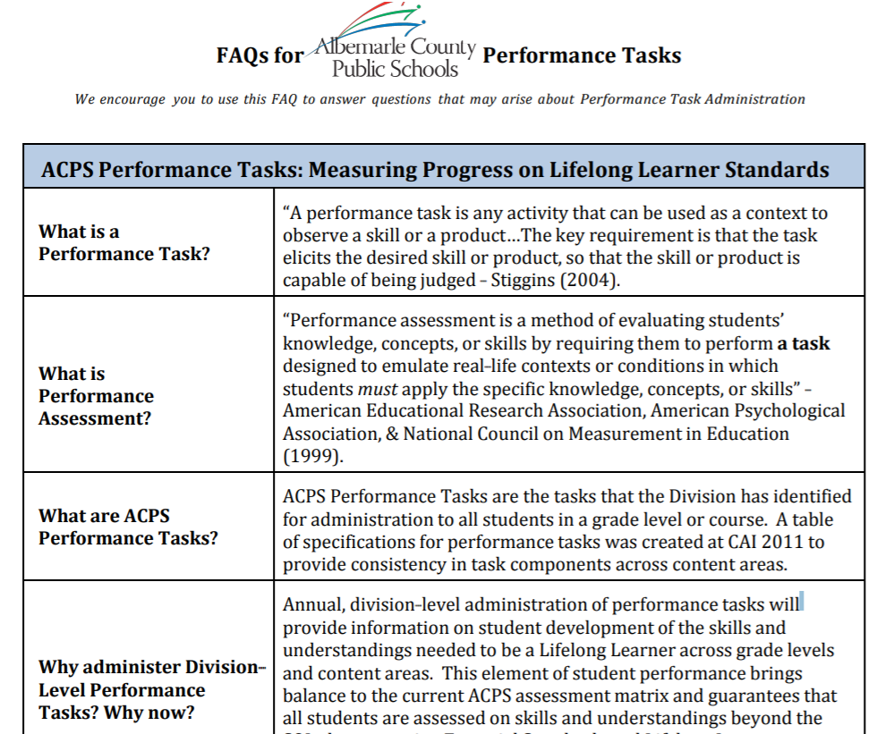
Building Understanding: Albemarle County
Albemarle County Public Schools shares information about performance tasks administered to students in each grade level on its website, including FAQ for ACPS Performance Tasks.
Note: Some links in documents provided by school divisions in 2020 may no longer work. Please contact the school division if you have questions.

Slide 47
A Tool for Sharing Information
Greensville County Public Schools provides Balanced Assessment Plans on its website. In addition to describing specific plans for each LAA content area, this comprehensive document shares general information about balanced assessment with the community.
Note: Some links in documents provided by school divisions in 2020 may no longer work. Please contact the school division if you have questions.

Slide 48
Greensville Stakeholder Communication Best Practice
This plan is posted on the school division website making it readily available for view by all stakeholders (staff, students, parents, and community members).
The published plan provides a comprehensive overview including:
an overview of the different types of assessment,
an assessment inventory for the division,
the plan for assessment across each required content area,
rubrics used for scoring assessments, and
the Virginia Quality Criteria Review Tool.
Note: Some links in documents provided by school divisions in 2020 may no longer work. Please contact the school division if you have questions.

Slide 49
Documenting Opportunities for the 5C’s
Balanced Assessment Plans should move toward documenting the opportunities for students to demonstrate the 5C’s:
Critical thinking
Creative thinking
Collaboration
Communication
Citizenship
Students K-12 need experiences that allow them to practice and demonstrate the 5C’s in order to build these skills and meet expectations described by the Profile of a Virginia Graduate.

Slide 50
Opportunities for 5C’s: Radford (1 of 2)
Radford City Schools has implemented Project Lead the Way (PLTW) in the elementary grades. School division leaders reported:
This program promotes and requires hands-on and highly engaging learning experiences, and students have opportunities that allow them to discover, experiment, reflect, evaluate and reimagine.
Students are required to demonstrate what they have learned through real world problem solving and authentic presentations of learning. These trainings and teacher observations during the PLTW lessons have shown teachers what really motivates students.

Slide 51
Opportunities for 5C’s: Radford (2 of 2)
Radford City Schools is developing a survey for students and families to offer all stakeholders a better idea of what assessments are most favored and which ones demonstrate acquisition of the 5C’s.
Radford’s attention to student demonstration of the 5C’s is shared with stakeholders, which is an example of best practice and evidence of the division’s commitment to the Profile of a Virginia Graduate.

Slide 52
Opportunities for the 5C’s: Spotsylvania
Spotsylvania County Public Schools used a planning template that provided a structured approach to creating performance assessments.
The inclusion of links to examples within each criterion section assists teachers as they become familiar with the planning process.
The individual criterion sections ensure each performance assessment address those areas necessary for a quality assessment, including opportunities for students to demonstrate the 5C’s.

Slide 53
Spotsylvania County Public Schools Sample
Note: Some links in documents provided by school divisions in 2020 may no longer work. Please contact the school division if you have questions.
Notes:
To access the linked Performance Assessment Teacher Planning Template, right click on the sample and choose Document Object. Select Open and the Word version of this document will become available.

Slide 54
Best Practice: Accessible Format
Essex County Public Schools created easily understood spreadsheets that provide a brief description, a time frame, and the type of assessment used. Plans differentiate between project based learning and performance assessments. Writing across the curriculum is an expectation.

Slide 55
Best Practice: Implementation Stages
Using the Framework for Local Alternative Assessment (LAA) Implementation provided by VDOE, York County developed a local framework to identify what work:
is completed,
still needs to be completed, and
should be continued.
“…a framework for assessing action steps completed and those to be completed in order to make sufficient progress toward our implementation goals.”

Slide 56
York County Schools Sample

Slide 57
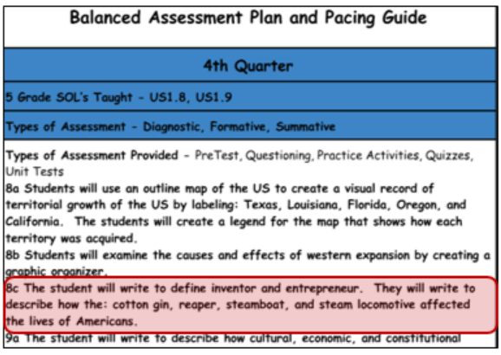
Best Practice: Use Available Materials
Bland County Public Schools completed the Balanced Assessment Plan by modifying its pacing guide for USI to include assessment types. Additionally, opportunities for writing across the curriculum and for critical thinking are evident in this plan.

Slide 58
Best Practice: Cross-Curricular and Vertical Alignment
School divisions are encouraged to incorporate opportunities for cross-curricular assessments and to use alignment between and among courses to inform these opportunities.

Slide 59
VDOE Resources to Support Cross-Curricular and Vertical Alignment
VDOE skills progression charts assist in determining alignment within and across disciplines.
Related VDOE Comprehensive Literacy Webinar Series topics include:
Balanced Assessment: Middle School Writing in the History Classroom
Interdisciplinary Collaboration: Integrating the English standards into other content areas

Slide 60
Prince William Vertical Alignment Best Practice
“The Vertical Alignment Guide for each course outlines learning targets students work to master by the end of the academic year. Each Guide contains learning targets focused on SOL skills, as well as learning targets focused on disciplinary writing. Also, each Guide contains sample student responses aligned to each learning target to provide teachers with exemplars of the end goal.”
Deliberate planning within the content area provides an enriching learning experience as the students build upon content and skill mastery from one year to the next.

Slide 61
Prince William County Public Schools Sample: US I
Notes:
To access the linked Vertical Alignment document right click on the sample and choose Document Object. Select Open and the Word version of this document will become available.

Slide 62
Prince William County Sample US II
Notes:
To access the linked Vertical Alignment document right click on the US I sample from slide 61 and choose Document Object. Select Open and the Word version of this document will become available.

Slide 63
Accomack County Public Schools Best Practice: Writing Across the Curriculum
One of the performance assessments in history/social science incorporates written essays and is completed in conjunction with the English classes.
This practice allows for students to see a connection between two content areas and enables content area experts to assist students with varying aspects of the assessment.

Slide 64
Accomack County Public Schools Sample

Slide 65
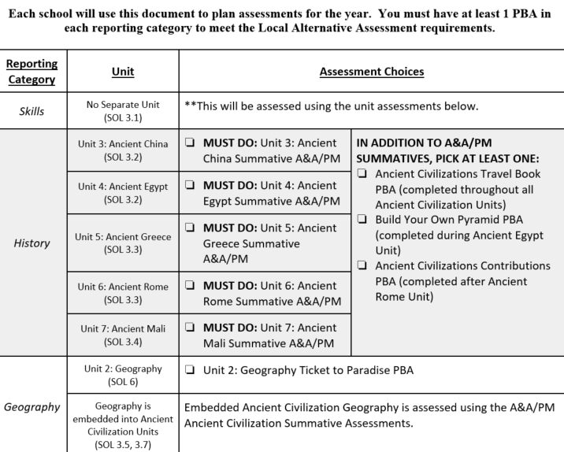
Best Practice: Embedding SOL Skills
Orange County Public Schools assesses grade 3 history by historical era and administers at least one performance assessment per reporting category. Some assessments are required, but others are chosen by teachers. Most skills are embedded within assessments for historical eras rather than measured separately.

Slide 66
Best Practice: Teacher Collaboration
Best practice: Teacher collaboration within and across divisions is strongly encouraged.
Participants from some divisions noted that their process went smoothly because of teacher input.
The addition of balanced assessment blended in smoothly with the processes the schools already had in place and when balanced assessment was seen as part of the process, not as something extra to do.

Slide 67
Best Practice: Regional Cooperation
Best practice: Participate in regional cooperation when possible, as there are benefits to sharing work across divisions.
Many participants in the Balanced Assessment Plan Desk Review interviews mentioned the importance of regional cooperation as they developed and implemented their plans.
For example, division personnel from Frederick County noted that the format for their Balanced Assessment Plan was shared by Alexandria City during a Region 4 meeting.

Slide 68
Best Practice: Continuous Improvement
Best practice: Incorporating balanced assessment practices to support deeper learning and inform instruction is best approached as a process for continuous improvement that includes regular and ongoing opportunities for teachers and leaders to provide feedback.

Slide 69
Adopting a Continuous Improvement Approach
School divisions are at different stages of implementation. Those with turnover in division- and school-level leadership reported more challenges with consistent implementation than divisions with stable leadership.
Division leaders in Brunswick County Public Schools have adopted thoughtful plan aimed at continuous improvement that includes face-to-face meetings with teachers, reassessing priorities, working with principals, providing professional development for teachers to meet their current needs, developing additional performance tasks, and re-evaluating existing performance tasks using the Quality Criteria Tool.
Note: Some links in documents provided by school divisions in 2020 may no longer work. Please contact the school division if you have questions.

Slide 70
Continuous Improvement: Richmond Public Schools
Richmond Public School leaders aligned resources and embedded performance assessment opportunities into curriculum guide. They continue working to evolve tasks and improve the assessments so students may demonstrate their learning.
They discussed looking at student work to make decisions:
What should this have looked like?
What assessment should it have been?
How can we take the content and embed it in writing tasks, so that it is a part of instruction and not a special event?

Slide 71
Best Practice: Reviewing Tasks
An example planning template from Richmond Public Schools shows continuous review and revision for Grade 5 Writing tasks and implementation. This planning template identifies the date and task to complete as well as the people involved and the additional resources needed for staff to complete the work.

Slide 72
Continuous Improvement: Lunenburg (1 of 3)
“In the fall of 2015, selected sub-group of teachers and administrators from across the region were recruited to continue the work of developing PAs with the aim of making available an inventory of 20 or more high-quality PAs.”
“The work of this design team has focused on (1) identifying rigorous and relevant subject-area standards that would be amenable to assessment with PAs, (2) ensuring that PAs meet requirements for state accountability, and (3) designing PAs that are of high quality PAs.”

Slide 73
Continuous Improvement: Lunenburg (2 of 3)
The Vision for the Use of LAAs in Region 8 and Lunenburg County Public Schools section includes information that acknowledges plans for the future as well as recognition of places where collaboration within the school and division is a key element to future success.
“Teachers have the expertise … to create and use LAAs that can serve as valid, reliable, and innovative alternatives to conventional accountability assessments. However, because the work … is complex, it requires time and collaboration.”

Slide 74
Continuous Improvement: Lunenburg (3 of 3)
“The use of authentic assessments can drive the increased use of innovative instructional practices, which can lead in turn to more meaningful and relevant learning experiences and outcomes for students. However, such changes require the shared understanding of instructional leaders in order to facilitate changes at the classroom level.”

Slide 75
Best Practice: Providing an Overview
An overview of Balanced Assessment Plans provides an opportunity for school divisions to share goals, priorities, and plans for the upcoming year(s). Brunswick County Public Schools tied its Balanced Assessment Plan to the division’s mission and vision, and its ongoing commitments to technology, formative assessment, and quality performance assessments are explained.
Note: Some links in documents provided by school divisions in 2020 may no longer work. Please contact the school division if you have questions.

Slide 76
Best Practice: Allowing for Student Choice
Provide students choice in how they will demonstrate their understanding.
Choice can increase interest and engagement for students.
Students may apply different skills from the 5C’s when completing different products.
Products should be consistent with expectations in the rubric and allow for the highest level of achievement described in the rubric.

Slide 77
Encouraged Practice: Assessment Innovation in Other Courses
School divisions are encouraged to include information about balanced assessment and instruction in other (non-LAA) courses in Balanced Assessment Plans.
This might include:
Description of performance tasks used in other areas
Information about professional learning for teachers focused on using rubrics to score tasks
Descriptions of cross-curricular task development and implementation

Slide 78
Documenting Balanced Assessment in Other Courses
Danville’s plan describes high school history teachers’ professional learning on performance assessment. Teachers focused on “Overcoming Barriers to Implement High Quality Performance Assessments” (from 2019 History & Social Science Deeper Learning Conferences) and worked together on next steps for implementation.
Note: Some links in documents provided by school divisions in 2020 may no longer work. Please contact the school division if you have questions.

Slide 79
Innovations in Balanced Assessment: Cornerstone Performance Tasks
Henry County Public Schools embeds links in its Assessment Inventory to Balanced Assessment Plans for LAA areas and to Cornerstone Performance Tasks administered to all K-12 students.

Slide 80
“Cornerstone One-Pager”
Administered across all content areas as summative assessments for units of study
Scored with rubrics designed to measure skills and knowledge
Allow students to demonstrate their learning in novel ways with real-world connections
Do not impact a student’s average in the class
Note: Some links in documents provided by school divisions in 2020 may no longer work. Please contact the school division if you have questions.

Slide 81
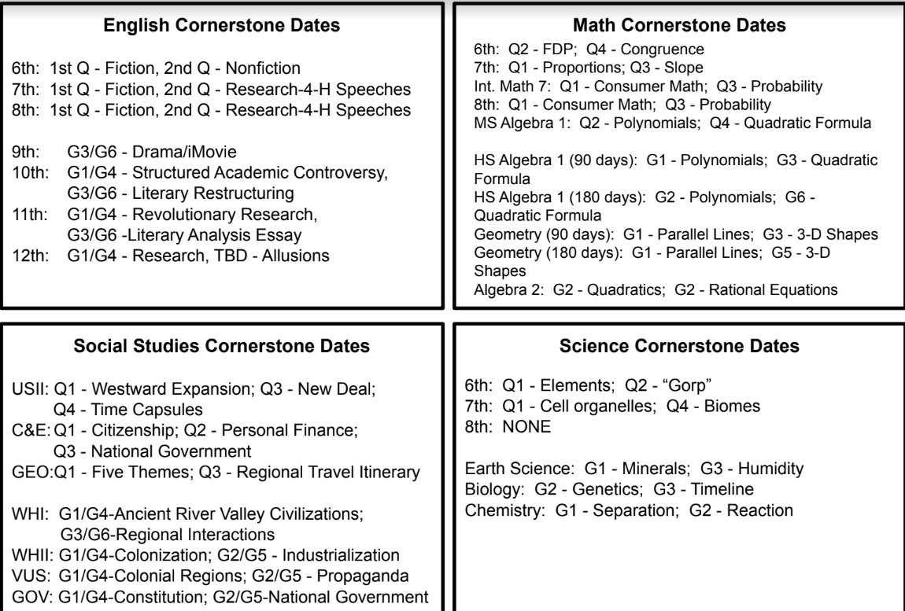
Cornerstone Task Units and Timeline: Grades 6-12, Henry County Public Schools

Slide 82
c
What is going well?
What is challenging?

Slide 83
What is going well? (1 of 2)
Students are more engaged and not just repeating memorized facts. They have the opportunity to apply their learning, be creative, and show understanding in different ways.
Grade levels and departments within schools are collaborating to create performance based assessments.
Instructional leaders meeting with groups of teachers regularly (professional learning communities) has been an effective way to influence changes in instruction that need to occur.
Some regions and divisions are collaborating.

Slide 84
What is going well? (2 of 2)
Teachers are invested and eager for more professional learning. “Having teachers in the room and giving them time to think about it creates buy in and builds capacity.”
Building a cohort of teacher experts has worked well. Some divisions have used content or instructional coaches to support the development of these teacher experts.
Using performance tasks during instruction helps prepare students to show their learning on the summative assessment.

Slide 85
What are the challenges? (1 of 2)
Many school divisions shared that time is a challenge. This includes:
Finding time to meet with teachers, especially at elementary
Ensuring adequate time is devoted to instruction in core content areas that no longer have an SOL test (K-5)
Providing ongoing professional development without overburdening teachers’ time
Finding time to pull teachers out of class for training is difficulty, and the lack of substitutes compounds this.

Slide 86
What are the challenges? (2 of 2)
There are not enough examples of good tasks.
In schools with struggles in reading and/or mathematics achievement, it can be challenging for school administrators to value and protect time for core content instruction in science and history. Professional learning opportunities are not always available or encouraged across core content areas.
There are not enough training opportunities for teachers. If there is not already some capacity for this work, it is difficult to build and sustain without ongoing training opportunities.

Slide 87
Challenges: Funding
Many school divisions shared that funding is also a challenge. This includes:
Providing substitutes to cover classes during scoring events, task development events, etc.
Providing substitutes for ongoing professional development
Providing funding for curriculum and assessment work

Slide 88
Challenges: Grading vs. Scoring
Using rubrics to score performance tasks is new for many teachers.
Shifting from grading work to scoring work and/or from a percent correct or letter grade to a rubric score with descriptive feedback is difficult.
Materials to support school divisions with this work would be beneficial.

Slide 89
>
Expectations Moving Forward,
Additional Content Resources
and Recommendations

Slide 90
Moving Forward with Balanced Assessment Plans: Expectations
No changes will be made in the expectations for Balanced Assessment Plans for 2020-2021.
Guidelines for Local Alternative Assessments for 2018-2019 through 2019-2020
Overview of Balanced Assessment Plans (Superintendent’s Memo 181-19)
Continue ongoing work to use a balanced approach and a variety of local alternative assessments that inform instruction and support deeper learning through the 2021-2022 school year.

Slide 91
Grade 3 Science Performance Assessments
School divisions are encouraged to incorporate performance tasks that:
measure subject-matter proficiency
require students to apply the content and skills they have learned
present opportunities for students to demonstrate acquisition of the “Five C’s”
Sample Grade 3 Science Performance Assessments

Slide 92
Grade 5 Writing Performance Assessments
A comprehensive literacy approach to instruction and assessment in Grade 5 Writing is best practice.
School divisions are encouraged to develop tasks in which students write about their reading and write across the curriculum.
See the Menu of Grade 5 Writing Options for suggestions that can be altered to fit local needs.

Slide 93
History and Social Science Performance Assessments
Strategies for creating tasks that integrate middle school writing skills with history content and skills are included in the Balanced Assessment: Middle School Writing in the History Classroom webinar.
Improving student achievement through quality instruction is the overarching goal of professional development offerings.
The VDOE 2019 Deeper Learning Conferences for History and Social Science (HSS) focused on performance tasks and assessments and scoring those student products (contact VDOE History and Social Science instruction for these materials).
2017 HSS SOL Institutes focused on skills emphasized in the 2015 HSS SOL, which will lead to the development of performance assessments.

Slide 94
Questions? Contact Us! (1 of 2)
Office of Student Assessment
student_assessment@doe.virginia.gov
Office of Humanities
Jill Nogueras, Coordinator of English, Jill.Nogueras@doe.virginia.gov
Christonya Brown, History & Social Science Education Coordinator, Christonya.Brown@doe.virginia.gov

Slide 95
Questions? Contact Us! (2 of 2)
Office of STEM and Innovation
Anne Petersen, Ph.D, Science Coordinator, Anne.Petersen@doe.virginia.gov
Tina Mazzacane, Mathematics Coordinator, Tina.Mazzacane@doe.virginia.gov

