Slide 1
Local Alternative Assessments and Balanced Assessment Plans in 2022-2023 and Beyond
October 24, 2022, Webinar

Slide 2
Agenda
Background and Requirements
Desk Review Selection and Process
Findings and Recommendations
Overarching Feedback
Content-Specific Feedback
Assessment Inventory
Updated Local Alternative Assessment Desk Review Form
Next Steps
Contact Information

Slide 3
Background and Requirements

Slide 4
2014 General Assembly Action (1 of 3)
The General Assembly enacted legislation that eliminated Standards of Learning (SOL) assessments in:
Grade 3 History
Grade 3 Science
Grade 5 Writing
U.S. History to 1865
U.S. History: 1865 to the Present
This legislation required school divisions to continue to teach the content and to measure student achievement with local alternative assessments (LAA), including performance assessments.

Slide 5
2014 General Assembly Action (2 of 3)
This legislation also required school divisions to “certify annually that they have provided instruction and administered an alternative assessment, consistent with Virginia Board of Education guidelines, to students in grades three through eight in each SOL subject area in which the SOL assessment was eliminated.”
Local school boards and division superintendents complete this certification through the annual Standards of Quality compliance assurance.

Slide 6
2014 General Assembly Action (3 of 3)
Such guidelines shall (1) incorporate options for age-appropriate, authentic performance assessments and portfolios with rubrics and other methodologies designed to ensure that students are making adequate academic progress in the subject area and that the Standards of Learning content is being taught; (2) permit and encourage integrated assessments that include multiple subject areas; and (3) emphasize collaboration between teachers to administer and substantiate the assessments and the professional development of teachers to enable them to make the best use of alternative assessments.
Taken from the Code of Virginia, § 22.1-253.13:3. Standard 3.

Slide 7
Guiding Documents for 2022-2023
Guidelines for Local Alternative Assessments: 2021-2022 and Beyond- provides current guidance for local alternative assessments, as announced in Superintendent’s Memo #214-21
Implementation Support for Balanced Assessment Plans- clarifies the requirements for Balanced Assessment Plans and offers suggestions for consideration when developing these plans

Slide 8
The Purpose of Desk Reviews
The purpose of these reviews will be to determine how local school divisions are verifying that the content is being taught, to determine the types of alternative assessments that are being administered, to identify exemplars of performance assessments that may be shared with other school divisions, and to assist teachers, schools, and school divisions in strengthening their own alternative performance assessments. The reviews will help Department staff to identify “best practices” for sharing with other Virginia school divisions.

Slide 9
Documentation to Maintain
Materials retained at the division for possible review should include:
Balanced Assessment Plan for each of the five replaced SOL assessments;
Copies of assessments administered, including performance tasks;
Division-specific material used to train teachers; and
Samples of student responses representing each of the various score points of the rubric.

Slide 10
Desk Review Selection and Process

Slide 11
Selection for Desk Review
VDOE developed a plan to ensure that all school divisions will participate in desk review at least one time within a five-year cycle.
School divisions selected for LAA desk reviews may also be selected for EITHER:
Verified Credit Plan desk reviews OR
Locally Awarded Verified Credit (LAVC) Plan desk reviews.

Slide 12
25 School Divisions Sampled
Region I: 3 divisions
Region II : 3 divisions
Region III: 3 divisions
Region IV: 3 divisions
Region V: 3 divisions
Region VI: 3 divisions
Region VII: 4 divisions
Region VIII: 3 divisions

Slide 13
Locale Descriptions*
City, Large: 1
City, Middle: 1
City, Small: 3
Town, Distant: 3
Town, Remote: 1
Rural, Distant: 7
Rural, Fringe: 5
Rural, Remote: 3
Suburb, Large: 1
*School Division Locale Descriptions are available on the Virginia School Directories page of the VDOE website.

Slide 14
Documentation Reviewed
Balanced Assessment Plan(s): Does the plan document that the division adheres to the Guidelines?
Assessment inventory (optional but encouraged, conducted between 2019 and 2022): Are divisions using this suggested practice? If so, how are results being used?
Fillable form responses: How does the division describe its support for local alternative assessments? What innovations, successes, and challenges are described?

Slide 15
Samples Requested
Two examples of local performance assessments or tasks and all ancillary materials for each assessment
Samples of scored student responses that correspond to one of the local performance assessments or tasks submitted
At least one scored student response that represents each score point of the common rubric
All personally identifiable information is to be removed
An example of communication that shows how the division reports information to parents/guardians about their child’s performance on local alternative assessments

Slide 16
Findings and Recommendations

Slide 17
Process Improvements
Based on feedback from VDOE staff regarding their experience with the documents reviewed, VDOE is changing its method for collecting information provided by school divisions.
VDOE has updated the desk review form. It will be provided to all divisions to:
Encourage a planning cycle that is reflective and continuous.
Help divisions anticipate what will be needed when selected for review.
VDOE will provide specific feedback to school divisions involved in these desk reviews moving forward.

Slide 18
General Findings (1 of 3)
Each division that participated in the desk reviews administered one or more common performance assessments/tasks (administered to all students in the course), which is best practice.
Organizational formats sometimes made it difficult for VDOE to determine how evidence aligned to expectations in the Guidelines.
Recommendations:
Clearly document that all SOL are taught and assessed.
Be clear about the types of assessments included in the BAP, with the knowledge that a variety of assessment types are required to measure a variety of knowledge and skills and that performance assessments can be formative or summative.

Slide 19
General Findings (2 of 3)
Within the same division, Balanced Assessment Plans for different content subjects are sometimes inconsistent.
Some subjects have greater variety of assessments documented than others within the same division.
Based on documentation, support for teachers (professional development, for example) is inconsistent across content subjects within the same division.
Recommendation:
Provide opportunities for instructional specialists from different content areas, teachers, and school leaders to work together on BAP.

Slide 20
General Findings (3 of 3)
Divisions (and teachers) are enthusiastic about using more “authentic” and engaging assessments with students but have concern about the time required to implement and score performance assessments.
Recommendations:
Include formative performance assessments/tasks that are integrated into instructional units and provide opportunities for students to learn content while also developing and demonstrating skills.
Schedule time for scoring during regularly occurring grade level, department, or faculty meetings.

Slide 21
General Recommendation:
Using Scored Samples
The Guidelines direct school divisions to retain “samples of student responses representing each of the various score points of the rubric.”
Divisions are encouraged to use scored samples of student responses to local performance tasks in a variety of ways:
Verify that students will be able to meet the achievement expectations described in the rubric if they fulfill the task requirements
Compare different scored samples that were assigned the same score
Select anchor responses to use during training with teachers
Develop annotations to highlight features of a scored sample to further illustrates the score point in the rubric

Slide 22
General Recommendation:
Assessment Inventory
School divisions are encouraged to conduct an assessment inventory to support the development of Balanced Assessment Plans.
The sample Assessment Inventory Tool can be used to collect information about the assessments administered to students.
For assessments the school division chooses to administer (those not required by state or federal regulations), the inventory can be used to:
Confirm that assessments serve their intended purpose,
Ensure that the data are meaningful and worth the loss of instructional time needed to administer the test, and
Identify redundancies or gaps in assessments that need to be addressed.

Slide 23
Performance Assessment
The Guidelines refer to performance tasks and/or performance assessments.
Performance assessments, performance tasks, projects, and project-based learning are sometimes used interchangeably but are not always the same.
Not all projects are performance assessments or performance tasks.
Performance assessments are typically summative in nature (but not always).
Formative and/or summative performance tasks/assessments can serve as LAA.
Performance tasks and performance assessments that serve as local alternative assessments should be completed at school to the greatest extent possible to ensure access to materials, resources, and instructional support during completion.

Slide 24
Project-Based Learning
Project-based learning – An educational approach emphasizing creativity and critical thinking which uses broad, complex problems as a method for learning both content and skills. Projects are authentic and generally cross-curricular and require collaboration, either with peers or experts. (from VDOE Glossary of Education Terms)
Project-based learning (PBL) usually includes student choice.
Performance assessment/task completion is usually a component of PBL.
Student-led project-based learning may not align to the SOL that must be taught.
Performance tasks that are part of PBL that also serve as LAA must align to the SOL in content and rigor, and the common rubric is to be used to score task responses.

Slide 25
Grade 3 Science (1 of 2)
Overall Strengths
There is evidence that students are using Scientific and Engineering Practices identified in the 2018 Science Standards of Learning.
Performance assessments enable students to demonstrate skills of the discipline that cannot be demonstrated through other types of assessment.

Slide 26
Grade 3 Science (2 of 2)
Opportunities for Growth
Ensure performance assessments are aligned to the concept and cognitive level indicated in the standards and Curriculum Framework.
Plan across grade bands to ensure students will have opportunities to demonstrate the skills across those grade bands.
Provide opportunities for teachers to practice scoring together to
Increase familiarity with the rubrics
Build common understanding of the “grade band” approach used in the rubrics
Foster consistency and confidence when scoring

Slide 27
Grade 5 Writing (1 of 2)
Strengths
There is clear evidence around the expectations and scoring process for the student writing.
There is clear evidence of the integration of the content areas with writing through the LAA.

Slide 28
Grade 5 Writing (2 of 2)
Opportunities for Growth
Document: How are you evaluating ALL of the writing standards? (It cannot just be in one writing sample.)
Increase opportunities for balanced assessment throughout the year.
Best practice:
Writing opportunities should be connected to instruction rather than presented as isolated, “stand alone” prompts.
Provide opportunities for students to write about the fiction and nonfiction text they are reading.

Slide 29
Grade 5 Writing: Understand Scoring
Divisions are strongly encouraged to use Understand Scoring for training scorers.
The anchor papers, annotations, Practice Sets, and Verification Sets were developed to support consistency when using the scoring rubrics for the 2017 English SOL.
Between August 1, 2021, and June 30, 2022, educators from 29 different Virginia school divisions have engaged with one or more of the Grade 5 Verification Sets in Understand Scoring through registered user accounts.

Slide 30
History LAA:
Grade 3, US History to 1865, and US History: 1865 to the Present (1 of 2)
Strengths
Using performance tasks has a significant impact on student engagement across the LAA courses.
There is flexibility to spend additional time on content in a course that captures students’ attention and learn more about that content while practicing and developing the historical thinking skills measured in the Core Expectations.
Building administrators and instruction leaders have observed more collaboration and communication about learning among students, between students and teachers (with teachers as facilitators of learning), and between and among teachers when performance tasks are a part of instruction.

Slide 31
History LAA:
Grade 3, US History to 1865, and US History: 1865 to the Present (2 of 2)
Opportunities for Growth
Plan across grade bands to ensure students will have opportunities to demonstrate the skills across those grade bands.
Provide opportunities for teachers to practice scoring together to
Increase familiarity with the rubrics
Build common understanding of the “grade band” approach used in the rubrics
Foster consistency and confidence when scoring
Grade 3 History
Protect instructional time for history and social science instruction in elementary classrooms.
Divisions report that it is challenging to find quality assessments that are also grade-level appropriate.

Slide 32
History LAA: Resources to Consider
C3 Teachers provides resources for the Inquiry Design Model (IDM).
The IDM structure is used in all state-developed performance tasks available for verifying credits in history and social science.
Low-stakes experience with IDM in earlier grades helps prepare students for completing this type of assessment in high school.
Published resources are a starting point for consideration.
Not all tasks available in the C3 Teachers website will be aligned to the Virginia SOL or appropriate for your students as written.
This website is a starting point, but you must determine if available tasks are appropriate or if they can be modified to meet your needs.
A webinar will be held later this fall to dig deeper into this resource and model its use.

Slide 33
Next Steps

Slide 34
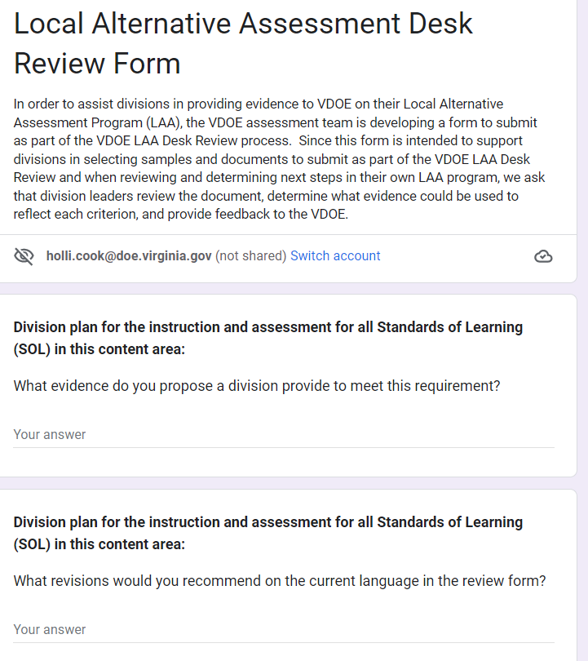
Local Alternative Assessment Desk Review Form (1 of 2)
Provide feedback on the draft LAA Desk Review Form by Friday, December 2, 2022.
Notes:
The deadline has been extended to December 2, 2022 due to the technical difficulties and need for individualized follow-up meetings with various groups.

Slide 35
Local Alternative Assessment Desk Review Form (2 of 2)
Use the desk review form to reflect on your division’s support for local alternative assessments.
Main ideas:
How does the division support local alternative assessments in the content/subjects where they are required?
What is the best evidence that this is happening within the division?

Slide 36
Reflect and Plan Ahead
Reflect on the Balanced Assessment Plans in your school division separately and as a whole.
Consider using the Assessment Inventory Tool to inform the next cycle of BAP revisions.
Review the Local Alternative Assessment Desk Review Form and use it as a tool to reflect on your current BAPs.
Establish division goal(s) and content/subject goal(s) and plan action steps to meet those goals.

Slide 37
Next Steps for VDOE
Share the desk review form with Division Directors of Testing and division instructional leaders for each of the LAA content/subject areas.
Develop additional supports for scoring with the common rubrics for science and for history and social science.
Provide additional information on resources and tasks for history and social science courses.

Slide 38
Contact Information

Slide 39
Contact English Language Arts Instruction Staff
Questions about the 2017 English Standards of Learning and using the instructional rubrics within a comprehensive literacy program should be directed to staff in the Office of Humanities.
Jill Nogueras, English Coordinator
Jill.Nogueras@doe.virginia.gov
Colleen Cassada, Middle School English Specialist Colleen.Cassada@doe.virginia.gov
Carmen Kurek, Elementary English/Reading Specialist Carmen.Kurek@doe.virginia.gov

Slide 40
Contact History and Social Science Instruction Staff
Questions about the 2015 History and Social Science Standards of Learning and implementing performance tasks during instruction should be directed to staff in the Office of Humanities.
Christonya Brown, History & Social Science Education Coordinator Christonya.Brown@doe.virginia.gov
Andrea Emerson, History & Social Science Secondary Specialist Andrea.Emerson@doe.virginia.gov
Brandi McCracken, Elementary History & Social Science Specialist Brandi.McCracken@doe.virginia.gov

Slide 41
Contact Science Instruction Staff
Questions about the 2018 Science Standards of Learning, the Science and Engineering Practices Progression, and sample performance assessments provided on the VDOE website should be directed to staff in the Office of STEM and Innovation:
Dr. Anne Petersen, Science Coordinator Anne.Petersen@doe.virginia.gov
Dr. Myra Thayer, Science Specialist
Myra.Thayer@doe.virginia.gov
Gregory MacDougall, Science Specialist Gregory.MacDougall@doe.virginia.gov

Slide 42
Contact Student Assessment Staff
Questions related to the Guidelines for Local Alternative Assessments: 2021-2022 and Beyond, the common rubrics used to score responses to local alternative assessments, desk reviews, the expectations for Balanced Assessment Plans, and Standards of Learning testing should be directed to the Office of Student Assessment.
Student_Assessment@doe.virginia.gov
(804) 225-2102

