Slide 1
World Geography
History and Social Science
Fall Institute
2016

Slide 2
Disclaimer
Reference within this presentation to any specific commercial or non-commercial product, process, or service by trade name, trademark, manufacturer or otherwise does not constitute or imply an endorsement, recommendation, or favoring by the Virginia Department of Education.

Slide 3
Questions to Ask During Planning
Essential Components in Planning an Effective Lesson
using the 2015 History and Social Science Standards of Learning
What do students need to know and understand by the end of this lesson?
What do students need to do during this lesson?
Which historical thinking skills are best suited for this standard?
What other content material should be added to provide historical context and richness to the lesson in order to maximize student understanding of the standard?
What student learning experiences would be most effective during this lesson?
How can I check for understanding effectively and accurately to measure the students’ content knowledge and historical thinking skills?

Slide 4
It starts with the . . .

Slide 6
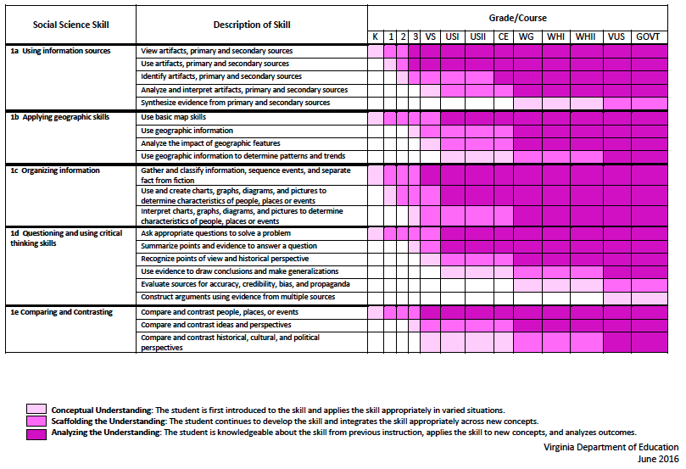
2015 SOL Skill Progression
Notes:
⇧

Slide 7
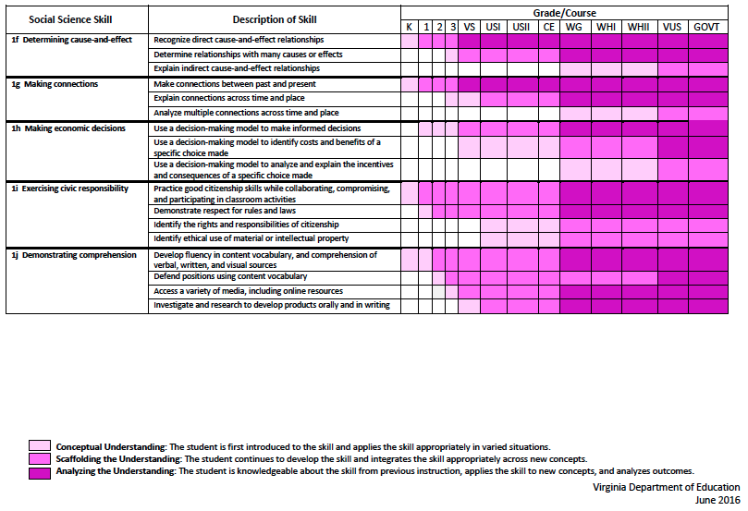
2015 SOL Skill Progression
2008 Standards:
Understand content
2015 Standards:
Understand content by applying the skill.
Skills are aligned with English Standards
Notes:
Discussion: Conceptual Understanding, Scaffolding the Understanding, Analyzing the Understanding
Arrow will rise up upon click after discussion to summarize difference between 2008 and 2015, then skills aligned with English SOLs. Great opportunity for common planning!
Purpose of today is to “teach” a lesson demonstrating skill based instruction, moving away from Lecture (Sit and Get)

Slide 8
Experiences for Essential Skills
What are Experiences?
Notes:
Bring attention to the Experiences and describe what they are and how they can be used.
Provide teachers with “experiences” and give them an opportunity to:
discuss what they are and how they can be used; and
develop their own to share with the group.

Slide 9
The experiences should be –
engaging,
rigorous with higher level thinking questions,
relevant (connecting time periods, places, and events to the present day).

Slide 10
Experiences
Are . . .
Are NOT. . .
Engaging- promoting discussion, collaboration, and understanding
Opportunities to practice social science skills using various content
Varied throughout the lesson to help students make connections
Worksheets
Specific to one Standard, topic, or course

Slide 11
Standards
Skills - WG1.c:
The student will demonstrate skills for historical thinking, geographical analysis, economic decision making, and responsible citizenship by creating, comparing, and interpreting maps, charts, graphs, and pictures to determine characteristics of world regions.
Content - WG3.b:
The student will apply the concept of a region by describing how regional landscapes reflect the physical environment and the cultural characteristics of their inhabitants

Slide 12
Geographic Scene Investigation
What do you see?
Where might this be?

Slide 13
World Geography Sample Lesson Ib: WG.11
This style of lesson is great for predicting and using evidence. Students are given a picture and asked to analyze the cultural landscape to then identify the location

Slide 14
GSI: Geographic Scene Investigation
What do you see?
This looks like it’s in the city because this is multiple floors and lots of electric lines and telephone poles. The buildings don’t look finished and there isn’t any glass in the windows so it’’s probably in an LDC. They could be apartment buildings so that means there’s a lot of people around (just not in this picture). There is a “HomeWorks South” billboard with some different writing (with wavy writing, pos. Sandskrit?) above it which means this city has multiple languages. The date on the billboard is like how the British write their dates so maybe connected to Britain. There is a thatch roof on that lean-to in front of the picture. The trees are green and look tropical. There are flags and other signs (not in English) over the door. There is a car and a motorcycle in the picture but no paved roads. It looks dirty. There are metal fans like exhaust fans all over the lean-to by the motorcycle. This might be someone’s business.
Student Example taken from VGA “WHAT WORKS”
Lesson 5 by Penny Anderson
https://php.radford.edu/~vga/?page_id=3691
Notes:
Handout: Student Sample (taken from slides 24 & 25 of this presentation

Slide 15
GSI: Geographic Scene Investigation
II. Where might this be?
Since this looks like it’s an LDC with a lot of people, and it looks tropical, and the writing is in both English and wavy writing (like Sandskrit) and it’s got electricity and lots of buildings, and India used to be the British crown colony, I think it is Mumbai, India.
Teacher’s Note:
Although this is not India, the student was very observant to see in the photo signage, architecture, and other cultural items. The student was on the right track with an LDC that was highly influenced by Britain. This is a picture of Bangkok, Thailand.
Student Example taken from VGA “WHAT WORKS”
Lesson 5 by Penny Anderson
https://php.radford.edu/~vga/?page_id=3691
Notes:
Handout: Student Sample (taken from slides 24 & 25 of this presentation

Slide 16
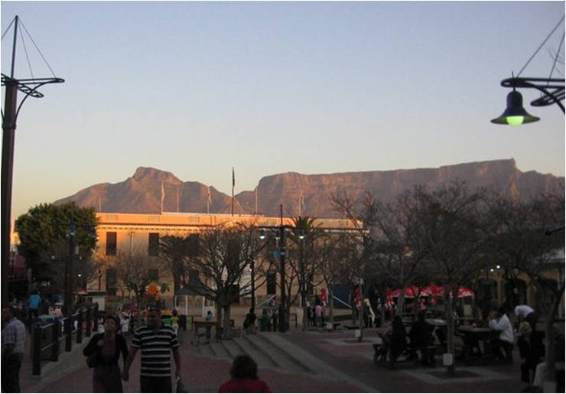
What do you see? 2. Where might this be?
http://www.arcgis.com/apps/MapTour/index.html?appid=20805a99ccfe47ef863db8f2e8f60525&webmap=7ec41f7a24db4273baca3e6282824e9f
Notes:
Capetown, South Africa - In addition to other physical characteristics of South Africa, such as the Drakensburg Mountains and the Witwaterstrand, is the iconic Table Mountain overlooking Cape Town. No where else in the world has a “Table Mountain”.

Slide 17
Capetown, South Africa - In addition to other physical characteristics of South Africa, such as the Drakensburg Mountains and the Witwaterstrand, is the iconic Table Mountain overlooking Cape Town. No where else in the world has a “Table Mountain”.

Slide 18
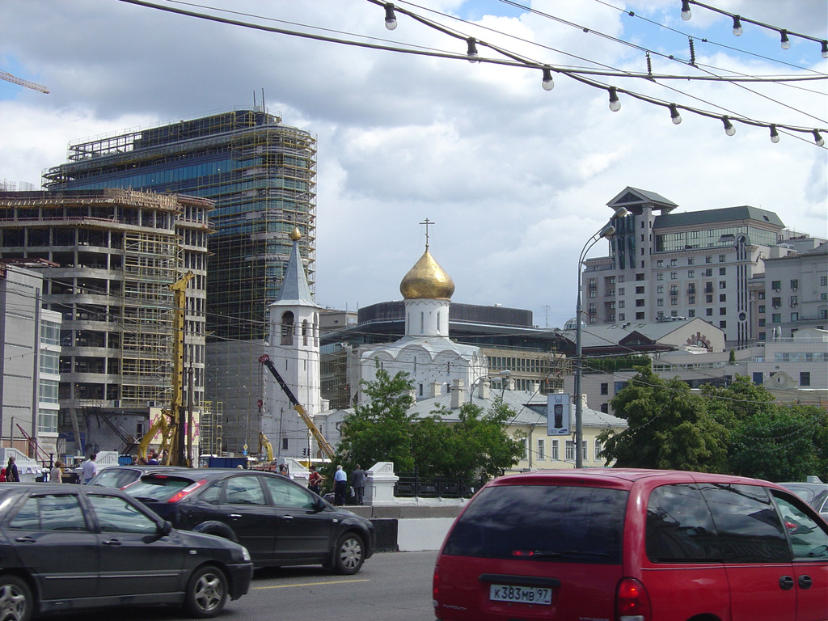
What do you see? 2. Where might this be?
https://php.radford.edu/~vga/?page_id=1766&album=6&photo=55&occur=1
Notes:
Moscow, Russia

Slide 19
Moscow, Russia

Slide 20
Standards
Skills – WG.1a:
The student will demonstrate skills for historical thinking, geographical analysis, economic decision making, and responsible citizenship by: synthesizing evidence from artifacts and primary and secondary sources to obtain information about the world’s countries, cities, and environments
Content – WG.15a
The student will apply social science skills to analyze past and resent trends in human migration and cultural diffusion by: determining how human migration and cultural diffusion are influenced by social, economic, political, and environmental factors

Slide 21
Learning Experience
Analyze one map with the “Layers of Inference” Graphic Organizer
Option 1 - Split into small groups and observe, reflect, and question each document as a group.
Option 2 - Create and post large, color pictures of the various maps. Participants use sticky notes to observe, reflect, and question in a gallery walk
Option 3 - create a QR code gallery walk rather than print large color pictures of the maps.
Extension - participants create an outline for a response answering the questions “Where do people choose to settle? What factors influence their decisions on settlement location?

Slide 22
SCIM
Survey: What do you see?
Contextualize: When does this take place in history? What other events are occurring?
Infer: What do you think is happening?
Monitor: What other information do you want to know?
Historical Inquiry, Virginia Tech
Notes:
1st activity to model and practice

Slide 23
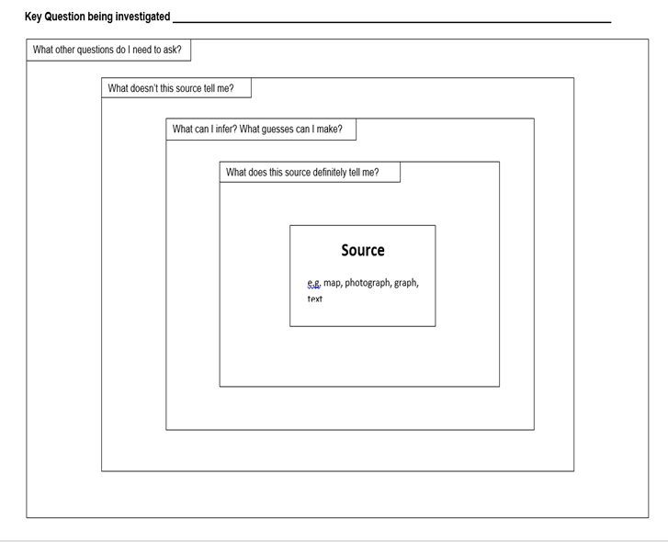
Notes:
Layers of Inference Graphic organizer taken from the Virginia Geographic Alliance presentation located at http://bit.ly/GeoHist

Slide 24
Layers of Inference Graphic organizer taken from the Virginia Geographic Alliance presentation located at http://bit.ly/GeoHist

Slide 25
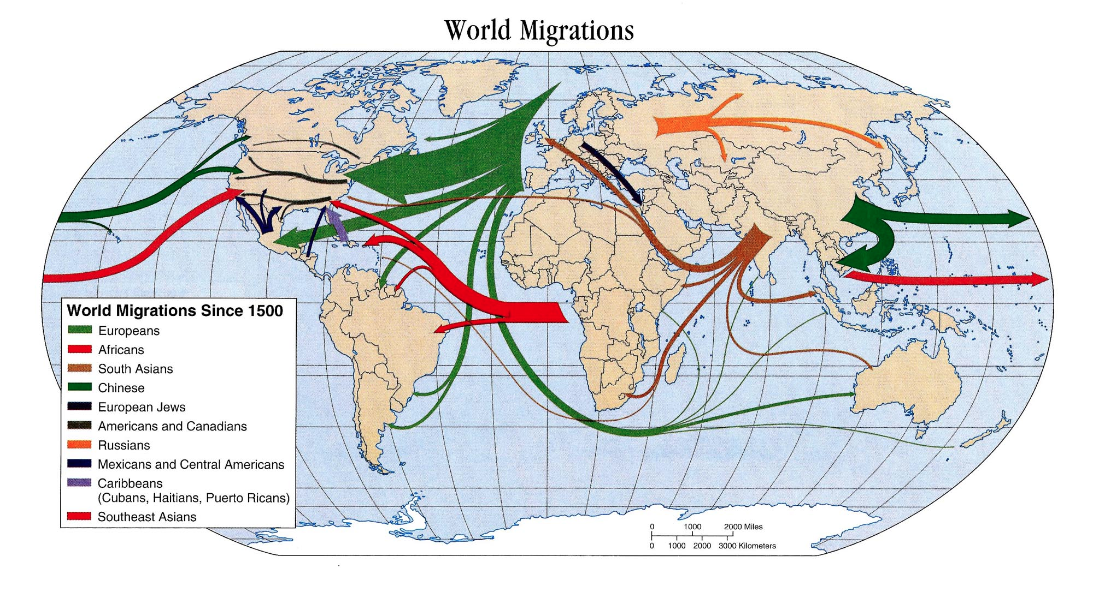
http://itsallaboutculture.com/great-migrations-lecture-and-maps/
Notes:
http://itsallaboutculture.com/great-migrations-lecture-and-maps/

Slide 26
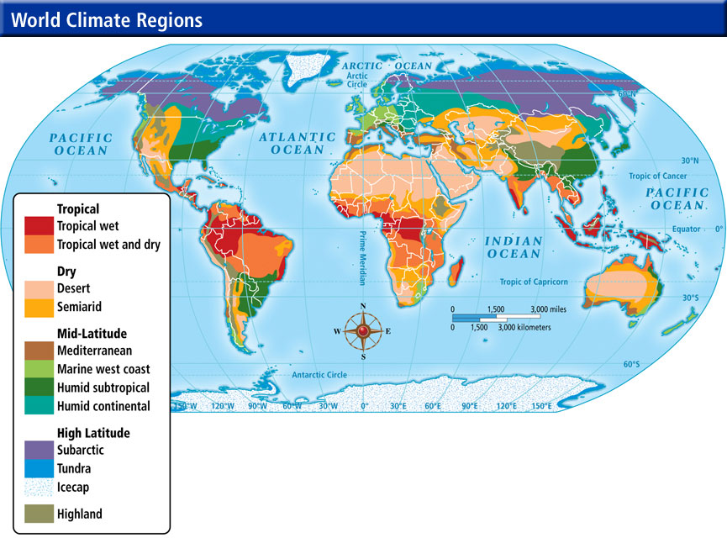
http://jb-hdnp.org/Sarver/Maps/WC/wc02_climateregionsm.jpg
Notes:
http://jb-hdnp.org/Sarver/Maps/WC/wc02_climateregionsm.jpg

Slide 27
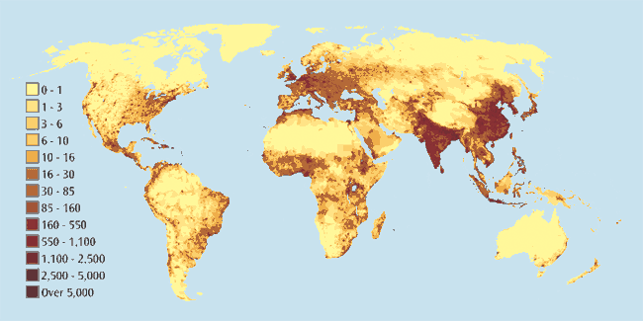
World Population Map
Notes:
http://www.theglobaleducationproject.org/earth/images/final-images/g-gpw-population-map.gif

Slide 28
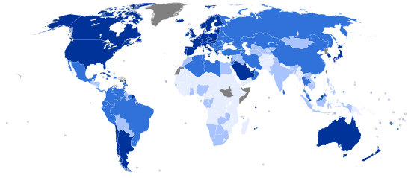
Human Development World Map
Notes:
World map indicating the categories of Human Development Index by country (based on 2013 data, published on July 24, 2014) by the Human Development Index
https://upload.wikimedia.org/wikipedia/commons/3/34/2014_UN_Human_Development_Report_Quartiles.svg

Slide 29
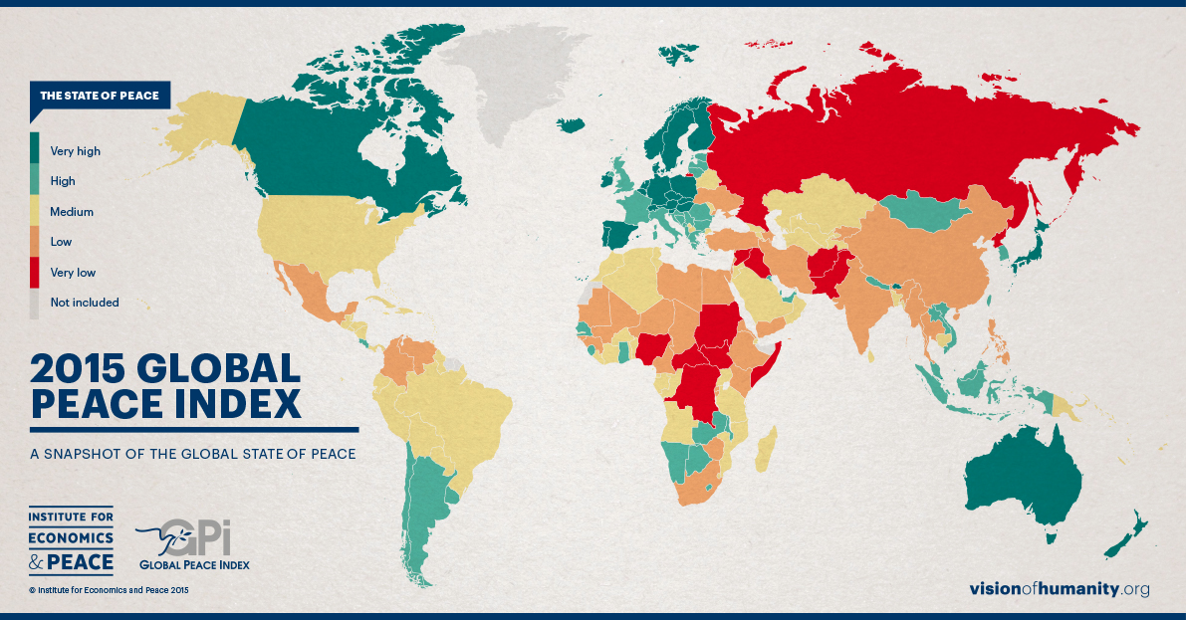
2015 Global Peace Index
Notes:
https://arirusila.files.wordpress.com/2015/06/global20peace20index20results20map.jpg

Slide 30
Education Around the World
Notes:
elearninginfographics.com

Slide 31
Standards
Skills -
SOL WG.1g - The student will demonstrate skills for historical thinking, geographical analysis, economic decision making, and responsible citizenship by: analyzing multiple connections across time & place
Content -
SOL WG.2b - The student will analyze how physical and ecological processes shape Earth’s surface by: describing how humans influence the environment and are influenced by it
SOL WG.8b & WG.8c - The student will analyze the characteristics of the Russian and Central Asian regions by: describing major physical and environmental features & explaining important economic characteristics like the shrinking of the Aral Sea & declining cotton production in Central Asia

Slide 32
Shrinking Aral Sea

Slide 33
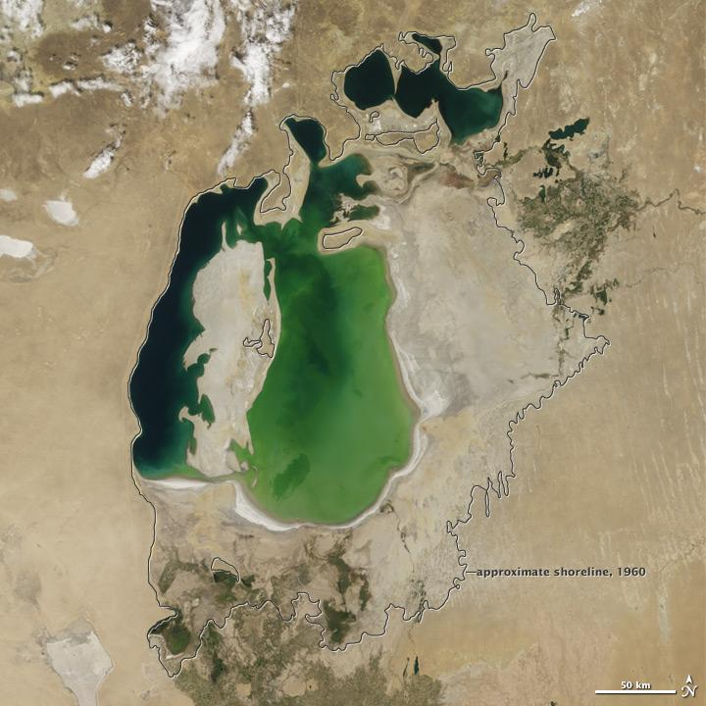
Aral Sea: August 25, 2000

Slide 34
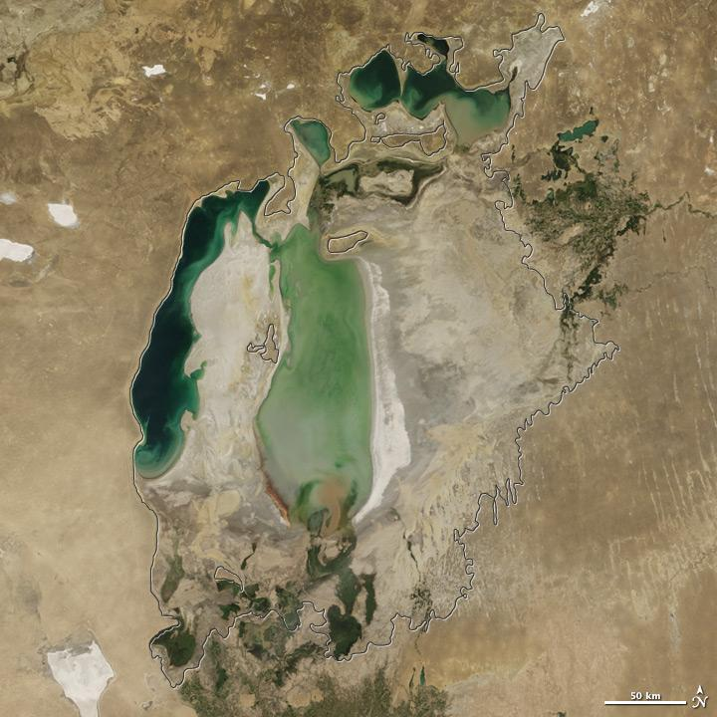
Aral Sea: August 12, 2005

Slide 35
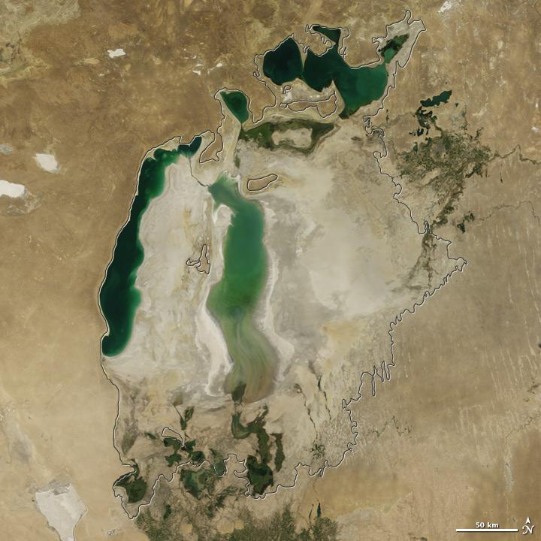
Aral Sea: August 26, 2010

Slide 36
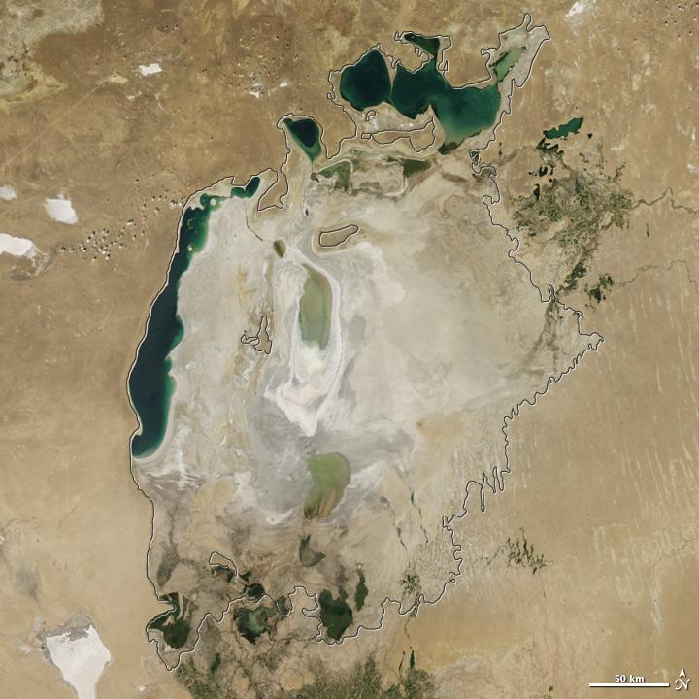
Aral Sea: August 13, 2015

Slide 37
Standards
Skills - SOL WG.1h
The student will demonstrate skills for historical thinking, geographical analysis, economic decision making, and responsible citizenship by: using a decision-making model to analyze and explain the incentives for and consequences of a specific choice made
Content - SOL WG.17c
The student will apply social science skills to analyze the impact of globalization by: mapping, describing, and evaluating economic unions like the European Union (EU)

Slide 38
Decision-Making Models
Effective decision-making models: compare the expected costs and benefits of alternative choices; identify the costs and benefits of specific choices made.
Two models or tools
Cost-Benefit Decision Guide
PACED

Slide 39
Tool #1 Cost-Benefit Decision Guide
Tool used for deciding whether or not an action should be taken by comparing its benefits and costs.
Use when a “Yes or No” decision needs to be made.
Importance of Tool
For Future Decisions – an intentional consideration of less
obvious factors that may be important to the outcome
For Past Decisions – provides context for the decision -
helping to understand why the action was taken and
evaluate whether the best decision was made.

Slide 40
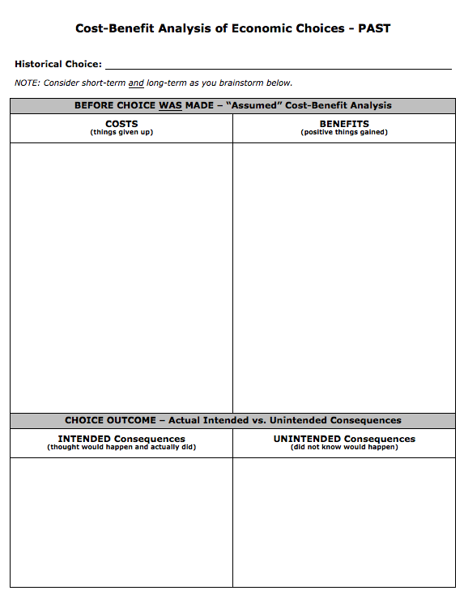
All Economic handouts
Notes:
All Economic handouts taken from the Virginia Council for Economic Education presentation located at http://tinyurl.com/skill-1h

Slide 41
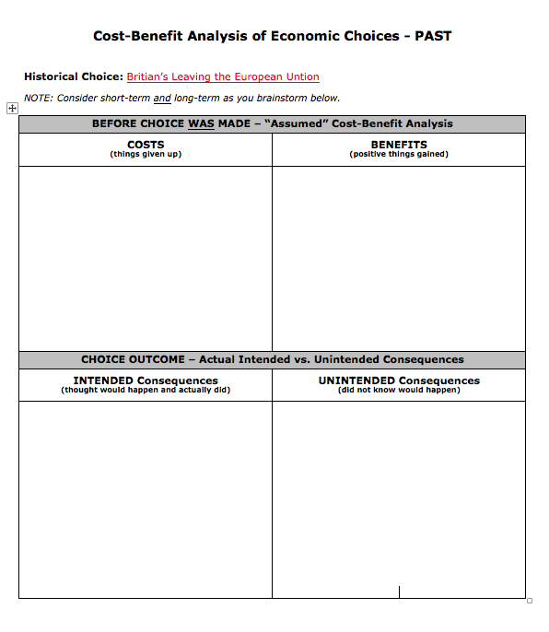
Teachers brainstorm initial answers and share out, via chart paper to show what they already know.
Jigsaw teachers into three groups, each group will focus on specific issue related to Brexit: Identity, Economy, or Sovereignty
Distribute one-page briefing paper to each group that matches their assigned issue and have them fill their own chart paper of Cost-Benefit chart.
Have each group share out OR have groups do a gallery walk to the remaining issues that have been charted out.
To wrap up, have participants stand by the issue that has the greatest COSTS, have participants talk with others standing in same group and be prepared to defend their answer. You can repeat this with BENEFITS
Britain Leaves the European Union
Notes:
Teachers brainstorm initial answers and share out, via chart paper to show what they already know.
Jigsaw teachers into three groups, each group will focus on specific issue related to Brexit: Identity, Economy, or Sovereignty
Distribute one-page briefing paper to each group that matches their assigned issue and have them fill their own chart paper of Cost-Benefit chart.
Have each group share out OR have groups do a gallery walk to the remaining issues that have been charted out.
To wrap up, have participants stand by the issue that has the greatest COSTS, have participants talk with others standing in same group and be prepared to defend their answer. You can repeat this with BENEFITS
Note: Briefing papers can be found at this pdf link: The EU Referendum 2016: exploring the issues and implications They come from The UK teacher resource network, The Guardian. This collection of articles explores the main issues behind the EU referendum - such as identity, economy and sovereignty - and their implications. It also looks at the campaigns launched by the Leave and Remain camps. I have also email the pdf of these briefing papers. Check my email dated July 18, 2016.

Slide 42
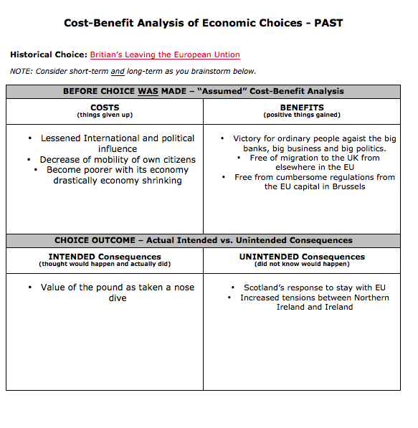
Britain Leaves the European Union
Notes:
Slide you can share with some answers that come from the readings or use as a teacher key.

Slide 43
Tool #2 PACED Decision-Making Grid
Tool necessary when deciding among
various alternatives
by considering the cost and benefits of each alternative against predetermined criteria.

Slide 44
Tool #2 PACED Decision-Making Grid
How do you decide?
PACED
Identify the Problem
List Alternatives or choices
State the Criteria - What’s most important?
Evaluate
Decide

Slide 45
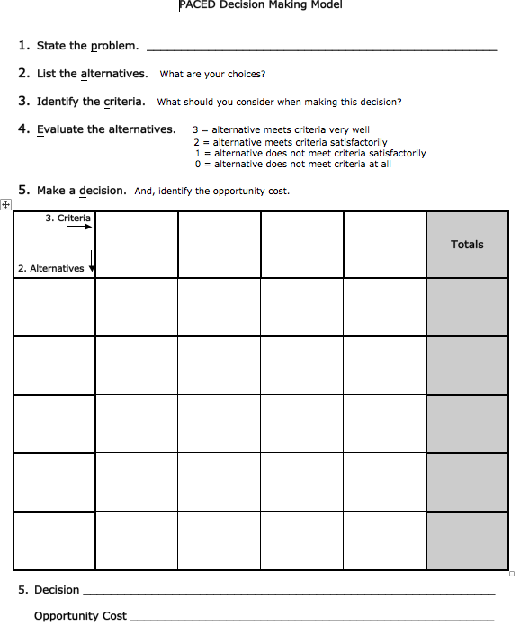

Slide 46
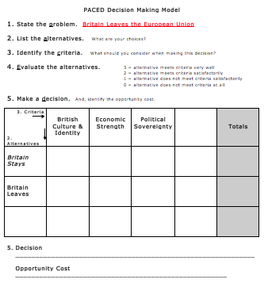
Use this model with Brexit AND/OR use the next slide with the Chinese migration example.
If you use Brexit,
model with participant input (based on what they just read) how to fill out chart.

Slide 47
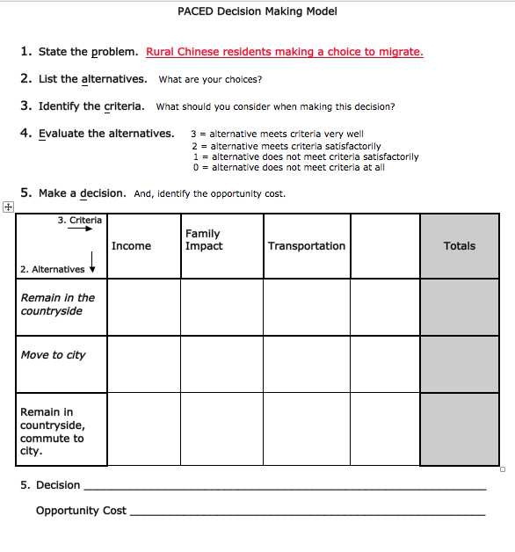
If you use Chinese Migration Article
Distribute article for teachers to skim.
Fill out PACED decision making model as a group.
Note: This article is about rural Chinese residents migrating to cities to work and the economic and social implications of their decision.
“In China, a Rare Return Lunar New Year Allows Migrant Workers to Leave Jobs in Cities for Rural Homes” from The Washington Post
Link to the article - http://wpo.st/Ur8o1

Slide 48
Exploring topics
What other topics might lend themselves well to using a decision-making model to analyze and explain the incentives for and consequences of a specific choice?
Brainstorm your thoughts and add them to the following shared google doc page.
http://tinyurl.com/WGdecisionmaking

Slide 49
Writing to Learn
Not graded
Prior to lesson
Assess student background knowledge
End of lesson
Check understanding
Make Connections
Answer BIG QUESTION
Free-write

Slide 50
Resources
Current Affairs
NEWSELA- database of current event articles that can be accessed in different formats by reading levels. Teachers can use Newsela to differentiate nonfiction reading. It’s indexed by broad themes (War and peace, Arts, Science, Health, Law)
The Guardian- The Guardian is a National British daily newspaper, known until 1959 as the Manchester Guardian. Along with its sister papers The Observer and The Guardian Weekly, The Guardian is part of the Guardian Media Group, owned by The Scott Trust Limited.
Economics
The Economist - The Economist online offers authoritative insight and opinion on international news, politics, business, finance, science and technology. All online articles are from The Economist print edition (including those printed only in British copies) and maintained in a searchable online archive that dates back June 1997. The Economist online is part of The Economist Group and is responsible for The Economist on the internet with offices in New York, London and San Francisco, and a growing worldwide editorial staff.
Virginia Council on Economic Education

Slide 51
Reflections:
3 things you learned,
2 ways you can use this learning in your class, and
1 question you still have

Slide 52
Questions?
Notes:
Respond to the parking lot questions that have been posted in each room.

Slide 53
World Geography Presenters
Brennan Sigel | Hanover | bsigel@hcps.us
Kelly Stead | Norfolk | Kestead@nps.k12.va.us
Bethany Augrom | Stafford | augrombl@staffordschools.net
Diana Jordan | Arlington | Diana.jordan@apsva.us
Sherry Cole | Washington | scole@wcs.k12.va.us
Jill Pritt | Campbell County | jpritt@campbell.k12.va.us

Slide 54
Virginia Department of Education
Christonya Brown, K-12, History and Social Science Coordinator
E-mail: Christonya.Brown@doe.virginia.gov
Betsy Barton, Elementary, History and Social Science Specialist
E-mail: Betsy.Barton@doe.virginia.gov
Jill Nogueras, English and History and Social Science Specialist
E-mail: Jill.Nogueras@doe.virginia.gov

