Slide 1
World History and Geography: 1500 A.D. (C.E.) to the Present
History and Social Science
Fall Institute
2016

Slide 2
Disclaimer
Reference within this presentation to any specific commercial or non-commercial product, process, or service by trade name, trademark, manufacturer or otherwise does not constitute or imply an endorsement, recommendation, or favoring by the Virginia Department of Education.

Slide 3
Questions to Ask During Planning
Essential Components in Planning an Effective Lesson
using the
2015 History and Social Science Standards of Learning
What do students need to know and understand by the end of this lesson?
What do students need to do during this lesson?
Which historical thinking skills are best suited for this standard?
What other content material should be added to provide historical context and richness to the lesson in order to maximize student understanding of the standard?
What student learning experiences would be most effective during this lesson?
How can I check for understanding effectively and accurately to measure the students’ content knowledge and historical thinking skills?

Slide 4
It starts with the . . .

Slide 6
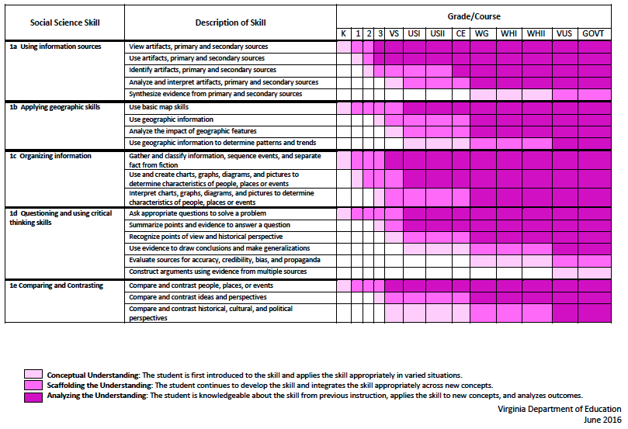
2015 SOL Skill Progression
Notes:
⇧

Slide 7
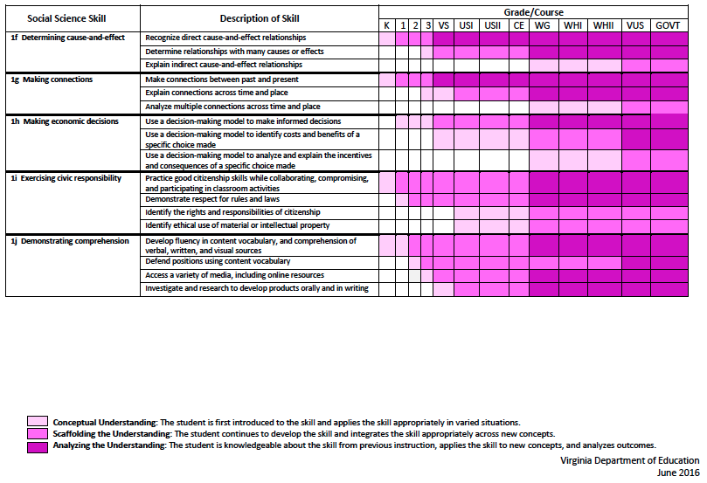
2015 SOL Skill Progression
2008 Standards:
Understand content
2015 Standards:
Understand content by applying the skill.
Skills are aligned with English Standards
Notes:
Discussion: Conceptual Understanding, Scaffolding the Understanding, Analyzing the Understanding
Arrow will rise up upon click after discussion to summarize difference between 2008 and 2015, then skills aligned with English SOLs. Great opportunity for common planning!
Purpose of today is to “teach” a lesson demonstrating skill based instruction, moving away from Lecture (Sit and Get)

Slide 8
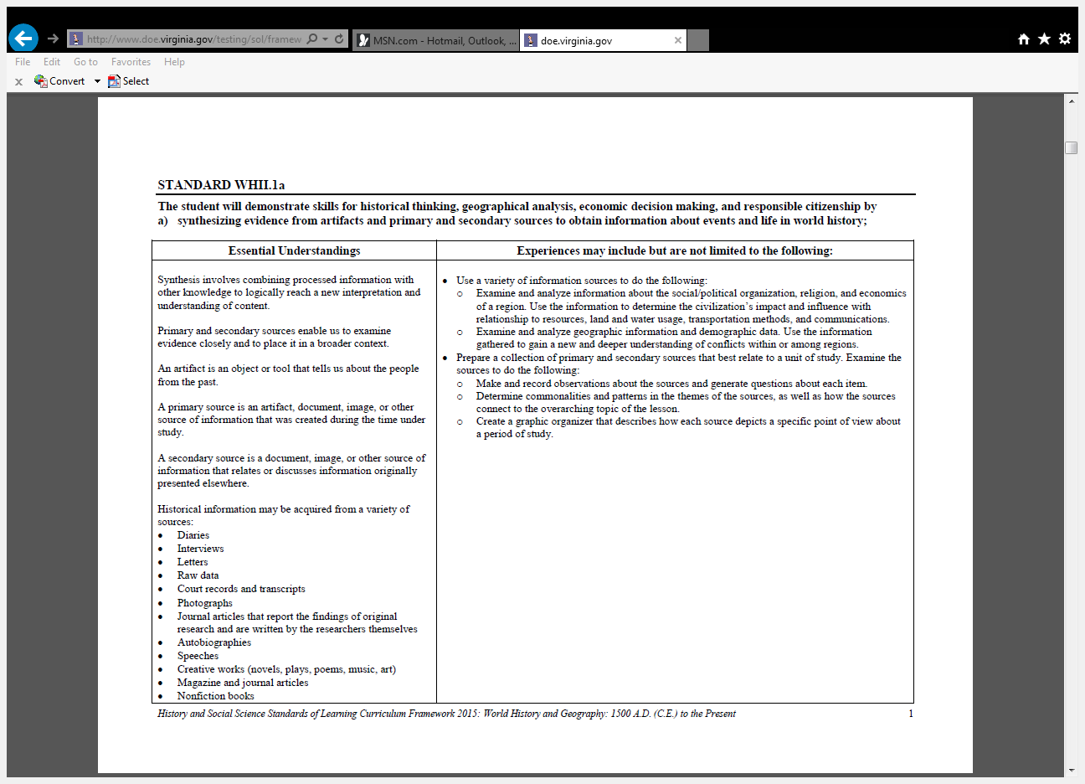
Experiences for Essential Skills
What are Experiences?
Notes:
Bring attention to the Experiences and describe what they are and how they can be used.
Provide teachers with “experiences” and give them an opportunity to:
discuss what they are and how they can be used; and
develop their own to share with the group.

Slide 9
The experiences should be –
engaging,
rigorous with higher level thinking questions,
relevant (connecting time periods, places, and events to the present day).

Slide 10
Experiences
Are . . .
Are NOT. . .
Engaging- promoting discussion, collaboration, and understanding
Opportunities to practice social science skills using various content
Varied throughout the lesson to help students make connections
Worksheets
Specific to one Standard, topic, or course

Slide 11
From the Library of Congress…
“Why use primary sources?”
Engage students
Develop critical thinking skills
Construct knowledge
The 2015 History and Social Science Standards of Learning require students to USE information, not just memorize information.

Slide 12
Essential Skill Standards
WHII.1The student will demonstrate skills for historical thinking, geographical analysis, economic
decision making, and responsible citizenship by
c) organizing Information by interpreting pictures to determine characteristics of people, places, or events.
d) evaluating sources for accuracy, credibility, bias, and propaganda;
f) explaining how indirect cause-and-effect relationships impacted people, places, and events in world history

Slide 13
WHII.9 The student will apply social science skills to understand global interactions between 1800 to about 1900 by
d) assessing European colonization and imperialism on Asia, Africa, the Pacific Islands, and Australia; and
e) analyzing the relationship between industrialization, imperialism, and nationalism.
To introduce the cause and effect of Imperialism one could use the following student experience based on ideas from the Library of Congress.

Slide 14
Analyzing Political Cartoons
Post the following political cartoons around the room, or make copies and create stations for students to move between, or create packets for students to analyze in groups at their tables.
Have students visit each cartoon and analyze it based on the LOC Primary Source Analysis tool.
Guide students with the sample questions to further analyze the images and to facilitate group discussion.
Have students draw conclusions about the motives for European Imperialism and the effects imperialism had on the indigenous peoples and governments.
One step further:
Use modern cartoon to discuss if imperialism still exists and if the motives are similar to the motives from the late 19th-early 20th centuries.

Slide 15
Notes:
An illustration from supplement to "Le Petit Journal", 16th January 1898. This reproduction from Bibliothèque nationale de France

Slide 16
Possible Guiding Questions:
What does the item on the table represent?
Identify the countries represented by each character.
What is the character in the background trying to do?
Explain his possible motivation.

Slide 17
Notes:
The Granger Collection, NYC: “The Devilfish in Egyptian Waters,” unknown American artist, 1882.

Slide 18
Possible Guiding Questions:
What do you notice first about this drawing?
How does this cartoon compare to the first one you examined?

Slide 19
Notes:
1896. Pughe, J. S. (John S.). Image and caption from the United States Library of Congress

Slide 20
Possible Guiding Questions:
What country does each of the characters represent?
Why is the central figure larger than the other two?
Identify examples of bias the artist used in the cartoon.
For what purpose did the artist include the bias?

Slide 21
Notes:
CARTOON: IMPERIALISM, 1885. The World's Plunderers. Germany, England, and Russia grab what they can of Africa and Asia. American cartoon by Thomas Nast, 1885 Harper’s Weekly.

Slide 22
Possible Guiding Questions:
Germany, Russia, and Great Britain appear to be gathering up parts of Africa and Asia in this cartoon. Which country seems to have a “head-start”?
How did the artist indicate this country had a head-start?
Predict the responses of people indigenous to Africa and Asia to being “grabbed up”?

Slide 23
Notes:
Gilliam, Victor “Showing how Uncle Sam has been an expansionist first, last, and all the time”
Judge, Arkell Publishing Company, NY, 1899

Slide 24
Possible Guiding Questions:
How does the artist have Uncle Sam changing over time?
What would this change indicate?

Slide 25
Reflection:
What do you think was happening his history when these cartoons were created?
Do the images present one area of the world as the aggressor over the other?
What might possible outcomes of these events in history be?

Slide 26
Questions:
Who?
What?
When?
Where?
How?
Why?
Have students draw conclusions about the motives for European Imperialism and the effects imperialism had on the indigenous peoples and governments.

Slide 27
One Step Further: Does imperialism still exist? Are the motives similar to motives during the late 19th –early 20th centuries?

Slide 28
Analysis Tools from LOC Hard copies are available from presenter and from http://www.loc.gov.teachers
For Students:
For Teachers:
Primary Source Analysis Tool
Teacher’s Guide

Slide 29
The Class Discussion
Use sample questions from Teacher’s Guide to help students share their observations, reflections and questions about the images.
Ask students to draw conclusions about the motives for European imperialism based on what they have observed in the images.
Have students determine the effects imperialism would have on the native people, governments, and economies.
Have students predict what the responses of the native peoples and governments would be to acts of imperialism. (ex: Boxer Rebellion, etc.)
One Step Further: Does Imperialism still exist? How do the motives compare? Predict the outcomes of modern imperialistic actions.

Slide 30
Create a learning experience for students to practice the following skills:
WHII.1 The student will demonstrate skills for historical thinking, geographical analysis, economic decision making, and responsible citizenship by:
f) explaining how indirect cause-and-effect relationships impacted people, places, and events in world history
h) using a decision-making model to analyze and explain the incentives for and consequences of a specific choice made;

Slide 31
Apply this skill to the following content Standards:
WHII.4 The student will apply social science skills to understand the impact of the European Age of Exploration by
a) explaining the political and economic goals of European exploration and colonization;
b) describing the geographic expansion into Africa, Asia, and the Americas;
c) comparing and contrasting the social and cultural influences of European settlement on Africa, Asia and the Americas;
d) analyzing how competition for colonies changed the economic system of Europe; and
e) defining and describing how the Scientific Revolution led to social and technological changes that influenced the European view of the world.

Slide 32
Exploring topics
What other topics might lend themselves well to organizing information by interpreting pictures to determine characteristics of people, places, or events?
Brainstorm ideas with your table.
Notes:
Individually or in pairs, have teacher brainstorm additional topics that would work well with the this skill. Discuss as a group. If there is no internet connection, ask teachers to write out their ideas and share out. You can offer to type them into this shared document

Slide 33
The Armenian Genocide
Content -
WHII.11d - examining the Holocaust and other examples of genocide in the twentieth century.
Skills -
WHII.1a – synthesizing evidence from artifacts and primary and secondary sources.
WHII.1d – evaluating sources for accuracy, credibility, bias, and propaganda.

Slide 34
The Armenian Genocide
Provide point of view (POV) of each website and list three pieces of evidence for each POV.
http://www.armenian-genocide.org/
http://www.gendercide.org/case_armenia.html
http://www.ataa.org/reference/tragedy-fein.html

Slide 35
The Armenian Genocide
Website POV
Did you find that any of the websites presented no facts, only POV? If so, which ones?
What websites would be inappropriate for use in an academic paper describing the events that took place in Turkey during World War I? Why?

Slide 36
The Armenian Genocide
What additional documents do historians need to research this genocide?
Answer: primary documents - interviews, diaries, letters, raw data, photographs, etc.

Slide 37
The Armenian Genocide
Assignment - Prepare a collection of primary and secondary sources on the Armenian genocide.

Slide 38
The Armenian Genocide
Based on your research and the definition of a genocide, answer the following question:
Was there an Armenian genocide?

Slide 39
Propaganda Gallery Walk
Content
WHII.10b – The student will apply social science skills to understand World War I and its worldwide impact by describing the location of major battles and the role of new technologies
Skill
WHII.1d – The student will demonstrate skills for historical thinking, geographical analysis, economic decision making, and responsible citizenship by evaluating sources for accuracy, credibility, bias, and propaganda

Slide 40
Document-Analysis Tool
H – Historical Context
I – Intended Audience
P – Purpose
P – Point of View
HIPP can be used to explore reliability of the document

Slide 41
Propaganda Gallery Walk
What persuasive techniques were used in these WWI posters?
What were the goals of the propaganda?

Slide 42
Notes:
Let's Go Forward Together American Propaganda Poster. Digital image. Propaganda and Ad Posters of Miscellaneous Years. N.p., n.d. Web. 20 Dec. 2016. <http://www.vintageadbrowser.com/propaganda-ads-misc-years/133>.

Slide 43
Notes:
Spirit of America WWI Propaganda Poster. Digital image. Propaganda and Ad Posters of Miscellaneous Years. N.p., n.d. Web. 20 Dec. 2016. <http://www.vintageadbrowser.com/propaganda-ads-misc-years/40>.

Slide 45
Notes:
Enlist Now An American WWI Propaganda Poster. Digital image. A Visual Conversation: Media Images During Wartime, 1898-1918. N.p., n.d. Web. 20 Dec. 2016. <http://fch.fiu.edu/FCH-2006/Spivey-A%20Visual%20Conversation.htm>.

Slide 46
Notes:
Flagg, James M. . I Want You for the US Army . Digital image. Library of Congress. N.p., n.d. Web. 20 Dec. 2016. <http://www.loc.gov/rr/print/guide/pp0594.jpg>.

Slide 47
Notes:
An Anti-German WWI Propaganda Poster. Digital image. A Visual Conversation: Media Images During Wartime, 1898-1918. N.p., n.d. Web. 20 Dec. 2016. <http://fch.fiu.edu/FCH-2006/Spivey-A%20Visual%20Conversation.htm>.

Slide 48
Notes:
Strothmann , Frederick. Beat Back the Hun with Liberty Bonds. Digital image. Library of Congress. N.p., n.d. Web. 20 Dec. 2016. <https://www.loc.gov/item/94505100/>.

Slide 49
Notes:
Poulbot, Francisque. Journée de Paris. 14 Juillet 1916. Au profit des oeuvres de guerre de l'Hôtel de Ville . Digital image. Library of Congress. N.p., n.d. Web. 20 Dec. 2016. <https://www.loc.gov/item/99613713/>.

Slide 50
Notes:
Englelhart, J. U. . Bolschewismus bringt Krieg, Arbeitslosigkeit und Hungersnot. Digital image. Library of Congress. N.p., n.d. Web. 20 Dec. 2016. <https://www.loc.gov/item/2004665871/>.

Slide 51
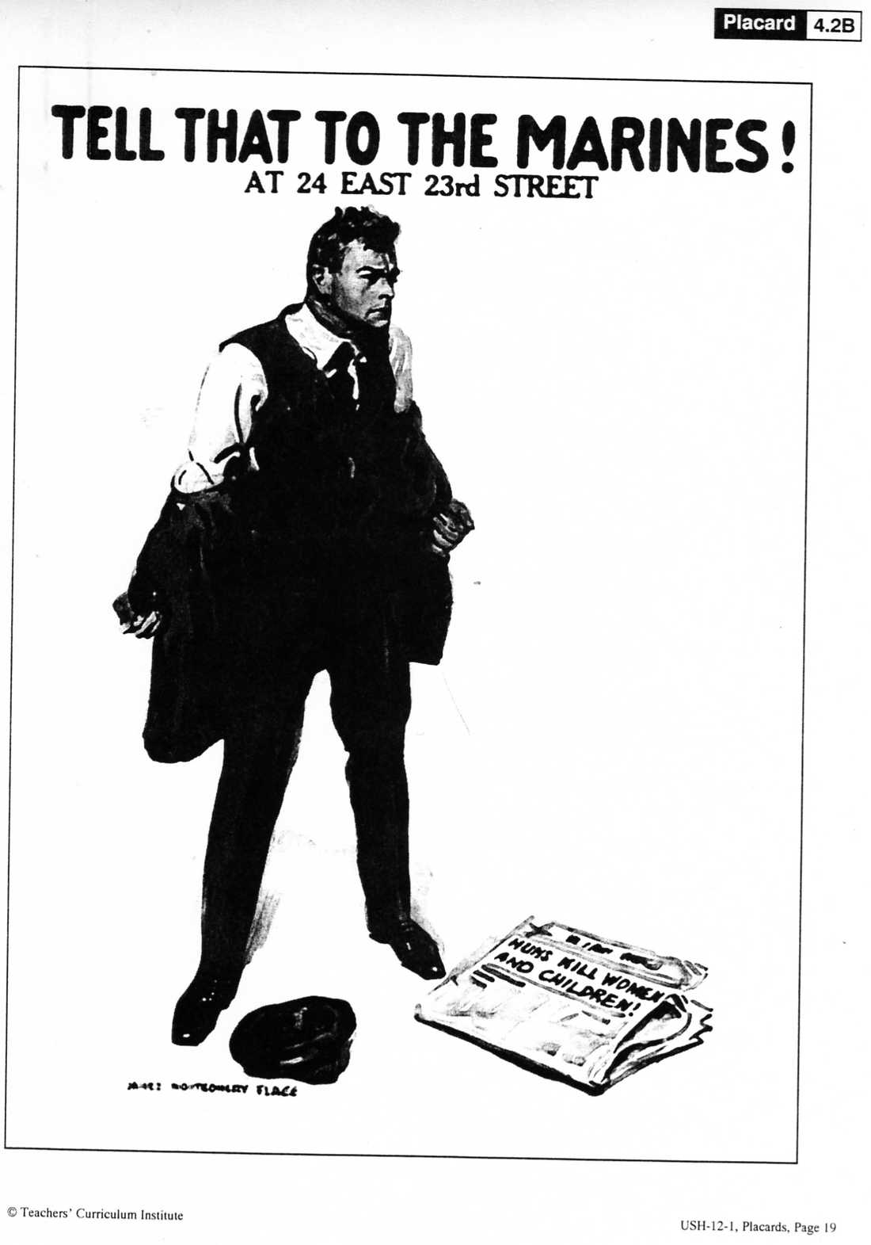
Notes:
Flagg, James Montgomery. Tell that to the Marines! At 24 E 23rd Street . Digital image. Library of Congress. N.p., n.d. Web. 20 Dec. 2016. <https://www.loc.gov/item/2008679015/>.

Slide 52
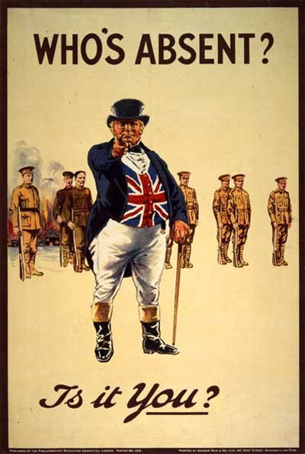
Notes:
Who's absent? Is it you? Digital image. Library of Congress. London : Parliamentary Recruiting Committee, [1915], n.d. Web. 20 Dec. 2016. <https://www.loc.gov/item/2003675386/>.

Slide 53
Notes:
Please Daddy WWI Propaganda Poster. Digital image. Canadian History. N.p., n.d. Web. <https://sites.google.com/site/chc2dcanadianhistory/unit-2-canada-and-the-first-world-war/wwi-propaganda-posters>.

Slide 54
Notes:
Wardle, Arthur . The empire needs men! The overseas states all answer the call. Helped by the young lions the old lion defies his foes. Enlist now. Digital image. Library of Congress. N.p., n.d. Web. 20 Dec. 2016. <https://www.loc.gov/item/2003663156/>.

Slide 55
Propaganda Gallery Walk
What persuasive techniques were used in these WWI posters?
Answers will include appeal to fear, name-calling, demonization, depictions of children, women, and pets, national symbols, catchy slogans, etc.
What were the goals of the propaganda?
Answers will include selling bonds, military conscription, asking women to join workforce, supporting total war, etc.
Find modern examples of propaganda and analyze its goals and persuasive techniques.

Slide 56
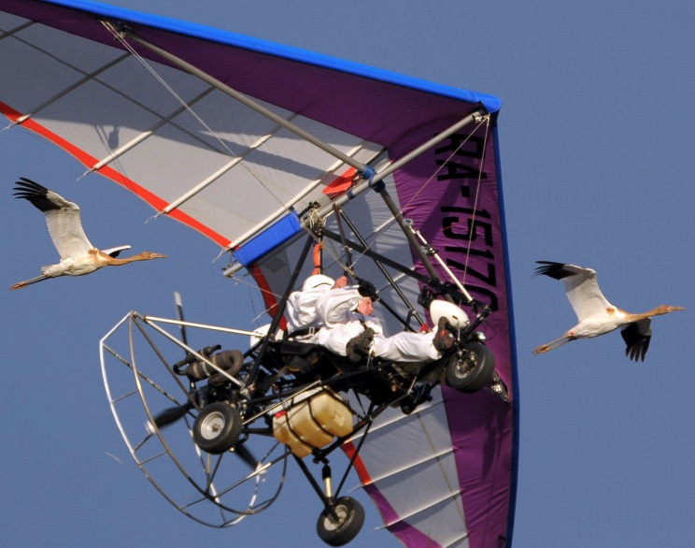
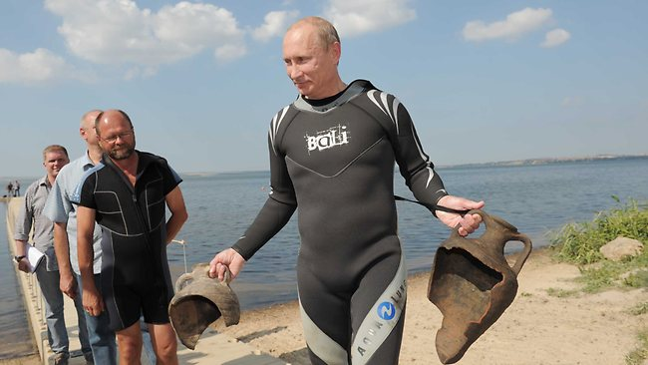
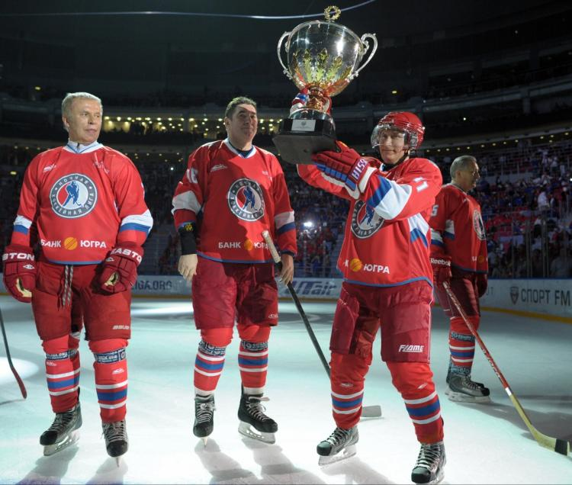
What persuasive techniques are being in these images?
What do you believe are the goals of the images?

Slide 57
Website POV
Did you find that any of the websites presented no facts, only POV? If so, which ones?
What websites would be inappropriate for use in an academic paper describing the events that took place in Turkey during World War I? Why?

Slide 58
What additional documents do historians need to research this genocide?
Answer: primary documents - interviews, diaries, letters, raw data, photographs, etc.
Assignment - Prepare a collection of primary and secondary sources on the Armenian genocide.

Slide 59
Thesis/ Short Answer/ Essay
Based on your research and the definition of a genocide, answer the following question:
Was there an Armenian genocide?

Slide 60
Propaganda Gallery Walk Citations
An Anti-German WWI Propaganda Poster. Digital image. A Visual Conversation: Media Images during Wartime, 1898-1918. N.p., n.d. Web. 20 Dec. 2016. <http://fch.fiu.edu/FCH-2006/Spivey-A%20Visual%20Conversation.htm>.
Englelhart, J. U. . Bolschewismus bringt Krieg, Arbeitslosigkeit und Hungersnot. Digital image. Library of Congress. N.p., n.d. Web. 20 Dec. 2016. <https://www.loc.gov/item/2004665871/>.
Enlist Now An American WWI Propaganda Poster. Digital image. A Visual Conversation: Media Images during Wartime, 1898-1918. N.p., n.d. Web. 20 Dec. 2016. <http://fch.fiu.edu/FCH-2006/Spivey-A%20Visual%20Conversation.htm>.
Flagg, James M. . I Want You for the US Army. Digital image. Library of Congress. N.p., n.d. Web. 20 Dec. 2016. <http://www.loc.gov/rr/print/guide/pp0594.jpg>.
Flagg, James Montgomery. Tell that to the Marines! At 24 E 23rd Street. Digital image. Library of Congress. N.p., n.d. Web. 20 Dec. 2016. <https://www.loc.gov/item/2008679015/>.
Hopps , Harry R. . Destroy This Mad Brut Enlist -U.S. Army. Digital image. Lirary of Congress. N.p., n.d. Web. 20 Dec. 2016. <https://www.loc.gov/item/2010652057/>.
Let's Go Forward Together American Propaganda Poster. Digital image. Propaganda and Ad Posters of Miscellaneous Years. N.p., n.d. Web. 20 Dec. 2016. <http://www.vintageadbrowser.com/propaganda-ads-misc-years/133>.

Slide 61
Propaganda Gallery Walk Citations (Continued)
Please Daddy WWI Propaganda Poster. Digital image. Canadian History. N.p., n.d. Web. <https://sites.google.com/site/chc2dcanadianhistory/unit-2-canada-and-the-first-world-war/wwi-propaganda-posters>.
Poulbot, Francisque. Journée de Paris. 14 Juillet 1916. Digital image. Library of Congress. N.p., n.d. Web. 20 Dec. 2016. <https://www.loc.gov/item/99613713/>.
Spirit of America WWI Propaganda Poster. Digital image. Propaganda and Ad Posters of Miscellaneous Years. N.p., n.d. Web. 20 Dec. 2016. <http://www.vintageadbrowser.com/propaganda-ads-misc-years/40>.
Strothmann , Frederick. Beat Back the Hun with Liberty Bonds. Digital image. Lirary of Congress. N.p., n.d. Web. 20 Dec. 2016. <https://www.loc.gov/item/94505100/>.
Wardle, Arthur. The empire needs men! Digital image. Library of Congress. N.p., n.d. Web. 20 Dec. 2016. <https://www.loc.gov/item/2003663156/>.
Who's absent? Is it you? Digital image. Library of Congress. London: Parliamentary Recruiting Committee, [1915], n.d. Web. 20 Dec. 2016. <https://www.loc.gov/item/2003675386/>.

Slide 62
Cause and Effect
WHII.1f - The student will demonstrate skills for historical thinking, geographical analysis, economic decision making, and responsible citizenship by explaining how indirect cause-and-effect relationships impacted people, places, and events in world history.

Slide 63
Read the story of Alphonse
List as many reasons as possible why the final straw broke his back
Notes:
Chapman, Arthur. "Camels, Diamonds, and Counterfactuals: a model for teaching causal reasoning." Teaching History 112 (2003): 46-53.
It is very important to impress upon our students that major historical events have multiple causes and effects.

Slide 64
Cause-and-Effect Chain

Slide 65
Cause-and- (Multiple) Effect(s)

Slide 66
Cause-and-Effect Interactions

Slide 67
Showing Cause-and-Effect Analysis Sentence Structures
As a result…
Because of…
(Person/evidence) was responsible for…
Since . . . then . . .
As a result…
____was responsible for…
(Evidence or person) made possible…
(Evidence) leads to…

Slide 68
Examples of Learning Experiences
Create a cause-and-effect chart of the events of the American/ Haitian/ French/Russian/Chinese Revolutions.
List reasons why the US became involved in WWI and WWII.
Identify consequences of US participation in WWI and WWII.
Cause-and-effect card sort (e.g. Industrial Revolution).
Six Degrees of Separation (e. g., using valid cause-and-effect connections, conquest of Constantinople by the Ottoman Turks and conquest of the New World by Europeans)
List multiple causes or effects of an event. Rank them in order of their significance.

Slide 69
Fall of the Soviet Union
Content -
WHII.12a - The student will apply social science skills to understand the conflicts during the second half of the twentieth century by explaining the causes of the Cold War, including the competition between the American and Soviet economic and political systems and the causes of the collapse of communism in the Soviet Union and Eastern Europe.
Skills -
WHII.1f - The student will demonstrate skills for historical thinking, geographical analysis, economic decision making, and responsible citizenship by explaining how indirect cause-and-effect relationships impacted people, places, and events in world history.

Slide 70
Event 1. D. Economic and Political Liberalization of the Soviet Union – 1986
Notes:
Democracy Perestroika Glasnost' Digital image. Музей СССР "20-й век". N.p., n.d. Web. 20 Dec. 2016. <http://20th.su/tag/perestrojka/>. On-line Museum of the Soviet History (in Russian)
Glasnost' Digital image. Seventeen Moments in Soviet History. MSU, n.d. Web. 20 Dec. 2016. <http://soviethistory.msu.edu/1985-2/perestroika-and-glasnost/perestroika-and-glasnost-images/#>.

Slide 71
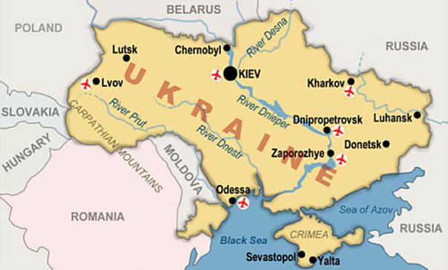
Event 2. F. Glasnost is Tested by the Chernobyl Disaster
Notes:
Map of Ukraine . Digital image. StudyBlue. N.p., n.d. Web. 20 Dec. 2016. <https://www.studyblue.com/notes/note/n/euro-countries/deck/4417845>.
Photo of the Chernobyl nuclear plant. Digital image. United Press International . N.p., n.d. Web. 20 Dec. 2016. <http://www.upi.com/25th-anniversary-of-Chernobyl-disaster/60811303819997/>.

Slide 72
Event 2. F. Glasnost is Tested by the Chernobyl Disaster

Slide 73
Event 3. A. Loss of Economic Control
Notes:
Vodka line in the USSR. Digital image. Дилетант. N.p., n.d. Web. 20 Dec. 2016. <http://diletant.media/photo-collection/26222846/>. A collection of Soviet photographs by a popular historical journal Diletant (in Russian)

Slide 74
Event 3. A. Loss of Economic Control

Slide 75
Event 4. G. Loss of Political Control
Notes:
Several republics protested against the Soviet occupation. Two million Latvia, Estonia, and Lithuania protested the anniversary of the Soviet-Nazi Pact of 1939 by creating a human chain.
Baltic Protest in 1989. Digital image. Euromaidan Press. N.p., n.d. Web. 21 Dec. 2016. <http://euromaidanpress.com/2014/09/08/estonia-and-ukraine-we-are-connected/>.
Several republics protested against the Soviet occupation. Two million Latvia, Estonia, and Lithuania protested the anniversary of the Soviet-Nazi Pact of 1939 by creating a human chain.

Slide 76
Event 5. C. The Failed Coup (August 19-21, 1991)
Notes:
Boris Yeltsin defends the Russian Parliament in 1991. Digital image. History . N.p., n.d. Web. 21 Dec. 2016. <http://www.history.com/topics/cold-war/fall-of-soviet-union>.

Slide 77
Event 6. B. Political Disintegration of the Soviet Union
Notes:
The photos shows destroyed Soviet passports.
Destroyed Soviet passports . Digital image. Спецпроект, посвященный событиям 1991 года. N.p., n.d. Web. 21 Dec. 2016. <http://1991.lenta.ru/1991/09/06/girdziusas/pic017.jpg>. A special collection of resources dedicated to the fall of the Soviet Union (in Russian)

Slide 78
Event 7. E. A Civilized Divorce
Notes:
Signing of the Belo-Vezha Treaty that dissolved the Soviet Union. Digital image. History . N.p., n.d. Web. 21 Dec. 2016. <http://www.history.com/topics/cold-war/fall-of-soviet-union>.

Slide 79
P.A.C.E.D. Grid (Problem – Alternatives – Criteria – Evaluate - Decision)
Problem: Mikhail Gorbachev and the decision when faced with demands of independence movements in the USSR
Criteria Alternatives | Allow Soviet republics leave the Union peacefully | Use military force to keep the Union together
Preserving power of Soviet elites
Keeping control of the Communist empire and Eastern Europe
Avoiding loss of human lives
Decision:

Slide 80
Fall of the Soviet Union Activity Citations
Baltic Protest in 1989. Digital image. Euromaidan Press. N.p., n.d. Web. 21 Dec. 2016. <http://euromaidanpress.com/2014/09/08/estonia-and-ukraine-we-are-connected/>.
Boris Yeltsin defends the Russian Parliament in 1991. Digital image. History. N.p., n.d. Web. 21 Dec. 2016. <http://www.history.com/topics/cold-war/fall-of-soviet-union>.
Democracy Perestroika Glasnost' Digital image. Музей СССР "20-й век". N.p., n.d. Web. 20 Dec. 2016. <http://20th.su/tag/perestrojka/>. On-line Museum of the Soviet History (in Russian)
Destroyed Soviet passports. Digital image. Спецпроект, посвященный событиям 1991 года. N.p., n.d. Web. 21 Dec. 2016. <http://1991.lenta.ru/1991/09/06/girdziusas/pic017.jpg>. A special collection of resources dedicated to the fall of the Soviet Union (in Russian)

Slide 81
Fall of the Soviet Union Activity Citations
Glasnost' Digital image. Seventeen Moments in Soviet History. MSU, n.d. Web. 20 Dec. 2016. <http://soviethistory.msu.edu/1985-2/perestroika-and-glasnost/perestroika-and-glasnost-images/#>.
Map of Ukraine. Digital image. StudyBlue. N.p., n.d. Web. 20 Dec. 2016. <https://www.studyblue.com/notes/note/n/euro-countries/deck/4417845>.
Signing of the Belo-Vezha treaty that dissolved the Soviet Union. Digital image. History. N.p., n.d. Web. 21 Dec. 2016. <http://www.history.com/topics/cold-war/fall-of-soviet-union>.
Photo of the Chernobyl nuclear plant. Digital image. United Press International. N.p., n.d. Web. 20 Dec. 2016. <http://www.upi.com/25th-anniversary-of-Chernobyl-disaster/60811303819997/>.
Vodka line in the USSR. Digital image. Дилетант. N.p., n.d. Web. 20 Dec. 2016. <http://diletant.media/photo-collection/26222846/>. A collection of Soviet photographs by a popular historical journal Diletant (in Russian)

Slide 82
Cold War
Who was primarily responsible for the Cold War – the United States or the Soviet Union?
82

Slide 83
Essential Skill Standards
The student will demonstrate skills for historical thinking, geographical analysis, economic decision making, and responsible citizenship by
a) synthesizing evidence from artifacts and primary and secondary sources to obtain information about events and life in world history;
d) evaluating sources for accuracy, credibility, bias, and propaganda;
e) comparing and contrasting historical, cultural, economic, and political perspectives in world history;
g) analyzing multiple connections across time and place;

Slide 84
Primary Sources
Pass out Documents A and B with guiding questions.
Students record their initial hypothesis based on these two documents.
Pass out Documents C and D with guiding questions.
Students record their second hypothesis based on these two documents.
See if students change their hypothesis from the first one they recorded.
84

Slide 85
Primary Sources
Class discussion:
Who was primarily responsible for the start of the Cold War?
What evidence do you have to support your claim?
Which of these documents do you believe is most trustworthy? Why?
Did anyone’s hypothesis change? How and why?
What other evidence would you need to strengthen your claim?
What other types of documents would you like to have seen? Why?
85

Slide 86
Timeline of Early Cold War Events
86

Slide 87
1948: June 24 – Berlin blockade begins
1949: July – NATO treaty ratified
1949: May 12 – Berlin blockade ends
1949: September – Mao Zedong, a communist, takes control of China
1949: September – Soviets explode first atomic bomb
1955: May – Warsaw Pact
87

Slide 88
Document A: The Iron Curtain Speech (modified)
It is my duty, however, to place before you certain facts about the present position in Europe.
From Stettin in the Baltic to Trieste in the Adriatic an iron curtain has descended across the Continent. Behind that line lie all the capitals of the ancient states of Central and Eastern Europe. Warsaw, Berlin, Prague, Vienna, Budapest, Belgrade, Bucharest, and Sofia; all these famous cities and the populations around them lie in what I must call the Soviet sphere, and all are subject, in one form or another, not only to Soviet influence but to a very high and in some cases increasing measure of control from Moscow.
In a great number of countries, far from the Russian frontiers and throughout the world, Communist fifth columns are established and work in complete unity and absolute obedience to the directions they receive from the Communist center.
I do not believe that Soviet Russia desires war. What they desire is the fruits of war and the indefinite expansion of their power and doctrines.
But what we have to consider here today while time remains, is the permanent prevention of war and the establishment of conditions of freedom and democracy as rapidly as possible in all countries.
Source: Excerpt from the “Iron Curtain Speech” delivered by Winston Churchill, March 1946 in Fulton, Missouri.
88

Slide 89
Document B: The Truman Doctrine (modified)
The United States has received from the Greek government an urgent appeal for financial and economic assistance . . . Greece is in desperate need for financial and economic assistance to enable it to resume purchases of food, clothing, fuel, and seeds.
The very existence of the Greek state is today threatened by the terrorist activities of several thousand armed men, led by Communists, who defy the government’s authority . . . Greece must have assistance if it is to become a self-supporting and self-respecting democracy. The United States must supply this assistance . . . No other nation is willing and able to provide the necessary support for a democratic Greek government.
It is necessary only to glance at a map to realize that the survival and integrity of the Greek nation are of grave importance in a much wider situation. If Greece should fall under the control of an armed minority, the effect upon its neighbor, Turkey, would be immediate and serious. Confusion and disorder might well spread throughout the entire Middle East . . . Should we fail to aid Greece and Turkey in this fateful hour, the effect will be far reaching to the West as well as to the East.
The free peoples of the world look to us for support in maintaining their freedoms. If we falter in our leadership, we may endanger the peace of the world. And we shall surely endanger the welfare of this nation.
Great responsibilities have been placed upon up by the swift movement of events.
Source: Excerpt from the “Truman Doctrine Speech,” delivered by President Truman to Congress on March 12, 1947.
89

Slide 90
Document C: Soviet Ambassador Telegram (modified)
The foreign policy of the United States, which reflects the imperialist tendencies of American monopolistic capital, is characterized in the postwar period of a striving for world supremacy. This is the real meaning of the many statements by President Truman and other representatives of American ruling circles; that the United States has the right to lead the world. All the forces of American diplomacy – the army, the air force, the navy, industry, and science – are enlisted in the service of this foreign policy. For this purpose broad plans for expansion have been developed and are being implemented through diplomacy and the establishment of a system of naval and air bases stretching far beyond the boundaries of the United States, through the arms race, and through the creation of ever newer types of weapons . . .
During the Second World War . . . [American leaders] calculated that the United States of America, if it could avoid direct participation in the war, would enter it only at the last minute, when it could easily affect the outcome of the war, completely ensuring its interests.
In this regard, it was thought that the main competitors of the United States would be crushed or greatly weakened in the war, and the United States by virtue of this circumstance would assume the role of the most powerful factor in resolving the fundamental questions of the postwar world.
Source: Excerpt from a telegram sent by Soviet ambassador Nikolai Novikov to Soviet Leadership in September 1946.
90

Slide 91
Document D: Henry Wallace (modified)
I have been increasingly disturbed about the trend of international affairs since the end of the war.
How do American actions appear to other nations? I mean actions [like] the Bikini tests of the atomic bomb and continued production of bombs, the plan to arm Latin America with our weapons, and the effort to secure air bases spread over half the globe from which the other half of the globe can be bombed. I cannot but feel that these actions must make it look to the rest of the world as if we were only paying lip service to peace at the conference table.
These facts rather make it appear either (1) that are preparing ourselves to win the war which we regard as inevitable or (2) that we are trying to build up a predominance [largest amount] of force to intimidate the rest of mankind.
Our interest in establishing democracy in Eastern Europe, where democracy by and large has never existed, seems to [the Soviets] an attempt to reestablish the encirclement of unfriendly neighbors which might serve as a springboard of still another effort to destroy [them].
Source: Secretary of Commerce and former Vice President Henry A. Wallace letter to President Harry S. Truman, July 23, 1946. Truman asked Wallace to resign shortly after this letter.
91

Slide 92
Guiding Questions
Iron Curtain Speech
Who was Winston Churchill? Why would Americans trust what he has to say about the Soviet Union?
What does Churchill claim that the Soviet Union wanted?
Truman Doctrine
Why did Truman believe Greece needed American aid in 1947?
What does Truman mean when he claims, “Should we fail to aid Greece and Turkey in this fateful hour, the effect will be far reaching to the West as well as to the East?
Does Truman present American policy as offensive or defensive? What words or phrases does Truman use to present policy this way?
First Hypothesis: Who was primarily responsible for the Cold War – the United States or the Soviet Union?
92

Slide 93
Guiding Questions (continued)
Soviet Ambassador Telegram
Who was Nicholas Nivikov? When did he write this telegram?
How does Novikov describe the United States? What evidence does he use to support his description?
Henry Wallace Letter
Who was Henry Wallace? When did he write this letter?
What is Wallace’s main argument?
How does Wallace’s description of American foreign policy compare to Truman’s and Noikov’s?
Second Hypothesis: Who was primarily responsible for the Cold War – the United States or the Soviet Union?
93

Slide 94
Resources
Current Affairs
www.newsela.com
www.thegaurdian.com www.procon.org
www.theday.co.uk
(note - theday.co.uk is for a trial period only)
Economics
www.vcee.org
Notes:
Question for our WG Trainers: Should we add a slide with the various resources we used for this presentation?
NEWSELA - database of current event articles that can be accessed in different formats by reading levels. Teachers can use Newsela to differentiate nonfiction reading. It’s indexed by broad themes (War and peace, Arts, Science, Health, Law)
thegaurdian.com - UK newspaper with a teaching resource section
theday.co.uk - UK daily news service. free trials where you can access free articles

Slide 95
Reflections:
3 things you learned,
2 ways you can use this learning in your class, and
1 question you still have
Notes:
Teachers will personally reflect then turn and talk to pair-share
5-10 minutes

Slide 96
Questions?
Notes:
Respond to the parking lot questions that have been posted in each room.

Slide 97
World History and Geography: 1500 A.D. (C.E.) to the Present Presenters
Maria Newby | Powhatan County | maria.newby@powhatan.k12.va.us
Candace Schafer-Southard | Williamsburg-James City County | Candace.Schafer-Southard@wjccschools.org
Thomas Callahan | Culpepper | tcallahan@culpeperschools.org
Michael Nagy | Campbell County | mnagy@campbell.k12.va.us
Brianna Rhodes | Grayson County | brianna.rhodes@grayson.k12.va.us
Joseph Servis | Appomattox | jservis@acpsweb.com
Jessica Mitchell | Newport News | Jessica48.Mitchell@nn.k12.va.us

Slide 98
and the
Virginia Department of Education
Christonya Brown, K-12, History and Social Science Coordinator
E-mail: Christonya.Brown@doe.virginia.gov
Betsy Barton, Elementary, History and Social Science Specialist
E-mail: Betsy.Barton@doe.virginia.gov
Jill Nogueras, English and History and Social Science Specialist
E-mail: Jill.Nogueras@doe.virginia.gov

