Slide 1
World History and Geography to 1500 A.D. (C.E.)
History and Social Science
Fall Institute
2016

Slide 2
Disclaimer
Reference within this presentation to any specific commercial or non-commercial product, process, or service by trade name, trademark, manufacturer or otherwise does not constitute or imply an endorsement, recommendation, or favoring by the Virginia Department of Education.

Slide 3
Questions to Ask During Planning
Essential Components in Planning an Effective Lesson
using the
2015 History and Social Science Standards of Learning
What do students need to know and understand by the end of this lesson?
What do students need to do during this lesson?
Which historical thinking skills are best suited for this standard?
What other content material should be added to provide historical context and richness to the lesson in order to maximize student understanding of the standard?
What student learning experiences would be most effective during this lesson?
How can I check for understanding effectively and accurately to measure the students’ content knowledge and historical thinking skills?

Slide 4
It starts with the . . .

Slide 6
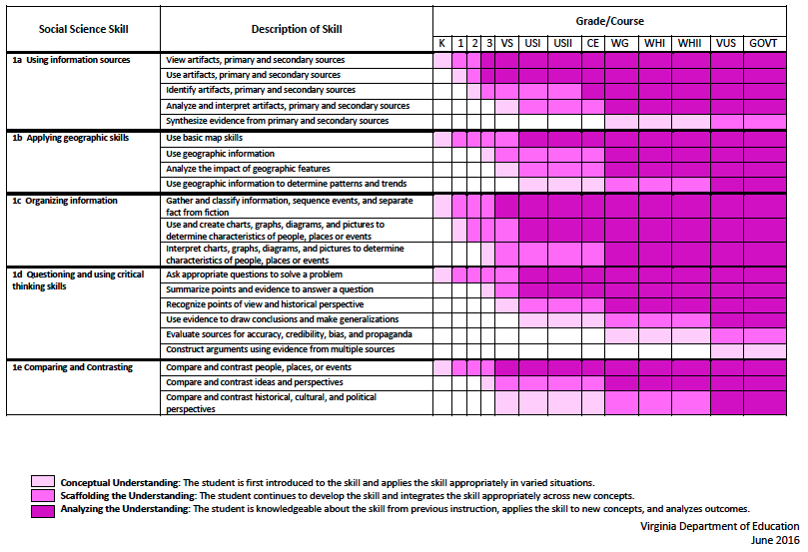
2015 SOL Skill Progression
Notes:
⇧

Slide 7
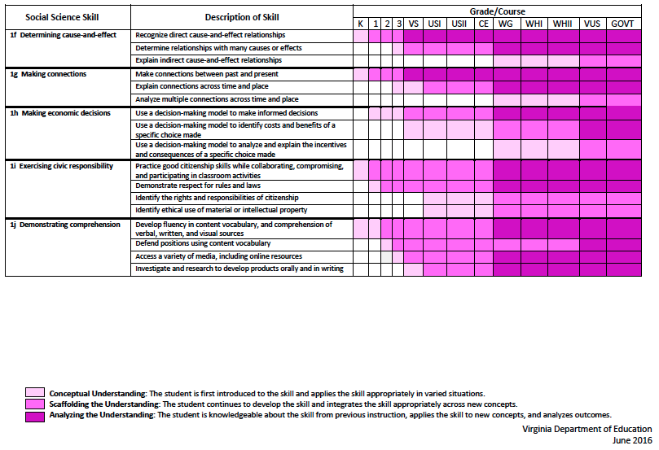
2015 SOL Skill Progression
2008 Standards:
Understand content
2015 Standards:
Understand content by applying the skill.
Skills are aligned with English Standards
Notes:
Discussion: Conceptual Understanding, Scaffolding the Understanding, Analyzing the Understanding
Arrow will rise up upon click after discussion to summarize difference between 2008 and 2015, then skills aligned with English SOLs. Great opportunity for common planning!
Purpose of today is to “teach” a lesson demonstrating skill based instruction, moving away from Lecture (Sit and Get)

Slide 8
Experiences for Essential Skills
What are Experiences?

Slide 9
Experiences
Bring attention to the Experiences and describe what they are and how they can be used.
Provide teachers with “experiences” and give them an opportunity to:
discuss what they are and how they can be used; and
develop their own to share with the group.

Slide 10
The experiences should be –
engaging,
rigorous with higher level thinking questions,
relevant (connecting time periods, places, and events to the present day).

Slide 11
Experiences
Are . . .
Are NOT. . .
Engaging- promoting discussion, collaboration, and understanding
Opportunities to practice social science skills using various content
Varied throughout the lesson to help students make connections
Worksheets
Specific to one Standard, topic, or course

Slide 12
Overview of Revisions
There is now an expectation that students move from “demonstrate knowledge” to “apply social science skills” to the content.
Notes:
This change can be found in the lead-in statements of each standard beginning with the course- United States History to 1865 and continuing through Virginia and United States Government.

Slide 13
Agenda
What Has Changed In The Framework For World History I? (Specifics)
General Introduction of Skills & Student Learning Experiences
Instructional Examples of Skill-Based Experiences
Work Session: Skill-Based Experience Focus

Slide 14
Types of Changes To The Revised Curriculum Framework
Basic Re-Organization
Example: Christianity (WHI 7) was pulled out of the previous standard on Rome and made into a stand-alone standard.
Addition of New Content
Example: European Exploration & Effects of European Contact on Indigenous Peoples (12.C & 13.C)

Slide 15
Essential Skills:
“The Art of Reasoning”
Planning inquiries, framing questions and synthesizing information from diverse sources
Analyzing demographic information that shapes decision making
Comparing and contrasting perspectives
Evaluating information
Constructing evidence-based arguments
Examining cause-and- effect relationships that shape events and inform decisions
Developing a plan and taking constructive action to influence change
Comparing expected costs and benefits of alternative choices
Applying civic virtues and democratic principles to make collaborative decisions
Communicating effectively the evidence-based plan of action to diverse audiences

Slide 16
Identifying & Analyzing Primary/Secondary Sources
1.A
1.D
Importance of Understanding Source Information
Understanding the background information and influences of a document is VITAL to understanding the analytical usefulness
Link to Point of View & Bias In Documents
Notes:
Refer Group To Supplemental Documentation on Standard/Skill Language Throughout Presentation
Use Primer Source -

Slide 17
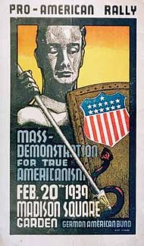
Observations & Inferences
(Without Additional Source Information or Context)

Slide 18
Group - Storm
What is the implied content of the document?
Where might this document have originated? Why?
What inferences would you make about this group? Culture? Time Period?
What information might you need to make a more well-rounded appraisal of the document?

Slide 19
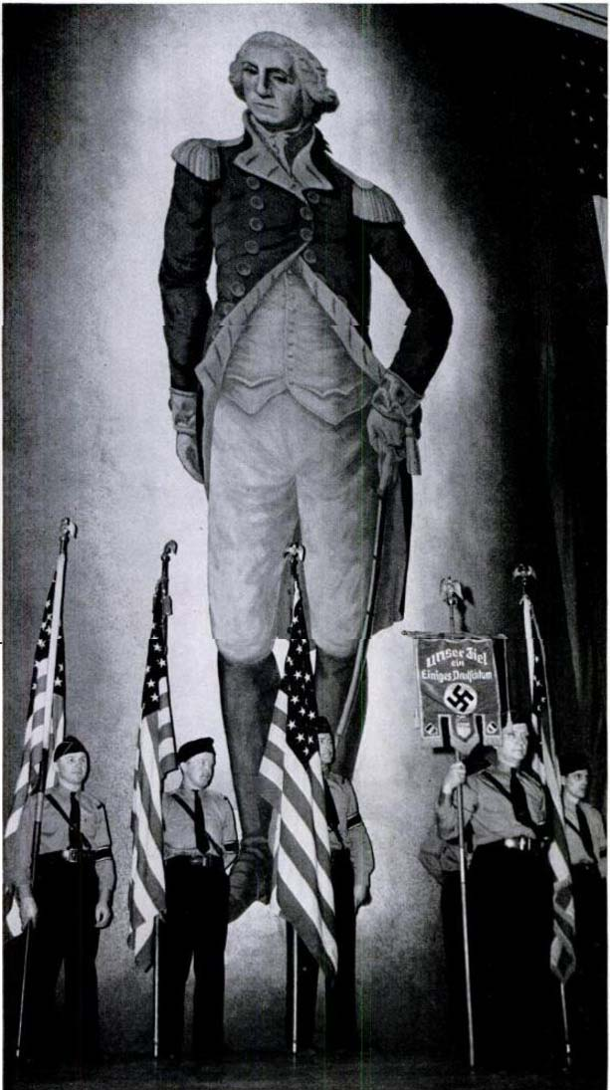
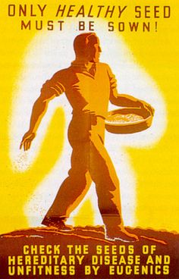
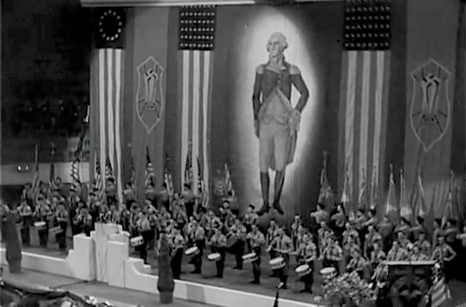
Source:
The German-American Bund, Madison Square Garden Rally 1939
Notes:
The emphasis here - even though this is VA/US history - is that sources that we know little or nothing about beforehand can be difficult to interpret correctly. The original image of the German-American Bund seems overtly patriotic and in keeping with what anyone would expect from a war time poster. The fact that this organization was pro-Nazi and pro-Eugenics is CRITICAL but entirely unknown without additional source information.

Slide 20
Checking the Source
The emphasis here - even though this is VA/US history - is that sources that we know little or nothing about beforehand can be difficult to interpret correctly.
The original image of the German-American Bund seems overtly patriotic and in keeping with what anyone would expect from a war time poster.
The fact that this organization was pro-Nazi and pro-Eugenics is CRITICAL but entirely unknown without additional source information.

Slide 21
Julius Caesar's Description of the Britons
Assessing Primary Source P.O.V.
Reliability
Truthfulness
Correctness of Content
Is it ever possible for a source to be completely objective?
Is a lack of objectivity a “bad thing” for historical investigation?

Slide 22
To what extent is this source reliable?
“The inland portions of Britain are inhabited by those who themselves say that according to tradition they are natives of the soil...For money they use either gold coins or bars of iron of a certain weight...They consider is contrary to the divine law to eat hare, chicken or goose yet they raise these animals for their own amusement and pleasure…
All the Britons paint themselves with woad...and for this reason they are much more frightful in appearance in battle. They permit their hair to grow long, shaving all parts of the body except the head and upper lip. Ten and twelve have wives common among them, especially brothers with brothers and parents with children.”
Translated by Cheyney De Bello Gallico, 55 B.C.

Slide 23
What additional information is needed to assess the reliability of this document?
“The nation of the Huns...surpasses all other barbarians in the wilderness of life...And though [the Huns] do just bear the likeness of men (of a very ugly pattern), they are so little advanced in civilization that they...feed upon the half-raw flesh of any sort of animal…”
The Chronicle of Events
Ammianus Marcellinus - Roman Soldier & Historian -- 4th Century C.E.

Slide 24
Geographic Information: Patterns & Trends
1.B
GIS Lessons
Outstanding Resource:
Virginia Geographic Alliance
https://php.radford.edu/~vga/?page_id=3893

Slide 25
World History Sample Lesson
Credit:
VGA

Slide 26
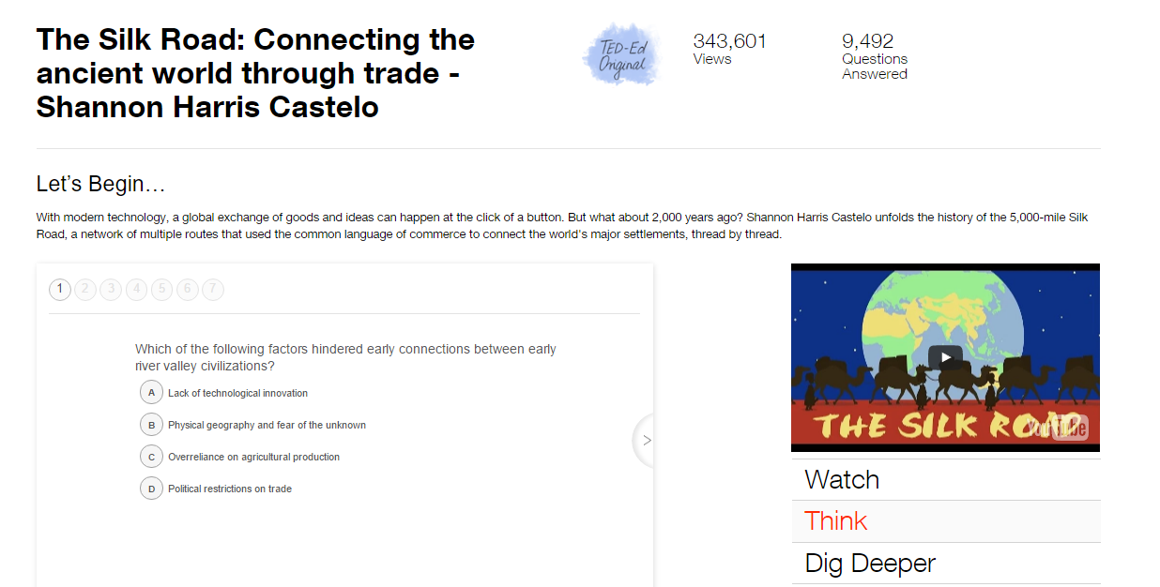
The Silk Road: Connecting the ancient world through trade – Shannon Harris Castelo
Credit:
VGA

Slide 27
P.A.C.E.D. Decision Model
1.H
The real-world applicability of trade-offs and opportunity costs is critically important to help students understand that the use of resources is a simultaneous loss of those resources to address other wants and needs.

Slide 28
P.A.C.E.D. Decision Model
1.H
Define the Problem
List Alternatives
Select Criteria
Evaluate Alternatives
Make Decision

Slide 29
P.A.C.E.D. Decision Model
Problem: Spanish conquistadors are approaching Cuzco. What do we do?
1.H
 | Criteria #1 | Criteria #2 | Criteria #3
Alternative #1
Alternative #2
Alternative #3
Desirability of Student Variance On Matrix
Evaluate Alternatives
Decide

Slide 30
P.A.C.E.D. Decision Model
Problem: Spanish conquistadors are approaching Cuzco. What do we do?
1.H
 | Save Lives | Preserve Cultural Autonomy | Project Political Power
Armed Resistance Against Invaders | 1 | 3 | 3
Capitulation | 2 | 1 | 2
Abandon The Capital | 3 | 2 | 1
Desirability of Student Variance On Matrix
Evaluate Alternatives
Decide

Slide 31
Cause & Effect Relationships
1.F
1.H
Deconstructing and evaluating WHY a certain event happened or HOW it affected one or more cultures/individuals is significantly more positively correlated to memory retention.
When students are able to critically engage information, there is a statistically significant gain in the amount of information retained over longer periods of time.
Place emphasis on multiple causation and effect as well as the difference between intentional and unintentional cause/effect.

Slide 32
1.F
1.H
Before Choice WAS Made - “Assumed” Cost- Benefit Analysis
Costs (Things Given Up) | Benefits (Positive Things Gained)
Before Choice WAS Made - Assessing Causation & Motivators
Direct Causation (Proximal To Event) | Indirect Causation (Contained Within General Time Period Contextual to Relevant Era)
Choice Outcome - Actual Intended vs. Unintended Consequences
Intended Consequences (Thought Would Happen & Actually Did) | Unintended Consequences (Did Not Know Would Happen)

Slide 33
1.F
1.H
Before Choice WAS Made - “Assumed” Cost- Benefit Analysis
Costs (Things Given Up) | Benefits (Positive Things Gained)
National Sovereignty Roman -Style Government Wealth | Civilians Spared Loss of Life From Futile Siege Defense
Before Choice WAS Made - Assessing Causation & Motivators
Direct Causation (Proximal To Event) | Indirect Causation (Contained Within General Time Period Contextual to Relevant Era)
Visigoth Invasion | Prior Siege of Goths (i.e. Alaric) Economic Inflation Collapse of Markets Political Instability Deterioration of Roman Legion Effectiveness
Choice Outcome - Actual Intended vs. Unintended Consequences
Intended Consequences (Thought Would Happen & Actually Did) | Unintended Consequences (Did Not Know Would Happen)
Spare Massacre of Civilian Population in Rome | Descent of Europe Into Dark Ages Division of Europe - Germanic Kingdoms Broad Loss of Literacy Created Barriers to Political Reunification of Europe
Rome Surrenders to Visigoths

Slide 34
Observations & Inferences
(Without Source Information)

Slide 35
Group - Storm
What is the content of the document?
Where might this document have originated?
What inferences would you make about this culture?
What information might you need to make a more well-rounded appraisal of the document?

Slide 36
Identifying & Analyzing Primary Sources
1.A
1.D
1.E
Importance of Understanding Source Information
Understanding the usefulness of diverse sources is VITAL to giving us a great insight to our past.

Slide 37
Observations & Inferences Otzi the Iceman Investigation
1.A
1.D
1.E

Slide 38
Activity Instructions
1.A
1.D
1.E
5 stations are set up that feature information about Otzi the Iceman.
Each student receives a graphic organizer to investigate each of the sources.
The goal in this activity is for students to gain an understanding of how cavemen lived by studying primary sources.

Slide 39
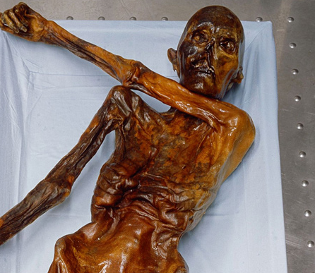
STATION 1: OTZI THE ICEMAN
1.A
1.D
1.E

Slide 40
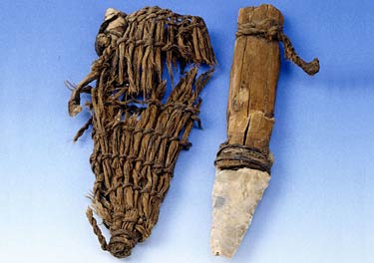
STATION 2: OTZI’S POUCH
1.A
1.D
1.E

Slide 41
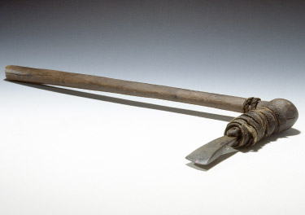
STATION 3: OTZI’S AXE
1.A
1.D
1.E

Slide 42
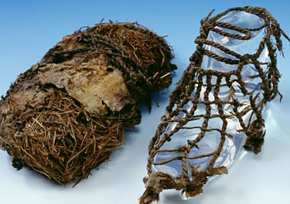
STATION 4: OTZI’S SHOES
1.A
1.D
1.E

Slide 43
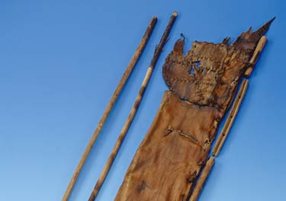
STATION 5: OTZI’S QUIVER AND ARROWS
1.A
1.D
1.E

Slide 44
REFLECTION QUESTION
1.A
1.D
1.E
Do you think Otzi was part of a Paleolithic hunter-gatherer society, or a Neolithic farming society?
Explain your opinion with evidence from the sources.

Slide 45
GOING FURTHER… DECIDING UPON THE 5 KEY QUESTIONS
1.A
1.D
1.E
Students work individually to identify what they think are the five “Big Questions” about Otzi that require further investigation.
The teacher leads a classroom discussion to create a list of ‘big questions’ and to narrow these down to the most popular five questions overall.

Slide 46
GOING FURTHER… SOLVING THE 5 KEY QUESTIONS
1.A
1.D
1.E
Students then write these five questions down on their graphic organizer and research the answers using the internet or provide the students with various articles that provide information about Otzi’s life.

Slide 47
Geographic Information
1.B
The knowledge of geography and application of geographic skills enable us to understand relationships between people, their behavior, places, and the environment for problem solving and historical understanding.
The physical geography of a location had a direct impact on the lives of people in world history and how they adapted to their environment.

Slide 48
In this activity, students will:
1.B
Use a variety of sources, including maps, images, primary sources, and diagrams.
Understand the improvements in art and science that occurred during the Renaissance along with a new desire to explore that led to great improvements in map-making.
Gather and analyze geographic information to determine patterns and trends related to the movement of population, products, resources, ideas, and language.

Slide 49
Additional Skills:
1.B
WHI.1a: Using primary and secondary sources
WHI.1b: Using geographic information to determine patterns and trends
WHI.1d: Evaluating sources for accuracy
WHI.1e: Comparing and contrasting historical, perspectives

Slide 50
Activity Instructions
1.B
Students, in groups are given 5 medieval maps to analyze by answering questions on a graphic organizer.
Students will give their answers and defend their order of maps before the teacher reveals the correct one.
End the activity by showing the proper order of the creation of maps and examining what historical events happened to cause the changes in the maps.

Slide 51
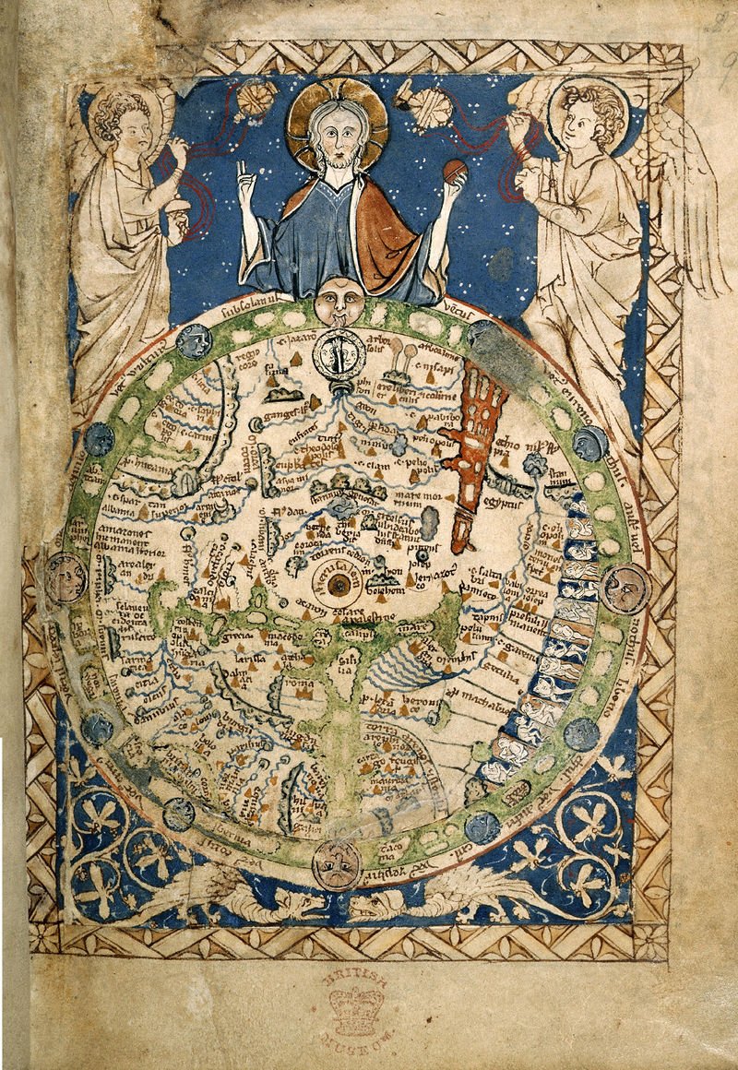
Map 1
1.B
Notes:
Psalter 1260

Slide 52
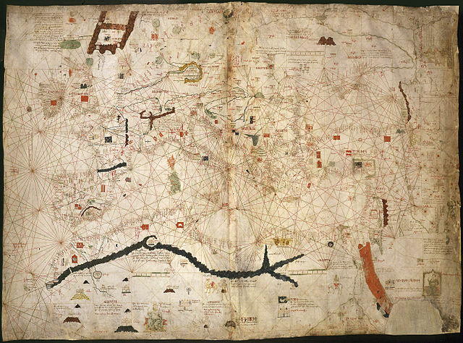
Map 2
1.B
Notes:
Angelino Dulcert 1339

Slide 53
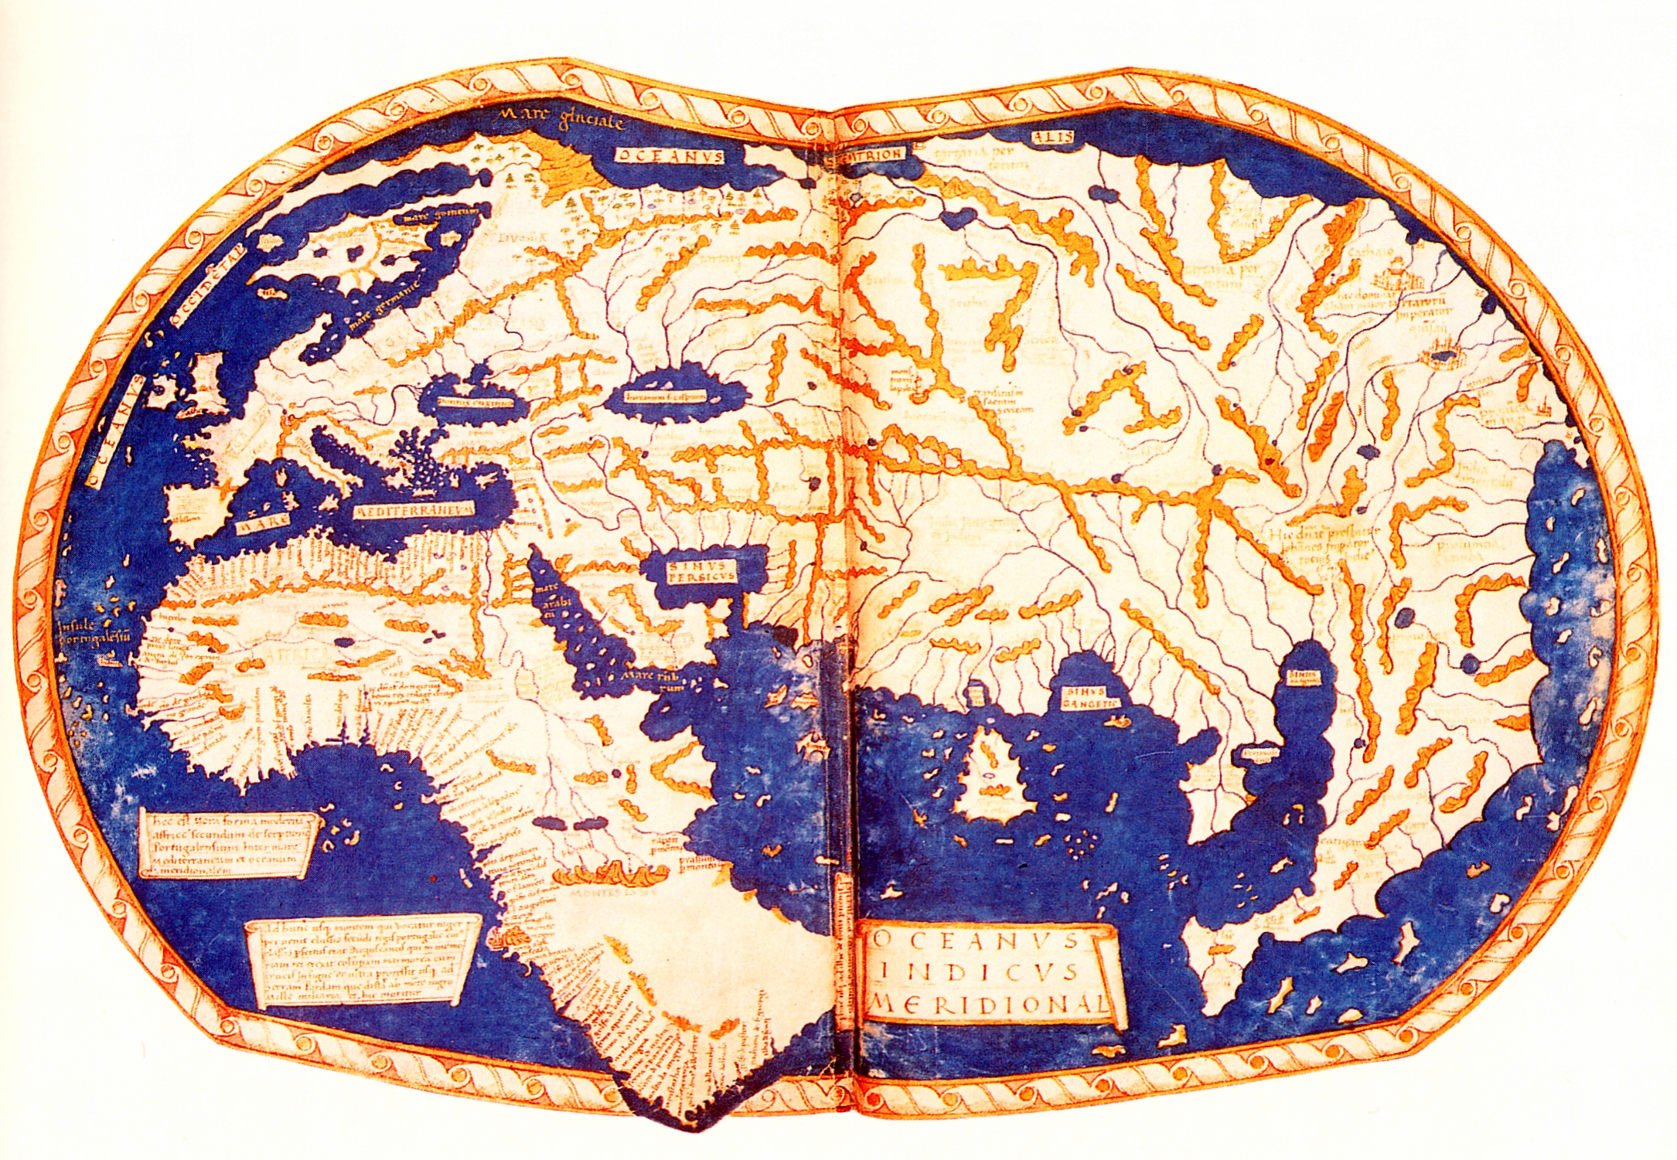
Map 3
1.B
Notes:
Martell 1491

Slide 54
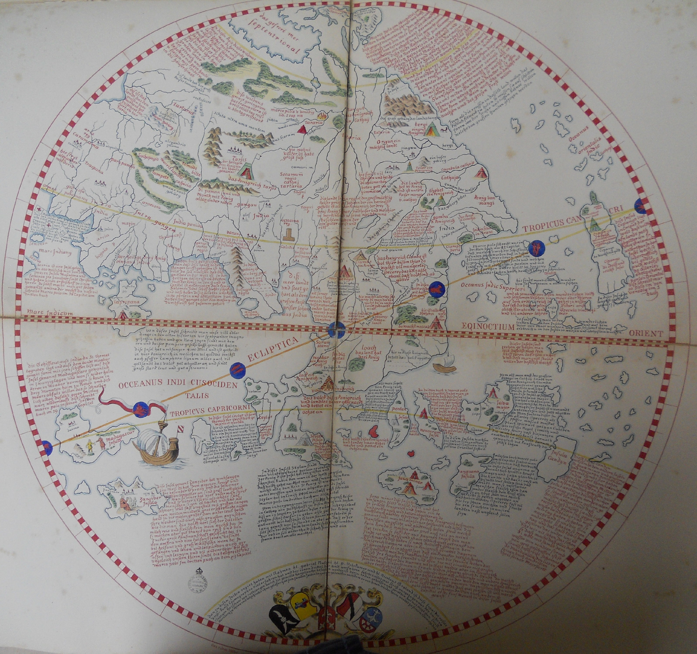
Map 4
1.B
Notes:
Behaim 1492

Slide 55
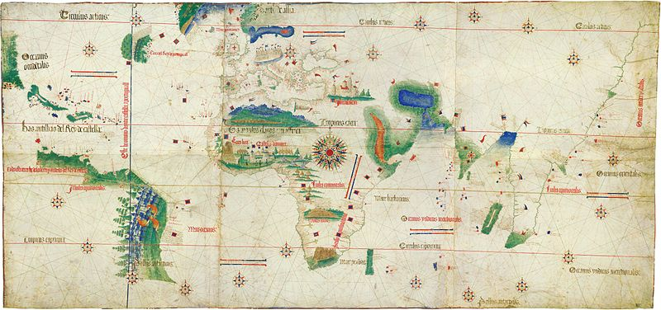
Map 5
1.B
Notes:
Cantino 1502

Slide 56
Maps
x
Historical Situation: Improvements in art and science during the Renaissance along with a new desire to explore because of the Reformation led to great improvements in cartography, map-making, at this time. Today you will see how these maps continued to change, inspire and become more accurate during this period.
Part 1 Instructions:
With your group look over the five maps and briefly discuss them. Look at them from different angles. Look closely. Look from far away. Think about what each is trying to show. Try to just take in as much as you can about them. Do this for five minutes - do not write anything.
For each of the five maps do the following:
Explain what you think the map is trying to show.
List three things on the map that you think are important.
What is something that makes this map unique?
Why might this map be useful for historians in learning about the past?
Arrange the 5 maps in order from the one your group thinks is the oldest to the one you think is the newest. Set them out on the desks in your group in this order:
oldest > next > next > next > newest
Write an explanation of what makes you think your first map was the oldest.
Write an explanation of what makes you think your last map is the newest.
List one thing about the oldest and newest maps that is similar.
Explain the major differences between the oldest and newest map.
1 2 3 4 5

Slide 58
Debrief
Need to debrief after part 1 by showing the proper order and examining what historical events happened to cause the changes. You may want to have students give their answers and defend their order before revealing the correct one.
Possible debrief questions:
What happened between x and x? (rounded Africa, discovered America, etc.)
What does it tell you about what was important in the world when it was made?
It might be helpful to name or code the maps in some way, possibly by author, for discussion purposes.

Slide 59
Going Further…
1.B
Create a full-page map of your school in the style of the medieval maps you’ve just analyzed. You want your map to be both accurate and artistic.
Your map must include at least three images representing important places, events, stories or people from your school.
Your map must also include at least three written captions describing important places, events, stories or people from your school.

Slide 60
Decision-Making Models
1.H
Choices have consequences that may be positive or negative, intended or unintended.
Decision making involves distinguishing between relevant and irrelevant information
Incentives are actions or rewards that encourage people to act. When incentives change, behavior changes in predictable ways.

Slide 61
Decision-Making Models
1.H
Decision-making models serve several purposes.
They can help us:
make decisions for the future
understand the choices made in the past
analyze the outcomes of the decisions already made
compare the expected costs and benefits of alternative choices
identify the costs and benefits of specific choices made

Slide 62
In this activity, students will:
1.H
Analyze the relationship between the physical geography of the Incas while comparing the expected costs and benefits of alternative choices.
Gather and analyze information to analyze the outcomes of the decisions already made
Use maps to explain how the location of resources influences patterns, trends and migration of a population and analyze the outcomes of the decisions already made
Synthesize primary sources to determine continuity and change between the Inca and Spanish.

Slide 63
Standards Covered Include:
1.H
WHI.1b: Using geographic information to determine patterns and trends.
WHI.1h: Using a decision-making model to analyze and explain the incentives for and consequences of a specific choice made.
WHI.13: The major civilizations of the Western Hemisphere, including the Mayan, Aztec, and Incan

Slide 64
Cost - Benefit Analysis
Past Economic Choices
1.H
Historical Choice: Cost & Benefits of Incan Road-Building
NOTE: Consider short-term and long-term as you brainstorm below.
Students will brainstorm and start the graphic organizer.
Before Choice WAS Made - “Assumed” Cost- Benefit Analysis
Costs (Things Given Up) | Benefits (Positive Things Gained)
Choice Outcome - Actual Intended vs. Unintended Consequences
Intended Consequences (Thought Would Happen & Actually Did) | Unintended Consequences (Did Not Know Would Happen)

Slide 65
1.H
Cost - Benefit Analysis Using Sources
Understand the choices made in the past
 | Intended Consequences (Thought would happen and actually did) | Unintended Consequences (did not know would happen)
Where the Inca road system is located.
Document A Hernando Pizarro on the Conquest of the Incas
Document B Las Castas
Document C Florentine Codex
Document D Maps
Notes:
This is an example of what teachers could use for this activity. I did not include the maps or documents for this activity.

Slide 66
Cost - Benefit Analysis
Past Economic Choices
1.H
Before Choice WAS Made - “Assumed” Cost- Benefit Analysis
Costs (Things given up) | Benefits (positive things gained)
Labor Increased deforestation Appropriation of resources | Government control Increased trade Faster communication Quicker mobilization of army
Choice Outcome - Actual Intended vs. Unintended Consequences
Intended Consequences (Thought would happen and actually did) | Unintended Consequences (did not know would happen)
Communication increased Military mobilization improved Trade increased | Invasions Spread of disease Created conflict among social classes

Slide 67
Analyzing multiple connections across time and place
1.G
Analyzing includes identifying the important elements of a topic.
Analytical thinking is further strengthened when connections are made between two or more topics.

Slide 68
Analyzing multiple connections across time and place
1.G
Activating prior knowledge helps make connections to new concepts and provides more complex information about people, places, experiences, and events in world history.

Slide 69
In this activity, students will:
1.G
Select an ancient civilization, religion, or event. Organize various aspects of the event to determine and explain how the civilization, religion, or event changed over time. Organizing aspects may include the following:
Social Factors
Political Factors
Economic Factors
Cultural Factors

Slide 70
In this activity, students will:
1.G
Identify how cultures changed to accommodate evolving ideas and beliefs, including the following:
Revolutions
Conflicts
Reforms
Human-environment interactions
Laws and policy changes
Advancements
Conflicts
Diversity
Movements and migrations

Slide 71
1.G
Learning Experience
Observe - Reflect – Question
Working in groups of 3, you will be given examples of art from multiple times and places. Use your paper to complete the activities listed below. You will want to pick a picture to “observe”, one to “reflect”, and one to “question.
Observe: What do you see? Try to be as basic and exact as you can without reading into the pictures or making educated guesses.
Reflect: Do you really know what you’re looking at? Now’s your time to shine! Use your paper to accurately describe the image and provide as much info about what you see as you can.
Question: After viewing the image, do you have any questions about it? Place of origin? Why was this piece used? Religious or cultural importance? What do you want to know about this piece?

Slide 72
Observe
________________________________________________________________________________________________
--------------------------------------------------------------------------------
Reflect
________________________________________________________________________________________________
--------------------------------------------------------------------------------
Question
________________________________________________________________________________________________

Slide 73
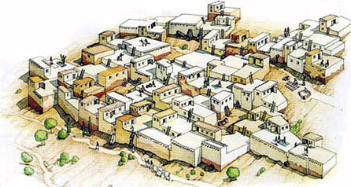
Notes:
persian

Slide 74
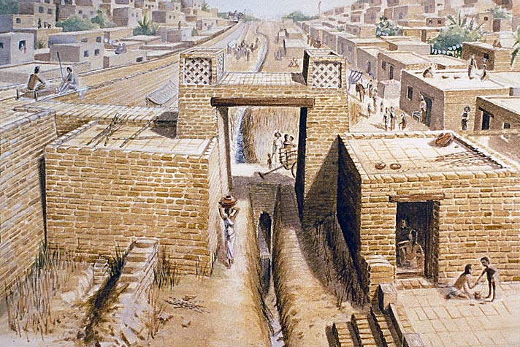
Notes:
arabic

Slide 75
Writing to Learn
Not graded
Prior to lesson
Assess student background knowledge
End of lesson
Check understanding
Make Connections
Answer BIG QUESTION
Free-write

Slide 76
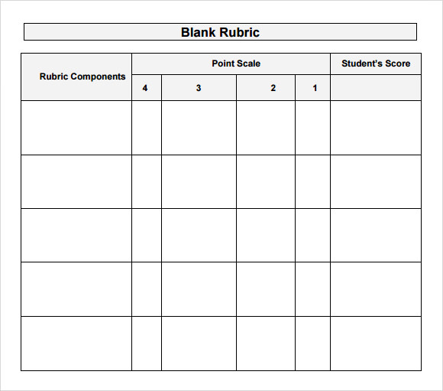
Traditional
Alternative
ideas
Exit Slips
Multiple Choice
Short Answer
Matching
True/False
Multiple Choice
Think, Create, and Write:
Thought Bubbles
Phone Activity
Witness Tree
Candy Bar
Answer the Big Question
Checking for Understanding

Slide 77
Whose Phone is This?
Each student/group will personalize their phone.
Exchange papers and then identify the owner of the phone.
What are the clues?

Slide 78
Playlist:
Write 3 song titles and artists that would be found on this region’s playlist. Be sure to explain your reasoning as to why these songs fit this region. 1.
2.
3.
Wallpaper:
Sketch the characteristics from a specific region on the cell phone wallpaper. Explain why this image choice would be relevant to this region.
Email:
This phone just received two emails. Who sent the emails? What was the significance of the message? What clues allows you to know from which region it came?
Apps
Create five APPS for this phone that describe the political, economic, and/or historical contributions

Slide 80
Students create a big question or multiple questions for the topic being studied that day.

Slide 81
Herodotus’ Description of the Persian Wars
Assessing Primary Source P.O.V.
Reliability
Truthfulness
Correctness of Content
Is it ever possible for a source to be completely objective?
Is a lack of objectivity a “bad thing” for historical investigation?

Slide 82
To what extent is this source reliable?
“These are the researches of Herodotus of Halicarnassus, which he publishes, in the hope of thereby preserving from decay the remembrance of what men have done, and of preventing the great and wonderful actions of the Greeks and the Barbarians from losing their due meed of glory; and withal to put on record what were their grounds of feuds.”
Translated by George Rawlinson
The Modern Library Edition of Rawlinson's text, published under the title of The Persian Wars by Herodotus, 1942

Slide 83
Geographic Information - Patterns & Trends
The knowledge of geography and application of geographic skills enable us to understand relationships between people, their behavior, places, and the environment for problem solving and historical understanding.
The physical geography of a location had a direct impact on the lives of people in world history and how they adapted to their environment.

Slide 84
Five Themes of Geography
Location: Defined according to its position on the earth’s surface; where is it?
Place: Locations having distinctive features that give them meaning and character that differ from other locations; what is it like?

Slide 85
Five Themes of Geography
Region: A unit on the earth's surface that has unifying characteristics; how are places similar or different?

Slide 86
Five Themes of Geography
Movement: The way people, products, and information move from one place to another; how do people, goods, and ideas move from one location to another?
Human-Environment Interaction: The relationship between people and their environment; how do people relate to the physical world?

Slide 87
Standards
Content SOL
WHI.6: Rome
WHI.7: Christianity
WHI.8: Byzantine Empire
Skills SOL
WHI.1a: Using primary and secondary sources
WHI.1b: Using geographic information to determine patterns and trends
WHI.1f: Explaining how indirect cause-and-effect relationships impacted people, places, and events

Slide 88
In this learning experience, students will:
Use a variety of sources, including maps, images, photographs, primary sources, and diagrams.
Analyze the relationship between the physical and human geography of the ancient Roman and Byzantine empires.
Gather and analyze geographic information to determine patterns and trends related to the movement of population, products, resources, ideas, and language.
Use maps to explain how the location of resources influences patterns, trends and migration of a population.
Synthesize the evidence from primary sources to determine continuity and change between the Roman and Byzantine Empires.

Slide 89
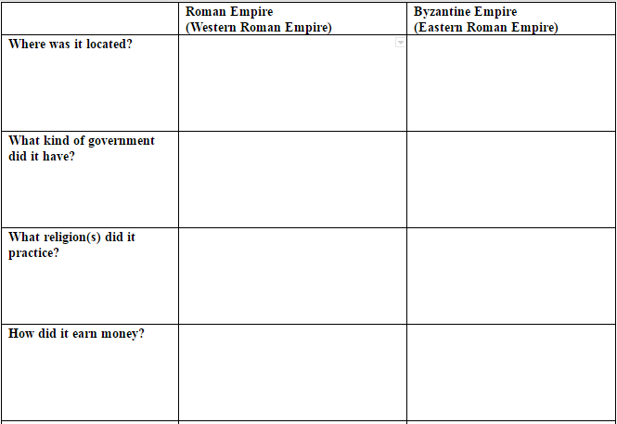
What do you know?
Have students write what they know about the Roman and Byzantine Empires

Slide 90
What do you know?
Discuss with the class when students finish the chart.

Slide 91
Gallery Walk
Students will analyze primary and secondary documents as either Roman or Byzantine using the five themes of geography.
Students should rotate around the room to collect information from the posters.
Use a timer to help students rotate through each of the images.
To avoid congestion, students do not need to complete the gallery walk in order.
Students should not make any conclusions in Column 1 - only collect information.

Slide 92
Gallery Walk
After the class has reviewed their responses for Column 1, proceed to Column 2.
When students have completed Column 2, review their answers as a class. Emphasize why each document is associated either with the Roman or Byzantine Empire by highlighting the evidence in each.
Students should be making inferences in Column 2.

Slide 93
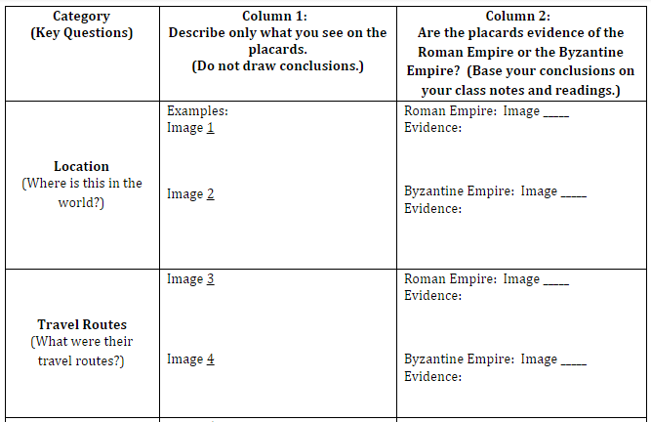
Gallery Walk
Only make observations here during the Gallery Walk
Make inferences here after the Gallery Walk

Slide 94
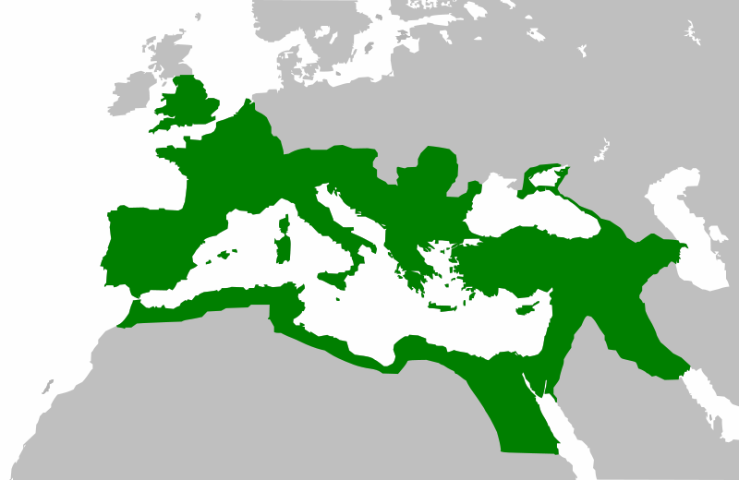
Image 1 Map of Roman Empire (Western Roman Empire)

Slide 95
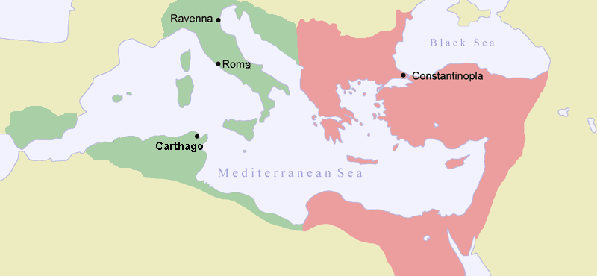
Image 2 Map of Byzantine Empire (Eastern Roman Empire)

Slide 96
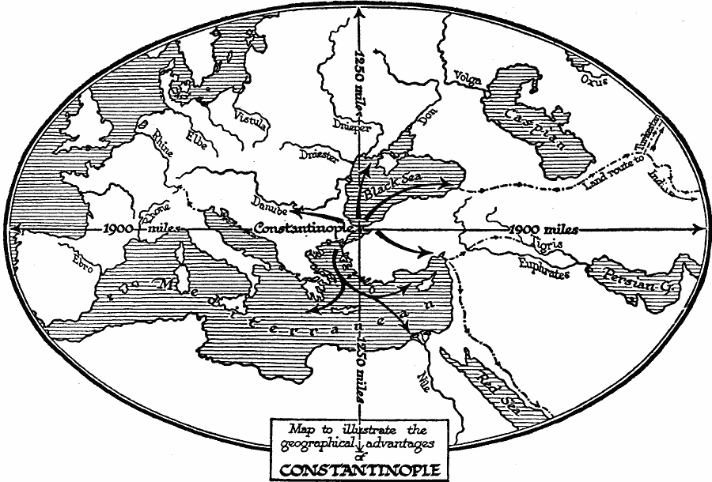
Image 3 Byzantine Empire (Eastern Roman Empire)

Slide 97
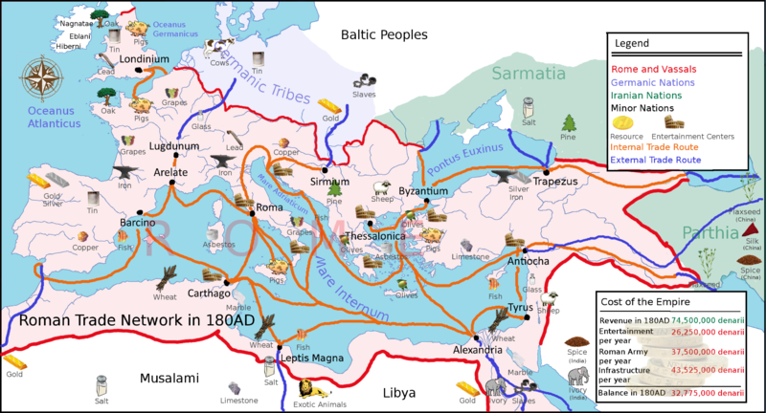
Image 4 Roman Trade Network in 180 AD/CE, Roman Empire (Western Roman Empire)

Slide 98
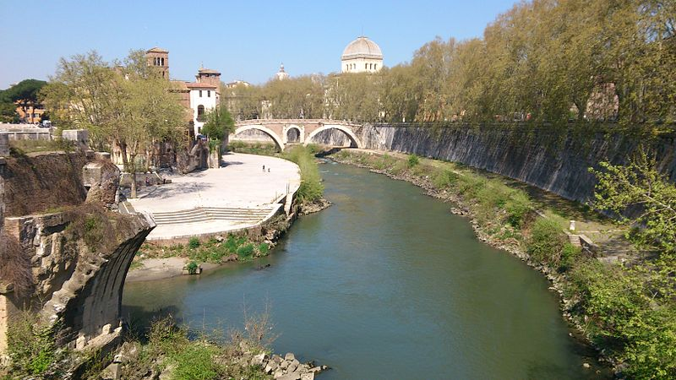
Image 5 Rome’s Tiber River, Roman Empire (Western Roman Empire)

Slide 99
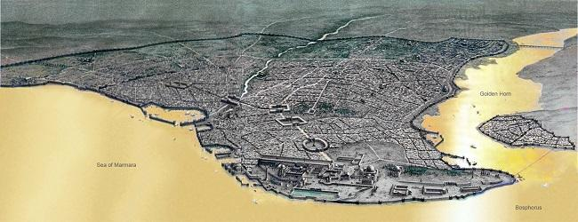
Image 6 Physical map of Asia Minor, Byzantine Empire (Eastern Roman Empire)
Golden Horn
Sea of Marmara
Bosphorus

Slide 100
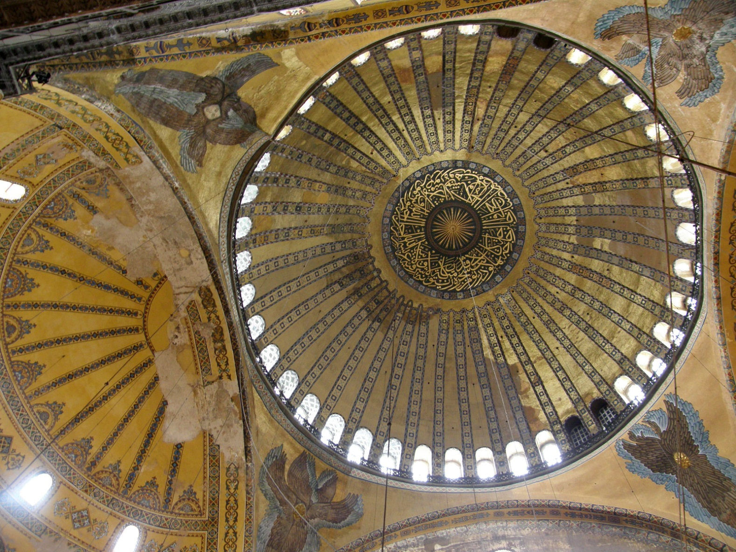
Image 7 Dome of the Hagia Sophia, Byzantine Empire (Eastern Roman Empire)
Source: Wikimedia Commons: Creative Commons Attribution-Share Alike 3.0 Unported license

Slide 101
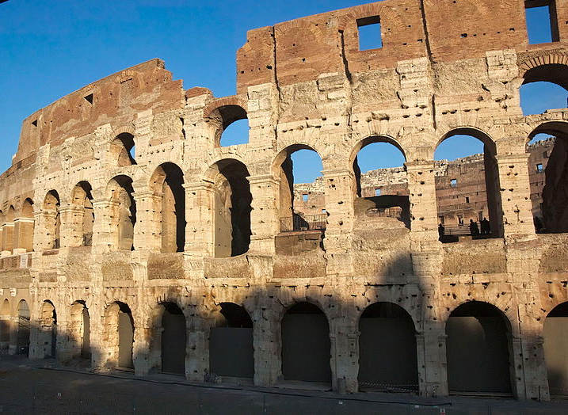
Image 8 The Colosseum, Roman Empire (Western Roman Empire)

Slide 102
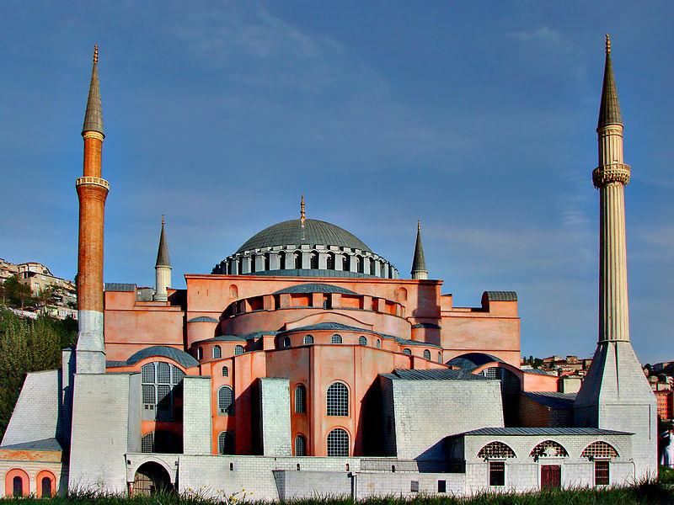
Image 9 The Hagia Sophia*, Byzantine Empire (Eastern Roman Empire) (*Minarets were added after the Empire’s fall)

Slide 103
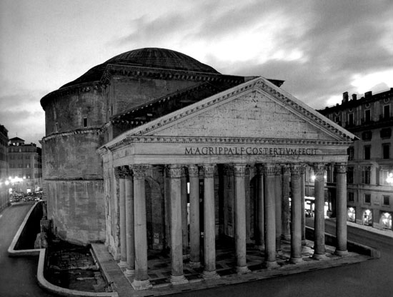
Image 10 Pantheon, Roman Empire (Western Roman Empire)
Source: http://www.artchive.com/artchive/R/roman/roman_pantheon.jpg.html

Slide 104
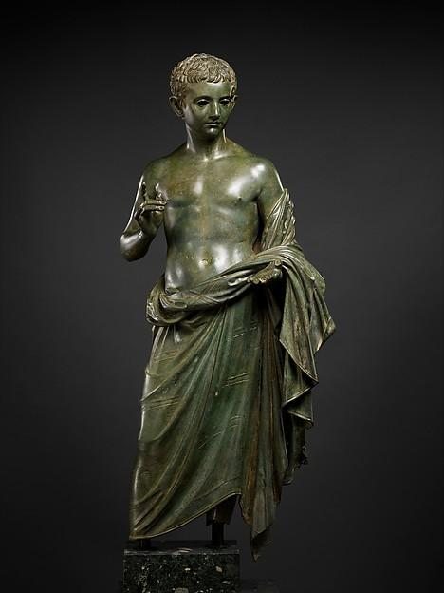
Image 11 Bronze Statue of an Aristocratic Boy, Roman Empire (Western Roman Empire)

Slide 105
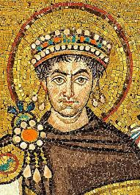
Image 12 Mosaic of Emperor Justinian, Byzantine Empire (Eastern Roman Empire)

Slide 106
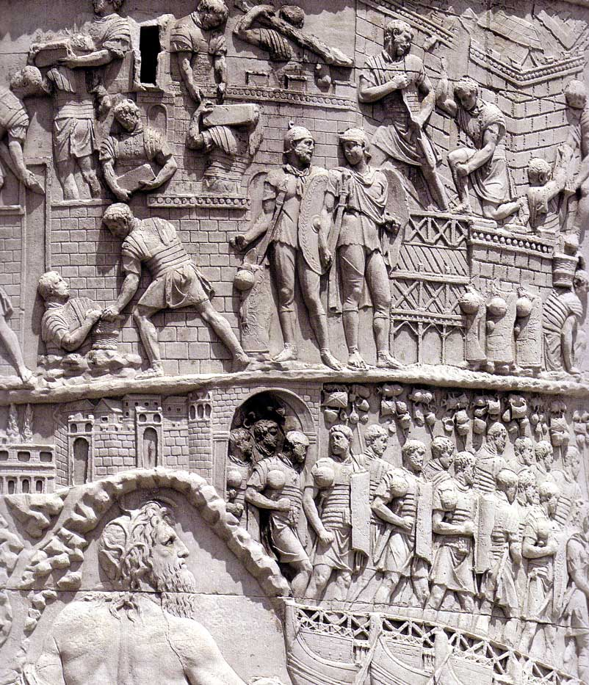
Image 13 Trajan’s Column, Roman Empire (Western Roman Empire)

Slide 107
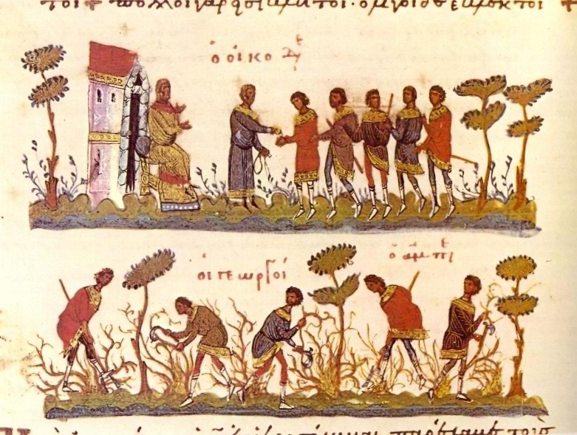
Image 14 “Parable of Workers in the Vineyard,” Byzantine Empire (Eastern Roman Empire)
Source: “Parable of Workers in the Vineyard,” Bibliotheque Nationale de France, via https://commons.wikimedia.org/wiki/File:Byzantine_agriculture.jpg

Slide 108
Continuity and Change Assessment
What specifically changed between the Roman and Byzantine Empires, and what remained the same?

Slide 109
Subject Area
Small Group Discussion
What other content area topics might lend themselves well to practicing these skills?
WHI.1a: Using primary and secondary sources
WHI.1b: Using geographic information to determine patterns and trends
WHI.1f: Explaining how indirect cause-and-effect relationships impacted people, places, and events
Notes:
Individually or in pairs, have teacher brainstorm topics that would work well with theses skills. Discuss as a group.

Slide 110
Layers of Inference
Using the Layers of Inference graphic organizer
Choose two of the maps and complete the graphic organizer
Develop an overarching question that will allow students to make cultural, social, economic, or political connections
Discuss which Essential Skills were used during the experience you created

Slide 111
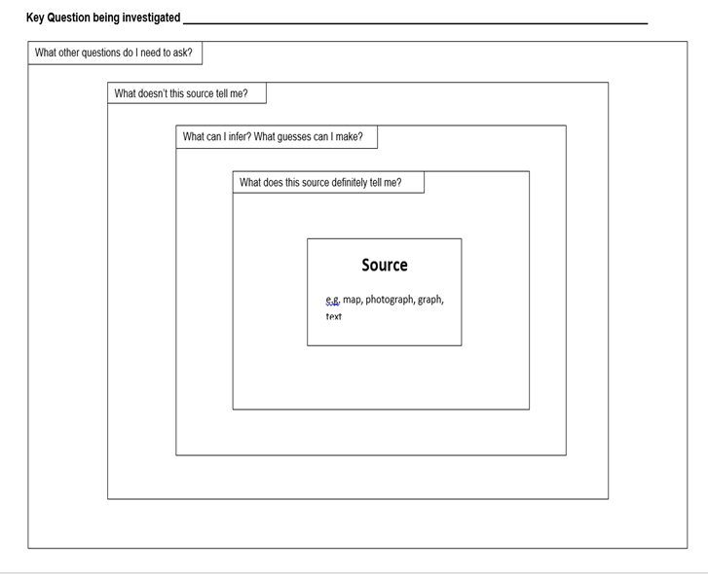
Notes:
Layers of Inference Graphic organizer taken from the Virginia Geographic Alliance presentation located at http://bit.ly/GeoHist

Slide 112
Essential Skills: “The Art of Reasoning”
1.A Synthesize evidence from artifacts & primary & secondary sources to obtain information about world history
1.B Use geographic information to determine patterns & trends to understand world history
1.C Interpret charts, graphs, & pictures to determine characteristics of people, places or events in world history
1.D Evaluate sources for accuracy, credibility, bias, & propaganda
1.E Compare & contrast historical, cultural, economic, & political perspectives in world history
1.F Explain how indirect cause-effect relationships impact people, places & events in world history
1.G Analyze multiple connections across place & time
1.H Use a decision-making model to analyze & explain the incentives for & consequences of a specific choice made
1.I Identify the rights & responsibilities of citizens & ethical use of materials & intellectual property
1.J Investigate & research to develop products orally & in writing

Slide 113
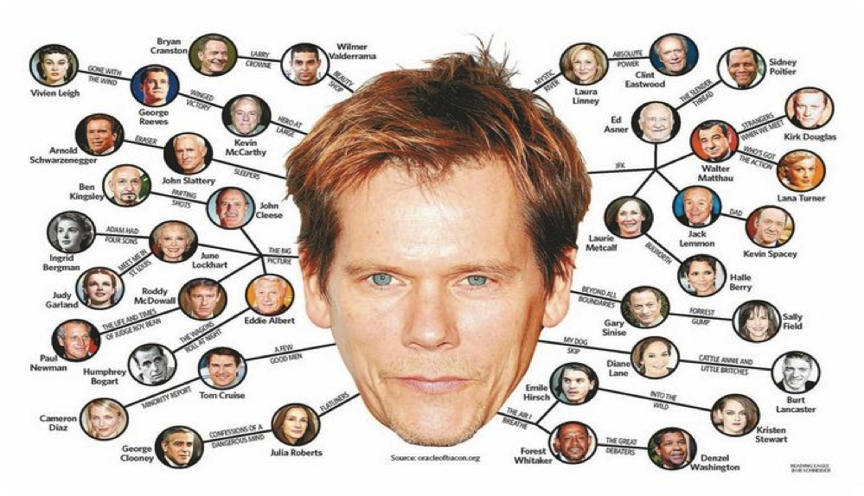
Essential Skills: “The Art of Reasoning”
1.G Analyze multiple connections across place & time
Six Degrees of Kevin Bacon Game

Slide 114
William the Conqueror
Ferdinand & Isabella
Leaders who worked to unify their respective countries
A legacy of bitterness b/n Christians, Muslims, & Jews
Weakened the Pope & the nobles
Effects of the Crusades
Joan of Arc
Russian Orthodox Church
Unifying factors in France & Russia, respectively
Moors
Saladin
Muslims

Slide 115
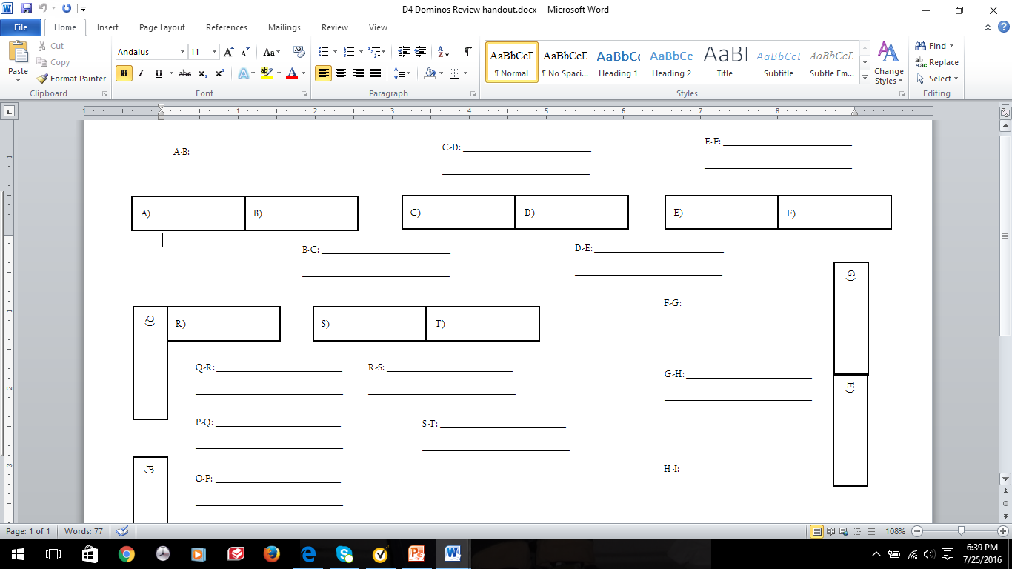
Graphic Organizer for Recording Answers

Slide 116
Analyzing multiple connections across time and place
1.G
Analyzing includes identifying the important elements of a topic.
Analytical thinking is further strengthened when connections are made between two or more topics.

Slide 117
Analyzing multiple connections across time and place
1.G
Activating prior knowledge helps make connections to new concepts and provides more complex information about people, places, experiences, and events in world history.

Slide 118
In this activity, students will:
1.G
Select an ancient civilization, religion, or event.
Organize various aspects of the event to determine and explain how the civilization, religion, or event changed over time.
Organizing aspects may include the following:
Social Factors
Political Factors
Economic Factors
Cultural Factors

Slide 119
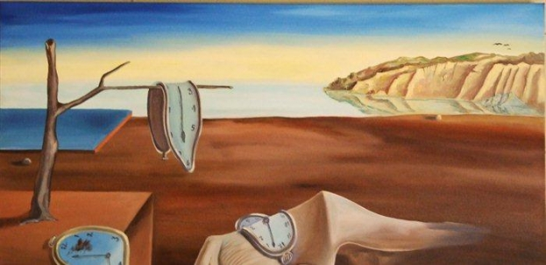
1.G
WHI.1 - The student will demonstrate skills for historical thinking, geographical analysis, economic decision making, and responsible citizenship by analyzing multiple connections across time and place;

Slide 120
In this activity, students will:
1.G
Select an ancient civilization, religion, or event.
Organize various aspects of the event to determine and explain how the civilization, religion, or event changed over time.
Organizing aspects may include the following:
Social Factors
Political Factors
Economic Factors
Cultural Factors

Slide 121
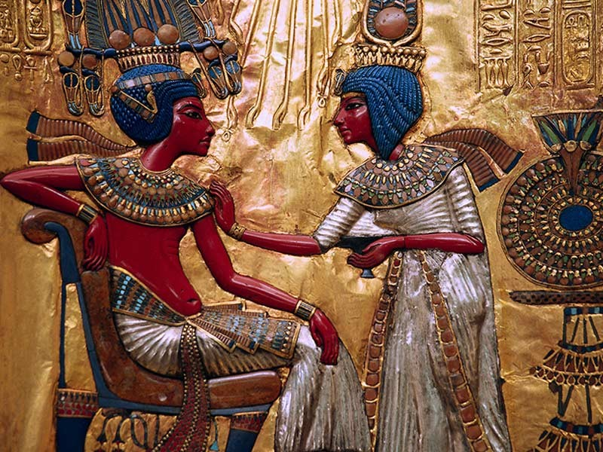
1.G
Identify how cultures changed to accommodate evolving ideas and beliefs, including the following:
Revolutions | Advancements
Conflicts | Conflicts
Reforms | Diversity
Human-environment interactions | Movements and migrations
Laws and policy changes

Slide 122
1.G
Learning Experience: Observe - Reflect - Question
Selections of Arabic, Persian, and Ottoman Art
Working in groups of 3, you will be given examples of art from multiple times and places, use your paper to complete the activities listed below. You will want to pick a picture to “observe”, one to “reflect”, and one to “question.
Observe
Reflect
Question

Slide 123
1.G
Learning Experience
Observe - Reflect - Question
Selections of Arabic, Persian, and Ottoman Art
Working in groups of 3, you will be given examples of art from multiple times and places, use your paper to complete the activities listed below. You will want to pick a picture to “observe”, one to “reflect”, and one to “question.
Observe: What do you see? Try to be as basic and exact as you can without reading into the pictures or making educated guesses.

Slide 124
1.G
Learning Experience
Observe - Reflect - Question
Selections of Arabic, Persian, and Ottoman Art
Working in groups of 3, you will be given examples of art from multiple times and places, use your paper to complete the activities listed below. You will want to pick a picture to “observe”, one to “reflect”, and one to “question.
Reflect: Do you really know what you’re looking at? Now’s your time to shine! Use your paper to accurately describe the image and provide as much info about what you see as you can.

Slide 125
1.G
Learning Experience:
Observe - Reflect - Question
Selections of Arabic, Persian, and Ottoman Art
Working in groups of 3, you will be given examples of art from multiple times and places, use your paper to complete the activities listed below. You will want to pick a picture to “observe”, one to “reflect”, and one to “question.
Question: After viewing the image, do you have any questions about it? Place of origin? Why was this piece used? Religious or cultural importance? What do you want to know about this piece?

Slide 126
Observe
________________________________________________________________________________________________
--------------------------------------------------------------------------------
Reflect
________________________________________________________________________________________________
--------------------------------------------------------------------------------
Question
________________________________________________________________________________________________

Slide 127
Notes:
persian

Slide 128
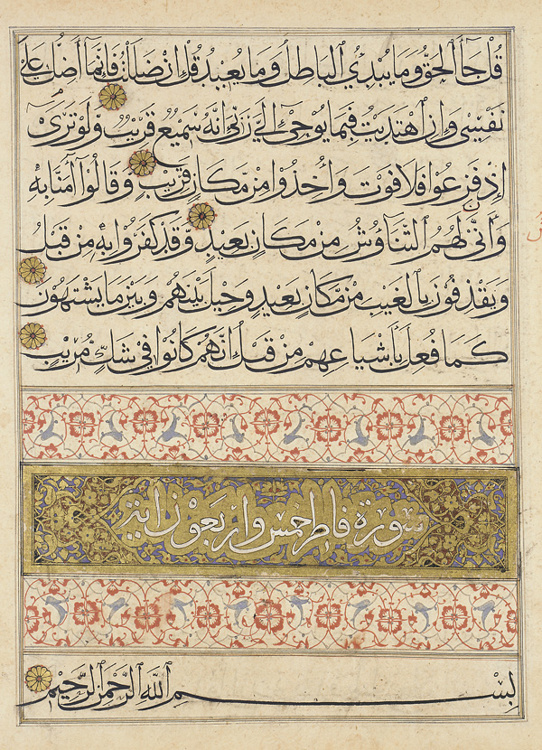
Notes:
arabic

Slide 129
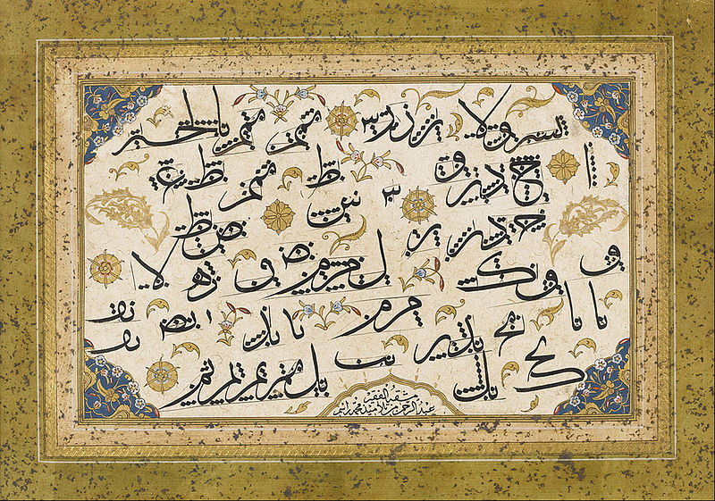
Notes:
ottoman

Slide 130
Decision-Making Models
1.H
Choices have consequences that may be positive or negative, intended or unintended.
Decision making involves distinguishing between relevant and irrelevant information
Incentives are actions or rewards that encourage people to act. When incentives change, behavior changes in predictable ways.

Slide 131
Decision-Making Models
1.H
Decision-making models serve several purposes. They can help us:
make decisions for the future
understand the choices made in the past
analyze the outcomes of the decisions already made
compare the expected costs and benefits of alternative choices
identify the costs and benefits of specific choices made

Slide 132
In this activity, students will:
1.H
Use a variety of sources, including maps, images, photographs, and primary sources.
Analyze the relationship between the physical geography of the Inca while comparing the expected costs and benefits of alternative choices.
Gather and analyze information to analyze the outcomes of the decisions already made
Use maps to explain how the location of resources influences patterns, trends and migration of a population and analyze the outcomes of the decisions already made
Synthesize the evidence from primary sources to determine continuity and change between the Inca and Spanish.

Slide 133
SOLs Covered Include:
1.H
WHI.1a: Using primary and secondary sources
WHI.1b: Using geographic information to determine patterns and trends
WHI.1h: using a decision-making model to analyze and explain the incentives for and consequences of a specific choice made;
WHI.13: The major civilizations of the Western Hemisphere, including the Mayan, Aztec, and Incan

Slide 134
Cost - Benefit Analysis Past Economic Choices
1.H
Historical Choice: Cost & Benefits of Incan Road-Building
NOTE: Consider short-term and long-term as you brainstorm below.
Before Choice WAS Made - “Assumed” Cost- Benefit Analysis
Costs (Things Given Up) | Benefits (Positive Things Gained)
Choice Outcome - Actual Intended vs. Unintended Consequences
Intended Consequences (Thought Would Happen & Actually Did) | Unintended Consequences (Did Not Know Would Happen)
Students will brainstorm and start the graphic organizer.

Slide 135
1.H
Cost - Benefit Analysis Using Sources
understand the choices made in the past
 | Intended Consequences (Thought would happen and actually did) | Unintended Consequences (did not know would happen)
Where the Inca road system is located.
Document A Hernando Pizarro on the Conquest of the Incas
Document B Las Castas
Document C Florentine Codex
Document D Maps

Slide 136
Cost - Benefit Analysis Past Economic Choices
Students will complete graphic organizer.
1.H
Historical Choice: Cost & Benefits of Incan Road-Building
NOTE: Consider short-term and long-term as you brainstorm below.
Before Choice WAS Made - “Assumed” Cost- Benefit Analysis
Costs (Things given up) | Benefits (positive things gained)
Labor Increased deforestation Appropriation of resources | Government control Increased trade Faster communication Quicker mobilization of army
Choice Outcome - Actual Intended vs. Unintended Consequences
Intended Consequences (Thought would happen and actually did) | Unintended Consequences (did not know would happen)
Communication increased Military mobilization improved Trade increased | Invasions Spread of disease Created conflict among social classes

Slide 137
RESOURCES
Library of Congress https://www.loc.gov
Federal Reserve of St. Louis https://www.stlouisfed.org/education
The Gilder Lehrman Institute of American History https://www.gilderlehrman.org
Stanford History Education Group https://sheg.stanford.edu
Beyond the Bubble https://beyondthebubble.stanford.edu
Teachers.net http://teachers.net/lessonplans/subjects/history/
Facing History and Ourselves https://www.facinghistory.org
PBS Learning Media http://www.pbslearningmedia.org
National Council for Social Studies http://www.socialstudies.org
Virginia Department of Education http://www.doe.virginia.gov
Library of Virginia http://www.lva.virginia.gov
National Archives and Records Administration https://www.archives.gov

Slide 138
Resources
Current Affairs
NEWSELA- database of current event articles that can be accessed in different formats by reading levels. Teachers can use Newsela to differentiate nonfiction reading. It’s indexed by broad themes (War and peace, Arts, Science, Health, Law)
The Guardian- The Guardian is a National British daily newspaper, known until 1959 as the Manchester Guardian. Along with its sister papers The Observer and The Guardian Weekly, The Guardian is part of the Guardian Media Group, owned by The Scott Trust Limited.
Economics
The Economist - The Economist online offers authoritative insight and opinion on international news, politics, business, finance, science and technology. All online articles are from The Economist print edition (including those printed only in British copies) and maintained in a searchable online archive that dates back June 1997. The Economist online is part of The Economist Group and is responsible for The Economist on the internet with offices in New York, London and San Francisco, and a growing worldwide editorial staff.
Virginia Council on Economic Education

Slide 139
Reflections:
3 things you learned,
2 ways you can use this learning in your class, and
1 question you still have

Slide 140
Questions?

Slide 141
World History and Geography to 1500 A.D. (C.E.) Presenters
Karen Adam | Hanover | kadam@hcps.us
Julie Blumenthal | Norfolk | jbblumen@nps.k12.va.us
Bradley Kraft | Montgomery County | bkraft@mcps.org
Thomas Callahan | Culpepper | tcallahan@culpeperschools.org
Marc Hudson | Campbell County | mhudson@campbell.k12.va.us
Layne Link | Roanoke County | llink@rcs.k12.va.us
Jeremy Beverly | Washington | jbeverly@wcs.k12.va.us
Kelly Jones | Greensville | ksjones@gcps1.com

Slide 142
Virginia Department of Education
Christonya Brown, K-12, History and Social Science Coordinator
E-mail: Christonya.Brown@doe.virginia.gov
Betsy Barton, Elementary, History and Social Science Specialist
E-mail: Betsy.Barton@doe.virginia.gov
Jill Nogueras, English and History and Social Science Specialist
E-mail: Jill.Nogueras@doe.virginia.gov

