Slide 1
Virginia and United States History
History and Social Science
Fall Institute
2016

Slide 2
Disclaimer
Reference within this presentation to any specific commercial or non-commercial product, process, or service by trade name, trademark, manufacturer or otherwise does not constitute or imply an endorsement, recommendation, or favoring by the Virginia Department of Education.

Slide 3
Questions to Ask During Planning
Essential Components in Planning an Effective Lesson
using the
2015 History and Social Science Standards of Learning
What do students need to know and understand by the end of this lesson?
What do students need to do during this lesson?
Which historical thinking skills are best suited for this standard?
What other content material should be added to provide historical context and richness to the lesson in order to maximize student understanding of the standard?
What student learning experiences would be most effective during this lesson?
How can I check for understanding effectively and accurately to measure the students’ content knowledge and historical thinking skills?

Slide 4

It starts with the . . .

Slide 5
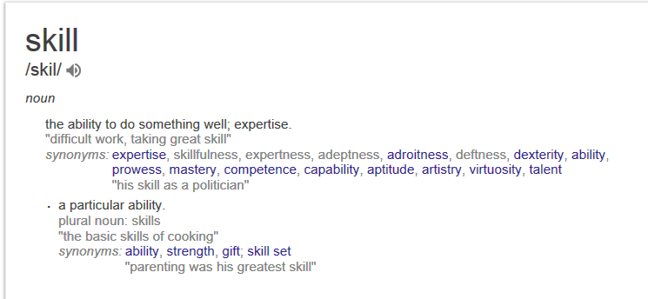

Slide 6
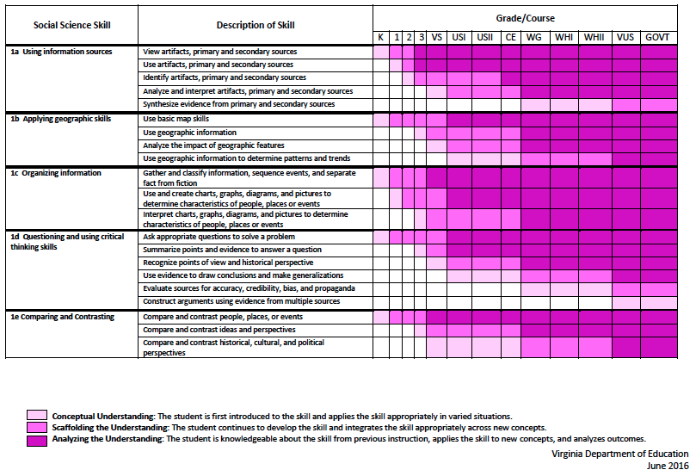
2015 SOL Skill Progression
⇧
Notes:
⇧

Slide 7
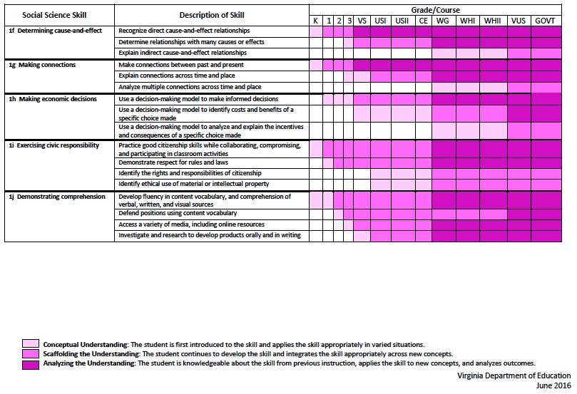
2015 SOL Skill Progression
2008 Standards:
Understand content
2015 Standards:
Understand content by applying the skill.
⇧
Skills are aligned with English Standards
Notes:
Discussion: Conceptual Understanding, Scaffolding the Understanding, Analyzing the Understanding
Arrow will rise up upon click after discussion to summarize difference between 2008 and 2015, then skills aligned with English SOLs. Great opportunity for common planning!
Purpose of today is to “teach” a lesson demonstrating skill based instruction, moving away from Lecture (Sit and Get)

Slide 8
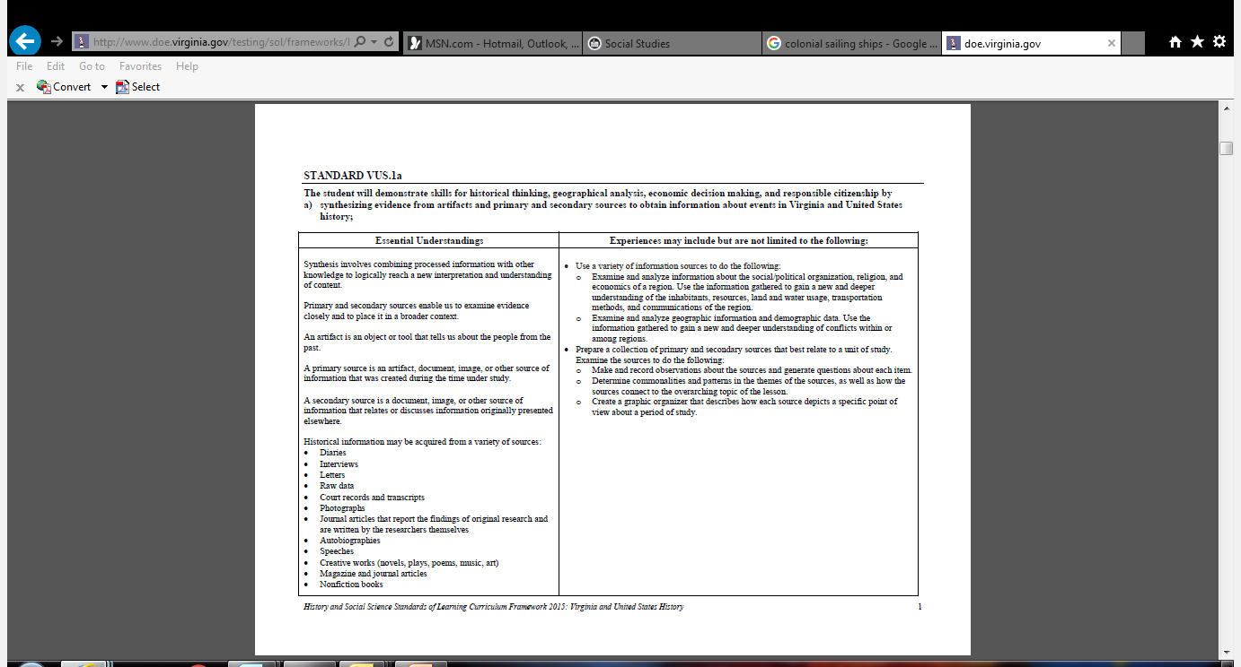
Experiences for Essential Skills
What are Experiences?

Slide 9
Experiences
Bring attention to the Experiences and describe what they are and how they can be used.
Provide teachers with “experiences” and give them an opportunity to:
  discuss what they are and how they can be used; and
  develop their own to share with the group.

Slide 10
The experiences should be –
engaging,
rigorous with higher level thinking questions,
relevant (connecting time periods, places, and events to the present day).

Slide 11
Experiences
Are . . .
Are NOT. . .
Engaging- promoting discussion, collaboration, and understanding
Opportunities to practice social science skills using various content
Varied throughout the lesson to help students make connections
Worksheets
Specific to one Standard, topic, or course

Slide 12

How can Virginia & United States History skills be incorporated into a standards-based lessons?
Notes:
Good practice: Use of aim/objective to give students a concrete goal for the lesson. “By the end of class/end of unit/etc., you should be able to…”

Slide 13
Good practice
Use of aim/objective to give students a concrete goal for the lesson.
“By the end of class/end of unit/etc., you should be able to…”

Slide 14

Today we will . . .
Practice strategies to incorporate new standards-based skills into daily lessons to teach and check for understanding of content

Slide 15
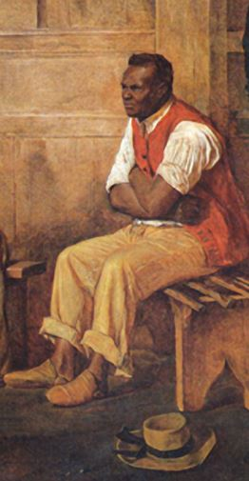
Class Opener
Discuss this Image
What do you see?
Who is this man?
What do you think he is doing?

Slide 16
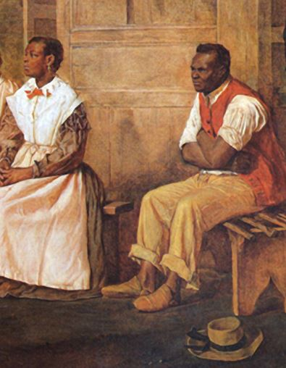
What do you see?
Who is this man and woman?
What are they doing?

Slide 17
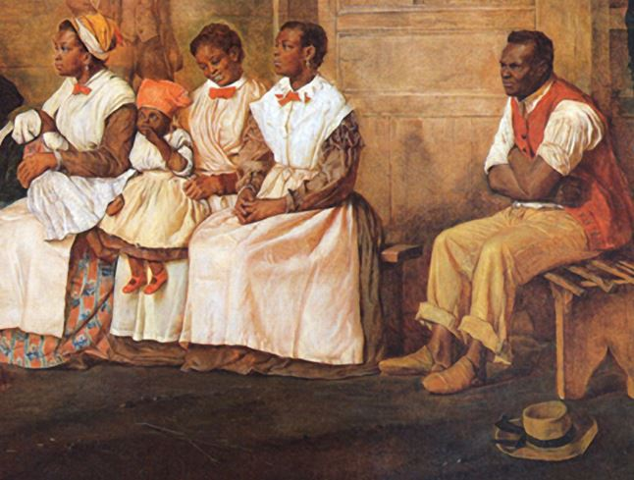
What do you see?
Who are these people?
What are they doing?

Slide 18
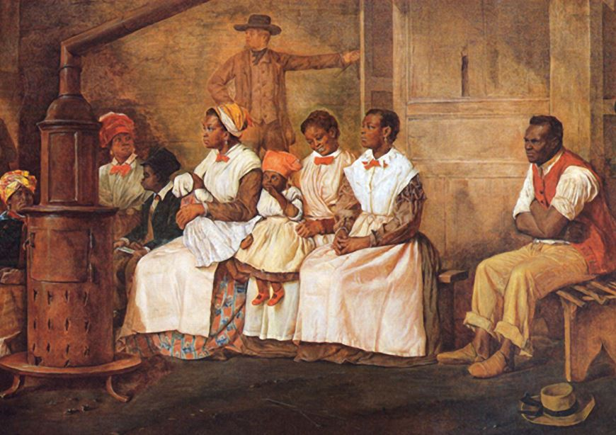

Slide 19
Why were the slaves dressed as they were?
What do you think was their fate?
Notes:
Discuss why it would have been beneficial for the slaves’ owners to spend money to dress them as they did

Slide 20
Slaves Waiting for Sale
Richmond, Virginia, (1861)
Eyre Crowe
Library of Virginia

Slide 21
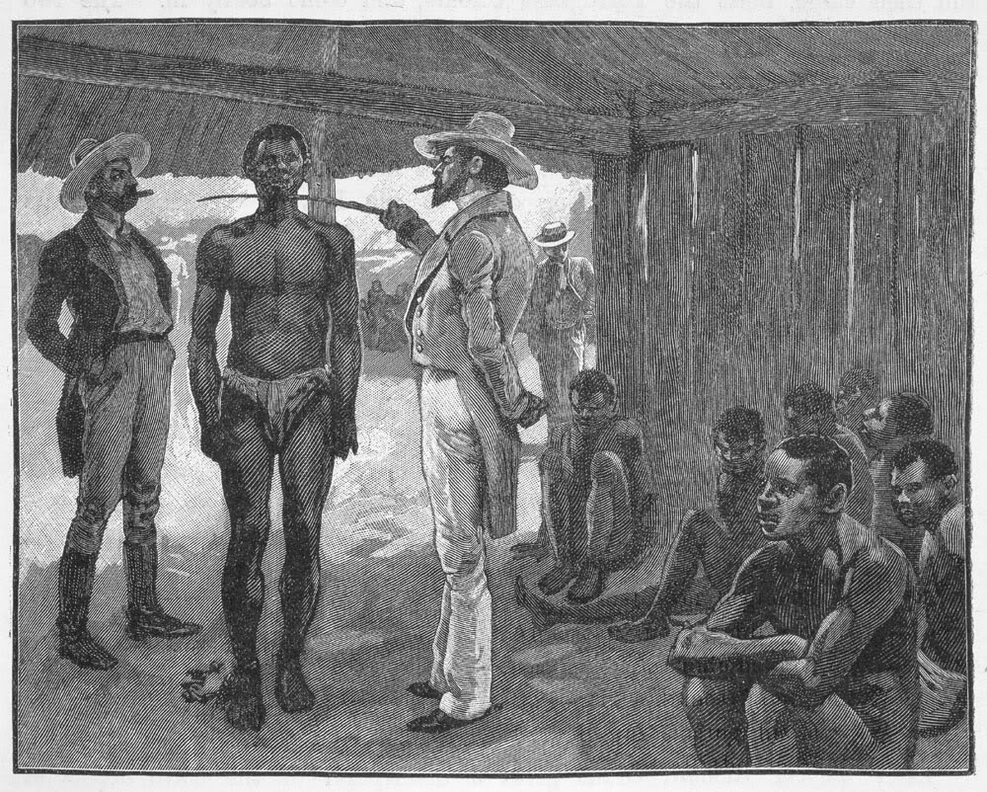
Notes:
This is a typical image many have of a slave auction/purchase. How does this differ from the previous image? Why would this owner/trader not care about dressing this particular slave in nice clothing? What do you think was the fate of these slaves?

Slide 22
Image Analysis
This is a typical image of a slave auction/purchase.
  How does this differ from the previous image?
  What can you infer about the owner/trader’s feelings about dressing this particular slave in nice clothing?
  What do you think was the fate of these slaves?

Slide 23
How are the images different (or similar)?
Other Questions?

Slide 24
The student will demonstrate skills for historical thinking, geographical analysis, economic decision making, and responsible citizenship by
VUS.1a
synthesizing evidence from artifacts and primary and secondary sources to obtain information about events in Virginia and United States History:
VUS.1b
using geographic information to determine patterns and trends in Virginia and United States history
VUS.1c
interpreting charts, graphs, and pictures to determine characteristics of people, places, or events in Virginia and United States history
VUS.1e
comparing and contrasting historical, cultural, economic, and political perspectives in Virginia and United States history.
VUS.1f
explaining how indirect cause-and-effect relationships impact people, places, and events in Virginia and United States history
Essential Skills Standards

Slide 25
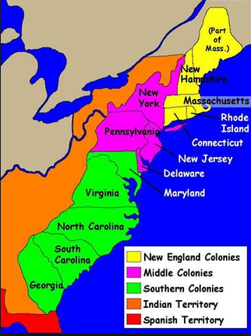
The student will apply social science skills to understand early European colonization by
VUS.3a: evaluating the economic characteristics of the colonies
VUS.3c: explaining the impact of the development of indentured servitude and slavery in the colonies
Content Standards

Slide 26

Climate and natural resources developed colonial characteristics

Slide 27

SCIM
Survey: What do you see?
Contextualize: When does this take place in history? What other events are occurring?
Infer: What do you think is happening?
Monitor: What other information do you want to know?
Historical Inquiry, Virginia Tech
Notes:
1st activity to model and practice

Slide 28
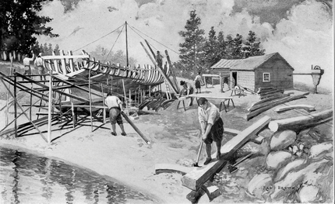
Monitor: Remaining questions
Infer: What do you think?
Contextualize: Where? When? What?
Survey: What do you see?
Describe life in the colonies

Slide 29
Monitor: Remaining questions
Infer: What do you think?
Contextualize: Where? When? What?
Survey: What do you see?
Image
#____
Explain life in the colonies

Slide 30
Summarize What do you see? | Contextualize Where? When? What? | Infer What do you think? | Monitor Remaining questions?

Slide 31
Image #1
Evans, C. W. - Some Notes on Shipbuilding and Shipping in Colonial Virginia.
Williamsburg: Virginia 350th Anniversary Celebration Corp. (1957)

Slide 32
Distribute this image to model the SCIM experience.
Afterwards, have students work in small groups to practice a SCIM.
Have copies of all other images.

Slide 33
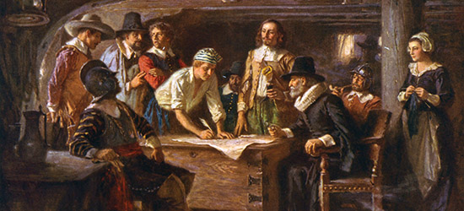
Image #2
Boston College, Boisi Center for Religion and American Public Life, Social Ethics and Social Practice in Puritan New England: A Reconsideration

Slide 34
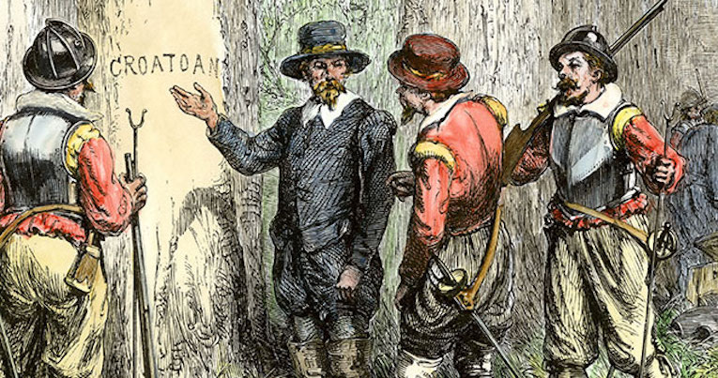
Image #3
“The Lost Colony,' a painting by Granger, shows John White returning to Roanoke Island and finding the word “Croatoan” carved on post. ( Fine Art America image )

Slide 35
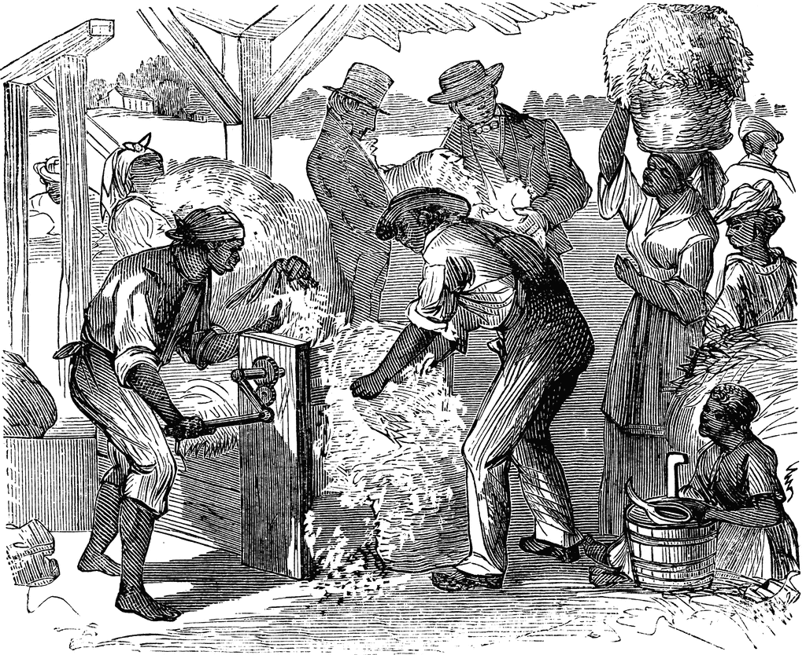
Image #4
The First Cotton-gin, by William L. Sheppard, published in Harper’s, December 18, 1869

Slide 36
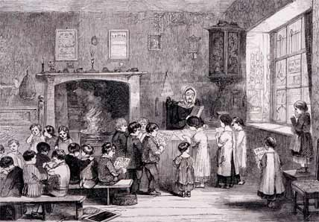
Image #5
Pondering Principles, Puritans & Education

Slide 37
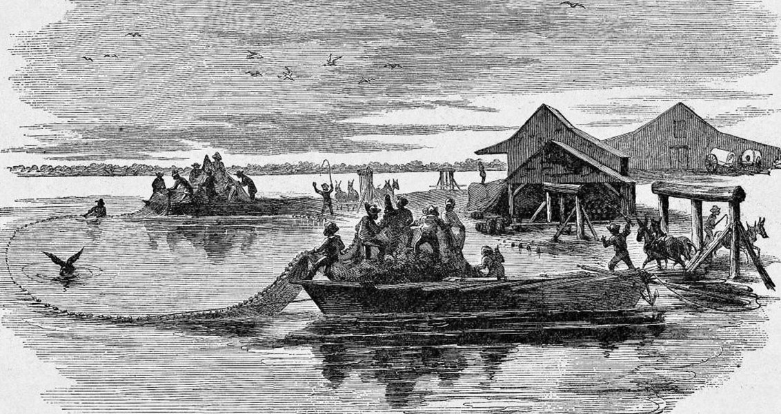
Image #6
Sein Fishing in North Carolina, Harper's Weekly (Sept. 28, 1861), p. 620.

Slide 38
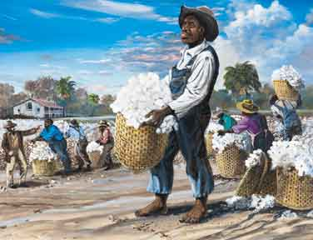
Image #7
"Slaves Picking Cotton,” Collection of Dr. Harold Rhodes III Charleston, South Carolina

Slide 39
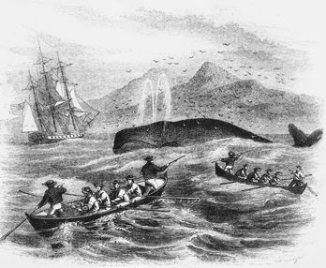
Image #8
The Columbia Encyclopedia, 6th ed., The Columbia University Press.

Slide 40
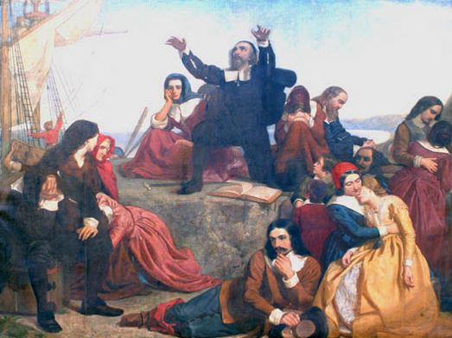
Image #9
Pilgrim Hall Museum, Collections & Exhibits, History Paintings

Slide 41
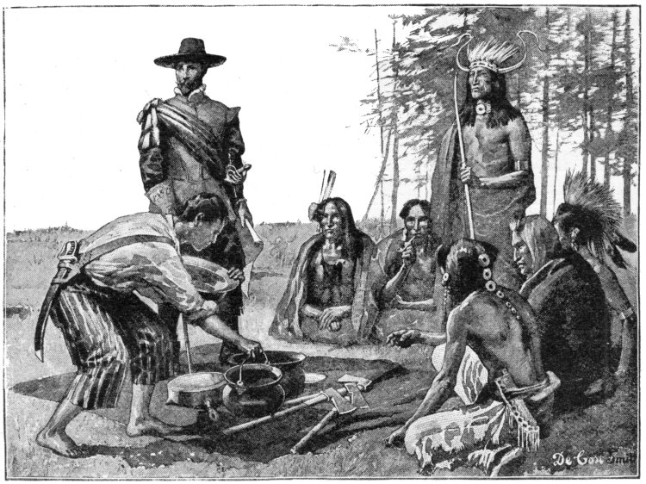
Image #10
The Project Gutenberg eBook, Stories of New Jersey, by Frank Richard Stockton

Slide 42
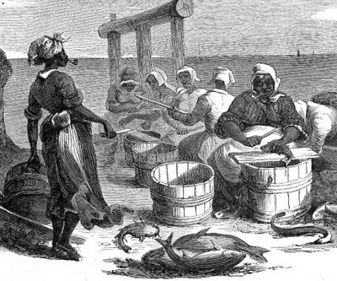
Image #11
Fish Processing in North Carolina 1861, Harper's Weekly (Sept. 28, 1861), p.621

Slide 43
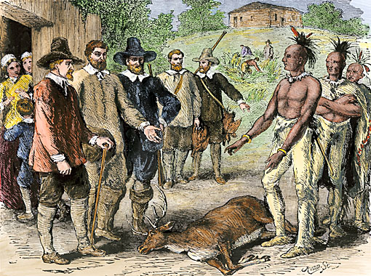
Image #12
North Wind Picture Archives

Slide 44
Images:
Another option . . .

Slide 45
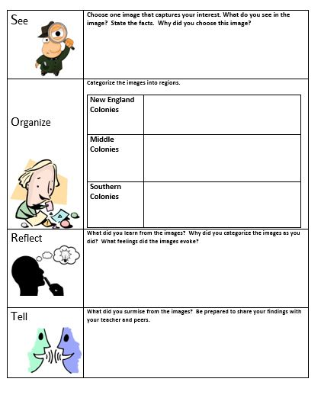
SORT Activity
Using images:
See
Organize
Reflect
Tell
Notes:
Alternative method to use images and can also be used to differentiate

Slide 46

Gallery Walk
Place images on large Post-It notes for students to:
  Write their thoughts
  Write what they see
  Questions they have
  How it relates to what has been taught

Slide 47
The student will demonstrate skills for historical thinking, geographical analysis, economic decision making, and responsible citizenship by
VUS.1a
synthesizing evidence from artifacts and primary and secondary sources to obtain information about events in Virginia and United States history
VUS.1c
interpreting charts, graphs, and pictures to determine characteristics of people, places, or events in Virginia and United States history
VUS.1d
Constructing arguments using evidence from multiple sources
VUS.1e
Comparing and contrasting historical, cultural, economic, and political perspectives in Virginia and United States history.
VUS.1g
Analyzing multiple connections across time and place
Essential Skills Standards

Slide 48

Checking for Understanding

Slide 49
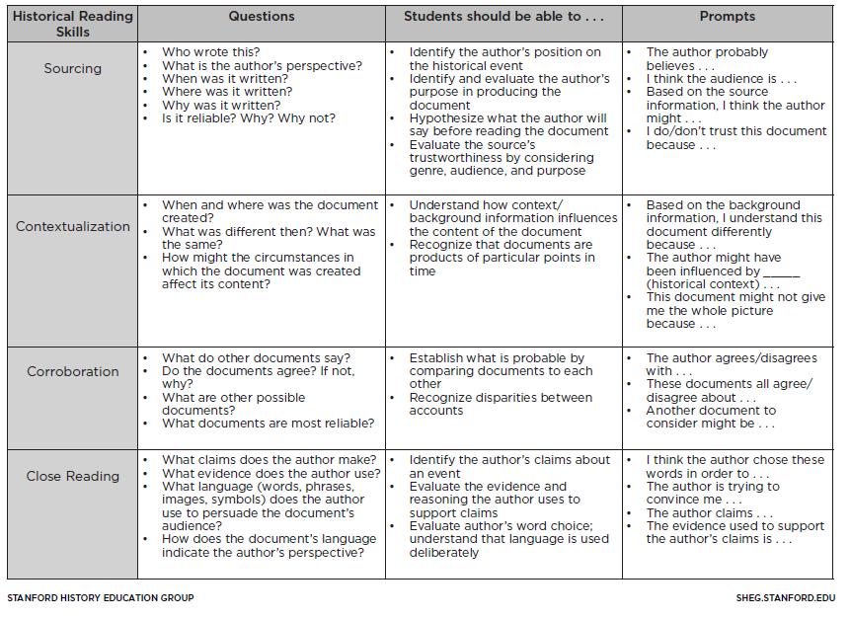
Historical Thinking Chart
This chart elaborates on the historical reading skills of sourcing, corroboration, contextualization, and close reading. In addition to questions that relate to each skill, the chart includes descriptions of how students might demonstrate historical thinking and sentence frames to support the development of these skills.

Slide 50
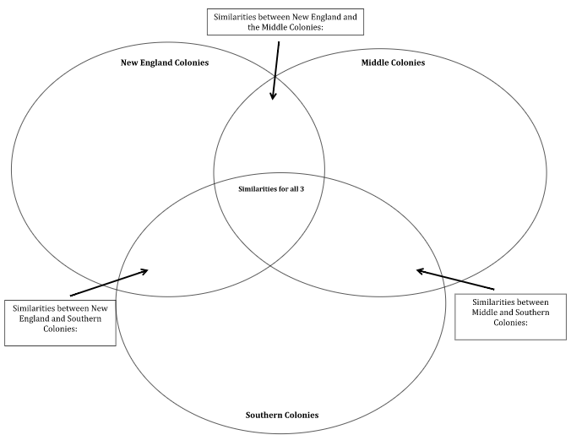
Triple Venn Diagram

Slide 51
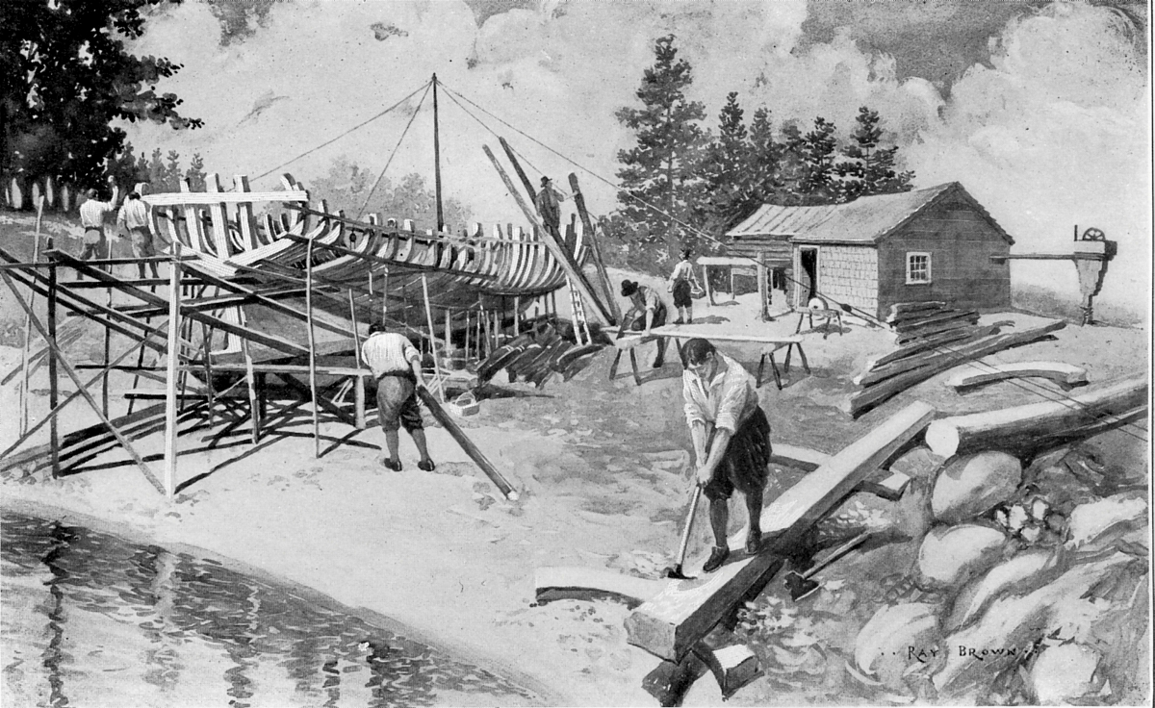
Tell Me About It!

Slide 52
Whose Phone is This?
Each student/group will personalize their phone.
Exchange papers and then identify the owner of the phone.
What are the clues?

Slide 53

Playlist:
Write 3 song titles and artists that would be found on this region’s playlist. Be sure to explain your reasoning as to why these songs fit this region.
1.
2.
3.
Wallpaper:
Sketch the characteristics from a specific region on the cell phone wallpaper. Explain why this image choice would be relevant to this region.
Email:
This phone just received two emails. Who sent the emails? What was the significance of the message? What clues allows you to know from which region it came?
Apps
Create five APPS for this phone that describe the political, economic, and/or historical contributions

Slide 54
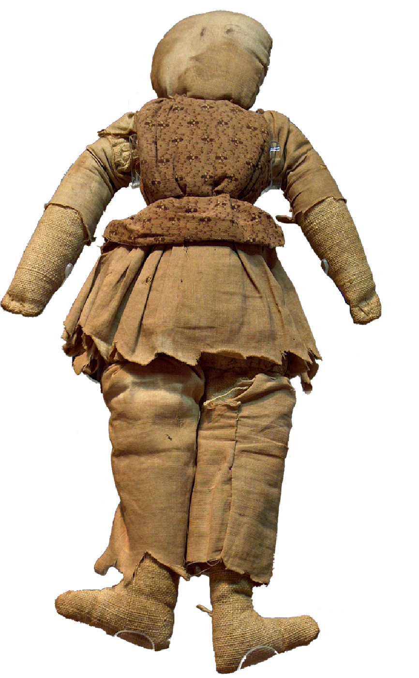
Silent Witness to the Surrender

Slide 55
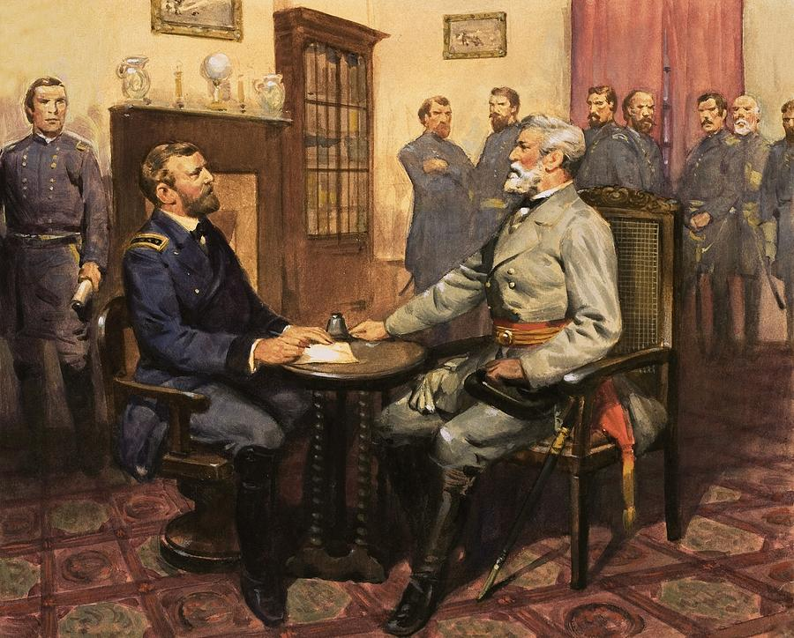
Perspective and Point of View

Slide 56
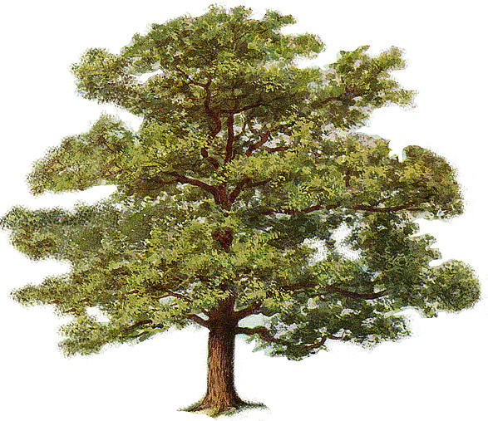
The Witness Tree
(silently observe)
Students will write from the perspective of a tree
Write what the tree observed that demonstrates knowledge of what they should have learned

Slide 57
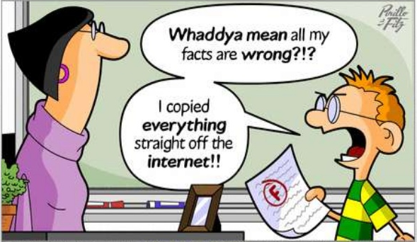
Writing to Learn
Not graded
Prior to lesson
  Assess student background knowledge
End of lesson
  Check understanding
  Make Connections
  Answer BIG QUESTION
  Free-write

Slide 58

Learn with Food!
Civil War Facts
Some Causes:
Sectional disagreements
Northern abolitionists v. Southern defenders of slavery
Lincoln: Key leader--insisted the Union be held together by force if necessary
Economic Impact:
South: left embittered and devastated. Much of the South lay in ruins.
North/Midwest: emerged with strong and growing economies

Slide 59

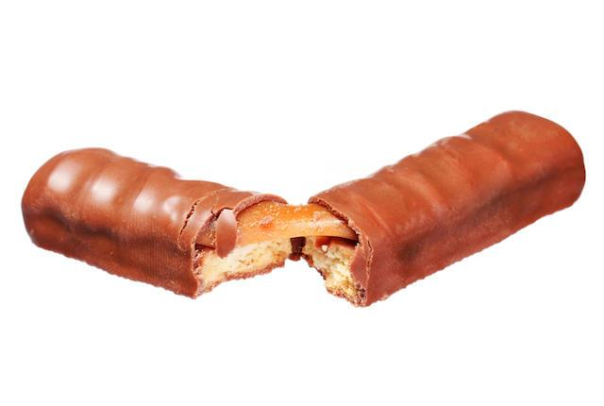
Big Question:
How was the Civil War like a Twix candy bar?
https://www.youtube.com/watch?v=D6iaxewbaXg
SOL VUS.7: The student will demonstrate knowledge of the Civil War and Reconstruction Era and their importance as major turning points in American history.
Notes:
Though this jumps forward, I think this will serve as a good model.

Slide 60
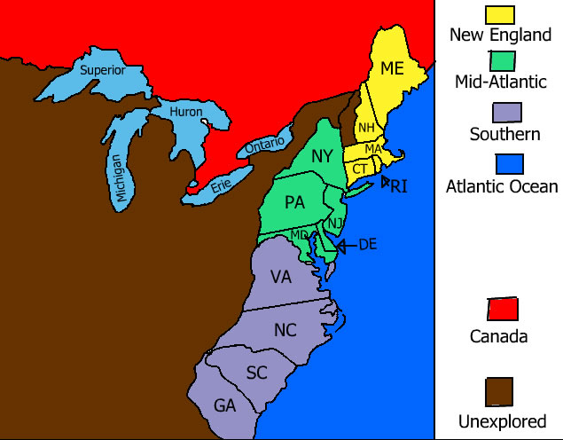
Time to Practice!
Examine the characteristics of the three colonial regions
If you had to choose a candy bar to match your region, what would it be? Why?

Slide 61
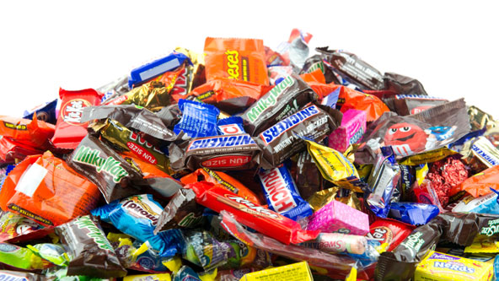
Candy for the Colonies!
What are the characteristics of each of the three colonial regions?
If a candy bar was chosen to match a region, what would it be? Why?

Slide 62

The student will demonstrate skills for historical thinking, geographical analysis, economic decision making, and responsible citizenship by
VUS.1b
Using geographic information to determine patterns and trends in Virginia and Unites States history
VUS.1c
interpreting charts, graphs, and pictures to determine characteristics of people, places, or events in Virginia and United States history
VUS.1e
Comparing and contrasting historical, cultural, economic, and political perspectives in Virginia and United States history.
VUS.1f
Explaining how indirect cause-and-effect relationships impact people, places, and events in Virginia and United States history
VUS.1g
Analyzing multiple connections across time and place
Essential Skills Standards

Slide 63

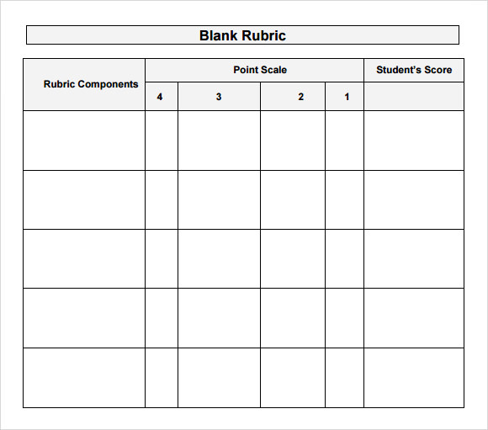
Traditional
Alternative
ideas
  Exit Slips
  Multiple Choice
  Short Answer
  Matching
  True/False
  Multiple Choice
Think, Create, and Write:
  Thought Bubbles
  Phone Activity
  Witness Tree
  Candy Bar
  Answer the Big Question
Checking for Understanding

Slide 64
How can Virginia & United States History skills be incorporated into standards-based lessons?

Slide 65
Standard VUS.3a
The student will apply social science skills to understand early European colonization by evaluating the economic characteristics of the colonies.
Content Standard

Slide 66
Skill Standard VUS.1c
The student will demonstrate skills for historical thinking, geographical analysis, economic decision making, and responsible citizenship by interpreting charts, graphs, and pictures to determine characteristics of people, places, or events in Virginia & United States History.
Essential Skills Standard

Slide 67
Learning Experience
Teachers will be given a driving historical question that will guide the lesson to ensure mastery of the content and practice with the aligned skill.
The skill will be to interpret the economic activities depicted in the images provided. Below is a sampling of the images to be used in the session.

Slide 68
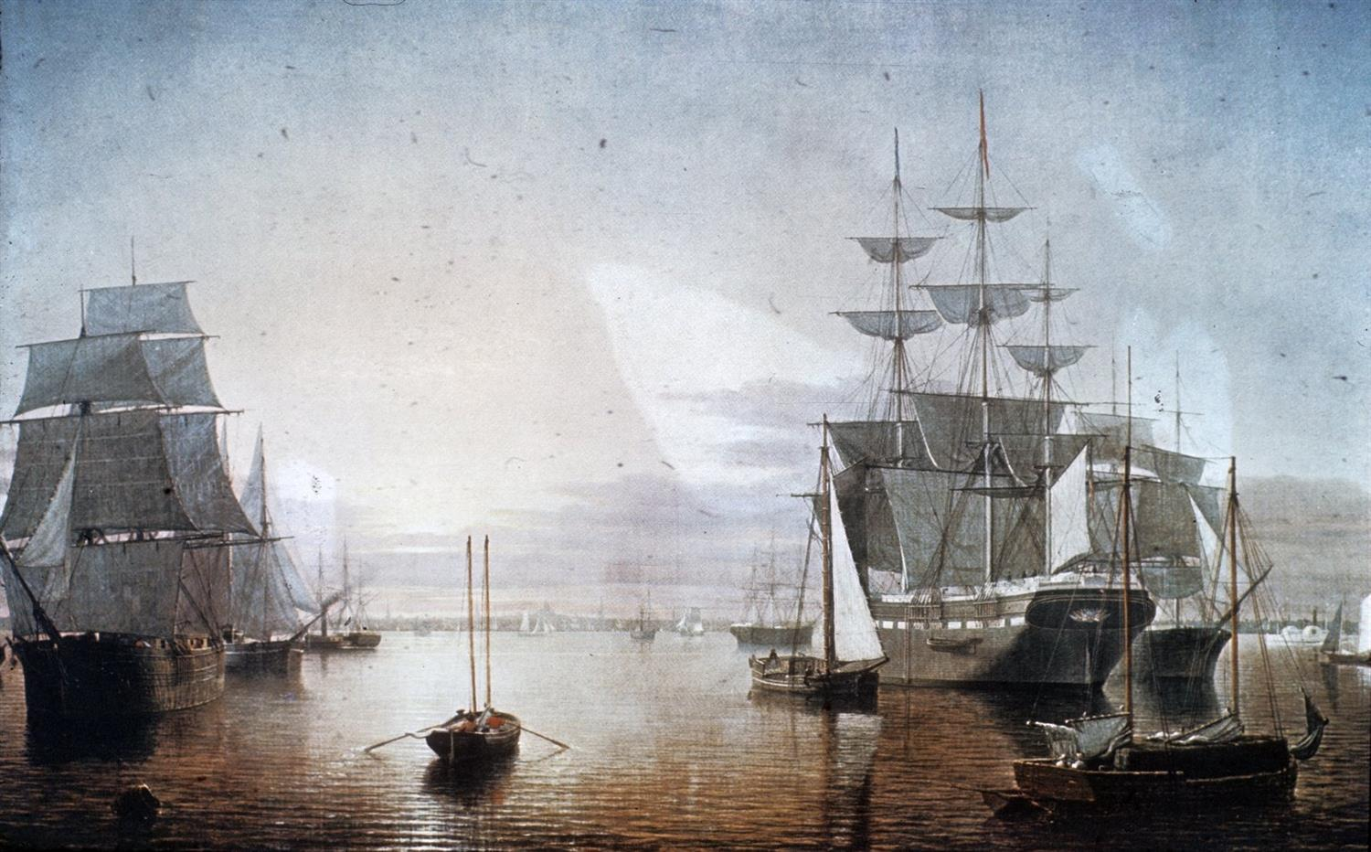
Notes:
Boston Harbor at Sunset c.1850
M. and M.Karolik Collection of American Paintings
Museum of Fine Arts, Boston

Slide 69
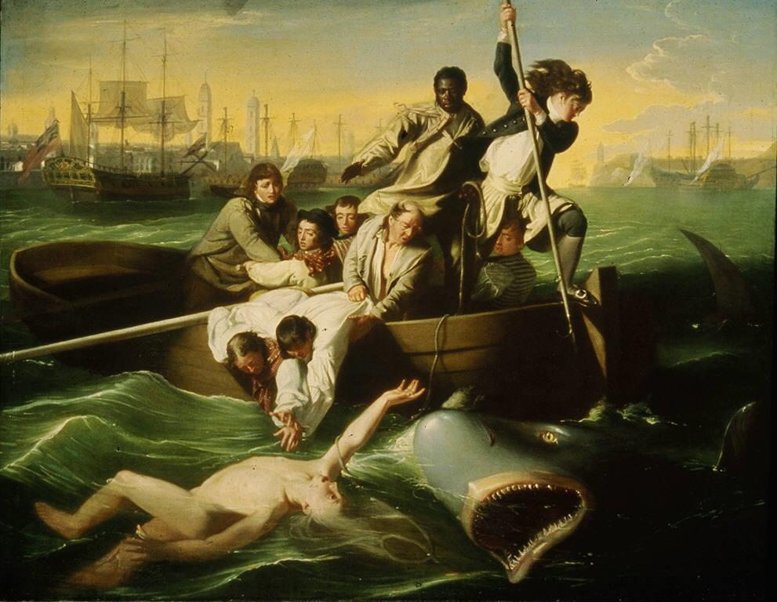
Notes:
John Singleton Copley's "Watson and the Shark," 1778. Ferdinand Lammot Belin Fund

Slide 70
Notes:
Evans, C. W. - Some Notes on Shipbuilding and Shipping in Colonial Virginia.
Williamsburg: Virginia 350th Anniversary Celebration Corp. (1957)

Slide 71
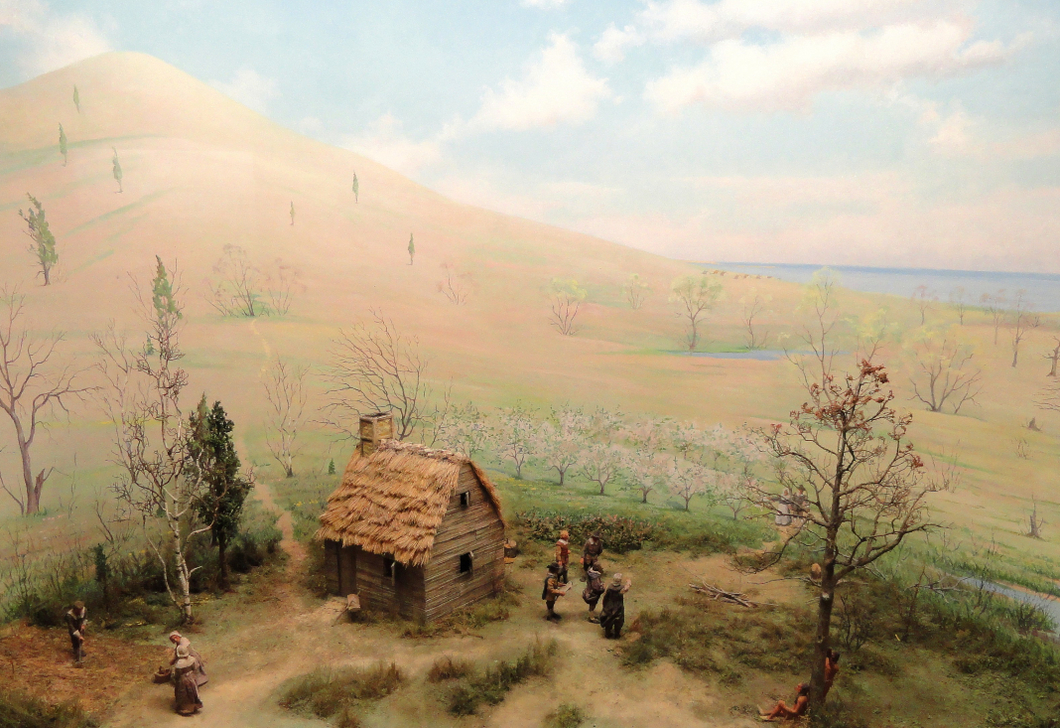
Notes:
The William Blaxton House, 1625. Boston Common with Beacon Hill in the background.

Slide 72
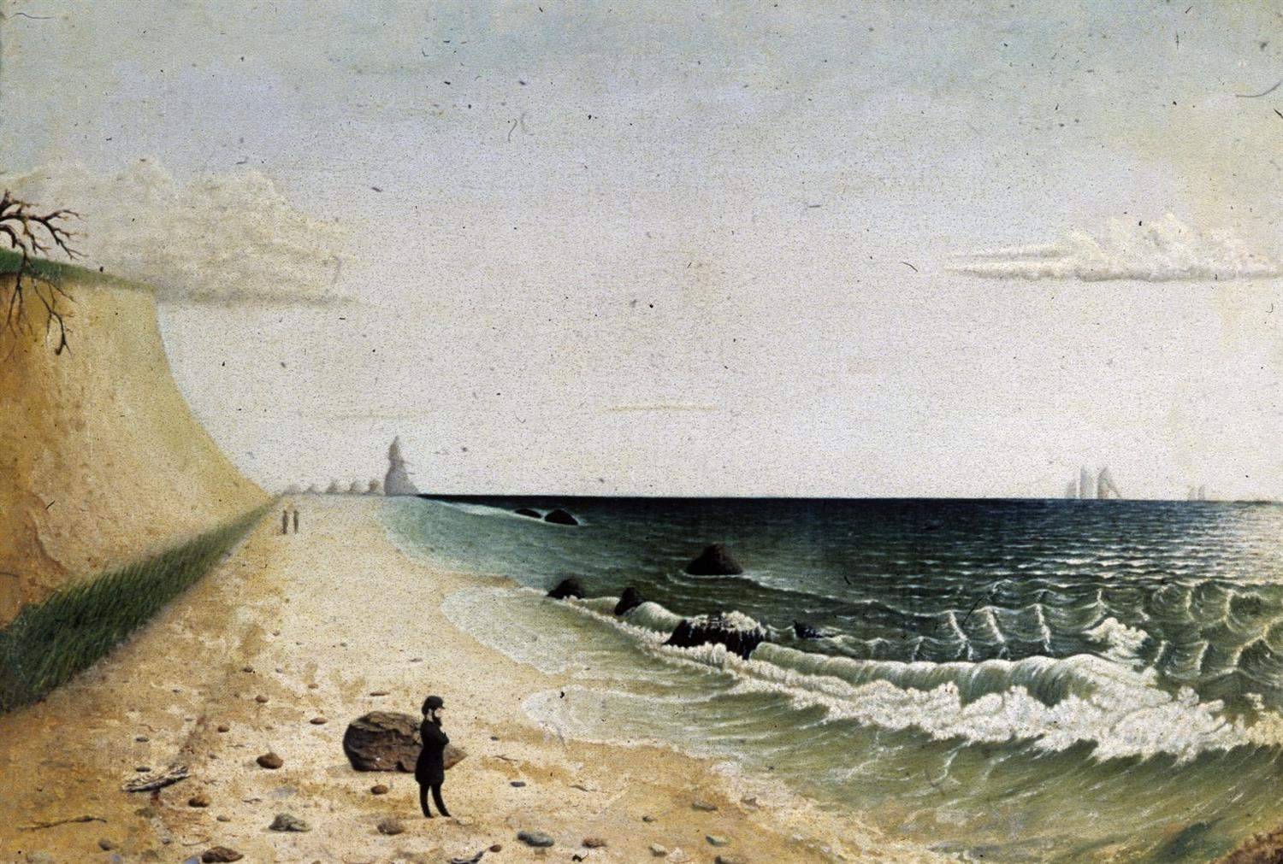
Notes:
Museum of Fine Arts, Boston, 1860s

Slide 73
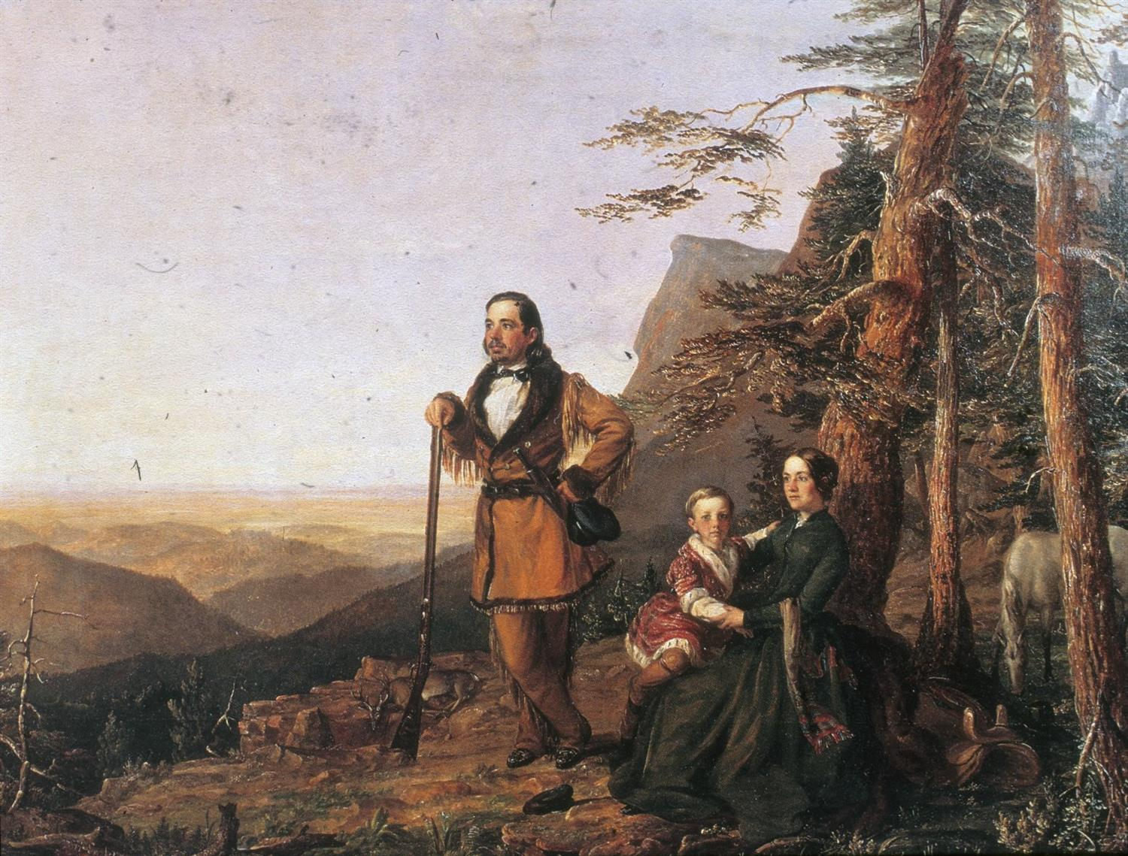

Slide 74
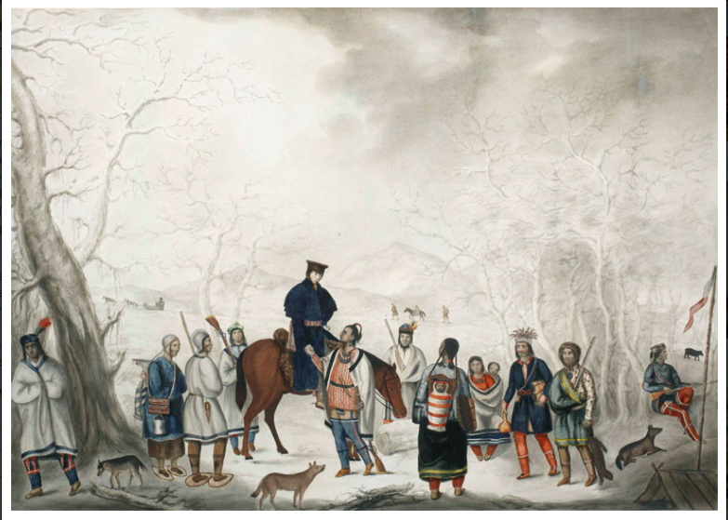
Notes:
Trader with Ojibwa Trappers, ca. 1820. This painting shows a trader meeting with an Ojibwa winter hunting party with furs to trade. The Ojibwas are wearing wool garments and carrying guns and metal knives—all products of European manufacture. Note also that items made by Ojibwas still are in use, such as fiber bags and snowshoes. This is a watercolor, gouache over pencil; artist anonymous. Courtesy of Royal Ontario Museum ©ROM

Slide 75
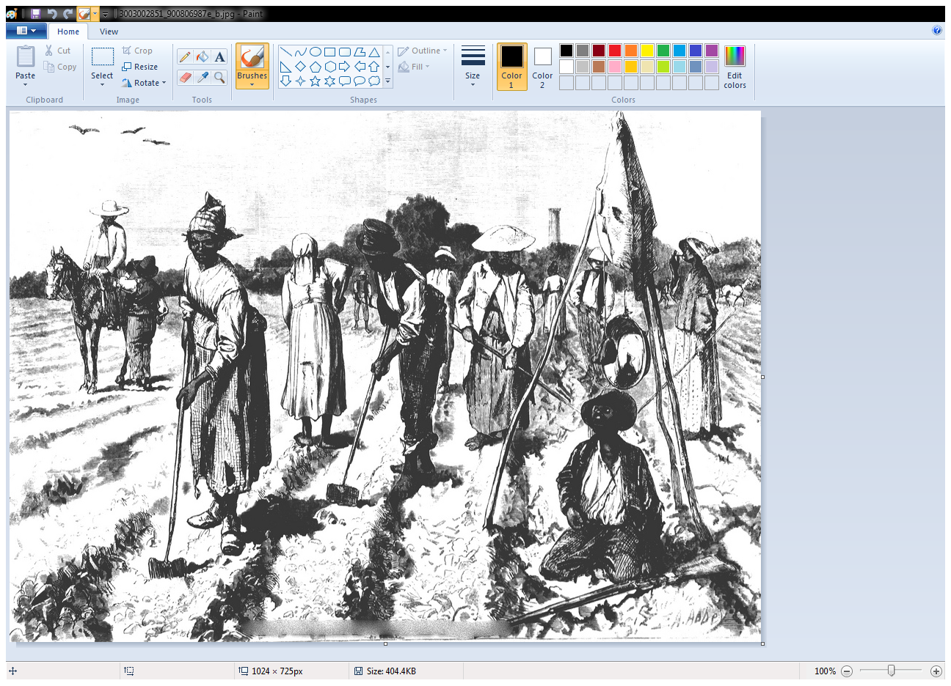
Notes:
Slaves working in a cotton field | by TylerRayne

Slide 76
Using Images for Other Skill Standards
VUS.1a: Using Information Sources
VUS.1b: Applying Geographic Skills
VUS.1c: Organizing Information
VUS.1d: Critical Thinking
VUS.1e: Comparison
VUS.1f: Causation
VUS.1g: Connections
VUS.1h: Economic Decisions
Essential Skills Standards

Slide 77
Standard VUS.3a
The student will apply social science skills to understand early European colonization by evaluating the economic characteristics of the colonies.
Content Standard
Notes:
Teachers will be given a second skill option for this standard.

Slide 78
Skill Standard VUS.1b
The student will demonstrate skills for historical thinking, geographical analysis, economic decision making, and responsible citizenship by evaluating the authenticity, authority, and credibility of sources using geographic information to determine patterns and trends in Virginia & United States History.
Essential Skills Standard
Notes:
Using the same standard, another skill will be introduced by using a topographical map. The task will be, based on the interpretation of the map, which economic activities would align best with each colonial regions. This experience is linked to analyzing the dynamic relationship between physical and human geography as well as using maps to explain how the location of resources influences patterns, trends, and migration of a population.

Slide 79
Another Experience
Using the same standard, another skill will be introduced by using a topographical map.
The task will be, based on the interpretation of the map, which economic activities would align best with each colonial regions.
This experience is linked to analyzing the dynamic relationship between physical and human geography as well as using maps to explain how the location of resources influences patterns, trends, and migration of a population.

Slide 80
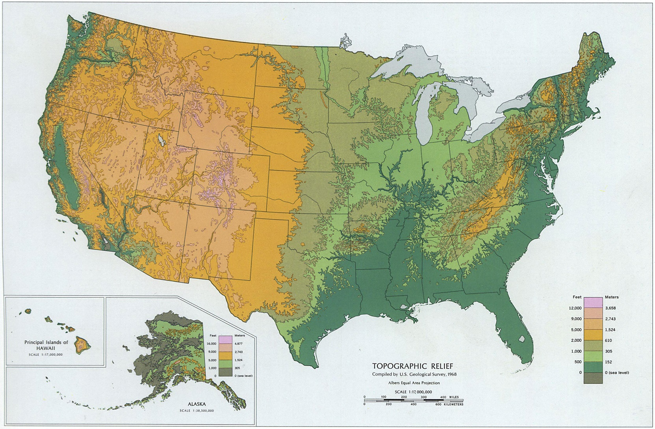

Slide 81
Helpful Hint . . .
Link the economic activities depicted in pictures used with VUS.1c with this map to determine the impact of physical geography on human geography.

Slide 82
Standard VUS.3a
The student will apply social science skills to understand early European colonization by evaluating the economic characteristics of the colonies.
Content Standard

Slide 83
Skill Standard VUS.1h
The student will demonstrate skills for historical thinking, geographical analysis, economic decision making, and responsible citizenship by using a decision-making model to analyze and explain the incentives for and consequences of a specific choice made;
Essential Skills Standard
Notes:
By making settlement decisions based on personal priorities, colonists experienced costs and benefits of those choices.

Slide 84
By making settlement decisions based on personal priorities, colonists experienced costs and benefits of those choices.

Slide 85
Essential Skills: “The Art of Reasoning”
1.H Use a decision-making model to analyze & explain the incentives for & consequences of a specific choice made
Cost-Benefit Decision Model
  Used to decide whether or not to do something
Cost-Benefit Decision Tree
    Used to decide between 2 choices
Essential Skills Standard

Slide 86
Essential Skills: “The Art of Reasoning”
1.H Use a decision-making model to analyze & explain the incentives for & consequences of a specific choice made
Cost-Benefit Decision Model
  Used to decide whether or not to do something
Cost-Benefit Decision Tree
    Used to decide between 2 choices
P.A.C.E.D. Decision Model
    Used to decide among a variety of options/alternatives
Essential Skills Standard

Slide 87
P.A.C.E.D. Decision Model
Problem
state the problem
Alternatives
list the alternatives
Criteria
identify the criteria
Evaluate
evaluate the alternatives
Decision
make a decision

Slide 88
The Driving Historical Question
What factors determined where colonists settled?

Slide 89
Problem: In which colonial region are we best suited?
Location to Family
Ties to Anglican Church
 |  |  |  | Climate for Farming
Criteria →
Quality Farmland
TOTALS
Alternatives
Decision
New England
Evaluate:
Assign numeric values
ex: 1-5 scale
1 = not very important
5 = very important
Middle
Southern

Slide 90
Options to Facilitate Student Understanding
Ship Manifests
Letters/Diary Entries/Sermons
Maps
Images
Advertisements/Broadsides
Teacher-created Scenarios

Slide 91
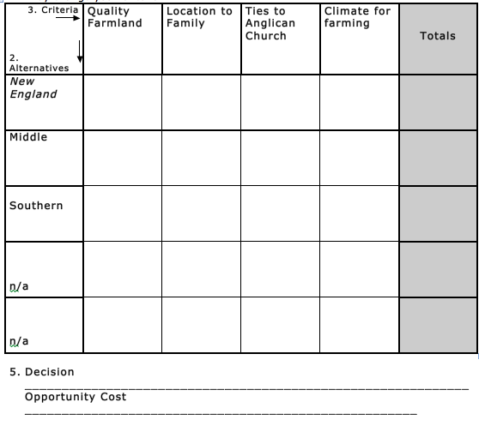
PACED
Decision making allows for critical thinking about colonial characteristics.
Notes:
Use handouts for printed directions.

Slide 92
Costs – Benefits of the Colonial Regions
In which colonial region are we best suited?
Follow-up questions & writing prompts:
To what extent did one choice outweigh the other?
Do agree/disagree with the decision that was made? Explain.
Which choice would you have made? Explain. (What factors led to this decision?)
Identify any alternative choices.

Slide 93
The Driving Historical Question
What factors determined where colonists settled?

Slide 94
Triple Venn Diagram
SOL 1.e: Comparison

Slide 95
Questions?
Notes:
Respond to the parking lot questions that have been posted in each room.

Slide 96
Virginia and United States History Presenters
Rodney Robinson | Richmond City | rrobins4@richmond.k12.va.us
Camille Beliveau | Chesapeake | Camille.Beliveau@cpschools.com
Elizabeth Glynn | Loudoun County | Elizabeth.glynn@lcps.org
Kelly White | Roanoke City | KSWhite@rcps.info
Tiffany Jenkins | Bristol County | tnjenkins@bvps.org
Lloyd Page | Nottoway County | Page.Lloyd@NottowaySchools.org
Cathy Nichols-Cocke | Campbell County | ccocke@campbell.k12.va.us

Slide 97

Virginia Department of Education
Christonya Brown, K-12, History and Social Science Coordinator
E-mail: Christonya.Brown@doe.virginia.gov
Betsy Barton, Elementary, History and Social Science Specialist
E-mail: Betsy.Barton@doe.virginia.gov
Jill Nogueras, English and History and Social Science Specialist
E-mail: Jill.Nogueras@doe.virginia.gov

