Slide 1
Virginia Studies
History and Social Science
Fall Institute
2016

Slide 2
Disclaimer
Reference within this presentation to any specific commercial or non-commercial product, process, or service by trade name, trademark, manufacturer or otherwise does not constitute or imply an endorsement, recommendation, or favoring by the Virginia Department of Education.

Slide 3
Questions to Ask During Planning
Essential Components in Planning an Effective Lesson
using the
2015 History and Social Science Standards of Learning
What do students need to know and understand by the end of this lesson?
What do students need to do during this lesson?
Which historical thinking skills are best suited for this standard?
What other content material should be added to provide historical context and richness to the lesson in order to maximize student understanding of the standard?
What student learning experiences would be most effective during this lesson?
How can I check for understanding effectively and accurately to measure the students’ content knowledge and historical thinking skills?

Slide 4

It starts with the . . .

Slide 5
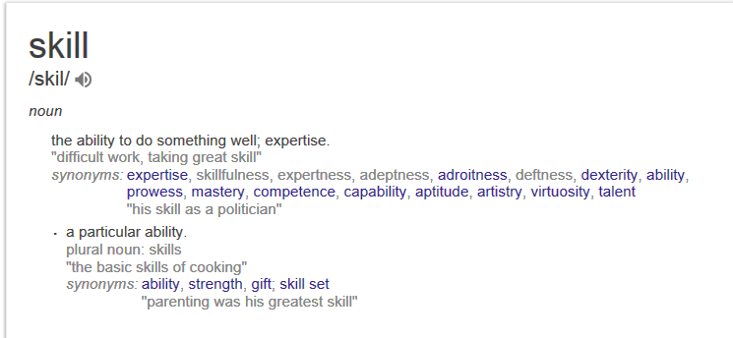

Slide 6
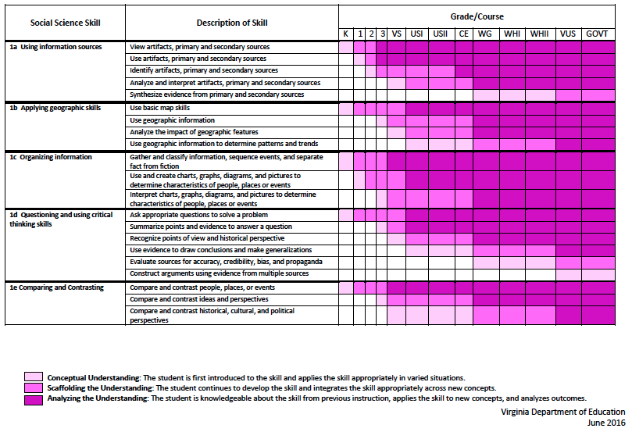
2015 SOL Skill Progression
⇧
Notes:
⇧

Slide 7
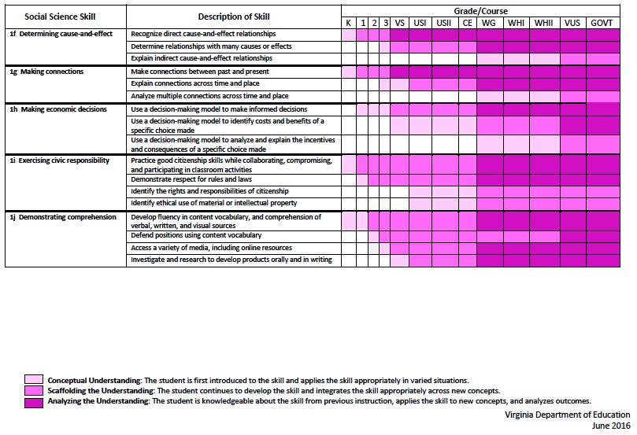
2015 SOL Skill Progression
⇧
2008 Standards:
Understand content
2015 Standards:
Understand content by applying the skill.
Skills are aligned with English Standards
Notes:
Discussion: Conceptual Understanding, Scaffolding the Understanding, Analyzing the Understanding
Arrow will rise up upon click after discussion to summarize difference between 2008 and 2015, then skills aligned with English SOLs. Great opportunity for common planning!
Purpose of today is to “teach” a lesson demonstrating skill based instruction, moving away from Lecture (Sit and Get)

Slide 8
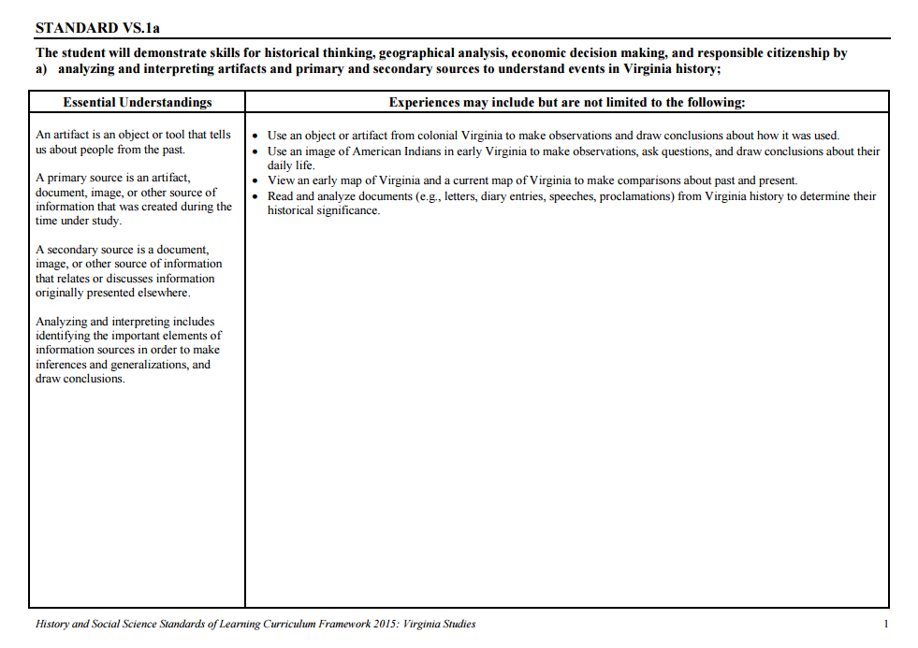
Experiences for Essential Skills
What are Experiences?

Slide 9
Experiences
Bring attention to the Experiences and describe what they are and how they can be used.
Provide teachers with “experiences” and give them an opportunity to:
  discuss what they are and how they can be used; and
  develop their own to share with the group.

Slide 10
The experiences should be –
engaging,
rigorous with higher level thinking questions,
relevant (connecting time periods, places, and events to the present day).

Slide 11
Experiences
Are . . .
Are NOT. . .
Engaging- promoting discussion, collaboration, and understanding
Opportunities to practice social science skills using various content
Varied throughout the lesson to help students make connections
Worksheets
Specific to one Standard, topic, or course

Slide 12

How can Virginia Studies history & social science skills be incorporated into standards-based lessons?
Notes:
Good practice: Use of aim/objective to give students a concrete goal for the lesson. “By the end of class/end of unit/etc., you should be able to…”

Slide 13
Good practice
Use of aim/objective to give students a concrete goal for the lesson.
“By the end of class/end of unit/etc., you should be able to…”

Slide 14

Today we will . . .
Practice strategies to incorporate new standards-based skills into daily lessons to teach and check for understanding of content

Slide 15

Today’s Learning Opportunities
Continue to build an awareness of changes in the new Standards of Learning for History & Social Sciences for Virginia Studies
Become familiar with skills related to Standard 1
Explore and model strategies and learning experiences that will promote rigorous social studies instruction
Notes:
Give teachers a moment to read Today’s Learning Opportunities. You may consider giving them a moment to TURN AND TALK about what they are looking forward to most about this session– then share a few with the whole group.

Slide 16

Today’s Working Norms
Be engaged
Be open to new ideas
Limit sidebar conversations
Laptop/Cell phone use
Notes:
Remind teachers that during this time together, you ask that they:
Be engaged
Be open to new ideas
Limit sidebar conversations
Laptop/Cell phone use – be mindful
Norms will help us maximize time and stay focused on our work together

Slide 17
Grounding:
Who Are We?
Introduce yourself to a shoulder partner
  Name, position, school/location you teach
  What is your favorite unit/topic to teach in Virginia Studies? Why?
Geography
New Nation
Reconstruction
Colonial Virginia
Civil War
Woodland Indians/
Jamestown
20th Century/Civil Rights
American Revolution

Slide 18
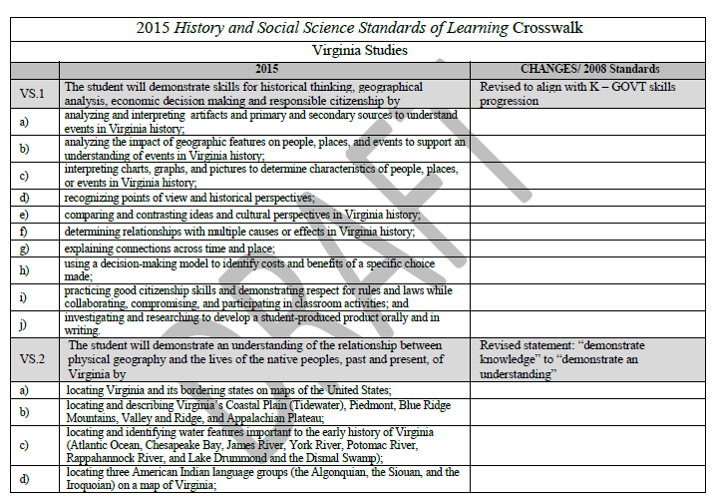

Virginia Studies:
Let’s Dig Deeper
Notes:
Since we are all teachers of Virginia Studies, let’s take a closer look at the changes specific to our content. (have teachers look at Crosswalk Document for VA Studies). Make sure they know that this document details what has been revised, added, and deleted.
IMPORTANT!!!
This would be a good time to remind teachers that the 2016-17 SOL test for VA Studies will be a CROSSWALK year – they will need to teach both standards (2008 and 2015) as the 2008 standards will be tested on the SOL and the 2015 standards will be field-tested. Students will see questions from the new standards, but they won’t count towards the final score.

Slide 19
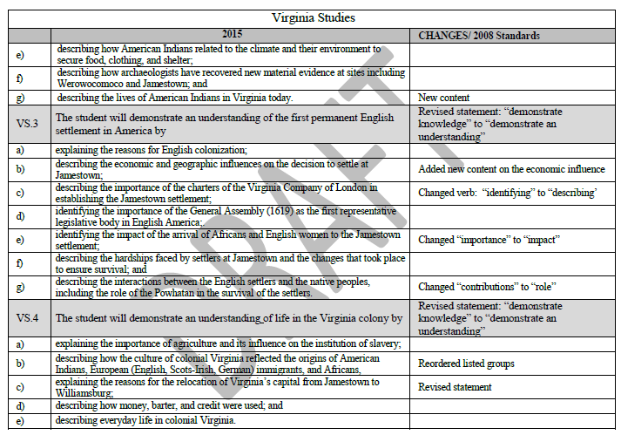
Virginia Studies:
Let’s Dig Deeper
Code Your Thinking:
! - Important
? - Question
* - I knew that
Take a moment to become familiar with the Crosswalk (changes, additions, deletions)
Notes:
Give participants about 5 minutes to look through this document individually. Encourage them to use the CODE YOUR THINKING strategy (which can be used to help students make sense of nonfiction text) which is explained on the slide.

Slide 20
Social Studies Instruction should…
New 2015 Standards of Learning
Align with new SOLs and Curriculum Framework
Embed Standard 1: SKILLS
Historical Thinking Skills
Embed historical thinking skills to promote deeper understanding of social studies concepts through the use of primary/secondary sources
Literacy Connections
Integrate literacy and social studies concepts to maximize instructional time and strengthen comprehension skills
Conceptual Understandings
Promote big ideas help students make connections and bring relevancy to new learning
Include essential questions that are open-ended, inquiry-based
Notes:
The new skills in Standard 1 paired with rigorous, meaningful learning experiences for students to learn new content will help build solid social studies instruction that might look something like this – (go through slide)
All of these are 21st Century Skills that students need to develop in order to be successful as 21st century learners.

Slide 21
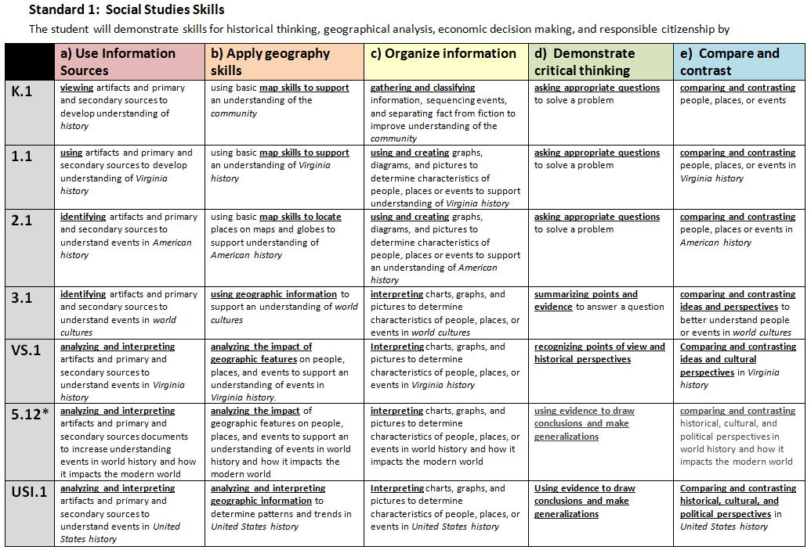

Standard 1: Skills
Take a moment to become familiar with the new Standard 1: SKILLS
Which of these skills are tied directly to literacy?
Notes:
This chart is very similar to the VDOE’s chart we just shared. It was created by Fairfax County Public Schools to help teachers see how action verbs change to reflect the scaffolding of skills in each grade level. Take a moment to become familiar with this chart, particularly for VA Studies. Have a conversation with someone near you or with your table group. Be thinking about:
How do many of these skills already tie into our content?
Which of these skills are tied directly to literacy and can also help students strengthen comprehension?
SHARE OUT WHOLE GROUP – what are some things you notice about the skills in Standard 1? What are some things you are thinking about or discussed with your partner/group?

Slide 22

What might these skills look like embedded within our content?
Notes:
So, let’s take a closer look at these skills and begin to think about what they might look like in social studies instruction…..

Slide 23
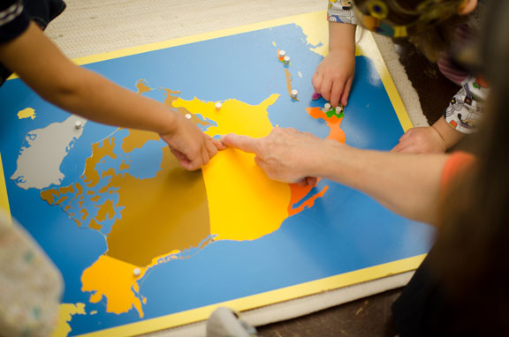
Let’s Explore:
Rigorous Social Studies
Learning Experiences
Notes:
Now we are going to take some time to explore some possible learning experiences for students that will help teachers grasp ways to embed skills from Standard 1 into content. As we look at and model each lesson idea, be thinking about ways to raise the rigor of social studies instruction and make literacy connections through these skills.

Slide 24
What are these experiences teachers are to provide for the students?
The experiences should be –
engaging,
rigorous with higher level thinking questions,
relevant (connecting time periods, places, and events to the present day).

Slide 25
How do I plan for these experiences?
When planning for these experiences you should think about how we learn about the past.
    Asking questions.
    Gathering the sources, organize them, and evaluate the evidence in the sources.
    Drawing conclusions that are supported by the evidence in the sources.

Slide 26

Geography
Notes:
The first strand we will take a look at is GEOGRAPHY.

Slide 27
This Learning Experience will focus on the following skills (standard 1):
VS.1b- applying geographic skills
VS.1c – organizing information
Notes:
The geography strand lends itself nicely to fostering these skills. The learning experiences we are about to engage in will offer examples of how these skills can be embedded within the geography strand. Be thinking about how we have built these skills intentionally into these learning opportunities alongside specific content.

Slide 28
Map It Out!
Take 1 minute and draw a map of Virginia (from memory).
Compare your map to your partner’s map to find similarities and differences.
Notes:
This activity is called “Map It Out.” Be thinking about various ways you might be able to use this.
Give each participant ½ sheet of white paper. Follow directions on slide.

Slide 29
Map It Out!
Think about the Virginia Studies standards for geography. What is missing?
Revise Your Map!
You have 1 minute to add additional content to your map.
Find a new friend! Compare your map and discuss similarities and differences.
Notes:
Follow directions on slide to facilitate the activity.

Slide 30
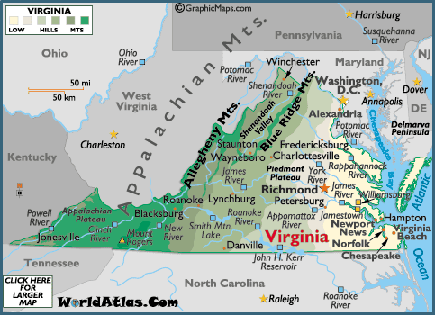
Map It Out!
Notes:
Ask - What’s missing from your map? What could you STILL add?

Slide 31

Mapping Virginia by Heart
These maps can be used throughout the year to help students apply geography skills.
Great Idea!
Student maps can be kept by the teacher and each time a new skill is taught, students draw a new map including new information. Different layers can be added to the map to help organize the content.
Notes:
Each time students create a new map. Maps can be kept by the teacher and students can compare them throughout the year.
(*Adapted from Mapping the World by Heart)

Slide 32
More Ideas for Mapping It!
Use as beginning of unit pre-assessment, on-going formative or end of unit summative assessment
Students can include:
Bordering States
Bodies of Water
Regions
Characteristics of each region
Rivers
Battles
Jamestown
Capitals
Any other ideas?
Notes:
Ask participants to come up with additional ideas for how maps can be used to apply geographic skills. What other skills from standard 1 are also embedded within an activity like this?

Slide 33
Extension Ideas
Cause and Effect
Have students use their maps to determine cause and effect relationships.
    Some examples might be:
    The Coastal Plain manufactures ships because ________________.
    Englishmen settled in Jamestown because ___________________.
    The Blue Ridge Mountains are important to Virginia rivers because _______________.
    The capital moved to Williamsburg (Richmond) because ____________.
    Settlers crossed through the Cumberland Gap because ______________.
    West Virginia was formed because ______________.
Students could make a T-chart at the bottom of their map to label the cause and effect relationships
Notes:
This is just some examples of cause and effect relationships that could be used with the maps. After labeling the map the students could make a t-chart at the bottom of the map. It would need to be modeled at first. Then the teacher could give the cause or effect and have the students fill in the missing part. Eventually the students would hopefully be able to use the map and their knowledge to just fill in a blank t-chart.

Slide 34

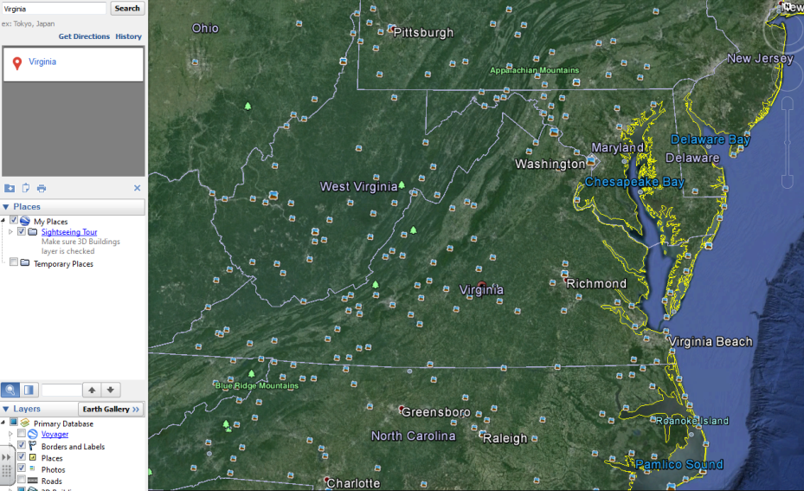
Virginia Has Neighbors
Using Google Earth
Notes:
Integrating technology is a great way to help students apply geographical skills. Here is a great way to utilize Google Earth to help students understand relative location, cardinal/intermediate directions, the bordering states of Virginia, and Virginia’s place in the world.
(Note – this will not be an ‘experience’ for teachers – just another idea to add to their toolbox for geography)

Slide 35
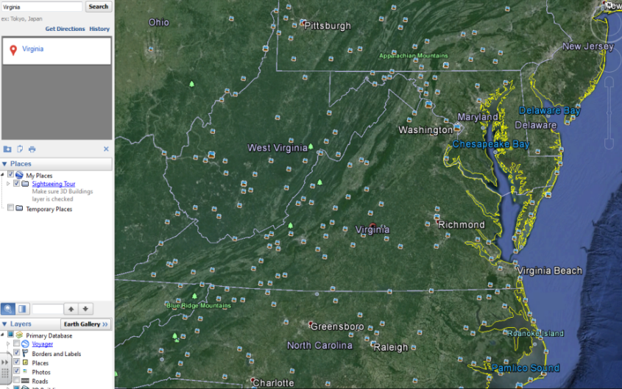
Virginia Has Neighbors
Using Google Earth
Using Google Earth do a search for Virginia and project the image for students to see. Using relative location terms, ask students:
Which state(s) is above Virginia? (Maryland, part of West Virginia)
Which state is directly below Virginia? (North Carolina)
Which state(s) is next to Virginia? (Kentucky, West Virginia)
Which state is also below us? (Tennessee)
Notes:
Go through directions on slide

Slide 36
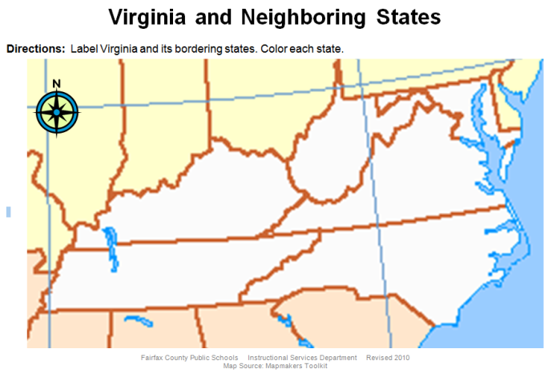
Virginia Has Neighbors
Using Google Earth
Extend student thinking by connecting relative location to cardinal and intermediate directions:
Maryland is north/northeast of Virginia
West Virginia is northwest of Virginia
North Carolina is south of Virginia
Kentucky is west of Virginia
Tennessee is southwest of Virginia
Label on Virginia Map
Notes:
Go through directions on slide

Slide 37
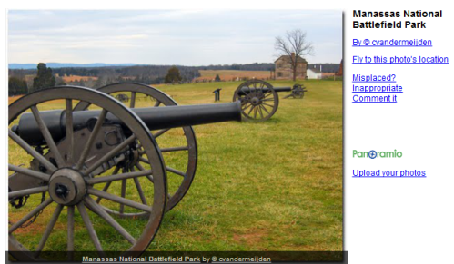
Extension Ideas
Using Google Earth
Working in pairs using Google Earth, search for Virginia and explore various landmarks (marked by icons) in Virginia.
Have students find at least one important/interesting landmark in Virginia that is located near a bordering state. For example, Manassas National Battlefield Park is located near Maryland (south of MD).
Have students plot each landmark they find on the map, in its correct location.
Encourage students to look at the pictures and descriptions of each landmark they place on their map to share these with larger groups or the whole class.
Notes:
Discuss extension options – ask for other ideas participants might have

Slide 38

Sharing Our Expertise
Notes:
5 minute share (pairs, table groups, or whole group) – What are some other ways we could embed geography skills into VA Studies? Are there specific standards and/or resources that come to mind?

Slide 39
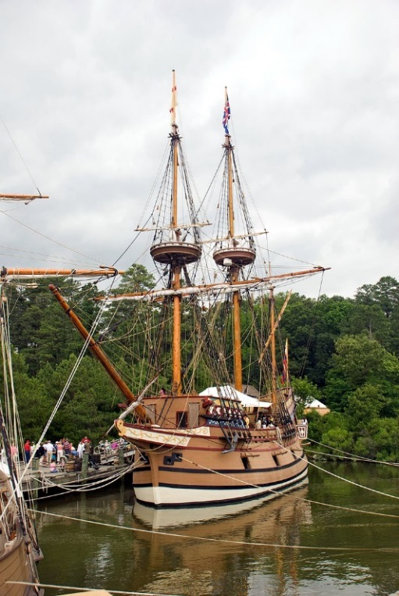
History
Image source: Jennifer L. Brown, Fairfax County Public Schools
Notes:
The next strand we will take a look at is HISTORY.

Slide 40
This Learning Experience will focus on the following skills (standard 1):
VS.1a- using information sources
VS.1d- demonstrate critical thinking
VS.1g- making connections
Notes:
Take a moment to think about how these skills could be embedded within many of the activities social studies teachers can engage students in.

Slide 41
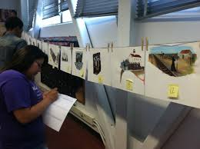
Gallery Walk
A discussion technique allowing engagement and collaboration throughout the class setting.
Notes:
Presenters – you will need to the following to prepare:
Materials:
*copy of all pictures
*print out of the notes from the power point
*post-it notes (enough for each person to have a few)
Instructions:
Print out all pictures/slides (41- 61) from the gallery walk. The pictures are in sequence of the events and form a timeline.
Place the pictures on the wall forming the timeline. Make sure the pictures are spaced far enough apart to prevent crowding.
Explain what a gallery walk is to the teachers.
Have the teachers walk through the gallery making observations and collaborating with peers about the images.
This has two options: (1) Tell the story after the teachers have collaborated but while they are at the gallery or (2) have the teachers go back to their seats and then tell the story.
-----------------------------------------------------------
A Gallery Walk is a discussion technique that allows engagement and collaboration throughout the class setting. A gallery walk can be simply observations with collaboration about the images. OR, it could include a list of questions that students have to form answers for. It could also include a think-pair-share activity. The walk could also include an analyzing activity of several particular images.
In this learning experience, we will be taking a closer look at standard:
VS. 9c The student will demonstrate an understanding of Virginia during the twentieth century and beyond by
c) describing the social and political events in Virginia linked to desegregation and Massive Resistance and their relationship to national history.
And focusing on the following skills:
Main Skills are using information sources, questioning/critical thinking, and making connections.
Presenters – you will need to the following to prepare:
Materials:
*copy of all pictures
*print out of the notes from the power point
*post-it notes (enough for each person to have a few)
Instructions:
Print out all pictures/slides (41- 61) from the gallery walk. The pictures are in sequence of the events and form a timeline.
Place the pictures on the wall forming the timeline. Make sure the pictures are spaced far enough apart to prevent crowding.
Explain what a gallery walk is to the teachers.
Have the teachers walk through the gallery making observations and collaborating with peers about the images.
This has two options: (1) Tell the story after the teachers have collaborated but while they are at the gallery or (2) have the teachers go back to their seats and then tell the story.

Slide 42

Take a ‘Gallery Walk’
Pictures tell a story….
What story might these
images tell?
Notes:
A Gallery Walk is a discussion technique that allows engagement and collaboration throughout the class setting. A gallery walk can be simply observations with collaboration about the images. OR, it could include a list of questions that students have to form answers for. It could also include a think-pair-share activity. The walk could also include an analyzing activity of several particular images.
In this learning experience, we will be taking a closer look at standard:
VS. 9c The student will demonstrate an understanding of Virginia during the twentieth century and beyond by
c) describing the social and political events in Virginia linked to desegregation and Massive Resistance and their relationship to national history.
And focusing on the following skills:
Main Skills are using information sources, questioning/critical thinking, and making connections.
Presenters – you will need to the following to prepare:
Materials:
*copy of all pictures
*print out of the notes from the power point
*post-it notes (enough for each person to have a few)
Instructions:
Print out all pictures/slides (41- 61) from the gallery walk. The pictures are in sequence of the events and form a timeline.
Place the pictures on the wall forming the timeline. Make sure the pictures are spaced far enough apart to prevent crowding.
Explain what a gallery walk is to the teachers.
Have the teachers walk through the gallery making observations and collaborating with peers about the images.
This has two options: (1) Tell the story after the teachers have collaborated but while they are at the gallery or (2) have the teachers go back to their seats and then tell the story.

Slide 43

Take a ‘Gallery Walk’
As you look at each image:
  Make observations (What do you see or notice?)
  Ask questions (I wonder….?)
  Make inferences (I’m thinking this might be______)
Feel free to place a “jot
thought” on a post-it if
you would like to share
a comment or feeling
you have about
an image!
Notes:
A Gallery Walk is a discussion technique that allows engagement and collaboration throughout the class setting. A gallery walk can be simply observations with collaboration about the images. OR, it could include a list of questions that students have to form answers for. It could also include a think-pair-share activity. The walk could also include an analyzing activity of several particular images.
In this learning experience, we will be taking a closer look at standard:
VS. 9c The student will demonstrate an understanding of Virginia during the twentieth century and beyond by
c) describing the social and political events in Virginia linked to desegregation and Massive Resistance and their relationship to national history.
And focusing on the following skills:
Main Skills are using information sources, questioning/critical thinking, and making connections.
Presenters – you will need to the following to prepare:
Materials:
*copy of all pictures
*print out of the notes from the power point
*post-it notes (enough for each person to have a few)
Instructions:
Print out all pictures/slides (41- 61) from the gallery walk. The pictures are in sequence of the events and form a timeline.
Place the pictures on the wall forming the timeline. Make sure the pictures are spaced far enough apart to prevent crowding. (make sure post-its are available either around each image or at each table for participants)
Explain what a gallery walk is to the teachers.
Have participants walk through the gallery making observations and collaborating with peers about the images.
Encourage them to write “jot thoughts” (comments or feelings) on post-its and place them around images as they walk and talk. Be thinking about the story these pictures might tell.
This has two options:
(1) Tell the story after the teachers have collaborated but while they are at the gallery or
(2) have the teachers go back to their seats and then tell the story.

Slide 44
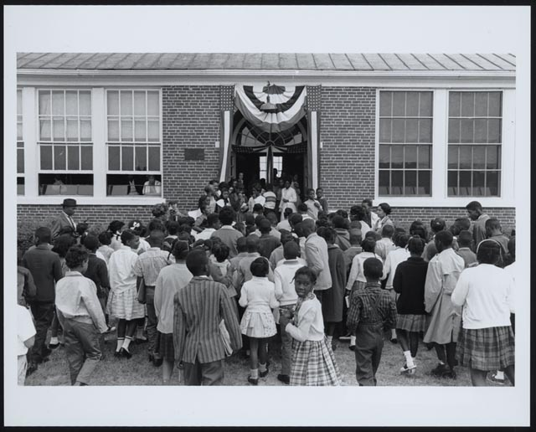
Prince Edward Public Schools segregated
http://crdl.usg.edu/export/html/loc/evenhand/crdl_loc_evenhand_br0203as.html?Welcome

Slide 45
Prince Edward Public Schools segregated
Prince Edward, Virginia---The Heart of Virginia
In 1951, public schools across America were segregated. Black students attended different school than white children.

Slide 46
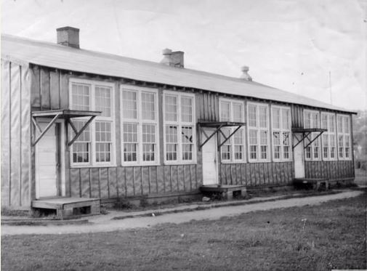
Robert Russa Moton High School in Prince Edward Virginia
segregated African American School - 1951
http://www.encyclopediavirginia.org/media_player?mets_filename=evm00001062mets.xml

Slide 47
Robert Russa Moton High School in Prince Edward Virginia
segregated African American School – 1951
This is Robert Russa Moton High School in Prince Edward Virginia. It was the public high school that educated Black/Colored students. The school was built using boards with tar paper covering them. It could legally hold 180 students but actually housed more than 400 students. The school did not have a gym, cafeteria, or science labs. It was a basic building with limited equipment. The Moton High School consisted of tar paper shacks with outdated learning materials, outdoor bathrooms, and inadequate heating during the winter months.

Slide 48
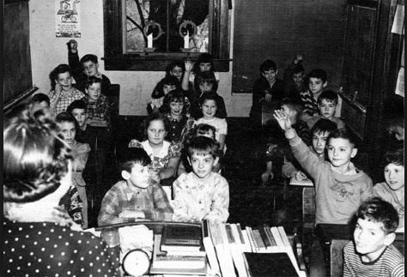
Prince Edward County Public Schools
segregated white school

Slide 49
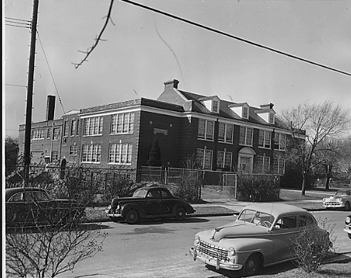
Prince Edward High School building for Whites 1951
https://www.archives.gov/files/education/lessons/davis-case/images/davis-exhibit-1.gif
Notes:
Prince Edward County Public High school for the White students. It was a brick building that also had a gym, cafeteria, and science labs. The building was in better shape than that of the Robert Russa Moton High School.

Slide 50
Prince Edward High School Building for Whites 1951
Prince Edward County Public High school for white students is pictured above. It was a brick building that also had a gym, cafeteria, and science labs. The building facilities were more modern than those of Robert Russa Moton High School.
https://www.archives.gov/files/education/lessons/davis-case/images/davis-exhibit-1.gif
Notes:
Prince Edward County Public High school for the white students is pictured above. It was a brick building that also had a gym, cafeteria, and science labs. The building facilities were more modern than those of Robert Russa Moton High School.

Slide 51

Notes:
In April of 1951, student Barbara Johns led a protest at the Moton High School of the separate but unequal conditions between Prince Edward Public Schools and Moton High School. The protest led to students walking out of school and refusing to return until they received equal treatment and an acceptable building.

Slide 52
In April of 1951, student Barbara Johns led a protest at the Moton High School of the separate but unequal conditions between Prince Edward Public Schools and Moton High School. The protest led to students walking out of school and refusing to return until they received equal treatment and an acceptable building.
Notes:
In April of 1951, student Barbara Johns led a protest at the Moton High School of the separate but unequal conditions between Prince Edward Public Schools and Moton High School. The protest led to students walking out of school and refusing to return until they received equal treatment and an acceptable building.

Slide 53
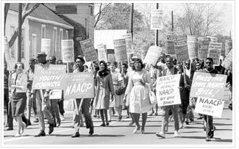
Notes:
Protest continued up and down the streets of Prince Edward, throughout the Town of Farmville.

Slide 54
Protests continued up and down the streets of Prince Edward County and throughout the Town of Farmville.
Notes:
Protests continued up and down the streets of Prince Edward County and throughout the Town of Farmville.

Slide 55
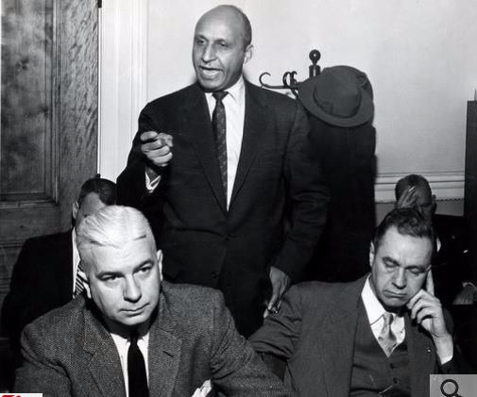
http://www.encyclopediavirginia.org/media_player?mets_filename=evm00000950mets.xml
Notes:
Attorney and Civil Rights Activist, Oliver W. Hill Sr. makes a visit to Prince Edward County.

Slide 56
Attorney and Civil Rights Activist, Oliver W. Hill Sr. makes a visit to Prince Edward County.
http://www.encyclopediavirginia.org/media_player?mets_filename=evm00000950mets.xml
Notes:
Attorney and Civil Rights Activist, Oliver W. Hill Sr. makes a visit to Prince Edward County.

Slide 57
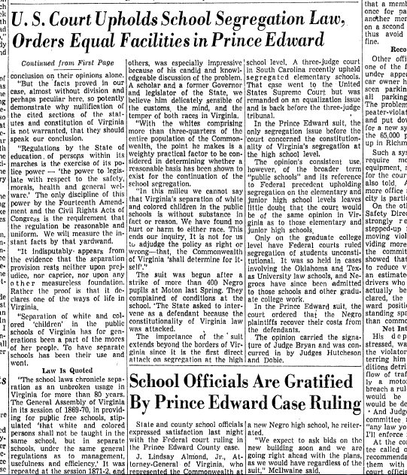
Notes:
March 1953, U.S. Court uphold the School Segregation laws in Virginia and Orders Equal Facilities.

Slide 58
March 1953, U.S. Court uphold the School Segregation laws in Virginia and Orders Equal Facilities.
Notes:
March 1953, U.S. Court uphold the School Segregation laws in Virginia and Orders Equal Facilities.

Slide 59
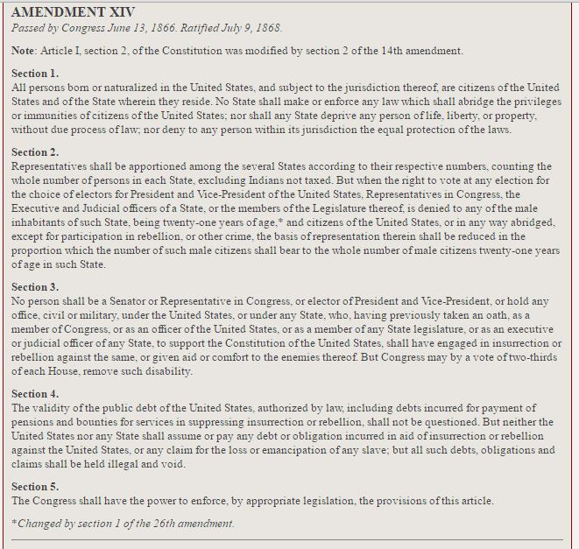
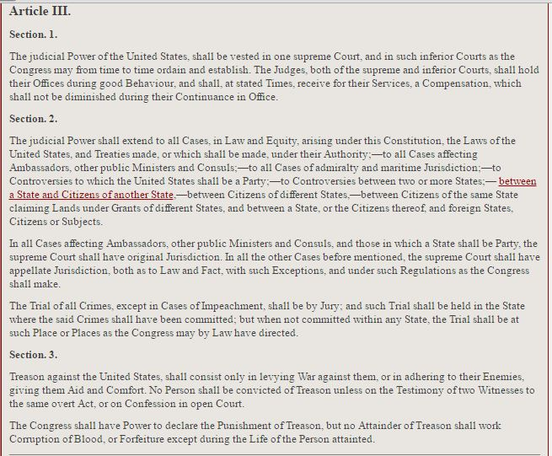
Notes:
The NAACP with Oliver W. Hill Sr. took to the U.S. Constitution. The first plan was to address the 14th Amendment, Due Process and the right to life, liberty, and property under equal protection from the law. It also address Article III of the U.S. Constitution, which states that court rulings can be heard by higher courts. The U.S. Supreme Court is the highest court in the United States.

Slide 60
The NAACP with Oliver W. Hill Sr. took to the U.S. Constitution. The first plan was to address the 14th Amendment, Due Process and the right to life, liberty, and property under equal protection from the law. It also address Article III of the U.S. Constitution, which states that court rulings can be heard by higher courts. The U.S. Supreme Court is the highest court in the United States.
Notes:
The NAACP with Oliver W. Hill Sr. took to the U.S. Constitution. The first plan was to address the 14th Amendment, Due Process and the right to life, liberty, and property under equal protection from the law. It also address Article III of the U.S. Constitution, which states that court rulings can be heard by higher courts. The U.S. Supreme Court is the highest court in the United States.

Slide 61
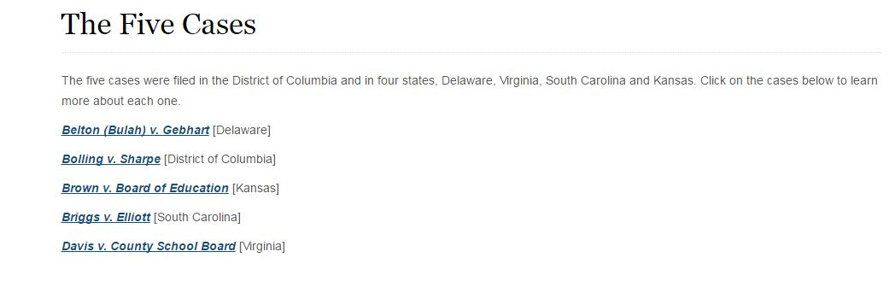
Notes:
NAACP lawyer and education funds attorney Thurgood Marshall led the petition for the United States Supreme court to hear the court case Brown v Board of Education, making segregation of schools a Federal Case. There were Five cases that were filled in the petition that represented four states and the District of Columbia. Oliver W. Hill Sr. of Richmond was the Virginia lawyer.

Slide 62
NAACP lawyer and education funds attorney Thurgood Marshall led the petition for the United States Supreme court to hear the court case Brown v Board of Education, making segregation of schools a Federal Case. There were Five cases that were filled in the petition that represented four states and the District of Columbia. Oliver W. Hill Sr. of Richmond was the Virginia lawyer.
Notes:
NAACP lawyer and education funds attorney Thurgood Marshall led the petition for the United States Supreme court to hear the court case Brown v Board of Education, making segregation of schools a Federal Case. There were Five cases that were filled in the petition that represented four states and the District of Columbia. Oliver W. Hill Sr. of Richmond was the Virginia lawyer.

Slide 63
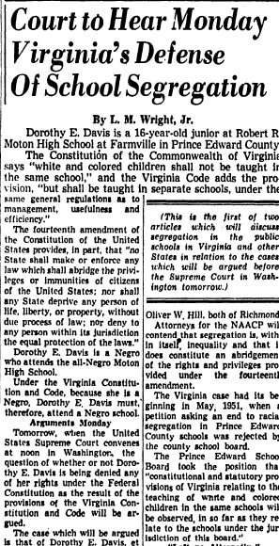
Notes:
Dec. 6, 1953 newspaper article showing the court proceedings that resulted from the Walk-Out coordinated by Barbara Rose Johns at the Robert Russa Moton High school in Prince Edward County Virginia. This is stating what Virginia’s role was in the Federal Court Case Brown v Board of Education.

Slide 64
Dec. 6, 1953 newspaper article showing the court proceedings that resulted from the Walk-Out coordinated by Barbara Rose Johns at the Robert Russa Moton High school in Prince Edward County Virginia. This is stating what Virginia’s role was in the Federal Court Case Brown v Board of Education.
Notes:
Dec. 6, 1953 newspaper article showing the court proceedings that resulted from the Walk-Out coordinated by Barbara Rose Johns at the Robert Russa Moton High school in Prince Edward County Virginia. This is stating what Virginia’s role was in the Federal Court Case Brown v Board of Education.

Slide 65
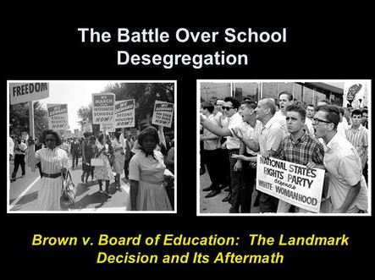

Slide 66
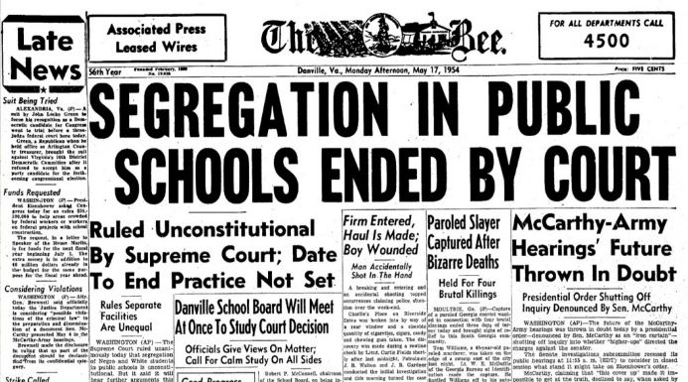
Notes:
On May 17, 1954, the United States Supreme Court ruled in the Brown v Board of Education, that “separate but equal” was unconstitutional. All public schools were ordered to desegregate.

Slide 67
On May 17, 1954, the United States Supreme Court ruled in the Brown v Board of Education, that “separate but equal” was unconstitutional. All public schools were ordered to desegregate.
Notes:
On May 17, 1954, the United States Supreme Court ruled in the Brown v Board of Education, that “separate but equal” was unconstitutional. All public schools were ordered to desegregate.

Slide 68
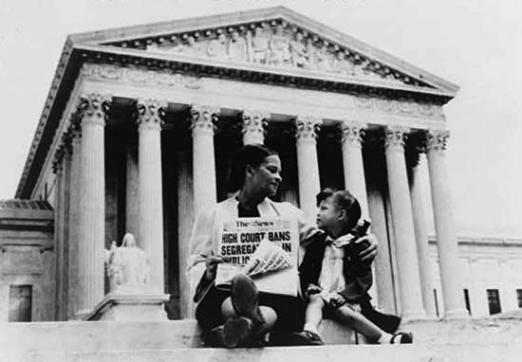

Slide 69
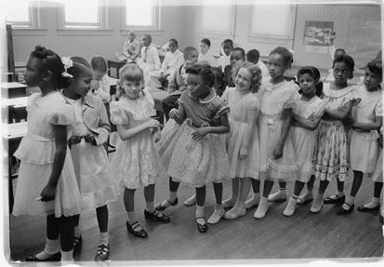
Notes:
In Virginia between 1954 and 1959, the majority of the public school desegregated until Massive Resistance.

Slide 70
In Virginia between 1954 and 1959, the majority of the public school desegregated until Massive Resistance.
Notes:
In Virginia between 1954 and 1959, the majority of the public school desegregated until Massive Resistance.

Slide 71
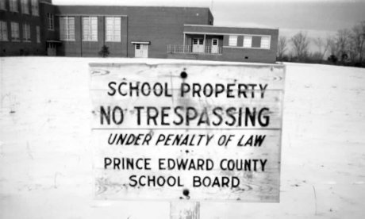
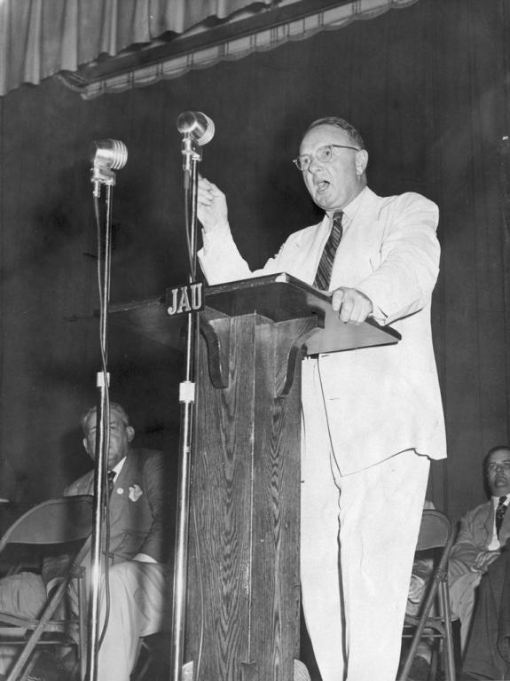
Virginia had other plans
Massive Resistance
Notes:
After the U.S. Supreme Court decision, Virginia Senator Harry F. Byrd Sr. promoted the “Southern Manifesto”, which is known as the Massive Resistance. Senator Byrd signed it on Feb. 25, 1956 creating a group of laws that prevented any public school from integrating.

Slide 72
Virginia had other plans
Massive Resistance
After the U.S. Supreme Court decision, Virginia Senator Harry F. Byrd Sr. promoted the “Southern Manifesto”, which is known as the Massive Resistance. Senator Byrd signed it on Feb. 25, 1956 creating a group of laws that prevented any public school from integrating.
Notes:
After the U.S. Supreme Court decision, Virginia Senator Harry F. Byrd Sr. promoted the “Southern Manifesto”, which is known as the Massive Resistance. Senator Byrd signed it on Feb. 25, 1956 creating a group of laws that prevented any public school from integrating.

Slide 73
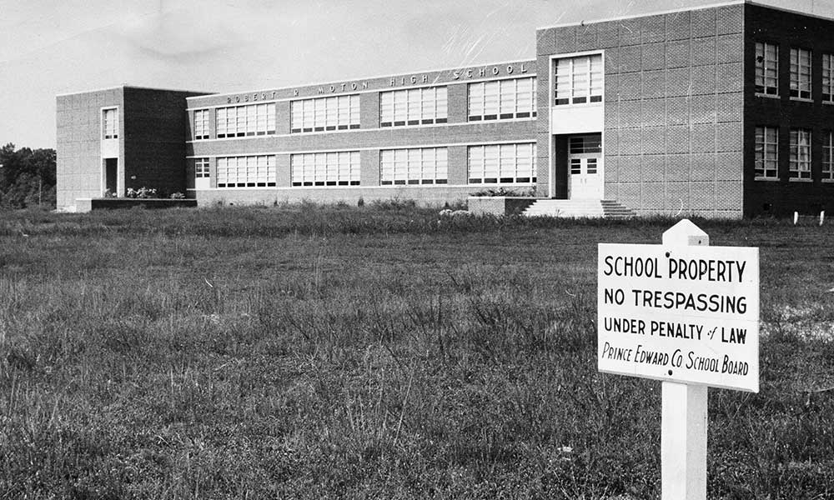
Notes:
January of 1959, The supervisors in Prince Edward County took Massive Resistance a step further by voting to end all local support for schools. Public schools in Prince Edward County were closed in September 1959 and remained closed for five years.

Slide 74
January of 1959, The supervisors in Prince Edward County took Massive Resistance a step further by voting to end all local support for schools. Public schools in Prince Edward County were closed in September 1959 and remained closed for five years.
Notes:
January of 1959, The supervisors in Prince Edward County took Massive Resistance a step further by voting to end all local support for schools. Public schools in Prince Edward County were closed in September 1959 and remained closed for five years.

Slide 75
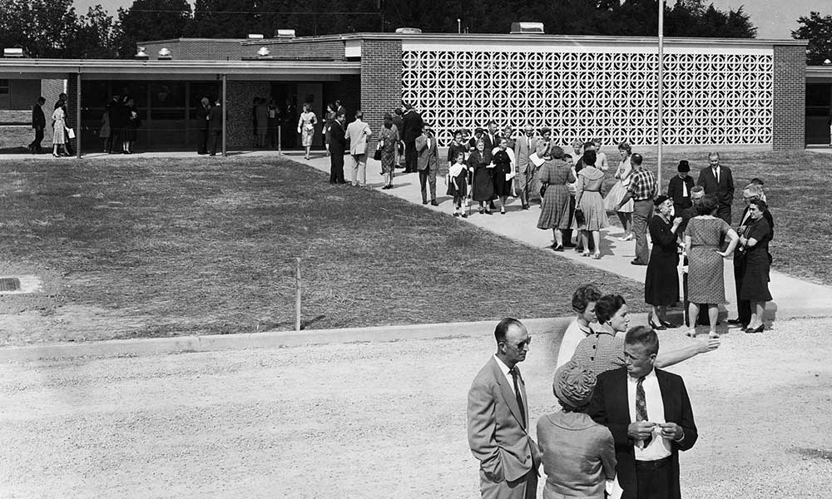
Prince Edward Academy
Notes:
Prince Edward Academy in Prince Edward Virginia was formed so that the white students could continue to get an education. It was funded primarily by the laws that were passed by Harry F. Byrd Sr. under Massive Resistance. Some of these laws gave government grants and vouchers for students that did not want to desegregate. This is an example of what was taking place in Virginia between the years of 1954-1959. Prince Edward County Public Schools remained closed beyond 1959.

Slide 76
Prince Edward Academy
Prince Edward Academy in Prince Edward Virginia was formed so that the white students could continue to get an education. It was funded primarily by the laws that were passed by Harry F. Byrd Sr. under Massive Resistance. Some of these laws gave government grants and vouchers for students that did not want to desegregate. This is an example of what was taking place in Virginia between the years of 1954-1959. Prince Edward County Public Schools remained closed beyond 1959.
Notes:
Prince Edward Academy in Prince Edward Virginia was formed so that the white students could continue to get an education. It was funded primarily by the laws that were passed by Harry F. Byrd Sr. under Massive Resistance. Some of these laws gave government grants and vouchers for students that did not want to desegregate. This is an example of what was taking place in Virginia between the years of 1954-1959. Prince Edward County Public Schools remained closed beyond 1959.

Slide 77
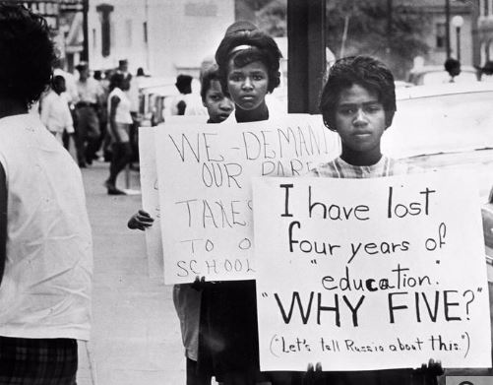
http://www.encyclopediavirginia.org/media_player?mets_filename=evm00000940mets.xml
Notes:
Students in protest about Massive Resistance and the some public schools remained closed. Black students were forced to live with family members in other counties or states, travel to surrounding counties for school, or not go to school at all.

Slide 78
Students in protest about Massive Resistance and some public schools remained closed. Black students were forced to live with family members in other counties or states, travel to surrounding counties for school, or not go to school at all.
http://www.encyclopediavirginia.org/media_player?mets_filename=evm00000940mets.xml
Notes:
Students in protest about Massive Resistance and some public schools remained closed. Black students were forced to live with family members in other counties or states, travel to surrounding counties for school, or not go to school at all.

Slide 79
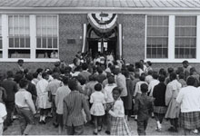
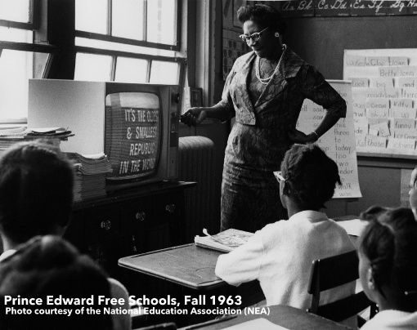
Notes:
Attorney General Robert Kennedy urged government officials to look at Prince Edward County. He joined state and private organizations to help the Prince Edward Free Schools. The funds were raised to rent three buildings and the Free School opened in 1963.

Slide 80
Attorney General Robert Kennedy urged government officials to look at Prince Edward County. He joined state and private organizations to help the Prince Edward Free Schools. The funds were raised to rent three buildings and the Free School opened in 1963.
Notes:
Attorney General Robert Kennedy urged government officials to look at Prince Edward County. He joined state and private organizations to help the Prince Edward Free Schools. The funds were raised to rent three buildings and the Free School opened in 1963.

Slide 81

1964
Notes:
In 1964, U.S. Supreme Court outlawed the Massive Resistance laws that were passed and ordered Prince Edward Public Schools to open integrated.

Slide 82
1964
In 1964, U.S. Supreme Court outlawed the Massive Resistance laws that were passed and ordered Prince Edward Public Schools to open integrated.
Notes:
In 1964, U.S. Supreme Court outlawed the Massive Resistance laws that were passed and ordered Prince Edward Public Schools to open integrated.

Slide 83
Sharing Our Expertise
Notes:
5 minute share (pairs, table groups, or whole group) – What are some other ways we could embed geography skills into VA Studies? Are there specific standards and/or resources that come to mind?

Slide 84

Civics

Slide 85
This Learning Experience will focus on the following skills (standard 1):
VS.1a – using information sources
VS.1i - exercise civic responsibility
VS.1j – demonstrate comprehension

Slide 86
Notes:
The Civics skills include civic responsibility and comprehension. This goes hand in hand with Historical Thinking so we are going to use a primary source analysis tool that is more often seen when analyzing historical images using another valuable tool, the Zoom-In. (Explain that this is a way of teaching students to examine the most minute details in an image.) Zoom-ins are a great way to introduce close reading images, as students become more practiced at doing this teachers should use the gradual release model to have students do this type of activity in small groups.
As teachers view the sections of the images, we are going to fill in the first column with specific observations.

Slide 87

Notes:
Presenter Note: Pass this out to teachers. As you close read the image together teachers should fill out their observations. They can hypothesize the meaning of what they see in the reflect column or you may discuss possible meanings together.

Slide 88

We are going to use a strategy called “Zoom-In” to help students analyze this primary source image. There are many variations of this technique. This is an enlargement of a piece of the image segment. You may choose to provide students with magnifying glasses (Oriental Trading Company sells them) or magnifying sheets (Dollar Stores carry these in their office supply sections). This often helps students notice important details not to be missed.
Notes:
We are going to use a strategy called “Zoom-In” to help students analyze this primary source image. There are many variations of this technique. This is an enlargement of a piece of the image segment. You may choose to provide students with magnifying glasses (Oriental Trading Company sells them) or magnifying sheets (Dollar Stores carry these in their office supply sections). This often helps students notice important details not to be missed.

Slide 89

What does the addition of the word “Virginia” signify? At this point it appears we have a Virginia nurse, what SOL could we be learning about?
Notes:
What does the addition of the word “Virginia” signify? At this point it appears we have a Virginia nurse, what SOL could we be learning about?

Slide 90

The top left shows Uncle Sam and an American flag. Ask participants to hypothesize about the inclined positioning of the people. When have they seen people like this? On bleachers/risers/stairs?
Notes:
The top left shows Uncle Sam and an American flag. Ask participants to hypothesize about the inclined positioning of the people. When have they seen people like this? On bleachers/risers/stairs?

Slide 91

We have added a sign. The next slide is a blow up of the sign.
Notes:
We have added a sign. The next slide is a blow up of the sign.

Slide 92

The sign states “$10,000 sold by the Richmond League”
Notes:
The sign states “$10,000 sold by the Richmond League”

Slide 93
Any guesses now? Where was this picture taken? When was this taken? Have participants discuss the importance of black and white photos and antiquated photography. What do they “know” about this type of photo? Probably that snapshots of instants of time were not common so this is probably a posed photograph.
Notes:
Any guesses now? Where was this picture taken? When was this taken? Have participants discuss the importance of black and white photos and antiquated photography. What do they “know” about this type of photo? Probably that snapshots of instants of time were not common so this is probably a posed photograph.

Slide 94
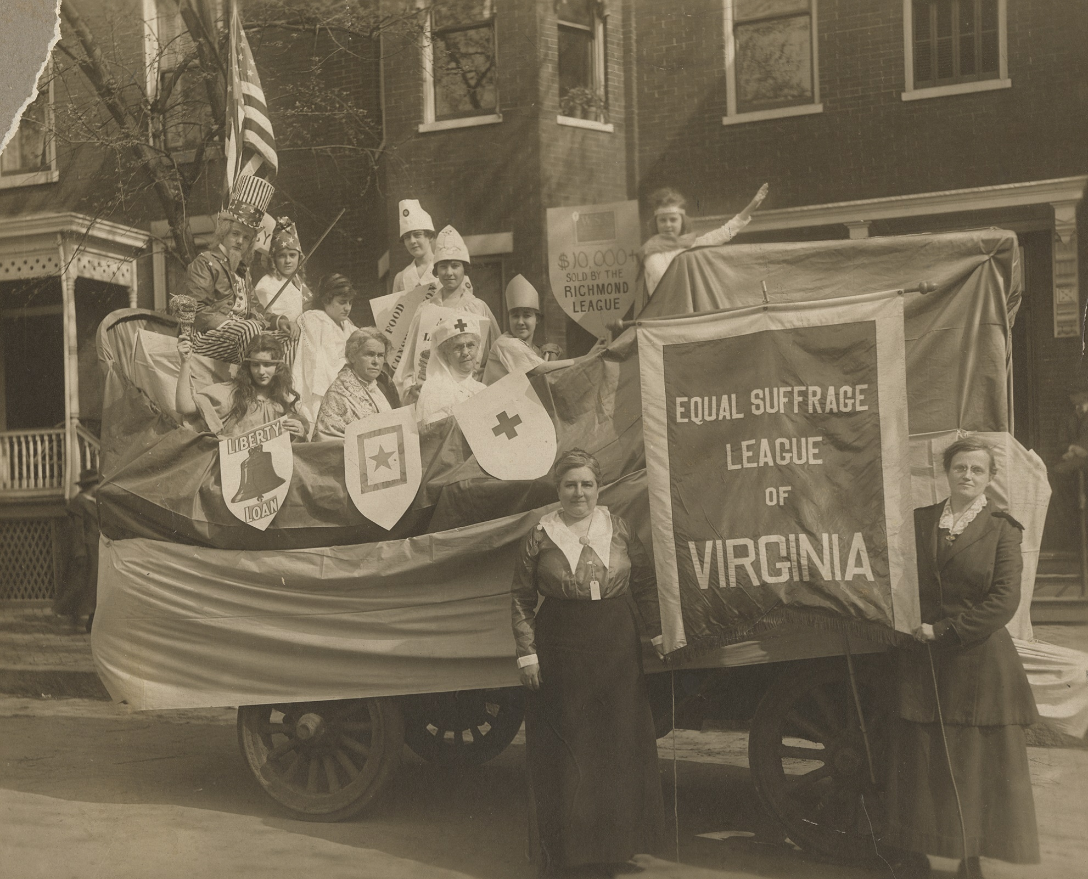
Notes:
Before sharing the bibliographical/background info, have teachers complete the second column.

Slide 95
Notes:
You can replace “reflect” with “infer” and predict the meaning of the picture.

Slide 96
Building Background Knowledge:
Equal Suffrage League of Virginia, Richmond, c. 1919
Equal Suffrage League of Richmond float in 1918 Liberty Bond Parade, Richmond Virginia.
Sepia-toned print shows costumed group of eleven people posing in a car that has been draped and decorated to make a parade float.
Ralph Harvie Wormeley (1904-1958), the only individual identified in the photograph, is dressed like Uncle Sam. A few women are dressed to represent liberty, the goddess Athena, the French Marianne figure and a Red Cross nurses. One sign reads "Liberty Loan."
Two women stand in front of the float and hold a large banner reading "Equal Suffrage League of Virginia" between them. Photograph is mounted to board bearing the "Foster / RICHMOND" imprint. 26.67 cm x 35.56 cm.
Notes:
This is the bibliographic information about this image, from the Virginia Historical Society. Teachers can find it using the title in blue. Ask teachers if they added anything to their Observations column before they move onto their Refection column.

Slide 97
Equal Suffrage League of Virginia, Richmond, c. 1919
There had been an effort to organize a suffrage club in Virginia, but it had failed. A second, more successful attempt was made in 1909, with the creation of the Equal Suffrage League of Virginia (ESL). Established in Richmond by Lila Meade Valentine, the club was initially small, but by 1916, its membership had grown to almost 16,000 individuals.
Notes:
Background information page 1

Slide 98
Equal Suffrage League of Virginia, Richmond, c. 1919
Despite its growth, the ESL failed to convince state representatives of the importance of female suffrage. The ESL also grappled with the issue of race—some members supported suffrage for all women, while others favored suffrage only for white women. Despite their trials, women across the nation celebrated the passage of the nineteenth amendment to the Constitution in 1920.
Notes:
Background Information page 2

Slide 99
Notes:
What questions did the bibliographical or background information bring to mind? How would this encourage your students to continue their study?

Slide 100
Sharing Our Expertise
Notes:
5 minute share (pairs, table groups, or whole group) – What are some other ways we could embed geography skills into VA Studies? Are there specific standards and/or resources that come to mind?

Slide 101

Economics
Notes:
As we look at the new changes to our VA Studies Curriculum it is important to remember that our focus moving forward is student experiences and growing skills, like decision making. Today we are highlighting VS1h-using Decision Making Models through examples that you can take back to use in your classroom with different units.

Slide 102
This Learning Experience will focus on the following skills (standard 1):
VS.1h
Use Decision Making Models to identify costs and benefits of a specific choice made.

Slide 103
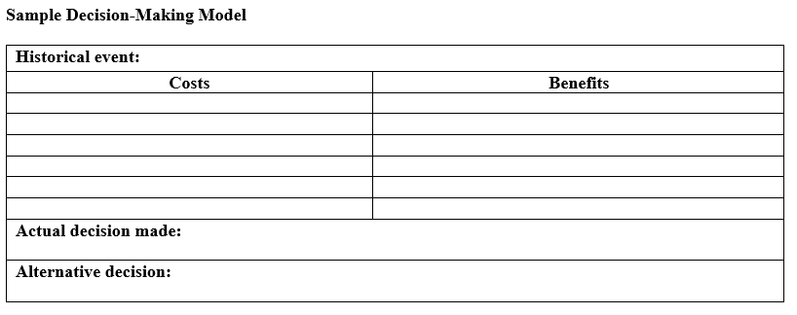
New VS.1h Skill: Decision Making Model
Essential Understandings:
Decision making models help inform economic decisions.
People use decision making models to identify costs & benefits of specific choices.
Effective decision making requires comparing the costs of alternatives with the benefits.
Notes:
Show the sample decision making model from the curriculum framework, then read the bulleted understandings from the framework.

Slide 104

New Skill (VS.1h):
Decision Making Model
Experiences may include but are not limited to the following:
Choose a historical event. Determine a concern or issue related to the event.
Use a decision making model to determine the costs and benefits.
Develop and explain an alternative decision by weighing the cost and benefits of the event.
Notes:
Bulleted experiences straight from the framework. Let teachers know we’ll explore this concept in these three ways:
For content where students should have sufficient background knowledge: generate a decision making model through whole group discussion
For content where students may have limited background knowledge: teacher provides information; students determine which of the given information is a cost and which is a benefit
As a culmination of their learning at the end of a unit, students create their own decision making model.

Slide 105

Cost/Benefit Analysis:
Joining NASA’s Moon Rock Mining Colony
Example 1: Students should have sufficient background knowledge to generate decision making model through whole group discussion.
1. Scenario: “NASA has just announced a new program. Anyone who is physically able can apply to live on the moon for 5 years to help mine valuable mineral resources from moon rocks. You must sign a labor contract and to work the entire time, but you can also earn a share of any profits made on the mission.” (For a more dramatic effect, present the scenario as is—wait until Slide 5 to reveal the connection to the Jamestown colony.)
2. Click to remove photo. Define the term cost. Lead a discussion where teachers generate a list of costs associated with joining the new moon colony, then click to reveal each point. (Conflict with native life forms is unlikely on the moon, but who knows what might happen when we start drilling down deep below the surface? Hee hee.)
3. Now define the term benefits. Allow teachers to generate some benefits, then click to reveal each point.
Notes:
Example 1: Students should have sufficient background knowledge to generate decision making model through whole group discussion.
1. Scenario: “NASA has just announced a new program. Anyone who is physically able can apply to live on the moon for 5 years to help mine valuable mineral resources from moon rocks. You must sign a labor contract and to work the entire time, but you can also earn a share of any profits made on the mission.” (For a more dramatic effect, present the scenario as is—wait until Slide 5 to reveal the connection to the Jamestown colony.)
2. Click to remove photo. Define the term cost. Lead a discussion where teachers generate a list of costs associated with joining the new moon colony, then click to reveal each point. (Conflict with native life forms is unlikely on the moon, but who knows what might happen when we start drilling down deep below the surface? Hee hee.)
3. Now define the term benefits. Allow teachers to generate some benefits, then click to reveal each point.

Slide 106
Cost/Benefit Analysis:
Joining NASA’s Moon Rock Mining Colony
Costs-
the effort, loss, or sacrifice necessary to obtain something
separation from family
lengthy journey
adapting to a new environment
will have to sign a labor contract
risk of illness, injuries, and even death
potential conflict with native life forms
Benefits-
what is gained when an action is taken or a choice is made
chance for a better life
possible wealth
new adventure
leadership opportunities
fame from being part of an important historic colony
Notes:
Example 1: Students should have sufficient background knowledge to generate decision making model through whole group discussion.
1. Scenario: “NASA has just announced a new program. Anyone who is physically able can apply to live on the moon for 5 years to help mine valuable mineral resources from moon rocks. You must sign a labor contract and to work the entire time, but you can also earn a share of any profits made on the mission.” (For a more dramatic effect, present the scenario as is—wait until Slide 5 to reveal the connection to the Jamestown colony.)
2. Click to remove photo. Define the term cost. Lead a discussion where teachers generate a list of costs associated with joining the new moon colony, then click to reveal each point. (Conflict with native life forms is unlikely on the moon, but who knows what might happen when we start drilling down deep below the surface? Hee hee.)
3. Now define the term benefits. Allow teachers to generate some benefits, then click to reveal each point.

Slide 107
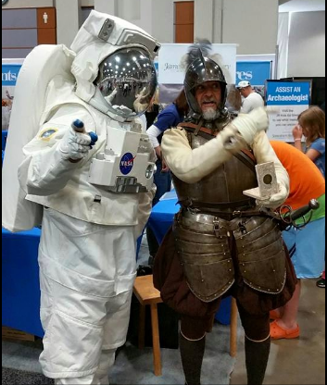
Cost/Benefit Analysis:
Joining NASA’s Moon Rock Mining Colony
Traveling from England to Jamestown to become a colonist
Costs-
the effort, loss, or sacrifice necessary to obtain something
separation from family
lengthy journey
adapting to a new environment
will have to sign a labor contract
risk of illness, injuries, and even death
potential conflict with native life forms
Benefits-
what is gained when an action is taken or a choice is made
chance for a better life
possible wealth
new adventure
leadership opportunities
fame from being part of an important historic colony
Actual Decision Made
Alternative Decision
Image credit Jamestown Rediscovery
Notes:
The list from the previous slide is consolidated and appears again for reference on this slide.
Given these costs and benefits, by a show of hands ask how many teachers would sign up to join NASA’s Moon Colony. Remind teachers that the decision making model is just a tool to help inform economic decisions, but because people value different things, the actual decision people make based on the same model will obviously vary.
Click to reveal alternative decision. Ask teachers if another option might be available. In this case, if the “costs” are too high, they might consider investing money to buy stock in the mining company NASA has contracted with instead of becoming a colonist.
Click to reveal the astronaut and Jamestown colonist photo. (Be silent for a moment to allow the audience to reflect on the connections between the explores for a fun dramatic effect.)
Click to reveal the new title for this cost benefit analysis. Give teachers a moment to notice how the same model fits both Jamestown and NASA. In their classroom, encourage teachers to generate their initial moon colony costs and benefits on chart paper and write them in general enough terms for them to also apply to Jamestown. Keep this chart on display throughout the Jamestown unit and refer back to it throughout the unit. It’s a great way for students to grasp the challenges the Jamestown colony would face.

Slide 108
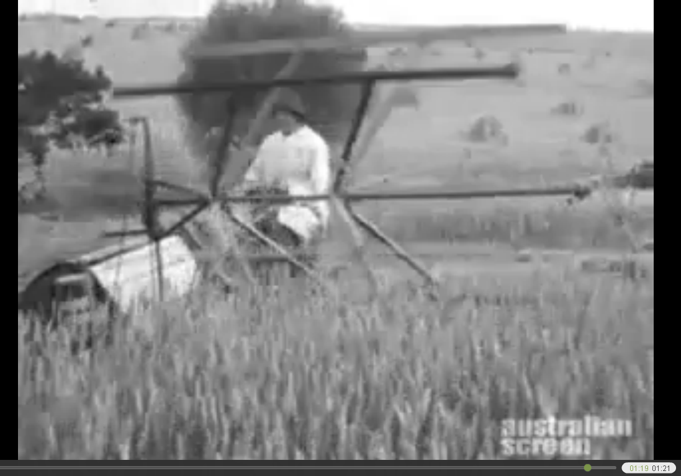
New VS.6c Content
The mechanical reaper allowed farmers to grow more wheat with fewer workers, which forced many Virginians to leave the state in search of jobs. –Curriculum Framework
Notes:
Example #2: Where students likely lack sufficient background knowledge, the teacher can supply the background knowledge. Students take the information given and identify which are costs and which are benefits.
Introduce the reaper with this primary source video. Click the picture to watch this SILENT 1 min 21 sec video. The 1st 50 seconds shows harvesting with a scythe and gathering and binding the wheat by hand; at 0:51 it shows McCormick’s reaper. (Note this video is from Australia in 1925, which shows just how far reaching McCormick’s invention really was!) Have students discuss the differences between the two methods of wheat harvesting.

Slide 109
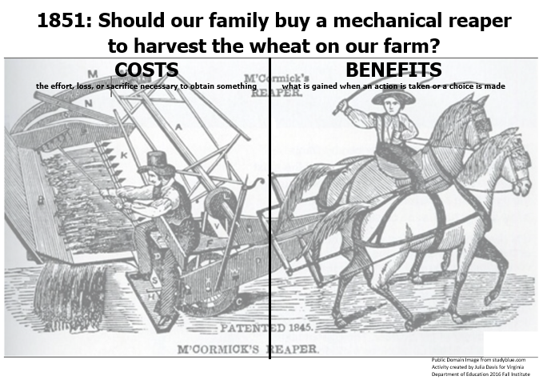
Notes:
This is a partner or small group activity.
This slide shows the sorting mat from page 1 of the Word Document “Mechanical Reaper Decision Making Model.” Each group will need 1 run on cardstock.
Also copy the sorting cards from page 2 on cardstock, precut them, and give each group a bag of the 10 statements. (Keep the sets you make to use in your own classroom!)
The costs and benefits have been supplied by the teacher for this activity since students will have limited background knowledge about the reaper. Student groups read each statement, determine if it’s a cost or benefit, and place it under the correct column. They’ll be 5 in each column. Groups that finish early can try to generate additional costs and benefits.
ANSWER KEY TO SORT IS ON NEXT SLIDE.

Slide 110
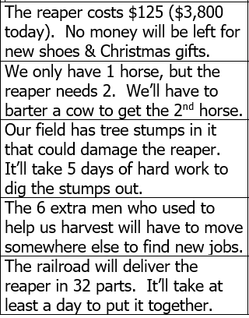
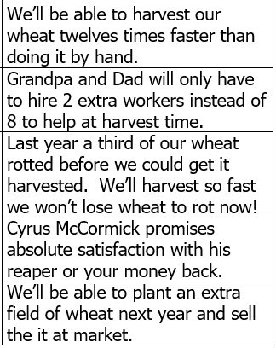

Notes:
Review the answers. Point out that an unintended consequence of the use of reapers was that is forced many Virginians to leave the state in search of jobs, which is the essential understanding in VS6c. Teachers can extend the concept by discussing other examples of “technological unemployment” (where machines replace people’s jobs)--such as the self-checkout lines in many stores.

Slide 111
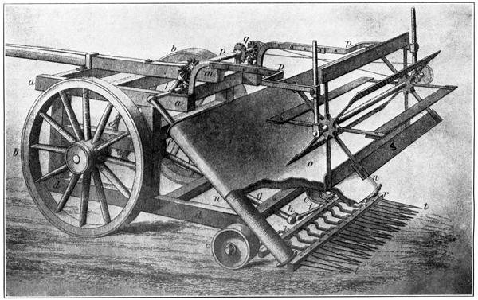
public domain image, studyblue.com
From VS1h Curriculum Framework
Notes:
Based on the costs and benefits, have participants determine whether this farm family should purchase a reaper or continue to harvest their wheat by hand. Note again that while a decision making model helps inform economic decisions, the actual decision made will vary based on what people value most.
Develop an alternative decision. For example, Cyrus McCormick actually allowed farmers to make term payments on his reaper. A $35 deposit plus the cost of the train freight was due with an order. The balance of the $125 could be paid after the next harvest. Instead of paying in full and foregoing new shoes & Christmas gifts, this family could decide to make term payments and go into debt.
Provide additional information about VS6c: Virginian Cyrus McCormick invented a mechanical reaper in 1831 and patented it in 1834. It allowed wheat to be harvested 12 times faster than by hand with a scythe. At first, he went bankrupt trying to sell his invention here in Virginia. He improved his prototype, moved to Chicago in 1849, and started a factory to mass produce them and ship them by railroad. By the 1860s, he had sold tens of thousands of them. The website www.virginiatrekkers.com includes an excellent video of a visit to the McCormick farm in Rockbridge County Virginia, an animation of how the reaper works, and some great links to additional information about this new content. Note that the effect of the cotton gin invention has also been added to VS6c as well.

Slide 112
Based on the costs and benefits, have participants determine whether this farm family should purchase a reaper or continue to harvest their wheat by hand. Note again that while a decision making model helps inform economic decisions, the actual decision made will vary based on what people value most.
Develop an alternative decision. For example, Cyrus McCormick actually allowed farmers to make term payments on his reaper. A $35 deposit plus the cost of the train freight was due with an order. The balance of the $125 could be paid after the next harvest. Instead of paying in full and foregoing new shoes & Christmas gifts, this family could decide to make term payments and go into debt.
Provide additional information about VS6c: Virginian Cyrus McCormick invented a mechanical reaper in 1831 and patented it in 1834. It allowed wheat to be harvested 12 times faster than by hand with a scythe. At first, he went bankrupt trying to sell his invention here in Virginia. He improved his prototype, moved to Chicago in 1849, and started a factory to mass produce them and ship them by railroad. By the 1860s, he had sold tens of thousands of them. The website www.virginiatrekkers.com includes an excellent video of a visit to the McCormick farm in Rockbridge County Virginia, an animation of how the reaper works, and some great links to additional information about this new content. Note that the effect of the cotton gin invention has also been added to VS6c as well.
From VS1h Curriculum Framework
Notes:
Based on the costs and benefits, have participants determine whether this farm family should purchase a reaper or continue to harvest their wheat by hand. Note again that while a decision making model helps inform economic decisions, the actual decision made will vary based on what people value most.
Develop an alternative decision. For example, Cyrus McCormick actually allowed farmers to make term payments on his reaper. A $35 deposit plus the cost of the train freight was due with an order. The balance of the $125 could be paid after the next harvest. Instead of paying in full and foregoing new shoes & Christmas gifts, this family could decide to make term payments and go into debt.
Provide additional information about VS6c: Virginian Cyrus McCormick invented a mechanical reaper in 1831 and patented it in 1834. It allowed wheat to be harvested 12 times faster than by hand with a scythe. At first, he went bankrupt trying to sell his invention here in Virginia. He improved his prototype, moved to Chicago in 1849, and started a factory to mass produce them and ship them by railroad. By the 1860s, he had sold tens of thousands of them. The website www.virginiatrekkers.com includes an excellent video of a visit to the McCormick farm in Rockbridge County Virginia, an animation of how the reaper works, and some great links to additional information about this new content. Note that the effect of the cotton gin invention has also been added to VS6c as well.

Slide 113

VS1.h Skill: Decision Making Model
Use a decision-making model to weigh the costs and benefits of the following:
  Buying stock in the Virginia Company
  Remaining loyal to the British or fighting for independence
  Living in a rural or an urban area
  Choose a specific geographic region of Virginia to settle with your family
Notes:
Example #3: As a culmination of their learning at the end of a unit, students create their own decision making model.
1. Divide participants up into small groups and provide each group some chart paper and markers.
2. Assign each group one of decisions from these framework suggestions to create a decision making model with. Note this decision making model only works with a question that can be answered as yes or no. For example, for a group assigned the last bullet, they’d have to choose a specific region and write it as a yes or no question: “Should our family move to the Valley and Ridge region?” (The PACED decision model, which we also explored at our Teacher Training, can be used to analyze multiple options, but is not included in the Framework and likely beyond many 4th graders so I chose not to include it for our presentation.)
3. Encourage groups to try to generate at least 3 costs and 3 benefits. Remind groups to include the actual decision made as well as an alternative decision at the bottom of their chart. (Go back one slide and display the chart from the framework while groups work to remind them of this.)
4. Each group will need to designate a person to share their chart with the whole group at the end. (Hang the completed charts up. During the teacher work session, teachers could copy down what other groups came up to help in their lesson planning.)

Slide 114

Give One Get One
Take a few minutes to think about other ways to incorporate economic decision making models in the economic units you teach.
Write 3 suggestions in the boxes on the left.
Move around the room and exchange ideas. Do this 3 times to get 3 ideas to take back to your school.
Notes:
On a piece of blank paper, have teachers fold it into 6-8 boxes. On one side they will write GIVE ONE and on the other side they will write GET ONE. Explain the directions – they will complete the “give one” side on their own and the “get one” side when they move around the room to exchange ideas.

Slide 115

For questions, comments, or concerns
please contact:
walkeram@pwcs.edu
Notes:
Add your contact information here!

Slide 116
On a piece of blank paper, have teachers fold it into 6-8 boxes. On one side they will write GIVE ONE and on the other side they will write GET ONE. Explain the directions – they will complete the “give one” side on their own and the “get one” side when they move around the room to exchange ideas.
Notes:
On a piece of blank paper, have teachers fold it into 6-8 boxes. On one side they will write GIVE ONE and on the other side they will write GET ONE. Explain the directions – they will complete the “give one” side on their own and the “get one” side when they move around the room to exchange ideas.

Slide 117
Reflections:
3 things you learned,
2 ways you can use this learning in your class, and
1 question you still have
Notes:
Teachers will personally reflect then turn and talk to pair-share
5-10 minutes

Slide 118
Questions?
Notes:
Respond to the parking lot questions that have been posted. (5-10 min)

Slide 119
Virginia Studies Presenters
Julia Davis | Hanover County | jadavis@hcps.us
Roberta Branch | Suffolk City | robertabranch@spsk12.net
Barbara Giese | Stafford County | gieseba@staffordschools.net
Anne Walker | Prince William County | walkeram@pwcs.edu
Lori Stone | Campbell County | lstone@campbell.k12.va.us
Diana Campbell | Henry County | dcampbell@henry.k12.va.us
Brandi McCracken | Washington County | bmccracken@wcs.k12.va.us
Betty Banks | Lunenburg County | betty.banks@k12lcps.org

Slide 120


Slide 121
and the
Virginia Department of Education
Christonya Brown, K-12, History and Social Science Coordinator
E-mail: Christonya.Brown@doe.virginia.gov
Betsy Barton, Elementary, History and Social Science Specialist
E-mail: Betsy.Barton@doe.virginia.gov
Jill Nogueras, English and History and Social Science Specialist
E-mail: Jill.Nogueras@doe.virginia.gov

