Slide 1
United States History:
1865 to the Present
History and Social Science
Fall Institute
2016
Notes:
1:00

Slide 2
Disclaimer
Reference within this presentation to any specific commercial or non-commercial product, process, or service by trade name, trademark, manufacturer or otherwise does not constitute or imply an endorsement, recommendation, or favoring by the Virginia Department of Education.

Slide 3
Questions to Ask During Planning
Essential Components in Planning an Effective Lesson
using the
2015 History and Social Science Standards of Learning
What do students need to know and understand by the end of this lesson?
What do students need to do during this lesson?
Which historical thinking skills are best suited for this standard?
What other content material should be added to provide historical context and richness to the lesson in order to maximize student understanding of the standard?
What student learning experiences would be most effective during this lesson?
How can I check for understanding effectively and accurately to measure the students’ content knowledge and historical thinking skills?

Slide 4

It starts with the . . .

Slide 5
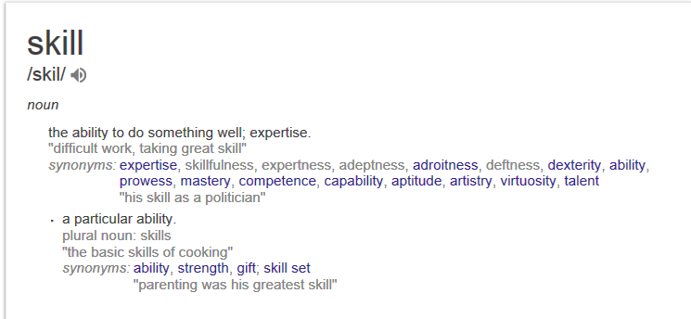

Slide 6
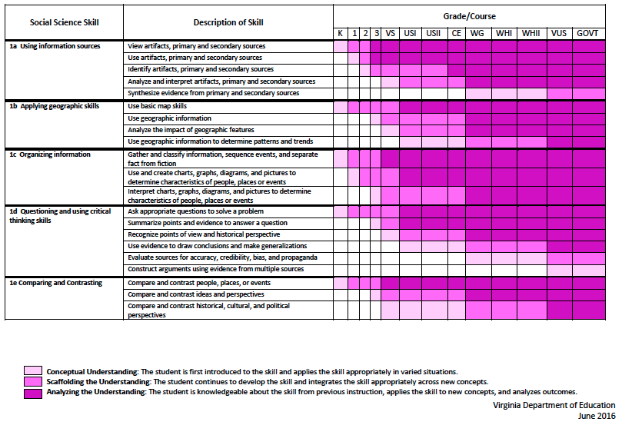
2015 SOL Skill Progression
Notes:
⇧

Slide 7
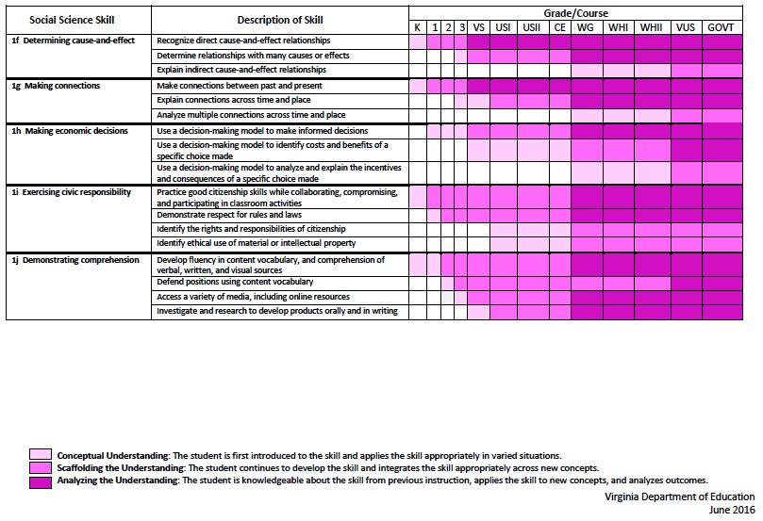
2015 SOL Skill Progression
2008 Standards:
Understand content
2015 Standards:
Understand content by applying the skill.
Skills are aligned with English Standards
Notes:
Discussion: Conceptual Understanding, Scaffolding the Understanding, Analyzing the Understanding
Arrow will rise up upon click after discussion to summarize difference between 2008 and 2015, then skills aligned with English SOLs. Great opportunity for common planning!
Purpose of today is to “teach” a lesson demonstrating skill based instruction, moving away from Lecture (Sit and Get)

Slide 8
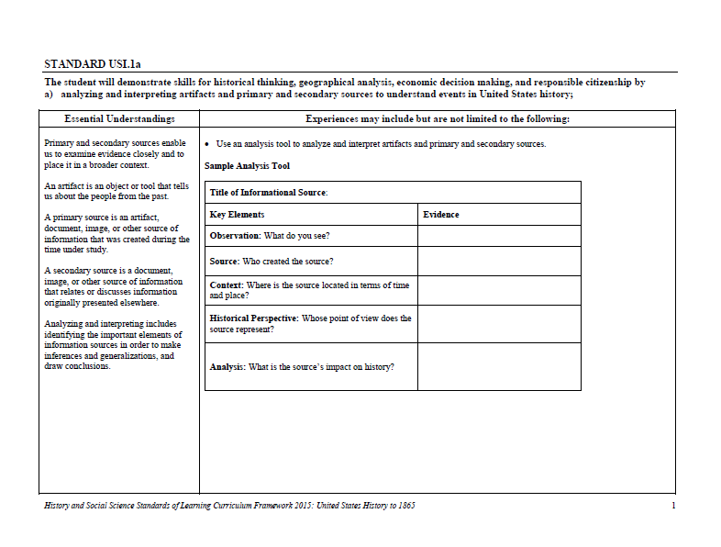
Experiences for Essential Skills
What are Experiences?
Notes:
Bring attention to the Experiences and describe what they are and how they can be used.
Provide teachers with “experiences” and give them an opportunity to:
discuss what they are and how they can be used; and
develop their own to share with the group.

Slide 9
The experiences should be –
engaging,
rigorous with higher level thinking questions,
relevant (connecting time periods, places, and events to the present day).

Slide 10
Experiences
Are . . .
Are NOT. . .
Engaging- promoting discussion, collaboration, and understanding
Opportunities to practice social science skills using various content
Varied throughout the lesson to help students make connections
Worksheets
Specific to one Standard, topic, or course

Slide 11
Today’s Learning Opportunities
Build an awareness of changes in the new Standards of Learning for History & Social Sciences
Become familiar with skills related to Standard 1
Explore strategies and learning experiences that will promote rigorous social studies instruction
Notes:
1:10 Nicole

Slide 12
Overview of Revisions
There is now an expectation that students move from “demonstrate knowledge” to “apply social science skills” to the content.
Notes:
Nicole & Aaron

Slide 13
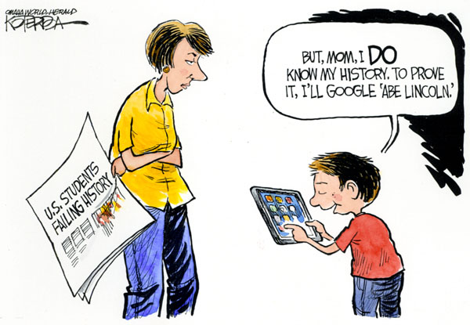

Slide 14
How do I move from
“demonstrate knowledge” to “apply social science skills” ?
Getting Students to Think Like a Historian
Geo-literate Students
Student learning experiences
Resources! Resources! Resources!

Slide 15
Finding the Thinking
In your table groups, read over the assigned standard. 1a, 1b, 1e, and 1h
Unpack the Standard
What is it really asking students to
accomplish?
Brainstorm examples of student learning experiences to help students apply those social science skills

Slide 16
Content Standards
USII.6 The student will apply social science skills to understand the social, economic, and technological changes of the early twentieth century by
  a) explaining how developments in factory and labor productivity, transportation (including the use of the automobile), communication, and rural electrification changed American life and standard of living;
  b) describing the social and economic changes that took place, including prohibition and the Great Migration north and west;
  d) analyzing the causes of the Great Depression, its impact on Americans, and the major features of Franklin D. Roosevelt’s New Deal.

Slide 17
Skill Standards
USII.1 The student will demonstrate skills for historical thinking, geographical analysis, economic
decision making, and responsible citizenship by
  a) analyzing and interpreting artifacts and primary and secondary sources to understand events in United States history;
  b) analyzing and interpreting geographic information to determine patterns and trends in United States history;
  d) using evidence to draw conclusions and make generalizations;
  e) comparing and contrasting historical, cultural, and political perspectives in United States history;
  f) determining relationships with multiple causes or effects in United States history;

Slide 18
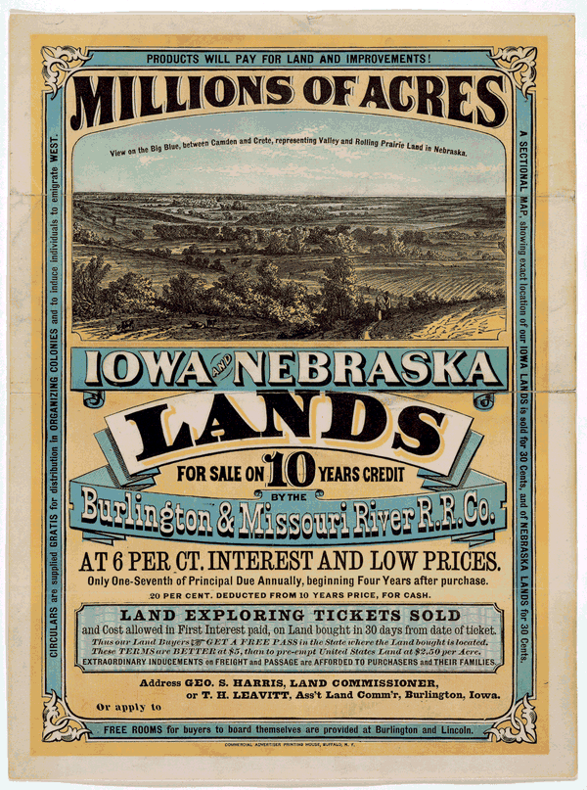
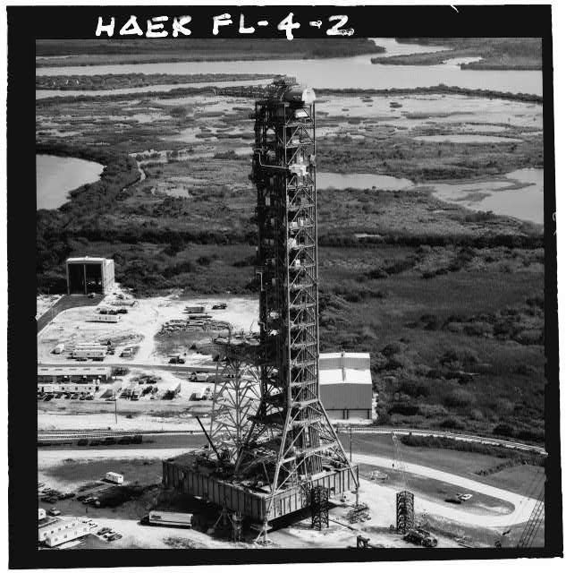
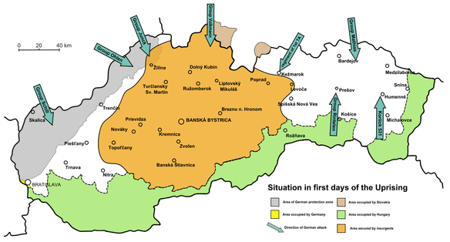
Interactive Classroom Strategies for Using Primary Sources
One interactive suggestion, when introducing Primary vs. Secondary sources is to show a picture, document, artifact, etc. and have the students stand if it is primary and remain seated if it is secondary.
Discuss answers to clarify any misunderstandings.
Examples:

Slide 19
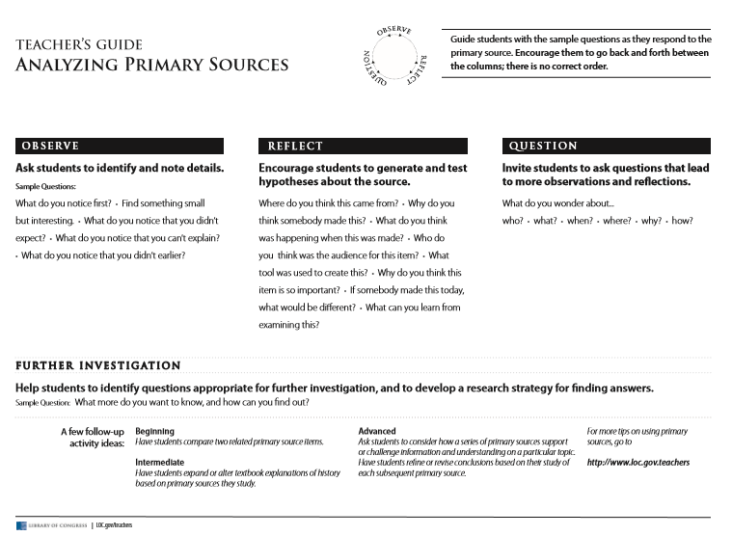
Notes:
Use this sheet as a Guide to walk participants through analyzing a picture. Give participants a copy of this to use in their classroom after completing the activity.

Slide 20
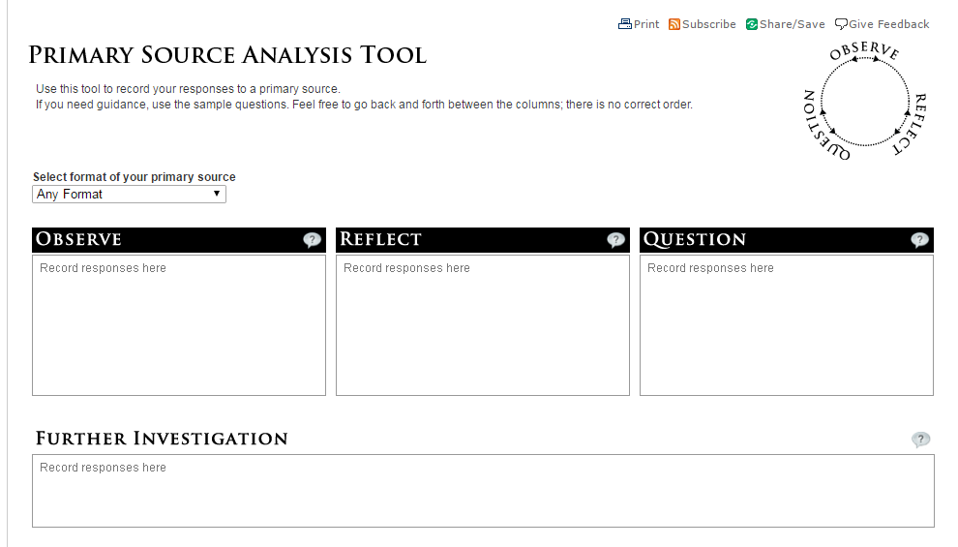
Analyzing Primary Sources
Notes:
Give as a handout and allow participants a few minutes to look at a picture and complete. Can work on any column in any order. Picture on next slide. Model. Scaffold. May work with partners or small groups.

Slide 21
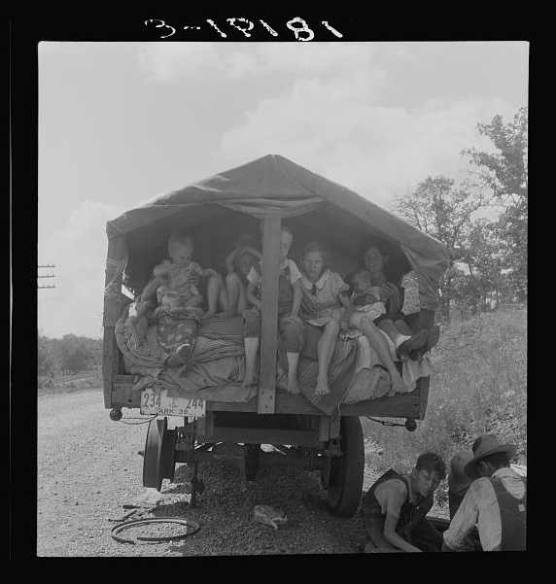
Complete the Analyzing Primary Sources
Notes:
Take about 3 minutes to analyze this photo using the LOC form.

Slide 22
Interactive Classroom Strategy to use with Primary Sources
Gallery Walk
How to use a gallery walk in your classroom.
https://www.facinghistory.org/resource-library/teaching-strategies/gallery-walk
Quick Demonstration:
You should each have 3 different colored post-it notes.
On one draw an eye (to record what you see that is of interest in a picture)
On another draw a ? (to record questions you have about a picture)
On the third draw a thought bubble (to record your thoughts about a picture).
On the Gallery Walk, record information on the appropriate sticky note (something you see of interest, questions raised by a picture, and your thoughts about another picture) and place your sticky notes next to the appropriate picture.
*Pictures to use for the gallery walk on the following slides.

Slide 23
Interactive Classroom Strategy to use with Primary Sources
Gallery Walk
Post pictures around the room and have have participants place 3 different post-it notes under pictures. At a quick glance the teacher can see patterns in questions, objects of interest, and thoughts that participants have.

Slide 24
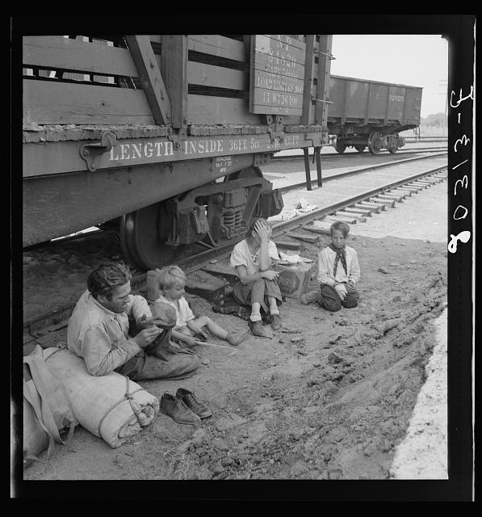
Notes:
Gallery Walk

Slide 25
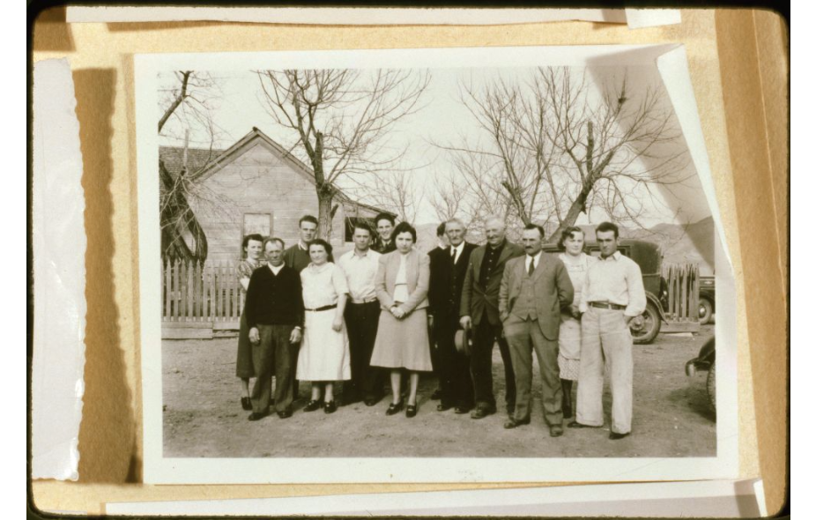
Notes:
Gallery Walk

Slide 26
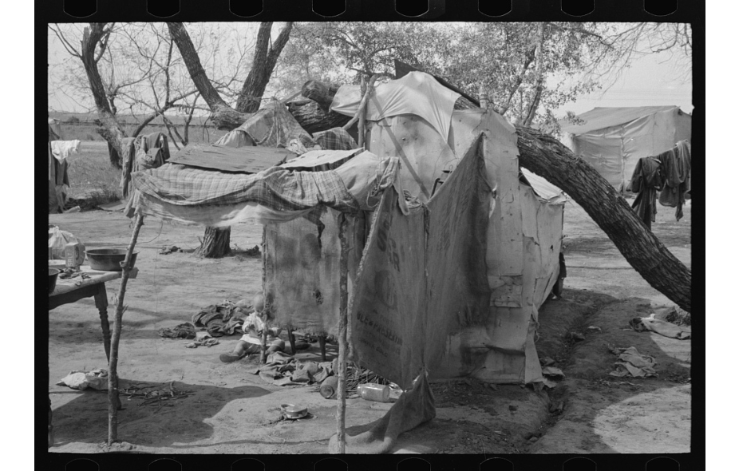
Notes:
Gallery Walk

Slide 27
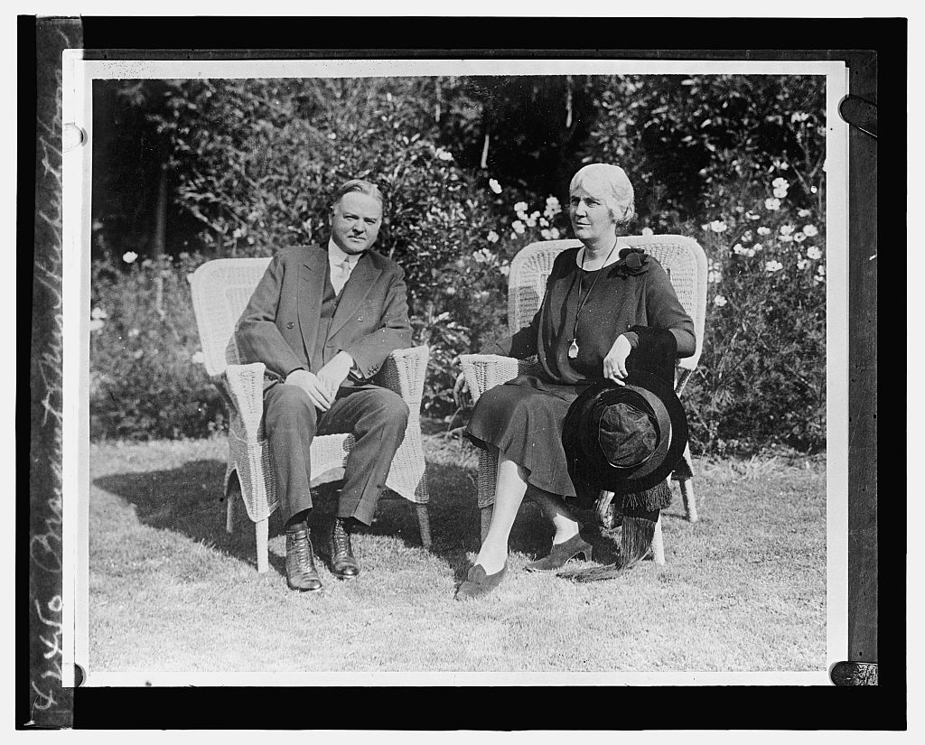
Notes:
Gallery Walk

Slide 28
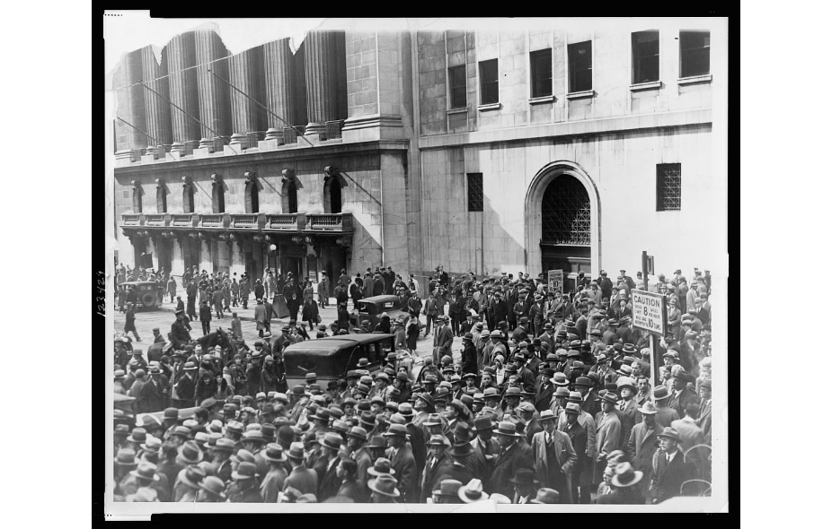
Notes:
Gallery Walk

Slide 29
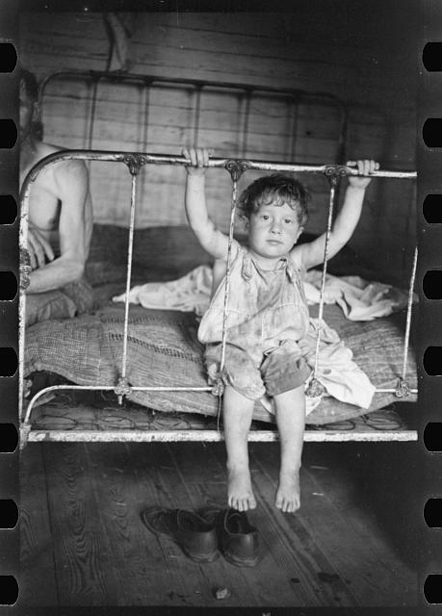
Notes:
Gallery Walk

Slide 30
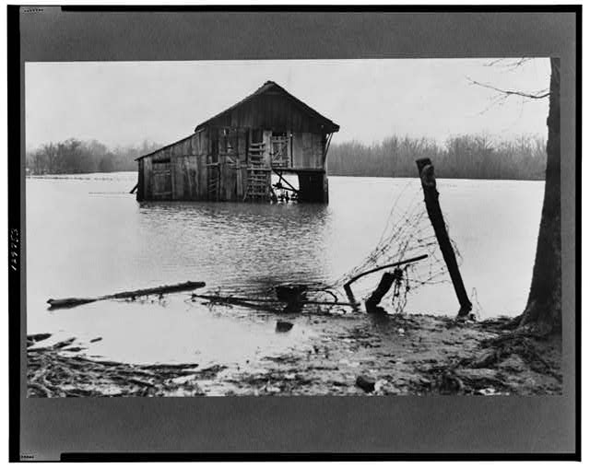
Notes:
Gallery Walk

Slide 31
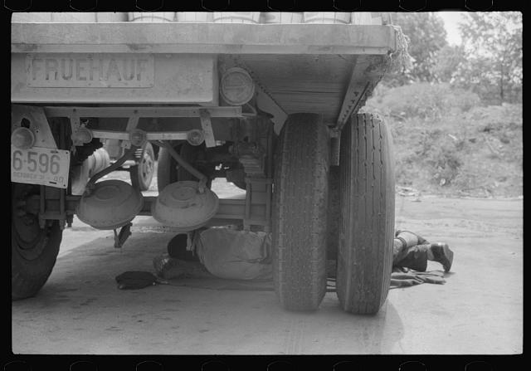
Notes:
Gallery Walk

Slide 32
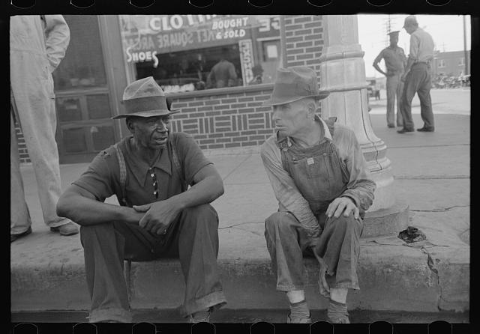
Notes:
Gallery Walk

Slide 33
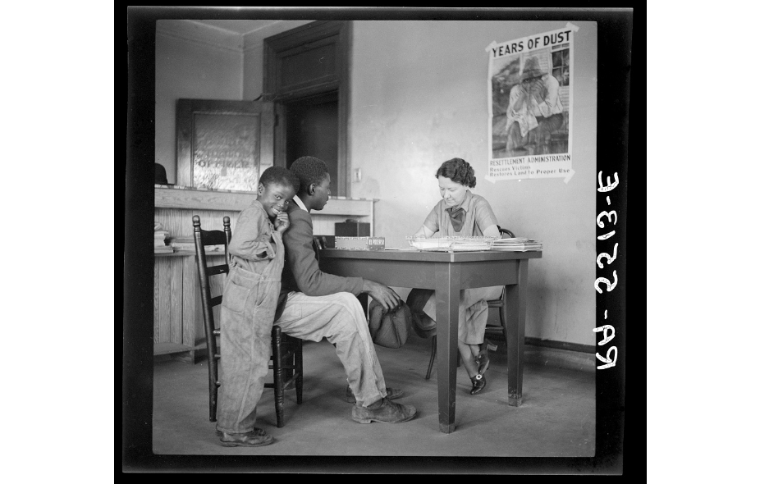
Notes:
Gallery Walk

Slide 35
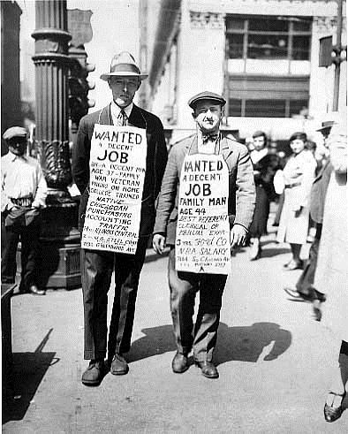

Slide 36
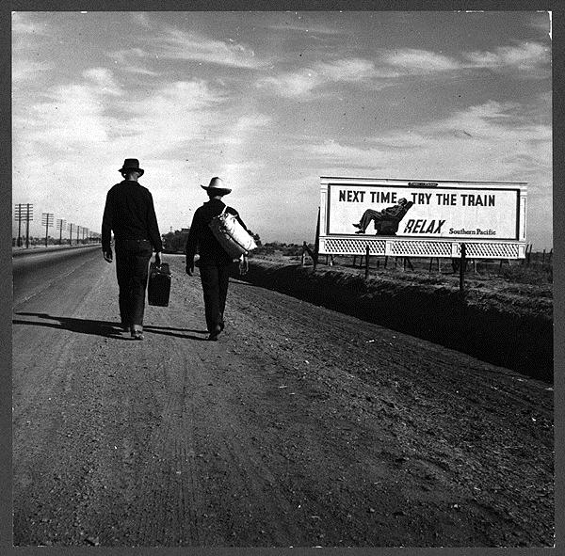

Slide 37
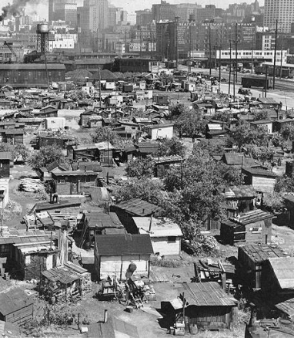

Slide 38
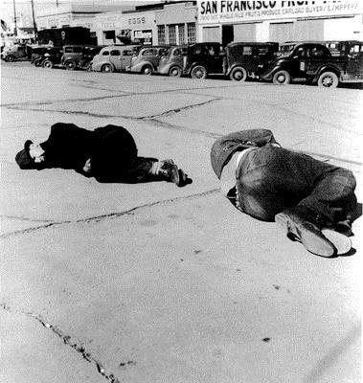

Slide 39
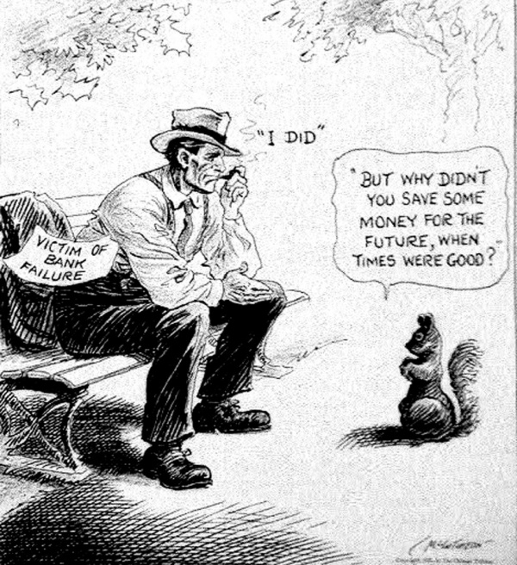
“A Wise Economist asks a Question” (1931) by John T McCutcheon
https://www.loc.gov/item/acd1996005778/PP/
Notes:
Aaron – https://www.loc.gov/item/acd1996005778/PP/

Slide 40
Debrief and Break
Talk with someone in your content area about how to determine which information sources are appropriate and which would be most effective to teach the content.
Notes:
3:00

Slide 41

2-Minute Challenge
Using a scrap piece of paper, draw a map of the United States.
No peeking
No using your laptop or SMARTphone.

Slide 42
2-Minute Share with a Partner!
Compare your map to a partner!
What similarities/differences do you see?
Would you change anything on your map based on your seeing your partner’s map?
Did you focus on political boundaries or physical features?
Discuss how you might use this activity or modify it with students.

Slide 43
Skill Standards
USII.1 The student will demonstrate skills for historical thinking, geographical analysis, economic
decision making, and responsible citizenship by
  a) analyzing and interpreting artifacts and primary and secondary sources to understand events in United States history;
  b) analyzing and interpreting geographic information to determine patterns and trends in United States history;
  using evidence to draw conclusions and make generalizations;
  g) explaining connections across time and place;

Slide 44
Geographical areas
What two geographic areas come to mind when you think about the Great Depression?
Notes:
2:30

Slide 45
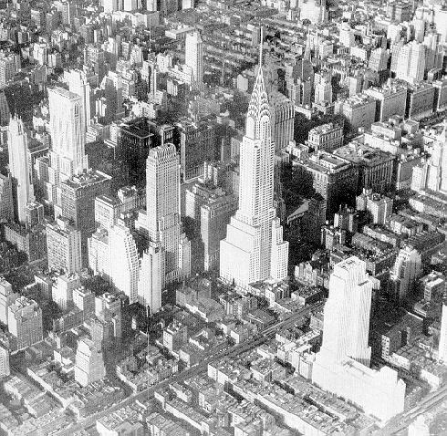
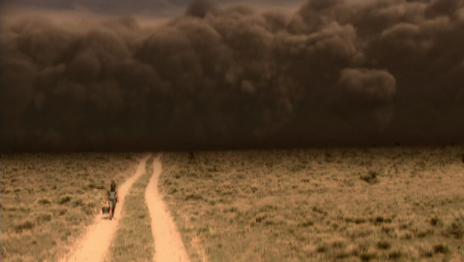
New York City and the Great Plains
New York image – bc.edu
Dustbowl image – history.com
Notes:
New York image – bc.edu
Dustbowl image – history.com

Slide 46
Lets Start with New York City

Slide 47
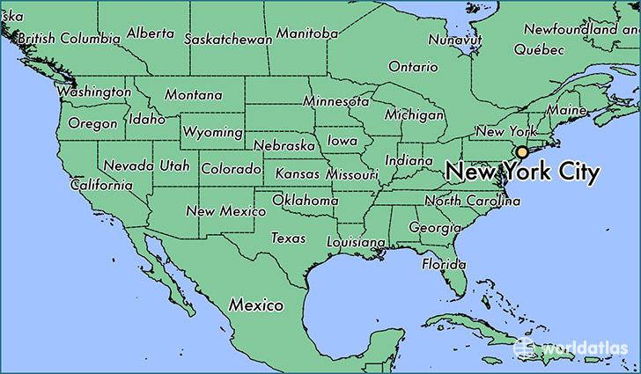
Location
Worldatlas.com
Notes:
Worldatlas.com

Slide 48
Location and the Great Depression
We know exactly where one of the major spots of the Great Depression was
We can see a relationship to where New York City is to the rest of the United States
How can this be connected with the impact on Americans during the Great Depression?

Slide 49
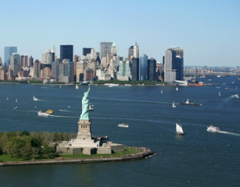
Place
Picture - http://www.essential-new-york-city-guide.com/visiting-the-statue-of-liberty.html
Notes:
Picture - http://www.essential-new-york-city-guide.com/visiting-the-statue-of-liberty.html

Slide 50
Place and the Great Depression
New York City situation along coast line – transportation and shipping hub
Statue of Liberty – entry point for immigrants searching for new beginnings
Large city that needed to be built higher
How can this be connected with the impact on Americans during the Great Depression?

Slide 51
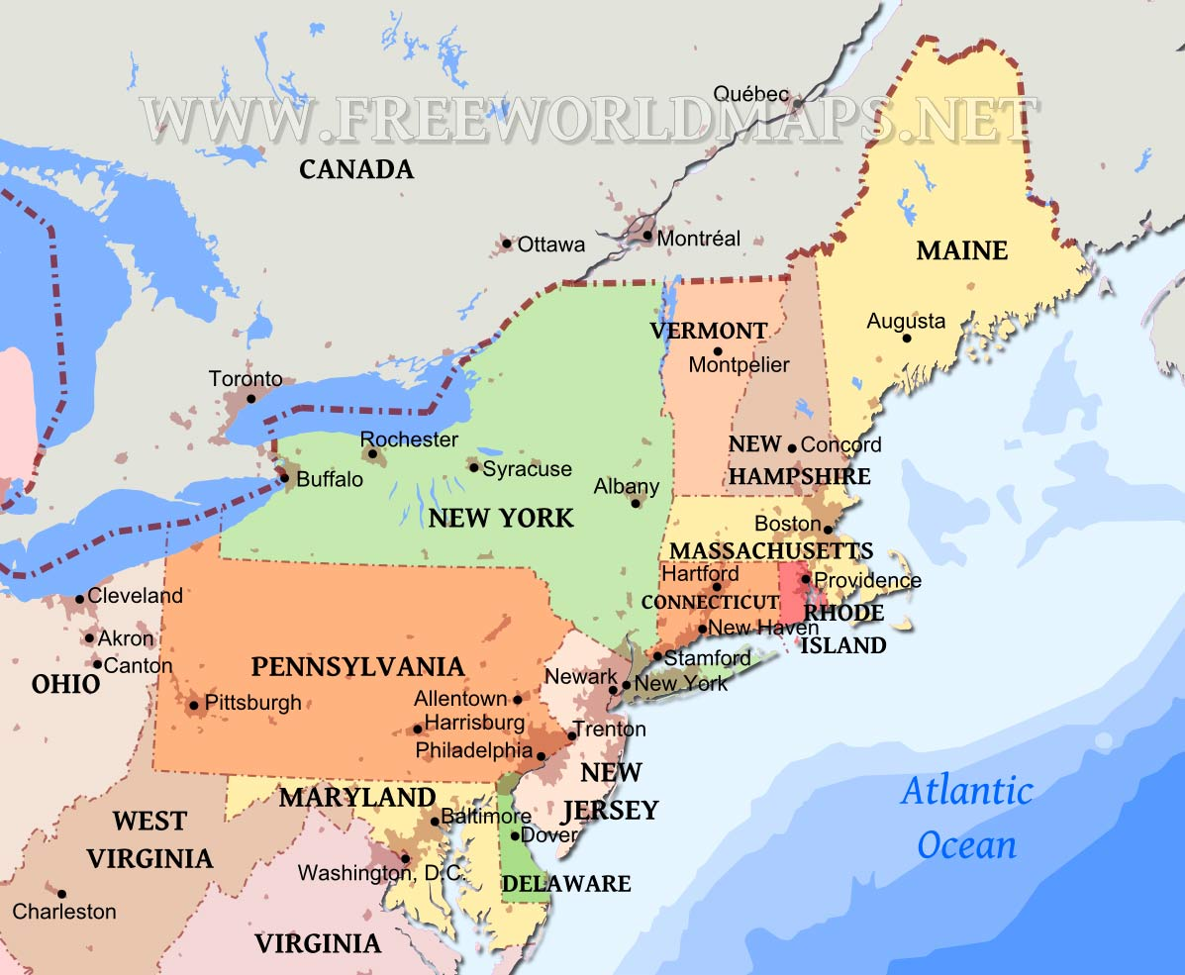
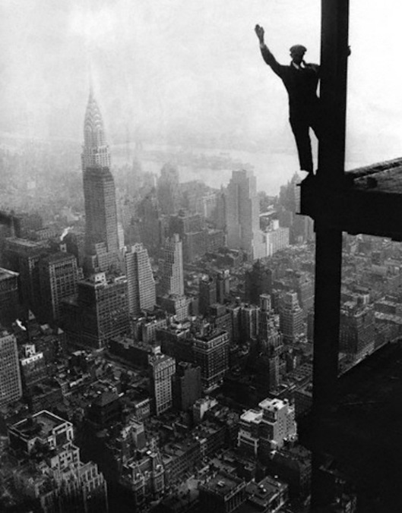
Region
Map – freeworldmaps.net
construction - http://www.dailymail.co.uk/news/article-2920453/Laughing-face-death-Incredible-pictures-construction-workers-fooling-built-America-s-iconic-buildings.html
Notes:
Map – freeworldmaps.net
construction - http://www.dailymail.co.uk/news/article-2920453/Laughing-face-death-Incredible-pictures-construction-workers-fooling-built-America-s-iconic-buildings.html

Slide 52
Region and the Great Depression
Northeast region – large cities
Manufacturing and industry
Mixed cultures and communities due to immigration
How can this be connected with the impact on Americans during the Great Depression?

Slide 53
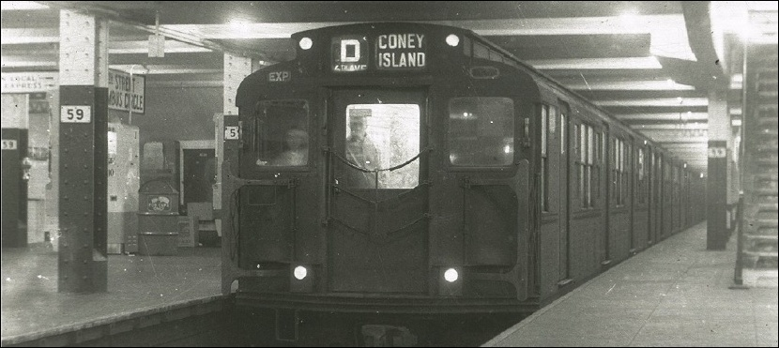
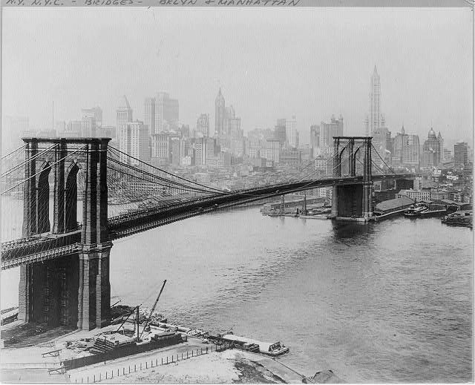
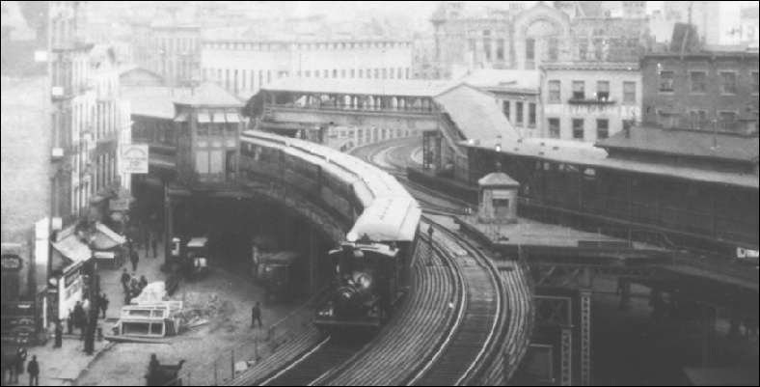
Movement
Subway – NYCsubway.org
Brooklyn Bridge - https://www.loc.gov/item/2006691795/
Notes:
Subway – NYCsubway.org
Brooklyn Bridge - https://www.loc.gov/item/2006691795/

Slide 54
Movement and the Great Depression
New York City a very connected and mobile city
Lots of flow in and out of city
How can this be connected with the impact on Americans during the Great Depression?

Slide 55
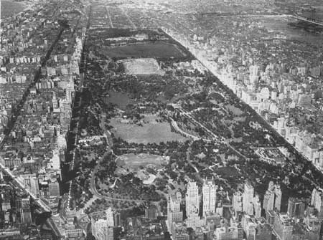
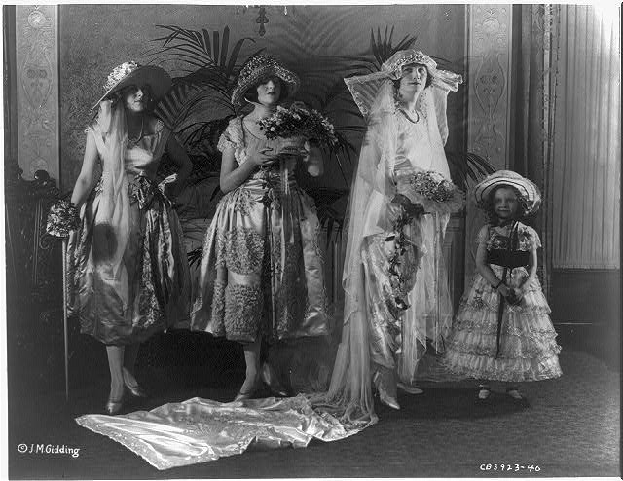

Human Environment Interaction
Central park – nps.org
Dresses - https://www.loc.gov/item/2012647944/
Wall street – google images
Notes:
Central park – nps.org
Dresses - https://www.loc.gov/item/2012647944/
Wall street – google images

Slide 56
Human Interaction and the Great Depression
City built upward while keeping outdoor space
High Culture and society
Wall Street = business and $$
How can this be connected with the impact on Americans during the Great Depression?

Slide 57
With a group of 3 or 4…
Use the pictures provided to fill out the geography interaction graphic organizer using the Great Plains as your location and the Great Depression as our connecting event

Slide 58
Geography Interaction
Theme | Picture | Relationship to Great Depression
Location
Place
Region
Movement
Human-Environment Interaction
Notes:
Teacher credit chart

Slide 59
Debrief and Break
Talk with someone in your content area about how you can infuse geographical skills into non-geography-centered units.
Notes:
3:00

Slide 60
Skill Standards
USII.1 The student will demonstrate skills for historical thinking, geographical analysis, economic
decision making, and responsible citizenship by
  a) analyzing and interpreting artifacts and primary and secondary sources to understand events in United States history;
  b) analyzing and interpreting geographic information to determine patterns and trends in United States history;
  using evidence to draw conclusions and make generalizations;
  f) determining relationships with multiple causes or effects in United States history;
  g) explaining connections across time and place;

Slide 61
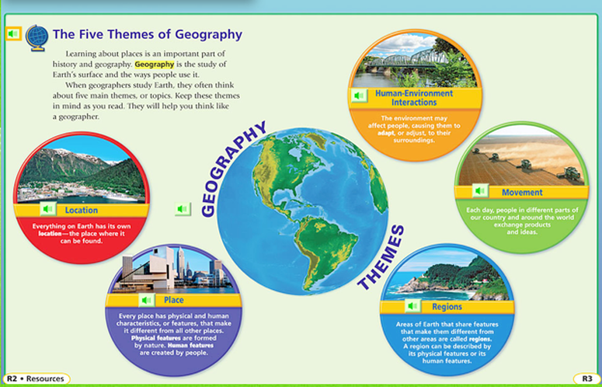
5 Themes of Geography

Slide 62
Working with the 5 Themes of Geography
Your task is to identify photos that represent each of the five themes of geography.
  Movement
  Regions
  Human-Environment Interaction
  Location
  Place
Study the set of photos in your packet.
With your partner or team, discuss which geographic theme each photo represents. (Some pictures may represent more than one theme, decide which one you believe it represents best.)
Group photos into the 5 themes.
Be ready to share your choices with the class.
Notes:
From VGA Virginia Studies.

Slide 63
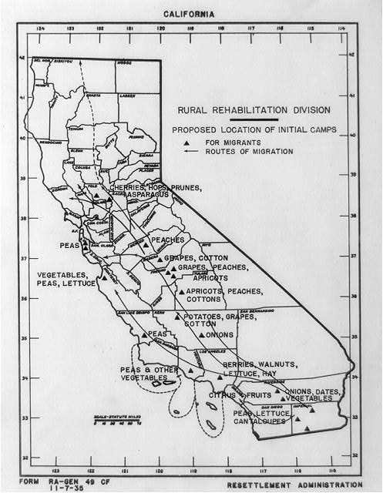
Notes:
Place

Slide 64
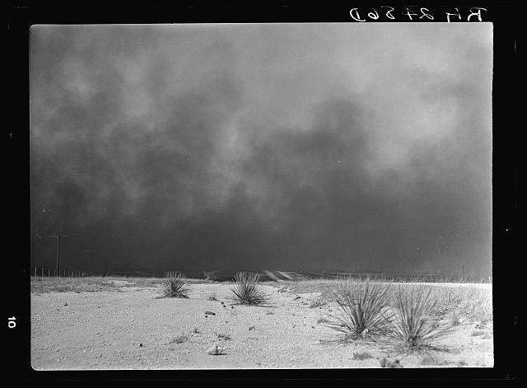
Notes:
Region

Slide 65
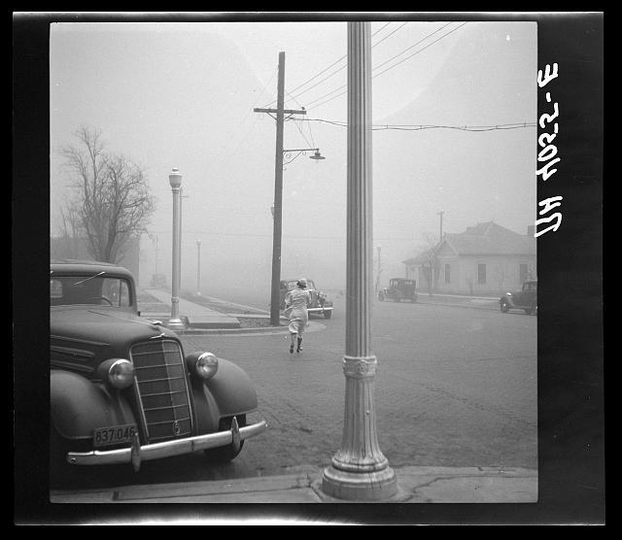
Notes:
Place

Slide 66
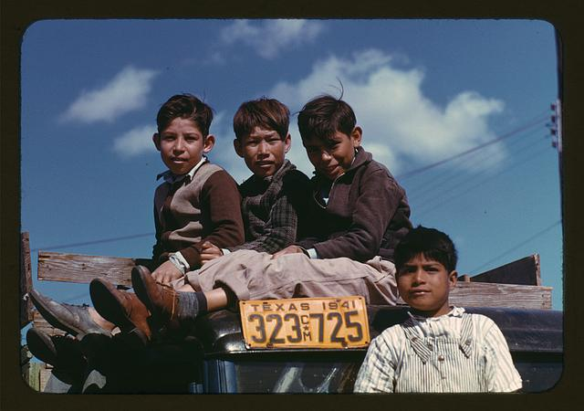
Notes:
Movement

Slide 67
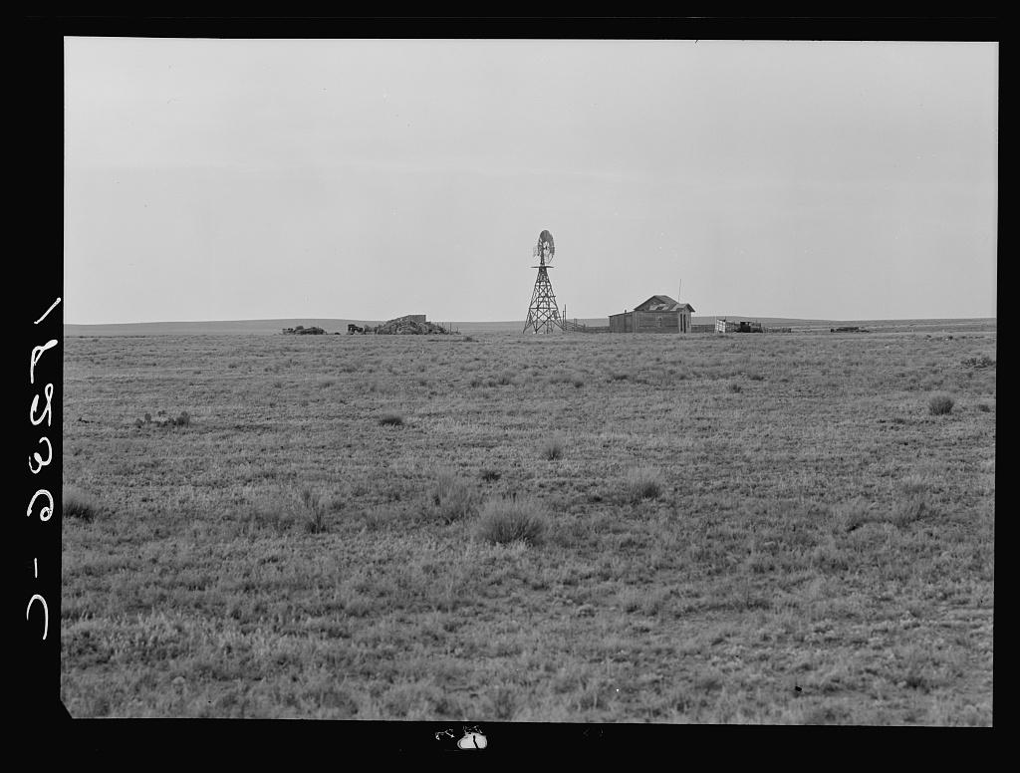
Notes:
Region

Slide 68

Notes:
Human-Environment Interactions

Slide 69
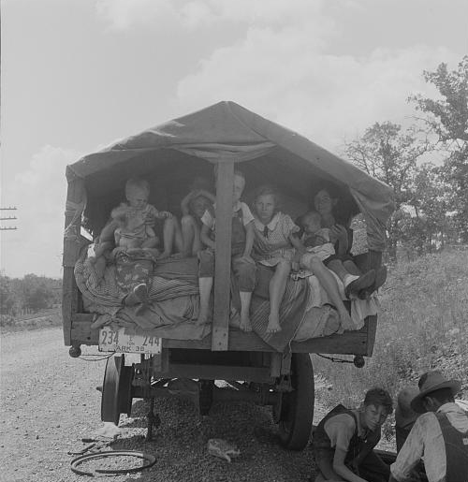
Notes:
Movement

Slide 70
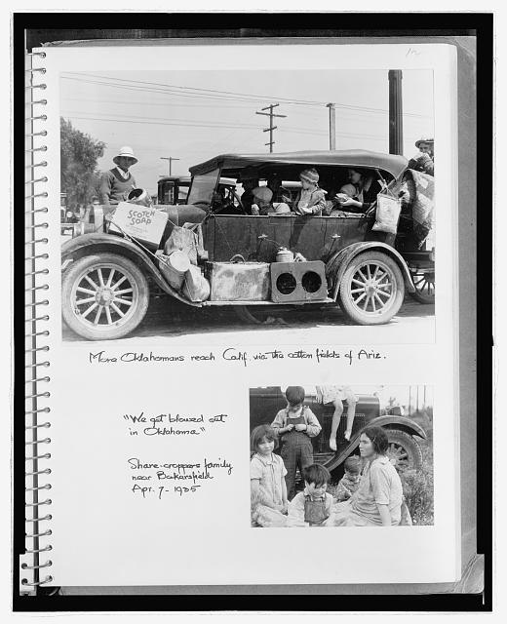
Notes:
Movement/Human-Environment Interactions

Slide 71
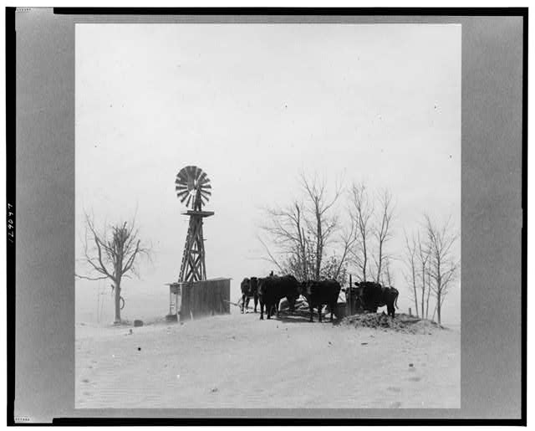
Notes:
Region

Slide 72
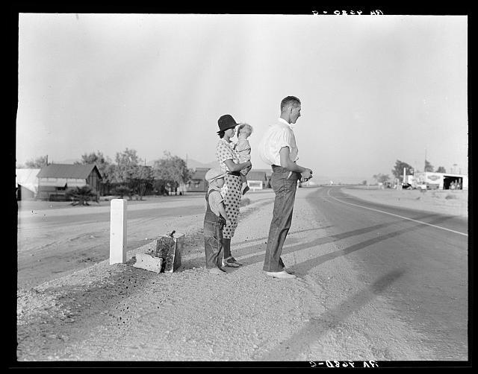
Notes:
Movement

Slide 73
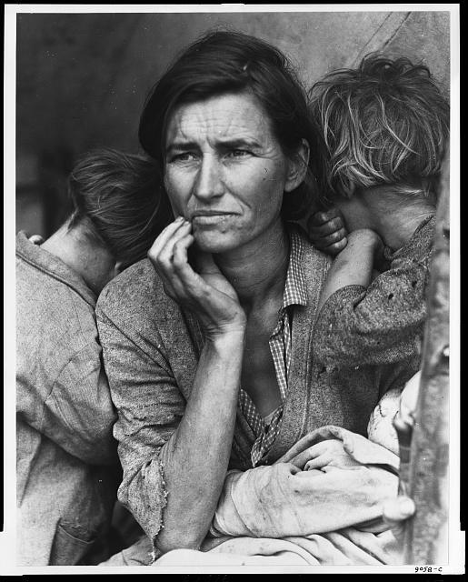
Notes:
Human-Environment Interactions

Slide 74
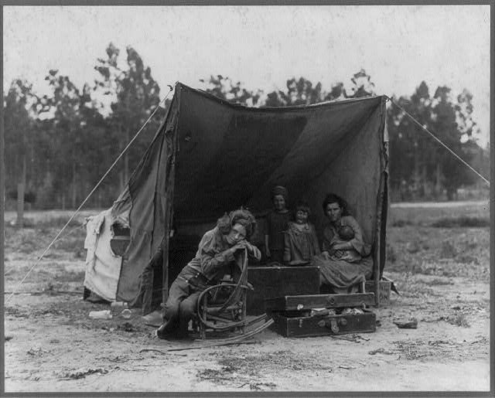
Notes:
Human-Environment Interactions

Slide 75
Debrief and Break
Talk with someone in your content area about how you can infuse geographical skills into non-geography-centered units.
Notes:
3:00

Slide 76
Skill Standards
USII.1 The student will demonstrate skills for historical thinking, geographical analysis, economic decision making, and responsible citizenship by
  a) analyzing and interpreting artifacts and primary and secondary sources to understand events in United States history;
  b) analyzing and interpreting geographic information to determine patterns and trends in United States history;
  using evidence to draw conclusions and make generalizations;

Slide 77
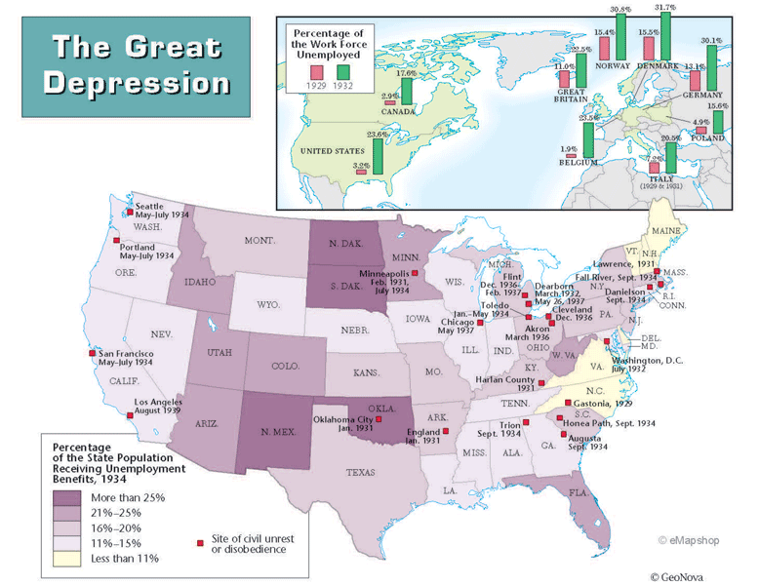

Analyzing Geography to Determine Patterns and Trends
Speculate on the reasons why certain areas had higher unemployment rates than others.
How did the unemployment figures from map one influence the population changes on map two?
Notes:
Give out copies of maps and have participants analyze and answer questions using critical thinking skills.

Slide 78
Notes:
Use the Shoulder Buddy strategy for quick discussion. Give a few minutes and take two volunteers to share.

Slide 79
Percent change in population 1930 to 1940
1940 US Census
Notes:
For this map two shoulder buddy groups join together and bring more into the discussion. Take a few volunteers to share answers. Then let 2x2 discuss activity and ideas for using and then have some groups share with the whole.

Slide 80

America on the Move
Primary Source Pictures, Clues, & Mapping
Notes:
Click on America on the Move. It is a hyperlink to lesson plans on how transportation affected America. Click on 1930 & 1940s for Great Depression sources. Concentrate on how transportation affected the US. Look at 6 primary source pictures. Give out a sheet of clues to provide further information. Map the movement. Lesson plans provided for 1880s-2000.

Slide 81


Layers of Inference

Slide 82
Investigate the Spanish-American War
Break students up into station groups
Each student gets a “police report” for each document
Students will rotate to each station and complete the questions on their police report
  Post reflection questions at the end for students to discuss and share out.

Slide 83


Your task:
Your task is to sort through all the evidence and decide who was responsible. As you read the accounts as well as look at the art, please remember that the people and artists have bias, which means that they were on one side or the other. Their perception of the event might change what they see or they may even be willing to lie about the incident.
Your job is to sort through all the evidence and try to determine the facts. The American people are extremely angry right now and we want to make sure we do a good job of truly studying the evidence. As you find important information, write it appropriately in your detective notebook.
Good luck... this might be the hardest case you will ever try to solve.

Slide 84
Do you support Cuban independence or Spanish control?
Have the students find all the evidence that they have complied over the past class periods for both Cuban independence and Spanish control.
Hand out the decision chart and documents that you want them to analyze
Students work individually or in groups to complete the PACED grid to figure out which side they would have supported.

Slide 85

PACED
Problem
Alternatives
Criteria
Evaluate
Decide
Criteria – What’s Important to me?
(Choices) | Criteria 1 | Criteria 2 | Criteria 3 | Criteria 4

Slide 86
Student Reflection
Explain which side your table decided to join? Was your table divided? Why?
What worked or didn’t work within your group?
In what other unit topics or ways would you find this useful in supporting students experiencing the content?

Slide 87

Mapping the Road to War!
Notes:
http://www.history-map.com/picture/000/American-Spanish-Map-War.htm

Slide 88
Mapping the Road to War!
Based on this map and what you already know about the issues between the Cubans and the Spanish:
Predict the outcome of the war.
  Who will win?
Why do you feel this way?
How did the map help make your decision?

Slide 89
To Declare or Not….
That is the Question!
Using the letter, written by the Spanish Ambassador to the United States, Enrique Dupuy de Lôme, who criticized American President William McKinley by calling him weak and publications of the explosion of the USS Maine, decide if declaring war is justifiable.
COSTS (things given up) | BENEFITS (positive things gained)

Slide 90


Letter from Spanish Ambassador to the United States, Enrique Dupuy de Lôme,
Transcript available at https://www.ourdocuments.gov/doc.php?doc=53&page=transcript

Slide 91
To Declare or Not….
That is the Question!
COSTS (things given up) | BENEFITS (positive things gained)
Actual Decision Made: _______________________________________
Alternative Decisions: ________________________________________

Slide 92
Skill Standards
USII.1 The student will demonstrate skills for historical thinking, geographical analysis, economic decision making, and responsible citizenship by
  using evidence to draw conclusions and make generalizations;
  explaining connections across time and place;
  use a decision-making model to identify the costs and benefits of a specific choice made.

Slide 93

Here is a scenario
It’s 1933. The United States is struggling through the Great Depression. People are losing homes, searching for jobs and in need of food and clothes. As a member of FDR’s cabinet you need to help him figure out how to get out of the Great Depression.
Picture – history.com
Notes:
Picture – history.com

Slide 94
You need to keep these things in mind
It has been four years since the Stock Market crashed, and US citizens need immediate help. Unemployment is 25% and banks and businesses continue to close each day. What decisions are going to help people out the most?
The United States does not want another Depression. We want to make sure that the economy is self-reliant and strong for the future. What decision will keep the United States strong and independent?
Economic decisions are hard. With so many people in need of help, a plan that will reach the masses is essential. What decision will be easiest to roll out and get to all people that needed assistance in the United States?

Slide 95
The Cabinet has come up with three options
Print more money - we know that in order to spend money people need money. Printing more money could instantly help people in need and those people could put that money right back into businesses.
Ask for foreign help - the United States has been a benevolent nation in the past (Spanish American War, WWI) and now needs help itself. Borrowing money from an overseas ally could give the financial jump start to right our economy.
Create more jobs - people need help and a job is an instant relief measure. By creating new jobs workers can find employment and begin to make more money to push back into the economy.

Slide 96
Your task…
Using the PACED model, determine what you think the best option for getting the United States out of the Great Depression will be.

Slide 97
Decision Making Model
Criteria
Alternatives

Slide 98
Skill Standards
USII.1 The student will demonstrate skills for historical thinking, geographical analysis, economic decision making, and responsible citizenship by
  a) analyzing and interpreting artifacts and primary and secondary sources to understand events in United States history;
  d) using evidence to draw conclusions and make generalizations;
  f) determining relationships with multiple causes or effects in United States history;

Slide 99
Flow Chart for the Causes & Effects of the Great Depression
Choose one of the following CAUSES of the Great Depression.
Provide students with information sources to review to determine effects.
Create a flowchart showing at least 4 effects your CAUSE had on America.
Provide a written description and visual in each box.
  CAUSES:
    People over-speculated on stocks.
    Using borrowed money that they could not repay when stock prices crashed.
    The Federal Reserves’ poor monetary policies contributed to the collapse of the banking system.
    High tariffs discouraged trade.
    Americans had too much debt from buying consumer goods on installment plans.

Slide 100


Cause & Effect
Effects
Stock Market Crashes
Businesses Close
People Lose Jobs
Families are Homeless & Hungry
Cause
People Overspeculated on Stocks

Slide 101
Flow Chart for the Causes & Effects of the Great Depression
Divide participants into groups.
Assign the above to each group.
Give groups 20 minutes to create their flowchart.
Share for 10 minutes.
Assign groups a time period to create an activity like this for that time period.
This website can help http://www.fallbrookhs.org/view/2054.pdf
There should be instruction provided to students that explains the effects of each of the causes.
The hyperlink ppt should be previewed was developed for high school students.

Slide 102
Skill Standards
USII.1 The student will demonstrate skills for historical thinking, geographical analysis, economic decision making, and responsible citizenship by
  h) use a decision-making model to identify the costs and benefits of a specific choice made.

Slide 103
Tools for Making Decisions
Cost-Benefit Decision Model
Cost-Benefit Decision Tree
PACED Decision Model

Slide 104

Learning to Use Economic Decision-Making Models to Become Informed Decision-makers
WHY is this skill important?
•Economic decision making helps students focus on making a choice BEFORE the choice is made
•Helps students be more thoughtful about all the possibilities and consequences before they make a choice
•Thinking rationally – making a choice because the benefits outweigh the costs—has life-long benefits.
•Considering past decisions using the same thought processes helps to understand why the choice was made, and to critically evaluate whether it was a good one.
All decision models can be used to:
consider choices made by others in the past
  viewed from their perspective at the time
  viewed in hindsight, from your perspective, what would you have done then—or now
consider choices and make a decision about what to do now—or in the future

Slide 105
Cost-Benefit Decision Model
Used when the choice is “yes” or “no” to do something.
For example, Should I buy this particular house?
Costs A cost is what you give up when you decide to do something | Benefits A benefit is what satisfies your wants
It will cost $250,000 The location isn’t as close to shopping and restaurants as I would like. The kitchen and bathrooms need to be modernized It doesn’t have a garage | $250,000 is less than many of the houses I have looked at I really like the floor plan I believe it is a good value that will appreciate There are good schools in the area

Slide 106
Cost-Benefit Decision Tree
Used to help you decide between two choices.
For example, Should I buy a house in the country or a house in the city? [Or, should I buy the house on Elm Avenue or the house on Mulberry Street?]
GOAL: Buy a house
Choice 1 – Buy a house in the country | Choice 2 – Buy a house in the city
Costs | Benefits
It is a long commute to work Most of my friends live in the city | I love the open land and have room for a garden I can get a nicer house for the same money
Costs | Benefits
Houses are generally more expensive in the neighborhoods I like. Taxes are higher. | It is closer to work I’m closer to shopping and restaurants.
Final Choice

Slide 107
Introduction to PACED
Decision-Making Model
PACED Decision Model. A more advanced model used when you have various options/alternatives but also certain things/criteria that are important to you that you are trying to fulfill.
PACED stands for:
    PROBLEM
    ALTERNATIVES
    CRITERIA
    EVALUATE
    DECISION

Slide 108


Slide 109
Good Reviews
Friends can go
Adventure
Time
Star Trek
Bourne
The Secret Life of Pets
Nerve
Notes:
Hand out blank PACED Model worksheet. Do movie example. Purpose is to show easy example. (Model/Scaffolding)

Slide 110
Ideas for Using the PACED
Model in USII
USII.4b,d,e Should I immigrate to the United States (Context: turn of the 20th century)?
  Benefits: Hope for better economic opportunities, religious freedom, escape from oppressive governments, the desire for adventure
  Costs: Overcrowded immigrant neighborhoods and tenements, unsafe working conditions, low wages, discrimination against immigrants, corrupt city governments
Historical decision: Millions of immigrants came to America in the late 1800’s and early 1900’s looking for a better life.
OR I’m immigrating to the America – which region (NE, Middle, or South) should I choose?
Possible criteria: Ability to find work; hospitable climate; religious tolerance; ability to participate in government

Slide 111
Ideas for Using the PACED
Model in USII
USII.6b Should the US pass a constitutional amendment to enforce Prohibition?
  Benefits: Prohibition would stop alcohol abuse which hurt many people, especially women who had few legal rights and were dependent on husbands who drank too much;
  Costs: People still drank liquor even though it was illegal; bootleggers made and smuggled alcohol illegally and promoted organized crime, loss of jobs and tax revenue
Historical decision: Prohibition was a failure. The amendment was repealed in 1933.

Slide 112
Resources for helping you Create or Locate Materials:
Library of Congress https://www.loc.gov
The Virginia Geographical Alliance php.radford.edu
The Virginia Council on Economic Education vcee.org
Federal Reserve of St. Louis https://www.stlouisfed.org/education
The Gilder Lehrman Institute of American History https://www.gilderlehrman.org
Standford History Education Group https://sheg.stanford.edu
Beyond the Bubble https://beyondthebubble.stanford.edu
Teachers.net http://teachers.net/lessonplans/subjects/history/
Facing History and Ourselves https://www.facinghistory.org
PBS Learning Media http://www.pbslearningmedia.org
National Council for Social Studies http://www.socialstudies.org
Virginia Department of Education http://www.doe.virginia.gov
Library of Virginia http://www.lva.virginia.gov
National Archives and Records Administration https://www.archives.gov
Notes:
Have groups work on different SOL’s so there is a good variety of information.

Slide 113

Writing to Learn
Not graded
Prior to lesson
  Assess student background knowledge
End of lesson
  Check understanding
  Make Connections
  Answer BIG QUESTION
  Free-write

Slide 114
Questions?
Notes:
Clipart

Slide 115


Slide 116
USII Presenters
Sara Kelley | Powhatan County | Sara.kelley@powhatan.k12.va.us
Wendy Burr | Chesapeake | Wendy.Burr@cpschools.com
Brenda James | Stafford County | jamesbs@staffordschools.net
Aaron Cebular | Prince William County | cebulaA@pwcs.edu
Michelle Holland | Campbell County | mholland@campbell.k12.va.us
Beth Simmons | Franklin County | beth.simmons@frco.k12.va.us
Debbie Manuel | Wythe County | dmanuel@wythek12.org
Laura Shaw | Prince William County | derenia@pwcs.edu

Slide 117
Virginia Department of Education
Christonya Brown, K-12, History and Social Science Coordinator
E-mail: Christonya.Brown@doe.virginia.gov
Betsy Barton, Elementary, History and Social Science Specialist
Email: Betsy.Barton@doe.virginia.gov
Jill Nogueras, English & History and Social Science Specialist
Email: Jill.Nogueras@doe.virginia.gov

