Slide 1
United States History to 1865
History and Social Science
Fall Institute
2016
Notes:
1:00

Slide 2
Disclaimer
Reference within this presentation to any specific commercial or non-commercial product, process, or service by trade name, trademark, manufacturer or otherwise does not constitute or imply an endorsement, recommendation, or favoring by the Virginia Department of Education.

Slide 3
Questions to Ask During Planning
Essential Components in Planning an Effective Lesson
using the
2015 History and Social Science Standards of Learning
What do students need to know and understand by the end of this lesson?
What do students need to do during this lesson?
Which historical thinking skills are best suited for this standard?
What other content material should be added to provide historical context and richness to the lesson in order to maximize student understanding of the standard?
What student learning experiences would be most effective during this lesson?
How can I check for understanding effectively and accurately to measure the students’ content knowledge and historical thinking skills?

Slide 4

It starts with the . . .

Slide 5
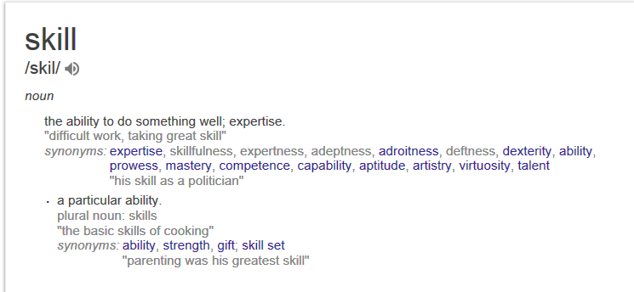

Slide 6
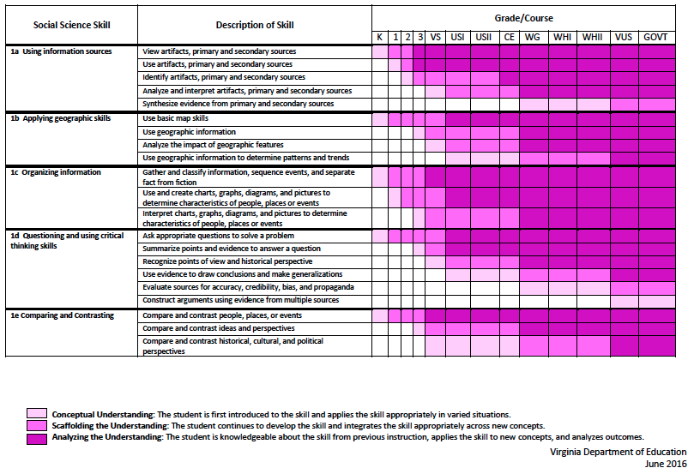
2015 SOL Skill Progression
Notes:
⇧

Slide 7
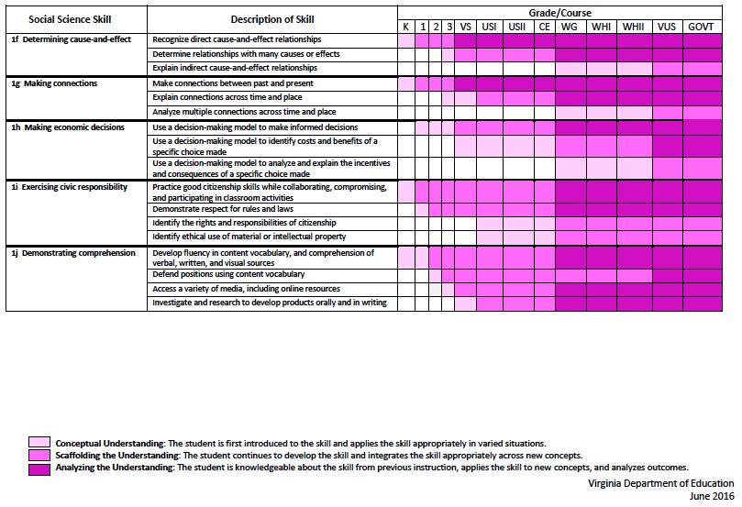
2015 SOL Skill Progression
2008 Standards:
Understand content
2015 Standards:
Understand content by applying the skill.
Skills are aligned with English Standards
Notes:
Discussion: Conceptual Understanding, Scaffolding the Understanding, Analyzing the Understanding
Arrow will rise up upon click after discussion to summarize difference between 2008 and 2015, then skills aligned with English SOLs. Great opportunity for common planning!
Purpose of today is to “teach” a lesson demonstrating skill based instruction, moving away from Lecture (Sit and Get)

Slide 8
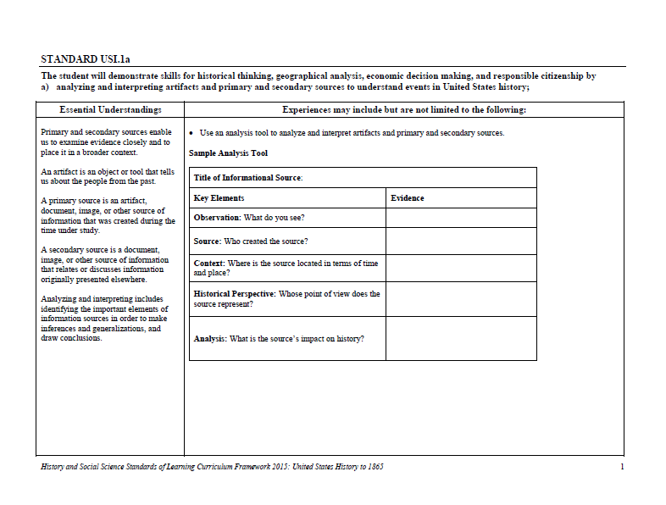
Experiences for Essential Skills
What are Experiences?
Notes:
Bring attention to the Experiences and describe what they are and how they can be used.
Provide teachers with “experiences” and give them an opportunity to:
discuss what they are and how they can be used; and
develop their own to share with the group.

Slide 9
The experiences should be –
engaging,
rigorous with higher level thinking questions,
relevant (connecting time periods, places, and events to the present day).

Slide 10
Experiences
Are . . .
Are NOT. . .
Engaging- promoting discussion, collaboration, and understanding
Opportunities to practice social science skills using various content
Varied throughout the lesson to help students make connections
Worksheets
Specific to one Standard, topic, or course

Slide 11
Today’s Learning Opportunities
Build an awareness of changes in the new Standards of Learning for History & Social Sciences
Become familiar with skills related to Standard 1
Explore strategies and learning experiences that will promote rigorous social studies instruction
Notes:
1:10 Nicole

Slide 12
Overview of Revisions
There is now an expectation that students move from “demonstrate knowledge” to “apply social science skills” to the content.
Notes:
Nicole & Aaron

Slide 13
What does this mean for our teaching?
Notes:
Aaron

Slide 14
Essential Skills
The following “learning experiences” will focus, at minimum, on the following skills:
1a – using information sources
1b- applying geographical skills
1h – using decision making models

Slide 15
1a – Using Information Sources
The student will demonstrate skills for historical thinking, geographical analysis, economic decision making, and responsible citizenship by…
  analyzing and interpreting artifacts and primary and secondary sources to understand events in US History.
Notes:
Nicole 1:15

Slide 16
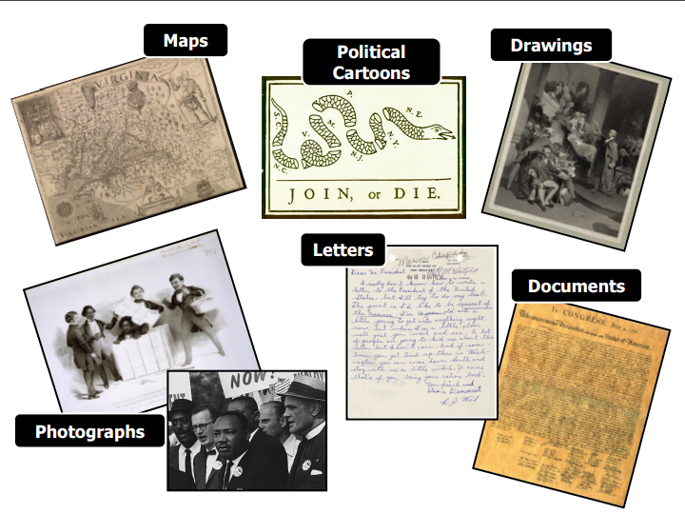
What are Primary Sources?
“The tools of historians”
Notes:
Slide images courtesty of Jennifer Brown, Fairfax County Public Schools

Slide 17
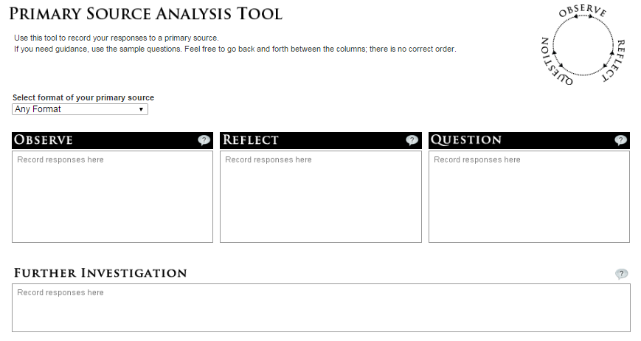
Introducing Primary Sources:
Library of Congress
Notes:
Hyperlinked
Image – Library of Congress

Slide 18

Visible Thinking
Image – Thinkingpz.org
Notes:
Image – Thinkingpz.org

Slide 19
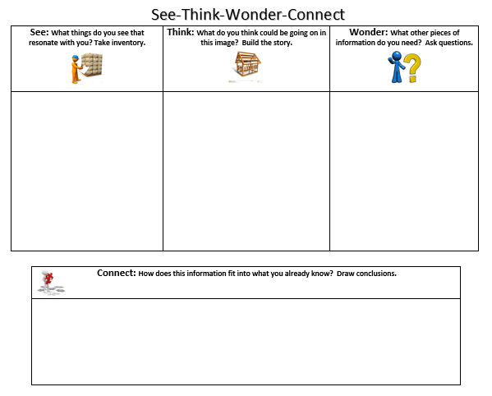
Notes:
Image courtesy of Nicole Bennett, Loudoun County Public Schools

Slide 20
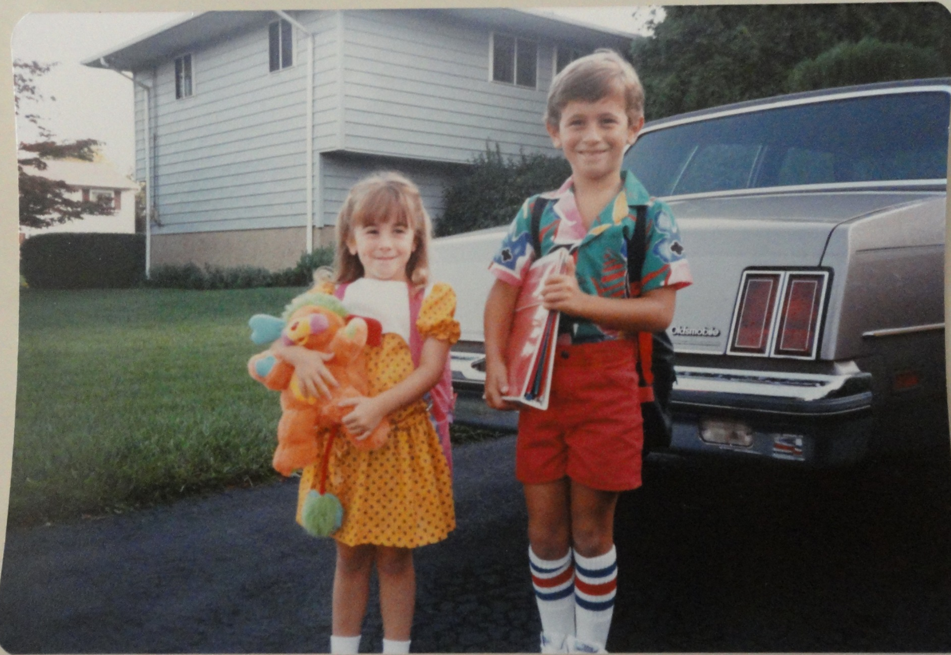
See-Think-Wonder OR Observe-Reflect-Question
Notes:
Image courtesy of Nicole Bennett, Loudoun County Public Schools

Slide 21
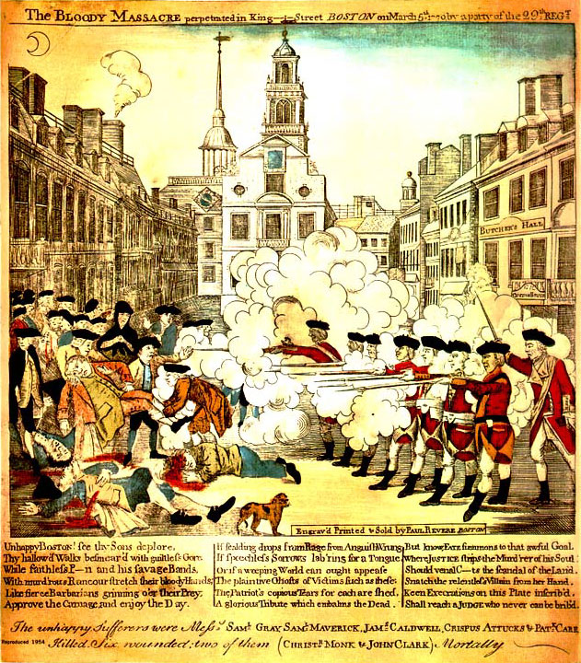
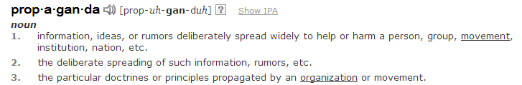
Paul Revere’s
Engraving:
News report or Propaganda?
Image – Boston Massacre Historical Society
http://www.bostonmassacre.net/gravure.htm
Notes:
Image – Boston Massacre Historical Society
http://www.bostonmassacre.net/gravure.htm

Slide 22
Take it up a notch…
Title of Informational Source:
Key Elements | Evidence
Observation: What do you see?
Source: Who created the source?
Context: Where is the source located in terms of time and place?
Historical Perspective: Whose point of view does the source represent?
Analysis: What is the source’s impact on history?
Notes:
Aaron 1:30 – Cebular personal doc

Slide 24
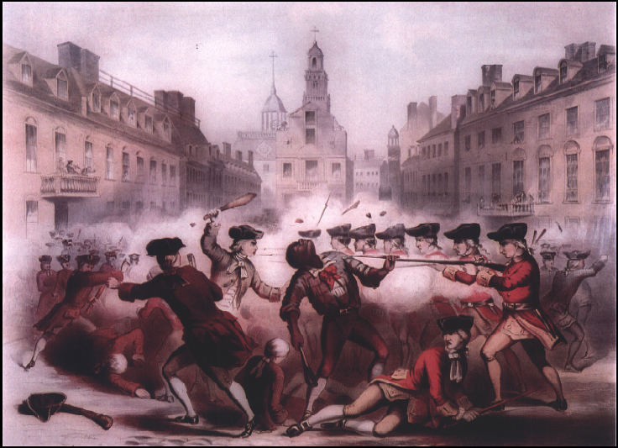
Image – TeachUSHistory.org
http://www.teachushistory.org/second-great-awakening-age-reform/resources/boston-massacre-champney
Notes:
Image – TeachUSHistory.org
http://www.teachushistory.org/second-great-awakening-age-reform/resources/boston-massacre-champney

Slide 25
Paul Revere’s Engraving
Engraving is a printing process in which an image is cut or carved into a wooden block or metal plate. Ink is then applied to the block or plate to create the image on paper; color is added only after printing.
Produced just three weeks after the Boston Massacre, this historic engraving was probably the most effective piece of war propaganda in American history.
Not an accurate depiction of the
actual event, it shows and orderly line
of British soldiers firing into an
American crowd and includes a poem
that Revere most likely wrote.

Slide 26
Bufford’s Chromolithograph (1856)
Lithography is printing technology, invented in Germany in 1798, based on the chemical repellence of oil and water.
Shows people firing into the crowds from the balconies. Colonists are also on both sides of the soldiers who, according to witness statements, should be formed into a semi-circle close to the Custom House stairs.
Crispus Attucks is front and center, showing him as a martyr/hero instead of a victim.
He created this work at the height of the Abolitionist movement in Boston and the U.S.

Slide 27
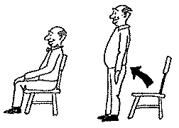
Take a Stand:
What do YOU think happened?
Directions:
  Stand up if you think Paul Revere’s account is more accurate.
  Stay seated if you think Bufford’s account is more accurate.
  Listen to me read the summary of the Boston Massacre. You may change your opinion at any time. Be prepared to justify why you decided to sit down or stand up when you did. We will count again at the end of the summary.
Notes:
Image - clipart

Slide 28
How can you apply this in your classroom?
USI group with Nicole
USII group with Aaron
Notes:
1:45

Slide 29
1b. Applying Geographical Skills
The student will demonstrate skills for historical thinking, geographical analysis, economic decision making, and responsible citizenship by…
analyzing and interpreting geographic information to determine patterns and trends in United States history
Notes:
2:00 Nicole

Slide 30
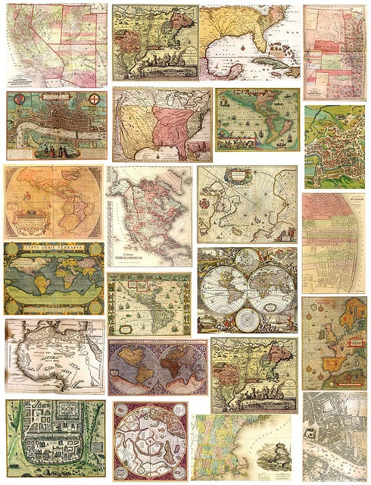
Why Maps?
Make connections
Observe and analyze
Promote inquiry
Draw conclusions
Show change over time
Gain perspective
Notes:
Image courtesy of Katie Blomquist, Fairfax County Public Schools

Slide 31
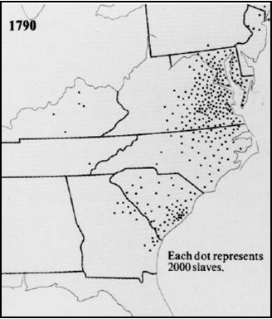
Compare and Contrast
http://www.vahistorical.org/sva2003/sov_southerners.pdf
Notes:
Katie 9:04-9:08
The Story of Virginia, Becoming Southerners, page 60.
:10http://www.vahistorical.org/sva2003/sov_southerners.pdf

Slide 32
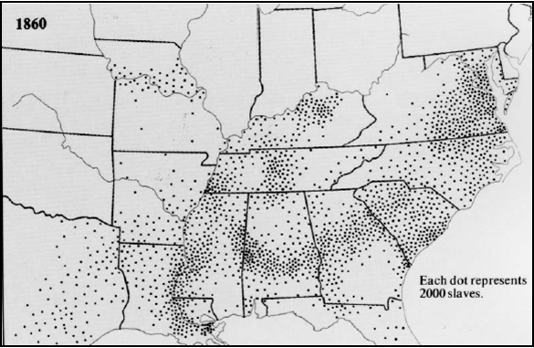
Compare and Contrast
http://www.vahistorical.org/sva2003/sov_southerners.pdf
Notes:
Katie 9:04-9:08
The Story of Virginia, Becoming Southerners, page 60.
http://www.vahistorical.org/sva2003/sov_southerners.pdf

Slide 33
Possible Questions to Ask Students
Brainstorm questions to ask students about the similarities and differences between the two maps.

Slide 34



Where Do I Find Awesome Maps?
http://www.virginiamemory.com/online_classroom/
http://www.encyclopediavirginia.org/
http://www.loc.gov/topics/maps.php
Notes:
Nicole 9:08-9:10

Slide 35

Introducing: Map Puzzles
Notes:
Image - Google images

Slide 36
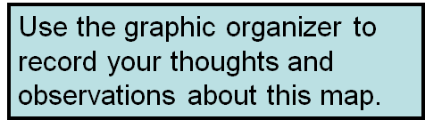

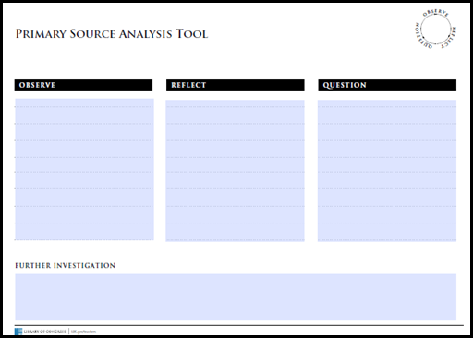
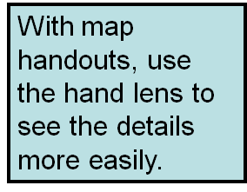
Historical Map Investigation
http://www.loc.gov/teachers/primary-source-analysis-tool/
Notes:
Nicole 9:10-9:13

Slide 37

Map Puzzles
Look at the LETTER on the back of your map.
Meet with others who have the same letter.
Record what you see (Observe), think (Reflect) and wonder (Question) on your Primary Source Analysis Tool.
Notes:
Image - clipart

Slide 38
Constructing the Complete Map
Look at the NUMBER on the back of your map.
Meet with others who have the same number.
Complete the puzzle.
Record new information on your graphic organizer.
Notes:
Katie 9:18-9:23
PASS OUT PEEPS

Slide 39
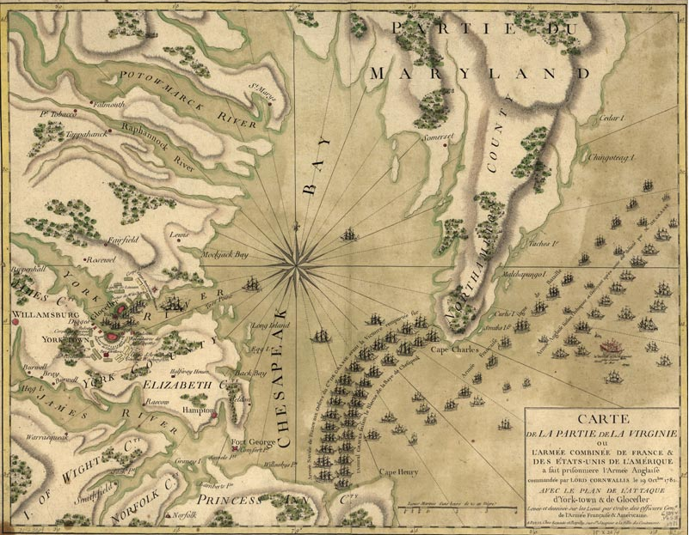
Image – Library of Congress
Notes:
Image – Library of Congress

Slide 40
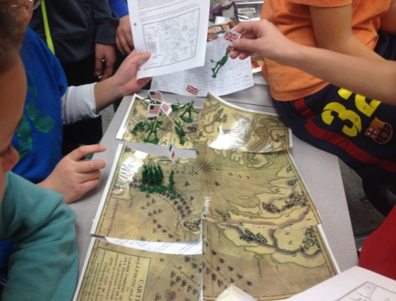
Next Level Fun…
Notes:
2:30

Slide 41
Another Geography Tool
5 Themes of Geography
  Location
  Place
  Region
  Movement
  Human-Environment Interaction
Notes:
Aaron

Slide 42


1h Make Economic Decisions
The student will demonstrate skills for historical thinking, geographical analysis, economic decision making, and responsible citizenship by…
Using a decision-making model to identify costs and benefits of a specific choice made
Notes:
Images - clipart

Slide 43


Decision Making Models
Structures and thought processes people use to make both every day choices and life-changing decisions
Notes:
Images – clipart

Slide 44
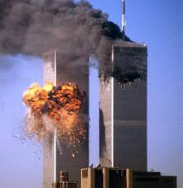
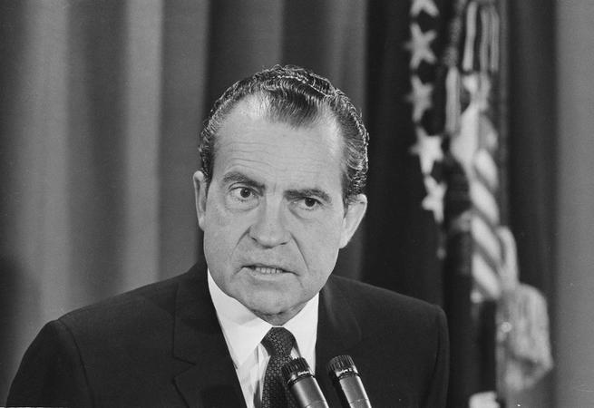
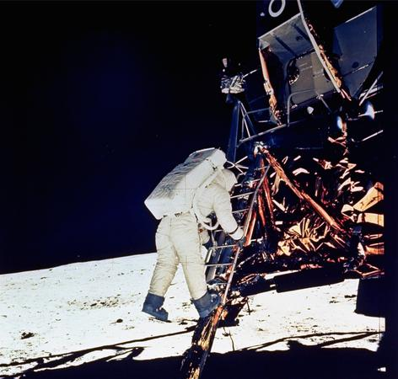
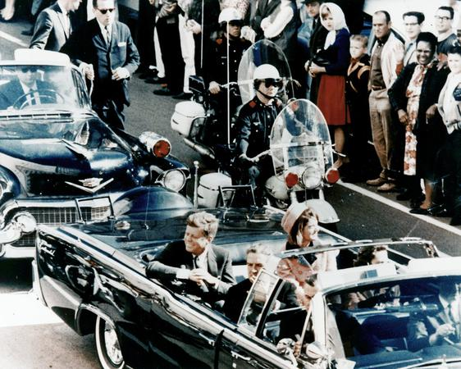
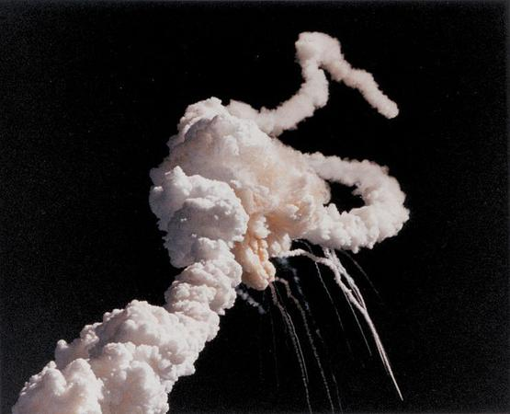
Student Activity: A Moment in History
What is a moment in history in YOUR life that you will never forget?
Notes:
Google images

Slide 45
What were the defining moments for some revolutionaries?
Deciding whether or not to…
  assist Thomas Jefferson with the drafting of the Declaration of Independence
  Become one of King George’s colonial governors
  serve next to Deborah Sampson in the Continental Army.

Slide 46
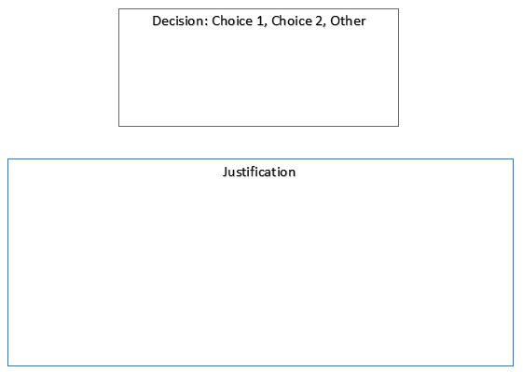
Decision Making Tree

Slide 47
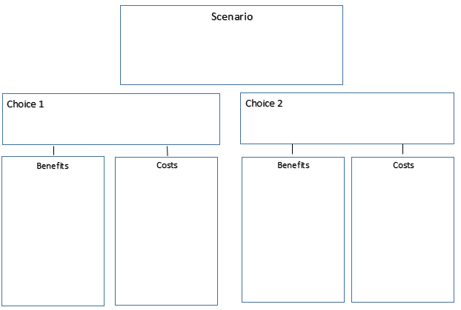
Decision Making Tree

Slide 48
Additional Ideas for Cost-Benefit Analysis
USI.4a, b Should Europeans explore North America?
Benefits: Economic benefits of gold, natural resources, trade and new farming techniques; the opportunity to spread Christianity; gain new lands for their empires and spread their own cultural beliefs; gain new farming techniques.
Costs: Potential for their own death by disease and starvation; facing the fear of the unknown; the harm done to Native Americans during exploration including loss of their land, slavery and death.
Historical decision: Spain, France and England explored regions of North America. There were positive cultural and economic interactions but also many areas of conflict.

Slide 49
USI.9: Should Abraham Lincoln have used military force to attempt to prevent Confederate states from seceding?
Benefits: Preservation of the Union and the belief that the US was one nation, not a collection of independent states; stopping the spread of slavery (which would become the total abolition of slavery as the war continued); enforcement of the belief that the federal government’s power was supreme over that of the states;
Costs: Hundreds of thousands of soldiers dead, family and friends were often pitted against one another; the economic devastation caused by war
Historical Decision: Southern states seceded and the Union resisted secession with military force. The economic, political and social effects of the Civil War would be felt into the next century.

Slide 50
PACED decision-making model
Use a PACED decision-making model to evaluate decisions made in United States history by analyzing the alternatives, criteria, and the decision made.
Define the Problem
List Alternatives
Select Criteria
Evaluate the Alternatives
Decision
Notes:
Aaron 3:25

Slide 51
For Example
It is Monday night and you need to decide what to have for dinner. You have the options of Spaghetti, Chicken and Rice and Oven Baked Pizza.
You will base your decision on the time it takes to make the meal, the nutritional value of the meal and the overall taste of the meal.
How can you come up with a decision?

Slide 52
What to eat for dinner?
Problem
 | Time to Make | Nutritional Value | Tasty
Spaghetti
Chicken and Rice
Oven Bake Pizza
Criteria
Alternatives

Slide 53
What to eat for dinner?
Problem
 | Difficulty in making | Nutritional Value | Tasty
Spaghetti | 1 | 2 | 2
Chicken and Rice | 2 | 3 | 1
Oven Bake Pizza | 3 | 0 | 3
Criteria
Alternatives

Slide 54
But what if you were a super healthy family?

Slide 55
What to eat for dinner?
Problem
 | Difficulty in making | Nutritional Value | Tasty
Spaghetti | 1 | 2 (x2) | 2
Chicken and Rice | 2 | 3 (x2) | 1
Oven Bake Pizza | 3 | 0 (x2) | 3
Criteria
Alternatives

Slide 56
1a Using informational sources
Analyze and interpret artifacts and primary and secondary sources to understand events in US History.

Slide 57
Sample Analysis Tool
Title of Informational Source: ________________
Key Elements | Evidence
Observation: What do you see? | Evidence
Source: Who created the source? | Evidence
Context: Where is the source located in terms of time and place? | Evidence
Historical Perspective: Whose point of view does the source represent? | Evidence
Analysis: What is the source’s impact on history? | Evidence

Slide 58
1b Applying geographic skills
Analyze and interpret geographic information
to determine patterns and trends in United States history.

Slide 59
5 Themes of Geography
Location:
Defined according to its position on Earth. Where is it?
Place:
Locations having distinction features that give them meaning and character that differ from other locations.
Region:
Unifying characteristics. How are the places similar?
Movement:
The way people, products move from one place to another
Human:
Environment Interaction – The relationship between people and their environment.

Slide 60
1e Comparing and Contrasting
Compare and contrast historical, cultural, and political perspectives in United States history.

Slide 61
Topic: Shays’s Rebellion | Reasons for Rebellion | People Involved | Reactions from Government | Results | Other differences
Source 1: Howard Zinn Farmers In Revolt
Source 2: Paul Jackson’s A History of the American People
Conclusions:
What were some major differences that you found?
What do you think the reasons were for these differences?

Slide 62

Notes:
George vs. George
New World vs. Old World
Boston Tea Party vs. Boston Massacre
Bunker Hill vs. Valley Forge
Loyalists vs. Patriot vs. Neutral

Slide 63
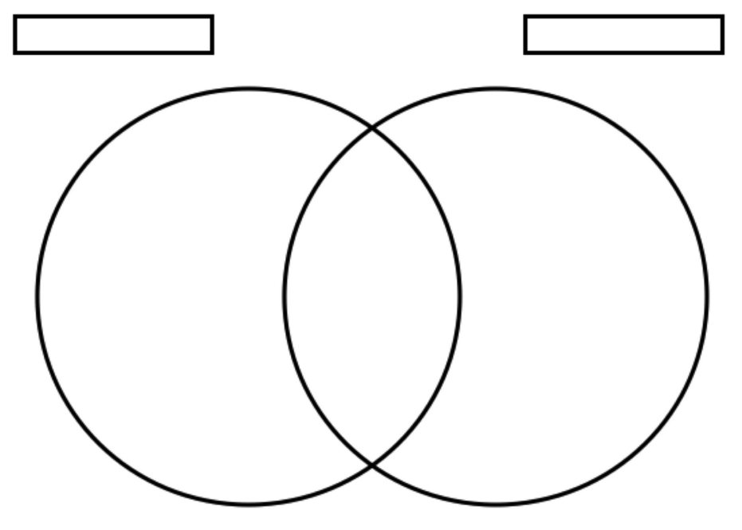
Notes:
George vs. George
New World vs. Old World
Boston Tea Party vs. Boston Massacre
Bunker Hill vs. Valley Forge
Loyalists vs. Patriot vs. Neutral

Slide 64
1h Making economic decisions
Use a decision-making model to identify the costs and benefits of a specific choice made.

Slide 65
Cost – Benefit Analysis
Note: Consider both short-term and long-term while brainstorming.
COSTS (things given up) | BENEFITS (positive things gained)

Slide 66
Student Learning Experiences…

Slide 67
Investigate the Boston Massacre
Break students up into station groups
Each student gets a “police report” for each document
Students will rotate to each station and complete the questions on their police report
Post reflection questions at the end for students to discuss and share out.

Slide 68

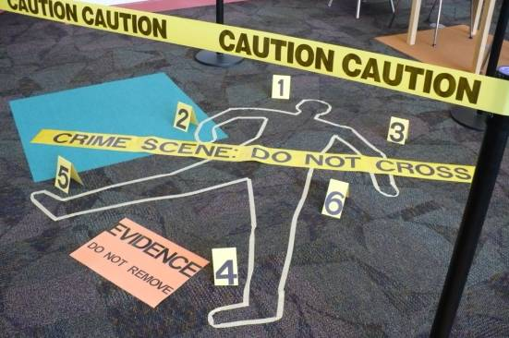
Your task:
Your task is to sort through all the evidence and decide who was responsible. As you read the accounts as well as look at the art, please remember that the people and artists have bias, which means that they were on one side or the other. Their perception of the event might change what they see or they may even be willing to lie about the incident.
Your job is to sort through all the evidence and try to determine the facts. The people of Boston are extremely angry right now and we want to make sure we do a good job of truly studying the evidence. As you find important information, write it appropriately in your detective notebook.
Good luck... this might be the hardest case you will ever try to solve.

Slide 69
Are you a Patriot or a Loyalist?
Have the students find all the evidence that they have complied over the past class periods for both Patriot and Loyalist
Hand out the decision chart and documents that you want them to analyze
Students work individually or in groups to complete the PACED grid to figure out if they would have been a Loyalist or a Patriot.

Slide 70

PACED
Problem
Alternatives
Criteria
Evaluate
Decide
Criteria – What’s Important to me?
(Choices) | Criteria 1 | Criteria 2 | Criteria 3 | Criteria 4

Slide 71
Student Reflection
Explain which side your table decided to join? Was your table divided? Why?
What worked or didn’t work within your group?
In what other unit topics or ways would you find this useful in supporting students experiencing the content?

Slide 72
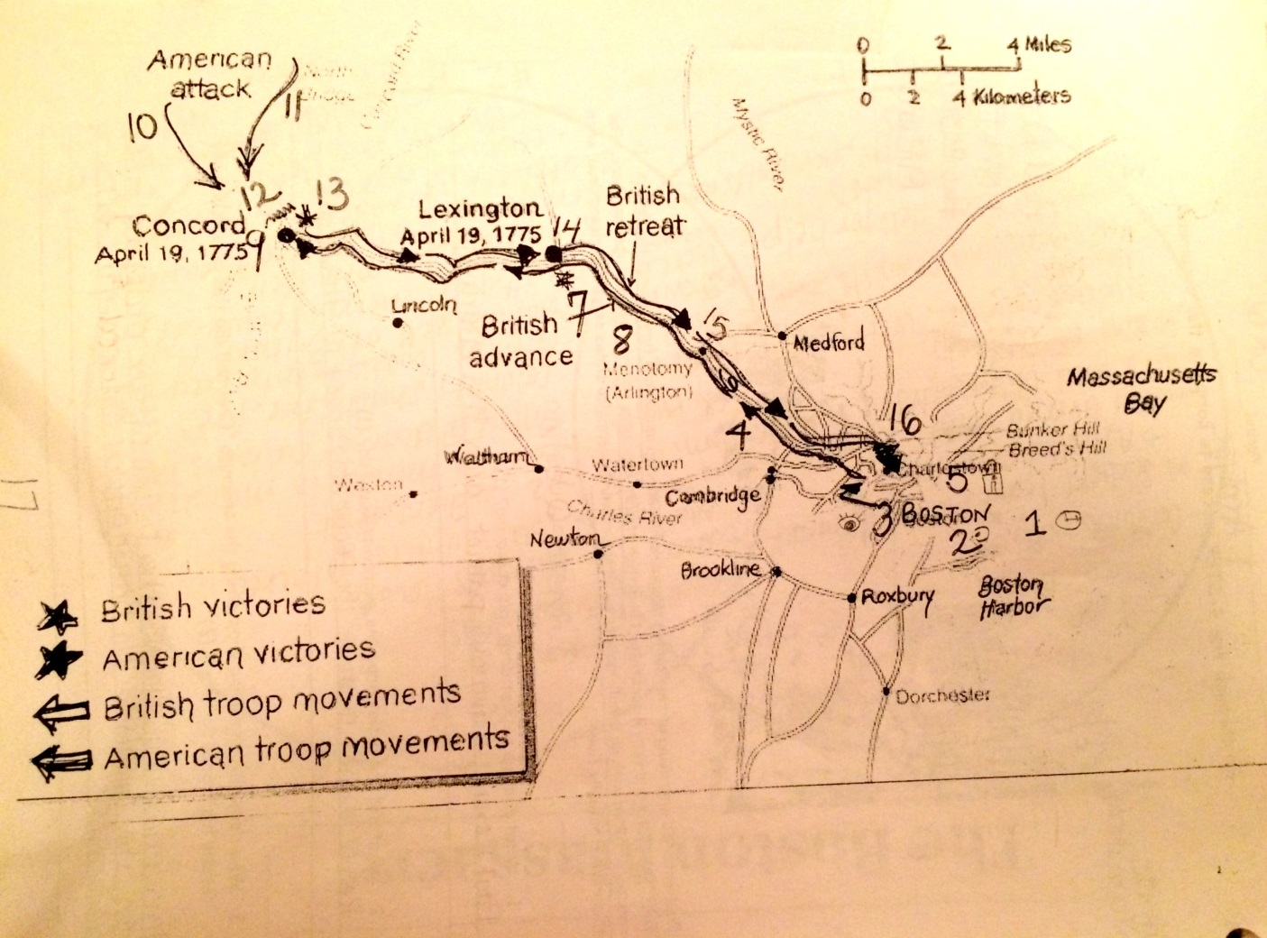
Mapping the Road to War!

Slide 73
Mapping the Road to War!
Based on this map and what you already know about the issues between the Patriots and the British, predict the outcome of the war.
Who will win?
Why do you feel this way?
How did the map help make your decision?

Slide 74
To Declare or Not….
That is the Question!
Using the Declaration of Independence, read over the colonists list of grievances against King George III (Part 3) and decide if declaring war is justifiable.
COSTS (things given up) | BENEFITS (positive things gained)

Slide 75
To Declare or Not….
That is the Question!
COSTS (things given up) | BENEFITS (positive things gained)
Actual Decision Made: _______________________________________
Alternative Decisions: ________________________________________

Slide 76
Now it’s your turn…
Choose a unit using the new 2015 standards to begin planning for your school year.
Work with table mates to plan learning experiences that each of the 4 standards.
Today we used: 1a, 1b, 1e, and 1h

Slide 77
Resources for further development
Visit:
Stanford History Education website
Virginia Geography Alliance website
www.teachinghistory.org
Library of Congress (Primary/Secondary sources) www.loc.gov
Virginia Council on Economic Education: vcee.org
And remember……
Introduce what historical thinking is, looks like, and sounds like in the classroom.

Slide 78
Debrief – Last one!
Meet with your content area to discuss where you plan to use a Decision Making Model in upcoming units!

Slide 79
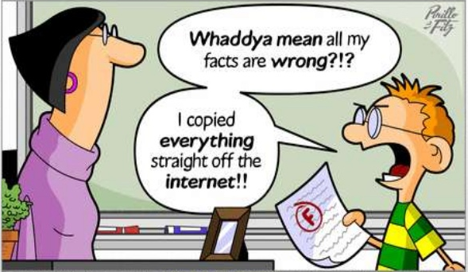
Writing to Learn
Not graded
Prior to lesson
  Assess student background knowledge
End of lesson
  Check understanding
  Make Connections
  Answer BIG QUESTION
  Free-write

Slide 80

How can you begin to support teachers
NOW, as they begin thinking about next year?
What should your role be in regards to successful implementation of new standards/thinking skills?
Notes:
clipart

Slide 81
Questions?
Notes:
Clipart

Slide 82


Slide 83
USI Presenters
Katherine Moore | Richmond City | kmoore2@richmond.k12.va.us
Melissa Viola-Askey | Prince William County | ViolaMA@pwcs.edu
Beth Davenport | Stafford County | teachreadcoach75@gmail.com
Nicole Bennett | Fairfax | NMBennett1@fcps.edu
Meagan Gilliam | Buckingham | mgilliam@bcpschools.org
Jenna Sprinkle | Roanoke County | jsprinkle@rcs.k12.va.us
Jessica Zumbrum | Lee County | Jessica.zumbrum@leecountyschools.net

Slide 84
Virginia Department of Education
Christonya Brown, K-12, History and Social Science Coordinator
E-mail: Christonya.Brown@doe.virginia.gov
Betsy Barton, Elementary, History and Social Science Specialist
Email: Betsy.Barton@doe.virginia.gov
Jill Nogueras, English & History and Social Science Specialist
Email: Jill.Nogueras@doe.virginia.gov

