Slide 1
Grade Two
History and Social Science
Fall Institute
2016

Slide 2
Disclaimer
Reference within this presentation to any specific commercial or non-commercial product, process, or service by trade name, trademark, manufacturer or otherwise does not constitute or imply an endorsement, recommendation, or favoring by the Virginia Department of Education.

Slide 3
Questions to Ask During Planning
Essential Components in Planning an Effective Lesson
using the
2015 History and Social Science Standards of Learning
What do students need to know and understand by the end of this lesson?
What do students need to do during this lesson?
Which historical thinking skills are best suited for this standard?
What other content material should be added to provide historical context and richness to the lesson in order to maximize student understanding of the standard?
What student learning experiences would be most effective during this lesson?
How can I check for understanding effectively and accurately to measure the students’ content knowledge and historical thinking skills?

Slide 4

It starts with the . . .

Slide 5
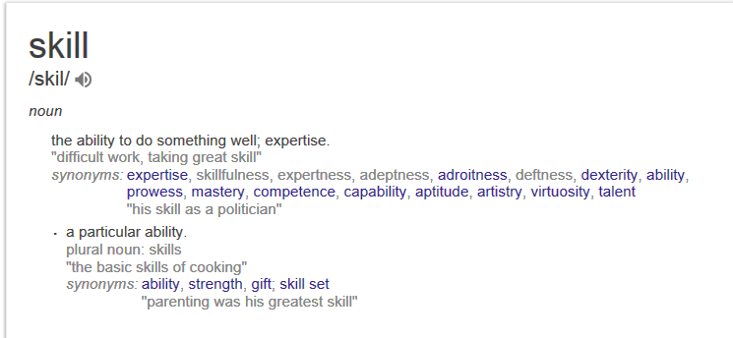

Slide 6
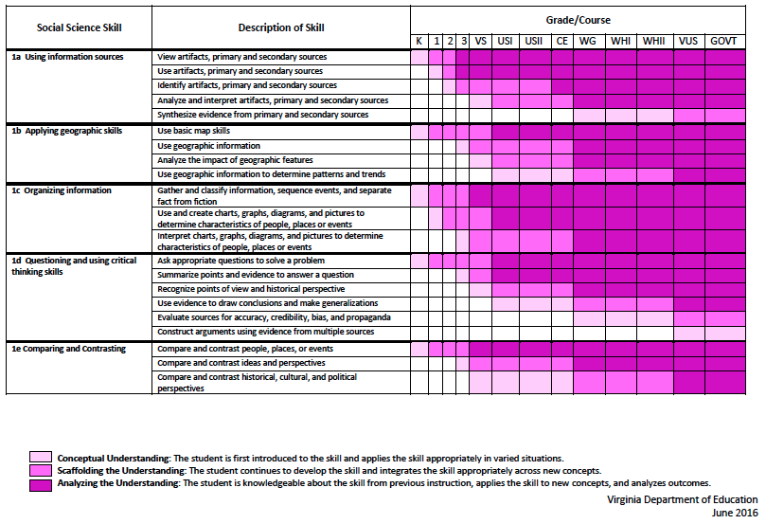
2015 SOL Skill Progression
⇧
Notes:
⇧

Slide 7
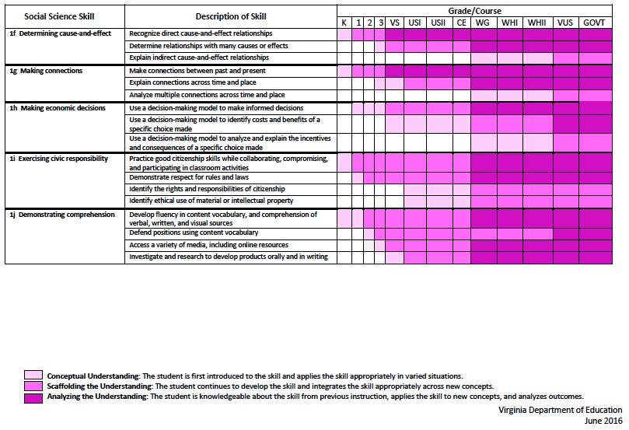
2015 SOL Skill Progression
⇧
2008 Standards:
Understand content
2015 Standards:
Understand content by applying the skill.
Skills are aligned with English Standards
Notes:
Discussion: Conceptual Understanding, Scaffolding the Understanding, Analyzing the Understanding
Arrow will rise up upon click after discussion to summarize difference between 2008 and 2015, then skills aligned with English SOLs. Great opportunity for common planning!
Purpose of today is to “teach” a lesson demonstrating skill based instruction, moving away from Lecture (Sit and Get)

Slide 8
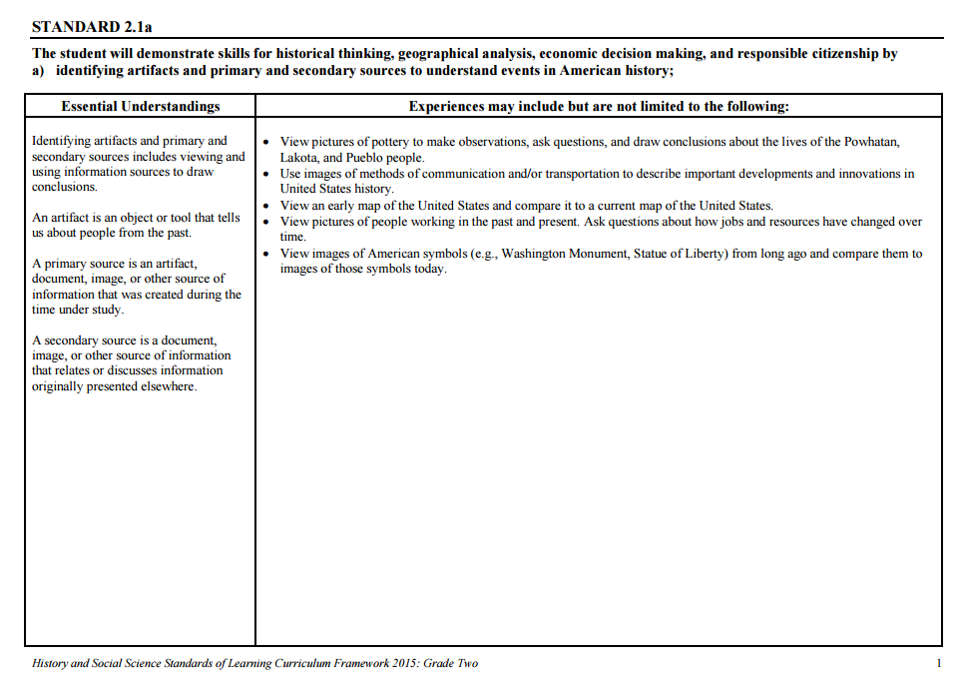
Experiences for Essential Skills
What are Experiences?

Slide 9
Experiences
Bring attention to the Experiences and describe what they are and how they can be used.
Provide teachers with “experiences” and give them an opportunity to:
  discuss what they are and how they can be used; and
  develop their own to share with the group.

Slide 10
The experiences should be –
engaging,
rigorous with higher level thinking questions,
relevant (connecting time periods, places, and events to the present day).

Slide 11
Experiences
Are . . .
Are NOT. . .
Engaging- promoting discussion, collaboration, and understanding
Opportunities to practice social science skills using various content
Varied throughout the lesson to help students make connections
Worksheets
Specific to one Standard, topic, or course

Slide 12

How can Grade Two history & social science skills be incorporated into standards-based lessons?
Notes:
Good practice: Use of aim/objective to give students a concrete goal for the lesson. “By the end of class/end of unit/etc., you should be able to…”

Slide 13
Good practice
Use of aim/objective to give students a concrete goal for the lesson.
“By the end of class/end of unit/etc., you should be able to…”

Slide 14

Today we will . . .
Practice strategies to incorporate new standards-based skills into daily lessons to teach and check for understanding of content

Slide 15
History and Social Science
Standards of Learning 2016 Fall Institute
Welcome
Meet-and-Greet
Agenda for the day
  Presentation of Learning Experiences
  Creating Skill Experiences
Questions

Slide 16
Today’s Working Norms
Be engaged
Be open to new ideas
Limit sidebar conversations
Laptop/Cell phone use

Slide 17
History and Social Science
Standards of Learning 2016 Fall Institute
Welcome
Meet-and-Greet
Agenda for the day
  Presentation of Learning Experiences
  Creating Skill Experiences
Questions

Slide 18
Today’s Working Norms
Be engaged
Be open to new ideas
Limit sidebar conversations
Laptop/Cell phone use

Slide 19
Grounding:
Who Are We?
Introduce yourself to a shoulder partner
  Name, position, school/location you teach
  What is your favorite unit/topic to teach in Social Studies? Why?
Geography
American Indians
Ancient Cultures
Famous Americans
History
Civics
Economics

Slide 20

Just Like Me
When you hear something that applies to you-
Stand up and say…
Just like me!

Slide 21
Implementing the new Social Studies Curriculum!
Getting Ready for 2017-2018

Slide 22
What are these experiences teachers are to provide for the students?
The experiences should be –
engaging,
rigorous with higher level thinking questions,
relevant (connecting time periods, places, and events to the present day).

Slide 23
How do I plan for these experiences?
When planning for these experiences you should think about how we learn about the past.
    Asking questions.
    Gathering the sources, organize them, and evaluate the evidence in the sources.
    Drawing conclusions that are supported by the evidence in the sources.

Slide 24
Questions to ask about the past….
How?
What?
When?
Where?
Who?

Slide 25
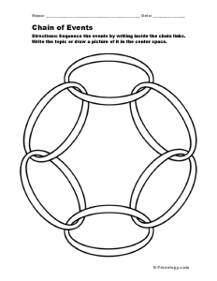
Things to consider→
Cause and Effect- events from the past have a short term and long term (often times unforeseen) effects on the development of societies.

Slide 26
Things to consider→
Change and Continuity- focus on change over time; understanding what changed and what remained the same, fosters a deeper understanding of the uneven pace for which events unfolded throughout history.

Slide 27

Things to consider→
Turning Points- focuses on events of great significance that caused individual experiences and societal developments to go in a different direction.

Slide 28

Things to consider→
Using the Past- finding the usable past and using it to better understand events from that time frame and how it relates to the present. This makes history relevant and gives history meaning.

Slide 29

Things to consider→
Through their Eyes- We need to see the world as they saw it in order to get a deeper understanding of why people thought and acted the way they did and the reasoning for the choices they made.

Slide 30
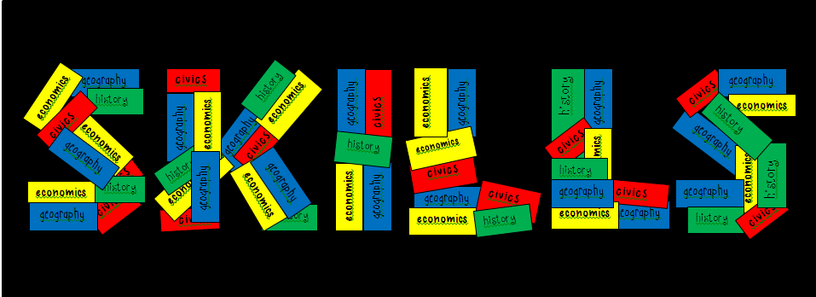
The Essential Skills, which are found in Standard 1 for each grade level or course, serve as tools to facilitate active engagement in learning, to deepen student understanding of content material and to create better-informed citizens.

Slide 31
Standard 1
Use information sources.
Apply geography skills.
Organize information.
Demonstrate critical thinking.
Compare and contrast.
Determine cause and effect.
Make connections.
Make economic decisions.
Exercise civic responsibilities.
Demonstrate comprehension.

Slide 32
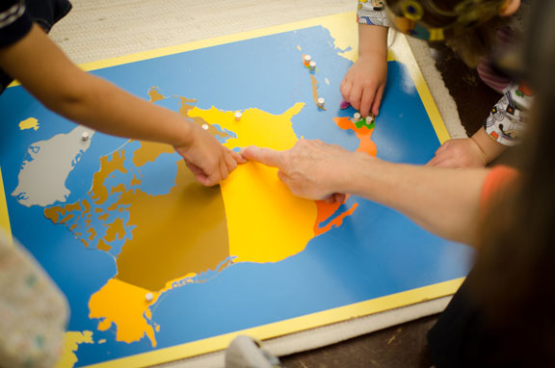
Let’s Explore:
Rigorous Social Studies
Learning Experiences
Notes:
Now we are going to take some time to explore some possible learning experiences for students that will help teachers grasp ways to embed skills from Standard 1 into content. As we look at and model each lesson idea, be thinking about ways to raise the rigor of social studies instruction and make literacy connections through these skills. Think about how the experience can be expanded to other grade levels.

Slide 33

Grade Two

Slide 34
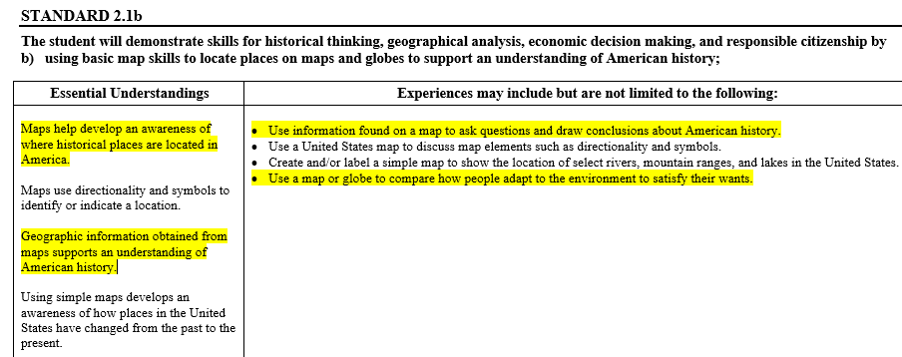
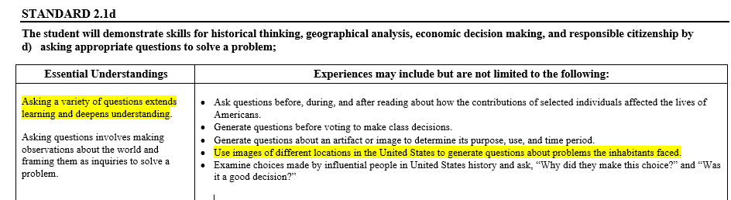
Application of Geography Skills:2nd Grade

Slide 35
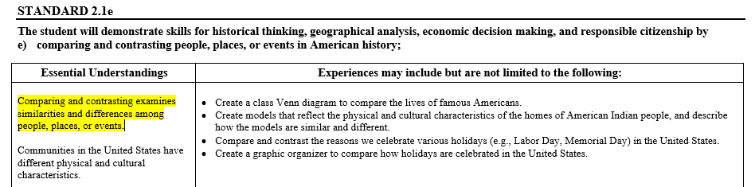
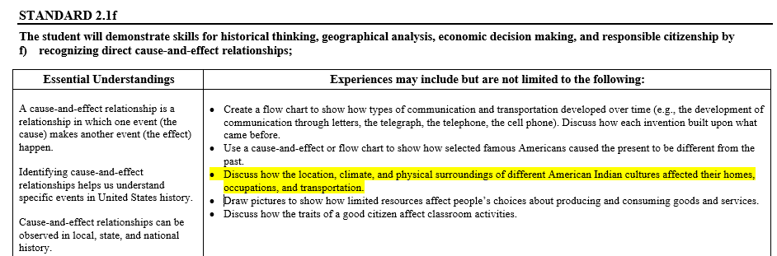
More Standards

Slide 36
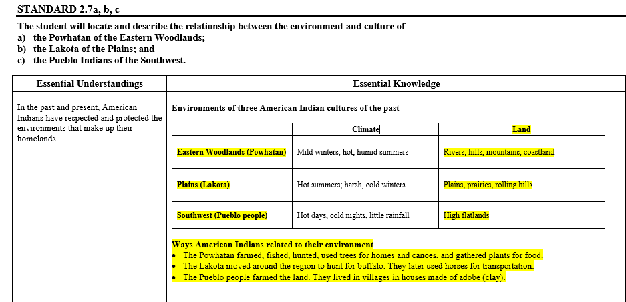
Content: Native Americans

Slide 37
Vocabulary: Preview
Previewing vocabulary provides students with background knowledge and a framework to organize and comprehend new knowledge
Rivers
Hills
Mountains
Coastland
Plains
Prairies
Rolling hills
High flatlands

Slide 38
Exclusion brainstorming: A Previewing strategy for vocabulary
With a partner, look at the picture of the vocabulary word and look at the list of words that are given under the topic word.
Discuss with your partner the words that you think belong with this vocabulary word and those that you think don’t belong.

Slide 39
Exclusion Brainstorming:
A Previewing Strategy For Vocabulary
Cross out the words that you don’t think belong and circle the words that do belong.
With your partner, use the circled words to develop a definition of the vocabulary word.
Share and compare.

Slide 40
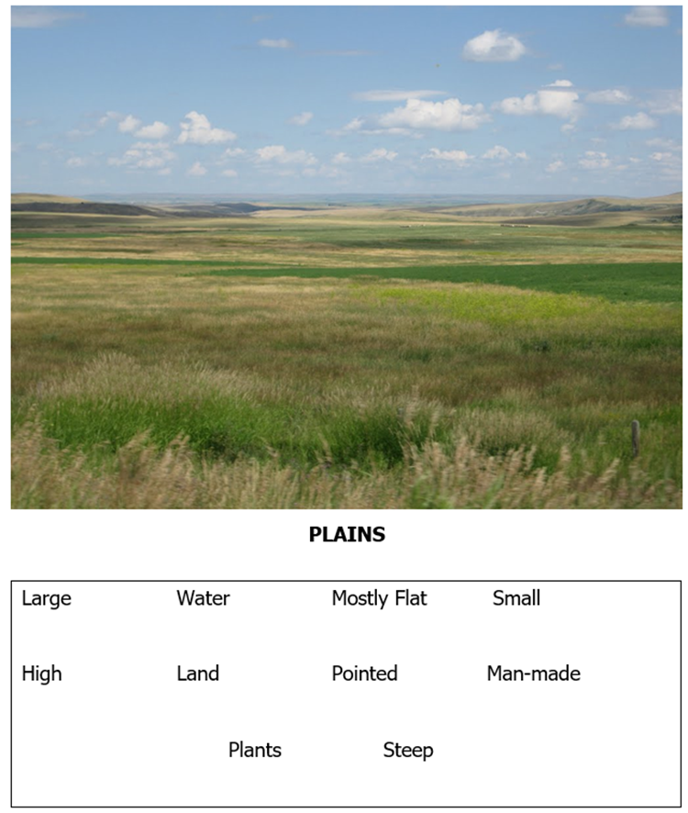
Exclusion Brainstorming
http://hauensteincenter.org/tag/great-plains/

Slide 41
Geography Resources
Google Earth
Google Lit Trips
National Geographic sites
Virginia Geographic Alliance
www.vgaplaces.weebly.com

Slide 42
Google Earth/Topographical Maps
Experience for 2.1b: Use a map or globe to compare how people adapt to the environment to satisfy their wants.
Use Google Earth to “tour” the US
Use tour guides on Google Earth for Virginia, Great Plains, New Mexico
Look at Topographical Maps of USA for any additional information
Fill in the graphic organizer for each region on the types of geographic features found

Slide 43
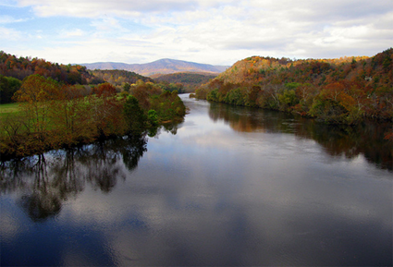
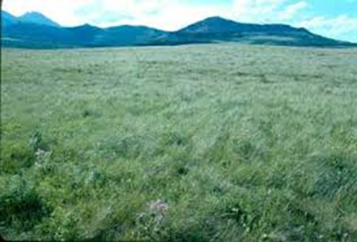
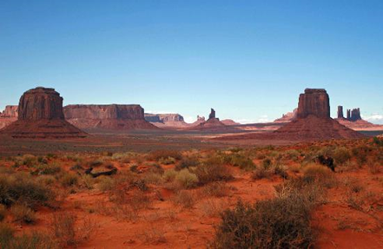
Images of Different Locations
http://www.natgeocreative.com/ngs/

Slide 44
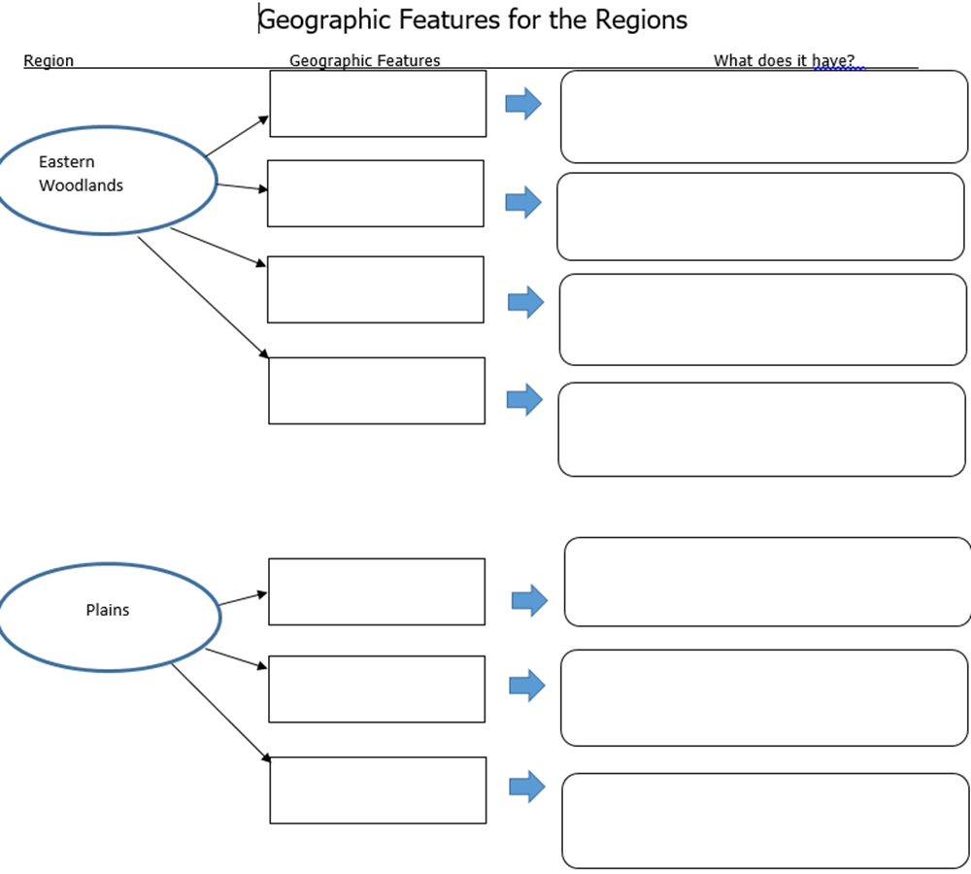

Slide 45
2.1 f Cause and Effect and
2.1e Comparisons
How did the location and physical surroundings in each region effect the Native American’s living there?

Slide 46
2.1f Cause and Effect and
2.1e Comparisons
Break into teams by region. Have team do a “jot thought” for each of the geographical features and what effect that had on them. Use the categories of food, shelter, transportation, water, clothing.
Each team shares out, create a class cause and effect chart.
Use the chart to make comparisons between the Native Americans and their adaptations.
Notes:
This slide is hidden, the idea of how to extend the lesson to include the cause and effect skill will be briefly shared.

Slide 47

Paradigm Shift - Moving from Activities to Experiences
As we shift from planning content activities to skills based experiences, we have to first look at the skills.
2.1b: using basic map skills to locate places on maps and globes to support understanding of American history
Our goal: Focusing on these skills allows us as educators to integrate more with ELA, Science, and Math.

Slide 48
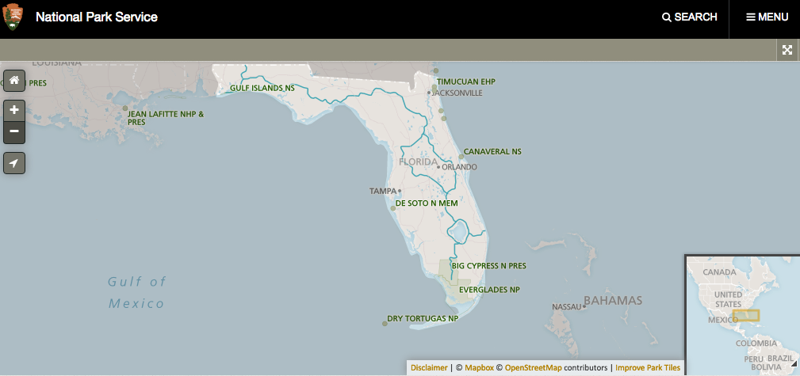
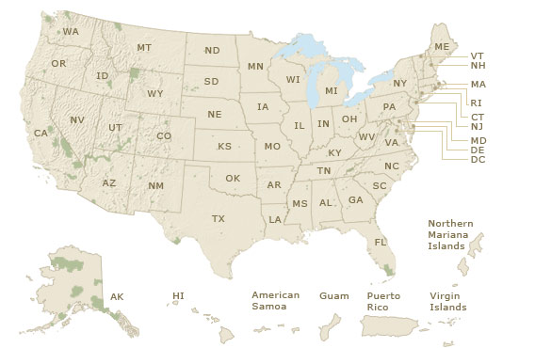

Finding The Everglades
National Park
Start with Our Great Big Backyard
Move to National Park Interactive Map

Slide 49
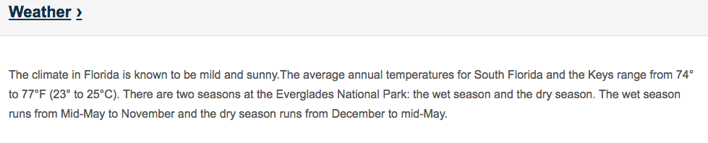
Exploring The Everglades
National Park
Compare images from Our Great Big Backyard to the homepage of The Everglades National Park.
Under info button look at the weather section.

Slide 50
Always Looping Back to the Skill
2.1b: using basic map skills to locate places on maps and globes to support understanding of American history
How do the people who live near The Everglades adapt to their environment?
What might daily life be like for people near The Everglades?
What type of animals and plants would we see if we went to The Everglades?
Once students have practiced this map skill, you can take this experience and duplicate it within your specific content areas.

Slide 51
Your Turn!
First, copy my model of finding a park from Our Great Big Backyard and asking questions about it by researching Big Bend National Park.
Then, think about a geographic location that your students could explore after having learned this skill. Some examples may be…
  Kindergarten - local park
  1st Grade - State Park, Famous Virginian’s Home
  2nd Grade - National Park near an American Indian tribal land
  3rd Grade - World Historic Landmark from an Ancient Culture
  All grades - location from a read aloud, location of a famous person, extreme weather occurrences, location of family members
Remember - These skills are taught and can come up in all content areas throughout the year. Repeat and reuse them!

Slide 52
Second Grade
Content SOL
2.7 The student will locate and describe the relationship between the environment and culture of the Powhatan of the Eastern Woodlands; the Lakota of the Plains; and the Pueblo Indians of the Southwest.
Skill SOL
2.1b The student will demonstrate skills for historical thinking, geographical analysis, economic decision making and responsible citizenship by using basic map skills to locate places on maps and globes to support understanding of American history.

Slide 53

Content Example
Conduct an interactive read-aloud of Our Great Big Backyard by Laura Bush.
Plot where the Powhatan, Lakota and Pueblo Indians lived.
Discuss how their environment/habitat influenced the way that they lived (needs, shelter, food, tools, etc.)

Slide 54
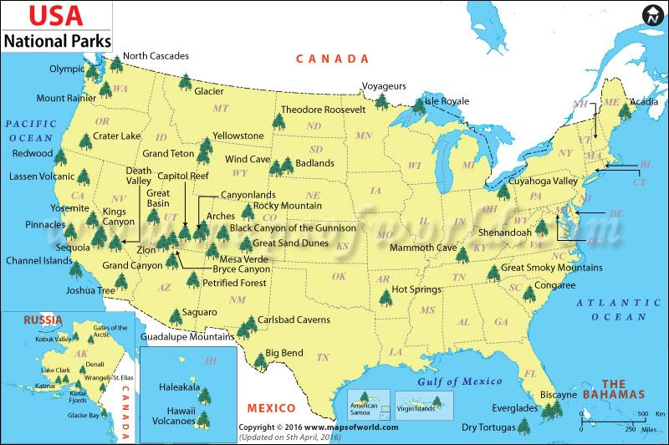
Guided Practice
Pick a Park
http://www.mapsofworld.com/usa/national-parks/
Pin a park on a map of the United States.
Discuss the climate and how people meet their clothing needs while on vacation.
Notes:
As a whole group we will read “Our great big backyard” by Laura Bush. Participants will (think/pair/share) select two national parks and discuss the climate, how people adapt their clothing to meet their needs while on vacation. Participants will receive a map of the various national parks in the United States along with a small piece of playdough and some toothpicks to pin a park in the area of the Powhatan/Eastern Woodland, the Pueblo and the Southwest Indians.

Slide 55
Independent Practice
Students will select three National Parks to plot. One park will be in the area of the Powhatan/ Eastern Woodland, Pueblo, and Lakota.
Given a paper doll, materials (construction paper, yarn, pipe cleaners, etc.), tools (glue, scissors, etc.) and a time constraint, students create a park visitor who is dressed appropriately for the environment of the selected park.
Notes:
Using the playdough and toothpicks, participants will plot a park in each area where the Indians lives. They will discuss the climate of each area and select one area to create a paper doll who is dressed appropriately for the selected park.

Slide 56

Debrief
What skill did you see?
How did it play out?
How can you use it in another way?

Slide 57

How can you use this method with another grade?

Slide 58

Sharing Our Expertise
Notes:
5 minute share

Slide 59
History and Social Science Updates
On The Web…
VDOE 2015 Standards of Learning
http://www.doe.virginia.gov/testing/sol/standards_docs/history_socialscience/index.shtml
2. VDOE Superintendent Memo #163-15
http://www.doe.virginia.gov/administrators/superintendents_memos/2015/163-15.shtml
Implementation Schedule
http://www.doe.virginia.gov/administrators/superintendents_memos/2015/163-15a.pdf

Slide 60

Skill Experience

Slide 61
Group Skill Experience
  Review the new History and Social Science Skill Heading SOLs. (K.1, 1.1, 2.1, 3.1)
  Choose one SOL bullet for your grade level.
  Create a lesson for your students.
  Share.

Slide 62
Reflections:
3 things you learned,
2 ways you can use this learning in your class, and
1 question you still have
Notes:
Teachers will personally reflect then turn and talk to pair-share
5-10 minutes

Slide 63
Questions?
Notes:
Respond to the parking lot questions that have been posted in each room.

Slide 64
Kindergarten – Grade Three Presenters
Carla Crump | Powhatan | carla.crump@powhatan.k12.va.us
Apryl-Dawn Julien | Richmond | awynter@richmond.k12.va.us
Quoteshia Hargett | Portsmouth | Quoteshia.Hargett@pps.k12.va.us
Melissa Mygas | Newport News | melissa.mygas@nn.k12.va.us
Megan Bush | Stafford | bushme@staffordschools.net
Jennifer Burgin | Arlington | jennifer.burgin@apsva.us
Kathy Nealon | Fairfax | Knealon@fcps.edu
Susan Mayo | Manassas City | smayo@mcpsva.org

Slide 65
Kindergarten – Grade Three Presenters
Jennifer Kettlekamp | Harrisonburg | jkettelkamp@harrisonburg.k12.va.us
Amy Cash | Augusta | acash@augusta.k12.va.us
Dawn Toole | Martinsville | dtoole@martinsville.k12.va.us
Krystal Heath | Floyd | heathk@floyd.k12.va.us
Misty Jeffers | Washington | mjeffers@wcs.k12.va.us
Bethany Collins | Tazewell | bcollins@tazewell.k12.va.us
Tamara Green | Buckingham | tgreen@bcpschools.org
Vanessa Mason | Halifax | vmason@halifax.k12.va.us

Slide 66


Slide 67
and the
Virginia Department of Education
Christonya Brown, K-12, History and Social Science Coordinator
E-mail: Christonya.Brown@doe.virginia.gov
Betsy Barton, Elementary, History and Social Science Specialist
E-mail: Betsy.Barton@doe.virginia.gov
Jill Nogueras, English and History and Social Science Specialist
E-mail: Jill.Nogueras@doe.virginia.gov

