Slide 1
Civics and Economics
History and Social Science
Fall Institute
2016

Slide 2
Disclaimer
Reference within this presentation to any specific commercial or non-commercial product, process, or service by trade name, trademark, manufacturer or otherwise does not constitute or imply an endorsement, recommendation, or favoring by the Virginia Department of Education.

Slide 3
Questions to Ask During Planning
Essential Components in Planning an Effective Lesson
using the 2015 History and Social Science Standards of Learning
What do students need to know and understand by the end of this lesson?
What do students need to do during this lesson?
Which historical thinking skills are best suited for this standard?
What other content material should be added to provide historical context and richness to the lesson in order to maximize student understanding of the standard?
What student learning experiences would be most effective during this lesson?
How can I check for understanding effectively and accurately to measure the students’ content knowledge and historical thinking skills?

Slide 4
It starts with the . . .

Slide 6
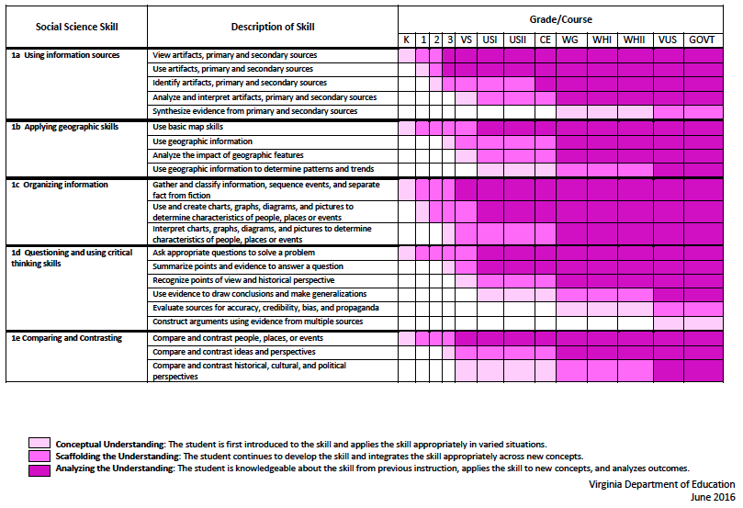
2015 SOL Skill Progression
Notes:
⇧

Slide 7
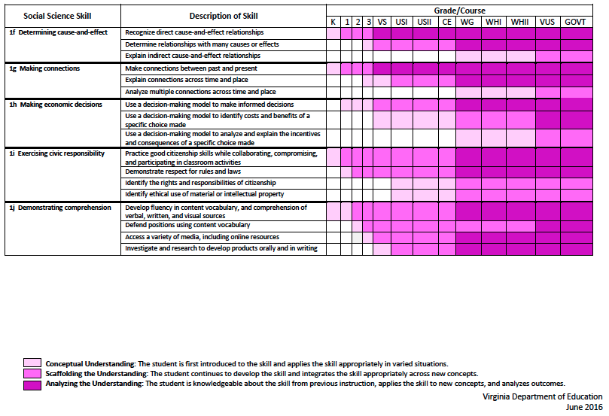
2015 SOL Skill Progression
2008 Standards:
Understand content
2015 Standards:
Understand content by applying the skill.
Skills are aligned with English Standards
Notes:
Discussion: Conceptual Understanding, Scaffolding the Understanding, Analyzing the Understanding
Arrow will rise up upon click after discussion to summarize difference between 2008 and 2015, then skills aligned with English SOLs. Great opportunity for common planning!
Purpose of today is to “teach” a lesson demonstrating skill based instruction, moving away from Lecture (Sit and Get)

Slide 8
Experiences for Essential Skills
What are Experiences?
Notes:
Bring attention to the Experiences and describe what they are and how they can be used.
Provide teachers with “experiences” and give them an opportunity to:
discuss what they are and how they can be used; and
develop their own to share with the group.

Slide 9
The experiences should be –
engaging,
rigorous with higher level thinking questions,
relevant (connecting time periods, places, and events to the present day).

Slide 10
Experiences
Are . . .
Are NOT. . .
Engaging- promoting discussion, collaboration, and understanding
Opportunities to practice social science skills using various content
Varied throughout the lesson to help students make connections
Worksheets
Specific to one Standard, topic, or course

Slide 11
Notes:
everyone needs a pep talk - play video and icebreaker activity (four corners - CE or GOVT?, Years of Experience, Familiarity with new standards, Whether they have seen Space Jam or not,

Slide 12
Student Learning Experiences
What is a “Student Experience”?
What it means:
Students will be more engaged and active in the process
They will be able to create a “product” that will demonstrate their mastery of the historical content and concepts in a contemporary concept.
bit.ly/CEGOVTskills
Notes:
Emphasize this throughout the presentation.

Slide 13
Start with the Content Standard...
CE 5e - ...examining the history of and requirements for voter registration...

Slide 14
Then choose a skill standard…
CE 1b - ...analyzing how political and economic trends influence public policy, using demographic information and other data sources

Slide 15
1b Essential Understandings
Analysis includes identifying important trends based on demographic information and other data sources.
Demographic information is often used by governments and businesses in the development of policies and decisions.

Slide 16
1b Essential Understandings
Demographic information is presented in a variety of forms, including the following:
Election data
Economic data
Census data

Slide 17
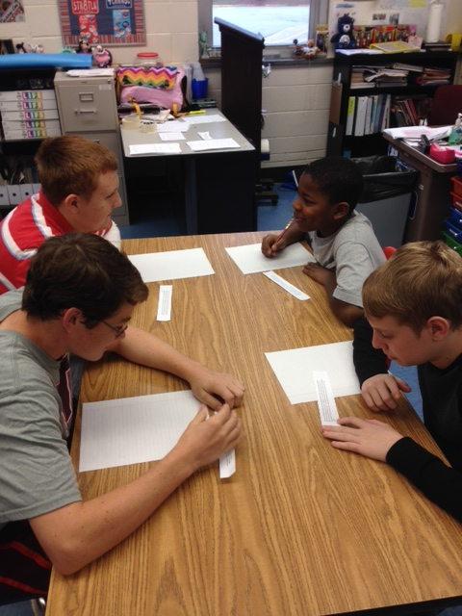
Voter Speed Dating

Slide 18
Let’s Try Another
Notes:
Hook for Next Lesson:
Before moving on, tell group an interesting article just came out that you want to get their opinion on given that they are all civics teachers. Handout a copy of the article linked below and host discussion about it (hoping someone will question the source of the information). Use this to introduce topic of next skills lesson - determining the accuracy and validity of sources
Hook Article from the Onion

Slide 19
Choose an Applicable Content Strand
SOL CE.5c
Strategies for evaluating campaign speeches, literature, and advertisements for accuracy.
Separating fact from opinion
Detecting Bias
Evaluating sources
Identifying propaganda

Slide 20
SOL CE 1d -
...determining the accuracy and validity of information by separating fact and opinion and recognizing bias
Choose a Skill Strand-

Slide 21
1d Essential Understandings
Not all primary and secondary sources are reliable and accurate
The context from the time period of the source can influence the information included

Slide 22
1d Essential Understandings
It is critical to determine the accuracy and validity of information and recognize bias to draw informed conclusions, solve problems, and make informed decisions.

Slide 23
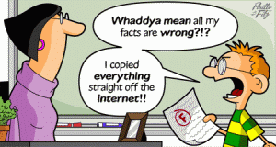
Hook Article from the Onion
Sort the Source!
learning experience where students use political cartoons to detect bias to evaluate sources
library.salve.edu

Slide 24
And Another!
SOL CE.3b (Content Strand)
The student will apply social science skills to understand citizenship and the rights, duties, and responsibilities of citizens by
describing the First Amendment freedoms of religion, speech, press, assembly, and petition, and the rights guaranteed by due process and equal protection of the laws
SOL CE.1a (Skill Strand)
analyzing and interpreting evidence from primary and secondary sources, including charts, graphs, and political cartoons;

Slide 25
Art Gallery
Using Primary Sources to
Teach Civil Rights

Slide 26
How About Another?
SOL CE.5e-
Reasons why citizens fail to vote:
Lack of interest
Failure to register
Belief that vote does not count…
No time or too busy
SOL CE 1h -
...using a decision-making model to analyze and explain the costs and benefits of a specific choice

Slide 27
1h Essential Understandings
Decision making models serve several purposes.
They can help us
make decisions for the future
better understand the choices people faced in the past
analyze the outcomes of the decisions that people already made

Slide 28
1h Essential Understandings
Effective decision making requires weighing the expected costs and benefits and recommending solutions, using a decision-making model.

Slide 29
1h Essential Understandings
Citizens manage their lives by making choices
Choices are based upon alternatives that seem to be the best because they involve the least cost and the greatest benefit.

Slide 30
Cost/Benefit Analysis
Why Are You Here?
Costs: Benefits:

Slide 31
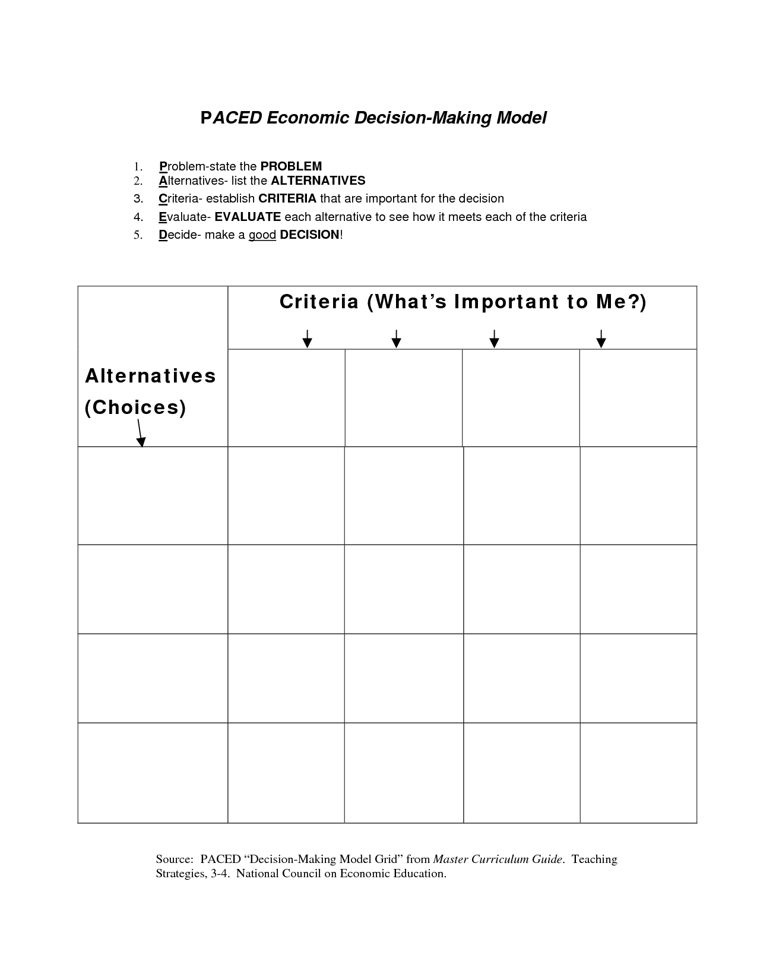
What should I get for my first car?

Slide 32
C/B Analysis Indep Practice
Should Election Day be a National Holiday?

Slide 33
Content Standards
CE 5c - ...analyzing campaigns for elective office, with emphasis on the role of the media

Slide 34
Detecting Bias
Sort the Source!
Notes:
Define bias for group; in presentation view, audience will see only the image on the left side of the slide, ask they what they see in the picture, click to show image on the right side of the slide and discuss bias/perception, then audience will participate in “Sort the Source” learning experience

Slide 35
Which skill did we practice?
CE 1d - ...determining the accuracy and validity of information by separating fact and opinion and recognizing bias
Notes:
Do not show skills until after debrief….we want audience to interact with skills and see if they can pick out the skill we were practicing
Debrief: How did it play out? What did you have trouble with? What do you think your students will have trouble with? How can you use it in another way?
How was this a “student learning experience”?

Slide 36
Content Standards
CE 5e - ...examining the history of and requirements for voter registration...

Slide 37
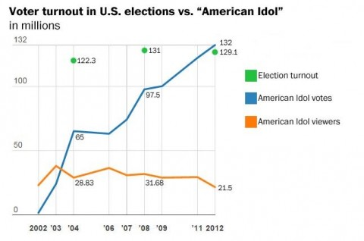
Source: https://www.washingtonpost.com/news/the-fix/wp/2015/05/11/rip-american-idol-the-show-that-gave-us-an-easy-shorthand-for-americans-not-voting/
Notes:
Source: https://www.washingtonpost.com/news/the-fix/wp/2015/05/11/rip-american-idol-the-show-that-gave-us-an-easy-shorthand-for-americans-not-voting/
Click present mode for this to see first graph shown to participants….
Image analysis worksheet - what do you see?, what do know?, what questions do you have?
Participants will share out as a whole group the answers to these questions
Participants will be shown the second graph (as seen above) and will answer the question - what have you learned?

Slide 38
Cost/Benefit Analysis:
Should I vote in this year’s presidential election?
Costs | Benefits
Notes:
Define costs and benefits for audience then teachers complete this individually then share out for discussion
Have discussion about costs/benefits AND consequences of not voting/write in candidacy

Slide 39
PACED Decision-Making Grid: What should our country do to increase voter turnout?
Notes:
Teachers will do this as a whole group
PACED acronym: Define the PROBLEM 2. List the ALTERNATIVES 3. Select CRITERIA 4. EVALUATE the alternatives 5. Make a DECISION
We are hoping they may suggest as the alternative choices: Make election day a national holiday, election day on a Saturday, online voting, compulsory voting, make it easier to get IDs
We are hoping they may suggest as the criteria: Easy to do, Cost effective, biggest bang for our buck
We will model how to assigned “points” for each alternative based on the criteria set and discuss how the PACED grid can be used to make a decision

Slide 40
Which skill did we practice?
CE 1h - ...using a decision-making model to analyze and explain the costs and benefits of a specific choice
Notes:
Do not show skills until after debrief….we want audience to interact with skills and see if they can pick out the skill we were practicing
Debrief: How did it play out? What did you have trouble with? What do you think your students will have trouble with? How can you use it in another way?
How was this a “student learning experience”?

Slide 41
Resources
Library of Congress
National Archives (DocsTeach)
Virginia Council for Economic Education
Virginia Geographic Alliance
Political Advertisements

Slide 42
Reflections:
3 things you learned,
2 ways you can use this learning in your class, and
1 question you still have
Notes:
Teachers will personally reflect then turn and talk to pair-share

Slide 43
Questions?
Notes:
Answer parking lot questions that weren’t answered

Slide 44
Tracey Zaval Horvath | Chesterfield County | Tracey_Zaval@ccpsnet.net
Ferida Cralle | Stafford County | crallefm@staffordschools.net
Don Brunner | Culpepper | dbrunner@culpeperschools.org
Curtis Young | Norfolk City | cyoung@nps.k12.va.us
Jack Jagodzinski | Roanoke City | jjagodzinski@rcps.info
Christopher Wilson | Wise County | cewilson@wisek12.org

Slide 45
Virginia Department of Education
Christonya Brown, K-12, History and Social Science Coordinator
E-mail: Christonya.Brown@doe.virginia.gov
Betsy Barton, Elementary, History and Social Science Specialist
Email: Betsy.Barton@doe.virginia.gov
Jill Nogueras, English & History and Social Science Specialist
Email: Jill.Nogueras@doe.virginia.gov

