Slide 1
Instructional Journey from Learning Experiences and Performance Tasks to Local Alternative Assessments
History and Social Science SOL Institutes
August 9, 16, and 17, 2017
October 16, 2017

Slide 2


Slide 3
What’s happening today . . .
VDOE Update:
    Code of VA and Board of Education Responses
    Implementation Schedule
    Local Alternative Assessment Guides and Resources
    Learning Experiences, Performance Tasks and Local Alternative Assessments
Morning Break
Virginia Quality Criterion Tool
Using the 2015 History and Social Science Standards of Learning and Curriculum Framework to develop Performance Tasks and construct Local Alternative Assessments

Slide 4

Access to Documents
http://tinyurl.com/vdoehss2017
Notes:
Type the link into the browser.

Slide 5
How have multiple choice
state assessments impacted your instruction and decisions about your instruction?
Notes:
Activity for teachers to discuss- “At your tables, discuss the question. As you discuss, collaborate and come up with one statement that answers this question. 144 Characters to respond.

Slide 6


Notes:
We would like for you and your team to think about a “balanced instructional program” that includes assessment and provides multiple paths to determining student understanding.

Slide 7
Code of Virginia and
Board of Education Responses

Slide 8
Code of Virginia
Legislative Mandate:
House Bill 930 and Senate Bill 306
Legislation in the 2014 General Assembly amended § 22.1-253.13:3.C of the Code of Virginia to eliminate several Standards of Learning (SOL) tests:
    Grade 3 History,
    Grade 3 Science,
    Grade 5 Writing,
    United States History to 1865, and
    United States History: 1865 to the Present.

Slide 9
Legislative Intent
The intent of the legislation was to encourage the broader range of assessments, such as performance assessments, that may be used by teachers to improve their instruction.
Such assessments provide information about what students have learned as well as the concepts and skills that they have not yet mastered.
Notes:
Based on the BOE Guidelines.
In response to increasing concern regarding the amount of testing in local school divisions and the time spent in test preparation activities, legislation passed in the 2014 General Assembly eliminated some of the tests previously used for accountability.

Slide 10
Virginia Board of Education
Guidelines for Local Alternative Assessments 2016-2017 through 2018-2019 clarify the expectation that school divisions are to demonstrate progress in moving toward the use of performance assessments in their schools.
School divisions are expected to use the Framework for Local Alternative Assessment Implementation included in the new guidelines to assess their progress in implementing performance assessments and to report their status on the continuum to the Department of Education.

Slide 11
Code of Virginia
Legislative Mandate:
House Bill 895 and Senate Bill 336
Legislation in the 2016 General Assembly amended,
§ 22.1-253.13:4.D of the Code of Virginia.
In establishing graduation requirements, the Board shall :
Develop and implement . . .a Profile of a Virginia Graduate . . .
Emphasize the development of core skill sets in the early years of high school.
Establish multiple paths toward college and career readiness . . .

Slide 12
Legislative Intent
The intent of the legislation was to
  involve a variety of stakeholders representing elementary and secondary education, higher education, and business and industry in the Commonwealth and including parents, policymakers, and community leaders
  provide a clarity about the knowledge, skills, experiences and attributes that students must attain to be successful in college and/or the work force and to be “life ready” in an economy and a world characterized by rapid change.
Notes:
Based on the BOE Guidelines.
In response to increasing concern regarding the amount of testing in local school divisions and the time spent in test preparation activities, legislation passed in the 2014 General Assembly eliminated some of the tests previously used for accountability.

Slide 13
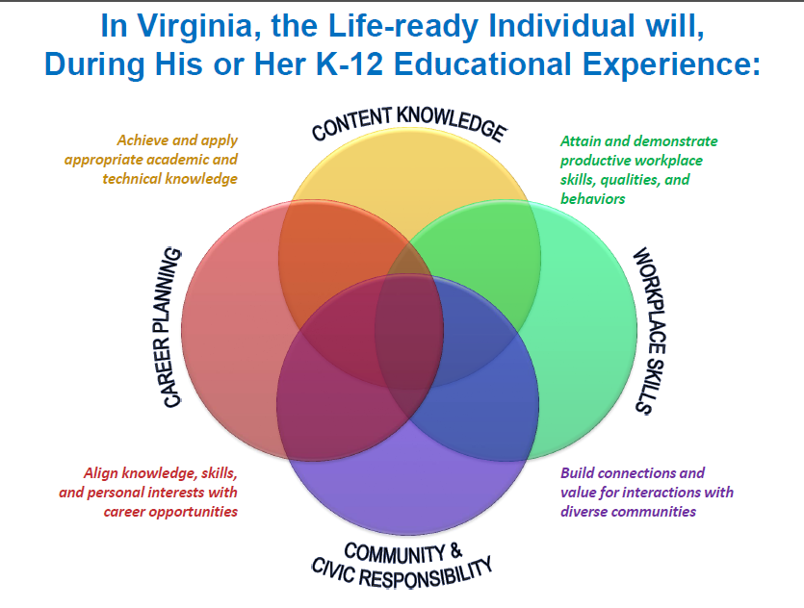
Virginia Board of Education
Notes:
Through legislation and instructions from the Governor, the VBOE was directed to develop the profile of a graduate. This profile should describe the knowledge, skills, experiences and attributes that students must attain to be successful in college and/or the work force and to be “life ready” in an economy and a world characterized by rapid change.

Slide 14
Virginia Board of Education
. . .earning a diploma should be about more than passing a prescribed series of courses and tests.
. . . graduates need skills and attributes such as critical thinking, creative thinking, communication, collaboration and citizenship, to be successful in life.
Notes:
Board heard from families, parents, students, military, businesses, higher education, etc…

Slide 15

What does this have to do with ME AND MY HISTORY AND SOCIAL SCIENCE COURSE?
Notes:
Partner discussion and post-it paper report outs.

Slide 16
Virginia Board of Education
The Guidelines for Local Alternative Assessments for 2016-2017 through 2018-2019 are intended to clarify the expectation that school divisions are to demonstrate progress in moving toward the use of performance assessments …and to provide the opportunity through a variety of approaches for students to be successful.

Slide 17

Notes:
Whether there is legislation, guidelines, or VDOE supports put into place, none of this gives permission for the following . . .

Slide 18
Does not give permission to
REMOVE History and Social Science from course offerings
REMOVE the instruction of History and Social Science
REMOVE the assessment of History and Social Science Standards of Learning

Slide 19
Code of Virginia
§ 22.1-253.13:1. Standard 1.
Instructional programs supporting the Standards of Learning and other educational objectives.
C. Local school boards shall develop and implement a program of instruction for grades K through 12 that is aligned to the Standards of Learning and meets or exceeds the requirements of the Board of Education. The program of instruction shall emphasize reading, writing, speaking, mathematical concepts and computations, proficiency in the use of computers and related technology, computer science and computational thinking, including computer coding, and scientific concepts and processes; essential skills and concepts of citizenship, including knowledge of Virginia history and world and United States history, economics, government, foreign languages, international cultures, health and physical education, environmental issues, and geography necessary for responsible participation in American society and in the international community; fine arts, which may include, but need not be limited to, music and art, and practical arts; knowledge and skills needed to qualify for further education, gainful employment, or training in a career or technical field; and development of the ability to apply such skills and knowledge in preparation for eventual employment and lifelong learning and to achieve economic self-sufficiency.

Slide 20
Code of Virginia
§ 22.1-253.13:1. Standard 1.
Instructional programs supporting the Standards of Learning and other educational objectives.
Local school boards shall develop and implement a program of instruction for grades K through 12 that is aligned to the Standards of Learning and meets or exceeds the requirements of the Board of Education.

Slide 21
Code of Virginia
§ 22.1-253.13:1. Standard 1.
Instructional programs supporting the Standards of Learning and other educational objectives.
The program of instruction shall emphasize reading, writing, speaking, . . . essential skills and concepts of citizenship, including knowledge of Virginia history and world and United States history, economics, government . . .

Slide 22
Implementation
Schedules

Slide 23
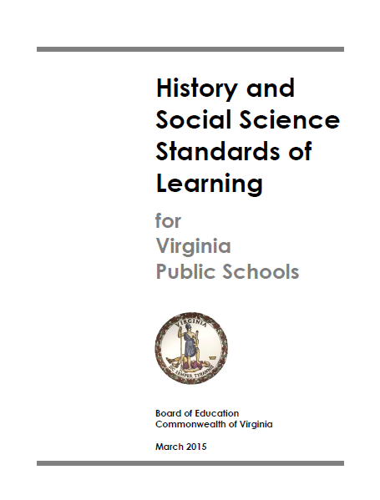

Full Implementation
Notes:
Familiarize and USE the 2015 Standards of Learning and Curriculum Frameworks

Slide 24
FULL Implementation of the
2015 History and Social Science Standards of Learning
Superintendent’s Memo #012-17
The Virginia Department of Education's goal is for full implementation of the 2015 History and Social Science Standards of Learning for schools beginning in the fall of 2018.

Slide 25
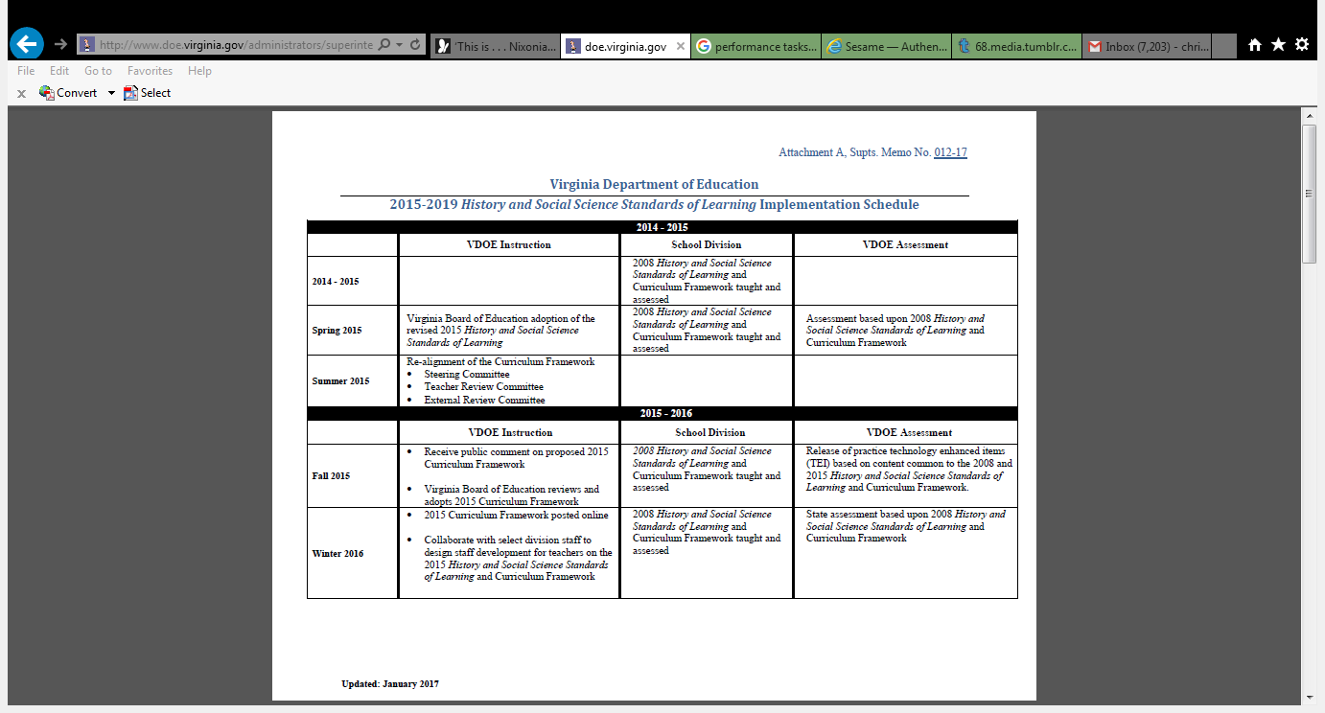
Superintendent’s Memo #012-17
Notes:
Discuss how the “new” Implementation Schedule supports school divisions, schools, and teachers with the opportunity to understand the transition of preparing instruction for students to take multiple choice state assessments to preparing instruction for students to take a local alternative assessments.

Slide 26
Implementation of
Local Alternative Assessments
Superintendent’s Memo #135-17
When: Timeline 2017-2020
Summer 2017
VDOE will work with points of contact (identified by region) to collect sample assessments in the areas of the five removed SOL assessments to begin the review and feedback process.
2017-2018 School Year
VDOE will expand upon the Virginia Quality Criterion Tool for Performance Assessment at multiple face-to-face and online workshops and offer professional learning opportunities through partnerships with other education organizations.
School divisions will continue to use the Virginia Framework for Local Alternative Assessment Implementation to guide implementation.

Slide 27
Implementation of
Local Alternative Assessments
Superintendent’s Memo #135-17
When: Timeline 2017-2020
Summer 2018
Every school division (3 staff per division) will participate in professional development regarding the Virginia Quality Criterion Tool for Performance Assessment and the use of rubric scoring. The train-the-trainer model will be used to support school divisions leading this effort locally. The processes could be used for performance assessments at the region, school division, school, or teacher team levels within the areas of the removed SOL assessments and other K-12 content area.
Summer 2019 and Summer 2020
VDOE will provide the forum to assist school divisions in the review of performance-based assessments and the use of scoring rubrics.

Slide 28
Local Alternative Assessment Guides and Resources

Slide 29
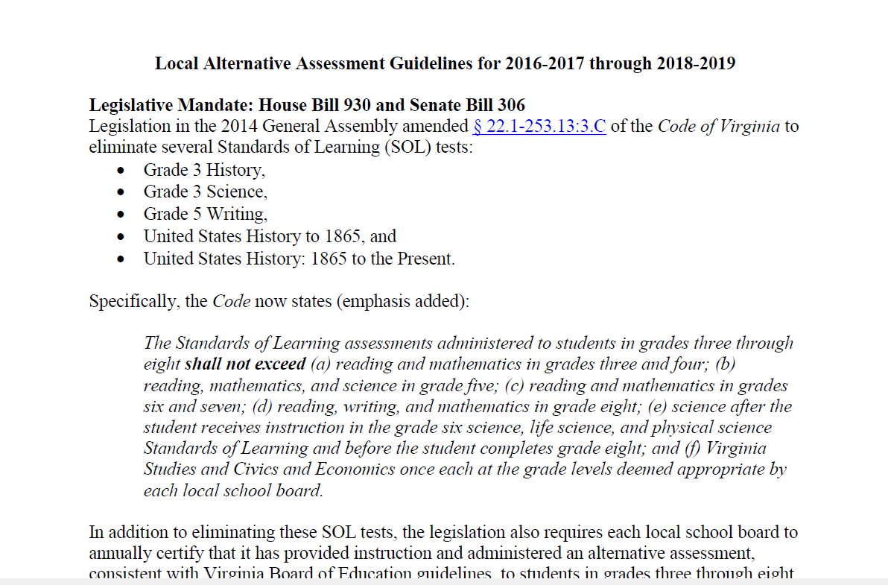
Virginia of Education Guidelines

Slide 30
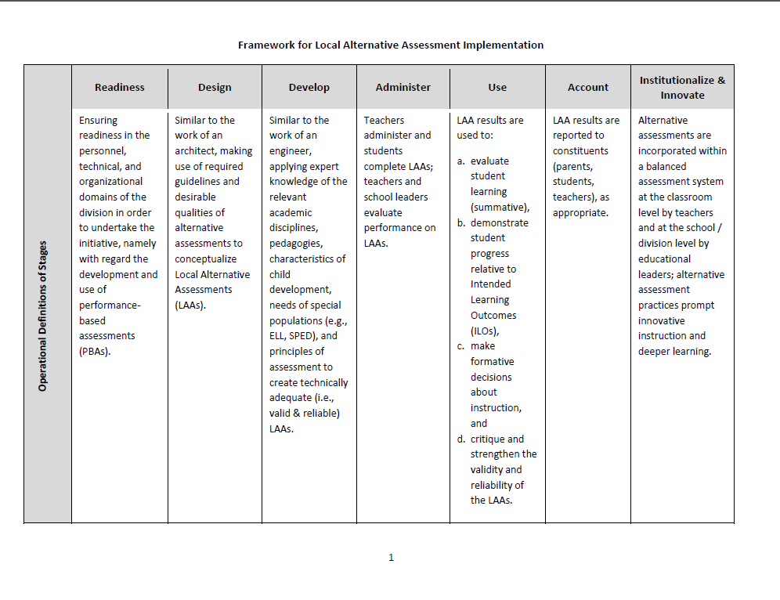
Framework for Local Alternative Assessment Implementation

Slide 31
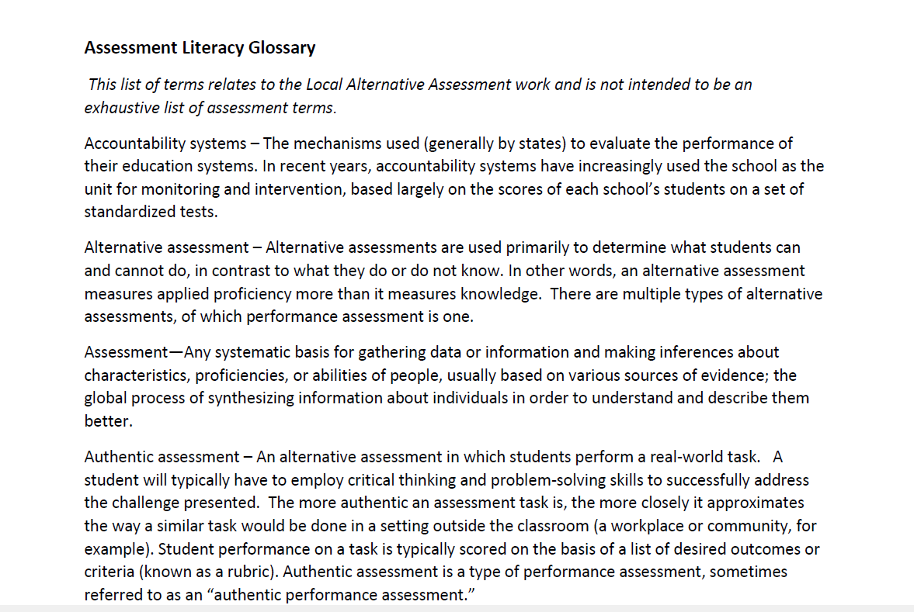
Assessment Literacy Glossary
Notes:
Assessment Activity:

Slide 32
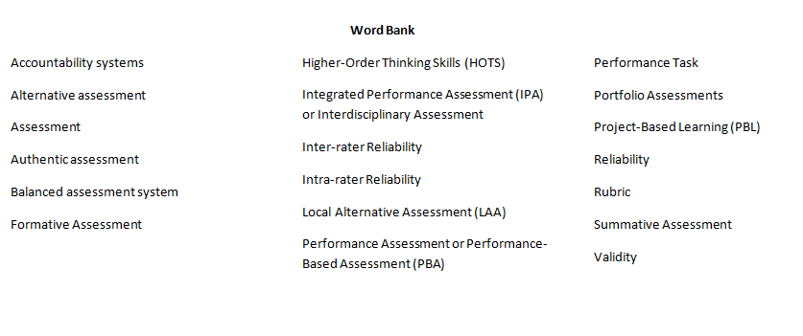
Categories
Notes:
Have teachers sort the assessment literacy glossary words into table defined categories. Have teachers discuss how they grouped the words and how they defined their categories. Have teachers talk at their tables and make any adjustments to their lists. Have tables report out and discuss.

Slide 33
Knowledge Rating Chart
Word | 1 I’ve never seen/heard this word before | 2 I know this word and how to use it, but couldn’t define for someone else | 3 I am pretty comfortable with this word. I can definitely it and use it | 4 I own this word.
Notes:
Have teachers sort the assessment literacy glossary words into the categories listed above. Ask teachers to talk with others at their table regarding the words and how they understand their purpose in classroom instruction and assessment.

Slide 34
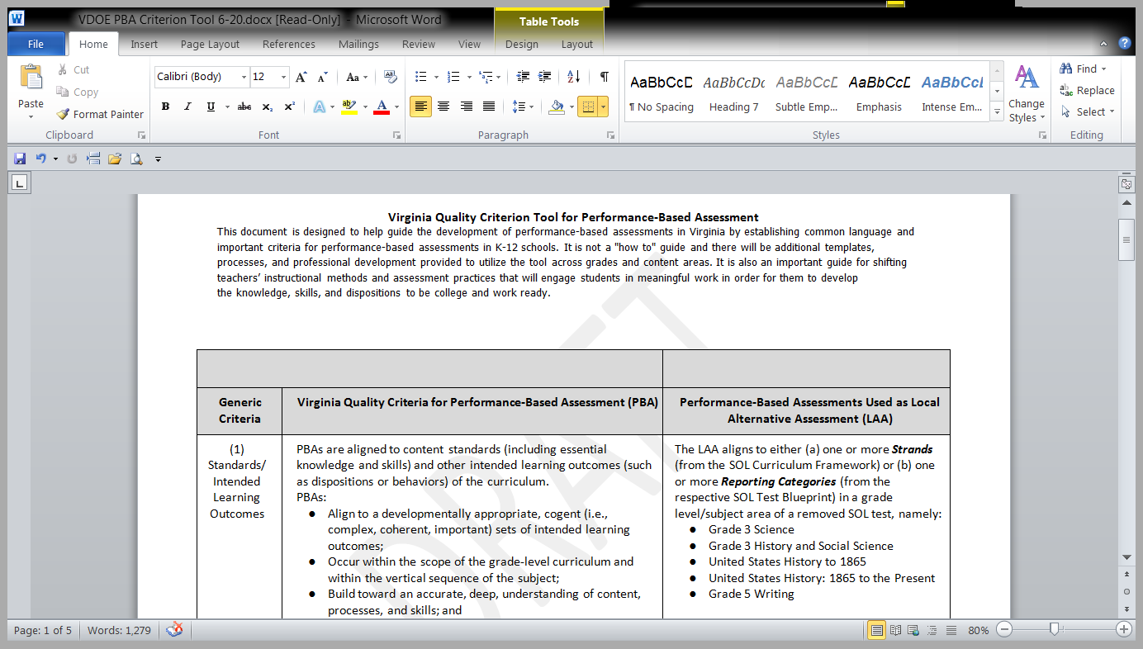
Virginia Quality Criterion Tool
Notes:
Sample LAAs to explain this Tool.

Slide 35

What questions do you still have?
Notes:
BIG POST - IT PAPER-
At your table- what are your questions. Record questions that you have, that participants may have based on the current guidelines. We will try to predict questions so that you are armed with knowledge, resources, etc. to respond.

Slide 36
Learning Experiences, Performance Tasks and
Local Alternative Assessments

Slide 37


Slide 38


Slide 39


Slide 40



Slide 41
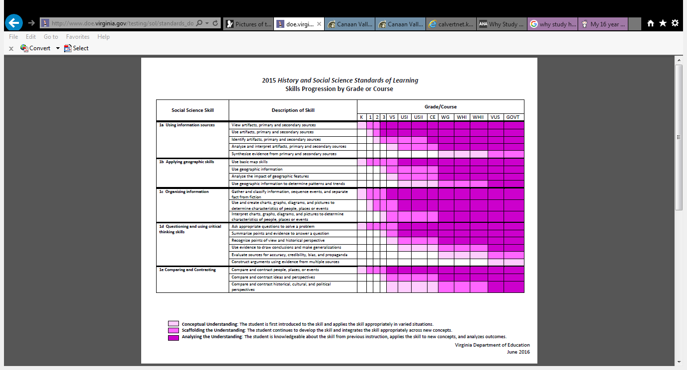
Skills Progression
Notes:
Discuss the progression of a skill from K – Government. Skills have always existed in the K-3 courses and the 2015 review spells out the skills for each of the K-3 courses. The skills define the expectations and will assist teachers as they plan their instruction.

Slide 42
What should the INSTRUCTION look like in the
Social Studies Classroom?
Notes:
Discuss:
The Learning Experiences and building to a Performance Task
What does the instruction “look” like?
How would you have students demonstrate their understanding of content and knowledge?

Slide 43
History and Social Science Instruction
Resources
Direct
Instruction
Checking for Understanding
Curriculum

Slide 44

We need to approach social studies instruction differently.

Slide 45

Fashion cycle of trends
Notes:
Even bell bottoms have come back around. Much like fashion, many people will say, “oh we did that when I first started teaching, before those SOLs.” Although this may be true, like those bell bottom jeans, they were constructed differently, developed for a different audience, and used different resources.

Slide 46

Notes:
We are looking to change history and social science instruction using learning experiences and performance tasks.

Slide 47
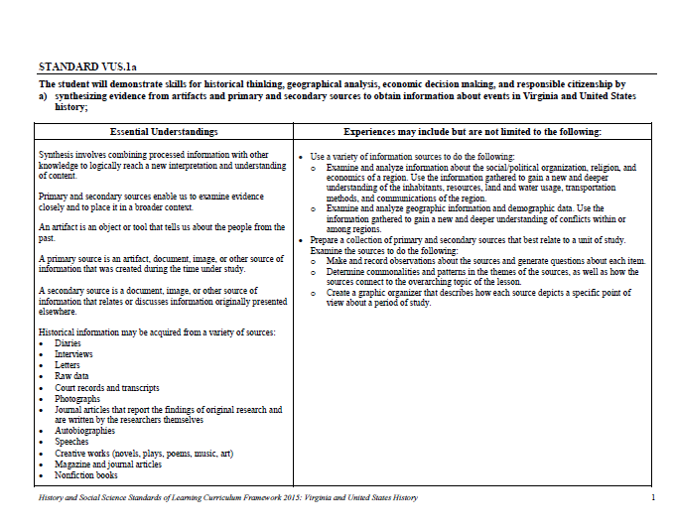
Experiences for Essential Skills
What are Experiences?
Notes:
Bring attention to the Experiences in the packet. Describe what they are and how they can be used. This is an example of what they can do for their presentations- Provide teachers with “experiences” and give them an opportunity to develop their own and share with the group.

Slide 48
Asking challenging questions that require students to give evidence or reasons for their conclusions and opinions.
Engaging students in organizing and interpreting content information.
Encouraging active student involvement with the teacher as the facilitator of learning.
Promoting and supporting interaction among students.
Connecting new learning and build prior knowledge.

Slide 49
ARTIFACT BOXES
Information Sources
Organize information
Compare and Contrast
Make Connections
Ask appropriate questions and summarize points and evidence
Notes:
Typically used in an elementary class. These same items, brought to a secondary level class, students have the ability and opportunity to:
See them as information sources
Organize them
Compare and contrast the items
Make connections between the items and/or with the content being taught
Ask questions about them, draw conclusions, summarize their points, and provide evidence
All of these actions are engaging

Slide 50

No longer is memorizing the facts enough.

Slide 51
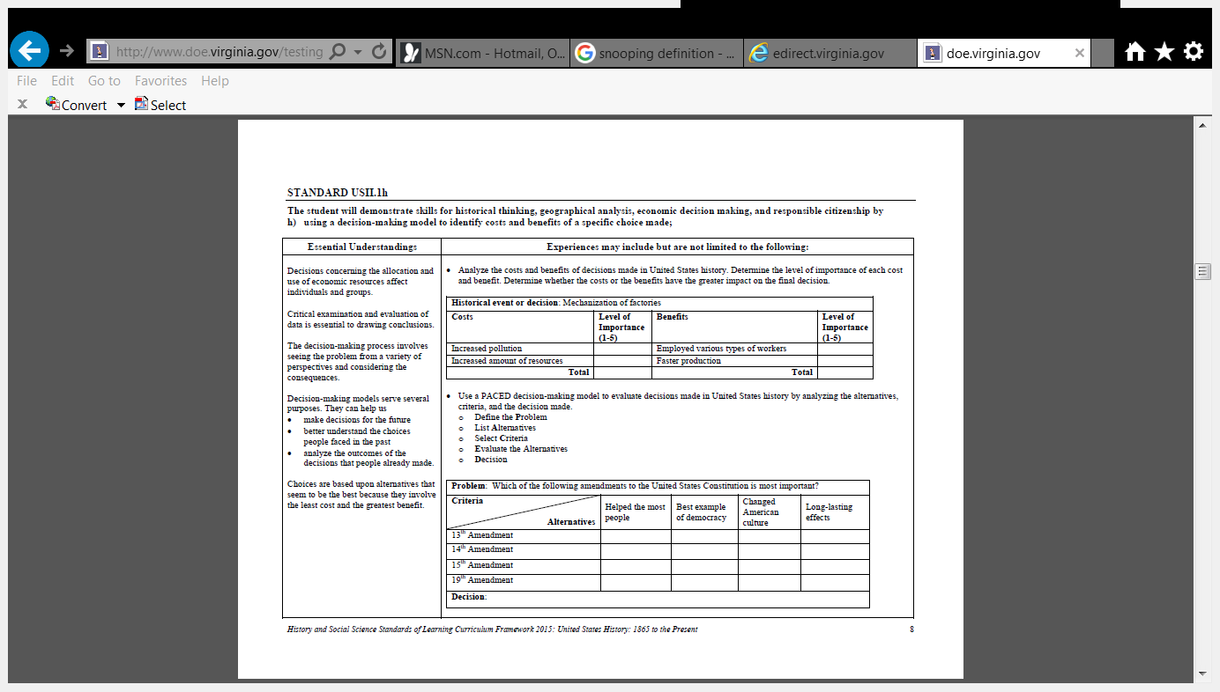
Using a decision-making model
Notes:
Decision-making model goes beyond knowing the content and context of each amendment.

Slide 52
Provide an opportunity to effectively collaborate and integrate.

Slide 53
Literacy Skills
Compared to History and Social Science Skills

Slide 54
History and Social Science
Analyzing and interpreting artifacts and primary and secondary sources to understand events in United States history.
Analyzing and interpreting geographic information to determine patterns and trends in United States history.
Interpreting charts, graphs, and pictures to determine characteristics of people, places, or events in United States history.
Using evidence to draw conclusions and make generalizations.
Comparing and contrasting historical, cultural, and political perspectives in United States history.
Determining relationships with multiple causes or effects in United States history. Explaining connections across time and place.
Using a decision-making model to identify the costs and benefits of a specific choice made.
Identifying the rights and responsibilities of citizenship and the ethical use of material or intellectual property.
Investigating and researching to develop products orally and in writing.
History and Social Science Standards of Learning, 2015.
Reading
Skim materials using text features such as type, headings, and graphics to predict and categorize information.
Identify main idea.
Summarize supporting details.
Create an objective summary including main idea and supporting details.
Draw conclusions and make inferences based on explicit and implied information.
Identify the author’s organizational pattern(s).
Identify transitional words and phrases that signal an author’s organizational pattern.
Differentiate between fact and opinion.
Identify cause and effect relationships.
Analyze ideas within and between selections providing textual evidence.
Use reading strategies to monitor comprehension throughout the reading process.
English Standards of Learning, 2017.

Slide 55
Performance Task
Performance Tasks allows for students to gather information and produce a product that demonstrates their understanding of content or a skill.
Notes:
Based on their work, they will determine what Manifest Destiny is? How and why was exploration encouraged? How did westward expansion impact the American Indian?

Slide 56

Think about what is essential for successful and effective instruction to prepare students for
Local Alternative Assessments

Slide 57

Thinking outside
of the box

Slide 58

Careful Planning

Slide 59

Thoughtful Collaboration

Slide 60
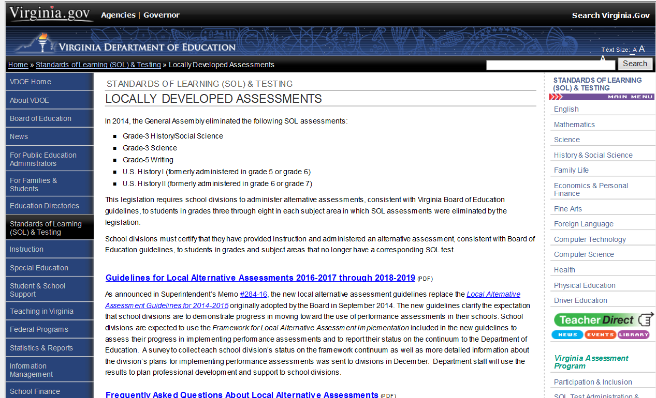
Virginia Department of Education
Notes:
Web page that will house information regarding LAAs

Slide 61
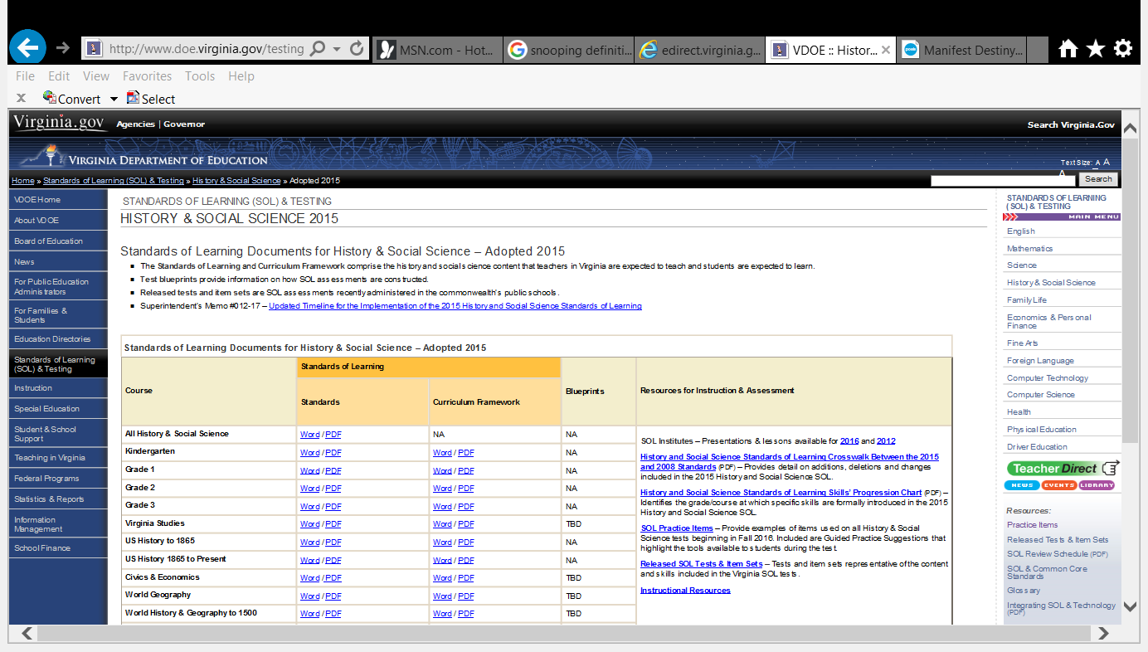
History and Social Science Standards of Learning

Slide 62
Places to Find Information Sources
CommonLit
https://www.commonlit.org/texts/manifest-destiny/paired-texts
The Library of Congress
https://www.loc.gov/
The Gilder Lehrman Institute of American History
https://www.gilderlehrman.org/
Stanford History Education Group
https://sheg.stanford.edu/
The Whitney Museum
http://collection.whitney.org/object/1192

Slide 63
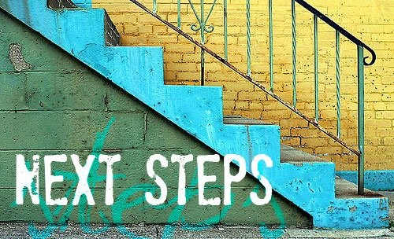

Slide 64

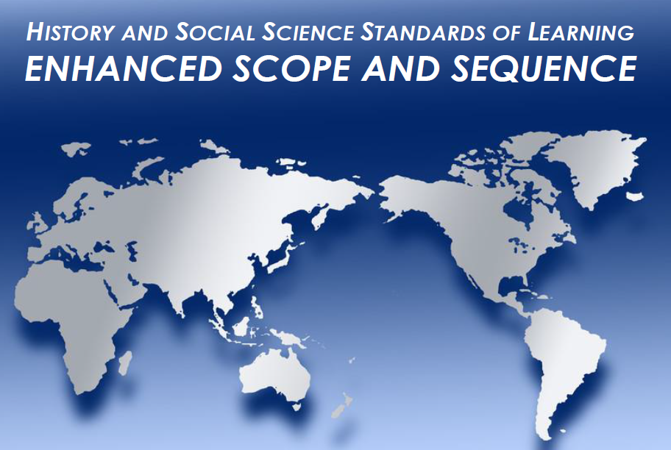
Resources

Slide 65





Resources
Notes:
Resources will come in the form of:
Flashdrive you were given at the registration table, partnerships, videos and other interactive platforms, while keeping in mind of what is available as an Open Educational Resource and keeping up with accessibility compliance standards.

Slide 66
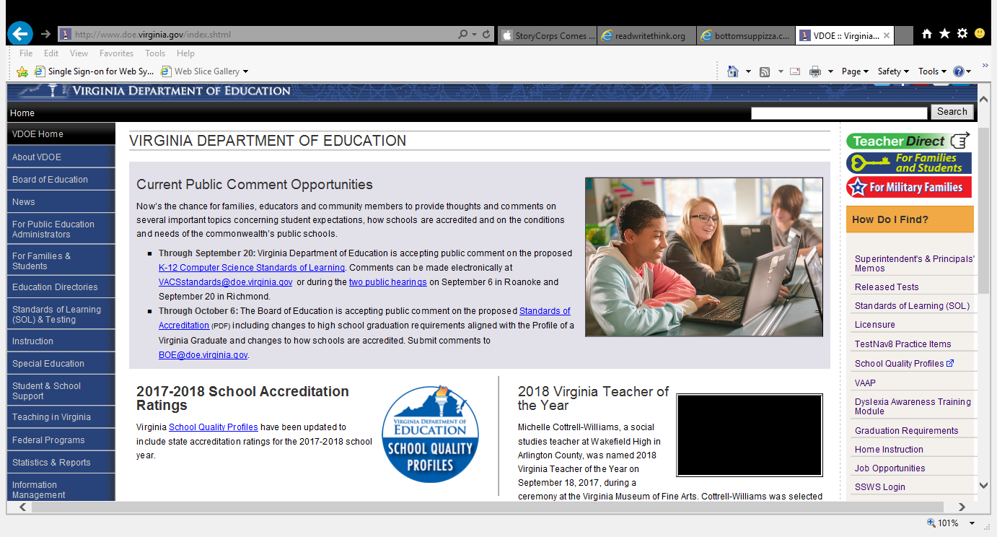
Communication
Notes:
Superintendent’s Memos are posted every Friday. Official correspondence from the VDOE to the public.

Slide 67
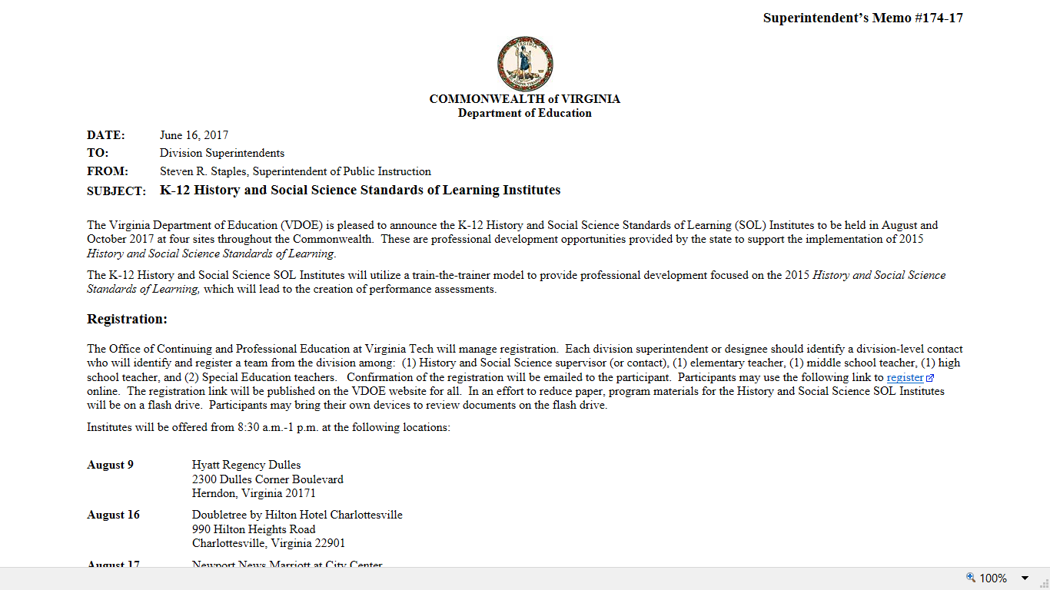
Communication
Notes:
Superintendent’s Memos are posted every Friday. Official correspondence from the VDOE to the public.

Slide 68
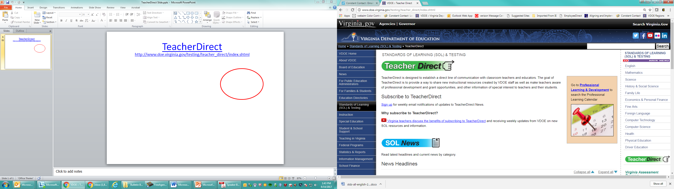
TeacherDirect
Communication
http://www.doe.virginia.gov/testing/teacher_direct/index.shtml

Slide 69


Slide 70
Exit Slip http://tinyurl.com/2017HSS
VDOE Presentation
3 | I have learned today . . .
2 | Questions I still have . . .
1 | Next step . . .

Slide 71

Betsy Barton, Elementary, History and Social Science Specialist
E-mail: Betsy.Barton@doe.virginia.gov
Jill Nogueras, English, History and Social Science Specialist
E-mail: Jill.Nogueras@doe.virginia.gov
Christonya Brown, K-12, History and Social Science Coordinator
E-mail: Christonya.Brown@doe.virginia.gov

Slide 72
Making Connections
Performance-Based Assessment within
a Balanced Assessment Framework
Please follow along: https://goo.gl/8Uj9qs
Lynne Bland
Chesterfield County Public Schools
Annie Evans
Charlottesville City Public Schools
Jennifer Brown
Fairfax County Public Schools
Ellen Stick
Roanoke City Public Schools
Notes:
30 seconds
Introduce ourselves
Mention we are one of 4 presentations going on around the state as we build a community of support and “risk takers” on our journey to quality first instruction and assessments.

Slide 73
Here’s What...Now What?
Local Alternative Assessment Guidelines 2016-2019
“This expanded use of authentic, performance assessments constitutes a direction for the Commonwealth that is still relatively new. As such there is no expectation that the performance assessments will be perfectly executed immediately; rather this should be viewed as an opportunity to engage in innovation that will provide new opportunities for students to demonstrate their knowledge of the curriculum.”
Source:
Attachment A to Supt’s Memo 284-16 November 11, 2016
Notes:
30 seconds
recap of Christonya’s earlier presentation. Spiral back to: Attachment A to Supt’s Memo 284-16 November 11, 2016
Include a copy in the handouts so they all have access and can read the full document.
Reiterate: We are a community of learners, this will be a process, it won’t be perfect at first and that is perfectly OK!!

Slide 74

Take Off-Touch Down
Structure adapted from Kagan
I am a classroom teacher/resource teacher
I am an administrator, educational leader, director, or superintendent
I am a specialist, coordinator, or supervisor of social studies
I have experience using performance-based assessments
I have created performance-based assessments
Notes:
2 min
Let participants know this is a Kagan Structure
Ask participants to stand up as the category applies to them (may stand for more than one, esp. the last 2 categories)
MINDSET - Want to be sure we communicate this is a way to EMPOWER teachers to embrace this shift in assessments, not a “Top Down” one size fits all mandate.

Slide 75
Today’s Learning Targets
Gain an awareness of performance-based assessments (PBA) within a balanced assessment approach
Explore the Quality Criterion Tool to understand the elements of a high-quality PBA.
Recognize the role of a PBA used as a Local Alternative Assessment (LAA)
Notes:
1 min
This follows a clear progression:
What is a PBA and how does it benefit our students, now here is a tool the state has provided to help teachers develop PBAs, and how do PBAs as part of a Balanced Assessment Plan fit into the state LAA guidelines?

Slide 76

We are on
a journey…
Notes:
30 seconds
As you know we are on a journey. A journey that began in 2001 when NCLB imposed accountability for teaching the standards through the SOL tests. Through the years, this has become our culture, our normal. We teach our students essential knowledge to prepare them for cumulative, high-stakes multiple-choice tests at the end of each school year. Over the past couple of years, our SOL tests have become more rigorous, requiring us to really make sure essential skills are part of our instruction – being taught in conjunction with essential knowledge. Skills like cause/effect, sequencing events, inferring, analyzing primary source documents – these are all skills that students need to think historically, but also to do well on the SOL test now. I think we can all agree that we have been living in a culture of high-stakes testing and have been conditioned to the multiple choice SOL tests for the a long time.
However, our journey in thinking about what good assessment practices truly are is only just beginning, as this year the state of Virginia has finally given us the flexibility to expand and stretch our thinking about assessment with the elimination of social studies tests in grade 3 and USI and USII. So, now the question becomes, what does balanced assessment look like? What does that mean for us in social studies?

Slide 77
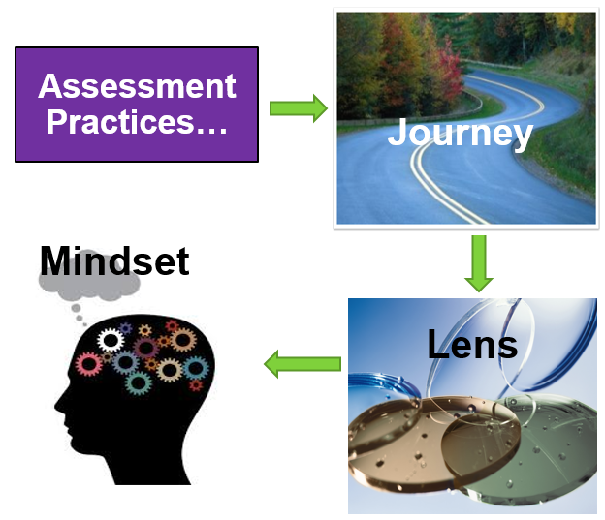
Notes:
30 seconds
On this journey, we have the opportunity to look at assessment and instruction through a different lens – shift our mindset and focus our instruction on higher levels of thinking, deeper understanding of content and applying knowledge through skills.
Reference “Profile of a Graduate”

Slide 78
BALANCED ASSESSMENT
Traditional Assessments
Multiple Choice Tests, Quizzes, Observations
Assess knowledge & skills; not usually authentic
Performance Assessments
Application, Transfer
Critical & Creative Thinking Skills
Authentic Assessments
Performance in an authentic context
Adapted from McTighe, 2013
Notes:
1 minute
What do you notice about this chart?
What questions do you have about what you notice?
Now, turn and talk at your table about these two things.
This chart shows a range of assessments that many of us already use in our classrooms. Traditional assessments are most commonly used to measure newly learned knowledge and skills. In social studies, this may take the form of multiple choice benchmark tests, or a geography quiz assessing whether students can locate continents and oceans on a map of the world. These formative assessments are still very valuable and play a large part in a balanced assessment framework. However, when we look to measuring learning goals that reflect 21st Century Skills (critical thinking, communication, collaboration, etc.) we need to consider performance assessments that can help students demonstrate application of knowledge and potential long term transfer. A balanced assessment plan include multiple forms of assessment, including multiple choice, constructed response, or PBAs.

Slide 79

Balanced Assessment
What do students know?
What can students do?
Essential Knowledge
Essential Understandings
Basic facts
transferable
Essential Skills
Concepts
Real World Situations
Adapted from Instruction for All Students, by Paula Rutherford
Notes:
1 minute
When we think about social studies assessment, and assessment in general, we want to try to provide opportunities for students that are balanced, and not just focused on one type of assessment (like a multiple choice test). Of course we want to assess essential knowledge, basic facts and concepts – we want students to be able to show what they know. However, it’s so much more than that. We also want students to be able to show us what they can DO with what they know. Multiple choice tests cannot assess whether students can actually apply concepts and transfer essential skills in real world situations.

Slide 80
Balanced Assessment
What do students know?
What can students do?
Multiple Choice
Matching
True/False
Fill-in-the-Blank
Performance-Based Assessments
Adapted from Instruction for All Students, by Paula Rutherford
Notes:
1 minute
In thinking about creating a balanced assessment framework in our classrooms, that is not to say there is no place for multiple choice, matching, true/false, fill-in-the-blank in our classrooms. These types of formative assessments still tell us great information about what our students know about newly learned content, especially in social studies. However, performance-based assessments and higher-level thinking type tasks can also tell us what students can DO with that newly learned content – do they TRULY understand how it applies to the world around them.

Slide 81

Performance-Based Assessment
Performance Assessments generally require students to perform a task or create a product that is typically scored using a rubric. Authentic performance assessments often include tasks that mirror those that might occur in a “real-life” situation.
Source: Attachment A to Supt’s Memo 284-16 November 11, 2016
Notes:
1 minute
Take a moment read the most recent definition of Performace-Based Assessment.
In looking at the most recent VDOE definition of Performance-Based Assessment, note the keywords that jump out to us:
perform a task / create a product
scored using a rubric
real-life situation

Slide 82

Characteristics of High-Quality Performance-Based Assessments
Clear connections to rigorous standards
Engaging, active learning
Authentic / real-world application
Open-ended / multiple right answers
Final product
Choice
Clear task and prompt
Criteria for measurement
(rubric, checklist, etc.)
Image courtesy of Microsoft clipart
Notes:
1 minute
Performance-Based Assessments are often characterized by the following attributes – we should keep these in mind when creating them:
Clear connections to rigorous standards
Engaging, active learning
Authentic / real-world application
Open-ended / multiple right answers
Final product
Choice
Clear task and prompt
Criteria for measurement (rubric, checklist, etc.)

Slide 83

Shifting Instruction
The new 2015 HSS Standards lend themselves to PBAs!
We teach content through the skills in Standard 1.
Notes:
I minute
Thinking about assessment in a different way will allow us to consider our instruction in a different way as well. We cannot focus our instruction any longer on just low level Bloom recall and comprehension of factual information. We must teach students how to synthesize and apply new learning in meaningful ways.
The 2015 SOLs, and particularly Standard 1 (SKILLS) lend themselves to this type of instruction will help prepare our students for performance-based types of assessments.
Refer to full Attachment A to Supt’s Memo 284-16 November 11, 2016 to read full text

Slide 84
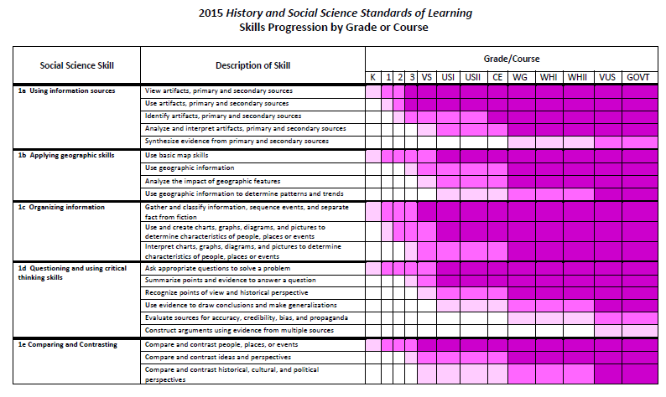
Standard 1
Be Thinking About….
How can these skills be leveraged within our instruction to help students:
deepen understanding of Social Studies content
solidify Profile of a Graduate attributes
Notes:
2 minutes
Take a moment to review the Skills Progression Chart that details Standard 1 (on tables).
Be thinking about how these skills can and should be leveraged to help students deepen understanding of social studies content and solidify Profile of a Graduate attributes.

Slide 85

How do we determine if a
performance-based assessment is
high-quality?
Notes:
30 seconds
During the next piece of our work together, we will focus on thinking about what makes a PBA a HIGH QUALITY assessment? How can we, as teachers, determine if the assessments we use or create are high quality?
Transition into using the tool with an actual PBA (VCEE developed PBA - used with permission).

Slide 86
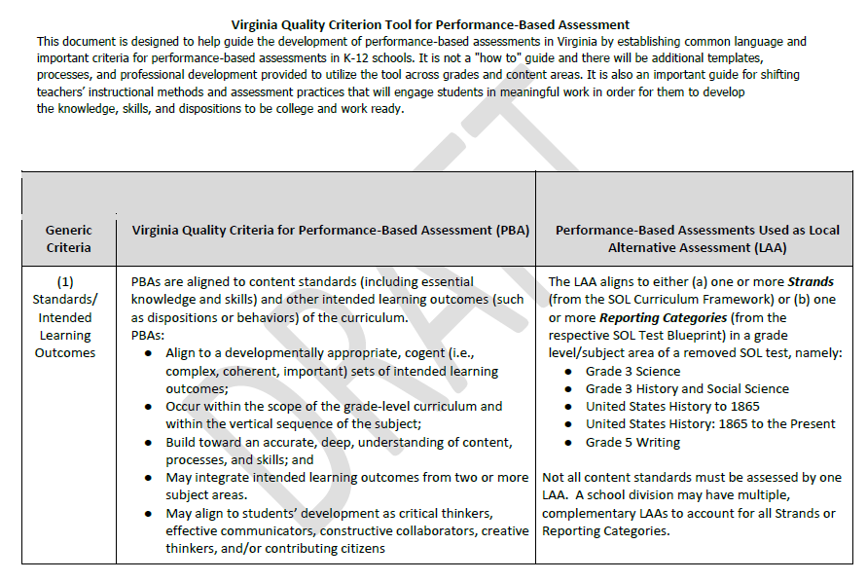
Virginia Quality Criterion Tool for PBA
Locate this document on your table!
Notes:
30 seconds
On your tables, you have a copy of the Virginia Quality Criterion Tool for PBA. Let’s take a few moments to explore this tool.

Slide 87

Virginia Quality Criterion Tool for Performance-Based Assessment
Take a few minutes to explore and become familiar with the
Virginia Quality Criterion Tool for Performance-Based Assessment.
Questions to Guide Thinking:
  What do you notice?
  Based on what you notice, what questions do you have?
highlight, take notes, jot thoughts and questions on post-its!
Notes:
10 minutes (Post its, highlighters already on table with hard copies of all activities EXCEPT exit ticket)
Invite participants to explore and become familiar with this tool on their own.
Encourage them to take notes, highlight and jot questions or comments on post-it notes to hang on chart paper.
Chart paper - - one for each criteria.
Put your I noticed comments on the big chart paper, and one scribe writes them on the Feedback Copy for VDOE to collect (different color paper)

Slide 88

Virginia Quality Criterion Tool for Performance-Based Assessment
Questions to Guide Discussion:
  What do you notice?
  Based on what you notice, what questions do you have?
Notes:
5 minutes
As a team or table group, share out thoughts about QCT using the guiding questions
On chart paper, have a scribe add comments to the “Feedback Copy” for VDOE
Need to have one person at each table “scribe” the overall impressions, questions on the “Feedback Copy” of the QT (on different colored paper). At end, when share out they add their feedback to the Feedback Copy of the tool at their table.

Slide 89
Let’s Take a Closer Look
Notes:
1 minute
Point out the paragraph at the TOP of the document:
establishing common language
important criteria
a “how to” guide
shifting instructional methods/assessment practices
Last sentence around Profile of a Graduate reminds us of where we want our students to be in the future……
Mention that this tool has been developed with the help of many teachers, college methods and assessment educators,professional educational organizations, as well as VDOE staff.

Slide 90
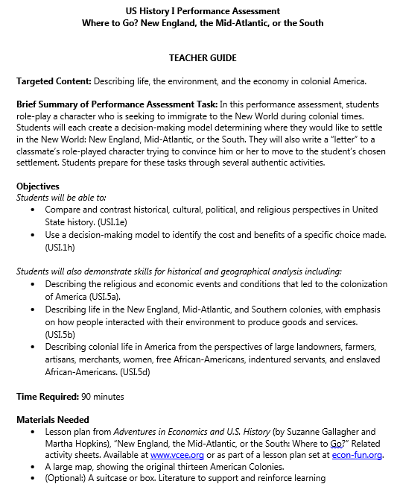

Your Task:
Familiarize yourself with this performance-based assessment.
In pairs or as a table group, analyze the strength of this PBA as you align it your assigned criteria from the QCT.
Discuss:
  Is this criteria strong? Weak? Why or why not?
  How might you modify this PBA to meet this PBA to meet this particular criteria?
Access this PBA from VCEE here.
Created by Ruth Cookson and Stephen Day for the Virginia Council on Economic Education (VCEE). Used with permission from VCEE.
Notes:
5-8 minutes Use table tents (numbered 1-10) to assign which Criteria each table will look at and compare to the PBA from VCEE.
Task:
become familiar with PBA (1-2 minutes) VCEE Lesson; Where to Go
Analyze the PBA and align it to the your group's’ assigned criteria (table tent #)
Discuss questions as a group:
Is this criteria strong in this PBA? Why or why not?
How might you modify this PBA to meet this particular criteria?

Slide 91

Thoughts, Considerations, Reflections
Notes:
Transition Slide:
Whole group discussion of each criteria as it aligns with the PBA

Slide 92
Virginia Quality Criterion Tool for Performance-Based Assessment
Generic Criteria | Evidence from sample PBA
(1) Standards Intended Learning Outcomes | Objectives Students will be able to: Compare and contrast historical, cultural, political, and religious perspectives in United States history. (USI.1e) Use a decision-making model to identify the cost and benefits of a specific choice made. (USI.1h) Students will also demonstrate skills for historical and geographical analysis including: Describing the religious and economic events and conditions that led to the colonization of America (USI.5a). Describing life in the New England, Mid-Atlantic, and Southern colonies, with emphasis on how people interacted with their environment to produce goods and services. (USI.5b) Describing colonial life in America from the perspectives of large landowners, farmers, artisans, merchants, women, free African-Americans, indentured servants, and enslaved African-Americans. (USI.5d)
Considerations:
Do objectives and standards = Intended Learning Outcomes?
Do the Intended Learning Outcomes align to multiple subject areas?
Do the Intended Learning Outcomes align to the 5cs?
Notes:
Here is where we compare the PBA to see if it matches the standard(s) nad if the intended learning outcomes are clear, as well as reference the 5 C’s :

Slide 93
Virginia Quality Criterion Tool for Performance-Based Assessment
Generic Criteria | Evidence from sample PBA
(2) Cognitive Demand | 6. Lastly, for the performance assessment, students must create a PACED decision-making model to make a final decision of where to live. They will then write a persuasive “letter” to another student in the class’ character urging him or her to move to where the student settled. The purpose of this is to make students describe colonial life from the perspectives of various settlers, and to consider how they interacted with their environment and the social conditions of different regions of the New World
Considerations:
Does the cognitive demand require more than simple recall?
Are higher-order thinking skills applied?
Are subject-specific competencies required?
Notes:
Is this really a good fit for a PBA - not a one word / recall or Google It answer, makes them think, reflect, analyze, HOTS …. are the skills in Standard 1 embedded and needed to complete the task?

Slide 94
Virginia Quality Criterion Tool for Performance-Based Assessment
Generic Criteria | Evidence from sample PBA
(3) Authenticity | Brief Summary of Performance Assessment Task: In this performance assessment, students role-play a character who is seeking to immigrate to the New World during colonial times. Students will each create a decision-making model determining where they would like to settle in the New World: New England, Mid-Atlantic, or the South. They will also write a “letter” to a classmate’s role-played character trying to convince him or her to move to the student’s chosen settlement. Students prepare for these tasks through several authentic activities.
Considerations:
Is authenticity reflected by a genuine task relatable to a similar task that would be done outside of the classroom and in a real-life setting (ex. a workplace or community)?:
Is there a target audience?
Notes:
Connection to Profile of a Graduate, career pathways, connect to immigrant experiences today, AVID

Slide 95
Virginia Quality Criterion Tool for Performance-Based Assessment
Generic Criteria | Evidence from sample PBA
(4) Verbal Reasoning Explanation | 5. Students will then have a discussion in which they share why they chose the region they did, and which other area they might have considered. They can even say why they may move back to the Old World (this gives more options). This allows students to become familiar with each other’s characters. The teacher should also make all the character descriptions available to each student, for reference. 6. They will then write a persuasive “letter” to another student in the class’ character urging him or her to move to where the student settled.
Considerations:
Are there opportunities for students to engage in constructive conversations?
Notes:
Again, opportunity to connect to the 5 Cs...decision making in skills in Standard 1

Slide 96
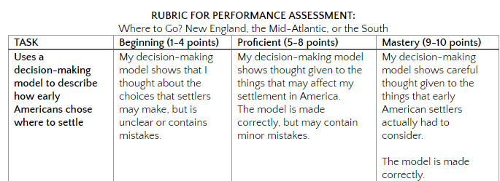
Virginia Quality Criterion Tool for Performance-Based Assessment
Generic Criteria | Evidence from sample PBA
(5) Success Criteria
Considerations:
Does the success criteria provide for a variety of assessment opportunities?
Notes:
Remind teachers it is OK to modify the task as needed to fit the needs of all learners - ELs, SPED, etc

Slide 97
Virginia Quality Criterion Tool for Performance-Based Assessment
Generic Criteria | Evidence from sample PBA
(6) Student Directions Prompt | Goal Your goal is to understand the difficult choices faced by early colonists as they tried to decide where in the colonies to settle. Role You will play the role of an early colonist from Europe who is trying to get other settlers to come begin a settlement. Your teacher will give you background information on your character so you can make more realistic choices. Audience Your audience is the other “settlers” in the class. It will be your job to try to persuade them to join you in your chosen place of settlement.
Considerations:
Are the student directions and prompt clear and developmentally appropriate, and aligned to the Quality Criteria?
Notes:
This is where piloting the PBAs, and analyzing student work in PLCs continues the learning for teachers …. it will NOT be perfect the first time, and that is okay. Analysis of student work helps us refine a task so it gets better for future use.

Slide 98
Virginia Quality Criterion Tool for Performance-Based Assessment
Generic Criteria | Evidence from sample PBA
(7) Accessibility | Instructional Modifications/Accommodations/Differentiated Instruction Required reading for this lesson is minimal, with prompts being very brief. The suitcase, map, paper characters, and decision-making model are all graphical/pictorial representations that help students to learn visually. Optional reading can be used as enrichment. Lesson encourages students to understand diverse perspectives.
Considerations:
Are all students able to access this assessment (students with special learning needs, limited access to technology, ELs, etc.)?
Notes:
Be sure to mention that it is okay to modify a PBA to meet the needs of all learners - if students need a paper/pencil version vs. digital, or students need a word bank or sent frame while they are still learning English, that is okay, in fact that is good practice! This is a HUGE shift in mindset -- as our state moves away from a more traditional multiple choice assessment, the intent of the legislation is clear that multiple assessements and using a variety of assessments will enhance the teaching and learning of the new standards. Standard 1 opens the door to teaching skills

Slide 99
Virginia Quality Criterion Tool for Performance-Based Assessment
Generic Criteria | Evidence from sample PBA
(8) Feasibility | Time Required: 90 minutes 4. After completing the lesson plan in which students choose where to settle, remind students that they are going to be writing a persuasive letter, so they should consider what they could say to get others to want to move to their region. 6. ...write a persuasive “letter” to another student in the class’ character urging him or her to move to where the student settled.
Considerations:
Is the duration and expectation of the task realistic and developmentally appropriate?

Slide 100
Virginia Quality Criterion Tool for Performance-Based Assessment
Generic Criteria | Evidence from sample PBA
(9) Instruction | Literature to Support and Reinforce Learning. These books can be used to increase student depth of knowledge with his or her assigned character. Outrageous Women of Colonial America (Mary Rodd Furbee, 2001). Books by James E. Knight: The Village: Life in Colonial Times (1982), The Farm: Life in Colonial Pennsylvania (1998), Seventh and Walnut: Life in Colonial Pennsylvania (1982), Salem Days: Life in a Colonial Seaport (1982), Journey to Monticello: Traveling in Colonial Times (1999). Some Suggested Lessons and Resources to Build Prior Knowledge The performance assessment is a companion to the lesson plan entitled “New England, the Mid-Atlantic, or the South: Where to Go?” described above. The lesson plan is necessary as background information. It can be obtained on the VCEE website (www.vcee.org), and is part of a set available for purchase at econ-fun.org.
Considerations:
What does instruction need to look like leading up to this PBA?
Do students have the skills and knowledge to be successful?
Notes:
Good opportunity here to mention Standard 1 in the new SOL - have we taught them the skills needed to be successful on this PBA? Do they know how to write a friendly letter? Have we practiced using a decision making model?

Slide 101
Virginia Quality Criterion Tool for Performance-Based Assessment
Generic Criteria | Evidence from sample PBA
(10) Teacher Materials Substantiation | Materials Needed Lesson plan from Adventures in Economics and U.S. History (by Suzanne Gallagher and Martha Hopkins), “New England, the Mid-Atlantic, or the South: Where to Go?” Related activity sheets. Available at www.vcee.org or as part of a lesson plan set at econ-fun.org. A large map, showing the original thirteen American Colonies. (Optional:) A suitcase or box. Literature to support and reinforce learning
Considerations:
Is the duration and expectation of the task realistic and developmentally appropriate?

Slide 102
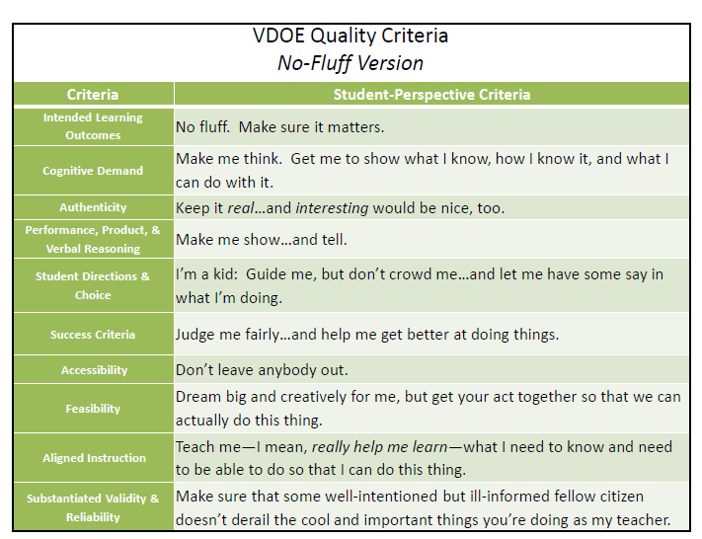
Food for Thought….
Used with permission of Dr. Chris Gareis
Notes:
2 minutes
Credit Dr. Chris Gareis…. William and Mary
Here is where we will “Keep it Real” - what do each of these criteria really mean in terms of my daily instruction and how it needs to change as we all move towards embedding the skills in standard 1 and changing the way we assess our students’ learning….

Slide 103

If we are asked to STRETCH our thinking about assessment, we also need to stretch our thinking about instruction…
Image courtesy of Microsoft clipart
Notes:
1 minute
So, if we are asked to stretch our thinking about assessment and look towards more balanced assessment practices, like PBAs, we also need to continue to stretch our thinking about instruction. What does our daily social studies instruction look like to prepare our students for PBAs? How can we prepare our students to be successful on high-level tasks and performance-based assessments?

Slide 104

What should social studies instruction look like to prepare our students to be successful with a performance-based assessment that we might give at the end of a unit of study?
Image courtesy of Microsoft clipart
Notes:
1 minute
So, now the question becomes:
What should social studies instruction look like to prepare our students to be successful with a performance-based assessment that we might give at the end of a unit of study?
In your next session, you will focus on this shift in instruction - what needs to happen in classrooms for students to be successful on PBAs?

Slide 105
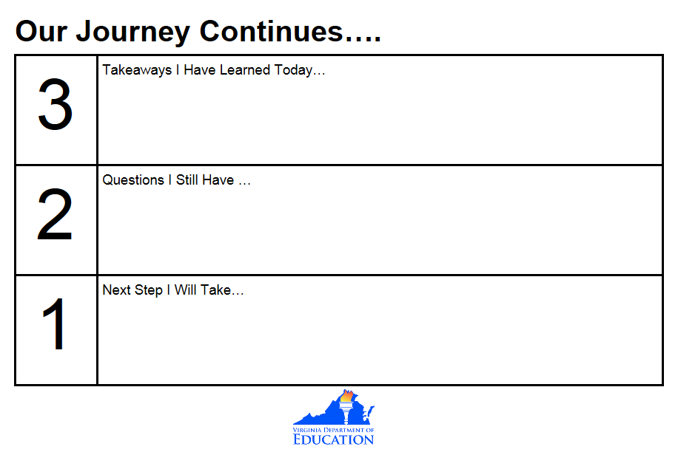
Final Thoughts
Submit Digital Responses via Google Form
Notes:
8 minutes
Time to reflect and submit, paper or digital copy…..

Slide 106
Disclaimer
Reference within this presentation to any specific commercial or non-commercial product, process, or service by trade name, trademark, manufacturer or otherwise does not constitute or imply an endorsement, recommendation, or favoring by the Virginia Department of Education.

Slide 107

Stay in Touch!

