Slide 1
Planning Instruction to
Prepare Elementary Students for
Local Alternative Assessments
August 2017

Slide 2
What to Consider When
Planning...
• SOL/Curriculum Framework
• Desired Student Outcome
  What do you want students to be able to do or know once you are finished with your lesson or unit?
• Social Science Skills
• Product (LAA)
• Performance Activities

Slide 3
Location, Location, Location
Geography
Geographic skills begin in K with
conceptual understanding and move to scaffolding the understanding in 1st – Virginia Studies

Slide 4
Social Science Skills
In every example K- Virginia Studies, we focused on the same social science skills:
  1a View artifacts, primary/secondary sources
  1b Use basic map skills
  1b Use geographic information
  1i Practice citizenship skills through collaborating, compromising, and participating in classroom activities
  1e Compare and Contrast people, places, or events
  1j Develop fluency in vocabulary, and comprehension of verbal, written, and visual sources.

Slide 5

Kindergarten
Standard: K.1b: The student will demonstrate skills for historical thinking, geographical analysis, economic decision making, and responsible citizenship by using basic map skills to support an understanding of the community
Desired Outcome: Create a map from our class to the playground and use relative location terms to describe where objects are located.

Slide 6
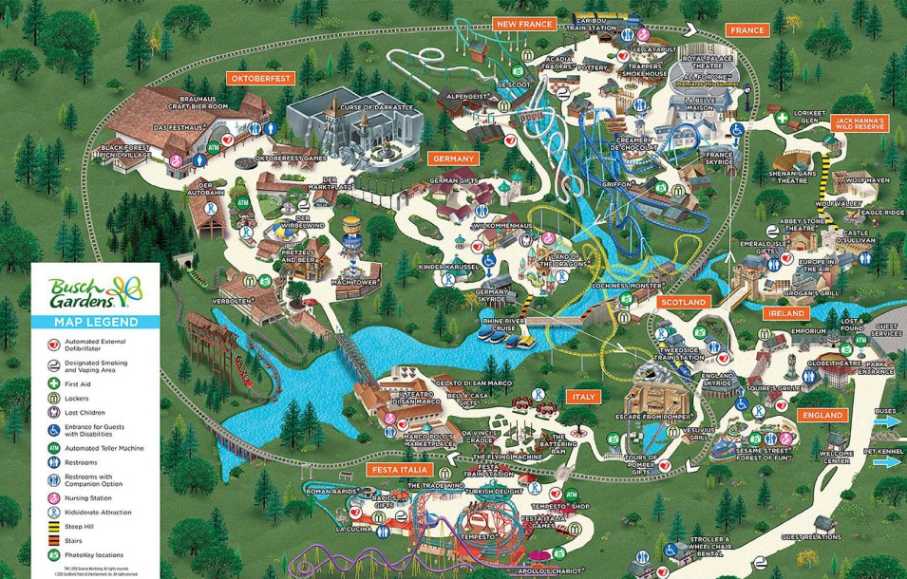
Think/Pair/Share
Notes:
Image: http://bgwfans.com/2016/map-and-fun-tracker/#map

Slide 7
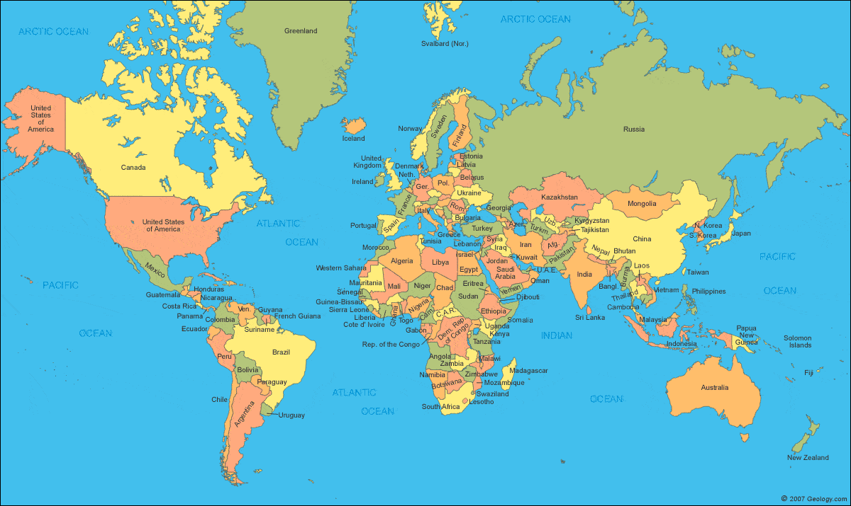
Think/Pair/Share
Image: http://geology.com/world/world-map.shtml

Slide 8
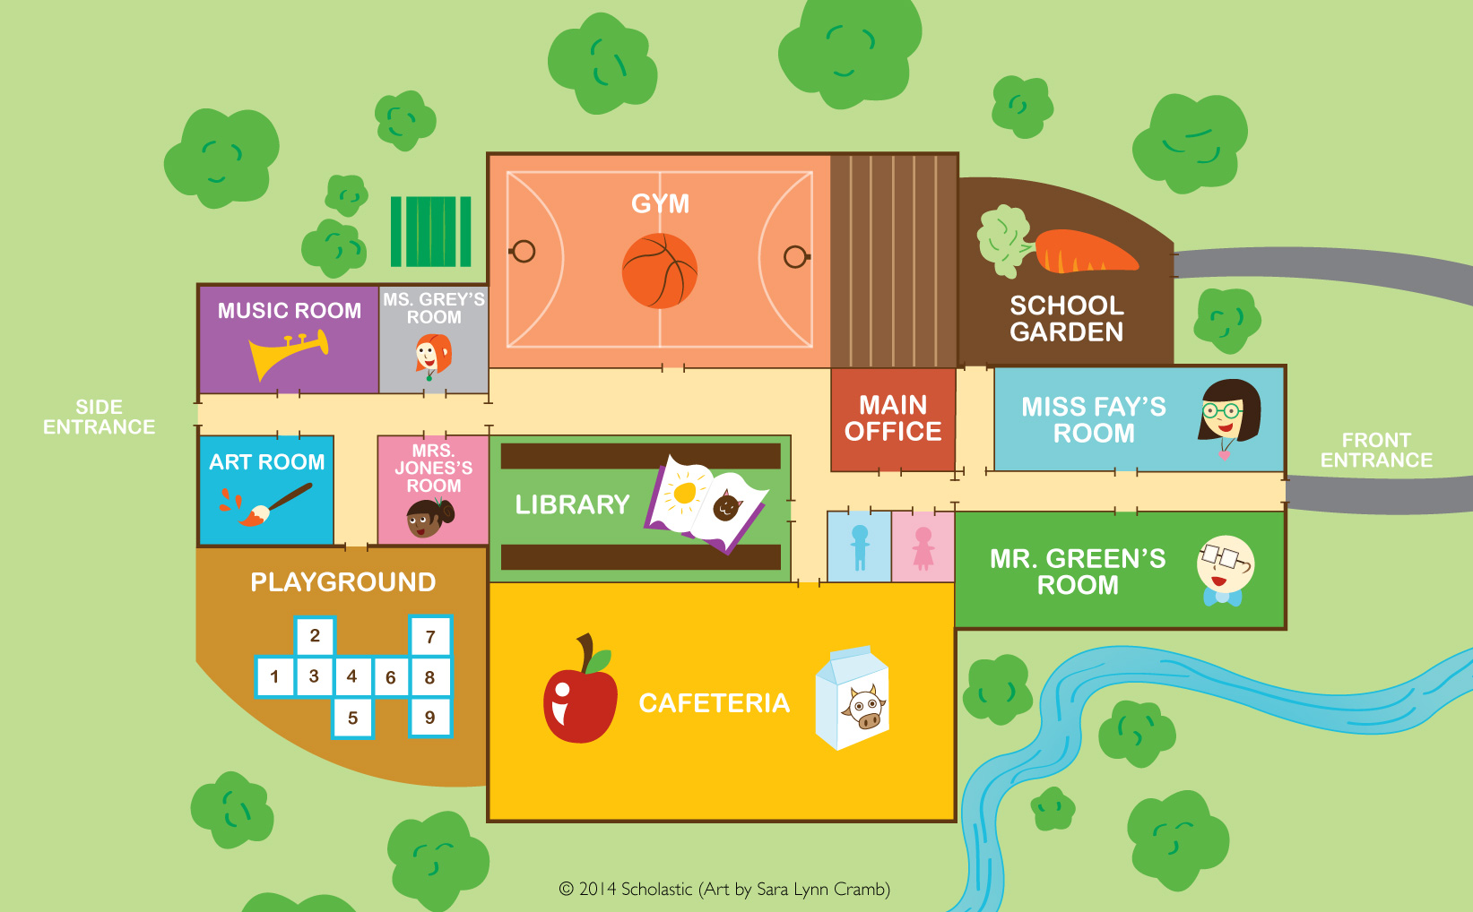
Think/Pair/Share
Image: https://www.scbwi.org/members-public/sara-cramb

Slide 9

Think/Pair/Share
Image: https://s-media-cache-ak0.pinimg.com/736x/c1/e1/c7/c1e1c7925b4cbb0fdeb0b9c4df89a571--globes-terrestres-world-globes.jpg

Slide 10

Globe vs Map
Globe: a round model of the Earth

Slide 11

Globe vs Map
Map: a drawing of a place to show where things are located.

Slide 12
Literacy and Social Studies

Slide 13
Application of Learning

Slide 14
Additional Learning Experiences
Compare and contrast maps of the local community from the past and present.
Pick a place that is familiar to students from across the division.
Example: Newport News – Christopher Newport University

Slide 15
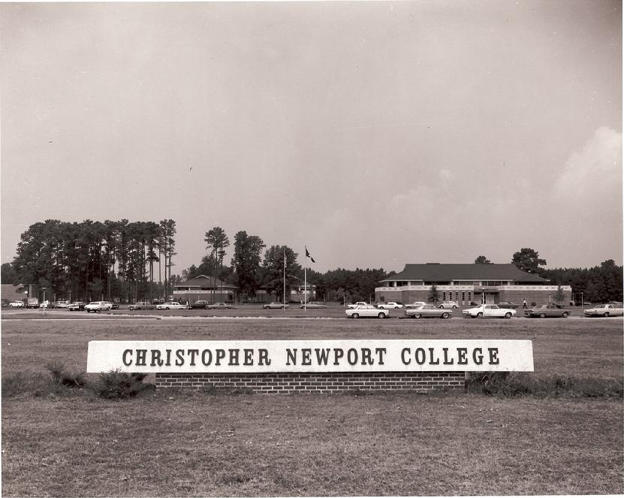
Think/Pair/Share
Image: http://www.cncfirstdecaders6171.com/1stdecadecampus.html
Notes:
Image: http://www.cncfirstdecaders6171.com/1stdecadecampus.html

Slide 16
Think/Pair/Share
Image: http://vcee.org/centers/christopher-newport-university/
Notes:
Image: http://vcee.org/centers/christopher-newport-university/

Slide 17
First Grade
Standard: 1.5e – The student will develop map skills by constructing simple maps, including a title, map legend, and compass rose.
Desired Outcome: Using an outline map of the state of Virginia, label the capital of Virginia, and label your city. Include a map legend, a title, and a compass rose.

Slide 18
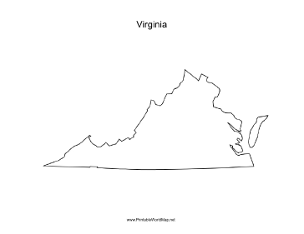
First Grade

Slide 19
Second Grade
Standard 1.7 – The student will locate and describe the relationship between the environmental and culture of:
  Powhatan
  Lakota
  Pueblo
Desired Outcome: The student will explain how the location of the Native American tribes impacted their lifestyles.

Slide 20
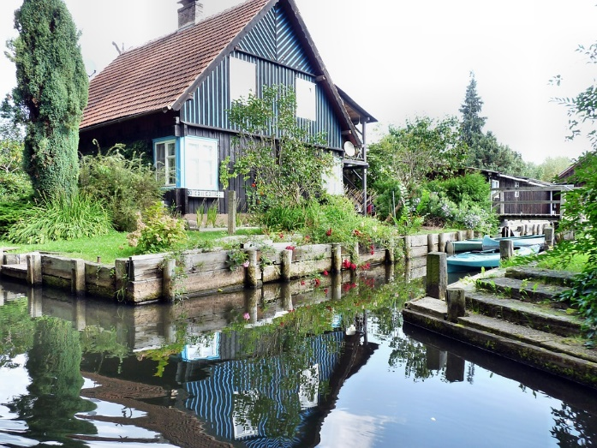
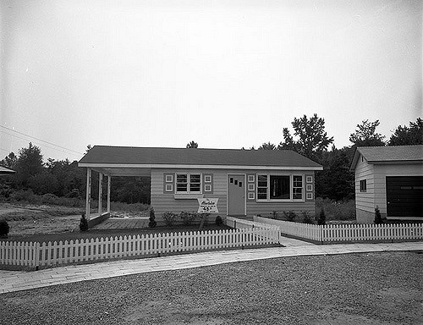
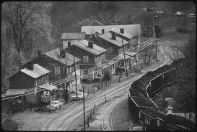
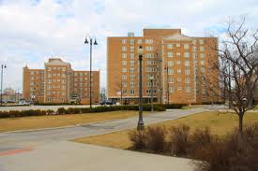
Home Sweet Home!
Compare and contrast homes from across the United States using a Venn diagram.

Slide 21
“I’ll build my house of straw.
I’ll build my house of sticks . . .”
Students will research geographic features, climate, and local resources for their assigned region of the United States.
Using this data, students will create a drawing or model of practical homes that will withstand local climate.
Think-Pair-Share groups to share why they chose their design.

Slide 22
Where do you live?

Slide 23
Third Grade
Standard: 3.1b – The student will demonstrate skills for historical thinking, geographical analysis, economic decision making, an responsible citizenship by using geographic information to support understanding of world cultures.
Desired Student Outcome: How did the geographical features of Ancient Mali affect trade?

Slide 24
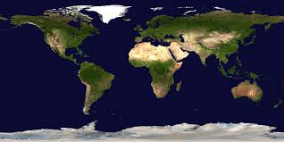
Where in the world is Africa?

Slide 25
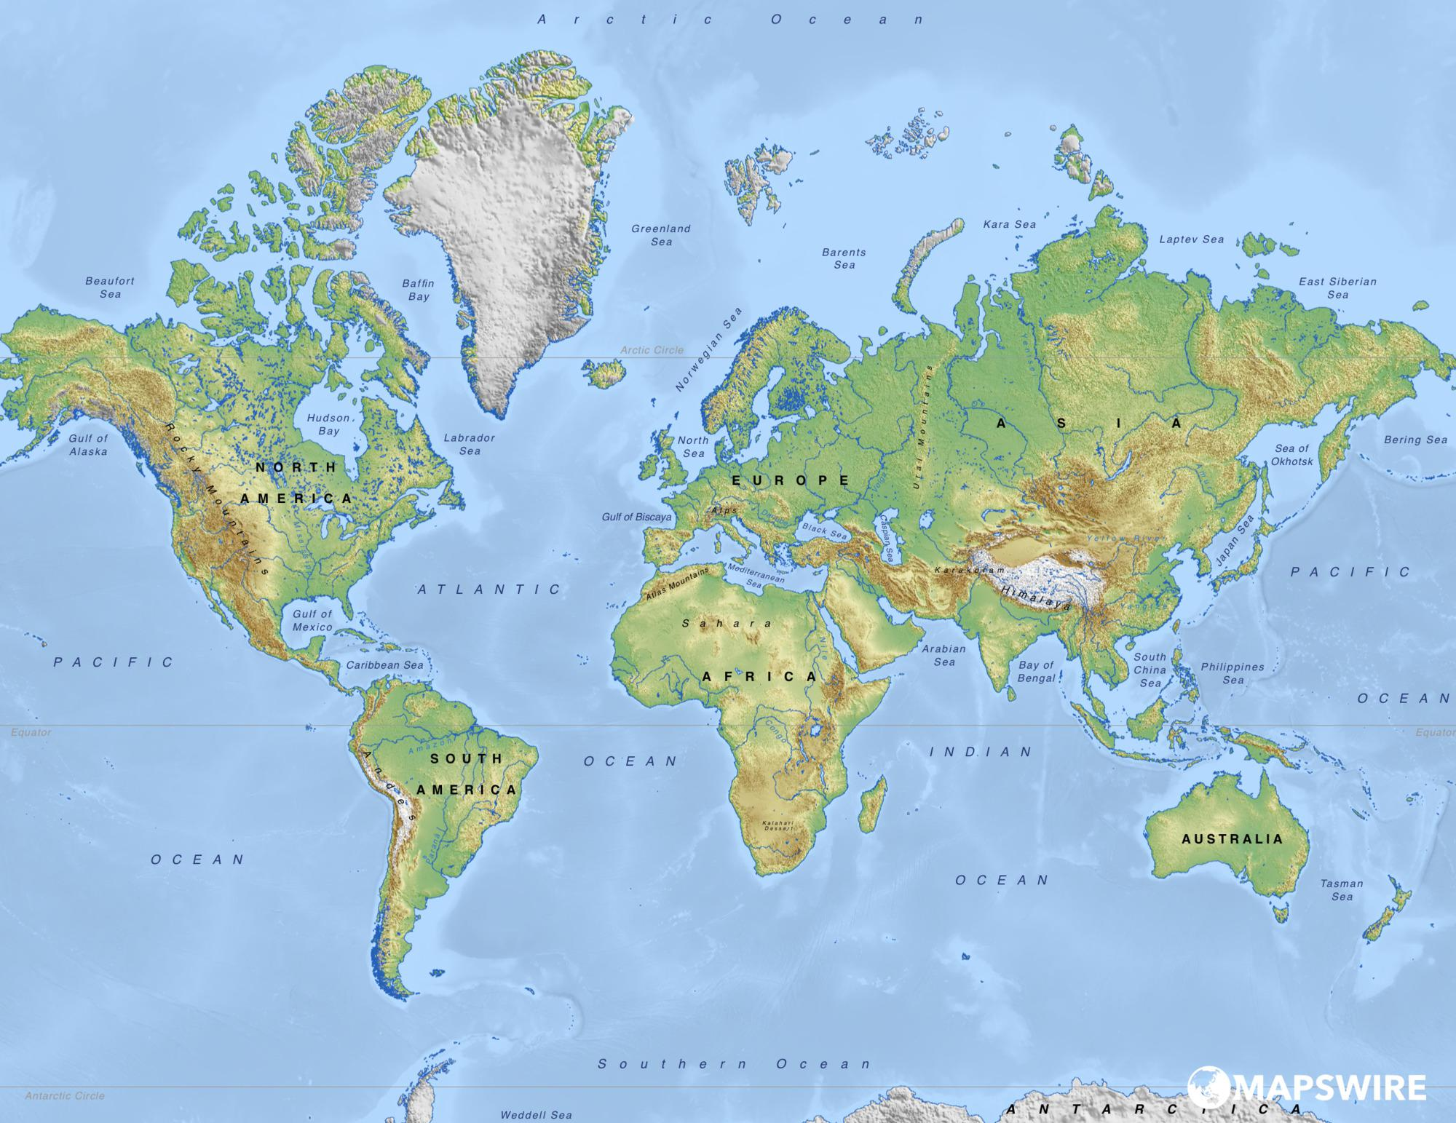
Where in the world is Africa?

Slide 26

Where in the world is Africa?

Slide 27

Where in the world is Africa?

Slide 28
Physical Characteristics
What do the different colors on this map represent?
What type of habitats do you think Africa has?

Slide 29
Physical Characteristics
Africa has mountains on the west coast.
Using the satellite image, where do you think the mountains are?

Slide 30
Physical Characteristics
Mali also has a river. It’s called the Niger River.

Slide 31
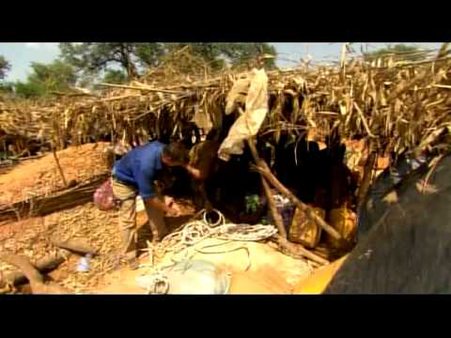
Mining for gold
Image: https://www.youtube.com/watch?v=KLpHQGExt68
Notes:
Image: https://www.youtube.com/watch?v=KLpHQGExt68

Slide 32
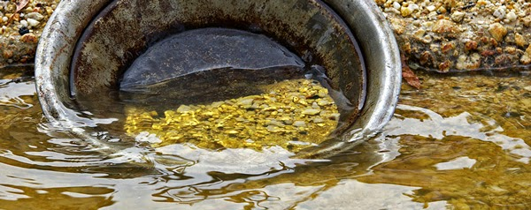
Mining for gold
Image: http://www.geologyin.com/2014/12/gold-panning.html
Notes:
Image: https://www.youtube.com/watch?v=KLpHQGExt68

Slide 33
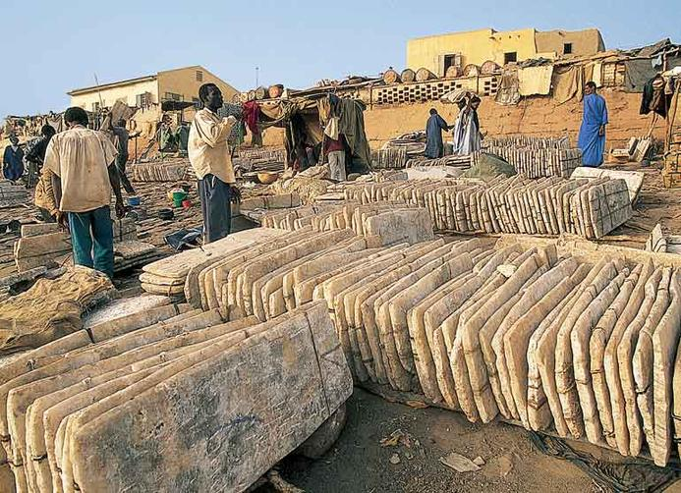
Mining for salt
Image: https://mrgrayhistory.wikispaces.com
Notes:
Image: https://mrgrayhistory.wikispaces.com/UNIT+5+-+WEST+AFRICA

Slide 34
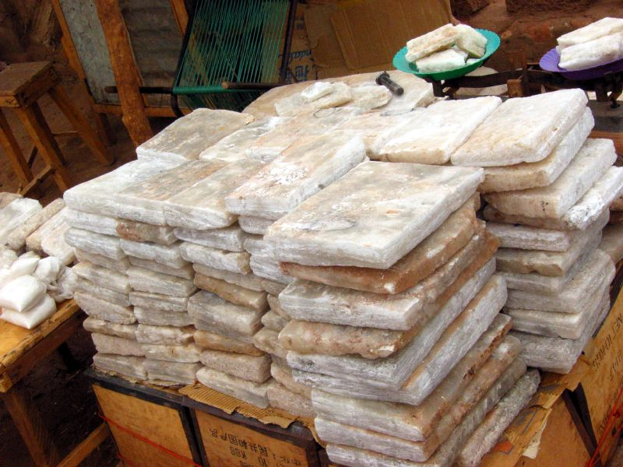
Mining for salt
Image: https://mrgrayhistory.wikispaces.com
Notes:
Image: https://mrgrayhistory.wikispaces.com/UNIT+5+-+WEST+AFRICA

Slide 35
Think about it . . .

Slide 36
Virginia Studies
Standard: VS.2b- The student will demonstrate understanding of the relationship between physical geography and the lives of the native peoples past and present of Virginia by locating and describing Virginia’s Coastal Plain (Tidewater), Piedmont, Blue Ridge Mountains, Valley and Ridge, and Appalachian Plateau.
Desired Outcome: Students will identify the contributions of the five geographic regions of Virginia, while comparing and contrasting the regions.

Slide 37
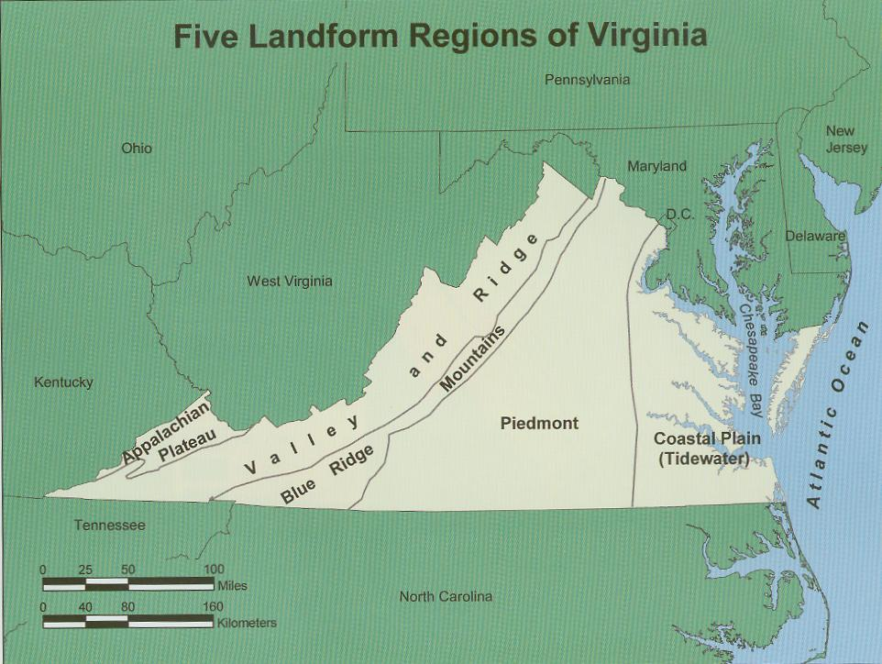
Beautiful Virginia!
Products of Virginia – whole and small group discussions followed by a mapping activity allowing students to demonstrate understanding of contributions of each region.
Throughout the unit, student groups will compile research for brochure (historical contributions, recreation, products, and local interest)
Notes:
http://www.bath.k12.va.us/history/Restricted%20Access%20Documents/Forms/DispForm.aspx?ID=303

Slide 38
Additional Learning Experiences
Compare maps of Virginia’s local regions, past and present
Gallery walks
Kahoot!

Slide 39
Suggestions
Throughout the unit, students will compile research on their assigned region.
Following lessons in Google Slides (or PowerPoint) student groups will begin to develop their own regional brochure highlighting their region.
This template can be modified to meet the needs of your students.

Slide 40
The Process
Throughout the process, there were some stumbles. However, we remained persistent realizing that in many cases the end result we were seeking to gauge our students’ understanding (very similar to what we (and you) are doing now!

Slide 41
The Process
At the end of the day, our goal remains same-
Student Growth and
Engagement!
You can do it!

Slide 42

What other tools do you use in your classroom?

Slide 43
Disclaimer
Reference within this presentation to any specific commercial or non-commercial product, process, or service by trade name, trademark, manufacturer or otherwise does not constitute or imply an endorsement, recommendation, or favoring by the Virginia Department of Education.

Slide 44
Contacts
Jennifer Burgin, Arlington Public Schools Email: Jennifer.Burgin@apsva.us
Melissa Mygas, Newport News City Public Schools Email: melissa.mygas@nn.k12.va.us
Brandi McCracken, Washington County Public Schools Email: bmccracken@wcs.k12.va.us

