Slide 2
Overview
Virginia’s Challenge
Findings from Executive Directive 4
Listening Sessions
Maximizing Access
Measuring and Improving Quality
Consolidating Oversight and Administration
Preschool Development Grant Birth to Five (PDG B-5)
What to Expect in 2020

Slide 3
Virginia’s Challenge
All children are capable of and deserve to enter school ready.
Nearly 100,000 students enter kindergarten classrooms in Virginia schools each fall. Only 60% of these children start school with the key literacy, math, and social-emotional skills needed to be successful in school. Most concerning is that only half of children from economically disadvantaged families enter school fully prepared for success.
Virginia ranks 33rd nationally in preschool funding; as a result, 24% of economically disadvantaged four-year-olds and 72% of economically disadvantaged three-year-olds lack access to quality preschool.
75% of Virginia’s early childhood programs that receive public funding do not participate in the state’s voluntary quality measurement system; vulnerable families as well as policymakers, practitioners and community leaders do not have uniform information on quality.
Virginia ranks 37th nationally in early childhood governance and lacks a uniform oversight and regulatory framework, making it difficult for communities to strengthen their local systems.

Slide 4
Executive Directive 4: Overview
Too many Virginia children enter school unprepared to fulfill their potential. To ensure every child has equitable access to opportunity, Virginia should invest more state resources to increase access to and improve the quality of its early childhood care and education system.
In response to Executive Directive 4, the Executive Leadership Team conducted listening sessions, analyzed data, collaborated across agencies and developed a comprehensive set of recommendations.
The public summary of findings outlines the challenges as well as recommended actions. It does not include fiscal impact as the formal recommendations are under review as part of the typical budgeting process.
New state resources will be needed to increase access for at-risk 3s and 4s as Virginia is generally maximizing available federal resources. It should be noted that an incremental or pilot approach is recommended for serving more at-risk 3s. As relates to quality, Virginia should continue to maximize federal resources first as well as pursue new funding such as the Preschool Development Grant.
To achieve these ambitious objectives and build the foundation for lasting change, Virginia should establish a single and durable point of accountability for school readiness.
Notes:
Presenter: James
Talking Points:
Walk through each of the four areas
Note that timeline is tight BUT this is necessary for preparing for 2020 General Assembly and Biennial Budget
Emphasize that access focus is on 3 and 4 year olds BUT that we must maintain our commitment to and investment in INFANTS and TODDLERS
Note how valuable the private sector is – infants and toddlers in particular are mostly served by private organizations – whether non-profit or for-profit – and this public-private partnership is something the state values very much
Clarify (again)that governor is calling on state agencies to develop recommendations on early childhood; Executive Directive is NOT a law or regulation

Slide 5
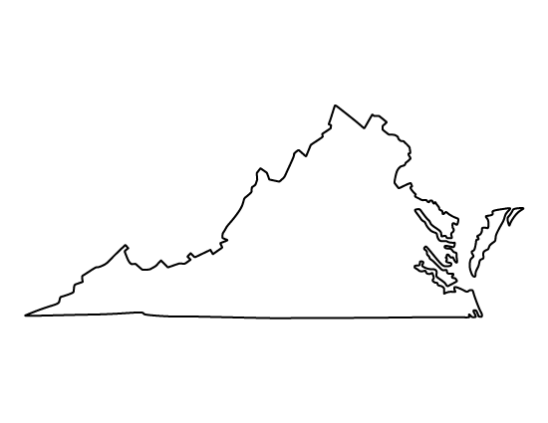
Listening Sessions
In partnership with Smart Beginnings, schools, social services, Head Start and child care, the Executive Leadership Team conducted listening sessions in Norfolk, Annandale, Salem, and Chesterfield.
Attendees were encouraged to make comments, ask questions, complete comment cards and/or submit online feedback.
More than 300 attendees representing 200+ organizations:
State, local, municipal government, elected officials
Head Start, Community Action agencies
Child care centers and family day home providers
Higher education and PreK-12 school systems
Non-profit organizations
Healthcare, consultants, media
Businesses
Notes:
Key Messages
Stakeholders expressed gratitude for focusing on early childhood and called for urgent action: “We don’t have gaps, we have chasms.”
School readiness is more than academics; helping children develop strong social-emotional skills may be the most important aspect of early childhood.
Increasing access is important and should occur at the same time as quality improvements.
Families are children’s first teachers, and their choices should be honored. The most vulnerable families benefit from comprehensive, two-generation strategies to support family well-being.
Improving quality requires a multi-faceted approach including but not limited to teacher preparation, professional development, classroom supports and compensation. Much of the early childhood workforce receives poverty-level wages yet are supporting children and families to overcome poverty.
Gaps in understanding the value of the first 5 years continue among parents and the general public.
A “future proof” and inclusive approach is needed to ensure lasting changes and necessitates building coalitions in communities with a broader set of stakeholders (e.g., libraries, arts programs, business, etc.).

Slide 6
Maximize Access for At-Risk 3s and 4s Summary of the Problem
Too few at-risk children in Virginia have access to early childhood programs. Not only are these children being denied opportunity but Virginia’s K-12 system, workforce and economy suffer.
Two-thirds of children under age 6 have all available parents in the workforce.
Child care is prohibitively expensive; infant care costs more than in-state college tuition in Virginia at $14,000/year while four year old preschool costs nearly $11,000/year in the private sector.
At risk families rely on a mix of federal, state and local funding. Without these resources, they opt out of the workforce or rely on unlicensed, unregulated family, friend and neighbor care.
Nearly all the public funding supports at-risk children yet resources are insufficient to meet the need at every age.
Funding alone will not resolve the problem; ~11,000 families were on Virginia Preschool Initiative (VPI) and subsidy wait lists last year yet Virginia was not using all of the funding committed. Supply, capacity and operational issues must be addressed.*
Access matters; at-risk children with no preschool experience are much less ready for kindergarten than their at-risk peers who participate in VPI. Recent research shows similar results for at-risk children served in private settings. Provided quality standards are met, participating in a two-year preschool experience can more fully prepare at-risk children.
*Example: By setting child targets and making other operational changes, Virginia has added more than 5,000 children to child care subsidy since January and reduced the wait list to less than 800.

Slide 7
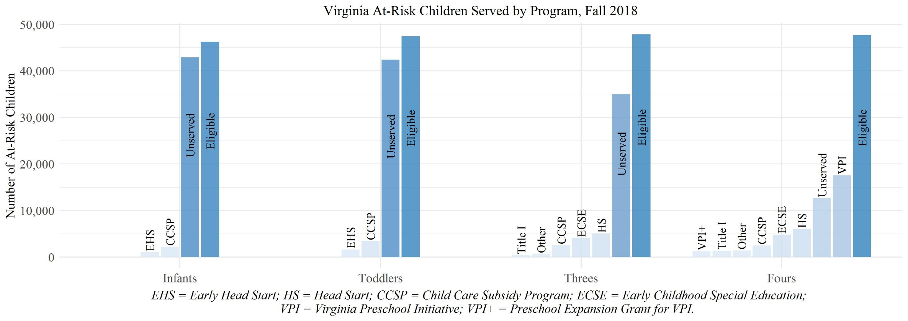
Unserved At-Risk Children by Age
Even with multiple funding sources, 24% of at-risk 4s and 72% of at-risk 3s are not being served with public funds. Virginia should address this but also consider how to improve infant and toddler access over time.
*Note that Child Care Subsidy Program is used in a diverse range of settings – child care centers, family day homes, religious-exempt child day centers and in-home care.

Slide 8
Incremental Action
The Executive Leadership Team recommends an incremental approach to serving at-risk threes.
Offering a slot to all at-risk 3s and 4s by 2025 would require adding up to ~47,000 at-risk children, doubling the current capacity for 3s and 4s.
Based on funding implications and system capacity, the Executive Leadership Team recommends a more incremental approach: use new state funds to expand to at-risk 3s on a pilot basis while also resolving longstanding challenges with VPI.
By expanding access thoughtfully in partnership with communities and the private sector, Virginia can ensure quality for new slots and preserve much-needed access for infants and toddlers.

Slide 9
Recommended Actions: Access
The Executive Leadership Team recommends that Virginia:
Preserve and maximize all available federal funding, specifically Early Head Start, Head Start, Child Care and Development Block Grant (CCDBG) and Individuals with Disabilities Education Act (IDEA).
Enhance VPI through four key actions to ensure all families of at-risk 4s have an option:
Increase rate and shift to benchmarking to quality requirements;
Incent public-private or mixed delivery in private settings;
Increase operational flexibility; and
Enable same-year reallocation to meet actual need.
Pilot the expansion of two existing state programs – VPI and Mixed Delivery – to include at-risk 3s on a small scale basis in both public and private settings. Additional expansion would be contingent on meeting quality thresholds and demonstrating positive outcomes.

Slide 10
Quality Measurement and Improvement Summary of the Problem
The most important aspects of quality in preschool education are stimulating and supportive interactions between educators and children and effective use of curricula. Yet Virginia only measures and provides this information for 5% of publicly-funded early childhood programs*.
Virginia Early Childhood Programs with Classroom Interaction and Curriculum Information for Families
*Note: 5% represents programs at levels 4 and 5 of Virginia Quality. Levels 1-3 do not require both. As of 2018, Virginia now requires both for all VPI programs but information is not available for families.
Notes:
Virginia has a diverse set of early childhood care and education programs that use nearly $390M in state or federal funds to provide care to at-risk children ages birth-5.
Virginia has limited information on how its public dollars support children’s birth-5 learning and development.
There is no one universal system that measures or supports improvement for all publicly-funded programs. Virginia Quality has attracted a wide range of participating programs but enrollment is voluntary and three out of four eligible programs do not participate.
Virginia invests an additional $15 million in quality improvement each year but differing program requirements, guidelines and measurement systems make it hard to collectively support improvement at the state or local level.
At-risk families cannot easily identify or choose a quality option due to lack of information.

Slide 11
Recommended Actions: Quality
The Executive Leadership Team recommends building a uniform measurement and improvement system that is required for all early childhood programs that take public funds. Specifically Virginia should:
Require measurement and focus on the quality of teacher-child interactions in all publicly-funded infant, toddler and preschool classrooms.
Build pathways to improvement that address the diverse needs of early childhood educators.
Support families to choose quality.
Build on current quality efforts and better track child outcomes.
Align health, safety and quality expectations, measure cost impact and incent private providers to take public funds.
Phase in system over three years.
Notes:
Require measurement to improve early learning and development outcomes. Focus on the quality of teacher-child interactions in all publicly-funded infant, toddler and preschool classrooms. Observing every classroom also enables all educators, regardless of setting or age of children, to receive individualized feedback and improve.
Build pathways to improvement that address the diverse needs of all early childhood educators and aligns educator preparation, instructional tools (e.g., curriculum), and professional development (e.g., training, coaching) with the uniform quality measurement system.
Support families to choose quality by providing a family-friendly measure they can understand and use to differentiate among options. Additional quality information should be provided to encourage best practices.
Build on current quality efforts such as in Virginia Quality and VPI and better track child outcomes.
Align health, safety and quality expectations, measure cost impact and incent private providers to take public funds, create a more level playing field and maintain equitable access.
Phase in system over three years to ensure all publicly-funded programs are participating by 2022 without jeopardizing access to publicly-funded programs for any at-risk children, especially infants and toddlers.

Slide 12
Oversight and Administration Summary of the Problem
Unifying the fragmented oversight of early childhood care and education out of the home would help Virginia execute Executive Directive 4 and ensure more lasting and sustainable change.
Notes:
The fragmented oversight and administration of the $390 million in federal, state, and local funding that supports early childhood care and education make it difficult for Virginia to systematically improve school readiness outcomes.
Families, providers and communities have to navigate differing health, safety and quality regulations, monitoring, funding levels, quality measurement, improvement supports and data systems. This is due in part to differing federal requirements (e.g., Head Start, Child Care and Development Block Grant).
Virginia’s Needs Assessment describes its early childhood “system” as “extremely diffuse” with “no single governance structure or authority charged with implementing early childhood priorities.” Without one state board and agency accountable, the state struggles to help strengthen collaboration and build coordinated infrastructure at the local level.
As also noted in the Needs Assessment, “The Commonwealth’s approach was rated as 37th out of 50 states relative to others in ‘creating a coordinated, integrated early childhood care and education system due, in part, to low levels of state funding, limited coordination between agencies, licensing standards, and lack of coordinated state leadership.”
https://www.epi.org/child-care-costs-in-the-united-states/

Slide 13
Recommended Actions: Oversight
The Executive Leadership Team recommends that Virginia:
Establish one board (Board of Education) and one agency (Virginia Department of Education) as responsible for oversight and administration of early care and education out of the home to create a single point of accountability for school readiness.
Transition Child Care and Development Block Grant (CCDBG) and Head Start Collaboration to the VDOE in phases.
Have VDOE contract with VDSS to continue certain functions:
VDSS to operate child care subsidy program and conduct child care background checks;
Local Departments of Social Services to conduct eligibility for families locally and help coordinate local enrollment. Families can continue to apply in-person at 120 local offices.
Task VDOE and VDSS to collaboratively design and build a new licensing platform prior to transition of child care licensing to support uniform quality measurement system.

Slide 14
Executive Summary: Recommendations
Here is a summary of the recommended actions to improve school readiness outcomes in Virginia:
Maximize Access for At-Risk 3s and 4s | Build a Uniform Measurement and Improvement System | Consolidate Oversight and Administration
Preserve and maximize all available federal funding, specifically Early Head Start, Head Start, Child Care and Development Block Grant (CCDBG) and Individuals with Disabilities Education Act (IDEA). Enhance VPI in four ways to ensure all families of at-risk 4s have an option. Expand two existing state programs – VPI and Mixed Delivery – to include at-risk 3s on a pilot basis in both public and private settings. | Require measurement to improve child outcomes. Build pathways to improvement that address the diverse educator needs and align with new measurement system. Support families to choose quality. Build on current quality efforts and better track child outcomes. Align expectations, measure cost impact and incent private providers. Phase in system over three years to avoid jeopardizing access for infants and toddlers. | Establish one board and one agency as responsible for child care and early learning to create a single point of accountability for school readiness. Transition Child Care and Development Block Grant (CCDBG) and Head Start Collaboration to the VDOE. Ensure continuity and preserve match by having VDOE contract with VDSS for child care background checks and child care subsidy program so families can easily apply online or be supported at local Social Services offices. Task VDOE and VDSS to collaboratively design and build a new licensing platform prior to transition.
Notes:
Presenter: James
Talking Points:
Walk through each of the four areas
Note that timeline is tight BUT this is necessary for preparing for 2020 General Assembly and Biennial Budget
Emphasize that access focus is on 3 and 4 year olds BUT that we must maintain our commitment to and investment in INFANTS and TODDLERS
Note how valuable the private sector is – infants and toddlers in particular are mostly served by private organizations – whether non-profit or for-profit – and this public-private partnership is something the state values very much
Clarify (again)that governor is calling on state agencies to develop recommendations on early childhood; Executive Directive is NOT a law or regulation

Slide 15
Rationale for Education
There are multiple advantages to consolidating within a Board and Department of Education>
Can establish direct line of authority for PreK, special education, Head Start and child care
Integrate early childhood to early elementary, including special education
More sustainable within state agency than at Governor’s Office
Of the ~10 states that have unified early childhood governance, most have consolidated within Education.
Standalone agency (Georgia, Massachusetts, Pennsylvania, Washington)
Consolidated within Education, typically with its own “office” (California, D.C., Florida, Louisiana, Maryland, Michigan, Oregon)
These states handle the child care block grant functions differently, especially eligibility
Consolidated within Health/Human Services or social services equivalent (North Carolina)
Other states have sought to “coordinate” through the Governor’s Office but policies, regulations, monitoring and funding typically remain very different (e.g., Ohio)

Slide 16
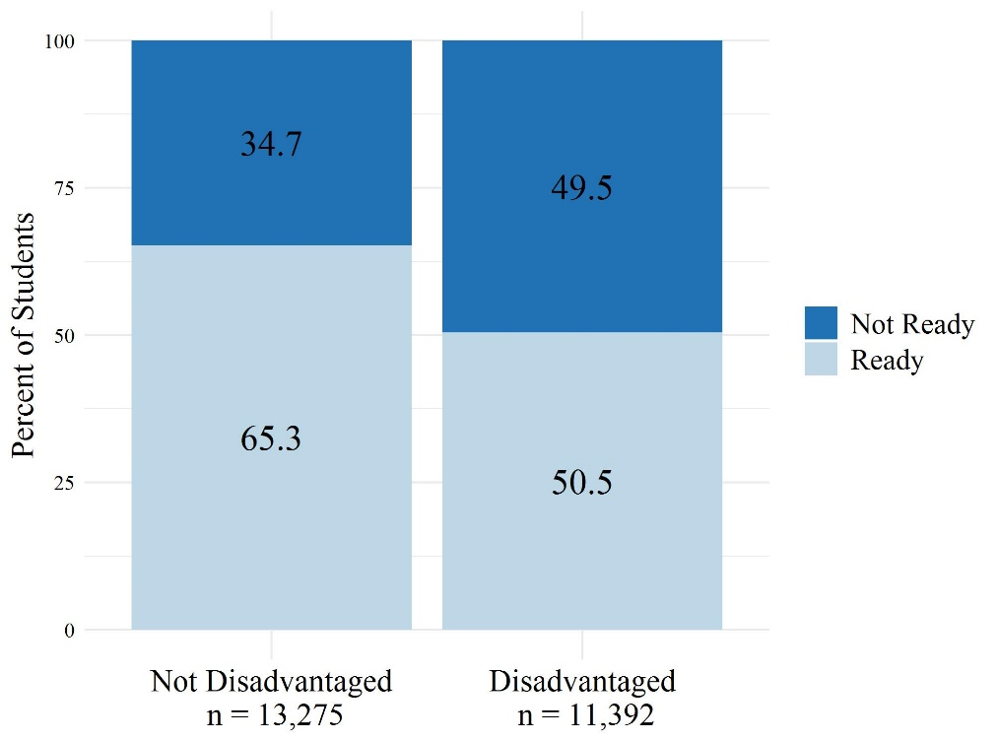
Equity and Readiness
All children are capable of and deserve to enter school ready yet socio-economic status still predicts success. To close the opportunity gap, Virginia must ensure at-risk children can participate in quality early childhood programs, regardless of setting, that promote children’s learning and development.
2018 Virginia Kindergarten Readiness Program Results
Only 38% of disadvantaged children with no preschool experience are fully ready for kindergarten.

Slide 17
Impact on K-12
School readiness predicts third grade reading results.
Bassok, Herring, McGinty, Miller, & Wyckoff, 2019

Slide 18
Preschool Development Grant
The Preschool Development Grant Birth to Five (PDG B-5) has enabled Virginia to strengthen its B-5 system :
Over the last ten months, Virginia’s 10 Community Pilots have:
Recruited new partners and built new relationships with schools, Head Starts and child care
Registered more than 575 sites and 2,500 teachers across family day home, child care, Head Start and schools in 27 jurisdictions
Collected 2,000 survey responses from educators with 30,000 family surveys to go out in November
Conducted self-assessments to determine how families learn about, apply and enroll in programs
Distributed more than $684,000 in funds via 1,140 checks to teachers and 228 checks to sites
Collaborated to design, build and launch a new data portal (LinkB5)
Pilots are not only strengthening their own systems but building models to be scaled to other communities. Lessons learned from these efforts are informing policymaking and practice at the state level.

Slide 19
What’s Next for PDG B-5
With an additional three years of PDG B-5 funding, Virginia proposes to expand current efforts to reach all communities in the Commonwealth.
Communities can apply for funding to partner with all publicly-funded, birth to five early childhood programs in family home settings, child care, Head Start and schools to:
Year 1: Building
Convene and coordinate
Measure access
Measure quality
Engage families
Year 2: Expanding
Expand relationships
Plan for and test new approaches to improve access, strengthen quality and deepen family engagement
Year 3: Sustaining
Establish more lasting governance
Measure impact
Sustain access, quality and family engagement efforts

Slide 20
What to Expect in 2020
2020 will offer opportunities to increase equitable access and improve quality in early childhood in Virginia:
Virginia will pursue a state budget that would incrementally increase the number of at-risk 3s and 4s served in public and private settings while continuing to maximize federal dollars.
Virginia will pursue legislation to require a uniform measurement and improvement system and consolidate early childhood functions under BOE/DOE.
Virginia will build out the infrastructure at the local level for coordination, measurement and improvement in three key areas: access and enrollment; quality; and family engagement.
Efforts will require ongoing engagement of diverse stakeholders to be led by Division of School Readiness.

