Slide 1
Rebenchmarking of the Direct Aid to Public Education Budget for the 2020-2022 Biennium
Presented to the
Board of Education
September 18, 2019
Christina P. Berta
Assistant Superintendent of Budget and Finance
Ed Lanza
Director, Office of Budget

Slide 2
Presentation Topics
Overview of 2020-2022 Rebenchmarking Process
2020-2022 Rebenchmarking Incremental Cost Detail
Graphs/Tables of Key Data Inputs Impacting 2020-2022 Rebenchmarking Cost
Appendix A: State Cost of 2020-2022 Rebenchmarking by Direct Aid Account

Slide 3
2020-2022 Rebenchmarking – State Cost
The state cost of rebenchmarking for the 2020-2022 biennium is $595.7 million.
  FY21 - $289.6 million
  FY22 - $306.1 million

Slide 4
Rebenchmarking Process
State and federal funding to school divisions for public education is provided through the Direct Aid to Public Education budget. The General Assembly appropriates the funding.
Direct Aid funding is appropriated in six budgetary categories:
    Standards of Quality (SOQ)
    Incentive Programs
    Categorical Programs
    Lottery Proceeds Fund Programs
    Supplemental Education Programs
    Federal Funds
In each odd-numbered year, the state cost of the Direct Aid budget is “rebenchmarked” for the next biennium, beginning the biennial budget development process. The process impacts 30 or more state Direct Aid programs in categories 1-4 above.

Slide 5
Rebenchmarking Process
The rebenchmarked budget represents the state cost of continuing the current Direct Aid programs into the next biennium, with updates to the input data used in the funding formulas that determine the cost of the programs.
  Input data used in the Direct Aid formulas are updated every two years to recognize changes in costs that have occurred over the preceding biennium.
  The state cost of SOQ and other Direct Aid accounts are recalculated step-by-step using the latest input data available, isolating the cost of each data update in incremental fashion. About 25 separate steps are involved, each of which can increase or decrease state cost.
The rebenchmarked budget is built off of the base Direct Aid budget from the previous biennium; the current FY20 Direct Aid budget (Chapter 854) is the starting point against which the rebenchmarking cost for each year of the 2020-2021 biennium (FY21 & FY22) is calculated. The FY20 base budget totals $7.29 billion - all state funds).

Slide 6
Rebenchmarking Process
Rebenchmarking is technical in nature and does not involve changes in funding policy or methodology or funding for new programs, other than those already approved and directed by the General Assembly.
Costs are projected forward for changes in enrollment, salaries, support costs, inflation, and other factors – costs can increase or decrease depending on the direction of each data update. (The FY21/FY22 state cost impact of the standard data updates is shown below.)
Because rebenchmarking impacts the total cost of the Direct Aid formulas, it impacts both state cost and the required local share that localities must fund for the SOQ and other Direct Aid programs with a local match.

Slide 7
Rebenchmarking Process - SOQ
SOQ funding is driven primarily by the instructional staffing standards in the Code and the salary/benefits costs for the required instructional positions. It also includes funding for support costs based on “prevailing costs.”
Some components of the SOQ funding process are policy-driven (e.g., standards) but others are technical and must be updated through rebenchmarking.
Since 90% of state Direct Aid funding is for SOQ programs, SOQ funding is most impacted by the rebenchmarking process; however, state Lottery, incentive, and categorical funding in Direct Aid is also impacted.

Slide 8
Rebenchmarking Process - SOQ
Key components of the SOQ funding formula include:
  Student enrollment;
  Staffing standards for instructional positions;
  Salaries of instructional positions;
  Fringe benefit rates;
  Support costs (salary and non-salary);
  Inflation factors;
  Support costs adjusted for deducted federal revenues; and
  Sales tax funding and division composite indices.

Slide 9
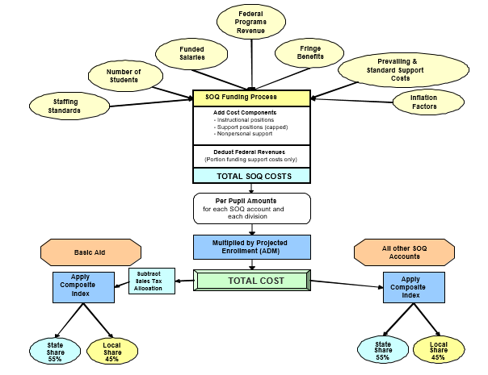
SOQ Funding Process

Slide 10
Rebenchmarking Data Inputs
Key data inputs used in 2020-2022 rebenchmarking calculations (most are specific to SOQ formulas; data is from FY18 & FY19):
  Funded instructional and support salaries
  Fall Membership and Average Daily membership projections
  Special education child count
  Career & technical education course enrollment
  SOL failure rates and free lunch eligibility rates for SOQ remedial education and other at-risk accounts
  Base-year expenditure data from 2017-2018 Annual School Report (for salaries & support costs)
  Health care premium expenditures

Slide 11
Rebenchmarking Data Inputs
Key data inputs used in 2020-2022 rebenchmarking calculations, continued:
  Non-personal cost inflation factors
  Federal programs revenue (for the revenue deduction from funded support costs)
  Prevailing textbooks costs used for funded Textbooks per-pupil amount
  Enrollment projections for remedial summer school and English as a Second Language programs
  Updates to support costs, including division superintendent, school board, nurses, and pupil transportation
  Support positions ratio cap

Slide 12
Rebenchmarking Data Inputs
Major Data Inputs that are
Fixed for the Biennium:
Funded Salaries
Special Education Child Counts
Initial Fall Membership & ADM Projections used in SOQ Model
CTE Course Enrollment
Composite Index
Head Start Enrollment (for VPI)
Free Lunch Eligibility Percentages
SOL Test Scores (for SOQ Prevention, Intervention, and Remediation)
Support Positions Caps
Inflation Factors (subject to General Assembly action)
Major Data Inputs that are
Updated Annually:
Enrollment Projections – Fall Membership, ADM, ESL, RSS
Reimbursement Account Projections
Lottery Revenue Estimates
VRS Fringe Benefit Rates (subject to General Assembly Action)

Slide 13
Rebenchmarking Data Inputs

Slide 14
Pending Inputs
The following updates will be completed this fall and included in the Governor’s 2020-2022 introduced budget released in December:
  Revised composite index for the 2020-2022 biennium (update input data from 2015 to 2017)
  Additional revisions to enrollment projections (Fall Membership and March 31 ADM)
  Revised Sales Tax and Lottery revenue projections
  Revised VRS fringe benefit rates

Slide 15
State Cost to Date
  The final amount of state funding for Direct Aid each biennium reflects 1) the final rebenchmarking costs funded and 2) any funding policy changes/new programs adopted by the General Assembly and the Governor.
  The state cost (above the FY20 base) of the rebenchmarking updates completed to date is $289.6 million in FY21 and $306.1 million in FY22, for a 2020-2022 biennial total of $595.7 million. (The state cost of the 2018-2020 rebenchmarking at this stage was $491.8 million.)

Slide 16
State Cost to Date
  The following four slides show the incremental state cost starting from the FY20 base budget of the 26 rebenchmarking steps completed to date.

Slide 17
State Cost of Each Rebenchmarking Update
(incremental cost above FY20 base)
Update # | Rebenchmarking Update | FY 2021 State Cost | FY 2022 State Cost | 2020-2022 Total State Cost
1 | Remove 25.69% Non-Participation Estimate for the Virginia Preschool Initiative (fully funds the formula assuming 100% slot usage; reinstating non-participation est. is policy decision) | 25,012,766 | 25,012,766 | 50,025,532
2 | Remove any FY20 One-Time Spending (N/A – none identified) | (1,150,763) | (1,150,763) | (2,301,526)
3 | Reset Non-personal Support Costs Inflation Factors to 0% in SOQ Model (linked with Step 19) | (55,685,606) | (55,685,606) | (111,371,212)
4 | Reset Personal Support Costs Inflation Factors to 0% from 5.00% in SOQ Model and Remove FY20 Compensation Supplement Funding (linked with Step 20) | (214,843,974) | (214,843,974) | (429,687,948)
5 | Update Fall Membership and Average Daily Membership Base-Year and Projected Enrollment Counts | 15,471,803 | 23,107,352 | 38,579,155

Slide 18
State Cost of Each Rebenchmarking Update
(incremental cost above FY20 base)
Update # | Rebenchmarking Update | FY 2021 State Cost | FY 2022 State Cost | 2020-2022 Total State Cost
6 | Update Special Education Child Count to December 1, 2018 | 10,100,747 | 10,305,258 | 20,406,005
7 | Update Career & Technical Education Enrollment to School-Year 2018-2019 | 661,552 | 645,382 | 1,306,934
8 | Update SOL Tests Failure Rate Data to School-Year 2017-2018 and Free Lunch Percentages to School-Year 2018-2019 | 3,554,453 | 3,581,285 | 7,135,738
9 | Update SOQ Gifted, Support Technology, and Instructional Technology Positions for Enrollment | (715,552) | (506,293) | (1,221,845)
10 | Update Base-Year Prevailing SOQ Instructional Salaries to FY18 | 26,556,957 | 26,529,777 | 53,086,734
11 | Update Base-Year Expenditures from Annual School Report to FY18 for Support Positions Costs (Prevailing Base-Year Positions Per Pupil and Salaries) | 24,388,460 | 24,590,810 | 48,979,270
12 | Update Base-Year Expenditures from Annual School Report to FY18 for Non-personal Support Costs Per Pupil | 68,975,611 | 68,674,395 | 137,650,006

Slide 19
State Cost of Each Rebenchmarking Update
(incremental cost above FY20 base)
Update # | Rebenchmarking Update | FY 2021 State Cost | FY 2022 State Cost | 2020-2022 Total State Cost
13 | Update Federal Revenue Deduct Per Pupil Amount (from FY18 revenues) | (11,094,689) | (11,122,438) | (22,217,127)
14 | Update Support Positions Ratio Cap (Ratio of Instructional to Support Positions from 4.27 to 1 to 4.30 to 1) | (1,904,221) | (1,437,227) | (3,341,448)
15 | Update Costs for Division Superintendents, School Boards, and School Nurses (without inflation) | 4,652,618 | 4,625,750 | 9,278,368
16 | Update Health Care Premium (without inflation) | 24,816,902 | 24,887,383 | 49,704,285
17 | Update Textbooks Per Pupil Amount (without inflation) | 4,191,324 | 4,198,258 | 8,389,582
18 | Update Pupil Transportation Costs | 33,793,666 | 33,982,491 | 67,776,157
19 | Update Non-personal Support Cost Inflation Factors (linked with Step 3) | 66,317,602 | 66,391,716 | 132,709,318
20 | Update Salary Inflation Factors (Instructional and Support) - recognize continuation cost of FY20 5.0% Compensation Supplement into 20-22 biennium (linked with Step 4) | 215,635,208 | 215,994,350 | 431,629,558

Slide 20
State Cost of Each Rebenchmarking Update
(incremental cost above FY20 base)
Update # | Rebenchmarking Update | FY 2021 State Cost | FY 2022 State Cost | 2020-2022 Total State Cost
21 | Update English as a Second Language Enrollment Projections | 2,387,255 | 5,006,294 | 7,393,549
22 | Update Remedial Summer School Per Pupil Amount and Enrollment Projections | 2,894,613 | 4,564,796 | 7,459,409
23 | Update Incentive Accounts | 5,876,195 | 5,902,547 | 11,778,742
24 | Update Categorical Accounts (Special Education - Homebound, Jails, and State Operated Programs) | 101,332 | 1,379,475 | 1,480,807
25 | Update Lottery Accounts (VPI, Algebra Readiness, Foster Care, K-3 Class Size Reduction, School Breakfast) | 39,618,030 | 41,479,290 | 81,097,320
Total State Rebenchmarking Cost for 2020-2022 (above FY20 Base) = |  | 289,612,289 | 306,113,074 | 595,725,363

Slide 21
Student Enrollment
Update # | Rebenchmarking Update | FY 2021 State Cost | FY 2022 State Cost | 2020-2022 Total
5 | Update Fall Membership and Average Daily Membership Base Year and Projected Enrollment Counts | 15,471,803 | 23,107,352 | 38,579,155

Slide 22
Special Education Child Count
Update # | Rebenchmarking Update | FY 2021 State Cost | FY 2022 State Cost | 2020-2022 Total
6 | Update Special Education Child Count to December 1, 2018 | 10,100,747 | 10,305,258 | 20,406,005

Slide 23
CTE Course Enrollment
Update # | Rebenchmarking Update | FY 2021 State Cost | FY 2022 State Cost | 2020-2022 Total
7 | Update Career & Technical Education Enrollment to 2018-2019 | 661,552 | 645,382 | 1,306,934
Comparison of Career and Technical Education Enrollment, Number of Courses, and Total Sections Across Base Years
 | Base Year 2016 (2018-2020 Biennium) | Base Year 2018 (2020-2022 Biennium) | Percent Variance
Career and Technical Education Enrollment (Duplicated Enrollment) | 635,603 | 646,649 | 1.7%
Number of Distinct Courses | 6,181 | 6,119 | (1.0%)
Total Course Sections | 35,288 | 35,945 | 1.9%

Slide 24
SOL Test Failure Rates
Update # | Rebenchmarking Update | FY 2021 State Cost | FY 2022 State Cost | 2020-2022 Total
8 | Update SOL Tests Failure Rate Data to School Year 2017-2018 and Free Lunch Percentages to School Year 2018-2019 | 3,554,453 | 3,581,285 | 7,135,738

Slide 25
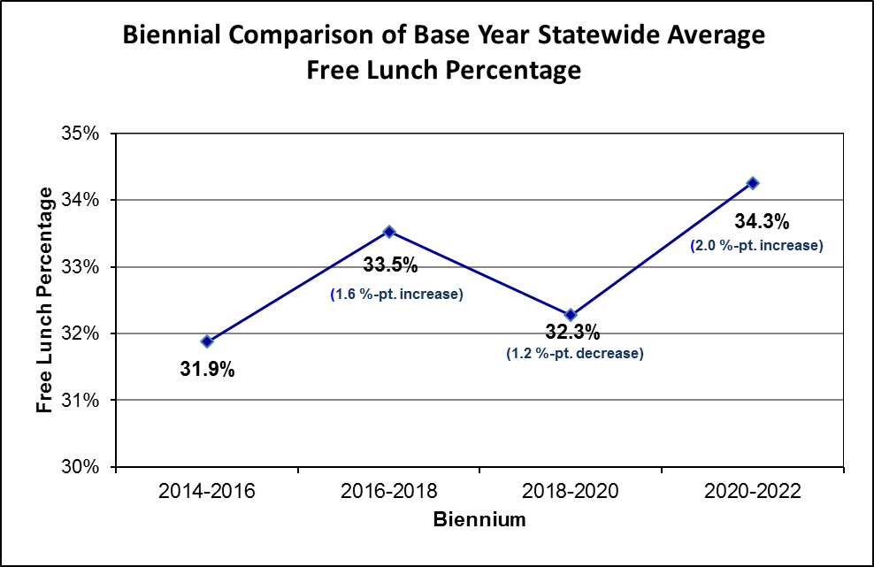
Free Lunch Eligibility
Update # | Rebenchmarking Update | FY 2021 State Cost | FY 2022 State Cost | 2020-2022 Total
8 | Update SOL Tests Failure Rate Data to School Year 2017-2018 and Free Lunch Percentages to School Year 2018-2019 | 3,554,453 | 3,581,285 | 7,135,738

Slide 26
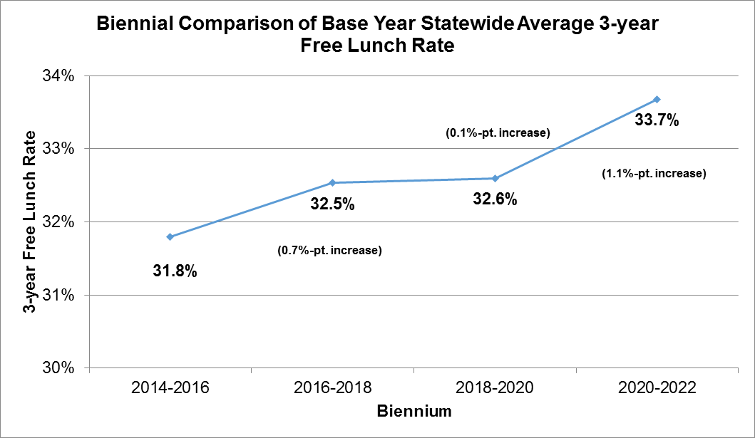
Three-Year Average Free Lunch Rates
Update # | Rebenchmarking Update | FY 2021 State Cost | FY 2022 State Cost | 2020-2022 Total
8 | Update SOL Tests Failure Rate Data to School Year 2017-2018 and Free Lunch Percentages to School Year 2018-2019 | 3,554,453 | 3,581,285 | 7,135,738

Slide 27
Base-Year Instructional Salaries
Update # | Rebenchmarking Update | FY 2021 State Cost | FY 2022 State Cost | 2020-2022 Total
10 | Update Base Year Prevailing SOQ Instructional Salaries to FY18 | 26,556,957 | 26,529,777 | 53,086,734
Comparison of Base Year Prevailing SOQ Instructional Salaries Across Biennia 2016-2018 to 2020-2022 (No Adjustment for State Funded Increases)
Instructional Position | 2016-2018 Prevailing Salary (2013-14 Data) | 2018-2020 Prevailing Salary (2015-16 Data) | Percent Variance | 2018-2020 Prevailing Salary (2015-16 Data) | 2020-2022 Prevailing Salary (2017-18 Data) | Percent Variance
Elementary Teachers | $46,488 | $47,351 | 1.9% | $47,351 | $48,925 | 3.3%
Elementary Asst. Principals | $66,128 | $67,201 | 1.6% | $67,201 | $68,125 | 1.4%
Elementary Principals | $81,622 | $83,446 | 2.2% | $83,446 | $85,122 | 2.0%
Secondary Teachers | $49,008 | $50,164 | 2.4% | $50,164 | $51,216 | 2.1%
Secondary Asst. Principals | $70,992 | $73,074 | 2.9% | $73,074 | $73,506 | 0.6%
Secondary Principals | $90,681 | $91,858 | 1.3% | $91,858 | $94,490 | 2.9%
Instructional Aides | $16,855 | $17,390 | 3.2% | $17,390 | $18,090 | 4.0%

Slide 28
Base-Year Support Salaries and Positions
Update # | Rebenchmarking Update | FY 2021 State Cost | FY 2022 State Cost | 2020-2022 Total
11 | Update Base-Year Expenditures from Annual School Report to FY18 for Personal Support Costs (both Base-Year Prevailing Positions and Salaries) | 24,388,460 | 24,590,810 | 48,979,270

Slide 29
Non-personal Support Costs
Update # | Rebenchmarking Update | FY 2021 State Cost | FY 2022 State Cost | 2020-2022 Total
12 | Update Base-Year Expenditures from Annual School Report to FY18 for Nonpersonal Support Costs Per Pupil | 68,975,611 | 68,674,395 | 137,650,006

Slide 30
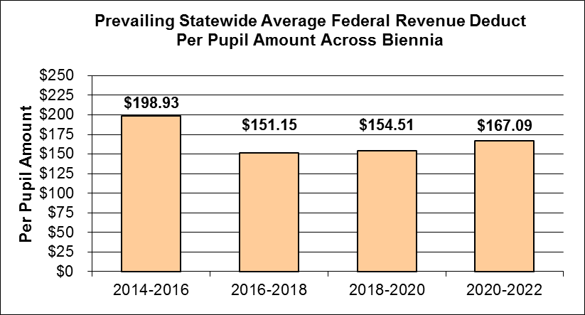
Federal Revenue Deduct
Update # | Rebenchmarking Update | FY 2021 State Cost | FY 2022 State Cost | 2020-2022 Total
13 | Update Federal Revenue Deduct Per Pupil – deducted from Support Costs (from FY18 revenues) | (11,094,689) | (11,122,438) | (22,217,127)
NOTE: Federal revenues include Title I, Part A, Title II, Part A, IDEA, IDEA Part B, and Perkins grants.

Slide 31
Support Positions Ratio Cap
Update # | Rebenchmarking Update | FY 2021 State Cost | FY 2022 State Cost | 2020-2022 Total
14 | Update Support Positions Cap Based on Divisions' Ratios of Instructional to Support Positions from 4.27 to 1 to 4.30 to 1 | (1,904,221) | (1,437,227) | (3,341,448)
Note: The instructional to support position ratio used for the support position funding cap was rebenchmarked for the 2020-2022 biennium. The ratio changed from 4.27 to 1 for FY 2020 to 4.30 to 1 for the 2020-2022 biennium. The ratio is calculated by taking a three-year average of divisions' ASR instructional positions divided by ASR support positions and then calculating a statewide linear weighted average (LWA) ratio from the division ratios. The LWA ratio is then applied to the generated number of support positions to cap them at the instructional to support ratio. This represents the rebenchmarked cost update and not a permanent change in policy.

Slide 32
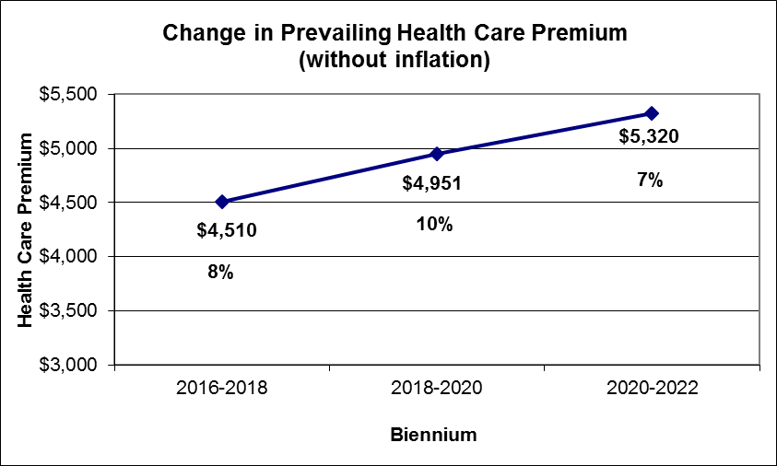
Health Care Premium
Update # | Rebenchmarking Update | FY 2021 State Cost | FY 2022 State Cost | 2020-2022 Total
16 | Update Prevailing Health Care Premium Per Position (without inflation) | 24,816,902 | 24,887,383 | 49,704,285
Note: The 2009 General Assembly changed the methodology for calculating the funded health care premium, beginning with the 2010-2012 biennium, by weighting each division’s annual employer-share health care premium used in the prevailing cost calculation according to the actual percentage of employees participating in each of the three general plan categories (employee, employee plus one, and family) and for actual overall employee participation.

Slide 33
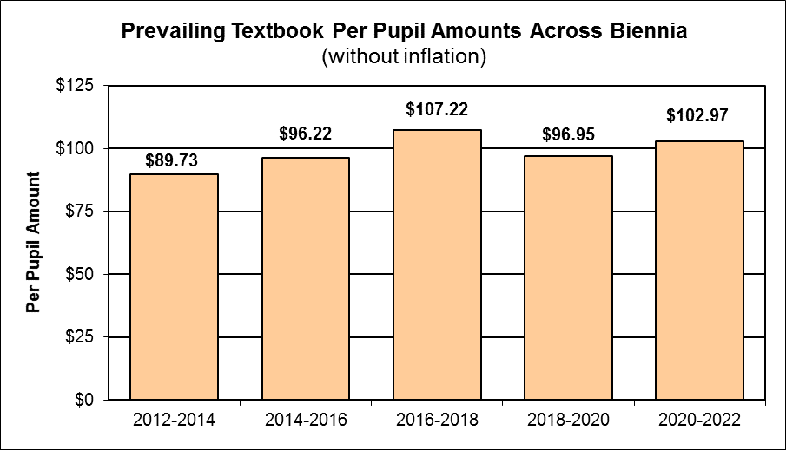
Textbooks Per Pupil
Update # | Rebenchmarking Update | FY 2021 State Cost | FY 2022 State Cost | 2020-2022 Total
17 | Update Prevailing Textbook Per Pupil Amount (without inflation) | 4,191,324 | 4,198,258 | 8,389,582

Slide 34
Non-personal Inflation Factors
Update # | Rebenchmarking Update | FY 2021 State Cost | FY 2022 State Cost | 2020-2022 Total
19 | Update Non-personal Support Cost Inflation Factors | 66,317,602 | 66,391,716 | 132,709,318

Slide 35
Funded Instructional Salaries
Update # | Rebenchmarking Update | FY 2021 State Cost | FY 2022 State Cost | 2020-2022 Total
20 | Update Salary Inflation Factors (Instructional & Support) - recognize continuation cost of FY20 5.0% Compensation Supplement into 20-22 biennium | 215,635,208 | 215,994,350 | 431,629,558

Slide 36
Funded Support Salaries
Update # | Rebenchmarking Update | FY 2021 State Cost | FY 2022 State Cost | 2020-2022 Total
20 | Update Salary Inflation Factors (Instructional & Support) - recognize continuation cost of FY20 5.0% Compensation Supplement into 20-22 biennium | 215,635,208 | 215,994,350 | 431,629,558

Slide 37
Standards of Quality Accounts
Standards of Quality Accounts | FY 2020 | FY 2021 |  | FY 2020 | FY 2022 |  | 2020-2022 Biennium Variance
 | Base State Cost | Updated State Cost | Variance | Base State Cost | Updated State Cost | Variance
 | (Chapter 854) |  |  | (Chapter 854)
Basic Aid | $3,295,069,550 | $3,602,324,544 | ($307,254,994) | $3,295,069,550 | $3,610,195,467 | ($315,125,917) | ($622,380,911)
Sales Tax | $1,486,302,403 | $1,486,302,403 | $0 | $1,486,302,403 | $1,486,302,403 | $0 | $0
Textbooks (General Fund) | $70,023,715 | $74,984,307 | ($4,960,592) | $70,023,715 | $75,108,216 | ($5,084,501) | ($10,045,093)
Vocational Education | $57,930,204 | $61,942,624 | ($4,012,420) | $57,930,204 | $61,772,805 | ($3,842,601) | ($7,855,021)
Gifted Education | $35,314,827 | $37,365,383 | ($2,050,556) | $35,314,827 | $37,437,197 | ($2,122,370) | ($4,172,926)
Special Education | $396,092,863 | $428,265,613 | ($32,172,750) | $396,092,863 | $428,775,580 | ($32,682,717) | ($64,855,467)
Prevention, Intervention and Remediation | $112,320,130 | $122,491,274 | ($10,171,144) | $112,320,130 | $122,390,690 | ($10,070,560) | ($20,241,704)
VRS Retirement | $442,260,022 | $471,109,261 | ($28,849,239) | $442,260,022 | $471,809,810 | ($29,549,788) | ($58,399,027)
Social Security | $200,465,243 | $213,422,556 | ($12,957,313) | $200,465,243 | $213,706,533 | ($13,241,290) | ($26,198,603)
Group Life | $13,596,751 | $14,529,554 | ($932,803) | $13,596,751 | $14,552,607 | ($955,856) | ($1,888,659)
English as a Second Language | $62,519,408 | $68,589,222 | ($6,069,814) | $62,519,408 | $71,208,261 | ($8,688,853) | ($14,758,667)
Remedial Summer School | $24,976,867 | $27,871,480 | ($2,894,613) | $24,976,867 | $29,541,663 | ($4,564,796) | ($7,459,409)
Standards of Quality | $6,196,871,983 | $6,609,198,221 | ($412,326,238) | $6,196,871,983 | $6,622,801,232 | ($425,929,249) | ($838,255,487)
SUB-TOTAL:
Note: a negative value in the variance columns indicates a cost increase in FY21 or FY22 compared to the Chapter 854 FY20 base, a positive value indicates a cost decrease in FY21 or FY22 compared to the FY20 base.

Slide 38
Incentive Accounts
Note: a negative value in the variance columns indicates a cost increase in FY21 or FY22 compared to the Chapter 854 FY20 base, a positive value indicates a cost decrease in FY21 or FY22 compared to the FY20 base.

Slide 39
Categorical Accounts
Categorical Accounts | FY 2020 Base State Cost (Chapter 854) | FY 2021 Updated State Cost | Variance | FY 2020 Base State Cost (Chapter 854) | FY 2022 Updated State Cost | Variance | 2020-2022 Biennium Variance
Adult Education | $1,051,800 | $1,051,800 | $0 | $1,051,800 | $1,051,800 | $0 | $0
Adult Literacy | $2,480,000 | $2,480,000 | $0 | $2,480,000 | $2,480,000 | $0 | $0
Virtual Virginia | $5,175,808 | $5,175,808 | $0 | $5,175,808 | $5,175,808 | $0 | $0
Indian Children (King William County) | $38,954 | $39,178 | ($224) | $38,954 | $38,450 | $504 | $280
School Lunch | $5,801,932 | $5,801,932 | $0 | $5,801,932 | $5,801,932 | $0 | $0
Special Education - Homebound | $4,867,702 | $4,940,843 | ($73,141) | $4,867,702 | $4,990,242 | ($122,540) | ($195,681)
Special Education - Jails | $3,507,385 | $3,530,221 | ($22,836) | $3,507,385 | $3,850,787 | ($343,402) | ($366,238)
Special Education - State Operated Programs | $35,660,182 | $35,665,313 | ($5,131) | $35,660,182 | $36,574,219 | ($914,037) | ($919,168)
Categorical SUB-TOTAL: | $58,583,763 | $58,685,095 | ($101,332) | $58,583,763 | $59,963,238 | ($1,379,475) | ($1,480,807)
Note: a negative value in the variance columns indicates a cost increase in FY21 or FY22 compared to the Chapter 854 FY20 base, a positive value indicates a cost decrease in FY21 or FY22 compared to the FY20 base.

Slide 40
Lottery Accounts
Note: a negative value in the variance columns indicates a cost increase in FY21 or FY22 compared to the Chapter 854 FY20 base, a positive value indicates a cost decrease in FY21 or FY22 compared to the FY20 base.

Slide 41
Summary – by Direct Aid Account Category
Note: a negative value in the variance columns indicates a cost increase in FY21 or FY22 compared to the Chapter 854 FY20 base, a positive value indicates a cost decrease in FY21 or FY22 compared to the FY20 base.

Slide 42
Questions?

