Slide 1
First Review of the Proposed 2020 Computer Technology Standards of Learning

Slide 2
First Review of the Proposed 2020 Computer Technology Standards of Learning
Current Name
Computer Technology Standards of Learning
Change in Mindset
Essential Role of Technology in Learning
New Name
Digital Learning Integration Standards of Learning

Slide 3
First Review of the Proposed 2020 Computer Technology Standards of Learning
The Strands
Empowered Learner
Digital Citizen
Knowledge Constructor
Innovative Designer
Computational Thinker
Creative Communicator
Global Collaborator

Slide 4
First Review of the Proposed 2020 Computer Technology Standards of Learning
Comments Received
(13)
October 2019 – February 2020

Slide 5
First Review of the Proposed 2020 Computer Technology Standards of Learning
Focus on learning, not technology
New strands based on student roles
New format shows learning progression
Learning Priority component
Connection to the
5 C’s
Differences:
current standards vs. new standards

Slide 6
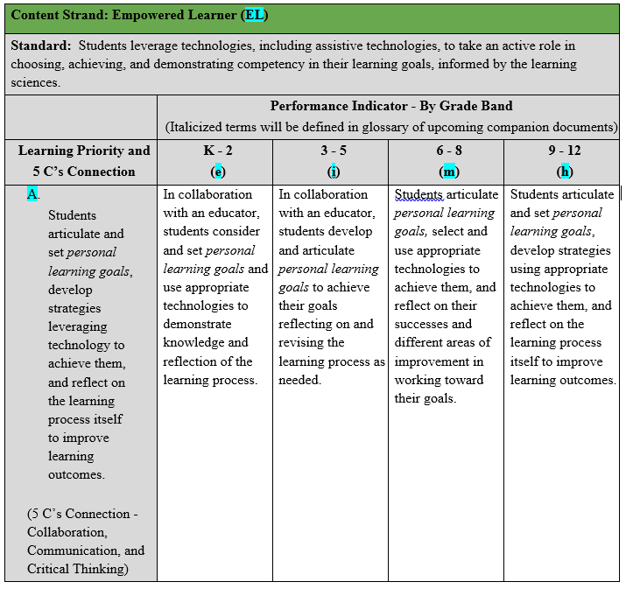
First Review of the Proposed 2020 Computer Technology Standards of Learning

Slide 7
First Review of the Proposed 2020 Computer Technology Standards of Learning
Learning Priority Examples
Digital Citizen: Cultivate and manage digital identity and reputation.
Innovative Designer: Know and use appropriate technologies in a purposeful design process.
Creative Communicator: Create original works or responsibly repurpose or remix digital resources.
Global Collaborator: Use collaborative technologies to work with others.
Computational Thinker: Formulate problem definitions suited for technology-assisted
methods in finding solutions.

Slide 8
First Review of the Proposed 2020 Computer Technology Standards of Learning
Questions?

