Slide 1
Early Childhood Updates January 22, 2020

Slide 2
Objective and Agenda
The objective of this presentation is to update Board on statewide kindergarten readiness results and activities related to early childhood.
Update on Kindergarten Readiness
Overview of Key Activities for 2020
Award of PDG B-5 Renewal
Proposed Legislation
Proposed Budget Funding
Implications for the Board of Education

Slide 3
Update on Kindergarten Readiness

Slide 4
Virginia Kindergarten Readiness Program (VKRP)
All 132 school divisions completed VKRP with all entering kindergartners in fall 2019.
VKRP is a set of coordinated assessments
Literacy (PALS), math, self-regulation, and social skills combined to provide teachers with a more comprehensive picture of students’ skills at the beginning of kindergarten
VKRP is a reporting system
Provides detailed and integrated information about students’ skills at the student (for teachers and families), classroom, school, division, and state levels
VKRP is a set of instructional resources
Supports teachers to understand students’ skill levels and to use instructional practices to support their learning and growth

Slide 5
Kindergarten Readiness in Virginia
All Virginia children, regardless of background or zip code, are capable of and deserve to enter kindergarten ready. Yet 44% do not enter ready.
Virginia Kindergarten Readiness Results – Overall and By Domain(2019)

Slide 6
Equity and School Readiness
More than 37,000 children enter Virginia public schools each year without the key academic and socio-emotional skills needed to be successful. The opportunity gap is greater than the third grade reading or math gap.

Slide 7
Gaps across Domains
Gaps cut across learning and developmental gains, meaning the holistic needs of Virginia’s most vulnerable children are not being met.
Virginia Kindergarten Readiness Results (2019)
% of Students Entering
“Ready”
88
86
84
80
75
76
74
68
Not Disadvantaged
Disadvantaged
Literacy
Math
Self-Regulation
Social Skills

Slide 8
Public Preschool Makes a Difference
Economically-disadvantaged children who attend public preschool are ~1.5 times more likely to be kindergarten than their peers who do not.
VKRP Results (2019) of Children from Low Income Backgrounds who Attend Public Preschool Compared to Those with No Preschool Experience

Slide 9
Public Preschool in a Private Setting Makes a Difference
Children in mixed-delivery classrooms received similar benefits and were prepared at similar levels as they transitioned into kindergarten.
Gains in Child Assessment Scores Among Children in Mixed Delivery and Public School VPI Classrooms, Fall 2017-Spring 2018

Slide 10
Key Activities in 2020

Slide 11
Preschool Development Grant B-5 Renewal
Virginia will expand and strengthen local capacity and infrastructure through the $33.5 million PDG B-5 Renewal Grant for 2020-2022.
Virginia has received three years of $11 million ($33.5 million overall) to expand the work of the initial 10 pilots.
Additional pilot communities will be invited to join to:
Build relationships across Birth-5 early care and education providers,
Increase access for Birth-5 children in their community,
Improve quality through local CLASS observations and professional development, and
Support family engagement.
Child care educators will be eligible for financial incentives.
This effort provides the foundation for the uniform measurement and improvement system.

Slide 12
Proposed Early Childhood Legislation
The General Assembly is considering legislation to unify Virginia’s early childhood care and education system.
The Governor’s Administration has proposed legislation to support the unification of Virginia’s birth-five system.
The legislation would:
Establish a unified public-private early care and education system administered by the VDOE and Board of Education;
Create a uniform quality measurement and improvement system for all early childhood programs that receive public funds;
Move oversight and licensure of care and education entities to the VDOE and Board;
Create early childhood advisory council to the Board; and
Phase in these activities over time with frequent updates to the General Assembly.

Slide 13
Proposed Funding for Early Childhood in Governor’s Budget
The proposed budget invests an additional $94.8 million over the biennium to transform the early childhood system and increase access for three and four-year-olds:
Enhance VPI and increase access to at-risk 4s via:
Increased per pupil amount;
Add-on funds ($2500) for VPI in mixed-delivery settings;
Ability to slightly increase class size, in-kind and locally-determined eligibility; and
Funds to eliminate waitlists through seat reallocation.
Pilot the expansion of two existing programs (VPI and Mixed Delivery Grants) to at-risk 3s in public and private settings.
Expand CLASS observations and professional development funding to all school-based pre-K (ECSE, Title I, and VPI).
Provide incentives to early childhood teachers working for low wages in private settings (in alignment with PDG B-5).

Slide 14
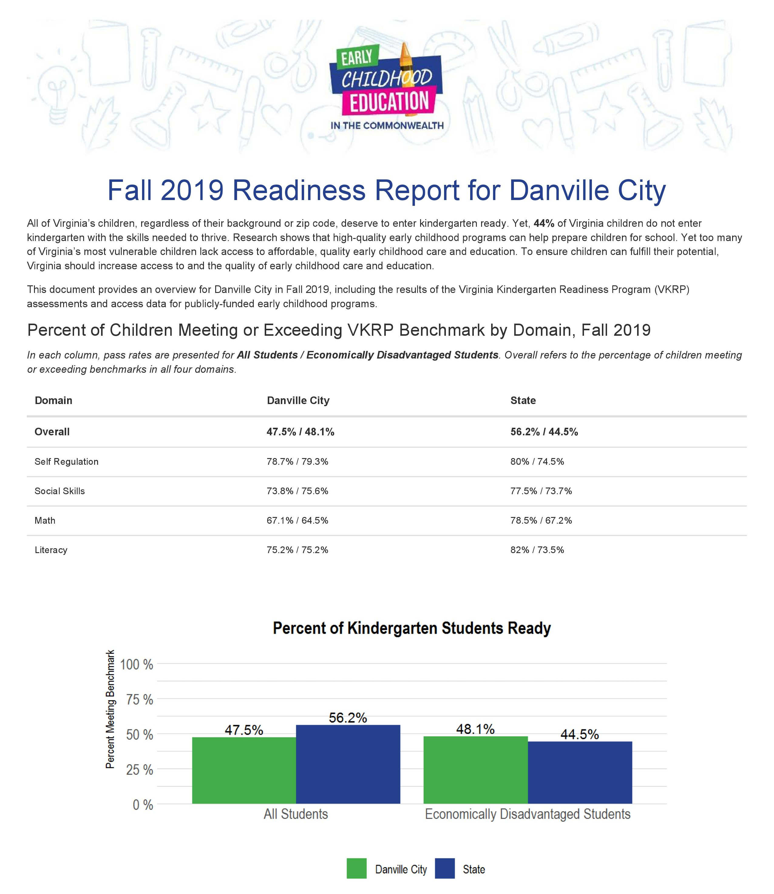
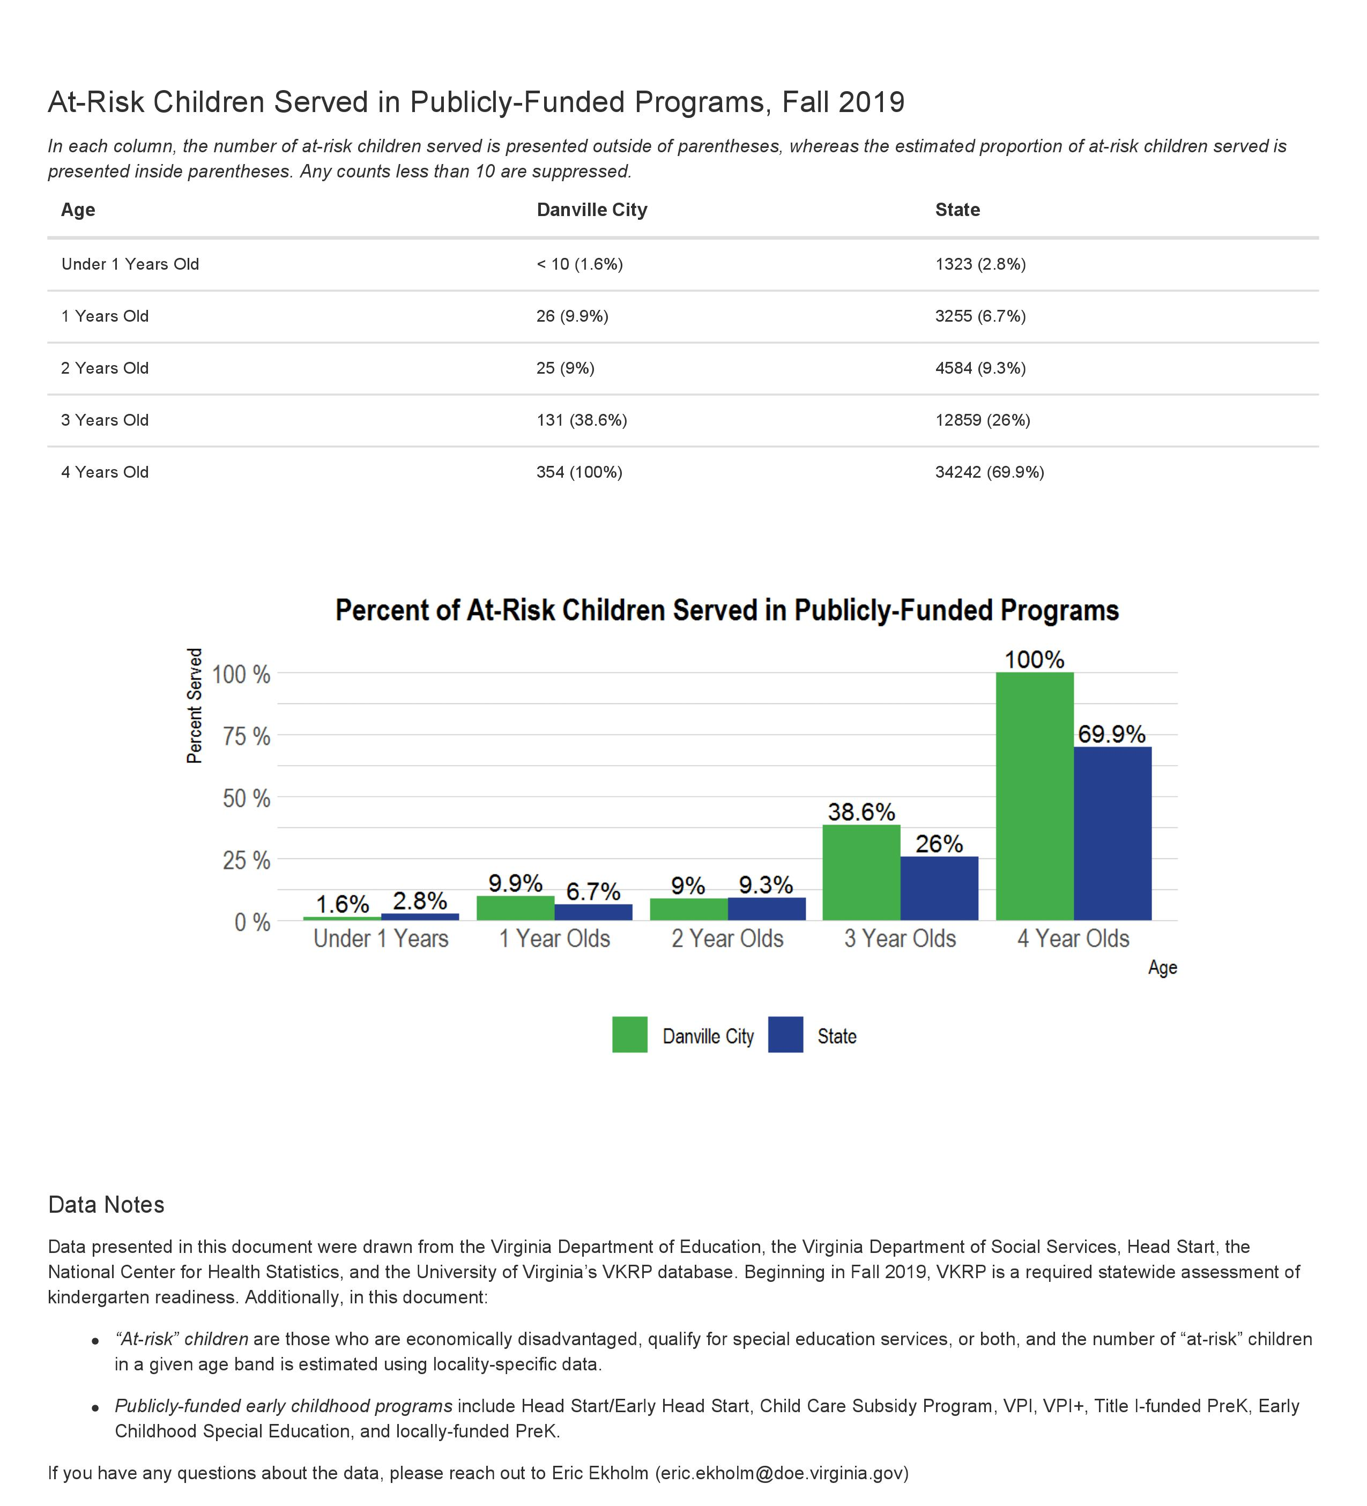
Field Engagement
VDOE is regularly engaging Superintendents, Budget Directors and program staff on changes to ensure successful implementation in 2020-2021.

Slide 15
Implications for the Board

Slide 16
What to Expect
VDOE staff will continue to update the Board on planning and progress as it relates to access, quality, consolidation and school readiness.
The Board should expect:
Periodic updates on access, quality, and the transition, including an implementation plan in summer 2020;
More staff at the VDOE to support the Division of School Readiness, most of whom will be federally-funded;
Recommendations from a new Early Childhood Advisory Council to offer deep early childhood expertise;
Regulations will shift over as of July 1, 2021 and then Division of School Readiness, in partnership with Policy, will review, align and submit to Board; and
Annual updates on school readiness (e.g., VKRP).

Slide 17
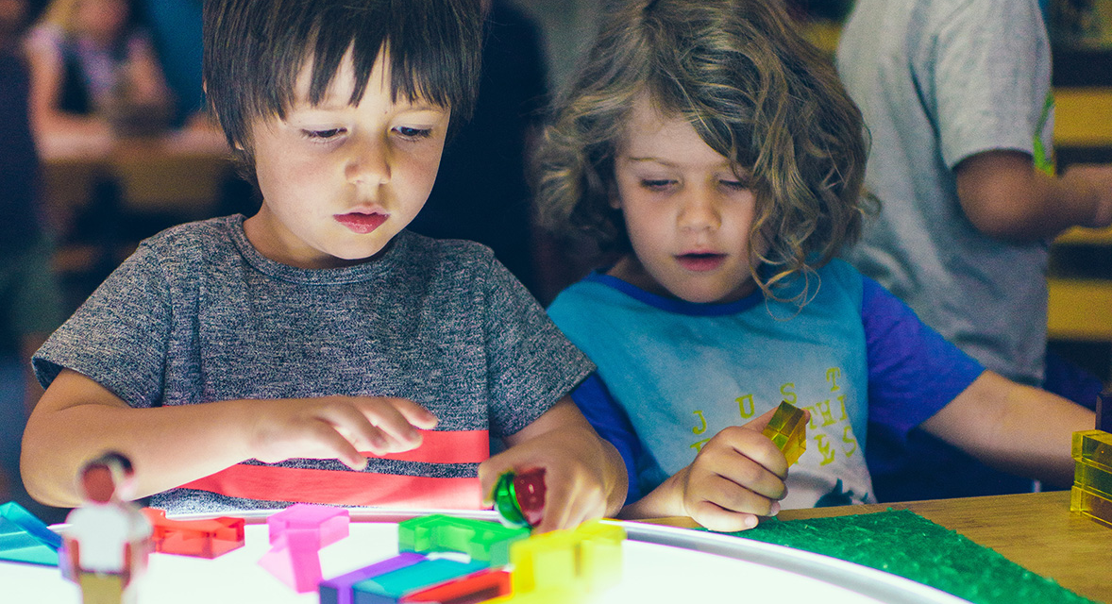
Questions?

