Slide 1
Guidelines for Practice Year 1 of the Early Childhood Unified Measurement and Improvement System
First Review
April 22, 2021

Slide 2
Preparing All Virginia Children for Kindergarten
Virginia’s current system does not offer every child equitable opportunity.
Quality early childhood experiences prepare children for success but families and children lack equitable access to these experiences.
Our system too often fails to prepare children who are Black, Hispanic, speak a language other than English at home, or have a diagnosed disability or developmental delay.
Virginia’s early childhood system must ensure that all children have access to quality teaching and learning experiences that meet their unique needs. Together, we will:
UNIFY around shared and equitable expectations for quality.
MEASURE and strengthen teacher-child interactions and curriculum use in all publicly-funded birth-to-five programs.
IMPROVE supports for educators, prioritizing those who need it most.
Notes:
JENNA

Slide 3
Building a More Unified and Equitable System
Virginia Quality (VQ), Head Start and VPI+
Virginia Quality, Head Start and VPI + use teacher-child interactions as a key component of classroom quality in a variety of birth-five settings, including in family day homes.
Preschool Development Grant (PBG B-5)
Virginia received funding to develop a unified strategy, increase equity and build infrastructure at the community level, focusing on relationships, quality, enrollment and family engagement, across PreK, ECSE, Head Start, child care centers and family day homes.
Early Childhood Unification Law
Governor Northam signed HB 1012/SB 578 into law in July 2020, officially unifying birth to five programs under the VDOE as of July 1, 2021; establishing the Early Childhood Advisory Council; and requiring the Board to adopt a uniform quality rating system by July 1, 2021.
2016
2019
2015
2018
2020
JLARC Early Childhood Study
Study found that Virginia has insufficient evidence about how well publicly-funded early childhood programs are preparing children for school
Recommendations included more comprehensive assessments of K readiness; improving the design, quality, and performance data of programs.
Executive Directive 4 on School Readiness
ED4 called for a plan to ensure that all at-risk 3 and 4-year-olds have equitable access to publicly-funded care and education and that all publicly-funded birth to five programs are measured as part of a uniform quality rating system. Virginia conducted listening sessions in the field, analyzed data, and collaborated across agencies to develop recommendations.
Notes:
V

Slide 4
Virginia Law Now Requires a Unified System
In July 2020, Governor Northam signed a law to create a Unified Measurement and Improvement System.
Law requires the Board to establish the new system by July 2021 and specifies that the first two years are practice-only so programs can learn the new system.
Preschool Development Grant (PDG)-funded efforts will help ensure broad participation in Practice Year 1.
Practice Year 1 data will be used to evaluate and refine the system.
Two practice years provides flexibility as programs recover from COVID-19.
By fall 2023, all publicly-funded programs will be required to participate with ratings shared publicly in fall 2024. Programs who do not receive public funds will have the option to participate.
Additional detail is available on Building a Unified Early Childhood System website.
Notes:
JENNA

Slide 5
What Will be Measured?
Virginia’s new Unified Measurement and Improvement System will measure the quality of infant, toddler and preschool teaching and learning based on two nationally-recognized quality indicators.
Interactions | Curriculum
Measure teacher-child interactions and instruction in a developmentally-appropriate way using the Classroom Assessment Scoring System (CLASS) | Measure the use of approved curricula that are aligned with Virginia’s Early Learning and Development Standards
Research shows that stimulating and supportive interactions between teachers and children and effective use of quality curricula promote children’s holistic learning and development, resulting in improved and more equitable school readiness.
Notes:
Research shows that stimulating and supportive interactions between teachers and children and effective use of quality curricula promote children’s holistic learning and development, resulting in improved school readiness.

Slide 6
Compelling Rationale for a Focused Approach
Why Interactions? | Why Curriculum?
✔ Responsive and effective teacher-child interactions form the foundation for all social and cognitive learning. ✔ 200+ studies show that children in classrooms with more effective teacher-child interactions, as measured by CLASS®, have better academic and social outcomes. ✔ Improvements in interactions are associated with improvements in children’s outcomes. ✔ All children, including those from diverse backgrounds, dual language learners (DLLs) and those with special needs, benefit from high quality interactions as measured by CLASS®. ✔ Virginia has used the CLASS® in early care and education settings for 10+ years. | ✔ Using effective curricula helps support learning and development in all settings. ✔ Curricula that are aligned with Virginia’s Early Learning Standards help ensure educators address all areas of children's learning and development. ✔ Quality curricula support cultural and linguistic diversity, and help individualize instruction based on children’s needs. ✔ Studies suggest that “intensive, developmentally-focused curricula with integrated professional development and monitoring of children’s progress offer the strongest hope for improving classroom quality and child outcomes.”
Notes:
Research shows that stimulating and supportive interactions between teachers and children and effective use of quality curricula promote children’s holistic learning and development, resulting in improved school readiness.

Slide 7
Quality Measurement Supports Improvement
To improve child outcomes, Virginia’s system must continually improve supports for educators, prioritizing those who need it most. It should ensure:
Educators receive frequent feedback and support to strengthen their practice:
Are recognized for their strengths and know areas for growth.
Have access to training and coaching based on their unique needs.
Program leaders have data that help deepen their understanding of the strengths and needs within their program:
Have access to aligned professional development supports for their site goals.
Community leads, professional development organizations and individuals (e.g., coaches) have insight into specific program needs as well as statewide focus areas:
Can align their improvement efforts and collaborate more effectively.
Virginia will also provide at least $1,500 annually directly to child care and family day home educators in publicly-funded programs to encourage participation, reduce turnover and support improvement.*
*Eligibility is limited to child care, FDH and Head Start educators who work 30 or more hours/week with children in publicly-funded programs participating in PDG and are not school system employees. Educators will receive an additional $500 in 2020-21. Eligibility is subject to change.
Notes:
JENNA

Slide 8
Program Level Results for Practice Year 1
Practice Year 1 results will be private and will not have any consequences.
Results will be shared with program leaders.
State level results will be used to analyze equity impact and improve the system.
Interactions Points (700 total points) | Average of all CLASS scores (all classrooms at a site) x 100
Curriculum Points (100 total points) | Programs using an approved curriculum in at least one classroom will receive 100 points added to their score
Total Points | Interactions Points + Curriculum Points = Total Points
Practice Year Rating | Exceeds Practice Year Expectations = 700 - 800 points Meets Practice Year Expectations = 400 - 699 points Needs Support = 100 - 399 points
Notes:
KRIS
Discuss/explain why some of these pieces are “starting points” for the practice year (- example - curriculum not required until May; 3 levels with a big middle_
Messaging around the VPI/VQ benchmarks compared to new system
Reflection/rationale on the big middle - using this as a place to start, having the field come to us with a call to the field to build understanding with use of data
“Approved” vs “vetted”
Cut points drawn from High-Mid-Low
Exemplary - The program performing at this level demonstrates performance that consistently and considerably surpasses the established standard. This rating is reserved for performance that is truly exemplary and done in a manner that exemplifies the state’s mission and goals for the practice year.
Satisfactory - The program meets the standard in a manner that is consistent with the state’s mission and goals for the practice year.
Needs Improvement - The program is performing below the established standard or in a manner that is inconsistent with the state’s mission and goals for the practice year
As a reminder, during the practice year, there will not be any consequences attached to the quality ratings. Rather, community and school leaders will use the performance rating scales for each standard, along with the overall practice rating results to understand the close connection between teacher-child interactions, instruction and child outcomes as they work with local leaders and teachers to prioritize pressing needs.

Slide 9
Supporting Improvement in Every Classroom
PREPARE
Leaders and educators understand what is being measured and why
RECOGNIZE, REFLECT AND ADJUST
Leaders and educators use data to recognize growth, reflect on what works and make adjustments to address challenges and gaps
MEASURE
All infant, toddler and preschool classrooms are observed and consistent information is collected to understand the experience of all children
SUPPORT
Leaders and educators engage in professional development that addresses their unique classrooms
GIVE FEEDBACK
Educators receive individualized feedback on their classroom’s strengths and opportunities for growth
Notes:
JENNA
This is a system that supports Improvement in every classroom. Information/Feedback for every educator.
The state is going to focus on those who need it most. (Individualized support) Prioritizing Or turn this into a story narrative.
Is there someone who could give an example of how they’ve been doing this. - hearing an example of how this empowers .
Before this consider showing some of the LInk B5 data to show how the data can be used to start to guide improvement
Brookings article

Slide 10
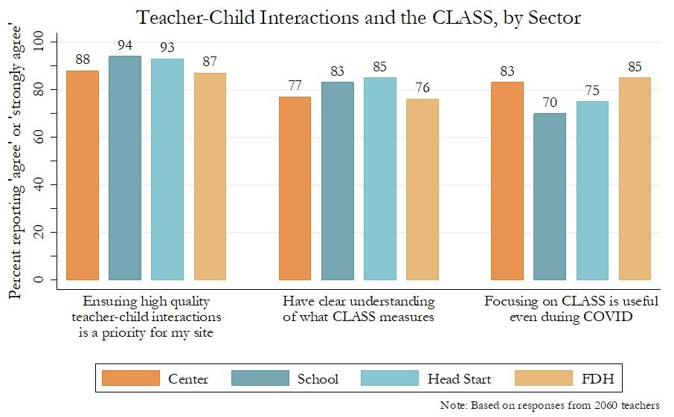
Virginia Educators Find CLASS Useful
Survey of 2000+ Virginia educators across program types suggests that interactions are a priority and CLASS is useful, even during COVID.
VA-PDG Fall 2020 Workforce Survey
Notes:
Across all sectors, most teachers agreed that high-quality interactions were a priority at their site
Add citation - daphna study fall 2020

Slide 11
Investment in Measurement and Improvement
Virginia will increase funding to build and ensure equity across the new system:
Fund communities to build relationships, conduct CLASS observations and support educators in Practice Year 1 through PDG B-5.
Fund programs to meet higher expectations:
VPI rate has increased by 21% with additional funding for private providers.
Mixed Delivery rate has increased.
Child care subsidy rates have increased with additional flexibility and benefits.
Integrate current improvement resources, increase their funding and make them more accessible to programs with fewer resources (i.e., child care, family day homes):
Millions in federal and state funding will support instructional and social-emotional supports (e.g., curriculum, mental health, etc.)
Incent more vulnerable educators directly:
Child care and family day home educators will receive at least $1500 annually to encourage participation, reduce turnover and support improvement.*
Study showed that the incentive reduced turnover by half (30% to 15%).
*Eligibility is limited to child care, FDH and Head Start educators who work 30 or more hours/week with children in publicly-funded programs participating in PDG and are not school system employees. Educators will receive an additional $500 in 2020-21. Eligibility is subject to change.

Slide 12
ECAC Endorsement and Public Feedback
VDOE received an endorsement with 3 recommendations from the ECAC. All recommendations have been incorporated into the Guidelines. VDOE has also received 70+ comments via online survey. Here are themes:
Strengths | Questions and Concerns
Common and consistent expectations for all types of programs Having time for practice before the full system launches Focus on teacher-child interactions and use of the CLASS tool Removal of barriers from previous rating systems Effort to ensure equity Focus on publicly funded programs Clear and easy to understand | Continued questions around communications, curriculum approval process, supports for programs, incentives/consequences and how scoring process works Importance of building on existing partnerships Remember the importance of family day home providers Flexibility is important because all programs are different and parents have different needs Need to translate materials into other languages Concerns about compensation and/or increase in minimum wage Concerns about cost of CLASS training and recertification Importance of parent education and/or awareness

Slide 13
Appendix A: Guiding Principles for the Unified System
Through this iterative development process, the VDOE has established the following guiding principles for the Unified Measurement System.
Virginia’s new Unified Measurement and Improvement System should:
Improve quality and result in improved school readiness for children.
Increase equity in 1) the outcomes that are measured, and 2) the process for making and using the system.
Use measures that can distinguish levels of quality and demonstrate growth over time.
Provide clear and actionable information, resources and incentives for improvement.
Be affordable for providers and the state.
Scale for use in over 6,000 programs and 10,000 classrooms.
Serve as a resource for families

Slide 14
Appendix B: Detail on Current Investments
Amount | How Funding Supports Improvement
~$107 million | Total Virginia Preschool Initiative funding for at-risk 3- and 4-year-olds, including a 21% increase in the per-pupil rate and nearly $5 million to support community or private providers who offer VPI
$5 million | Total Mixed Delivery Grant (MDG) funding for at-risk 3- and 4-year-old children at a higher per-child rate to support quality preschool in private settings
~$177 million estimated | Federal funding through the Child Care and Development Block Grant for child care assistance to low income families and quality supports across the system
~$8 million | Preschool Development Grant (PDG B-5) funding to support quality measurement and improvement efforts in PDG B-5 communities, including the educator incentive program
$7 million | Governor’s Educational Emergency Relief Fund (GEER) funding to bolster early childhood mental health consultation (ECMHC) services in schools, increase the educator incentive program, expand developmental assessments for children in preschool, and develop a resource hub for educators
~$204 million* | Consolidated Appropriations Act of 2021 funding to expand eligibility for and strengthen the child care subsidy program, bolster ECMHC services, and strengthen improvement supports for child care
~$794 million* | American Rescue Plan Act funding including direct grants to providers and expanding access to child care
~$1.3 billion | TOTAL
Note: Some funding is multi-year and chart does not include federal-to-local funding to support Head Start programs.

