Slide 1
Guidelines for Practice Year 1 of the Early Childhood Unified Measurement and Improvement System
Final Review
June 17, 2021

Slide 2
Preparing All Virginia Children for Kindergarten
Virginia’s current system does not offer every child equitable opportunity.
Quality early childhood experiences prepare children for success but families and children lack equitable access to these experiences.
Our system too often fails to prepare children who are Black, Hispanic, speak a language other than English at home, or have a diagnosed disability or developmental delay.
Virginia’s early childhood system must ensure that all children have access to quality teaching and learning experiences that meet their unique needs. Together, we will:
UNIFY around shared and equitable expectations for quality.
MEASURE and strengthen teacher-child interactions and curriculum use in all publicly-funded birth-to-five programs.
IMPROVE supports for educators, prioritizing those who need it most.
Notes:
JENNA

Slide 3
Virginia Law Now Requires a Unified System
In July 2020, Governor Northam signed a law to create a Unified Measurement and Improvement System.
Law requires the Board to establish the new system by July 2021 and specifies that the first two years are practice-only so programs can learn the new system.
Preschool Development Grant (PDG)-funded efforts will help ensure broad participation in Practice Year 1.
Practice Year 1 data will be used to evaluate and refine the system.
Two practice years provides flexibility as programs recover from COVID-19.
By fall 2023, all publicly-funded programs will be required to participate with ratings shared publicly in fall 2024. Programs who do not receive public funds will have the option to participate.
Additional detail is available on Building a Unified Early Childhood System website.
Notes:
JENNA

Slide 4
Progress Update
ECAC Endorsements:
On March 24, 2021, the Early Childhood Advisory Committee (ECAC) endorsed the Guidelines for Practice Year 1 of the Early Childhood Unified Measurement and Improvement System with three recommendations. All three recommendations were included as well as other changes (e.g., rating names).
On May 19, 2021 ECAC again endorsed the Guidelines and VDOE’s approach towards implementation.
Stakeholder Engagement:
Since April, VDOE has continued to engage stakeholders:
Quality Matters Part 2 webinar and feedback survey- 342 live attendees; 611 recording views; 80+ online feedback survey responses
18 presentations to stakeholder groups
Ongoing consultations with data, content and equity experts
Email updates and Building a Unified Early Childhood System website.
Notes:
3 Listening sessions with 65 educators from across the state (mention specific to equity?)
XX consultants with data and content experts
Information and resources shared broadly through email; newsletters and posted online.
SUMMER-FALL 2020
Reviewed and modeled current quality data from Virginia.
Conducted stakeholder engagement webinars and presentations.
Hosted listening sessions and phone calls.
Conducted a statewide survey for input from the field.
Developed proposals based on national research and current Virginia landscape.
WINTER 2021
Finalized proposed set of measures
Used data from fall 2019-2020 to test the proposed set of measures
Developed policy proposal based on feedback and data modeling
Finalized Virginia Quality transition plan
Launched VDOE Building a Unified Early Childhood System website to share information about the new measurement and improvement system.

Slide 5
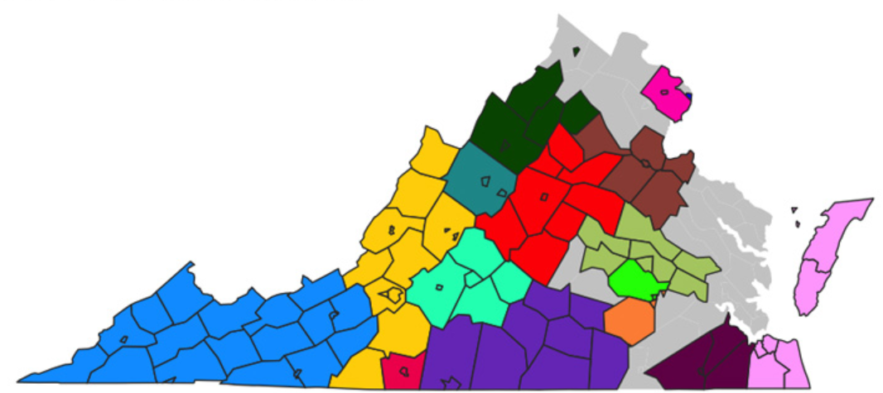
PDG Expansion and Coverage for Practice Year 1
Virginia has strategically used the Preschool Development Grant Birth-Five (PDG B-5) funding to unify the system from the ground up. PDG B5 communities receive more than $5.5 million in funding and support to build the the unified measurement and improvement system in their region.
All PDG B-5 communities will participate in Practice Year 1.
There are currently 2 cohorts of PDG B-5 Community Networks, several of which have recently expanded their coverage area.
Cohort 3 will join this summer
PDG is anticipated to be available in approximately 82% of localities and to 83% of publicly-funded programs in the state next year.
Map of Cohort 1 and Cohort 2 PDG Communities. Cohort 3 will be added this summer.

Slide 6
What Will be Measured?
Virginia’s new Unified Measurement and Improvement System will measure the quality of infant, toddler and preschool teaching and learning based on two nationally-recognized quality indicators.
Interactions | Curriculum
Measure teacher-child interactions and instruction in a developmentally-appropriate way using the Classroom Assessment Scoring System (CLASS) | Measure the use of approved curricula that are aligned with Virginia’s Early Learning and Development Standards
Research shows that stimulating and supportive interactions between teachers and children and effective use of quality curricula promote children’s holistic learning and development, resulting in improved and more equitable school readiness.
Notes:
Research shows that stimulating and supportive interactions between teachers and children and effective use of quality curricula promote children’s holistic learning and development, resulting in improved school readiness.

Slide 7
Program Level Results for Practice Year 1
Practice Year 1 results will be private and will not have any consequences.
Results will be shared with program leaders.
State level results will be used to analyze equity impact and improve the system.
Interactions Points (700 total points) | Average of all CLASS scores (all classrooms at a site) x 100
Curriculum Points (100 total points) | Programs using an approved curriculum in at least one classroom will receive 100 points added to their score
Total Points | Interactions Points + Curriculum Points = Total Points
Practice Year Rating | Exceeds Practice Year Expectations = 700 - 800 points Meets Practice Year Expectations = 400 - 699 points Needs Support = 100 - 399 points
Notes:
KRIS
Discuss/explain why some of these pieces are “starting points” for the practice year (- example - curriculum not required until May; 3 levels with a big middle_
Messaging around the VPI/VQ benchmarks compared to new system
Reflection/rationale on the big middle - using this as a place to start, having the field come to us with a call to the field to build understanding with use of data
“Approved” vs “vetted”
Cut points drawn from High-Mid-Low
Exemplary - The program performing at this level demonstrates performance that consistently and considerably surpasses the established standard. This rating is reserved for performance that is truly exemplary and done in a manner that exemplifies the state’s mission and goals for the practice year.
Satisfactory - The program meets the standard in a manner that is consistent with the state’s mission and goals for the practice year.
Needs Improvement - The program is performing below the established standard or in a manner that is inconsistent with the state’s mission and goals for the practice year
As a reminder, during the practice year, there will not be any consequences attached to the quality ratings. Rather, community and school leaders will use the performance rating scales for each standard, along with the overall practice rating results to understand the close connection between teacher-child interactions, instruction and child outcomes as they work with local leaders and teachers to prioritize pressing needs.

Slide 8
Investment in Measurement and Improvement
Virginia will increase funding to build and ensure equity across the new system:
Fund communities to build relationships, conduct CLASS observations and support educators in Practice Year 1 through PDG B-5.
Fund programs to meet higher expectations:
VPI rate has increased by 21% with additional funding for private providers.
Mixed Delivery rate has increased.
Child care funding has increased with additional flexibility and benefits.
Integrate current improvement resources, increase their funding and make them more accessible to programs with fewer resources (i.e., child care, family day homes):
Millions in federal and state funding will support instructional and social-emotional supports (e.g., curriculum, mental health, etc.)
Incent more vulnerable educators directly:
Child care and family day home educators will receive at least $2000 annually to encourage participation, reduce turnover and support improvement.*
Study showed that the incentive reduced turnover by half (30% to 15%).
*Eligibility is limited to child care, FDH and Head Start educators who work 30 or more hours/week with children in publicly-funded programs participating in PDG and are not school system employees. Educators will receive an additional $500 in 2020-21. Eligibility is subject to change.

Slide 9
Practice Year 1 Timeline
Here is the timeline for Practice Year 1 for PDG communities.
July 2021
Practice Year 1 Begins
Fall 2021
Local CLASS Observations and curriculum use entered in LinkB5
Spring 2022
Local CLASS Observations and updates to curriculum use entered in LinkB5
Summer 2022
VDOE uses LinkB5 data from Practice Year 1 to calculate practice ratings
Fall 2022
Programs receive their practice rating results
Fall 2021 - Spring 2022
External CLASS observations also occur for some sites
July 2022
Practice Year 2 Begins

Slide 10
Next Steps: Preparing for Practice Year 1
VDOE is currently coordinating with partners to prepare for Practice Year 1.
VDOE and the Virginia Early Childhood Foundation (VECF) are currently providing support to PDG Communities through weekly office hours which will continue over the summer. Each week focuses on a different aspect of the measurement and improvement system and includes opportunities for communities to learn from each other.
Cohort 3 will participate in an orientation session in July.
VDOE and VECF are planning for full day TA sessions in June and September
VDOE is updating the Local Observation Guidebook and developing a site-level implementation guide with the timeline and protocols for Practice Year 1.
UVA is working on Link B5 revisions and enhancements, as well as developing protocols for birth to five external CLASS observations.
PDG Communities are offering Foundational CLASS training and resources this summer to help prepare educators for fall CLASS observations.
VDOE will post a schedule for CLASS Observation Training this summer.

Slide 11
Appendix A: Guiding Principles for the Unified System
Through this iterative development process, the VDOE has established the following guiding principles for the Unified Measurement System.
Virginia’s new Unified Measurement and Improvement System should:
Improve quality and result in improved school readiness for children.
Increase equity in 1) the outcomes that are measured, and 2) the process for making and using the system.
Use measures that can distinguish levels of quality and demonstrate growth over time.
Provide clear and actionable information, resources and incentives for improvement.
Be affordable for providers and the state.
Scale for use in over 6,000 programs and 10,000 classrooms.
Serve as a resource for families

Slide 12
Appendix B: Supporting Improvement in Every Classroom
PREPARE
Leaders and educators understand what is being measured and why
RECOGNIZE, REFLECT AND ADJUST
Leaders and educators use data to recognize growth, reflect on what works and make adjustments to address challenges and gaps
MEASURE
All infant, toddler and preschool classrooms are observed and consistent information is collected to understand the experience of all children
SUPPORT
Leaders and educators engage in professional development that addresses their unique classrooms
GIVE FEEDBACK
Educators receive individualized feedback on their classroom’s strengths and opportunities for growth
Notes:
JENNA
This is a system that supports Improvement in every classroom. Information/Feedback for every educator.
The state is going to focus on those who need it most. (Individualized support) Prioritizing Or turn this into a story narrative.
Is there someone who could give an example of how they’ve been doing this. - hearing an example of how this empowers .
Before this consider showing some of the LInk B5 data to show how the data can be used to start to guide improvement
Brookings article

Slide 13
Appendix C: Detail on Current Investments
Amount | How Funding Supports Improvement
~$107 million | Total Virginia Preschool Initiative funding for at-risk 3- and 4-year-olds, including a 21% increase in the per-pupil rate and nearly $5 million to support community or private providers who offer VPI
$5 million | Total Mixed Delivery Grant (MDG) funding for at-risk 3- and 4-year-old children at a higher per-child rate to support quality preschool in private settings
~$177 million estimated | Federal funding through the Child Care and Development Block Grant for child care assistance to low income families and quality supports across the system
~$8 million | Preschool Development Grant (PDG B-5) funding to support quality measurement and improvement efforts in PDG B-5 communities, including the educator incentive program
$7 million | Governor’s Educational Emergency Relief Fund (GEER) funding to bolster early childhood mental health consultation (ECMHC) services in schools, increase the educator incentive program, expand developmental assessments for children in preschool, and develop a resource hub for educators
~$204 million* | Consolidated Appropriations Act of 2021 funding to expand eligibility for and strengthen the child care subsidy program, bolster ECMHC services, and strengthen improvement supports for child care
~$794 million* | American Rescue Plan Act funding including direct grants to providers and expanding access to child care
~$1.3 billion | TOTAL
Note: Some funding is multi-year and chart does not include federal-to-local funding to support Head Start programs.

Slide 14
Appendix D: Public Feedback
VDOE has gathered feedback about the new unified measurement and improvement system proposal throughout the spring via an online survey, listening sessions and stakeholder presentations. Here are the themes:
Strengths | Questions and Concerns
Common and consistent expectations for all types of programs Having time for practice before the full system launches Focus on teacher-child interactions and use of the CLASS tool Removal of barriers from previous rating systems Effort to ensure equity Focus on publicly funded programs Clear and easy to understand | Continued questions around communications, curriculum approval process, supports for programs, incentives/consequences and how scoring process works Importance of building on existing partnerships Remember the importance of family day home providers Flexibility is important because all programs are different and parents have different needs Need to translate materials into other languages Concerns about compensation and/or increase in minimum wage Concerns about cost of CLASS training and recertification Importance of parent education and/or awareness

