Slide 1
Early Literacy Starts at Home
Dr. Tamilah Richardson, Director of Early Childhood Learning
Office of Early Childhood
Virginia Department of Education

Slide 2
About Me:
Mother of three children, ages 12, 17 and 20
Virginia born and breed!
Served the early childhood and elementary education fields for over two decades as a former prekindergarten teacher for the Virginia Preschool Initiative (VPI), early childhood administrator and school library media specialist.
Passionate about high-quality early care and education systems building; early literacy development; family engagement and empowerment; and equity and excellence in education.
Favorite things to do: read, dance and spend time with family
Tamilah (Say: TAM-ǐ-luh) Richardson, Ed.D.
Director of Early Childhood Learning
VDOE

Slide 3
Session Objectives and Agenda
As a result of this presentation, families and communities will:
Become familiarized with foundational early childhood development and school readiness information and resources.
Learn ways they can support early literacy, a core school readiness focus area, at home and in their communities.
Agenda:
Grounding Context (Family Engagement and Early Child Development)
Virginia’s ELDS
School Readiness
Supporting Communication and Language Development
Engaging children with books
Next Steps

Slide 4
Grounding Context
Family Engagement
Birth to Five-- The Critical Years

Slide 5
Families are Children’s First and Forever Teachers!
Your child is watching and learning from you. Babies are born to learn!
Children will use your actions as a guide to make sense of the world around them and to develop skills to further them along in life.
No one knows your child better than you!
“Every home is a university, and the parents are the teachers.” -Mahatma Gandhi-
Photo by Larry Crayton on Unsplash

Slide 6
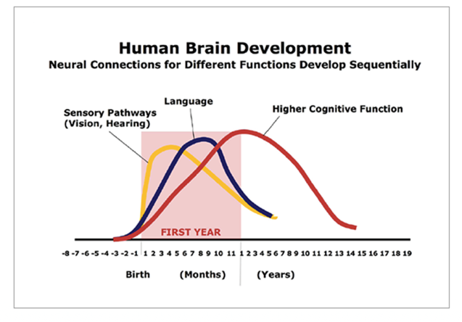
The Most Critical Years for a Child’s Learning and Development Are Between Ages Birth to Five
Did you know?
90% of brain development occurs between birth and five years (particularly birth to three years).
Source: C.A. Nelson (2000). Credit: Center on the Developing Child/
Harvard Center on the Developing Child, What is Early Childhood Development? A Guide to the Science

Slide 7
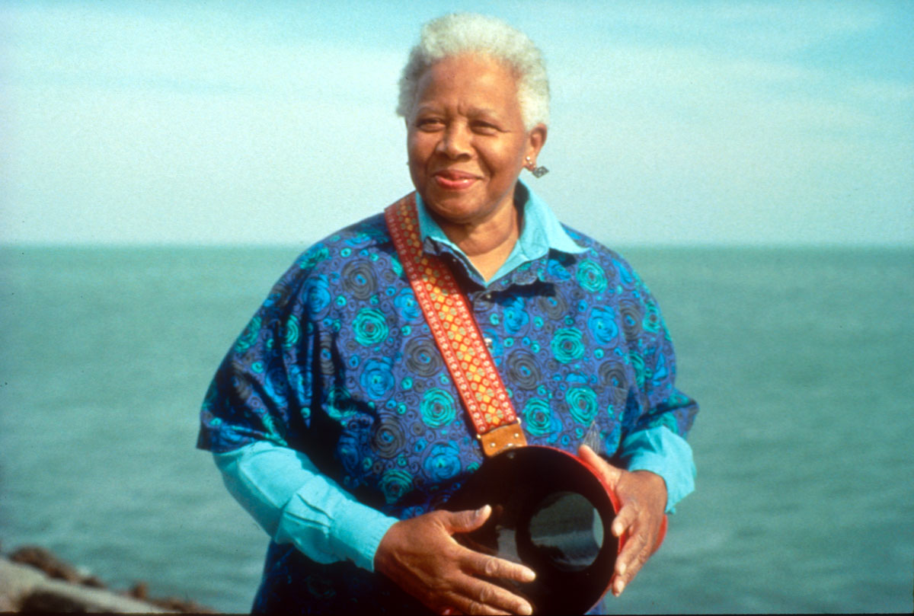
Reflection Prompt and Activity #1: Share a Story/Make a New Memory
Think about your early childhood--
Is there a positive early learning experience (can be with a parent, family, or community member) that comes to mind?
Share your story with your little one and make a new memory!
Tamilah’s Top Pick:
Learning nursery rhymes, hand games and sing-alongs with my mom. Miss Mary Mack was my favorite! Do you know Ella Jenkins?
Photos from Smithsonian Institute website: Ella Jenkins the First Lady of Children’s Music Artist Spotlight

Slide 8
Virginia’s Early Learning and Development Standards
Birth to Five Learning Guidelines

Slide 9
Learning and Development Across the Birth to Five Continuum
Virginia has developed a new unified set of early learning and development standards (ELDS) to provide families, caregivers and educators:
Guidance on what children should know and be able to do at various ages and stages of the birth to five continuum
Grounding knowledge for developmentally appropriate and culturally and linguistically responsive adult-child interactions
A cohesive set of early learning standards serves as a critical tool in supporting child development across all developmental areas, including literacy.

Slide 10
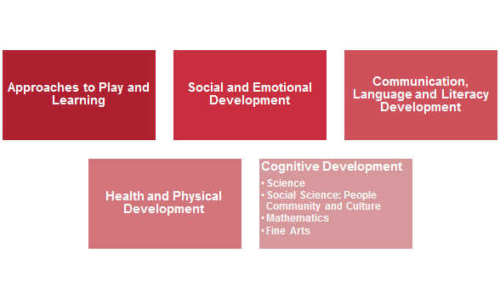
About the Structure of the Early Learning Standards
Virginia’s new ELDS are unique in their 1) focus on all aspects of learning and development, and 2) explicit overlap in age-bands and skill markers. There are five core areas of development.

Slide 11
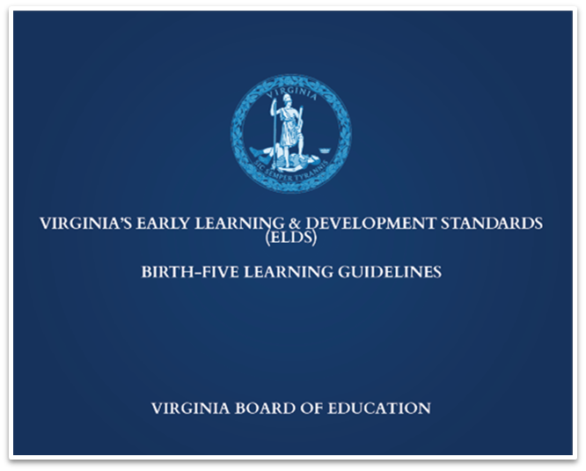
Where can I find Virginia’s new ELDS?
Virginia’s new Early Learning and Development Standards, Birth to Five Learning Guidelines can be found on the VDOE Early Childhood Curriculum and Instruction webpage.

Slide 12
School Readiness

Slide 13
Ready Children, Families and Communities!
Defining School Readiness
A ready child is prepared socially, personally, physically and intellectually within key developmental areas.
Ready families have adults who understand they are the most important people in the child’s life and take responsibility for the child’s school readiness through direct, frequent and positive involvement and interest in the child.
Ready Communities support schools and families through information and access to high-quality child care and other early learning opportunities and services.
Virginia Department of Education- School Readiness

Slide 14
Virginia’s “Big Picture” for School Readiness
All Virginia children, regardless of background or zip code, are capable of and deserve to enter kindergarten ready. Yet too many children enter kindergarten without this opportunity.
In Fall 2020, 45% of kindergarten students fell below the benchmark in one or more foundational areas of learning - reading, mathematics, self-regulation and social skills.
32% fell below the literacy (PALS) benchmark as of spring 2021
Did you know? Virginia assesses all entering kindergartners’ school readiness skills in the areas of literacy, mathematics, self-regulation and social skills in the fall and spring of each school year. Beginning Fall 2021, VKRP expands to pre-K.

Slide 15
What is the Virginia Kindergarten Readiness Program (VKRP)?
VKRP is a multi-dimensional system that provides detailed and integrated information about young children’s skills across four core areas at the student (for teachers and families), classroom, school, division and state levels.
Literacy: PALS-PreK | Mathematics: Early Mathematics Assessment System (EMAS) | Self-Regulation & Social Skills: Child Behavior Rating Scale (CBRS)

Slide 16
How does the VKRP benefit families?
Information that is gathered through VKRP, in combination with PALS data, helps families better understand:
Where their child started in the fall— areas of strength and those that might require additional support
Specific ways in which they can support their child’s skill development across all core school readiness areas
How their child’s school readiness skills have grown over the year
Read more about the VKRP Benefits for Families

Slide 17
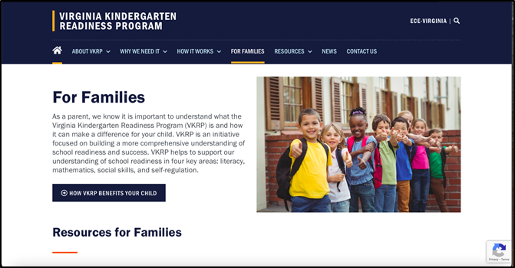
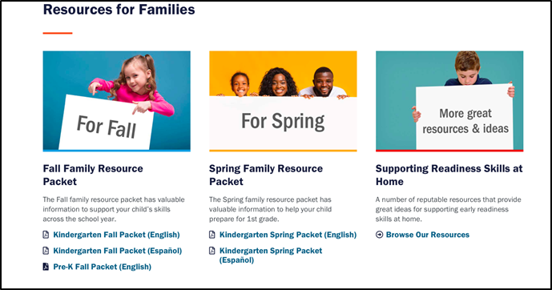
VKRP Family Resources
Families can access Family Resource Packets and find links to other resources to support school readiness at home from the VKRP website.

Slide 18
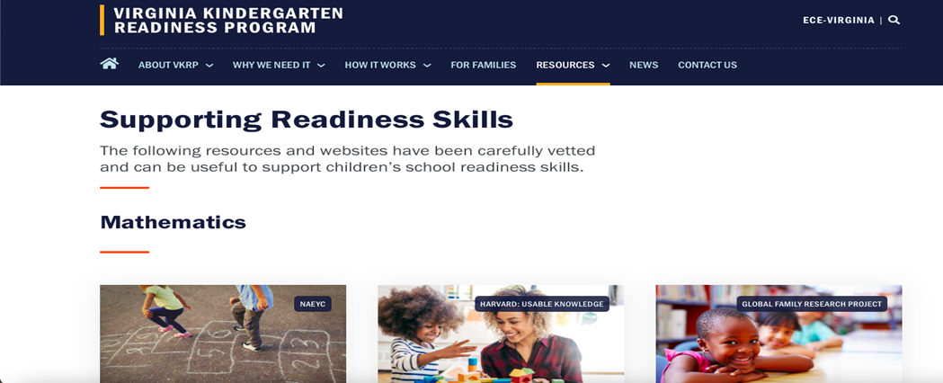
Supporting School Readiness Skills
There are also resources on the VKRP website that are designed to help families support school readiness skills across all four core areas, including literacy and for English language learners.

Slide 19
Supporting Early Literacy at Home

Slide 20
Building the Continuum
The fundamental skills upon which reading success builds begins far before children enter kindergarten.
The strongest predictors of early literacy success are phonological awareness (rhyme and beginning sound awareness) and alphabet knowledge.
The strongest predictor of long-term reading success is language.
At-Home Early Literacy Support
Phonological Awareness and Alphabet Knowledge
Language Development

Slide 21
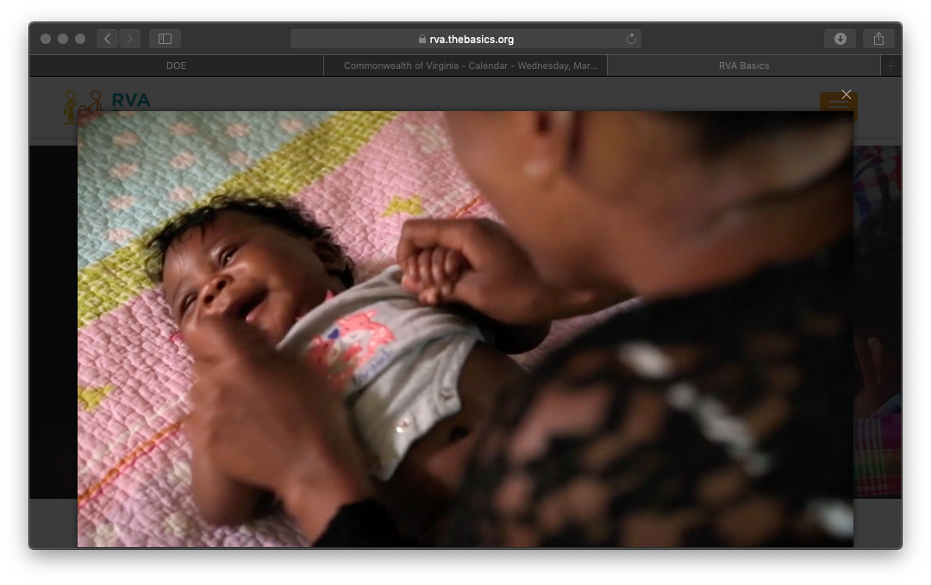
“The Basics” For Children Ages 0-3
Virginia Public Media (VPM), in collaboration with regional partners, developed a resource to help families and caregivers engage their young children in everyday routines that support optimal cognitive and social-emotional learning and development. There are five key principles covered by The Basics:
Maximize Love, Manage Stress
Talk, Sing, and Point
Count, Group, and Compare
Explore Through Movement and Play
Read and Discuss Stories
RVA The Basics Overview Video

Slide 22
Language Development 101s for All Early Learners
There are many strategies that families can consistently use to support early language development. Try these:
Self-talk
Describe what you are doing
Parallel Talk
Describe what your child is doing
Repeat and extend
Ex: “Yes, it is a truck (repeat)– it’s a big, red, fire truck, and it has a ladder and hoses so firefighters can help put out fires” (extend).

Slide 23
Other High-Yield Early Literacy Development Strategies
Beyond “The Basics” and 101s for supporting language development, these high-yield early literacy development strategies can be easily incorporated into everyday activities at home.
“Serve and Return”
Asking Open-Ended Questions
Implementation of “The Basics”
Engaging your child with books
Increased Early Literacy Skills & Reading Success

Slide 24
Serve and Return
Serve and Return is an important early language strategy that helps shape brain architecture.
A child shows interest in something (serves) and the adult responds in a supportive way (returns)- much like a game of tennis or ping pong).
There are five steps:
Share the focus
Support and Encourage
Name it
Take turns back and forth
Practice endings and beginning
Harvard Center on the Developing Child; Serve and Return video link.

Slide 25
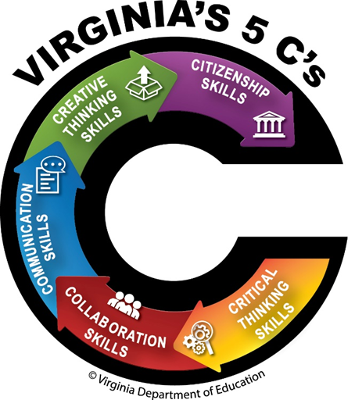
Ask “Big” Questions
One of Virginia’s 5 Cs (Profiles of a Virginia Graduate) is critical thinking.
Families can support this important skill by helping their child to reflect, reason, and share their views of the world by asking open-ended questions.
Go beyond just asking the “who” or “what,”- ask “why,” “how,” ”what do you think,” etc.
Encourage critical thinking (analyze, evaluate, create)
You may find Big Questions for Young Minds by Janis Strasser & Lisa Bresson of interest; it includes a special section for families. View the authors’ webinar.
Authors Janis Strasser & Lisa Bresson

Slide 26
Read with your child everyday!
Insert books from various focus areas (e.g., From Head to Toe)
This photo is licensed under Think Stock Photos
Choose a variety of interdisciplinary focused books to bridge learning across all areas of a child’s learning and development. And don’t forget to visit your local library when able!

Slide 27
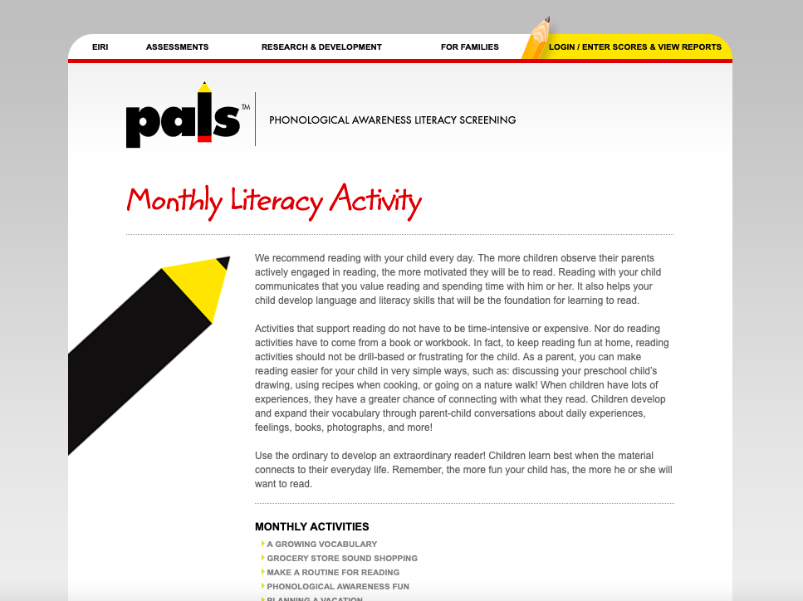
PALS Resources for Families
VKRP/PALS provides links to activities and websites that support literacy and reading skills in fun and engaging ways. These include:
Discussing your child’s drawings
Using recipes while cooking with your child
Going on nature walks and talking about the sights, smells and sounds
Just having fun with language!
PALS For Families also provides a list of Early Literacy Resources for Home.
Visit the PALS website and tune into the Phonological and Phonemic Awareness and pre-recorded PALS recordings for this special event (VDOE Family Literacy Night).

Slide 28
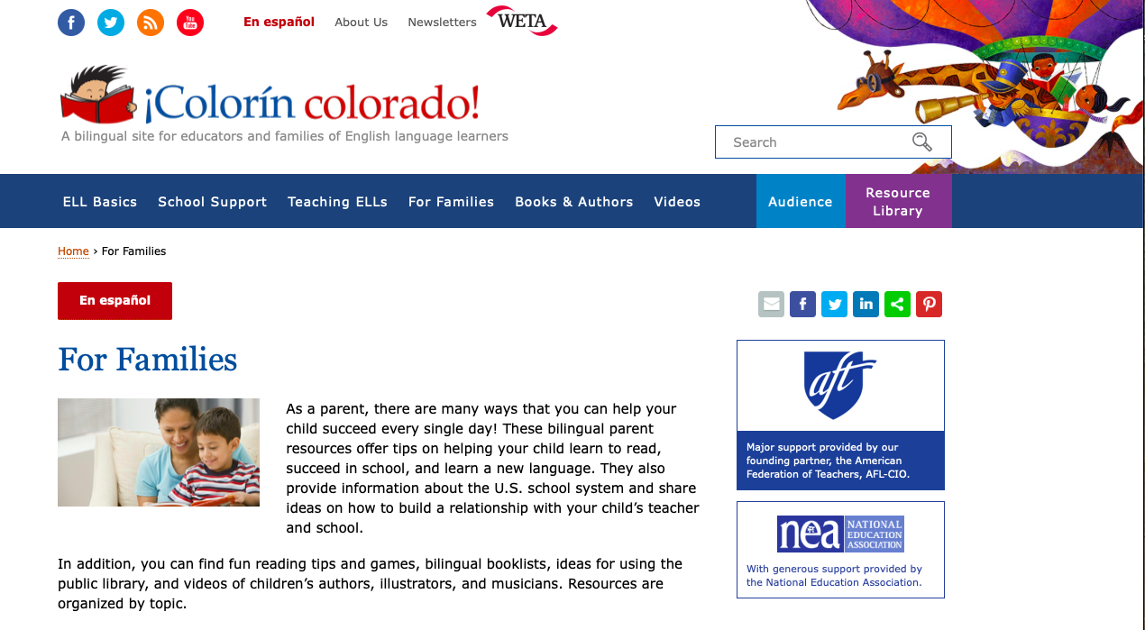
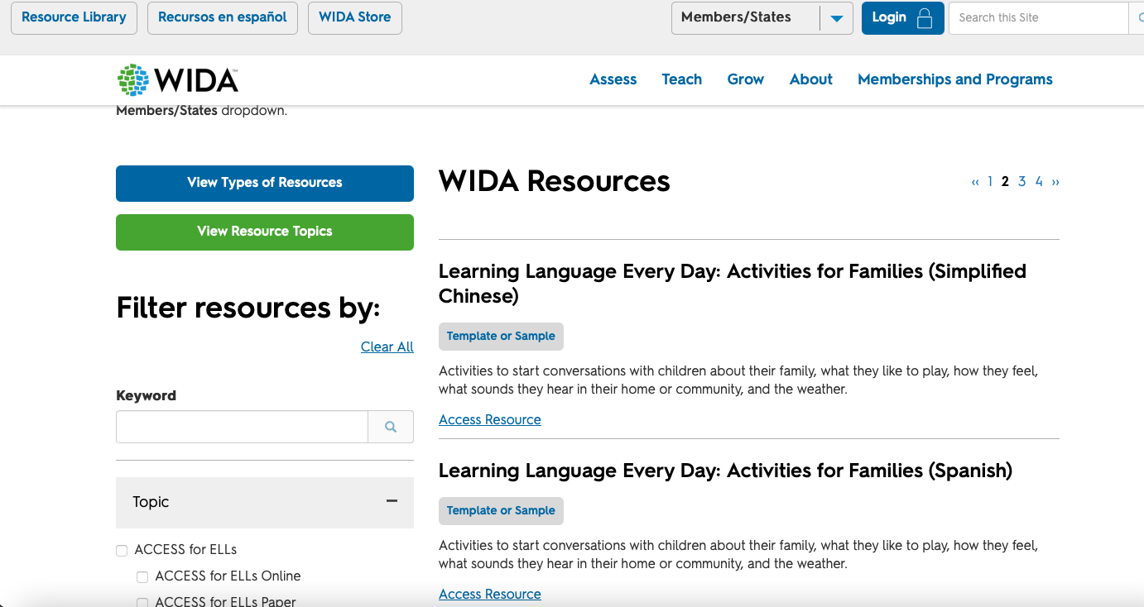
Multi-lingual/English Language Learner Resources
Colorín Colorado!: Provides bilingual parent resources that offer tips on helping your child learn to read, succeed in school, and learn a new language.
WIDA™ Early Years: Provides activities to help families start conversations with their children about their family, what they like to play, how they feel, what sounds they hear in their home or community and the weather.
Learning Language Every Day: Activities for Families (available in English, Arabic, Simplified Chinese, and Spanish)

Slide 29
Reflection Prompt and Activity #2: Integrating Games, Music and Movement
Children love games! Make learning fun by integrating old games, music, movement (and more) into your toolkit for building early literacy skills.
What songs and games do you remember from your childhood that helped you build phonological awareness (rhyming and beginning sounds) or alphabet knowledge?
Revisit these games and activities and engage your child with them. What new favorites can you develop together? Get creative!
Tamilah’s Top 3
Singing the “Name Game”
Drawing/writing in finger paints, shaving cream or even chocolate pudding (yum!); painting with plain water on sidewalks and walls can be just as fun!
Playing “I Spy” with beginning letters or sounds (“I Spy with my little eye something that begins with the letter p or makes the /p/ sound”)
Terry, Terry, Bo-Berry…

Slide 30
Engaging Children with Books

Slide 31
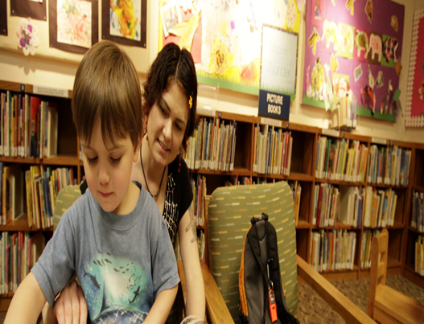
The Benefits of Reading to Your Child
Reading to your child has multiple, evidence-based benefits. This critical early literacy development activity helps support:
✔ Development of solid parent-child relationships
✔ Increased listening skills
✔ Increased language skills and cognitive development
✔ Increased attention span
✔ Expanded vocabularies
✔ Creativity
✔ Life lessons
✔ Social and Emotional Development
This Photo by Unknown Author is licensed under CC BY-SA-NC
Children are made readers on the laps of their parents.
Emilie Buchwald
Healthline Benefits or Reading to Children

Slide 32
Tips on How to Raise a “Ready Reader”
The U.S. Department of Education outlines several ways families can help their child become “ready readers.” These Reading Tips for Parents include:
Making Books “Key Members of the Family”
Storytelling
Writing Notes
Using the Library with the Whole Family
Find a summary of these highlighted tips on the GetReadytoRead.org. A Home Literacy Checklist is also accessible from this website to help you create a literacy-friendly home or classroom.
Notes:
English and Spanish checklist available

Slide 33
The Importance of Diversity in Children’s Literature
Early exposure to diverse literature fosters inclusiveness, tolerance and empathy in young children. “Diversity” goes beyond race/ethnicities and multiculturalism, it encompasses:
Abilities,
Socio-economics,
Gender,
Religion,
Languages spoken at home and
Community/geographical diversity
Did you know?
A child’s healthy development of identity/sense of self can be positively shaped by exposure to affirming representations of themselves in the literature. Visit the ALA website for lists of notable books that celebrate diversity.
Learn more about Virginia’s commitment to equity in education: #EdEquityVA.

Slide 34
Diversify Your Child’s “Reading Diet” by Genre and Type
Diversity in literature can also be categorized according to the genres and types of literature young children are exposed to:
Wordclouds.com
Don’t forget the classics! (Think Winnie the Pooh and Frog and Toad)
Visit the Association for Library Service to Children (a division of the American Library Association) website to view Younger Readers’ Notable Book Lists for 2021 and Past Years.
Book Covers are Google Images; Fair Use Copyright

Slide 35
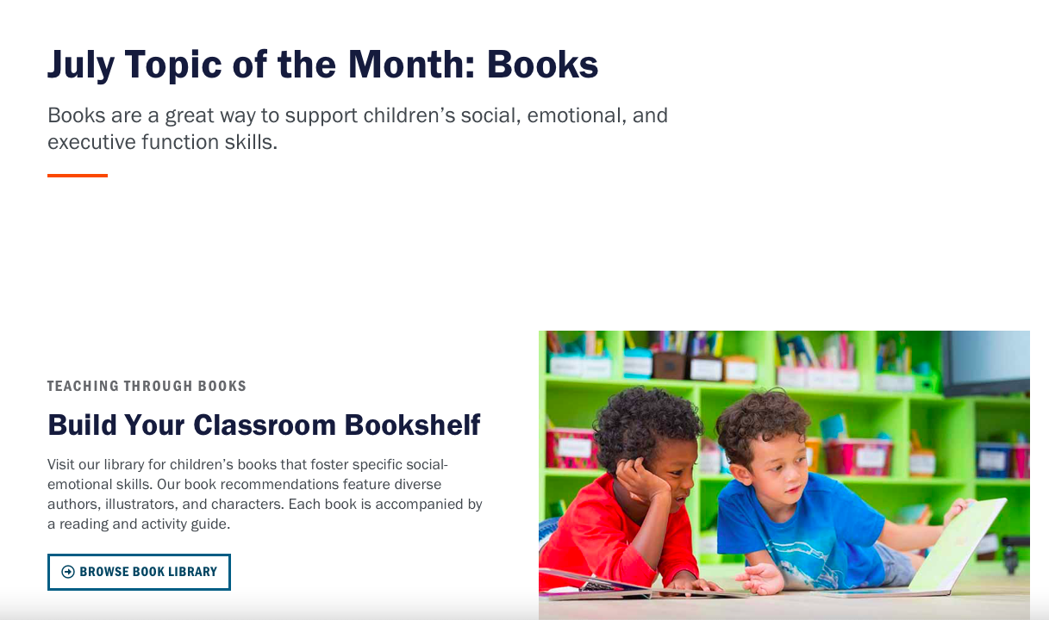
Fostering Social-Emotional Skills Through Literature
The ECE Resource Hub is a teacher-focused toolkit designed to help early educators better foster children’s social-emotional skills.
Of interest to families, the featured topic and resources for July includes:
A curated list of books that foster specific social-emotional skills.
Book recommendations feature diverse authors, illustrators and characters.
Each book is accompanied by a reading and activity guide.
Remember: YOU are your child’s first and forever teacher!
Look for the pre-recorded video on this special school readiness/early literacy resource on the Family Literacy Night webpage.

Slide 36
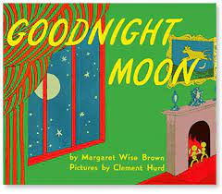
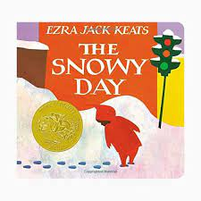
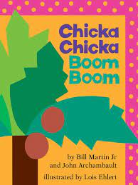
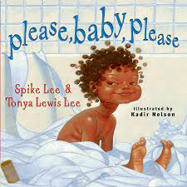
Reflection Prompt and Activity #3: Favorite Books
What was/were your favorite book(s) as a child? Why was the story so special to you?
Share the story with your child. Telling the story from memory is also a great option if you cannot get access to a print or digital copy!
Ask your child what their favorite story or book is and why…
Tamilah’s (and her 3 kiddos ☺ ) Top 4:
The Snowy Day, Good Night Moon, Chicka Chicka Boom Boom; Please, Baby Please!
Google Images; Fair Use Copyright

Slide 37
Closing Thoughts and Next Steps

Slide 38
Next Steps
The focus of this presentation was to provide you with foundational knowledge about supporting school readiness, and most specifically fostering early literacy development for your child. Suggested next steps include:
Accessing and becoming familiar with Virginia’s new Early Learning and Development Standards.
Learning how you can support your child’s school readiness and early literacy development by reviewing VKRP and PALS resources.
Implementing key literacy development strategies and tips (e.g., serve and return or asking “big questions”).
Expanding your child’s exposure to diverse literature, across varied genres and types.

Slide 39
Reflection Prompt and Closing Activity: Develop An Action Plan
Families are critical partners in helping to prepare all children to enter kindergarten ready to thrive!
What will your child’s school readiness journey be like?
In what ways do you believe you can be better supported by the state and your local school and community partners?
What does meaningful and equitable family engagement look like to you?
What will be your next steps, and how can we help?

Slide 40
Contact
Tamilah.Richardson@doe.virginia.gov for questions about Virginia's new ELDS or those related to this presentation.
vkrponline@virginia.edu for questions relating to VKRP and VKRP Family Resources.
pals@virgina.edu for questions relating to PALS and PALS Family Resources.

Slide 41
Highlighted References and Additional Resources
Early Literacy Start at Home- Reflection Prompts and Activity Worksheet
Early Childhood Education-Virginia (ECE-VA)
Early Childhood Education (ECE) Resource Hub
Harvard Center on the Developing Child, What is Early Childhood Development? A Guide to the Science
PALS
Serve and Return video link
The Basics
Virginia Department of Education- Office Early Childhood
Virginia’s Early Learning and Development Standards, Birth-Five Learning Guidelines
Virginia Kindergarten Readiness Program (VKRP)
Note: Additional references and links are included in the slides throughout this presentation.

