Slide 1
An Explanation of Your Student’s SOL Test Score Reports
Jason A. Ellis
Test Results Utilization Specialist
Office of Student Assessment
Virginia Department of Education
Family Literacy Night 08/31/21

Slide 2
Agenda
Two Types of Tests
Standards of Learning (SOL) Tests
Fall 2021 Growth Assessments
Student Report for Standards of Learning Tests
Student Detail By Question Report for Fall 2021 Growth Assessments
Questions

Slide 3
What Types of State Required Tests Do Students Take? (1 of 2)
Standards of Learning (SOL) Tests
Administered to students in grades 3-12
Reading, Mathematics, Science, History, and Writing content areas
Used to provide feedback on student content mastery and for state and federal accountability calculations

Slide 4
What Types of State Required Tests Do Students Take? (2 of 2)
Fall 2021 Growth Assessments
Administered to students in grades 3-8
Reading and Mathematics content areas only
Used to provide feedback on current student content understanding, as well as to measure student growth during the school year

Slide 5
Student Report for SOL Tests - Description
The report that follows is created for multiple tests in different content areas; Reading, Math, Science, and History.
The best attempt for any test completed by the student is included in the report.
The report is two or more pages.

Slide 6
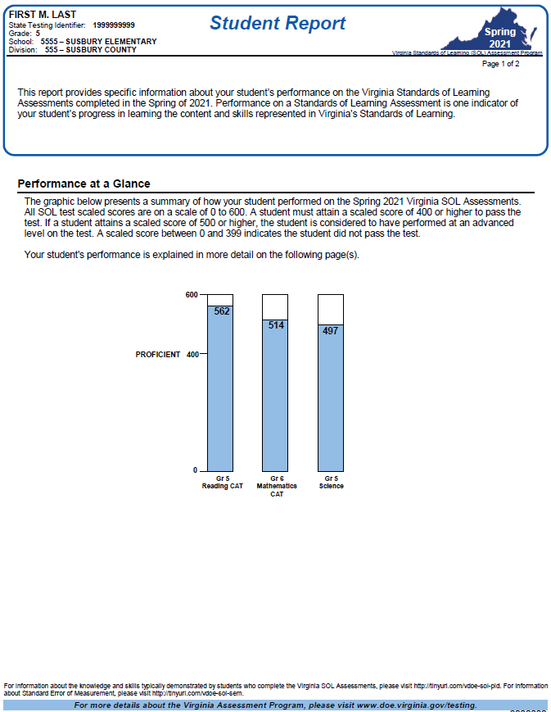
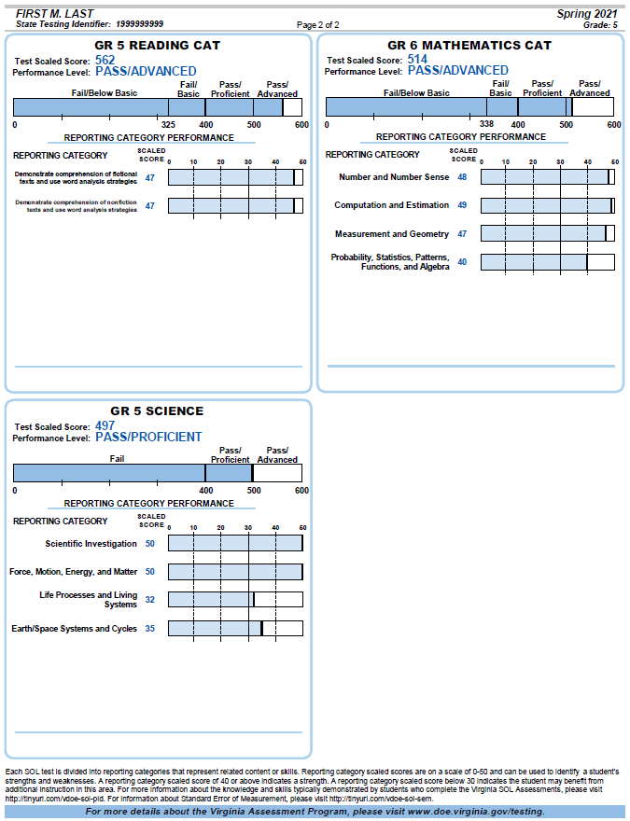
Student Report for SOL Tests (1 of 4)

Slide 7
Student Report for SOL Tests (2 of 4)
This section of the report contains demographic information for the student and a brief description of the report.

Slide 8
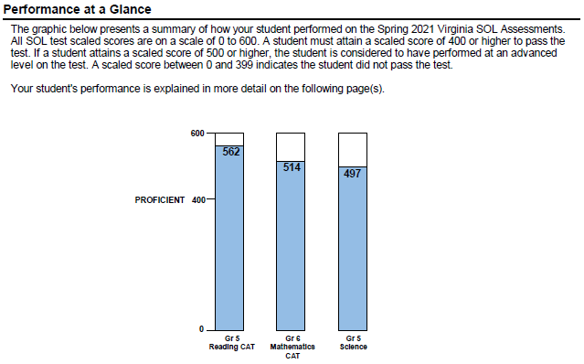
Student Report for SOL Tests (3 of 4)
The graphic in this section of the report includes each test that your student has taken during the test administration.

Slide 9
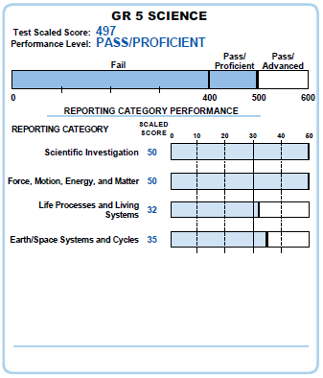
Student Report for SOL Tests (4 of 4)
This section of the report describes your student’s performance on the overall test and each of the reporting categories.
The footer on this page will provide more information about reporting category scaled scores.

Slide 10
Student Detail By Question (SDBQ) Report for Fall 2021 Growth Assessments Description
The SDBQ report is created for each completed test in each subject area, Reading or Math.
This report will provide information about every test question your student answered on their test.
A descriptive phrase about the test item, item difficulty, Standard of Learning number, and whether the student answered it correctly or incorrectly
This report is one page.

Slide 11
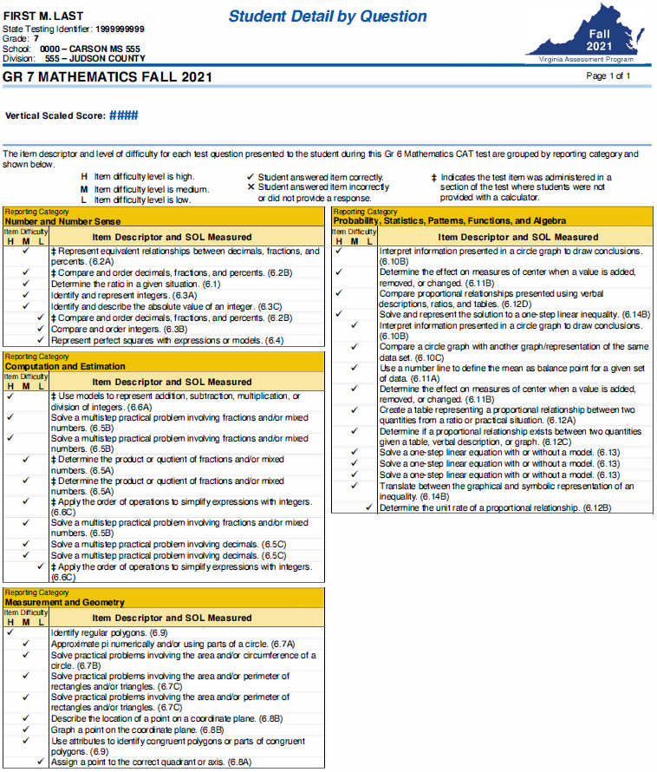
SDBQ Report for Fall 2021 Growth Assessments (1 of 4)
The test completed by your student is separated into reporting categories and all of the item descriptors in each category are listed.

Slide 12
SDBQ Report for Fall 2021 Growth Assessments (2 of 4)
This section of the report contains demographic information for the student and a brief description of the report.

Slide 13
SDBQ Report for Fall 2021 Growth Assessments (3 of 4)
This section of the report contains the test name, vertical scaled score, and the key for the symbols used in the report.

Slide 14
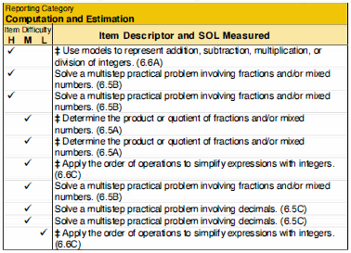
SDBQ Report for Fall 2021 Growth Assessments (4 of 4)
Each item descriptor includes information about the skill and content for each test question.

Slide 15
Thank you for joining me tonight!
If you have any questions regarding your student’s score reports, please send them via email to student_assessment@doe.Virginia.gov.
I wish you and your family a wonderful school year!

