Slide 1
Virginia Department of Education
English Deeper Learning Conference
Jill Nogueras
K-12 English Coordinator
Fall 2019

Slide 2

Welcome
#VAisForReaders

Slide 3
Break Out Sessions
Morning- 10:30 a.m.-12:00 p.m. | Afternoon- 1:00 p.m.-2:30 p.m.
K-2: PALS Workshop | K-2: Writing Instruction as part of an Integrated Unit
3-5: Integrating the 2017 SOL using paired passages | 3-5: Writing Instruction that could lead to a performance assessment
Division Leaders: Free Choice | Division Leaders: PALS Division Rep Meeting
Morning- 10:30 a.m.-12:00 p.m. | Afternoon- 1:00 p.m.-2:30 p.m.
K-2: PALS Workshop | K-2: Writing Instruction as part of an Integrated Unit
3-5: Integrating the 2017 SOL using paired passages | 3-5: Writing Instruction that could lead to a performance assessment
Division Leaders: Free Choice | Division Leaders: PALS Division Rep Meeting
Morning- 10:30 a.m.- 12:00 p.m. | Afternoon- 1:00 p.m.- 2:30 p.m.
Middle School: Writing in Middle School | Middle School: Secondary Reading with the 2017 SOL
High School: Scoring Performance Assessments for Verified Credit | High School: Secondary Reading with the 2017 SOL

Slide 4
2018-2019 Reading SOL Pass Rates
Morning- 10:30 a.m.-12:00 p.m. | Afternoon- 1:00 p.m.-2:30 p.m.
K-2: PALS Workshop | K-2: Writing Instruction as part of an Integrated Unit
3-5: Integrating the 2017 SOL using paired passages | 3-5: Writing Instruction that could lead to a performance assessment
Division Leaders: Free Choice | Division Leaders: PALS Division Rep Meeting
Test | 2016-2017 Pass Rate | 2017-2018 Pass Rate | 2018-2019 Pass Rate
Grade 3 English Reading | 75 | 72 | 71
Grade 4 English Reading | 79 | 76 | 75
Grade 5 English Reading | 81 | 80 | 78
Grade 6 English Reading | 78 | 80 | 77
Grade 7 English Reading | 82 | 81 | 79
Grade 8 English Reading | 76 | 77 | 76
End of Course English Reading | 87 | 87 | 86

Slide 5
2018-2019 Writing SOL Pass Rates
Test | 2016-2017 Pass Rate | 2017-2018 Pass Rate | 2018-2019 Pass Rate
Grade 8 Writing | 73 | 73 | 70
End of Course Writing | 84 | 84 | 81

Slide 6
Summary of Changes in the 2017 English Standards of Learning
Alignment with the 5 Cs: Critical Thinking, Creative Thinking, Communication, Collaboration, and Citizenship
Alignment to the applicable VA Workplace Readiness Skills
Reorganization of K-3 to align with 4-12
Expansion of technical reading & writing in grades 9-12

Slide 7
New Communication Strand Grades K-3
Formerly Oral Language
New Communication and Multimodal Literacies strand focuses on:
  Building communication skills
    Ask questions; collaborate with partners or groups
  Strengthening early oral literacy skills
    Retell stories; participate in creative dramatics
  Developing presentation skills
    Speak clearly; organize ideas; use multimodal tools

Slide 8
New Research Strand Grades K-3
Strand focuses on:
  Generating topics of interest
  Asking questions to gather information
  Identifying pictures, texts, or people as sources
  Collecting information
    From provided sources or student-selected resources
  Organizing and recording information
    Orally and/or in writing

Slide 9
Literary Nonfiction Grades 3-12
Previously referred to as Narrative Nonfiction in Grade 3
Literary Nonfiction is a type of narrative text
  Uses story elements and language to share accurate information about real people, places, and events
  Including but not limited to biography and autobiography

Slide 10
Clarification of Theme and Main Idea Grades K-5
Students will now identify theme in fictional texts and poetry
Teachers should teach theme as a literary term with fiction texts and main idea with nonfiction texts
  *Please note these terms are not interchangeable
Students will continue to identify main idea in nonfiction

Slide 11
Pairing Literary and Informational Nonfiction Texts- Grades 4 & 5
Creation of standards requiring students to compare/contrast details between literary fiction and informational nonfiction texts
Students will:
  Analyze similarities and differences between paired fiction and nonfiction texts
  Texts can be paired based on similar themes, topics, or patterns of events
  Pairings can include books, articles, poems, media, or graphics

Slide 12
Focus on the Writing Process (1 of 2)
Emphasis on ethical use of the Internet when gathering and using information (Grades 3-12)
Writing process increases in complexity and rigor as students progress through K-12
  Kindergarten = narrative and descriptive
  Grade 1 = narrative, descriptive, and opinion
  Grade 2 = narrative, descriptive, opinion, and expository
  Grade 3 = narrative, descriptive, opinion, and expository
  Grade 4 = narrative, descriptive, opinion, and expository
  Grade 5 = narrative, descriptive, expository, and persuasive

Slide 13
Focus on the Writing Process (2 of 2)
Introduction of a focus on a mode of writing at each grade level:
  6th- narrative & reflective
  7th & 8th – expository & persuasive
  9th & 10th – persuasive & analytical
  11th & 12th – persuasive & argumentative

Slide 14
Strands of the 2017 English Standards
The strands of the 2017 English Standards:
  Communication & Multimodal Literacies
  Reading
  Writing
  Research
  The goals are to teach students to read, write, research and communicate. The strands are developed separately, but expected to be seamlessly integrated in the classroom. Through the rigorous application of the English Standards of Learning, students become critical thinkers, effective contributors, and global citizens.

Slide 15
The Spiraling of Skills
The concepts, skills, and content in English Language Arts spiral; teachers should note each grade level builds skills that carry to the following grades. Each grade level within the English Curriculum Framework builds from kindergarten through grade 12, creating a comprehensive instructional tool, which prepares students for success in future postsecondary education and the workplace. Teachers should review the Curriculum Framework for the scope of learning in each of the strands in previous grades and in the grades to follow.

Slide 16
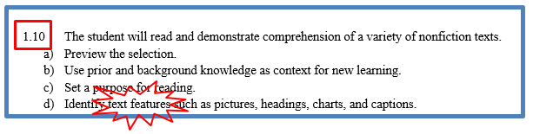
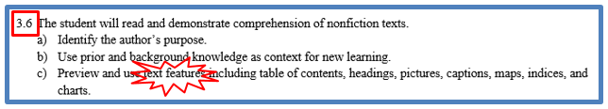




Text Features Spiral of Standards

Slide 17

2017 English Curriculum Framework (1 of 5)

Slide 18
2017 Curriculum Framework (2 of 5)
The 2017 English Standards of Learning are expanded by the Essential Knowledge, Skills, and Processes (EKSP) in the Curriculum Framework
  This is not meant to be an exhaustive list, nor one that limits what is taught in the classroom
  The EKSP is not a one-to-one match of the standards
  If the standard is self-explanatory, there will be no additional explanation

Slide 19
2017 Curriculum Framework (3 of 5)
Overview of strand on Strand Introduction page
Teacher Notes appear on Introduction page
Suggested Instructional Strategies and Best Practices are on Teacher Notes page
First column Understanding the Standard has been deleted and that information moved to introduction page
CF Columns: Essential Understandings & Essential Skills, Knowledge, and Processes

Slide 20
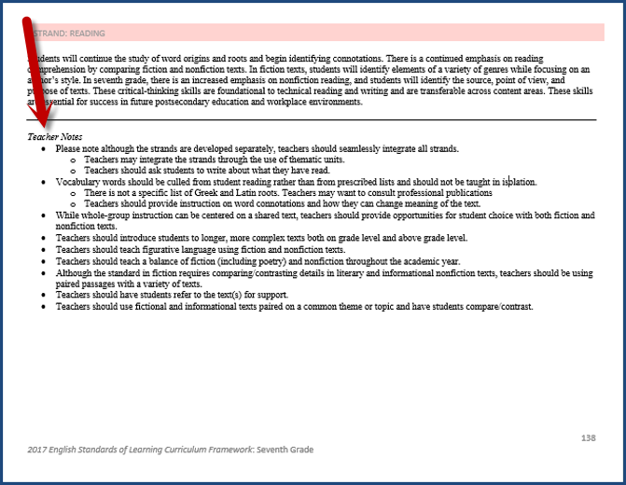
2017 Curriculum Framework (4 of 5)

Slide 21
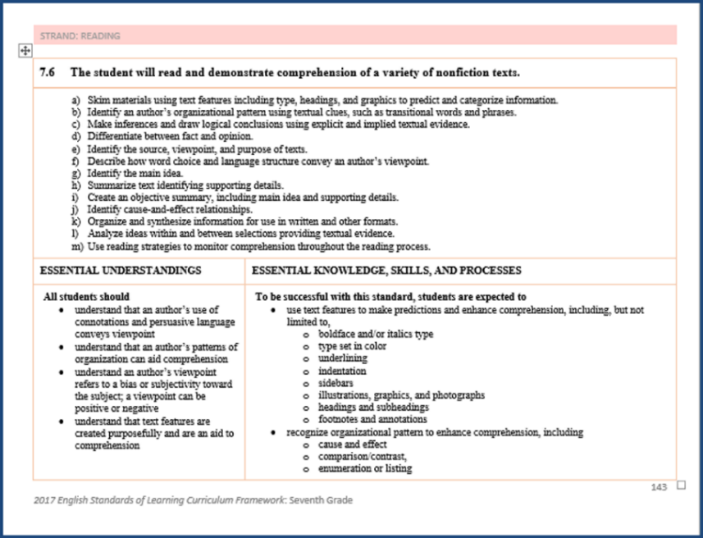
2017 Curriculum Framework (5 of 5)

Slide 22
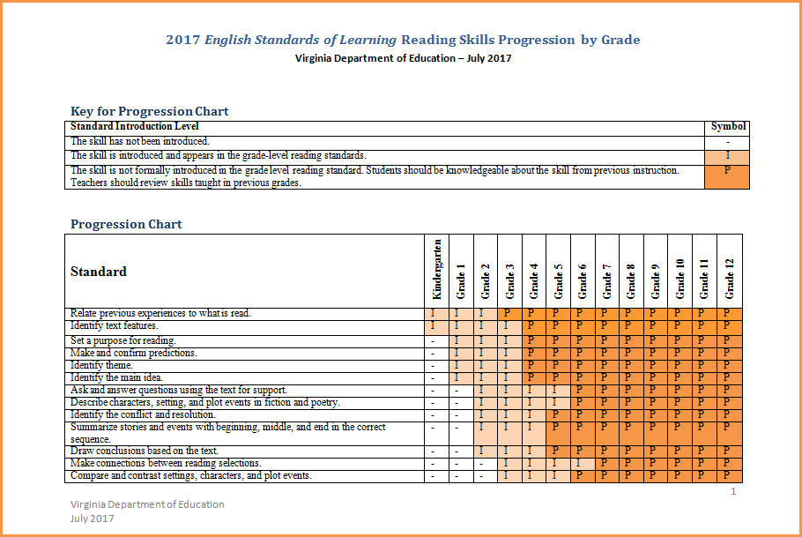
2017 SOL Progression Charts

Slide 23
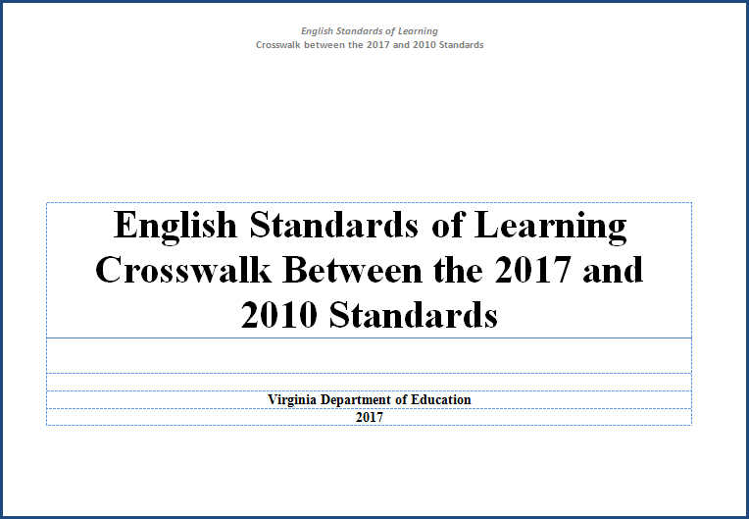
2017 SOL Crosswalk

Slide 24
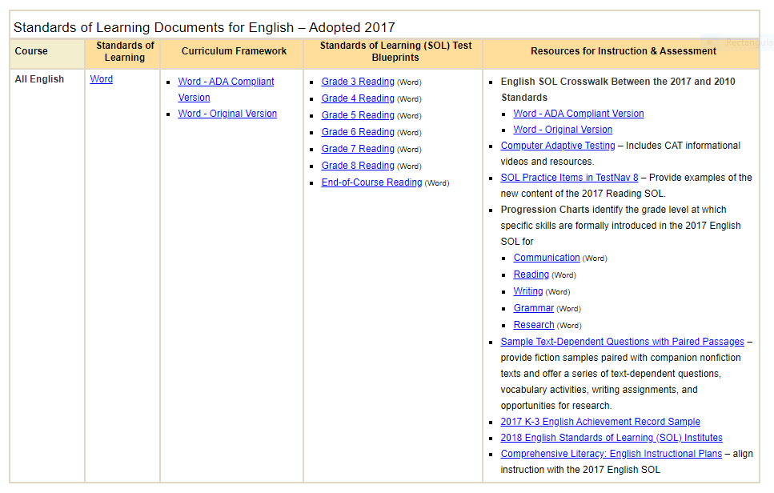
Assessment & the 2017 English Standards of Learning

Slide 25
Writing Blueprints
There are no new writing blueprints that align with the 2017 SOL.
SOL writing tests remain on the 2010 SOL.
School divisions are currently required to use the local alternative assessment for 5th grade writing.
School divisions are currently required to use the 8th grade writing SOL test.
School divisions have the option to use the EOC SOL writing test or the local high school performance assessment to verify credit in writing.

Slide 26
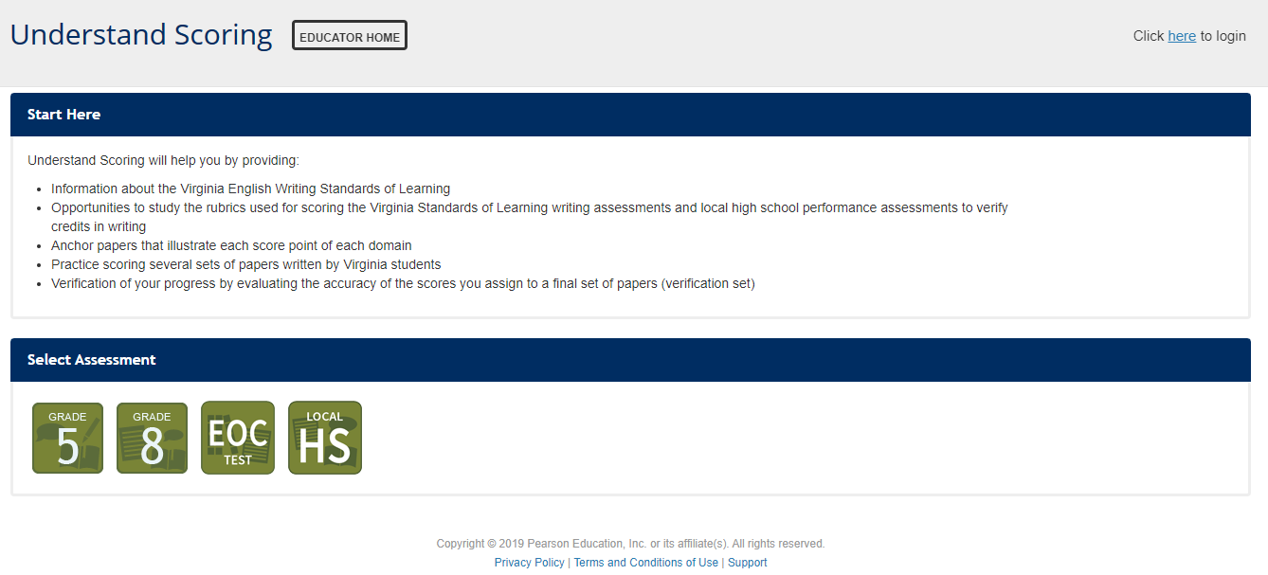
Understand Scoring (1 of 2)

Slide 27
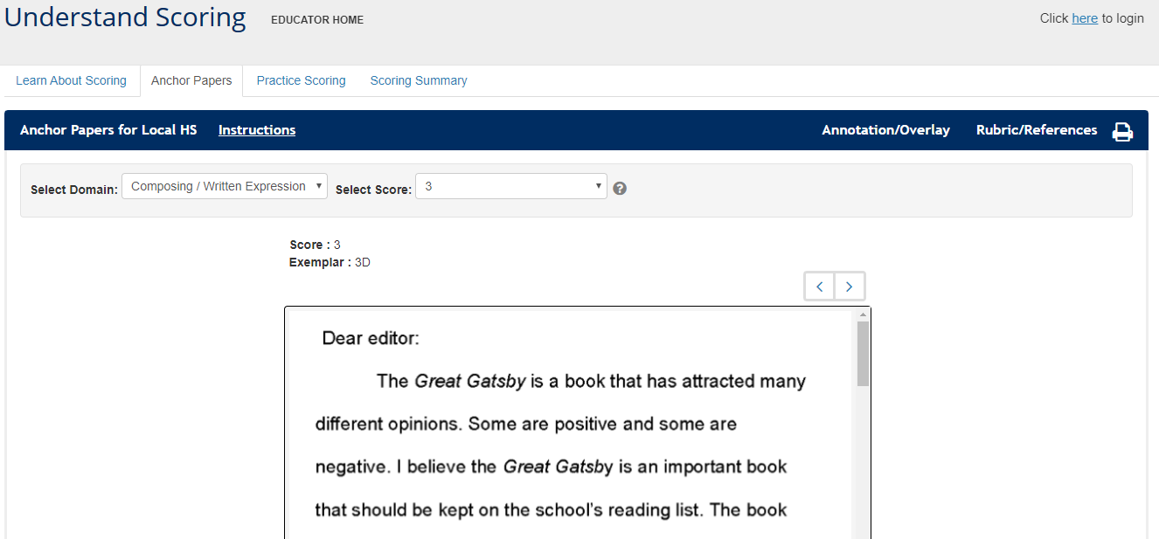
Understand Scoring (2 of 2)

Slide 28

Seamless Integration of
English Strands
Reading
Writing
Research
Communication/ Multimodal Literacies

Slide 29
Read! Read! Read!
Students need opportunities to read daily.
Students need to read extended pieces of text and grade level material.
All students need opportunities to read grade level text daily, including nonfiction and fiction pieces.
Schools should provide students with opportunities to read and compare paired passages (fiction and nonfiction) on the same topic as appropriate.
When students are analyzing ideas in two texts and searching for textual evidence to support their conclusions, they are engaging in deeper learning and thinking critically.

Slide 30
Successful English Instruction
Integrate the strands
  Reading
      Specific vocabulary from authentic texts
      Both fiction & nonfiction text
      Text-rich environment with variety of text and media
      Student choice whenever possible
  Writing
      Writing as a process for a variety of authentic purposes
      Regular writing conferences
      Use of Writing Portfolios
  Research
      Ongoing and embedded in the learning process (when applicable)
  Communication/Multimodal Literacies

Slide 31
Successful English Instruction
Best Practices
  Use of text-dependent questions
  Use of inference questions
  Use of text-based vocabulary
  Response to reading
  Writing components in every lesson
  Frequent research components

Slide 32
Paired Texts and Text Sets
Paired texts can include books, plays, articles, poems, functional text, graphics, or digital media
Focus on a common theme or topic that fits history and social science or science content
Compare and contrast texts to increase the level of thinking

Slide 33
Integration of Skills
Choose a theme or topic
Choose a variety of text and media options
Incorporate all strands during the unit
Select standards to introduce or review
Think about your students – What will interest them?
Provide opportunities for shared and independent reading
Model the writing process and meet with students for writing conferences

Slide 34
The Reading/Writing Connection
Use mentor texts to read like a writer and write like a reader
  Imitate an author’s style and structure
  Appreciate the author’s craft
Incorporate daily writing
  A warm-up prior to beginning a unit of study
  Incorporate writing into formative assessment
  After a thought provoking reading, discussion, or class experiment, students write their thoughts
Find authentic writing opportunities
  Blogging or Social media connections
  Professional writing
Notes:
Writing can and should be integrated in all reading and all contents.

Slide 35
The Forgotten “R”
The elimination of the grade 5 Writing SOL assessment threatens writing/research instruction
Writing, like reading, is a life skill and should be included in all curricular areas.
How much writing does your job require?

Slide 36
Assigned vs. Taught
Students write only on teacher selected topic, purpose and audience
Students are given a task without the instruction on how to complete it successfully
Minimal improvement in writing
Students rewrite only to correct errors in usage and mechanics
Students select their own topic, purpose, and audience
Teacher time is spent in class teaching writing skills and strategies
Students use models and strategies to complete each assignment
Students move through the recursive process
Because Writing Matters by Carl Nagin
The National Writing Project
Notes:
There is a great difference between assigning writing and teaching writing. Although all students can write, direct instruction by the teacher is needed to develop an awareness of good writing and the skills needed to create it.
Direct instruction of concepts such as audience and purpose and skills such as revision can be followed by student choice and reflection. Then as the writing begins, the instruction continues with teacher modeling.

Slide 37
When writing is taught…
Teachers model by
  Writing with the students
  Revealing the hard work of writing
  Thinking aloud through revision of their writing
  Editing only after revision is complete
Notes:
Modeling is one of the most effective instructional strategies and that is true in writing as well as other areas. Teachers should write as students are writing and then model the steps in the writing process, fine tuning the modeling to meet the students’ needs. If composing is the weakest area then the teacher might conduct a think aloud through the process of selecting main ideas and developing organization and elaboration. If first drafts are generally solid but revision is lacking, then the teacher can model strategies such as developing sentence variety or replacing bland language for more vivid vocabulary.

Slide 38
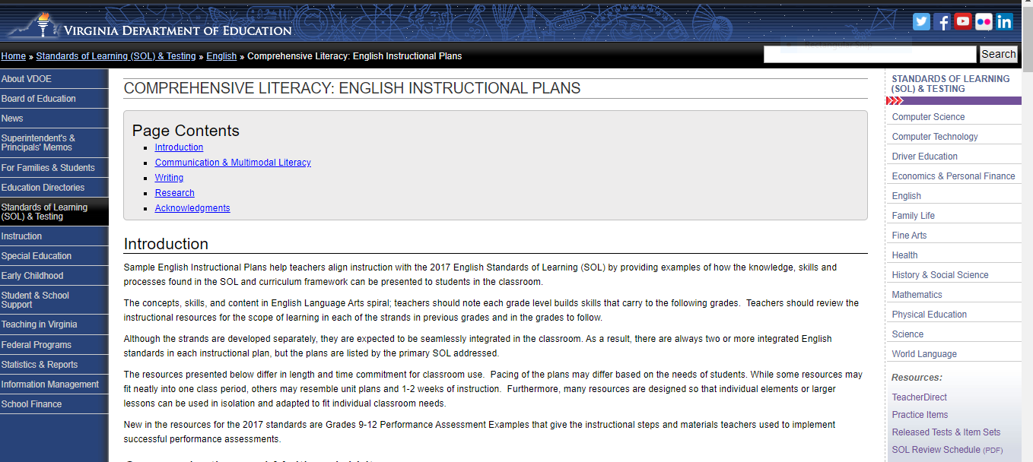
Resources that Align with the 2017 SOL
Comprehensive Literacy: English Instructional Plans
VDOE English Standards of Learning Webpage

Slide 39
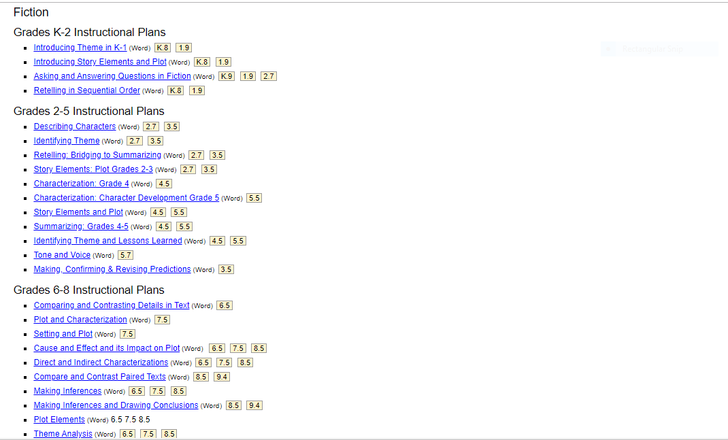
Comprehensive Literacy: English Instructional Plans

Slide 40
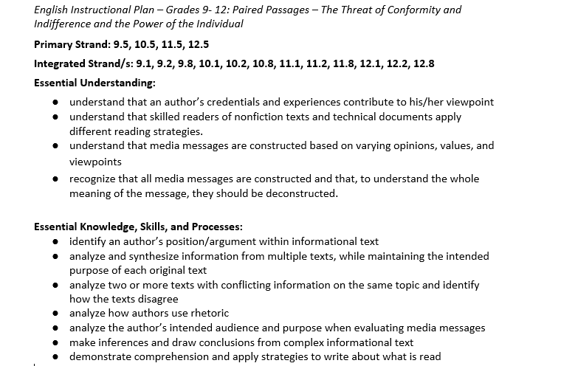
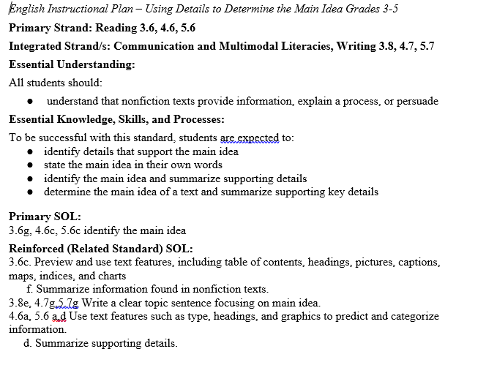
English Instructional Plan Samples

Slide 41


Slide 42
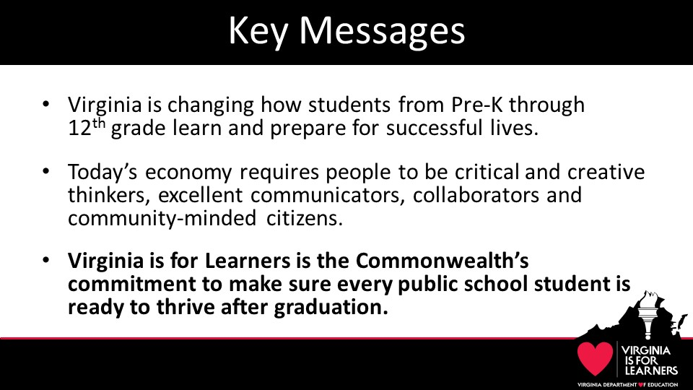
Virginia Is For Learners

Slide 43

Virginia Is For Learners Webpage

Slide 44
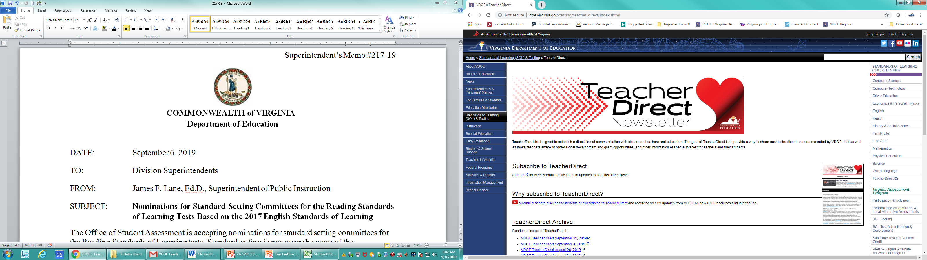
Teacher Direct
Access TeacherDirect from “Instruction” Link on the left side of the VDOE home page

Slide 45
VDOE Disclaimer
Reference within this presentation to any specific commercial or non-commercial product, process, or service by trade name, trademark, manufacturer or otherwise does not constitute or imply an endorsement, recommendation, or favoring by the Virginia Department of Education.
Reference within this presentation to any specific commercial or non-commercial product, process, or service by trade name, trademark, manufacturer or otherwise does not constitute or imply an endorsement, recommendation, or favoring by the Virginia Department of Education.

Slide 46
Stay Connected
Jill Nogueras
K-12 English Coordinator
Jill.Nogueras@doe.virginia.gov
Carmen Kurek
Elementary English/Reading Specialist
Carmen.Kurek@doe.virginia.gov
Taylor Snow
English/History & Social Science Specialist
Taylor.Snow@doe.Virginia.gov
Assessment Office
Student_Assessment@doe.virginia.gov

