Slide 1
Standards-Based Individualized Education Program
Module Four: Assessing and Reporting Student Progress
Notes:
SBIEP Module Four: Assessing and Reporting Student Progress - As student progress is assessed and reported, the progress monitoring provision requires that the IEP specify how the student and parents will be regularly informed of the student’s progress toward the annual goals. It helps IEP teams determine whether the student’s progress toward the annual goals is considered sufficient or if there is a lack of expected progress and allows the team to make decisions concerning the effectiveness of curriculum delivery. Progress must be reported at least as often as parents of nondisabled students are informed of their child’s progress, so check your local school division’s progress reporting schedule to determine the required dates.
For more information, refer to 34 CFR 300.320 (a)(3)

Slide 2
Assess and Report the Student’s Progress Throughout the Year (1 of 2)
Ask:
How does the student demonstrate what he/she knows on classroom, benchmark, and state assessments?
Is a variety of assessments used to measure progress?
How will progress be reported to parents?
Notes:
As you assess and report the student’s progress throughout the year, ask yourself, how does the student demonstrate what he/she knows on classroom, benchmark, and state assessments; is a variety of assessments used to measure progress; and how will progress be reported to parents?

Slide 3
Assess and Report the Student’s Progress Throughout the Year (2 of 2)
Ask:
Did the student make the progress expected by the IEP Team?
How does the student’s performance compare with the performance of general education students?
Is the student more independent in the goal area?
Will work toward the goal be continued, or will the student be dismissed from this goal area?
Notes:
In addition, ask, did the student make the progress expected by the IEP team; how does the student’s performance compare with the performance of general education students; is the student more independent in the goal area; and will work in the goal be continued or will the student be dismissed from this goal area?

Slide 4
A. Monitoring Student Progress
At the time an IEP is developed, it must specify and document how the child’s progress toward each annual goal will be measured, including:
What will be monitored,
Who will monitor it,
When it will be monitored,
Where the monitoring will be conducted, and
How the data will be reported.
Notes:
As an IEP is developed, it must specify and document how the child’s progress toward each annual goal will be measured, including; what will be monitored, who will monitor it, when it will be monitored, where the monitoring will be conducted, and how the data will be reported.
Evaluation procedures and tools selected to collect and measure data and student progress should be identified in the IEP. Selecting a variety of data collection tools representing different types of measurement can provide a clear picture of student progress.
Progress monitoring tools include, classroom participation , worksheets, class work, homework, observation, special projects, tests and quizzes, written reports, criterion-referenced tests, norm-referenced tests, and other tools.
In addition, an evaluation schedule should be included in the IEP stating the date, intervals or frequency of the progress monitoring and data compilation, such as weekly, daily, etc.

Slide 5
B. Reporting Student Progress
Progress on IEP goals and short-term objectives (if required) is reported to parents as often as nondisabled students receive academic progress reports.
Timeline: Mid-Quarter (Interim Reports) and Quarterly
Format: Compilation Forms, Graphs, and Narratives
Notes:
Progress on IEP goals and short-term objectives (if required) is reported to parents as often as nondisabled students receive academic progress reports. A timeline such as Mid-Quarter Interim Reports or Quarterly Report Cards, in a format such as compilation forms, graphs, or narratives should be indicated.

Slide 6
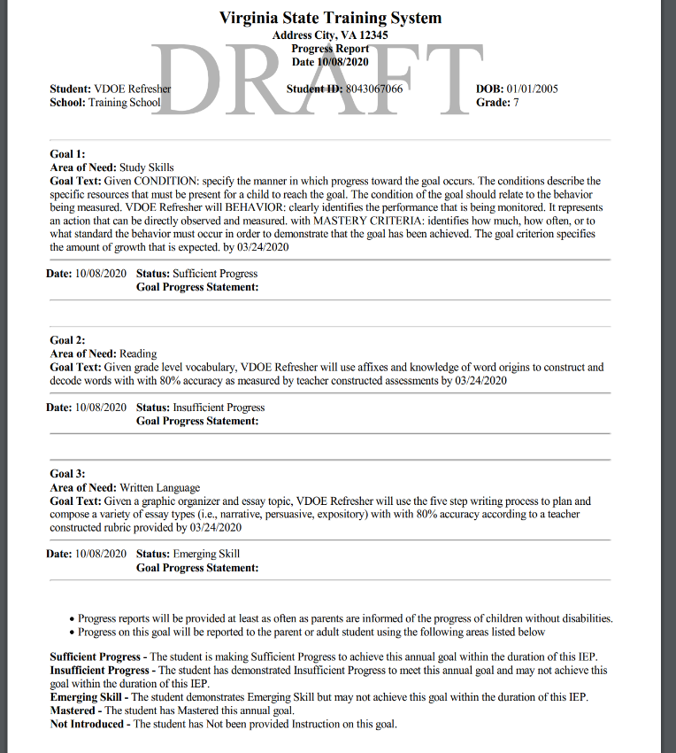
Sample: Reporting Tool
Notes:
This is a sample reporting tool from the VA IEP system.
Progress must be reported at least as often as parents of nondisabled students are informed of their child's progress.
This goal will be reported to the parent or adult student using the following codes.
SP – to indicate the student is making Sufficient Progress to achieve this annual goal within the duration of this IEP.
IP – to indicate the student has demonstrated Insufficient Progress to meet this annual goal and may not achieve
this goal within the duration of this IEP. If this code is used an explanation is needed.
ES – to indicate the student demonstrates Emerging Skill but may not achieve this goal within the duration of this
IEP.
M – to indicate the student has Mastered this annual goal and
NI – to indicate the student has Not been provided Instruction on this goal.
To provide a more detailed summary of a student’s performance, an optional narrative summary with discussion of the evaluation tool is encouraged.

Slide 7
Quick Check: Assessing and Reporting Student Progress (1 of 2)
The frequency and manner of reporting to parents is determined in consideration of a student’s unique needs.
Progress is reported to parents in a manner that is understood by them (e.g., jargon-free) and is objective, not subjective.
Notes:
For the Quick Check: Review for the following content.
As you assess and report student progress to parents, ensure that the frequency and manner of reporting is determined in consideration of a student’s unique need; that progress is reported in an understandable, jargon free, objective (not subjective) manner.

Slide 8
Quick Check: Assessing and Reporting Student Progress (2 of 2)
Specific data is included in measurable terms regarding the extent to which the student is progressing towards meeting annual goals.
The information included in reports to parents is sufficient to identify a student’s lack of progress early enough that the IEP Team could, if necessary, reconvene to review and, if appropriate, revise the student’s IEP to ensure the student is provided the appropriate supports to reach the annual goals.
Notes:
Determine that specific data is in measurable terms and indicates the extent to which the student is progressing towards meeting annual goals; and a lack of progress is provided early enough that the IEP team could, if necessary, reconvene, review and, revise the plan to ensure the student is provided the appropriate supports to reach his/her annual goals.

Slide 9
Standards-Based Individualized Education Program Module Four: Assessing and Reporting Student Progress
The resources used during the development of this training module are in the guidance document found on the VDOE Standards-Based IEP webpage.
Notes:
This concludes the fourth of nine training modules on developing Standards-based IEPs. Additional information can be found on the Virginia Department of Education’s website by accessing the link on the screen.

