Slide 1
Standards-Based Individualized Education Program
Module Five: Identifying Special Education and Related Services
Notes:
SBIEP Module Five: Identifying Special Education and Related Services - On behalf of the student and based on peer-reviewed research to the extent possible, the IEP team needs to develop a statement of the special education and related services and supplementary aids and services. The statement defines the program modifications or supports for school personnel that will be provided to enable the student to advance appropriately toward attaining the annual goals, be involved and progress in the general curriculum, including participation in extracurricular and other nonacademic activities with other children with and without disabilities.

Slide 2
Identifying Special Education and Related Services
Ask:
What related services or accommodations are needed to enable the student to access the knowledge in the general education curriculum?
What accommodations have been used by the student, and were they effective?
Has the complexity of the materials been changed in such a way that the content has been modified?
Notes:
When identifying special education and related services, ask yourself, what related services or accommodations are needed to enable the student to access the general education curriculum; What accommodations have been used by the student and were they effective; and has the complexity of the materials been changed in such a way that the content has been modified?

Slide 3
A. Determining Related Services
Notes:
Related services include transportation and such developmental, corrective, and other supportive services as are required to assist a child with a disability to benefit from special education.
This may include but not limited to the following: speech-language therapy; psychological services; early identification and assessment of disabilities in children; medical services for diagnostic or evaluation purposes; job coaching , audiology services; physical and or occupational therapy; counseling services, including rehabilitation counseling; school health services; school nurse services; interpreting services; recreation, including therapeutic recreation; orientation and mobility services; social work services in schools; parent counseling and training and other.

Slide 4
Types of Related Service Interventions Offered by Schools Include:
Direct Services
Indirect Services
Notes:
According to Center for Parent Information and Resources, there are two basic kinds of related services interventions offered by schools to meet the range of student needs. These are: direct services and indirect services.

Slide 5
Direct Services
The professional should also:
Monitor the student’s performance within the educational setting so that adjustments can be made to improve student performance as needed; and
Consult with teachers and parents on an ongoing basis so that relevant strategies can be carried out through indirect means at other times.
Notes:
Direct services usually refer to face-to-face interactions between professional and
student. These interactions can take place in a variety of
school settings, such as the classroom, gym, health office, resource room, counseling
office, playground, or in the community (e.g. during a work experience).
Typically, the professional Monitors the student's performance within the educational
setting so that adjustments can be made to improve student performance, as needed,
and Consults with teachers and parents on an ongoing basis, so that relevant strategies
can be carried out through indirect means at other times.

Slide 6
Indirect Services
The intervention procedure is designed by the related service professional (with IEP Team input) for an individual student.
The related service professional has regular opportunities to interact with the student.
The related service professional provides ongoing training, monitoring, supervision, procedural evaluation, and support to staff members and parents.
Notes:
Indirect services may involve teaching, consulting with, and/or directly supervising other personnel (including paraprofessionals and parents).
For example, a school psychologist might train teachers to implement a program to decrease the child's problem behaviors. Similarly, a physical therapist may serve as a mobility consultant and provide expertise to solve problems regarding a student's mobility through school.
Good practice includes an intervention procedure that is designed by the related service professional for the individual student; provides regular opportunities for interaction with the student; and provides ongoing training, monitoring, supervision, procedural evaluation, and support to staff members and parents.

Slide 7
Direct and Indirect Services
Notes:
The type of service provided depends upon the individual needs of the student and his or her educational goals. A service or provider can provide both direct and indirect services. Decisions about service delivery are made by the IEP team on an individual, case-by-case basis.
For example, psychological counseling can be provided directly in one-on-one counseling, or indirectly by training the teacher to implement a behavior management program. Physical therapy can be provided directly in a small group or indirectly by adapting a lesson to be used in a physical education class. Speech therapy can be implemented directly in a co-taught English class or indirectly by consulting with a classroom teacher to plan written language activities.

Slide 8
Identifying the Supplementary Aids and Services
Accommodations
Modifications
Do not reduce learning expectations
Provide access
Practices that change, lower, or reduce learning expectations
Can increase the gap between achievement and proficiency
Notes:
Supplementary aids and services are aids, services, and other supports that are provided in general education classes, other education-related settings, and in extracurricular and nonacademic settings, to enable children with disabilities to be educated with nondisabled children to the maximum extent appropriate. These aids and services are often identified as accommodations and modifications.
The difference between accommodations and modifications is that accommodations do not reduce learning expectations. They provide access. However, modifications refer to practices that change, lower, or reduce learning expectations. Modifications can increase the gap between the achievement of students with disabilities and expectations for proficiency at a particular grade-level.

Slide 9
Examples of Classroom Accommodations
Notes:
Classroom accommodations are generally categorized into four types: presentation, response, setting, test scheduling.
Examples of Classroom Accommodations are listed on the screen.
The student should be familiar with accommodations selected and their use should not be limited to state assessments only. An accommodation should provide equal access and should not be selected solely to enhance performance. Some accommodations used during instruction or classroom assessment may not be allowable on statewide assessments. Questions about the appropriateness of a specific accommodation should be directed to the division Director of Testing.

Slide 10
Examples of Transition Accommodations
Use of voice recognition computer software versus scribe to compose a paragraph
Use of augmentative communication device versus personal assistant to request appropriate accommodations
Use of a cell phone alarm versus father’s reminders to take medications (so that student can live in his own apartment).
Notes:
Another form of accommodations are Transition Accommodations: They are supports that are included in a transition IEP and facilitate the transition to adult life. They include those that increase student’s independence; are designed for student’s continued use after high school; and support the achievement of students postsecondary goals.
The use of voice recognition computer software instead of a scribe to compose a paragraph;
The use of a augmentative communication device instead of a personal assistant to request appropriate accommodations; and
The use of a cell phone alarm instead of father’s reminder to take medications are examples of accommodations that could allow a student to be able to live in his own apartment.

Slide 11
Quick Check: Identifying Special Education and Related Services (1 of 2)
The IEP Team has described the student-specific services for: special education (specially designed instruction), related services, supplementary aids and services, or program modifications.
Notes:
As you identify student-specific supplementary aids and services, ensure that the IEP team has included services for special education, related services, and supplementary aids and services or program modifications.

Slide 12
Quick Check: Identifying Special Education and Related Services (2 of 2)
For each service the IEP Team described: frequency and amount, location (e.g., general education classroom, special education classroom, lunchroom), and duration.
The services are based on peer-reviewed research to the extent possible.
Notes:
Also, each service specifies frequency and amount, location (for example, general or special education classroom, lunchroom, etc.); and duration. In addition, the services must be based on peer-reviewed research to the extent possible.
The Do’s and Don’ts When Selecting Accommodations are listed in the guidance document.
- Thompson, S., Morse, M., Sharpe, M., and Hall, S. (2005)

Slide 13
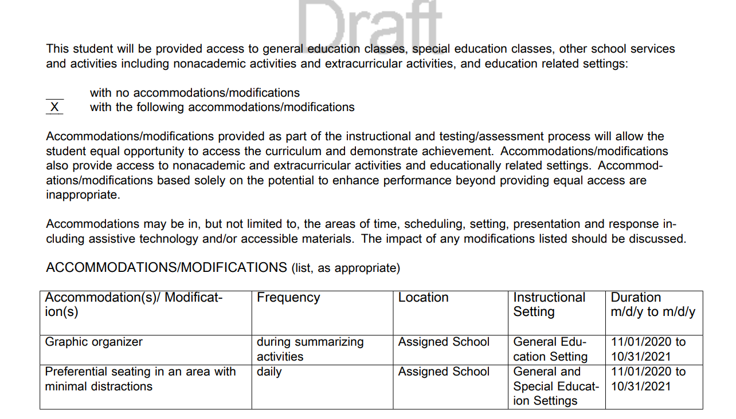
Sample: Accommodations/Modifications Document
Notes:
Once again, accommodations and modifications provide equal access to the curriculum and allow students to demonstrate achievement. They provide access to nonacademic, extracurricular activities, and educationally related settings. Accommodations and modifications based solely on the potential to enhance performance are inappropriate. Accommodations may be in, but not limited to, the areas of time, scheduling, setting, presentation and response. IEP teams should discuss the impact of any modifications listed. The location of the services can be a specific public or private school site or multiple sites and must be listed if a parent expresses concerns about the location of the services or refuses the proposed site. A listing of more than one anticipated location is permissible, if the parents do not indicate that they will object to any particular school or state that the team should identify a single school.

Slide 14
Standards-Based Individualized Education Program Module Five: Identifying Special Education and Related Services
The resources used during the development of this training module are in the guidance document found on the VDOE Standards-Based IEP webpage.
Notes:
This concludes the fifth of nine training modules on developing Standards-based IEPs. Additional information can be found on the Virginia Department of Education’s website by accessing the link on the screen.

