Slide 1
Digging in to get the learning out!
Paired Passages as Part of an Integrated Unit
2019

Slide 2
Contact Information
Susan Hoch – Reading Specialist – Galax City Schools
  susanhoch@galaxschools.us
Jessica Kidd – 5th Grade Reading – Galax City Schools
  jessicakidd@galaxschools.us
Nathalie Rose – Reading Specialist – Newport News Schools
  Nathalie.rose@nn.k12.va.us
Christine Steigleman – Reading Specialist – Newport News Schools
  christine.steigleman@nn.k12.va.us

Slide 3
When and Why Teach Paired Passages?
Comparison of text should be taught from Kindergarten.
Students must have exposure to paired texts in 2nd – 4th to prepare them for testing in 5th grade.
Grade 4 – SOL 4.5i
  Compare/contrast details in literary and informational nonfiction texts.
Grade 5 – SOL 5.5l (TESTED)
  Compare/contrast details in literary and informational nonfiction texts.

Slide 4
What Are We Asking Our Students to Do?
Compare characters, their personalities, and actions
Compare story events and plot lines
Compare lesson, themes, or messages in stories
Compare themes, ideas, issues in fiction and nonfiction text pairs
Find common themes, writing styles, or perspectives in the work of a single author
Compare the treatment of common themes by different authors
Compare different versions of familiar stories
-Strategies That Work, Stephanie Harvey & Anne Goudvis

Slide 5
What are Paired Texts?
A paired text is two texts that are conceptually related in some way, for example, topic, theme, or genre. Paired text is based on the beliefs that reading is about making connections and “readers make personal connections between the books they are currently reading and their past experiences. (Harste & Short, with Burke, 1988)
Video on Paired Texts

Slide 6
Paired passages are passages that are connected in someway
You will have questions about each individual passage
You will have questions about both passages. Make sure you use evidence from both passages to answer.
Make sure you refer to the correct passage to answer these questions.

Slide 7
Digging Deeper!
Hook Them
Build Background
Investigate
Research
Build Complexity

Slide 8
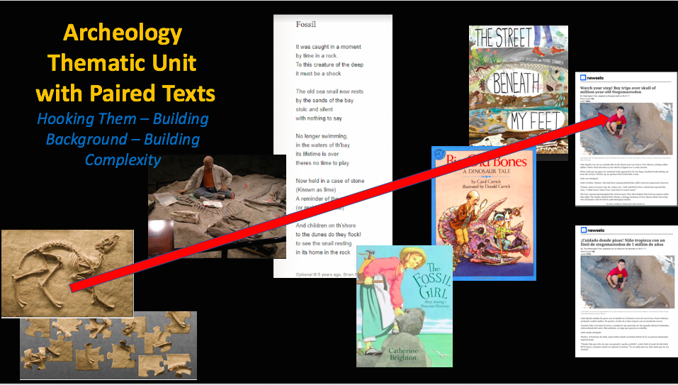
Archeology Thematic Unit with Paired Texts

Slide 9
Hook Your Students
Beginning the Thematic Unit
  Lower Grades- Begin unit with a puzzle scavenger hunt. Students are given a map with an X on puzzle pieces around the classroom. They work to find puzzle pieces & put puzzle together to find out what they will be studying.
  Upper Grades- students write about what they think they will be studying in this thematic unit.

Slide 10
Poetry – Building Background
Building Background:
  Suggested Materials
    A poem about fossils
    The Fossil Girl – literary nonfiction
  Take time to build a strong background as you lay the foundation for beginning an investigative study of your topic, as well as motivating your students toward deeper learning.

Slide 11
Digging Deeper: Fiction vs. Nonfiction 1 of 2
Paired Text: Big Old Bones: A Dinosaur Tale by Carol Carrick and The Street Beneath My Feet by Charlotte Guillain
Suggestions
  Teacher Read Aloud (3 key vocabulary words)
  Teacher Think Aloud
    Teacher reads the first few pages of each book through think aloud and then hands off the reading/thinking aloud to the students to complete.

Slide 12
Digging Deeper: Fiction vs. Nonfiction 2 of 2
Graphic Organizers
  Answer questions from both pieces
  Student work in pairs to compare and contrast fiction vs. nonfiction text as well as comparing back to the previous poem, and narrative nonfiction.

Slide 13
Building Complexity: Article 1 of 2
Fiction/Nonfiction vs. Article (English & Spanish)
Suggestions:
  Teacher Read Aloud/Think Aloud – Teacher reads article, thinking aloud about the article.
  Students Read Together – Students reread article analyzing the strengths in each piece of literature

Slide 14
Building Complexity: Article 2 of 2
Graphic organizers
  T-chart
    Students divide paper into 5 columns and write strengths (information learned) from each piece of literature.

Slide 15
Research/ Presentation 1 of 2
Suggestions for Digging Even Deeper:
  What Else Do You Want to Know
    Teacher leads discussion and creates a chart finding out what else students would like to know regarding thematic unit topic.
    Students chose question & begin research & create oral presentation to share

Slide 16
Research/Presentation 2 of 2
Choosing different fossils from a bag & research that fossil, write about your fossil & create a presentation to share.
Making their own fossils, describing & sharing.

Slide 17
Standards - Archeology Thematic Unit – 3rd Grade 1 of 2
3.5 The student will read and demonstrate comprehension of fictional texts, literary nonfiction, and poetry.
  b) Make connections between reading selections
  c) make, confirm and revise predictions
  k) Use reading strategies to monitor comprehension throughout the reading process
  l) differentiate between fiction and non-fiction

Slide 18
Standards – Archeology Thematic Unit – 3rd Grade 2of 2
3.6 The student will read and demonstrate comprehension of nonfiction texts.
  b) Use prior knowledge and background knowledge as a context for new learning
  l) use reading strategies to monitor comprehension throughout the reading process
3.8 The student will write in a variety of forms to include narrative, descriptive, opinion, and expository.
3.10 The students will demonstrate comprehension of information resource to research a topic and complete a research product

Slide 19
Standards – Archeology Thematic Unit – 4th Grade 1 of 2
4.5 The student will read and demonstrate comprehension of fictional text, literary nonfiction texts, and poetry.
  k) Use reading strategies to monitor comprehension throughout the reading process
  i) compare and contrast details in literary and informational non-fiction texts

Slide 20
Standards – Archeology Thematic Unit – 4th Grade 2 of 2
4.6 The student will read and demonstrate comprehension of non-fiction texts
  h) Use reading strategies to monitor comprehension throughout the reading process
4.7 The student will write in a variety of forms to include narrative, descriptive, opinion and expository.
4.9 The student will demonstrate comprehension of information resources to create a research product.

Slide 21
Standards – Archeology Thematic Unit – 5th Grade 1 of 2
5.5 The student will read and demonstrate comprehension of fictional texts, literary nonfiction, and poetry.
  l) Compare/contrast details in literary and informational non fiction texts.
  m) Use reading strategies to monitor comprehension throughout the reading process
5.6 The student will read and demonstrate comprehension of non-fiction texts.
  g) Locate information from the text to support opinions, inferences, and conclusions

Slide 22
Standards – Archeology Thematic Unit – 5th Grade 2 of 2
  j) compare and contrast details and ideas within and between texts
  k) Use reading strategies to monitor comprehension throughout the reading process.
5.7 The student will write in a variety of forms to include narrative, descriptive, opinion and expository.
5.9 The student will find, evaluate, and select appropriate resources to create a research product.

Slide 23
Paired Passage Thematic Unit Correlates to the 5 c’s
Critical thinking begins from day one with introduction of unit & continues throughout
Collaboration skills are developed through reading & comparing, discussions & working toward final presentations
Communications skills developed during discussion through comparison of text, and in presentations
Creative thinking as students research & develop culminating projects and presentations
Units designed around citizenship

Slide 24
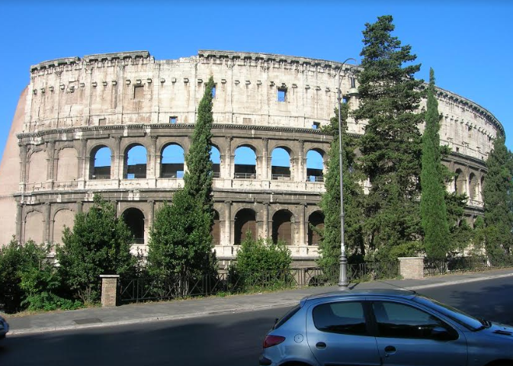
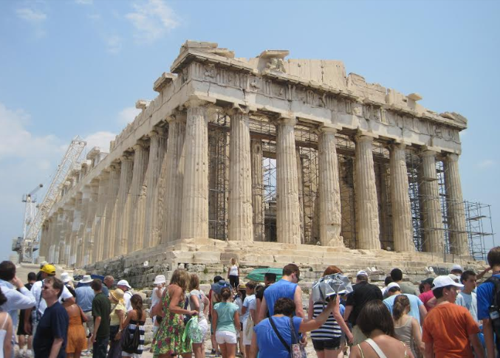
Picture Comparison: ELL & Struggling Reader Support 3rd Grade History Standards

Slide 25
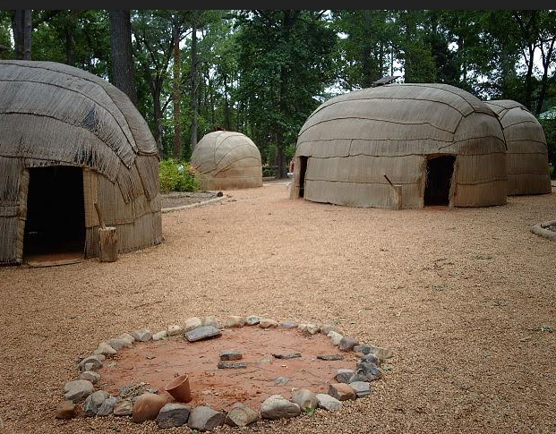
Picture Comparison: ELL & Struggling Reader Support 4th Grade History Standards

Slide 26
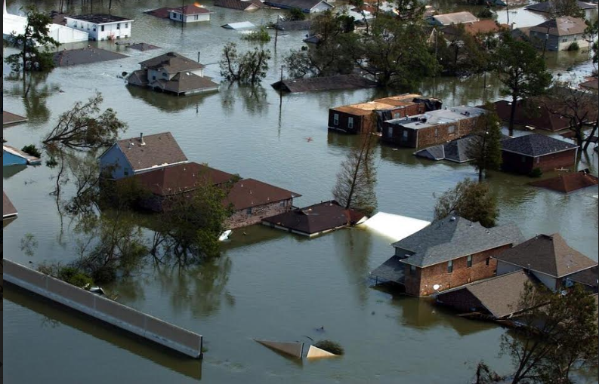
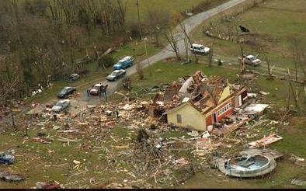
Picture Comparison: ELL & Struggling Reader Support 5th Grade Science Standards
Natural Disasters

Slide 27

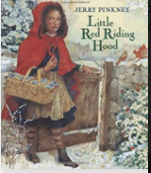
Fairytale Paired Texts: Multicultural Comparison

Slide 28
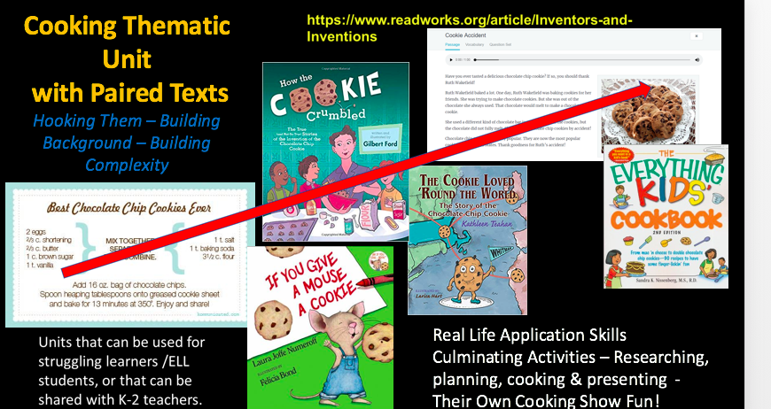
Cooking Thematic Unit with Paired Texts
Units can be used for struggling readers/ELL students, or can be shared with K-2 teachers.
Real life application skills
Culminating activities – researching, planning, cooking & presenting their own cooking show

Slide 29
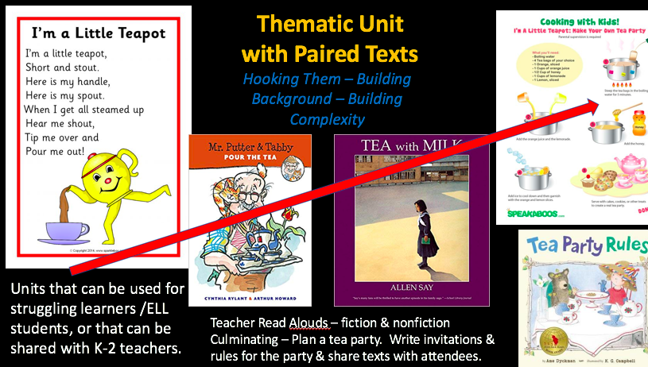
Thematic Unit with Paired Texts
Units can be used for struggling readers /ELL students, or can be shared with K-2 teachers.
Culminating activities– Plan a tea party. Write invitations & rules for the party & share texts with attendees.

Slide 30
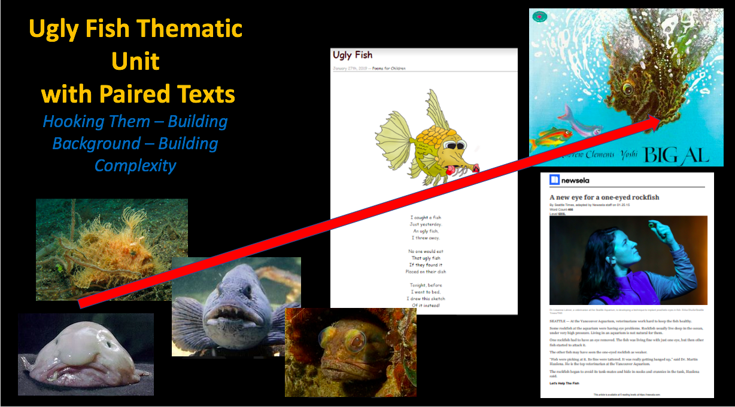
Ugly Fish Thematic Unit with Paired Texts

Slide 31
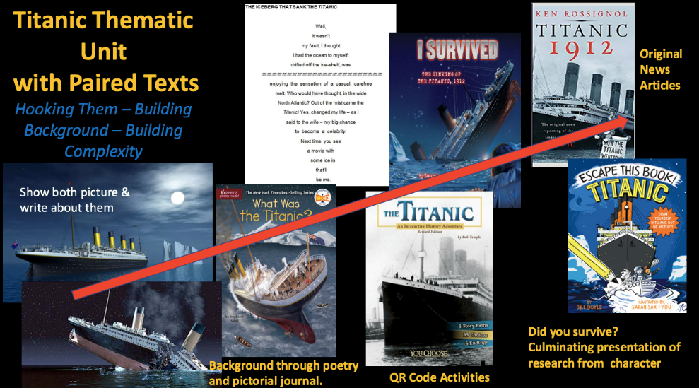
Titanic Thematic Unit with Paired Texts
Show both pictures & write about them
Background through poetry and pictorial journal
QR Code Activities
Original News Articles
Did You Survive? Culminating presentation of research from character

Slide 32
Bibliography 1 of 3
Bintz, W. (2015). Using paired text to meet the common core. New York, NY: Guilford Publications.
Harvey, S. & Goudvis, A. (2017). Strategies that work, 3rd ed. Portsmouth, NH: Stenhouse Publishers.
Link to Archaeologist Photo(archeologist photo)
Link to fossil photo(fossil poem)

Slide 33
Bibliography 2 of 3
Hyperlink to ugly fish poem (ugly fish poem)
Hyperlink to hairy fish photo(hairy fish photo)
Hyperlink to Sarcastic Fish Photo (sarcastic fish photo)
Hyperlink to blob fish photo (blobfish photo)
Hyperlink to Atlantic Wolf Fish Photo(Atlantic wolfish photo)
Hyperlink to Powatan Reflection(Powhatan reflection)

Slide 34
Bibliography 3 of 3
Hyperlink to Jamestown Settlement Photo(Jamestown settlement)
Hyperlink to tornado photo
Hyperlink to natural disaster photo

Slide 35

Disclaimer
Reference within this presentation to any specific commercial or non-commercial product, process, or service by trade name, trademark, manufacturer or otherwise does not constitute or imply an endorsement, recommendation, or favoring by the Virginia Department of Education.

