Slide 1
Reflective Writing
Where Do I start?
Melissa Harrell
mhharrell@shenandoah.k12.va.us
Twitter @pmelissahh

Slide 2
WRITING IS NOT ONLY FOR THE SOL TESTED YEARS!
We MUST be helping our students build the needed foundation and skills every year!

Slide 3
Why Write?
So, you may not have an SOL writing test at the end of grades 6 and 7, but how you prepare your students in these grades will have a huge impact on how well they score on the 8th grade and EOC Writing tests, as well as (and more importantly), how they will succeed in their writing in high school and beyond.
Another GREAT reason to have your students writing is that writing provides a fabulous way for you to assess their comprehension. If students can explain it in writing, then they understand it. Writing can serve as an easy formative assessment tool.
Our students MUST be able to articulate opinions and communicate through writing to be successful in the world.

Slide 4
Definition (1 of 2)
Reflective writing is an analytical practice in which the writer describes a real or imaginary scene, event, interaction, passing thought, memory, form, adding a personal reflection on the meaning of the item or incident, thought, feeling, emotion, or situation in his or her life. (Wikipedia)

Slide 5
Definition (2 of 2)
Reflective writing gives the writer insights and can lead to further learning. It is like rewinding your life to a past event and then thinking about how that event affected your life, what you could have done differently to change the outcome, or what came out of the event. (Dictionary.com)

Slide 6
Standards 6-8
6.7 The student will write in a variety of forms to include narrative, expository, persuasive, and reflective with an emphasis on narrative and reflective writing.
7.7 The student will write in a variety of forms to include narrative, expository, persuasive, and reflective with an emphasis on expository and persuasive writing.
8.7 The student will write in a variety of forms to include narrative, expository, persuasive, and reflective with an emphasis on expository and persuasive writing.

Slide 7
Standards 9-12
9.6 The student will write in a variety of forms to include expository, persuasive, reflective, and analytic with an emphasis on persuasion and analysis.
10.6 The student will write in a variety of forms to include persuasive, reflective, interpretive, and analytic with an emphasis on persuasion and analysis.
11.6 The student will write in a variety of forms, to include persuasive/argumentative, reflective, interpretive, and analytic with an emphasis on persuasion/argumentation.
12.6 The student will write in a variety of forms to include persuasive/argumentative, reflective, interpretive, and analytic with an emphasis on persuasion/argumentation.

Slide 8
Framework Details
Write reflectively to explain and analyze an experience, a skill, or event, and as a response to reading
Three examples of reflective writing include:
Technical – which includes what worked or did not work and why, problem-solving techniques, and theories that were used or tested.
Collaborative – which is centered on team dynamics; how everyone worked together and why, and what worked or did not work and why.
Individual - What did I learn, how did I learn it, and what could I have done better?

Slide 9
Reflective Writing Suggestions
Response journals
Dialogue journals
Essays (What and Why focus)
QAR: Author and You QAR Lesson
Book,Head, Heart graphic organizer
Reflective Prompts
Portfolio Reflections
Grade Earned Reflection
Group Evaluations
Opinion/Proof

Slide 10
Individual Examples
Let’s start with response journals: As your students read their independent books or class book, give them an opportunity to stop and reflect on the reading. Pull in Author and You question to help guide the reflection and connection to the reading.
You can offer guidance with prompts, or let them express what they are thinking.
Prompt Suggestions for Fiction: Esperanza Rising Examples
What connection are you making with the character?
As you are reading, how is the author helping you as a reader stay connected to the story?
If you could change one thing about the plot, what would you change and why this change?

Slide 11
Individual
Portfolio Reflections/Grade Earned Reflections:
Have students look at their writing portfolios mid year and at the end of the year and reflect on their growth as a writer. It can also be used for them to have input in the grade they feel they earned.
Prompt Suggestions:
How have you grown as a writer?
What do you notice about your use of elaboration from August to now?
Did you meet your writing goal? If yes, how? If no, what do you need to change in your plan?
What is your strongest writing genre? Why?
What is your weakest writing genre? Why?
What grade do you feel you earned this period? Why?

Slide 12
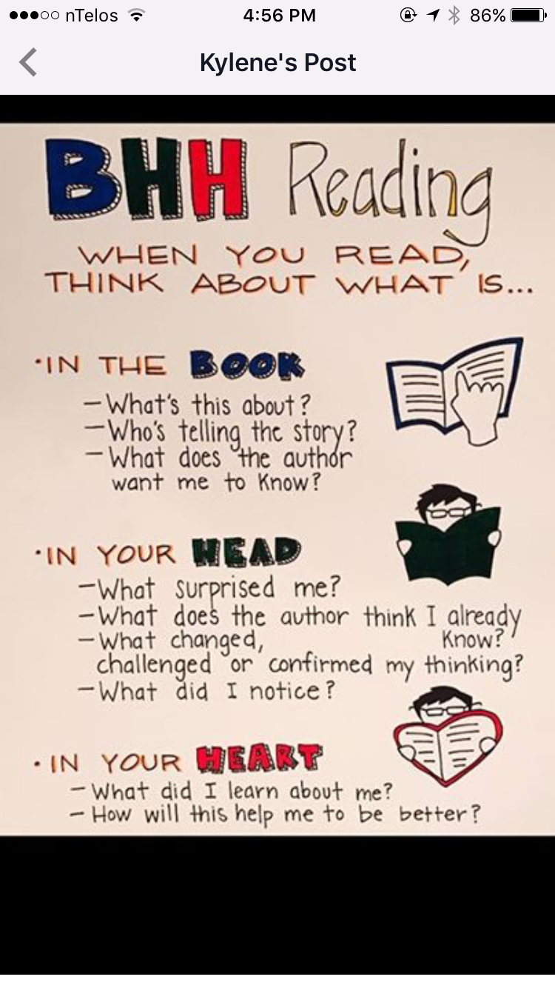
Individual (1 of 2)
BHH( Book, Head, Heart) graphic Organizer: Reflective thinking without the fear of writing.
· Click on link to have access to the graphic organizer I created for use in the classroom.
BHH graphic organizer.
This is from the book Disruptive Thinking Why How We Read Matters by Kylene Beers and Bob Probst.

Slide 13
Individual (2 of 2)
Opinion/Proof
Opinion/Proof (Ray Jones website)
You ask a pre reading or pre unit question and as they read texts they find the proof to back up their opinion. I used this with a unit which included reading Jurassic Park and holding a mock congressional hearing on cloning. This can be done for fiction or nonfiction and in other content areas. Great lead in activity to an essay.
Question: In your opinion should cloning be legal and backed with federal funding?

Slide 14
Collaborative
Collaborative – which is centered on team dynamics; how everyone worked together and why, and what worked or did not work and why.
Have students reflect on how well the group worked together on a project or a collaborative assignment. Here is a link to a Collaboration Rubric used during Literature Circle unit.
This was the summative, but they completed a weekly one as well in order to make needed changes for the next week.

Slide 15
Sum It Up!
We want our students thinking about their thinking and being able to express their thoughts with clarity and cohesiveness.
Most of you are already doing some sort of reflective writing in your classrooms.
Keep in mind that with reflective writing it is the STUDENTS’ thinking and not ours that is important.
Reflective writing in the classroom allows students to collaborate through discussion, engage on a deeper level, and form opinions on different topics and content while also navigating opinions that differ from their own.

Slide 16
Using the Strategies Across grade Levels
We can’t assume that students know how to write, so we must meet them where they are. At any grade level, we as teachers must provide the modeling and scaffolding needed. The amount of modeling or scaffolding required will be determined by the students you teach. These strategies can be used across grade levels as long as the needed support is provided for them to be successful.
Think : I do, We do, You do !

Slide 17
One Last Note
If you email me, I will gladly share resources that I have for reflective writing.
I will gladly help you get a unit started.
I will gladly give you input on a unit or project that you are creating or have created and respond to questions about adding reflective writing.
I encourage you to look at the professional people I follow on Twitter.There are so many amazing minds on reading and writing!

Slide 18
Sources
Beers, Kylene, and Robert E Probst. Disruptive Thinking Why How We Read Matters. Scholastic, 2017.
“ReadingQuest Strategies: A to Z List of Strategies.” ReadingQuest Strategies | A to Z List of Strategies, www.readingquest.org/a-z-strategies.html.
Virginia Department of Education. “Virginia Department of Education.” VDOE :: Virginia Department of Education Home, www.doe.virginia.gov/

Slide 19
Disclaimer
Reference within this presentation to any specific commercial or non-commercial product, process, or service by trade name, trademark, manufacturer or otherwise does not constitute or imply an endorsement, recommendation, or favoring by the Virginia Department of Education.

