Slide 1
Data Trends Used to Inform
Virginia’s Strategic Plans for Educator
Recruitment and Retention
Dr. Joan B. Johnson, Assistant Superintendent
Teacher Education & Licensure
September 15, 2022

Slide 2
Proposed Multi-Year Process (2022-2025)
Phase I
Phase II
Phase III
Landscape Analysis & Strategic Plan Development
Pilot Strategies & Actions
Evaluate & Revise Plan
Continuous Stakeholder Engagement

Slide 3
The Teacher Licensure Collaborative
ME
WA
VT
NH
MA
AK
MT
ND
OR
MN
NY
ID
WI
RI
SD
MI
CT
WY
PA
MD
NJ
IA
DE
NE
OH
IL
IN
WV
Washington D.C.
NV
UT
VA
CA
CO
MO
KY
KS
NC
TN
OK
SC
AZ
NM
AR
AL
GA
MS
HI
LA
TX
FL

Slide 4






The National Partners
4

Slide 5
State Comparisons
State | Teacher Vacancies (and other indicators of shortages) | Source
Maryland* 122,260 Total | ● 1,621 teacher vacancies on the first day of the 2021-22 school year, but 1,999 teacher vacancies by the end of the 2021-22 school year. ● In addition, 3,567 conditional certificates were issued in 2022. | State Superintendent of Schools Presentation, July 26, 2022. Reports vacancy figures reported to the state by LEAs at the beginning and end of the 2021-22 school year.
North Carolina 94,342 Total | ● 3,619 ( 3.83%) K-12 teacher vacancies at the start of the 2022-23 school year. This is likely an undercount, since it includes 98 out of 115 school districts. | Survey of 98/115 North Carolina School Superintendents Association members. Reported as of August 19, 2022.
Tennessee* 68,751 | ● 1,024 (1.48%) PK-12 teacher vacancies in January 2022 ● Additional 1,670 positions filled by uncredentialed and out-of-field teachers. | Tennessee Department of Education data presented May 11, 2022 based on LEA reporting of snapshot data from January 2022 (2021-22 school year). LEAs report to TDE the number of positions unfilled by a licensed teacher for 20 or more days excluding permits and endorsement exemptions.

Slide 6
State | Teacher Vacancies (and other indicators of shortages) | Source
Virginia* 91,736 | ● 3,307 (2.83%) teacher vacancies on the first day of the 2022-23 school year 2593.69 | August Start of the School Year Staffing Snapshot Survey Positions and Exits Collection, 2021-2022- August 2021 ( early fall)

Slide 7
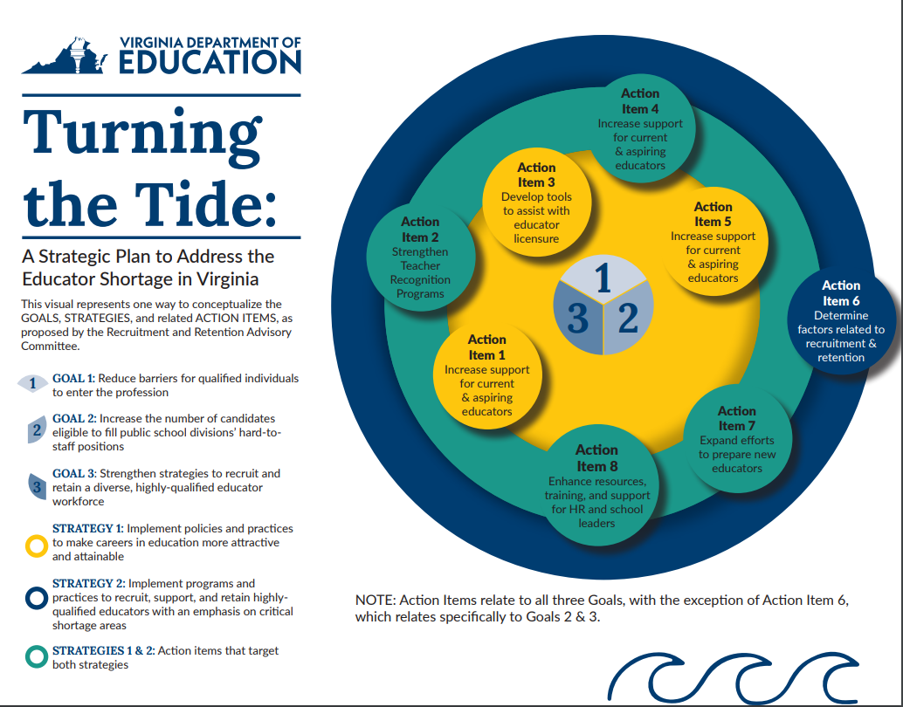

Slide 8
Goals:
Goal 1: Reduce barriers for qualified individuals to enter the profession
Goal 2: Increase the number of candidates eligible to fill public school divisions’ hard-to-staff positions
Goal 3: Strengthen strategies to recruit and retain a diverse, highly-qualified educator workforce
Strategies:
Strategy 1: Implement policies and practices to make careers in education more attractive and attainable
Strategy 2: Implement programs and practices to recruit, support, and retain highly-qualified educators with an emphasis on critical shortage areas

Slide 9
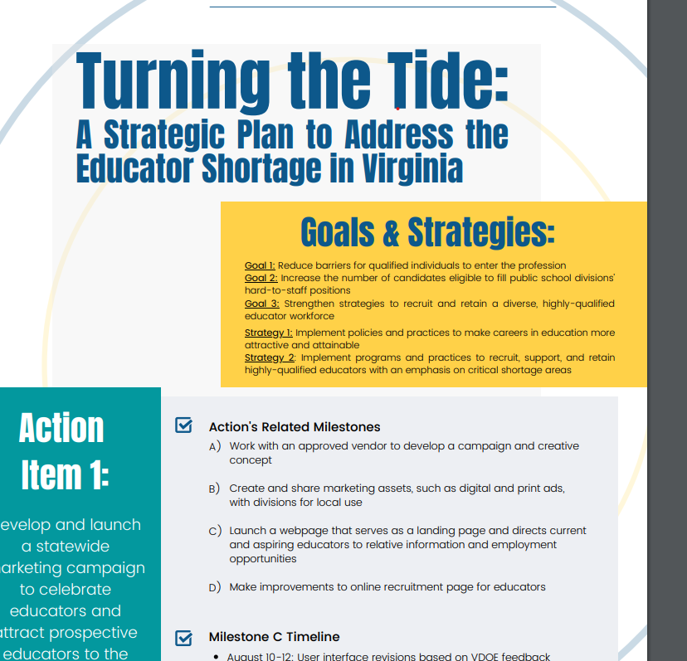
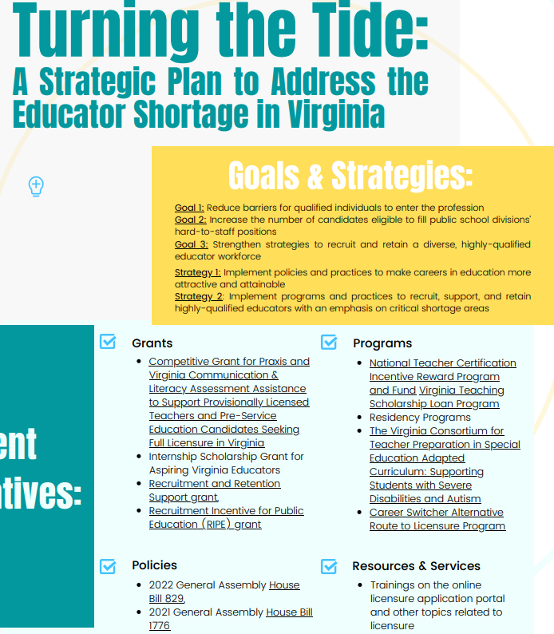

Slide 10
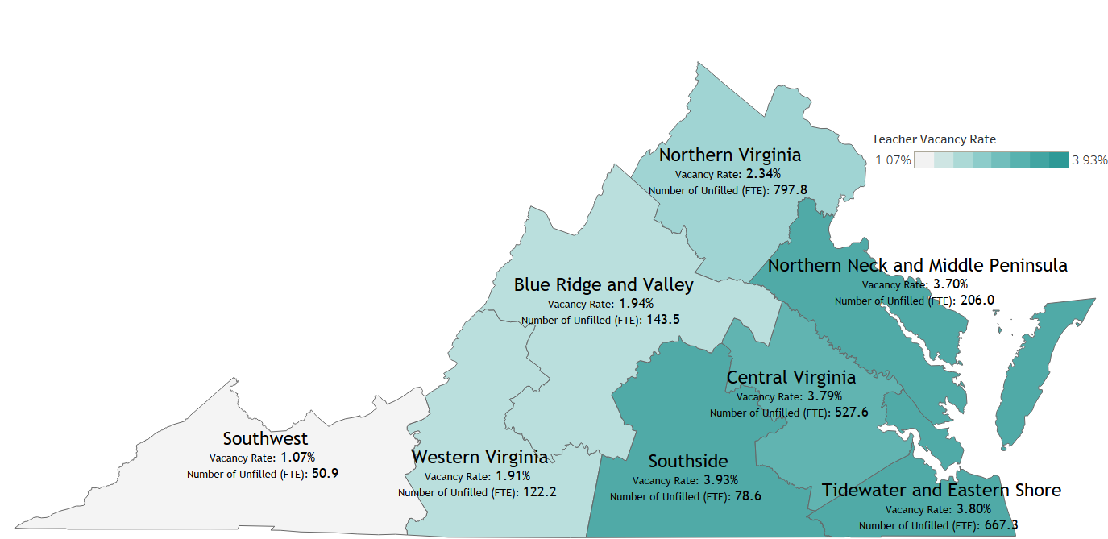
Statewide teacher vacancy rate: 2.83%
Statewide unfilled teacher FTEs: 2,593
Statewide Teaching Positions by FTE 91,736
Data-Informed Practices, Barriers, & Priorities
Virginia Teacher Vacancy Rate and Unfilled FTEs by Region October Report 2021
Region 4
Lower Vacancy Rate
Higher Vacancy Rate
Region 3
Region 5
Region 1
Region 7
Region 6
Region 8
Region 2
Data source: Positions and Exits Collection, 2021-2022, available here: https://doe.virginia.gov/teaching/workforce_data/index.shtml

Slide 11
Positions and Exits Collection (PEC)
Code of Virginia § 22.1-79 and 22.1-290.2
Requirements of the Code of Virginia and ESEA TITLE II
-Local school boards were required to report the number and type of teacher, other instructional personnel, and support staff vacancies as well as bus drivers (Oct. 2021).
-Identify critical shortages by geographic area, school division, and subject matter, measure growth and decline of required staffing levels, and evaluate the reasons licensed personnel leave the field (exit) (August 15, 2022).
-Replaces the Supply and Demand Survey and the IPAL Survey Data collection beginning with the 2021-2022 school year.

Slide 12
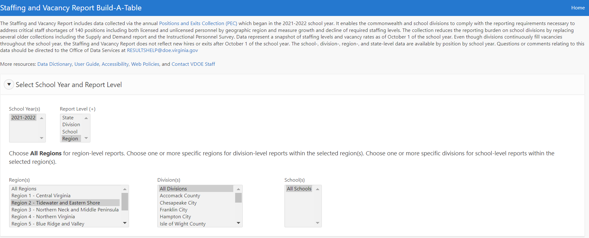
Build-A-Table Sample
https://www.doe.virginia.gov/teaching/workforce_data/index.shtml

Slide 13
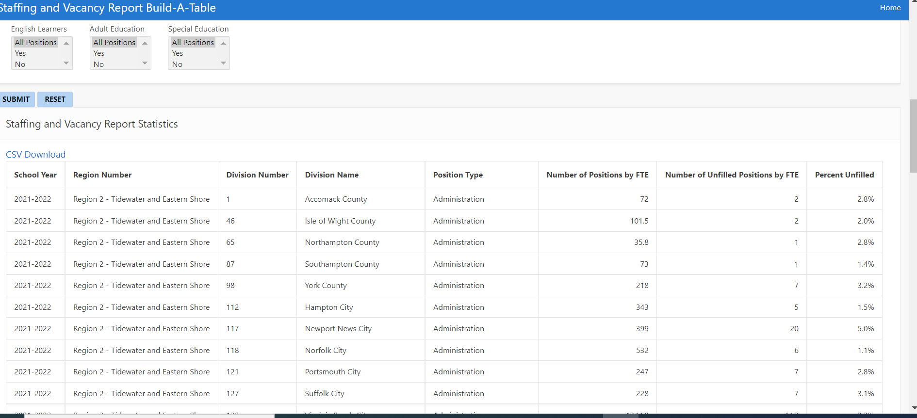

Slide 14
Definitions
Exits by FTE--The number of positions that were vacated by licensed employees after their contract was signed for the current school year.
Unfilled Positions by FTE--The number of positions by FTE that were unfilled. Unfilled positions only include those positions that were advertised as available but no one qualified was hired. If the duties of the position were given to an existing employee in lieu of hiring a new employee, the position should still be included in this count.
Positions by FTE--The number of Positions by FTE include all positions held by school-level and division-level personnel, both licensed and unlicensed.

Slide 15
Ratings
The fall collection of the PEC is designed to collect information on the total number of full-time equivalent positions (FTEs) for licensed and unlicensed personnel in public school divisions and regional centers.
Rate: FTE of Unfilled Positions divided by the FTE of all Positions
Data represent a snapshot of staffing levels and vacancy rates as of October 1 of the school year.
It also collects the number of filled and unfilled bus driver positions by headcount.

Slide 16
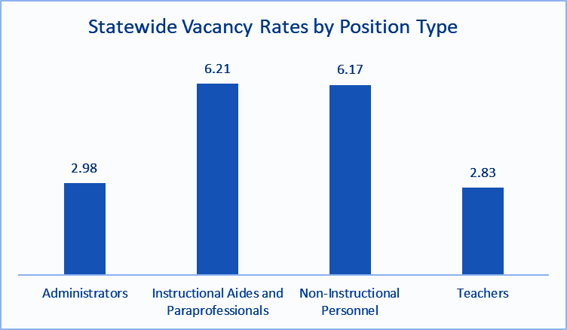
Statewide Vacancy Rates by Position Type

Slide 17
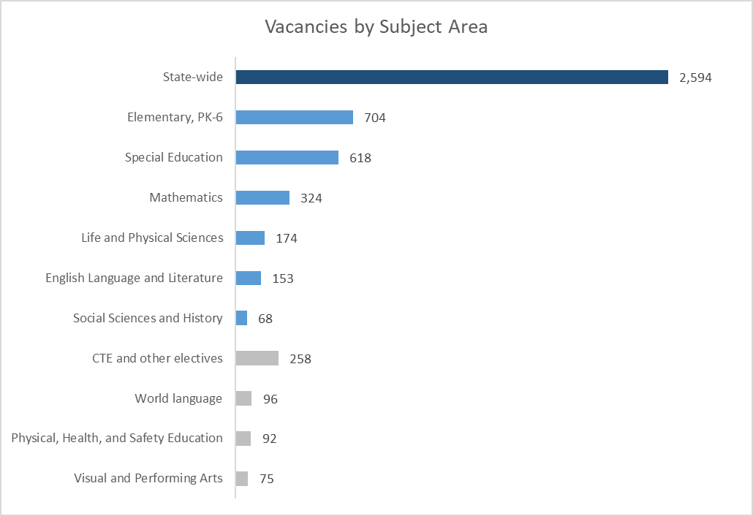
68,751
Statewide Teaching Positions by FTE 91,736.92
*state-wide data is dark blue, core content subjects are medium blue, and non-core subjects are grey
Notes:
2.83

Slide 18
Enrollment and Completion in Virginia Teacher Preparation Programs
USED collects program enrollment and program completer information from teacher preparation programs
Source: USED Title II Reports: https://title2.ed.gov/Public/Report/StateHome.aspx

Slide 19
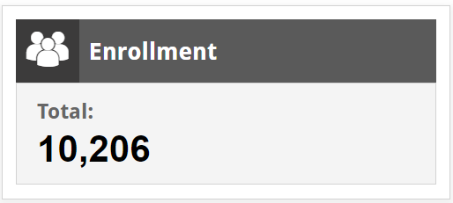
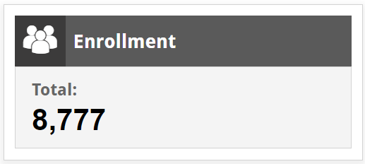
Data-Informed Practices, Barriers, & Priorities
EPP Trends
(2015-16 AY)
(2019-20 AY)
 | 2015 | 2016 | 2017 | 2018 | 2019 | 2020 | 2021 | 2022 | Total
Postgraduate Professional License (earned Master’s +, 10 yr, renewable) | 20,623 | 18,745 | 20,976 | 19,539 | 19,465 | 16,493 | 14,214 | - | 130,055
Collegiate Professional License (earned Bachelor's, 10 yr, renewable) | 8,139 | 8,719 | 10,177 | 9,773 | 9,305 | 7,253 | 5,845 | - | 59,211
Provisional License (3 yr, non-renewable) | 117 | 192 | 446 | 767 | 1,669 | 2,804 | 2,698 | - | 8,693
 | 28,879 | 27,656 | 31,599 | 30,079 | 30,439 | 26,550 | 22,757 |  | 197,959
Licensure Trends
Notes:
from perspective of HR.. Short term fix, but not best option.. Turnover, impact students and professional overall*
Collegiate- traditional pathway ( EPP) Applications are Down Since 2015. This Correlates with the Decline in Teacher Graduates From our Universities preparation programs

Slide 20
Start of the School Year Staffing Snapshot Survey
August 2022
.

Slide 21
Methodology
The Virginia Department of Education (VDOE) administered a brief survey (5 Q) between August 15 and August 18, 2022 to collect the number of teacher vacancies (actual or anticipated) by school division as of the first day of the 2022-2023 school year.
For the purposes of this survey, vacancies include any teaching positions that are unfilled, held by a board certified substitute, or by an individual without appropriate licensure credentials. School Divisions that had not yet begun the 2022-2023 school year were asked to estimate the anticipated number of vacant positions by the start of the school year.
VDOE received responses from 111 of 131 school divisions (85 percent).

Slide 22
Table 1. Teacher Vacancy Counts and Rates by Superintendent’s Region and the State
Statewide teacher vacancy rate: 2.83% 3.94%
Statewide unfilled teacher FTEs: 2,593 3, 307
Statewide Teaching Positions by FTE 91,736
Level | Teacher Vacancy Count | Teacher Vacancy Rate
Virginia | 3,307 | 3.94%
Region 1: Central Virginia | 610 | 4.58%
Region 2: Tidewater and Eastern Shore | 934 | 5.97%
Region 3: Northern Neck | 339 | 6.37%
Region 4: Northern Virginia and Middle Peninsula | 933 | 2.87%
Region 5: Blue Ridge and Valley | 174 | 3.36%
Region 6: Western Virginia | 130 | 2.03%
Region 7: Southwest | 81 | 1.95%
Region 8: Southside | 106 | 7.36%

Slide 23
Table 2. Teacher Vacancy Counts of Total Vacancies by Critical Shortage Area for Superintendent’s Regions and the State
Level | Teacher Vacancy Counts and Proportion by Critical Shortage Area
 | Elementary Education (PK-6) |  | Special Education |  | Middle Education (Grades 6-8) |  | Mathematics (Grades 6-12) |  | Career and Technical Education
 | Count | % of Total | Count | % of Total | Count | % of Total | Count | % of Total | Count | % of Total
Virginia | 1,041 | 31.48% | 847 | 25.61% | 476 | 14.39% | 263 | 7.95% | 184 | 5.56%
Region 1: Central Virginia | 194 | 31.80% | 140 | 22.95% | 112 | 18.36% | 58 | 9.51% | 46 | 7.54%
Region 2: Tidewater and Eastern Shore | 395 | 42.29% | 162 | 17.34% | 129 | 13.81% | 94 | 10.06% | 34 | 3.46%
Region 3:Northern Neck | 96 | 28.32% | 82 | 24.19% | 41 | 12.09% | 38 | 11.21% | 12 | 3.54%
Region 4: Northern Virginia and Middle Peninsula | 257 | 27.55% | 339 | 36.33% | 99 | 10.61% | 39 | 4.18% | 47 | 5.04%
Region 5: Blue Ridge and Valley | 34 | 19.54% | 42 | 24.14% | 34 | 19.54% | 9 | 5.17% | 12 | 6.90%
Region 6: Western Virginia | 24 | 18.46% | 27 | 20.77% | 31 | 23.85% | 14 | 10.77% | 8 | 6.15%
Region 7: Southwest | 18 | 22.22% | 22 | 27.16% | 9 | 11.11% | 7 | 8.64% | 9 | 11.11%
Region 8: Southside | 23 | 21.70% | 33 | 31.13% | 21 | 19.81% | 4 | 3.77% | 16 | 15.09%

Slide 24
Perceptions of Vacancies Compared to 2021-2022
Level | Compared to the start of the 2021-2022 school year, the teacher vacancies in my division are:
 | Much better | Somewhat better | About the same | Somewhat worse | Much worse
Virginia | 8.11% | 7.21% | 42.34% | 25.23% | 17.12%
Region 1: Central Virginia | 25.00% | 8.33% | 25.00% | 16.67% | 25.00%
Region 2: Tidewater and Eastern Shore | 8.33% | 0.00% | 25.00% | 33.33% | 33.33%
Region 3: Northern Neck | 7.14% | 0.00% | 57.14% | 14.29% | 21.43%
Region 4: Northern Virginia and Middle Peninsula | 6.25% | 6.25% | 31.25% | 43.75% | 12.50%
Region 5: Blue Ridge and Valley | 0.00% | 12.50% | 56.25% | 25.00% | 6.25%
Region 6: Western Virginia | 7.14% | 7.14% | 50.00% | 21.43% | 14.29%
Region 7: Southwest | 0.00% | 11.76% | 47.06% | 29.41% | 11.76%
Region 8: Southside | 20.00% | 10.00% | 40.00% | 10.00% | 20.00%

Slide 25
Next Steps (Sept. – Nov. 2022)
Summarization of the End-of-the-Year PEC data collection results (exit data)
  Consider any correlations with exit reason and vacancies.
Finalize Strategic Plan and solicit feedback from various stakeholders (VDOE Leadership, Recruitment Advisory, ABTEL, EPP Leadership)
Visualization Creation and VDOE Website Development for Launch of Strategic Plan (10.15)
Marketing Campaign Launch (Unique Micro Website 10.3)
Survey Division HR and Administrators on Effectiveness and Awareness of Existing Strategies & Actions (ESSER III & State Funded)
Teacher Apprenticeship Registration by January 2023

