Slide 1
Guidelines for Practice Year 2 of the Early Childhood Unified Measurement and Improvement System (VQB5)
First Review
April 21, 2022

Slide 2
Summary
This presentation provides an overview of the plans and enhancements provided in the VQB5 Guidelines for Practice Year 2.
Virginia State Code (§ 22.1-289.03) directs the Board of Education to establish a unified quality rating and improvement system for all publicly funded providers.
In June 2021, the Board approved the Guidelines for Practice Year 1 of the Unified Measurement and Improvement System (known as VQB5).
The Guidelines for Practice Year 2:
Have been updated and enhanced based on Practice Year 1 data and feedback from the field;
Were endorsed by the Early Childhood Advisory Committee (ECAC); and
Will help prepare for the full implementation of VQB5 in Fall 2023.

Slide 3
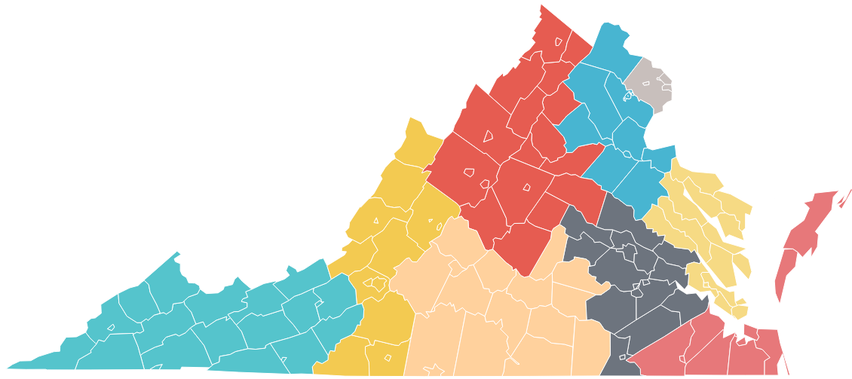
Big Picture: VQB5 Practice Year 2 (2022-2023)
Here are the key overall points to know:
Required activities and expectations for participating programs will generally remain the same for Practice Year 2.
100% of early childhood programs in Virginia are invited to participate in Practice Year 2 with a focus of including all publicly-funded programs.
Ready Regions (not PDG Community Networks) will support the implementation at the community level.
As of July 2022…
VQB5 Coordinated statewide through READY REGIONS

Slide 4
Developing the Practice Year 2 Enhancements
Here are key activities used to develop the proposed enhancements:
Ask, Listen and Learn - Feedback from diverse stakeholders in the field was sought through a variety of formats (e.g., survey, forums, webinars, small group presentations).
Analyze - Analysis of Practice Year 1 data was completed in partnership with community and higher education partners.
Anticipate - Strategic analysis was completed to anticipate what might be needed when VQB5 is “real” and includes all publicly-funded programs statewide.

Slide 5
Overview of VQB5 Enhancements for 2022-2023
Here are the proposed enhancements for Practice Year 2 (2022-2023):
1
PARTICIPATION
Increase participation of publicly funded programs
2
CLASS OBSERVATIONS
Ensure educators receive consistent observations and supportive feedback
3
CURRICULUM
Increase support for accessing and using quality curriculum
4
IMPROVEMENT SUPPORT
Prioritize VQB5 participants for Improvement Supports
5
PRACTICE RATINGS
Pilot a Site-Level Quality profile
6
LINKB5
Improve LinkB5 user experience
7
APPEAL PROCESS
Develop a structured process to address unique situations

Slide 6
Increase Participation of Publicly Funded Programs
1
Here is how we are responding to feedback from the field to ensure all publicly funded programs are informed and prepared for the new system.
Practice Year 2 Enhancements
VQB5 participation available statewide through Ready Regions (100% of programs are invited to participate) Practice Year 2 Interest Form and Info-Flyer available for new programs Updated FAQs related to participation Clarifications added to Practice Year 2 Guidelines Direct Communications with publicly funded program leaders regarding participation requirements (letters to site leaders, webinars/presentations for specific stakeholders, Supt Memos and updated guidelines for school divisions)

Slide 7
Ensure educators receive consistent observations and supportive feedback
2
Here is how we are responding to feedback to ensure local observers are supported, and addressing the potential need to ensure educators receive consistent feedback.
Practice Year 2 Enhancements
Update and strengthen local CLASS observation guidelines, protocols and feedback procedures. Use local-external observation alignment data during Practice Year 1, to develop and implement regional plans for supporting local observers to provide educators with consistent and supportive feedback. In addition to local observations, increase the use of external observations to support local observers and provide educators with additional feedback.

Slide 8
Increased Support for Accessing and Using Quality Curriculum
3
Here is how we are responding to feedback from the field to ensure VQB5 programs have access and support for using quality curriculum.
Practice Year 2 Enhancements
Continue to expand program choices and provide additional supports to access quality curriculum, focusing on VQB5 programs without an approved curriculum in place Curriculum options for VQB5 during Practice Year 2 include: Option 1 - Seek approval for a curriculum the site already has in place Option 2 - Choose and use one of the 32 (and growing) VDOE approved curriculum options Option 3 - Access STREAMin3 as an open-source option, with low-or-no cost training and resources

Slide 9
Prioritize VQB5 Participants for Improvement Supports
4
Here is how we are responding to feedback to prioritize VQB5 programs for improvement supports in response to their needs.
Practice Year 2 Enhancements
Ready Regions lead agencies will work with existing improvement partners to ensure there are PD options, such as resources, training, coaching and learning communities, available to the VQB5 programs in their region. Improvement supports will be prioritized for publicly funded programs participating in VQB5 and in response to needs identified in VQB5 measurements. VDOE will continue to unify and align all state- and federally-funded quality improvement efforts, including ensuring supports for VQB5 programs are available consistently across Ready Regions.

Slide 10
Pilot a Site-Level Quality Profile
5
Here is how we are addressing the potential need to ensure the practice year rating information is provided in a clear, useful and thoughtful manner.
Practice Year 2 Enhancements
With input from the field, VDOE will develop a site quality profile prototype to include information about completion of required activities, performance on measurements (i.e. practice rating results), improvement progress and other topics of interest to families and the general public to better prepare sites for the information that will be shared following the practice years. Site Quality Profiles for Practice Year 2 would be shared privately with site administrators in the fall of 2023 (not posted publicly) Feedback from the practice year site quality profile prototype will inform the development of the public site quality profiles, to be shared in the fall of 2024.

Slide 11
Improve LinkB5 User Experience
6
Here is how we are responding to feedback to ensure LinkB5 users have a positive experience entering and using VQB5 data.
Practice Year 2 Enhancements
When LinkB5 opens for registration in August 2022, Ready Regions will be represented in the online data portal. The windows for fall and spring CLASS score data entry will align with the observation windows. Users can have multiple roles within one user-account. New user dashboards and upgrades to improve system navigation, data entry, and user experience. Hotline support will continue to increase to support more users.
Information about LinkB5 can be found on the LinkB5 Resources website

Slide 12
Develop a Structured Process to Address Unique Situations
7
Here is how we are addressing the potential need to have a process for dealing with unique situations related to VQB5.
Practice Year 2 Enhancements
VDOE will provide a structured process for programs to request a review of a decision related to site/classroom eligibility, observation results, curriculum approval, practice rating or other applicable topics. Information gathered during Practice Year 2 will help document the frequency and types of requests to inform the development of future guidelines and procedures, including the development of a formal appeals process in future years.
Notes:
Gather baseline data

Slide 13
Next Steps: Practice Year 2 Timeline
Practice Year 2 will follow the VQB5 annual measurement and improvement cycle:
Summer 2022 | Fall 2022 | Winter 2023 | Spring 2023 | Summer 2023
Program registration and preparation for fall CLASS observations Practice Year 1 data analysis and verification | Local CLASS observations and curriculum use information for every classroom entered in LinkB5. Practice Year 1 ratings privately shared with sites | Programs use information from fall to engage in professional development based on program and classroom needs. | Local CLASS observations and curriculum use information updated (if needed) for every classroom entered in LinkB5. | Program registration and preparation for fall CLASS observations Practice Year 2 data analysis and verification.
Fall 2023
Practice Year 2 ratings privately shared with sites
External CLASS observations will be used in some classrooms to gather information, support local observers and provide additional feedback.

Slide 14
Appendix Slides

Slide 15
Appendix: Guiding Principles for the Unified VQB5 System
Through this iterative development process, the VDOE continues to use the following guiding principles.
VQB5 should:
Improve quality and result in improved school readiness for children.
Increase opportunity for all children in 1) the outcomes that are measured, and 2) the process for making and using the system.
Use measures that can distinguish levels of quality and demonstrate growth over time.
Provide clear and actionable information, resources and incentives for improvement.
Be affordable for providers and the state.
Scale for use in over 6,000 programs and 10,000 classrooms.
Serve as a resource for families

Slide 16
Appendix: VQB5 Practice Year 2 Ratings
Practice Year ratings are calculated at the end of the academic year using the following point system. Practice Year 2 ratings will be shared privately with site-administrators in the fall of 2023 for information only.
Interactions Points (700 total points) | Average of all CLASS scores from the fall and the spring (all classrooms at a site*) x 100
Curriculum Points (100 total points) | Programs using an approved curriculum in at least one classroom, by May 31st, will receive 100 points added to their score
Total Points | Interactions Points + Curriculum Points = Total Points
Practice Year 2 Ratings | Exceeds Practice Year Expectations = 700 - 800 points Meets Practice Year Expectations = 400 - 699 points Needs Support = 100 - 399 points
Sites with practice ratings will be provided with Professional Development options in response to their practice rating results. Programs that fall into the “Needs Support” category within the practice years will be a priority for improvement support.

